Slide 1
Intel Trusted Execution Technology (Intel TXT)
Thomas Gaska
CS-680 Virtualization

Slide 2
Agenda
Threats
Trusted Computing Challenge
Trusted Execution Technology Overview
Protection Requirements
Protected Execution
Root of Trust and the TPM
Late Launch
The Realization in Chipsets
What’s the Future
References

Slide 3
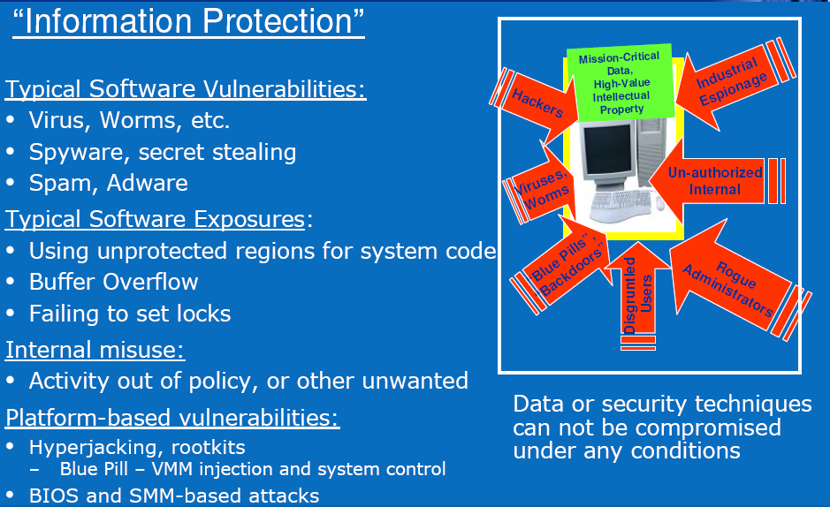
Threats

Slide 4
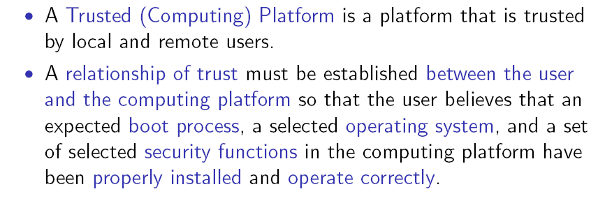
Trusted Computing

Slide 5
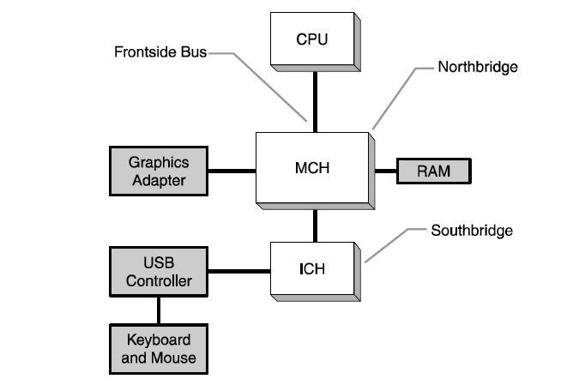
Standard PC Computer Architecture
MCH = Memory Controller HW
ICH = I/O Controller HW

Slide 6
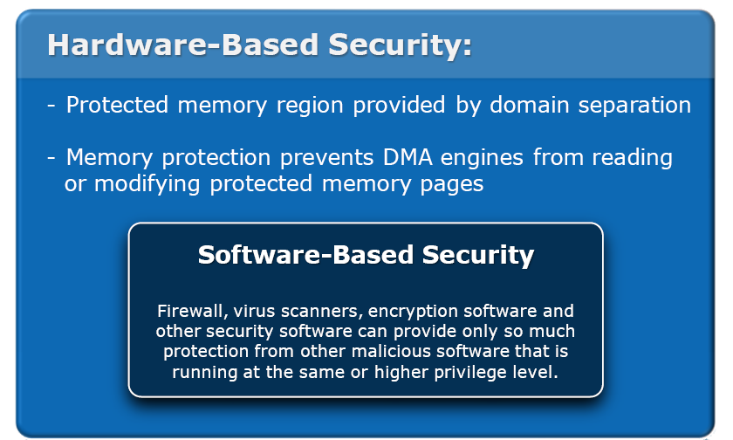
Hardware Security Context

Slide 7
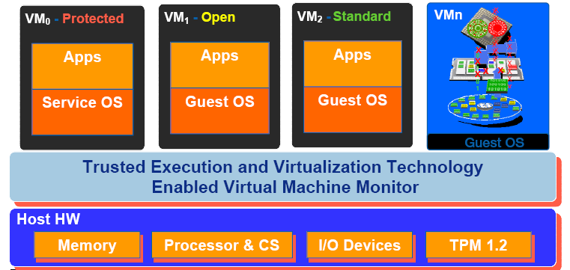
Trusted Computing Challenges
Protected Execution – Run isolated protected execution environments
Sealed Storage – Encrypt and store keys and secrets
Protected Input – Encrypt I/O
Protected Graphics – Establish a trusted channel
Attestation – Measure software
Protected Launch – Controlled launch and registation

Slide 8
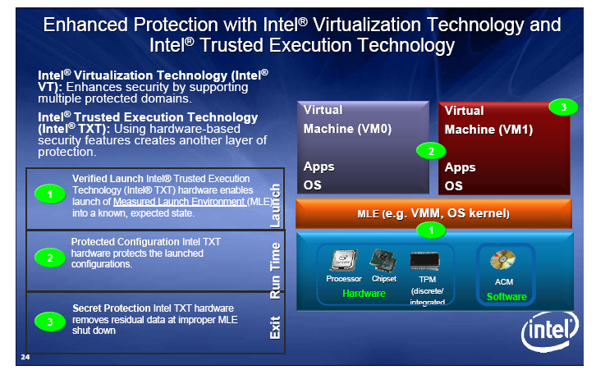
Hardware Assisted TXT Technology

Slide 9
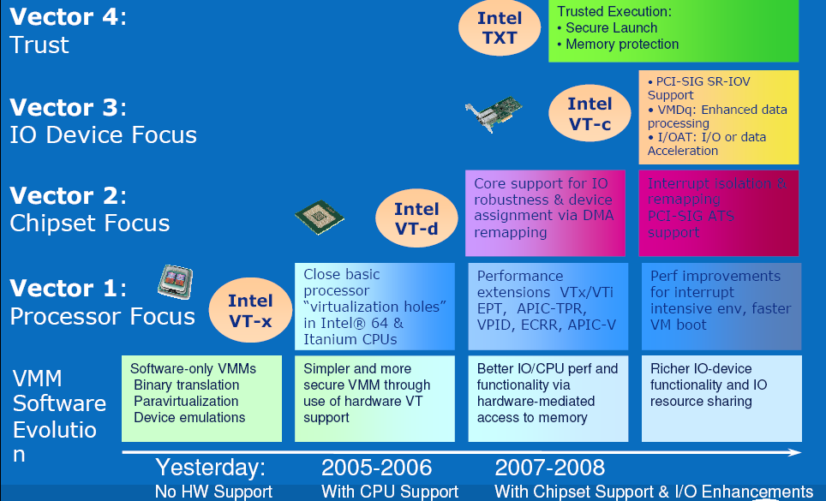
Another Hardware Virtualization Extension

Slide 10
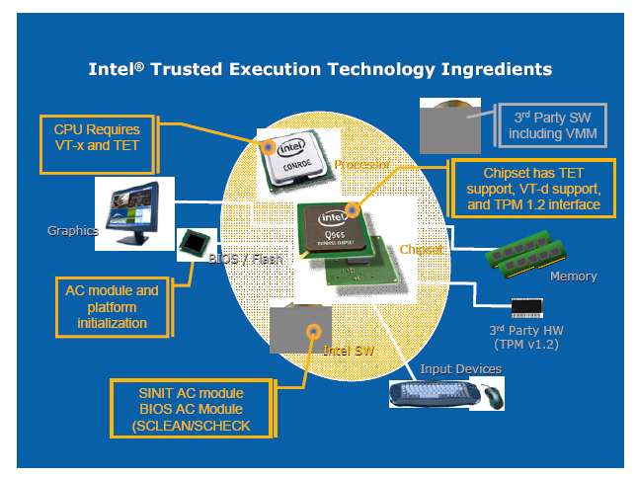
TXT = TET Integrated Architecture

Slide 11
Protection Requirements
Enable ability to assign a physical memory page to a specific VM and protect the page from other VM and DMA access
Enable a mechanism that protects keyboard, mouse, and display data from attack while data is in transit
Protect any secrets with a robust, long-term storage protection mechanism
Support protection across PC platform corner cases like
Reset
Initialization
Power Management
BIOS Configuration

Slide 12
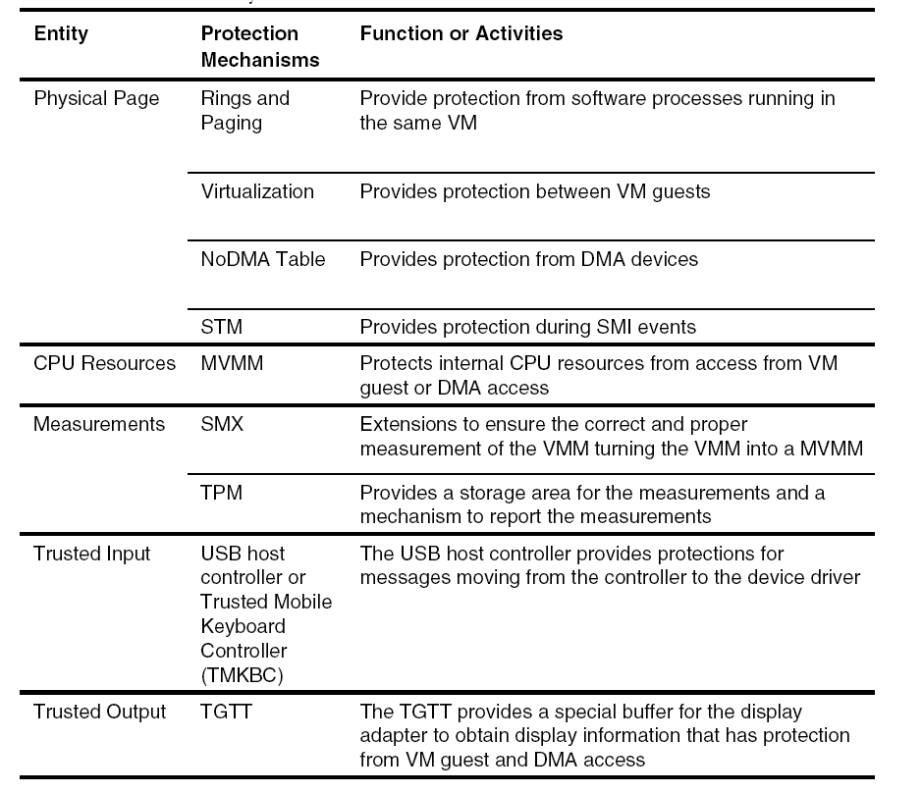
Resource Boundary Protections

Slide 13
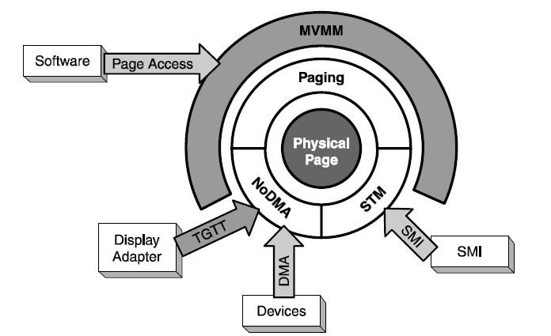
Page Protection Mechanisms

Slide 14
Measured Virtual Machine Monitor (MVMM)
Measurement and Launch of a MVMM must meet the following requirements:
All measurement and storage of the measurement must occur prior to passing control
Measurement process must defend against spoofing
Ensure all processors run the same VMM and start at same entry point
No other bus masters, processors, devices, or cache snooping can subvert the VMM measurement or launch
No misconfiguration or misinterpretation of processor, chipset, or platform state must be able to subvert the launch
A major feature of the MVMM is the ability to launch and terminate a Guest Partition and enforce a Policy
Memory Access
Resource Assignment and Access Virtualization
Communication Channel
Partitioning Lifecycle
Implemented via Safer Mode Extensions (SMX)

Slide 15
Trusted Computer Group
Open organization to “develop, define, and promote open standards for hardware-enabled trusted computing and security technologies.”
These secure platform primitives include
Platform integrity measurements
Measurement attestation
Sealed storage
Can enable
Trusted boot (not secure boot)
Attestation
Goals:
Ensure absence of malware
Detect spyware, viruses, worms, …

Slide 16
TPM and Roots of Trust
Need
Roots of Trust for Measurement (RTM)
Root of Trust for Reporting (RTR)
Root of Trust for Storage (RTS)
Solution is the Trusted Platform Module (TPM)
Slave Device on the LPC bus
Performs a set of Defined Commands
Validates command bit stream, each parameter, command authorization
Creates response packet
Secure Hash (SHA-1)
Converts string of arbitrary length to fixed length output (20 bytes)
24 + Platform Configuration Registers (PCR)
Used to storage measurements reported to the TPM
PCR Extension is defined as PCR = SHA-1(PCR old value, new value)
Can generate a Digital Signature of the PCR value that the requesting entity can verify

Slide 17
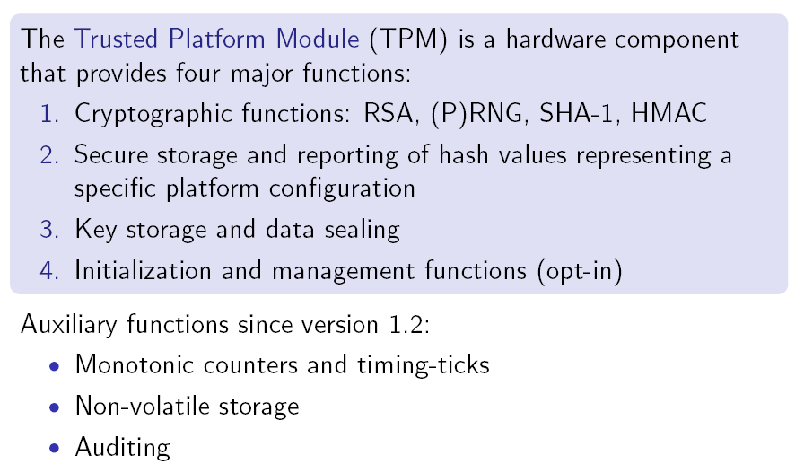
TPM Capabilities

Slide 18
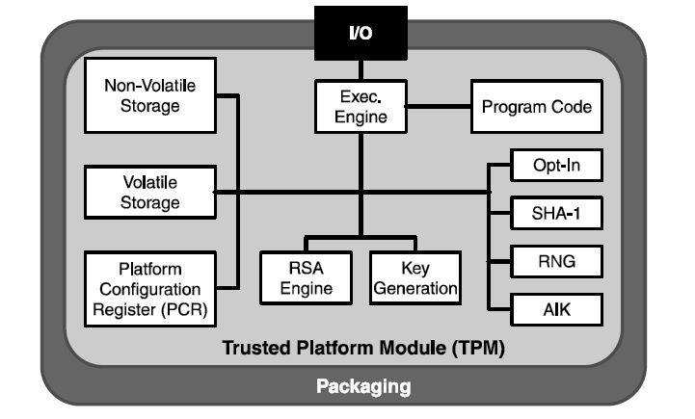
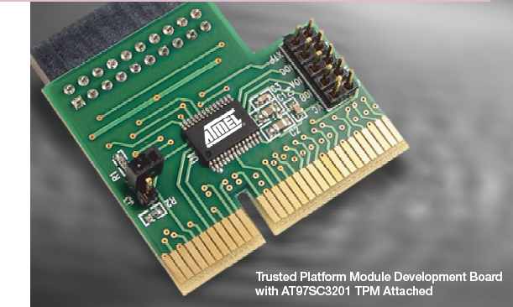
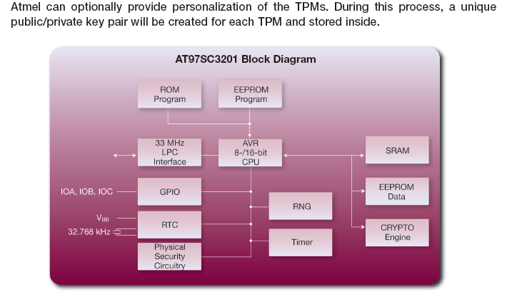
Trusted Processor Module (TPM)

Slide 19
TPM Remote Attestation & Sealed Storage
Remote attestation (PCRs + AIK)
Attestation Identity Keys (AIKs) for signing PCRs
Attest to value of integrity measurements to remote party
Sealed storage (PCRs + SRK)
Protected storage + unlock state under a particular integrity measurement (data portability concern)

Slide 20
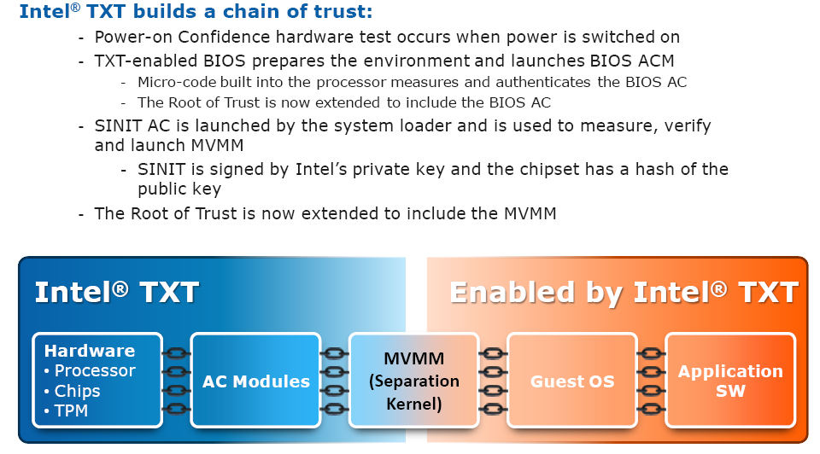
Establishing Root-of-Trust

Slide 21
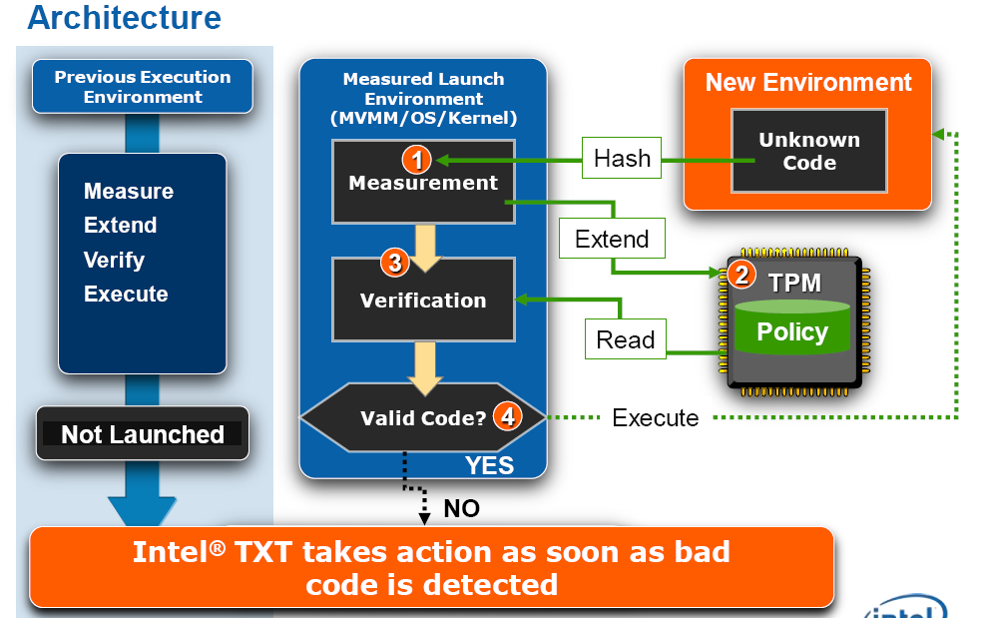
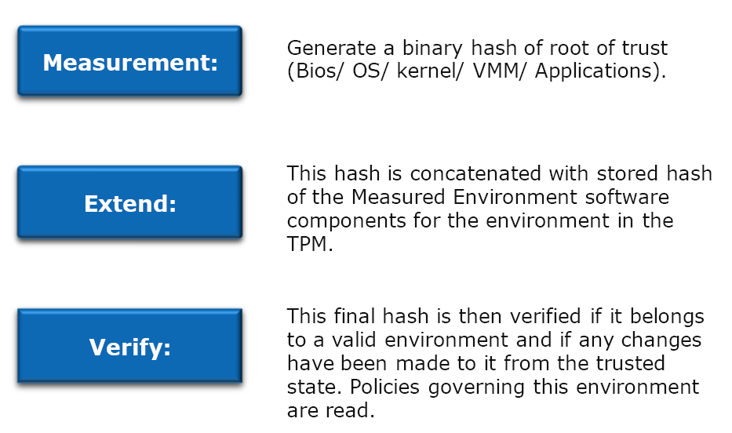
TXT Environment Enforcement

Slide 22
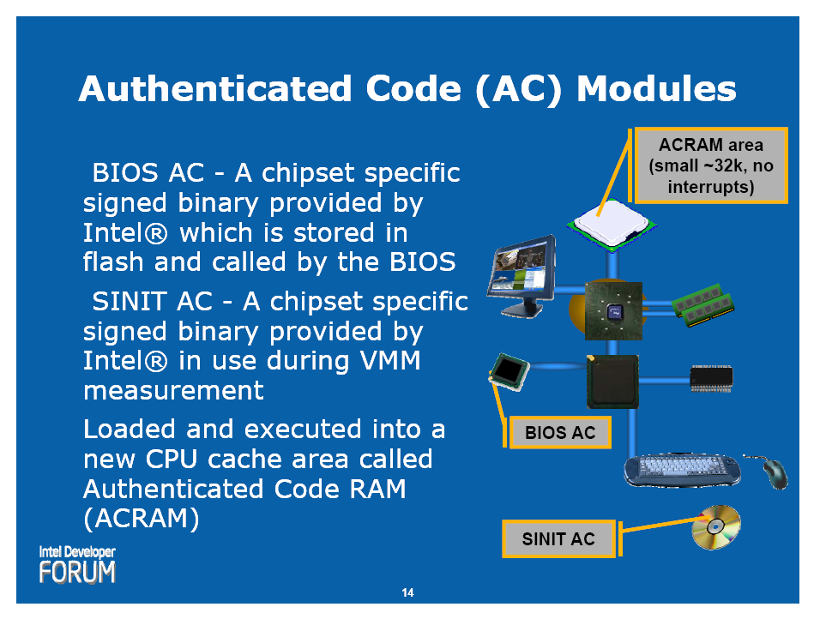
Authenticated Code Modules

Slide 23
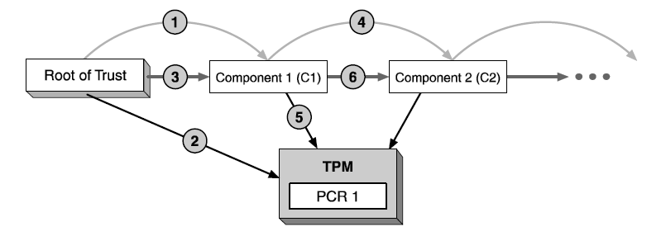
TPM Transitive Trust
Provide a way for relying parties to trust a larger circle of entities from a single root of trust:
Measure the next entity and compute Hash
Store the Hash measurement in TPM PCR
Pass control to the measured entity

Slide 24
Bootstrap Sequence
Hardware
Option
ROMs
Memory
BIOS
boot
block
OS
loader
BIOS
OS
Application
Network
Root of trust in integrity measurement
New OS
Component
TPM
measuring
Root of trust in integrity reporting
reporting
storing values
logging methods

Slide 25
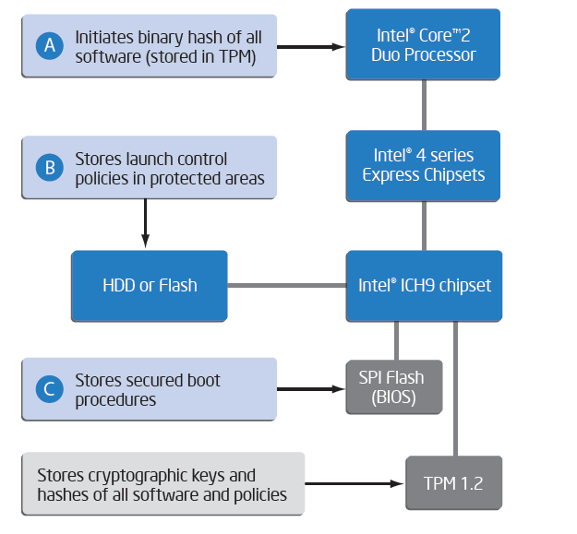
Protected Launch Mechanism

Slide 26
Late Launch
Create a reboot without doing a complete platform reset
Enable a Dynamic MVVM1 to MVMM2 transition after initialization at any time
Prepare for GETSEC [SENTER]
Accurately measure SENTER launch code using Hash
Load the MVMM using SINT-AC
Pass Control to the MVMM
Remove MVMM through GETSEC [SEXIT]
SENTER is a disruptive event
Initiate protections at any time and allow for removal of the partition
Make sure all CPUs participate (Multicore and Hyperthreads)
Detect any tampering with the launch process
Allow multiple invocations of processed partitions without reboot
Ensure properly configured hardware
SEXIT is a disruptive event
Ensure complete removal of all CPU state for protected partition

Slide 27
Launching Protected Partition Events
IPL loads SINIT Module and MVMM
Must be in Ring0, have TXT Chipset, have TPM, no machine checks
Controlling entity can be BIOS or OS
Neither SINT or MVMM have any protection against modification at this time
IPL invokes GETSEC [SENTER]
All CPUs Synchronize with ACKs
INT, NMI, SMI events are masked, chipset is locked except for ILP
IPL loads, launches, and authenticates SINT-AC
Chipset manufactures vouches for SINT module and generates a digital signature
ILP obtains Chipset Hash and compares with calculated Module Hash to authenticate
IPL updates TPM Dynamic PCRs for the measurement of SINIT
SINIT Authenticated Code invokes MVMM
Establish NoDMA Table
IPL Measures and Stores MVMM measurement to the TPM and measures the STM
Passes Control to the VMM

Slide 28
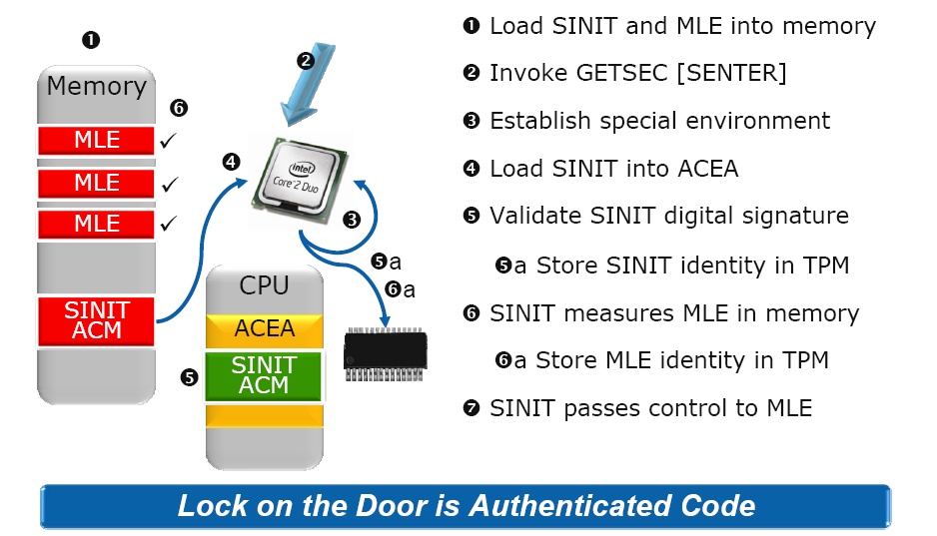
Late Launch Control Points
Safe Mode Extensions (SME)
MLE = Measured Launched Environment , in my charts this is also called the
MVMM and the SVMM

Slide 29
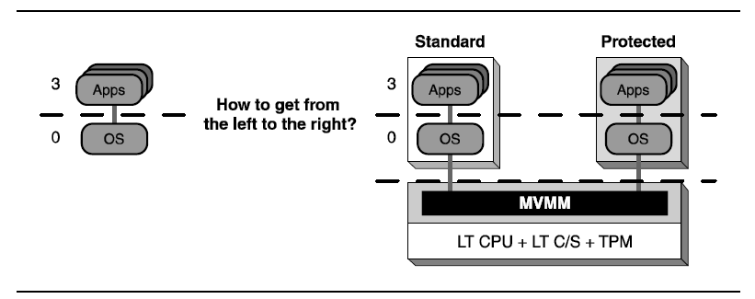
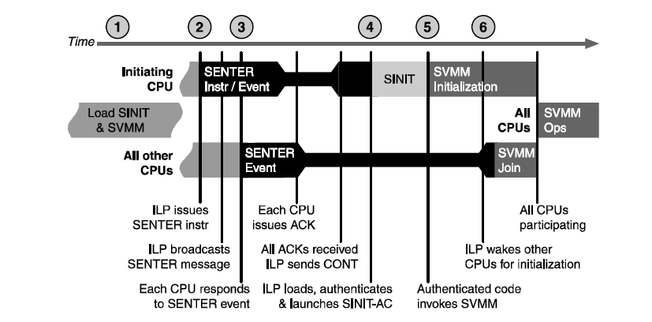
Launching the Protected Partition
ENTER
ILP = Initiating Logical Processor
PCR = Platform Configuration Register
RLP = Responding Logical Processor
CONT =
SINIT-AC =
Secure SVMM
Measured MVMM

Slide 30
Exiting the Protected Partition
Boot Strap Processor validates the MVMM issued the command
Broadcast a message to rendezvous the processors
Ensure that all processors respond to the broadcasts
Shut down the MVMM
Remove all protections and allow normal operations

Slide 31
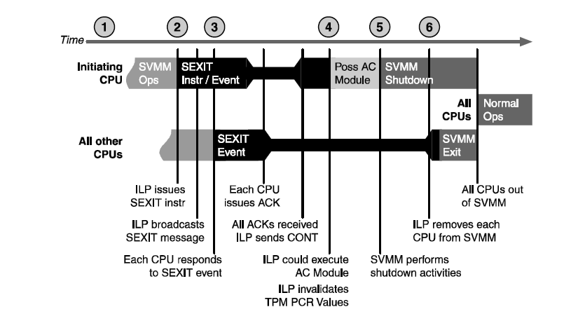
Exiting the Protected Partition
EXIT
GETSEC [SEXIT]
ILP = Initiating Logical Processor
PCR = Platform Configuration Register
RLP = Responding Logical Processor
Secure SVMM
Measured MVMM

Slide 32
TXT System Design
Enter VMM mode using GETSEC[SENTER] instruction, measures VMM before transferring control
Enables the attestation chain to that point to be discarded, giving a fresh reset. Referred to as Dynamic Root of Trust for Measurement (DRTM)
CPU provides internal RAM that can execute code after hashing code and verifying against embedded digital signature. Enter Authenticated Code (AC) mode using GETSEC[ENTERACCS] instruction.
Will only run software signed by Intel using a private key corresponding to a public key in the chipset itself

Slide 33
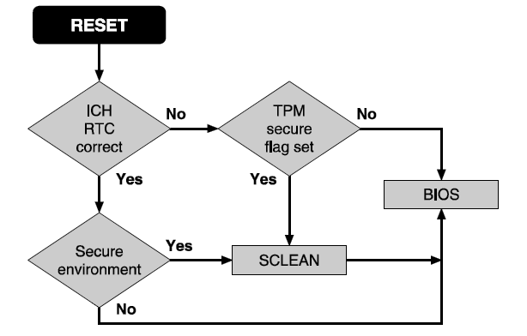
SCLEAN
SCLEAN AC Module provides way to remove secrets by erasing selected system memory
Writes a data pattern to each byte of memory
After reset, chipset can request startup code to locate, load, and cause execution of SCLEAN
Module is an AC Module specific to the chipset embedded in the BIOS and has no reliance on system memory
RESET Protection is also supported with interlocks to block all accesses to system memory until safe

Slide 34
System Management Mode (SMM)
Operating mode in which all normal execution is suspended including the operating system
Special separate software (firmware or a hardware-assisted debugger) is executed in high-privilege mode
Legacy from the Intel 386 to current processors
Some uses of SMM are:
Handle system events like memory or chipset error, system safety mgmt (temp, power)
Emulate or forward calls to a TPM
SMM is entered via the SMI (system management interrupt), which is caused by:
Chipset signaling processor pin, Software SMI, I/O write operation
By design, the operating system cannot override or disable the SMI
SMM Vulnerability:
New place to hide rootkits
No page table means all memory is accessible
Hander must have the same trust level as the MVMM

Slide 35
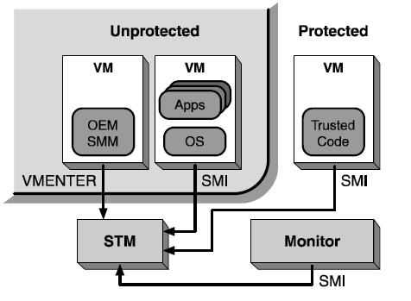
SMM Transfer Module (STM)
Conceptual mechanism to accept the SMI, invoke the SMM, and ensure no leakage of information to the SMM
STM requires accurate measurement, reliable storage of the measurement, and verifiable reporting of the measurement
BIOS holds the SMM code
Problem:
Measurement technique for SINIT and MVMM won’t work with STM
Open to attack as demonstrated in Black Hat 2009

Slide 36
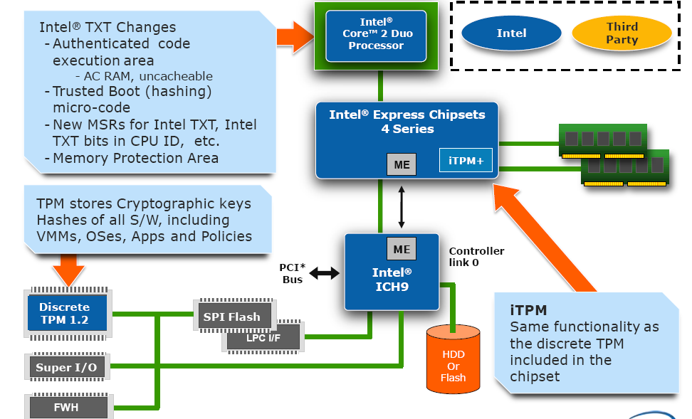
TXT Hardware Components

Slide 37
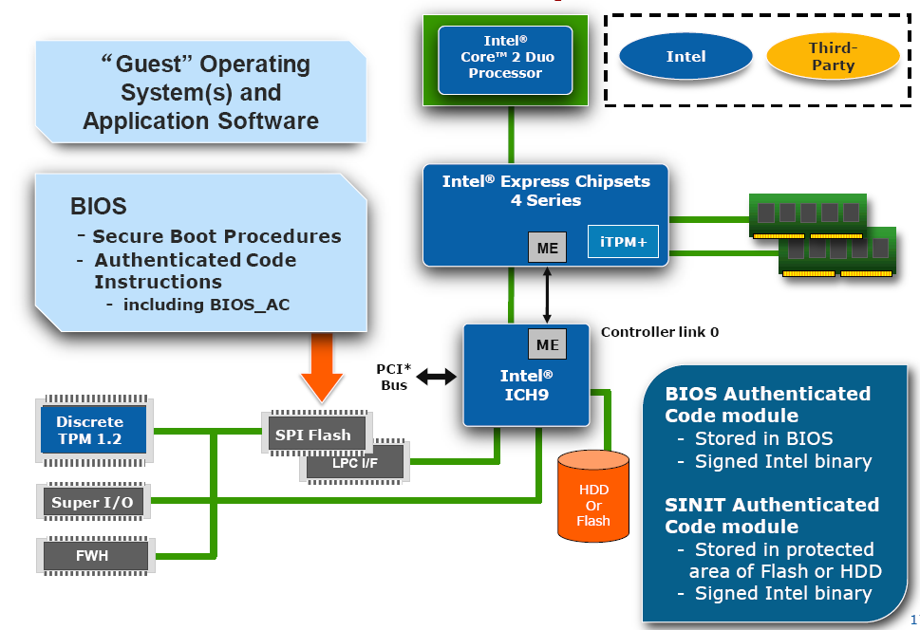
TXT Software Components

Slide 38
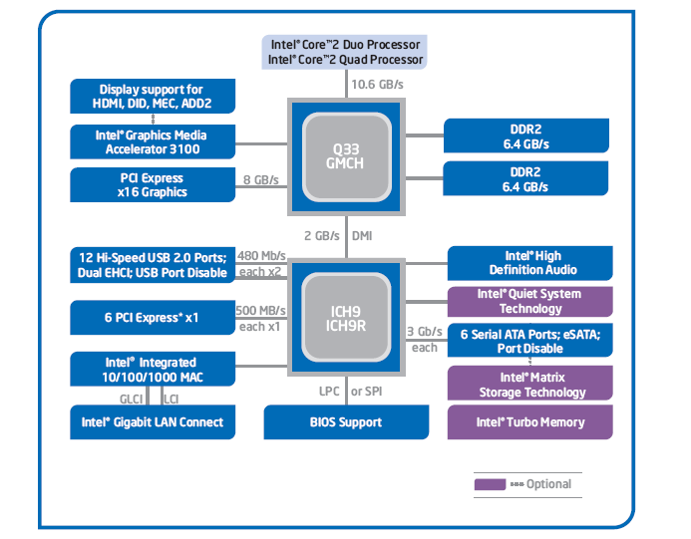
Q33 TXT Enhanced Chipset

Slide 39
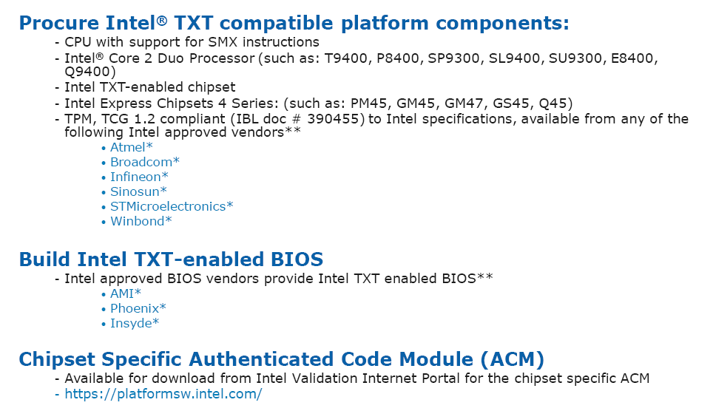
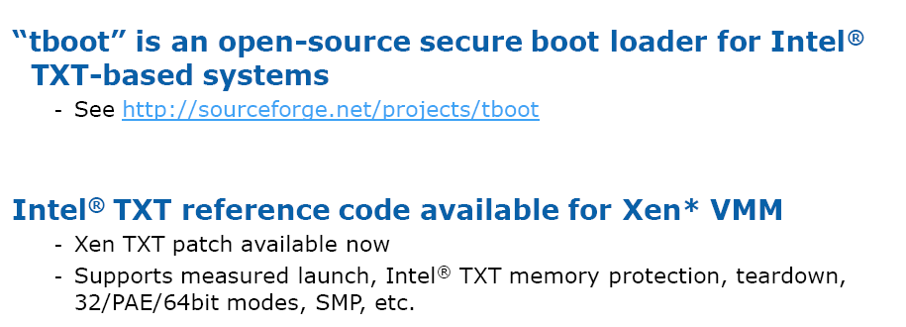
Required Support For TXT Features

Slide 40
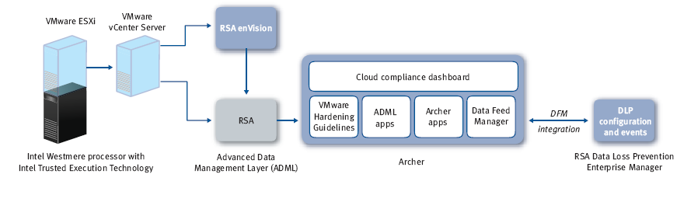
Future = Measuring/Monitoring Clouds

Slide 41
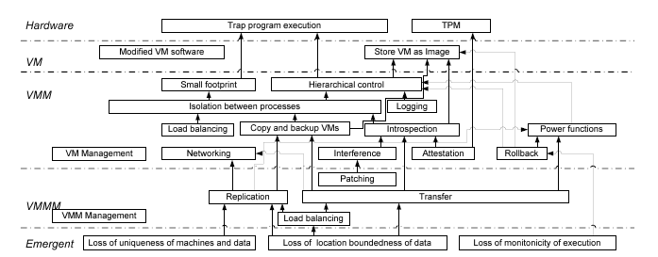
Virtualization Feature Dependencies

Slide 42
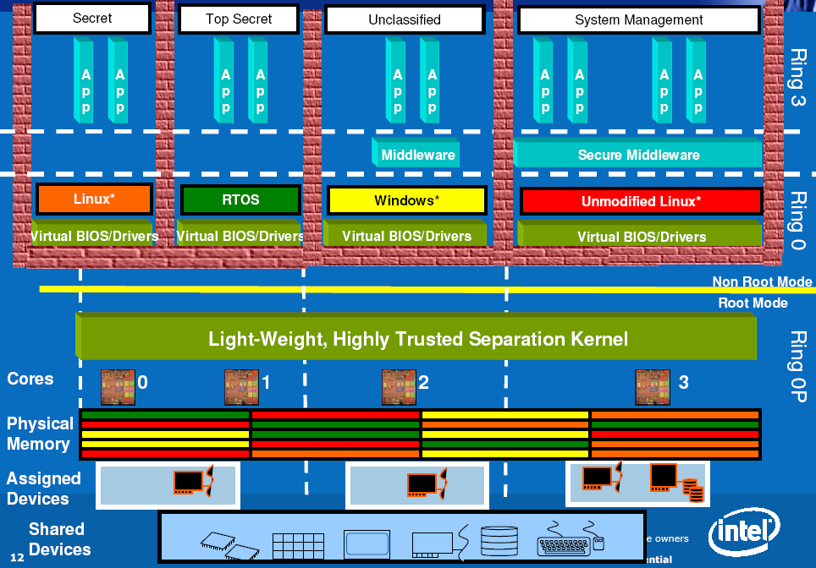
Addition of a Trusted Separation Kernel

Slide 43
References Beyond Base Papers
The Intel Safer Computing Initiative
http://files.rsdn.ru/19450/SECC_100Validation.pdf
My favorite highlight was David Grawrocks section on Secure Launch Recap. He states “I do not understand why you are confused. I have been working on this for many years and do not understand why you cannot pick it up in an hour or so.” [page 208]
Security Implications of Virtualization: A Literature Study
http://doc.utwente.nl/68164
Infrastructure Security: Getting to the Bottom of Compliance in the Cloud
http://www.rsa.com/innovation/docs/CCOM_BRF_0310.pdf

