Slide 1

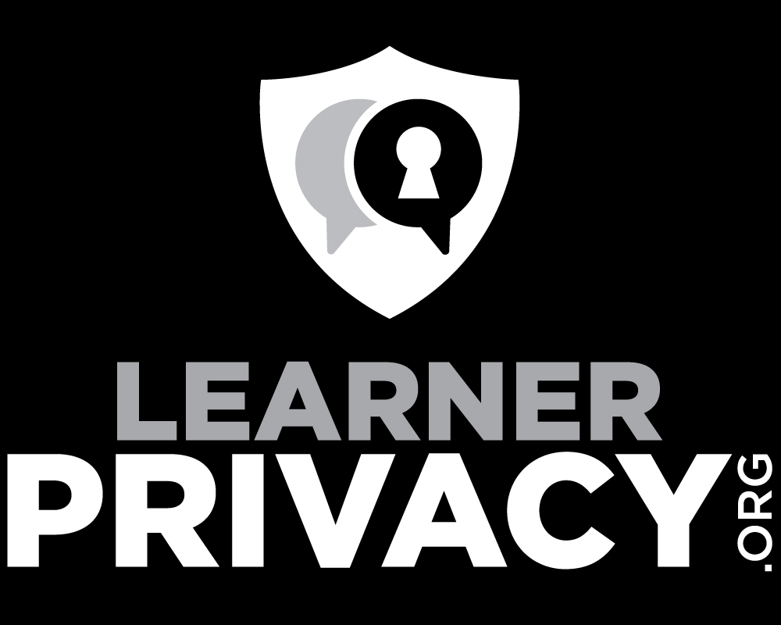

Slide 2
The Fallacy of FERPA
FERPA is Privacy Theatre
Talking about edTech on campus is always about FERPA
Four privacy laws
Freedom of Information Act (FOIA)
Healthcare Insurance Portability and Accountability Act (HIPAA)
Health Information for Economic and Clinical Health Act (HITECH)
Federal Educational Records Privacy Act (FERPA)

Slide 3
Before FERPA - FOIA
Please go read the Wikipedia article on FOIA
Laws around government transparency started in 1946
FOIA as a stand alone act went into effect July 4, 1967
According to one federal court describing FOIA, one of the premises of is the belief that "an informed electorate is vital to the proper operation of a democracy." It is important to give citizens access to the information on the basis of which government agencies make their decisions, thereby equipping the populace to evaluate and criticize those decisions
https://en.wikipedia.org/wiki/Freedom_of_Information_Act_(United_States)

Slide 4
Fun with FOIA
Public Universities are an extension of the government – so FOIA applies
Fun Example – U Michigan / Coursera contract
Classic fun example – FOIA college grades of a politician

Slide 5
Medical Privacy - HIPAA
Passed in 1996
Criminal consequences, prison terms fines (e.g. $1.5M)
Created with input from those affected
HIPAA was created to “improve the portability and accountability of health insurance coverage” for employees moving between jobs. It modernized the flow of healthcare information, stipulated how Personally Identifiable Information maintained by the healthcare and healthcare insurance industries should be protected from fraud and theft.
https://en.wikipedia.org/wiki/Health_Insurance_Portability_and_Accountability_Act

Slide 6
Medical Technology Privacy – HITECH Act
Beyond HIPAA – Passed in 2008
Defined compliance/accountability metrics
All kinds of technical details - log of who accessed what
Revised penalties
The HITECH Act encouraged healthcare providers to adopt electronic health records and improved privacy and security protections for healthcare data.
https://en.wikipedia.org/wiki/Health_Insurance_Portability_and_Accountability_Act

Slide 7
FERPA
Passed in 1974 – a.k.a the Buckley Act
First, it gives students the right to inspect and review their own education records, request corrections, halt the release of personally identifiable information. Second, it prohibits educational institutions from disclosing "personally identifiable information in education records" without the written consent of the student, or if the student is a minor, the student's parents Schools that fail to comply with FERPA risk losing federal funding.
https://www.epic.org/privacy/student/ferpa/

Slide 8
FERPA
Traditional legislative history for FERPA as it was first enacted is unavailable because the Act was offered as an amendment on the Senate floor to a bill extending the Elementary and Secondary Education Act of 1975 and was not the subject of committee consideration. Congress offered no opportunity to those affected by FERPA to be heard prior to its enactment. There was no legislative committee study and review nor any public hearings to receive testimony from institutions or individuals. However, in a speech explaining the Act to the Legislative Conference of Parents and Teachers, Senator Buckley said FERPA was adopted in response to "the growing evidence of the abuse of student records across the nation."
https://www.epic.org/privacy/student/ferpa/

Slide 9
MOAR FERPA
Penalty: "school might lose federal funding"
No criminal penalties – might get "pain and suffering"
Patched through amendments 1974-2011
Fine tuned the exceptions and restrictions between schools and public
Nothing about cloud vendors or wholesale transfer of student data to third parties
Compare to HIPAA
https://en.wikipedia.org/wiki/Health_Insurance_Portability_and_Accountability_Act

Slide 10
FERPA Today
Necessary but not sufficient
When the university counsel reads the law
Protect federal funding
If you hand student data to a third party make sure you can sue them
File cabinets full of "I agree to follow FERPA" contracts
No real concern for student privacy – just protects the school
No assessment of the long term risk of actually losing data
Does not stop students from voluntarily publishing their work

Slide 11
If we cared about Learner Privacy
If we outsource our LMS to a third party we must understand risks
Data breach
What about the private sale of the company or data?
What about machine analysis of our student's data for commercial gain?
What about sharing with vendors / contractors
If we use a learning tool...
Does it need Personally Identifiable Information (PII)
How long will it retain the PII?

Slide 12
What Worries Me
For some early adopters, Canvas possesses almost a decade of every bit of most critical and private student activity data
Blackboard and D2L have forced their clients into the Cloud more recently – but from this point forward their retained data will grow
Very few LTI Tool Vendors need to hold PII at all and most could hold it for <90 days – but they just take it all and keep it forever – it is easier and builds future company value

Slide 13
A "Beyond FERPA" Conversation
Things can get scary quickly – it is nice to work up a plan when we are not in a panic
Lets get an inventory or all the places that have our data, what data they have, and how long we think they should keep the data
Lets come up with a common set of questions to ask our vendors about privacy
Lets start working improving learner privacy into our strategic plans

Slide 14
Hey, we could make a privacy law
Like Europe's General Data Protection Regulation (GDPR) or The California Consumer Privacy Act (CCPA)
A modern law about privacy
Detailed guidance
Has fines and legal consequences
Sounds great.....
But it has one *massive* flaw – that is the topic of another podcast

Slide 15
Summary
FERPA is not a law about privacy of Cloud edTech services
Universities are more interested in a file cabinet full of signed contracts than they are about actual learner activity data privacy
Lets get the conversation from meeting compliance requirements to actually protecting learner privacy

