Slide 1

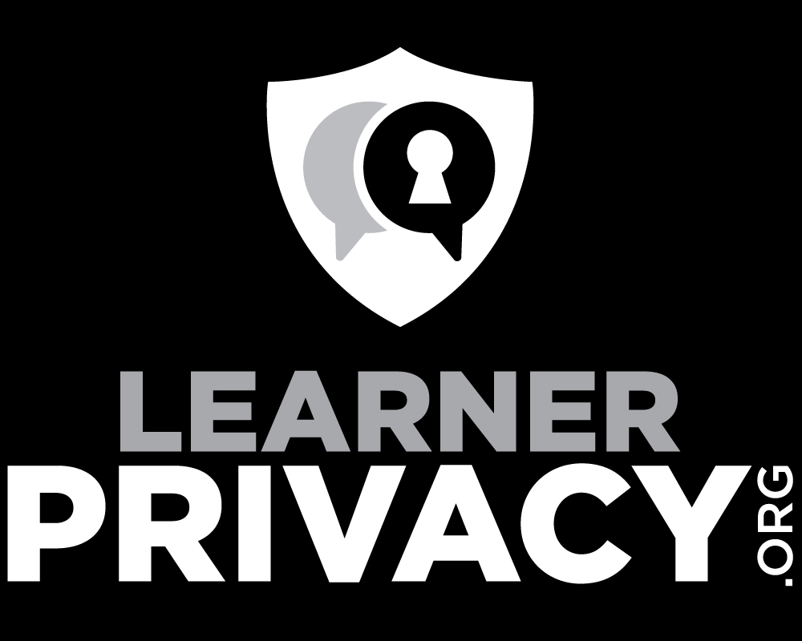
Episode 002

Slide 2
The FERPA Fig Leaf
Most campuses have no privacy strategy beyond FERPA
FERPA is Privacy Theatre
Lets look Medical Privacy and then compare it

Slide 3
Medical Privacy – HIPAA and HITECH
Medical Record Privacy is a core value of the medical profession
A long time ago, most people had one doctor their whole life
HIPAA – 1996
HITECH – Medical Privacy in the electronic record era 2008
https://en.wikipedia.org/wiki/Health_Insurance_Portability_and_Accountability_Act
https://en.wikipedia.org/wiki/Health_Information_Technology_for_Economic_and_Clinical_Health_Act

Slide 4
HITECH Act
The HITECH Act (2008) encouraged healthcare providers to adopt electronic health records and improved privacy and security protections for healthcare data.
https://en.wikipedia.org/wiki/Health_Insurance_Portability_and_Accountability_Act
https://en.wikipedia.org/wiki/Health_Information_Technology_for_Economic_and_Clinical_Health_Act

Slide 5
Medical Privacy – HIPAA and HITECH
If you build software – you get practical guidance
It is not just "best practice" – it is the law
Criminal consequences, prison terms fines (e.g. $1.5M)
HIPAA Summit (29th Annual)
The legal structure for Medical record privacy is a pretty impressive bit of legislation and impressive in its implementation ….
https://en.wikipedia.org/wiki/Health_Insurance_Portability_and_Accountability_Act
https://en.wikipedia.org/wiki/Health_Information_Technology_for_Economic_and_Clinical_Health_Act

Slide 6
FERPA Basics
Passed in 1975, latest revision 2011
Not about handing learner data to third party cloud servers
FERPA prohibits educational institutions from disclosing "personally identifiable information in education records" without the written consent of the student or the student's parents.
Schools that fail to comply with FERPA risk losing federal funding.
https://www.epic.org/privacy/student/ferpa/

Slide 7
FERPA in the Context of FOIA
FOIA as a stand alone act went into effect July 4, 1967
Government transparency
Most universities - the salary book stuffed way back in the library
Great for journalists
Get a copy of vendor contract and skewer it
Get the grades of a person and skewer them
https://en.wikipedia.org/wiki/Freedom_of_Information_Act_(United_States)

Slide 8
FERPA – Shady Beginnings
FERPA was offered as an amendment on the Senate floor to a bill extending the Elementary and Secondary Education Act of 1975. FERPA was not the subject of committee consideration, there were no public hearings, and there was no testimony from institutions or individuals before FERPA was enacted.
In a later speech, Senator Buckley said FERPA was adopted in response to "the growing evidence of the abuse of student records across the nation."
https://www.epic.org/privacy/student/ferpa/

Slide 9
MOAR FERPA
Penalty: "school might lose federal funding"
No criminal penalties – might get "pain and suffering"
Patched through amendments 1974-2011
Fine tuned the exceptions and restrictions between schools and public
Nothing about cloud vendors or wholesale transfer of student learning activity data to third parties
Compare to HIPAA
https://en.wikipedia.org/wiki/Health_Insurance_Portability_and_Accountability_Act

Slide 10
FERPA Today
Necessary but not sufficient
Release – sure. What about handling, retention, consent…?
When the university counsel reads the law
Protect federal funding
If you hand student data to a third party make sure you can sue them
File cabinets full of "I agree to follow FERPA" contracts
Compliance strategy is not a privacy strategy

Slide 11
Steps to Protect Learner Privacy
Lets get an inventory or all the places that have our learners data, what data they have, and how long we think they should keep the data
Lets come up with a common set of questions to ask our vendors about privacy
Lets add examination of learner privacy into our campus strategic plans
IMS GLC has been working and will continue to work in this area – it is time to give this and other efforts more attention

Slide 12
Summary
FERPA is not a law about privacy of Cloud edTech services
Lets start to look at the real risks of schools losing control of private student data
Together, lets move from checking the FERPA compliance box to actively protecting the learner privacy

