Slide 1
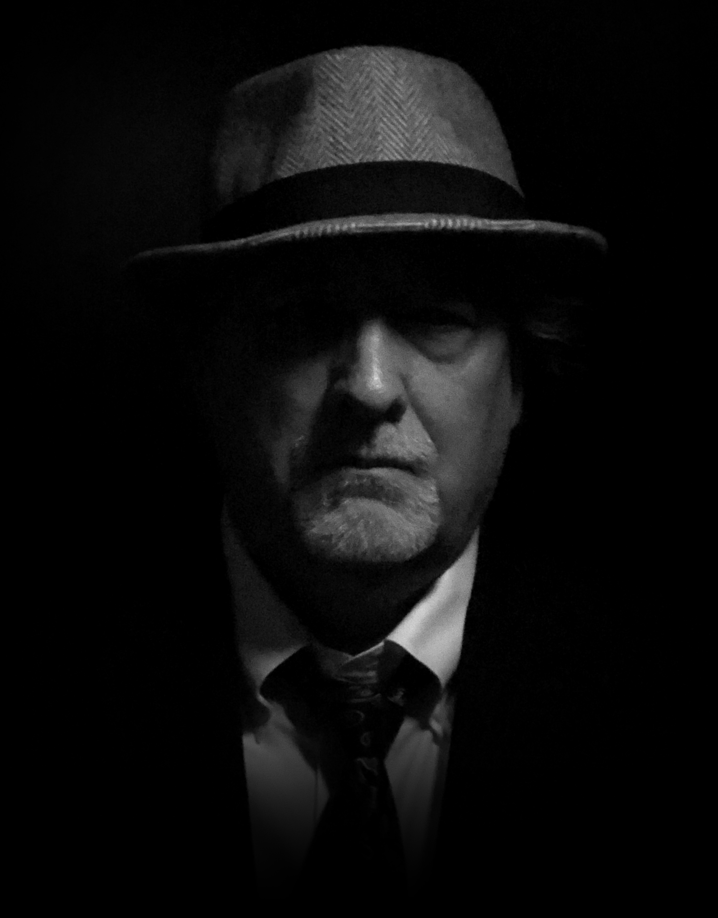

Episode 007 - Zoom

Slide 2
Making A Decision
Organizations are more interested in legal / regulatory compliance
We as individuals (particularly teachers) need to do the right thing

Slide 3
Episode 007 - Zoom

