Slide 1
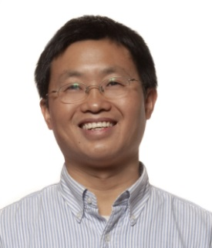
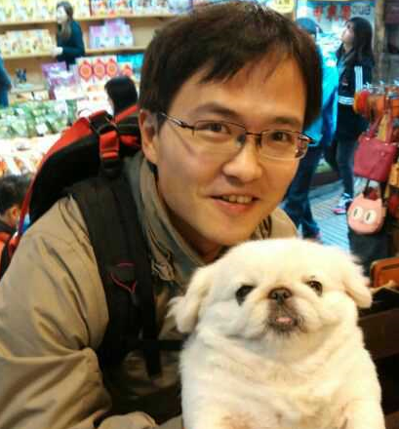
Docker in BSP
CBC Larry Cai/Jay Li
Notes:
2015-10-10
1
new updates

Slide 2
agenda
What is docker
Background of BSP using docker
Docker usage in BSP with 3 demos
Summary

Slide 3
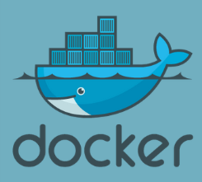
What is docker
Docker is rising star in Cloud
Docker is an open-source tool helps:
Pack your software with dependence into a container
Deliver your container to another server with docker installed
Start container in seconds
$ docker run -it ubuntu
Notes:
2015-09-01
3
Docker: Promise for 10x Software Developmment
BUCI-15:003098 Uen, Rev PA1

Slide 4
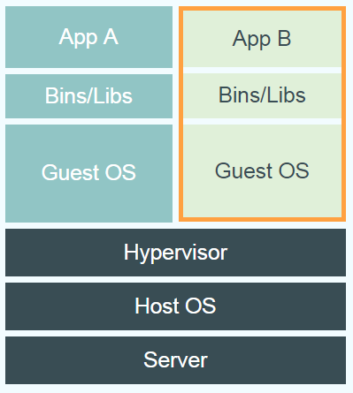
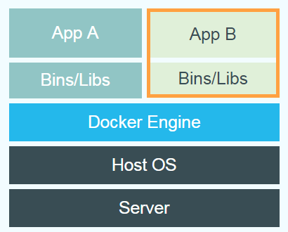
So, Virtual machine ?
Most of the use case are the same
Complete app environment like OS, java environment
Isolated environment from host Windows/Mac …
Possible to reuse
And docker container is
Much much Faster
Much much Smaller
Docker can be installed in local PC (ELX is better, Windows is also ok)
Notes:
2015-09-01
4
Docker: Promise for 10x Software Developmment
BUCI-15:003098 Uen, Rev PA1

Slide 5
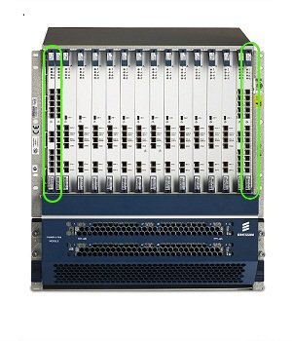
HW is expensive
HW is quite limited resource (always), Everyone want to have its own?
Booking system ?
How long it takes to verify a bug like small changes in COM component in BSP ?
Can we do verification locally before sending for review/testing ?

Slide 6
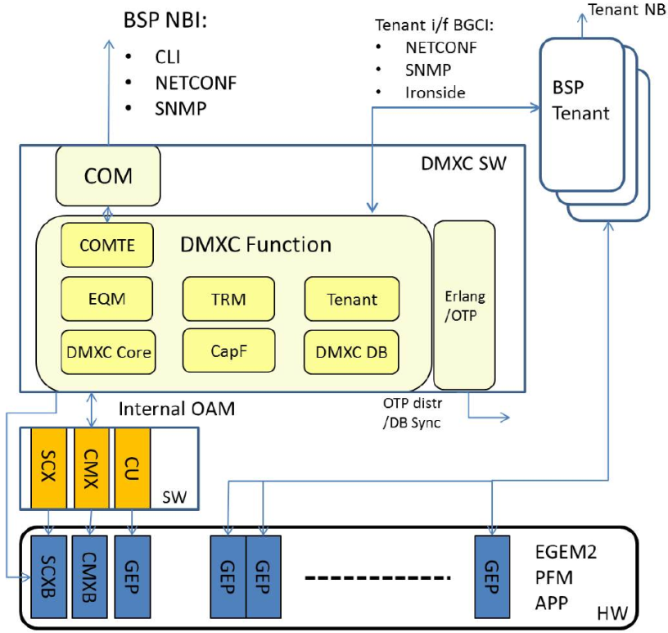
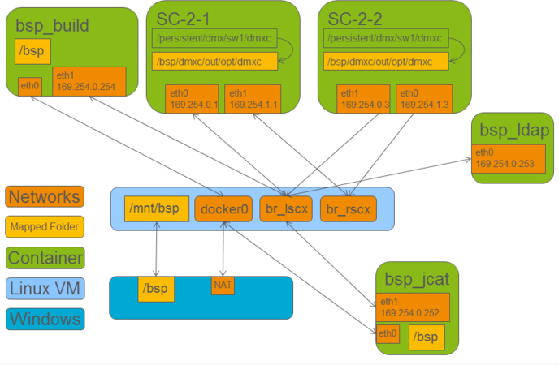
Docker env for BSP
Running environment for DMXC/COM
ubuntu is used with no changes in source code
All NBI interface include CLI are supported

Slide 7
Docker usage in BSP
Design env
Running BSP env (demo1)
compile/unit test (investigate & discussed in 2015)
jcat testing are supported (demo2)
Continuous Integration
Regression test without HW (demo3)
JCAT training
Doing JCAT BSP development without HW
BSP Demo
Basic features (O&M)
CPI ..

Slide 8
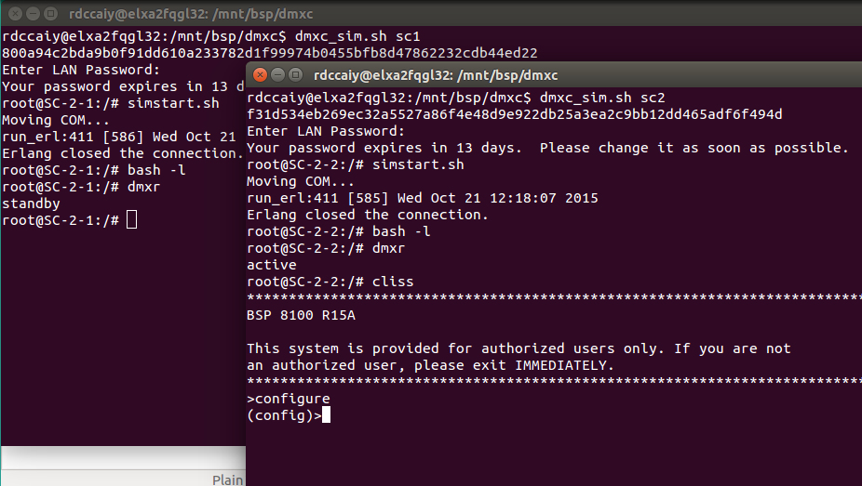
Running environment

Slide 9
Demo – 1 running BSP in seconds
$ dmxc_sim.sh start

Slide 10
Docker based Design env
bsp_15a_dev
….
snmp-dev
python
make
bsp_15a_dev
bsp_15b_dev
erlang-otp
….
snmp-dev
….
snmp-dev
python
python
make
make
CI build machines
erlang-otp
erlang-otp
Host os
bsp_15a_dev
bsp_15b_dev
bsp_15a_dev
Host os
Host os

Slide 11
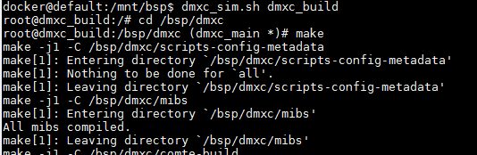
Design environment
git clone in ELX host
All the build is done in docker container (need to install erlang/3pp/…)
Central env management

Slide 12
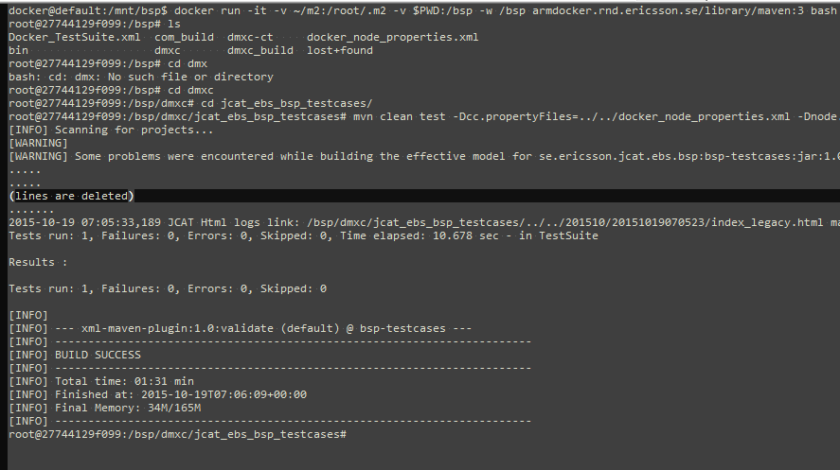
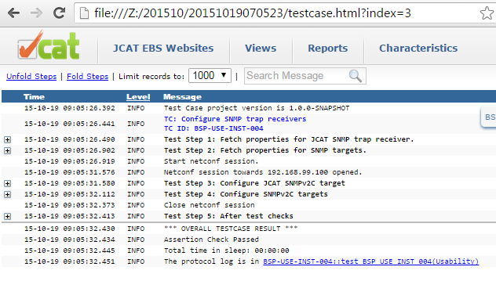
JCAT test case

Slide 13
Demo – 2 JCAT testing
$ dmxc_sim.sh ldap $ dmxc_sim.sh testcase $ /start.sh

Slide 14
Docker based BSP testing in CI
t1_sc2_1
t1_ldap_1
compose project=t1
t1_sc2_1
t1_ldap_1
Jenkins
t1_bsp_testcase_1
t2_sc2_1
t1_ldap_1
compose project=t2
t2_sc2_1
t2_ldap_1
t2_bsp_testcase_1
Docker Host (Jenkins Slave)

Slide 15
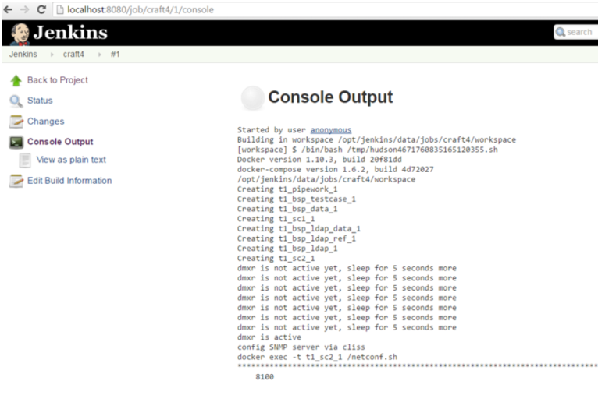
Demo – 3 regression testing
$ http://localhost:8080
Blog: Docker compose in CI - basic structure

Slide 16
Docker usage in BSP
Design env
Running BSP env
compile/unit test (investigate & discussed in 2015)
jcat testing are supported
Continuous Integration
Regression test without HW
JCAT training
Doing JCAT BSP development without HW
BSP Demo
Basic features (O&M)
CPI ..

Slide 17

summary
Docker is new hot cloud/container technology
Docker can be used in BSP development to save money & improve development efficiency.
Understand benefit/limitations
Define use case and roadmap
Docker can help us to prepare for the future both in competence and product (BSP & HDS)
What to do next
Experiment & feedback
Build docker competence to enhance the solution

Slide 18
Docker community docker@mailman.lmera.ericsson.se
wiki https://wiki.lmera.ericsson.se/wiki/Docker
Notes:
2015-08-19
18
Share with Ericsson docker registry
BUSS-15:000901 Uen, Rev PA1

Slide 19
Notes:
2015-10-10
19
new updates

Slide 20


Design env in detail
dmxc_build (docker container)
make
Mapped Folder
/bsp
erlang-otp 18.0
Container
ELX (docker)
Linux (docker host)
/mnt/bsp/dmxc
Notes:
2015-08-19
20
SIMULATORS IN BSP
BUCI-15:002871 Uen, Rev PA2

Slide 21
Comparison
Both are docker based and working in local machine
Good enough now for designers
Seamless integrated into make system, less knowledge needed for docker
Covers more use cases (designer, testers and runtime environment)
Central design env management
easy to extend (network, volume, more service)
Roland’s existing solution
CBC’s new docker solution

Slide 22
Central design env
Design environment shall be configure manageable
Make sure the env is always the same !!
Issues for using ELX currently (ELX is good, but can be improved)
apt-get update will cause different library (ELX repo is changing)
Manage own BSP ubuntu repo
Install and maintain design by individual cause issues (time/consistency)
OTP 16.2 – OTP 18.0 -> OTP 18.1 ?
Switch from different design base (bug fix for old release)
module command is used in LWMP to support this
Docker is one of the solution

Slide 23
reference
Wiki
Roland’s current solution: https://eforge.ericsson.se/sf/wiki/do/viewPage/projects.dmx/wiki/RunningSimulatedInDocker
CBC’s docker solution: https://eforge.ericsson.se/sf/wiki/do/viewPage/projects.dmx/wiki/RunningInDocker
Ericsson Global Docker registry
https://wiki.lmera.ericsson.se/wiki/ARM/KB/Docker_registry
Network – Pipework https://github.com/jpetazzo/pipework

Slide 24
suggestion
Stabilize the Roland’s solution to meet current need for designers
Docker images issues need to be fixed (see next slides)
Improve unstable issues (Makefile/start/stop process)
No need to change to docker based design env (like compile in docker), which leads to experienced docker user/Windows user)
Experiment other use cases for CBC’s docker solution
Simulated runtime environment
Testers design env for JCAT test case
Training/demo

Slide 25

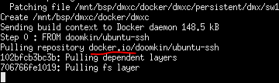
Docker image
Issues now:
It points to external docker image, which could be updated with time going on https://hub.docker.com/r/doomkin/ubuntu-ssh/
Use external ubuntu repo (cause connection outside during `make docker_build` always)
Slow if we always connect outside (may need config proxy)
Solution: Use internal docker registry instead of https://hub.docker.com
Add ELX ubuntu repo based on doomkin/ubuntu-ssh and store new docker image to EITTE global docker registry
Update Dockerfile to armdocker.rnd.ericsson.se/proj_switching_dev/bsp-base-doomkin_ubuntu_ssh

