Slide 1
C Reload Day 1
Shin Hong

Slide 2
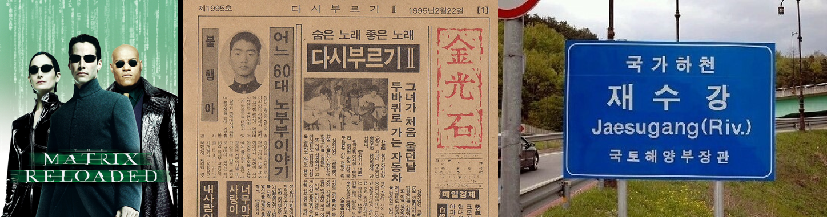
What this camp is for?
http://hisnet.handong.edu/myboard/read.php?id=19680&Page=1&Board=B0029

Slide 3
Channels
KakaoTalk
https://open.kakao.com/o/gchHBwvb
Github
http://github.com/hongshin/LearningC

Slide 4
Programming Environment
Linux
http://peace.handong.edu:8000/register/
Mac
Download and install Xcode from the Mac App store
Windows
MinGW http://www.codebind.com/cprogramming/install-mingw-windows-10-gcc/
Download and install Ubuntu 16.04 LTS from the MS app store

Slide 5
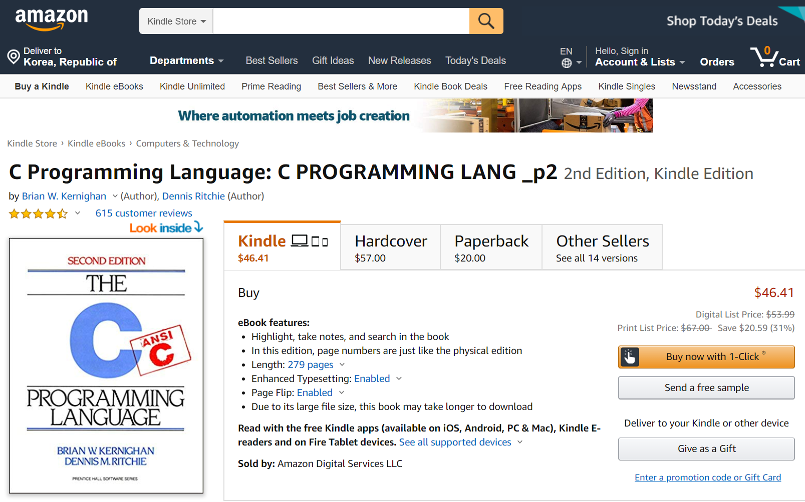
Textbook
The C Programming Language, 2/e, by Brian Kernighan and Dennis Ritchie

Slide 6
What is computing?
What is programming?

Slide 7
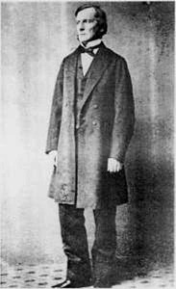
George Boole
Formulate a calculus of reasoning
Claim that logic should be considered as a branch of math, rather than a part of philosophy
Argue that there are math laws to express the operation of human mind
Showed that Aristotle's syllogistic logic could be rendered as algebraic equitation
A Brief History of Computing by G. O’Regan
George Boole (1815--1864)

Slide 8
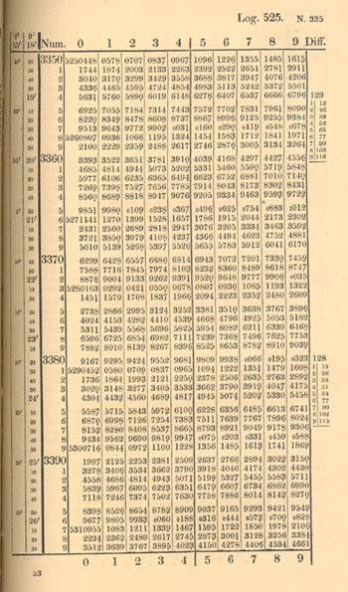
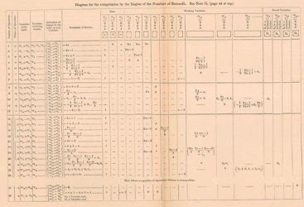

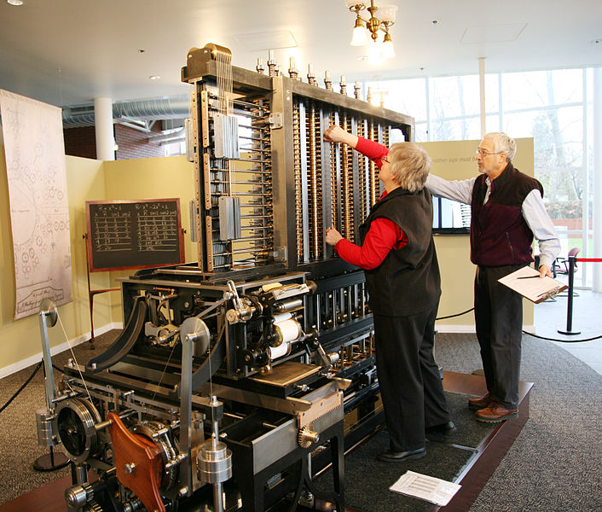
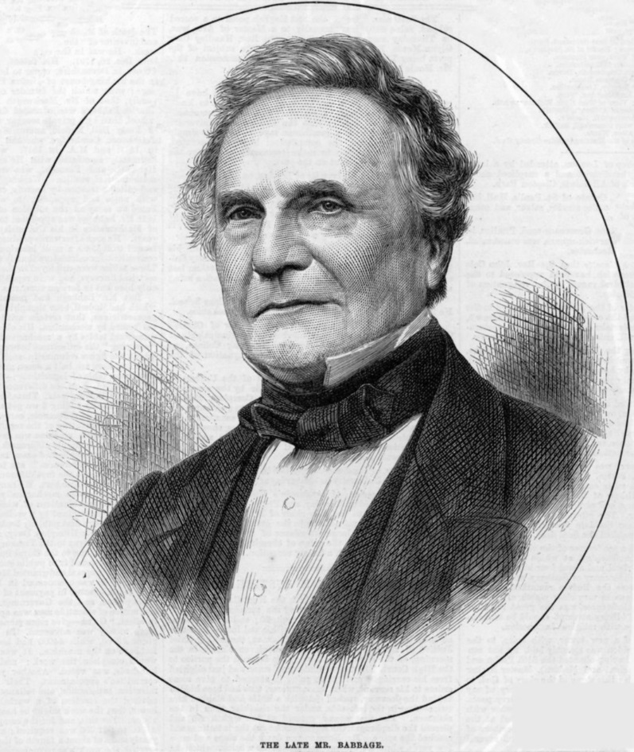
Charles Babbage
Develop mechanical methods to perform calculation
Difference engines
Propose a concept of computer
Analytic engine
Charles Babbage (1791—1871)

Slide 9
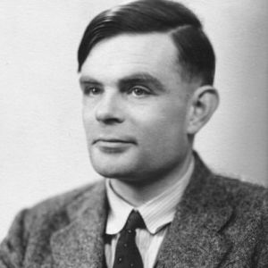

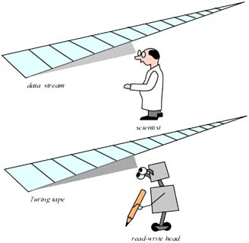
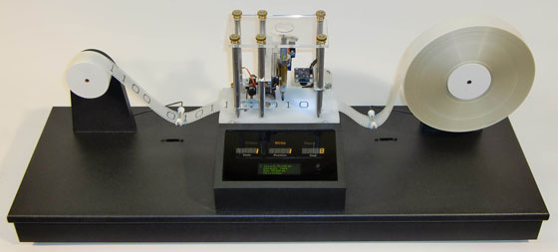

Slide 10
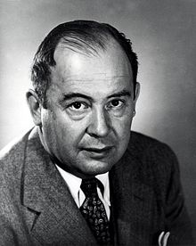
Computer Model
Memory is a map from addresses to values
A memory address is a non-negative integer
A value is either a number or instruction
number: 0 to 255
instruction
receive an input
produce an output
evaluate an expression over memory addresses
assign a value to a memory address
jump to a memory address
finish
A processor loads and executes instructions from address 0

Slide 11
Simple Computer Example
Memory addresses: 0, 1, ..., 29
Instruction
READ [m] Receive a new input and write it on address m
WRITE [m] Print out the number at address m
ASSIGN [m] [c] Put a number c to address m
MOVE [md] [ms] Put the value at address ms to address md
ADD [md] [mx] [my] Put the add of values in memory addresses mx and my to md
MINUS [md] [mx] [my] Put the minus of values in memory addresses mx and my to md
MOD [md] [mx] [my] Put the modulo of values in memory addresses mx and my to md
EQ [md] [mx] [my] Put 1 to md if the value at mx is equivalent to the value at my.
Otherwise, put 0 to md.
LESS [md] [mx] [my] Put 1 to md if the value at mx is less than the value at my.
Otherwise, put 0 to md.
JUMP [m] [c] Jump to address m if the value at c is not zero
TERM Finish the program execution

Slide 12
Exercise 1. Prime Number
Write a program for the simple computer model that checks whether or not a given positive number is prime
Construct a map/table of the 30 memory addresses
Ex. check whether a given number is even
0: READ 21
1: EQ 23 21 22
2: JUMP 23 10
3: JUMP 24 7
4: ASSIGN 24 20
5: MINUS 21 21 20
6: JUMP 1
7: ASSIGN 24 22
8: MINUS 21 21 20
9: JUMP 1
10: PRINT 24
11: TERM
...
20: “1”
21:
22: “0”
23:
24: “1”

Slide 13
Partners

