Slide 1
Learning Board Design Draft
05/31/2016

Slide 2
Landing page
Design

Slide 3
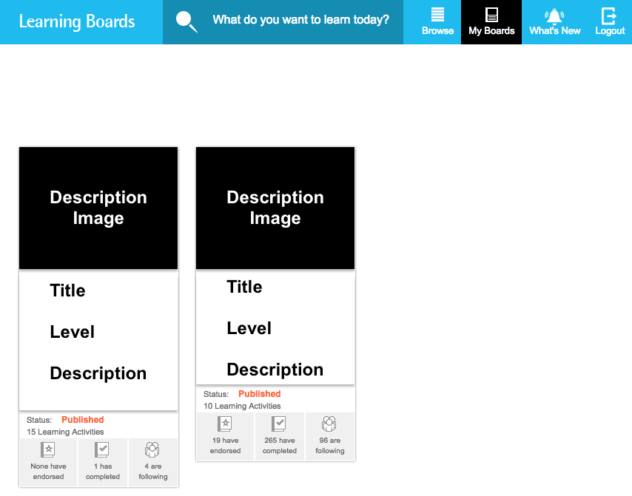

Landing page lists most popular boards
Fields:
- image
- title
- level
- description
- status
- learning activities
- endorsed
- completed
- following
boards
read

Slide 4
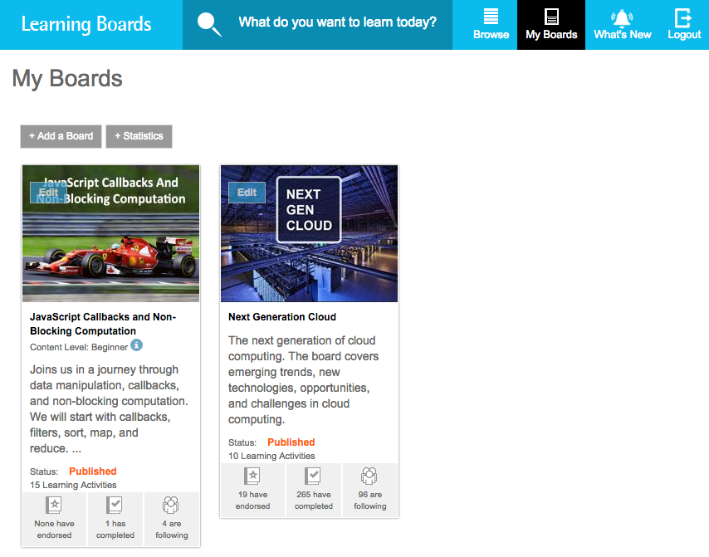
List filtered by user
Fields:
- image
- title
- level
- description
- status
- learning activities
- endorsed
- completed
- following
Create new new board
boards
read

Slide 5
Board creation
Design

Slide 6
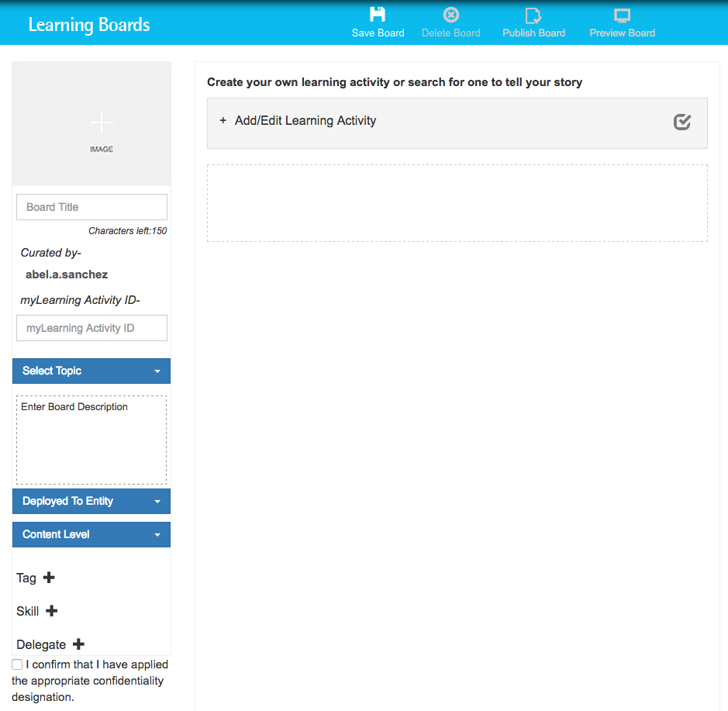
Fields:
- image
- title
- level
- description
- tags
write
boards

Slide 7
Activity creation
Design

Slide 8
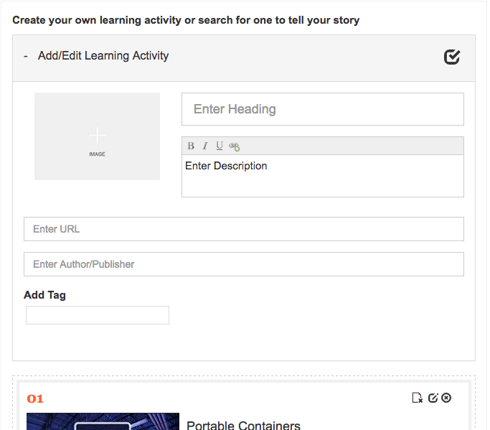
Fields:
- image
- title
- description
- url
- author
- tags
write
activities

Slide 9
Author board view
Design

Slide 10
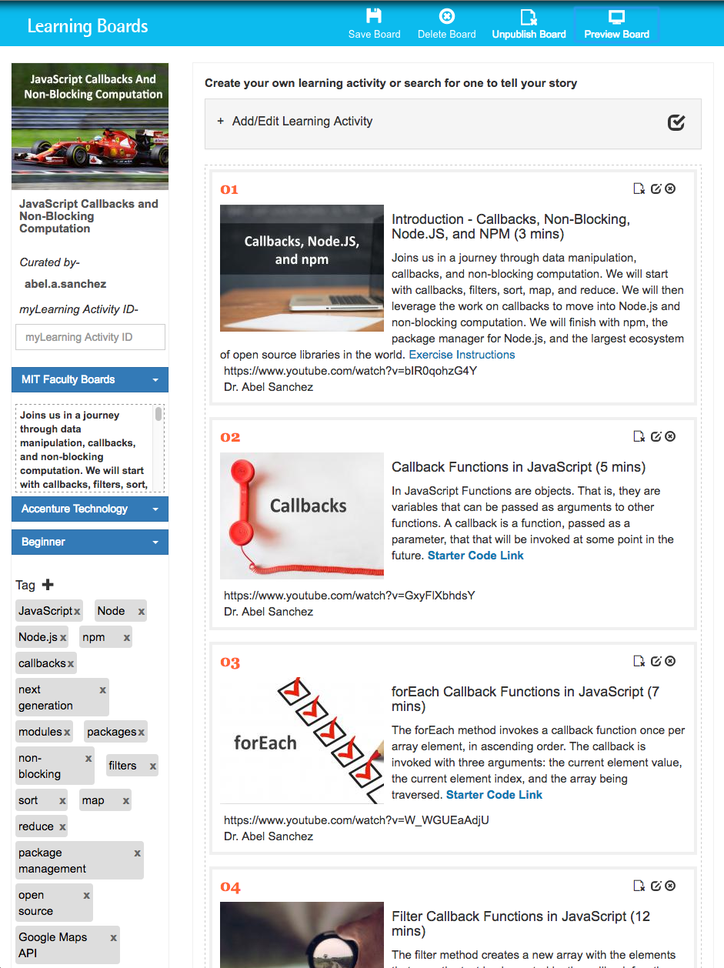
unpublish
Number sequentially
edit
delete
List board info
List activities
read
read
activities
boards

Slide 11
user board view
Design

Slide 12
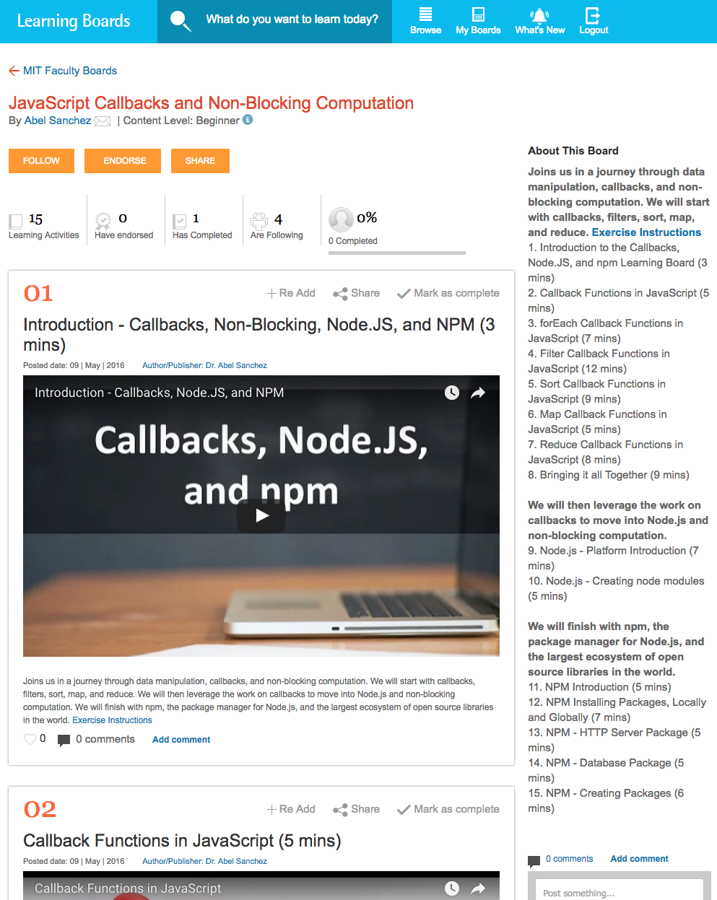
activities
Board info
read
read
Activities
boards

Slide 13
Menu bar
Design

Slide 14


Buttons when board is first created
Buttons once board is created

Slide 15
statistics
Design

Slide 16
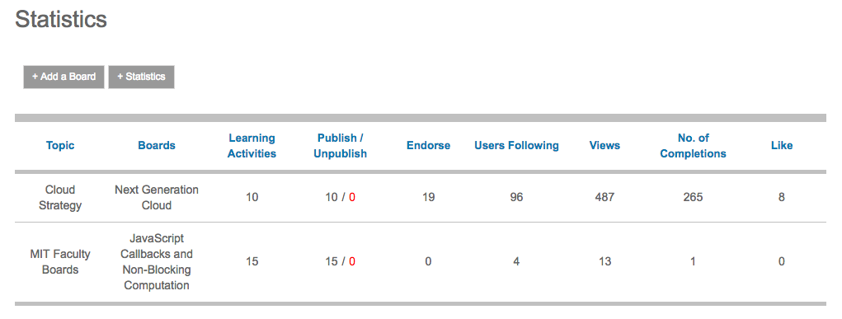
Fields:
- image
- title
- description
- url
- author
- tags
statistics

Slide 17
vision
Design

Slide 18












Holon
Small pieces, loosely joined (coupled)
Independent pieces:
- video
- content
- exercises
- assessment
- stats
Can the learning board be the glue?

Slide 19
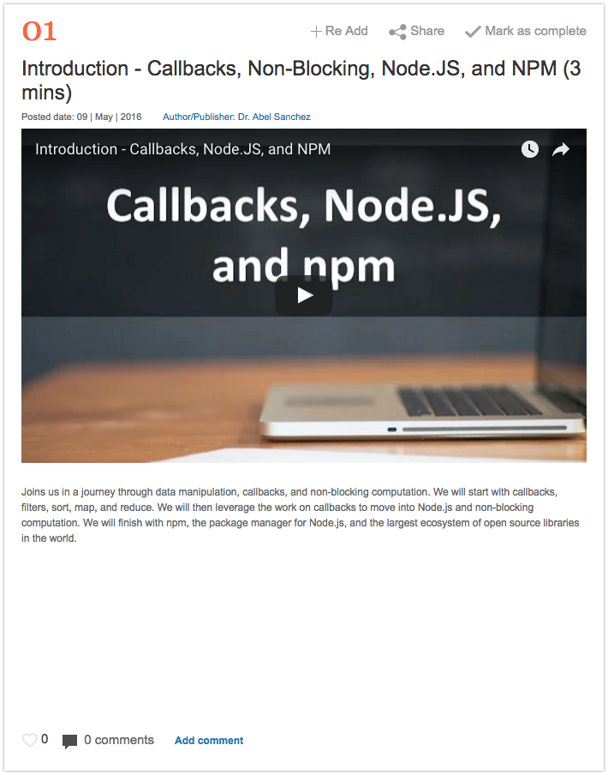
Activity Material:
Exercises
Readings
Quiz yourself

