Slide 1
Securing Method Level Security: PART-1
Soham Sengupta

Slide 2
Basic Approaches of Spring Security
URL level security (We already know this)
Method level security
Entity /Object Level security

Slide 3
Method Level Security- what & why?
Additional Layer of Security
Decouple & less-rely on Front-end logic for ‘ROLE based access ‘
Survives in case of developer- mistake (E.g. renaming paths – which allowed other roles to access resources)

Slide 4
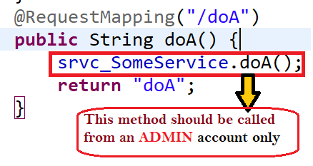
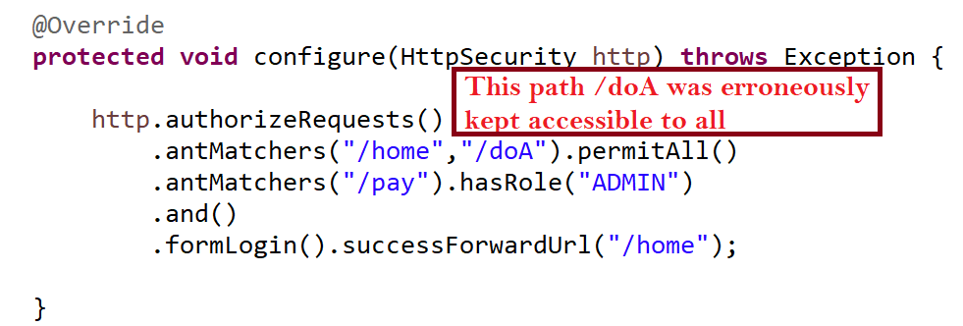
What does that mean?

Slide 5
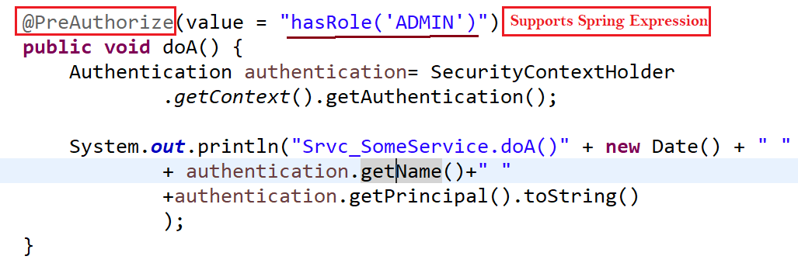
Let’s prevent the method ,too

Slide 6
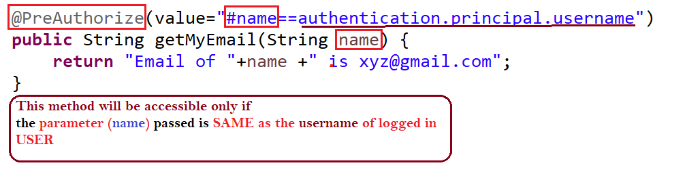
What happens?
Even if any other role is allowed to access /doA
Access to this method will be FORBIDDEN (HTTP Status: 403)
@PreAuthorize is capable of:
Evaluating Spring Expressions
Access Method Parameters

Slide 7
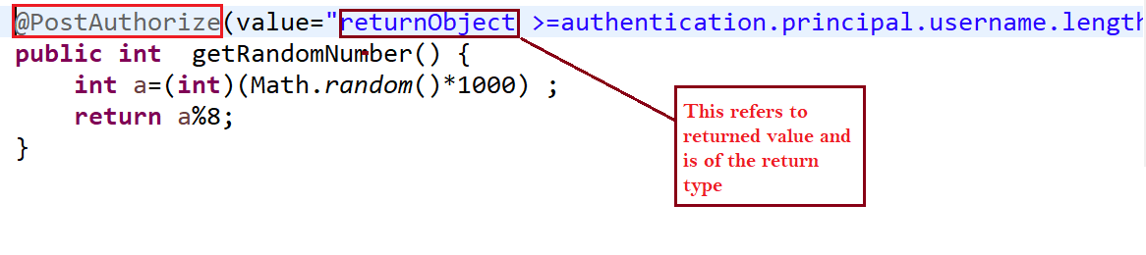
@PostAuthroize
This helps control access to succeed depending on returned value of the method
E.g. -a very silly impractical USE-CASE-
Let Access succeed as long length of the username <= Radom() mod 8

Slide 8
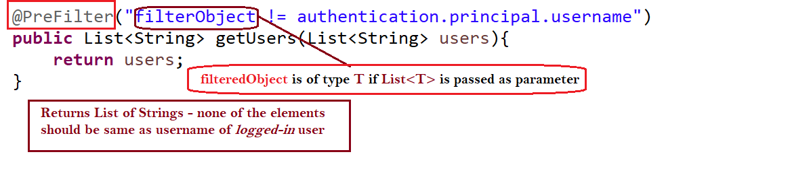
@PreFilter
Helps filter out from a method, objects from a Collection passed as parameter to a method

Slide 9
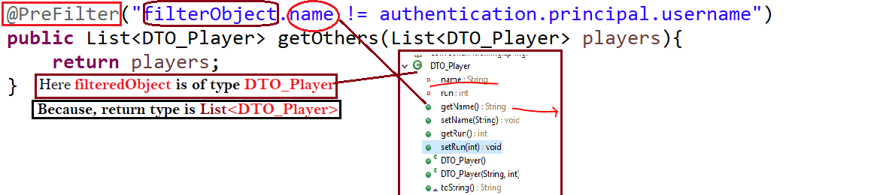
@PreFilter – Contd.
Use Case – List all Users except yourself – (E.g. Facebook –chat pane shows all friends of your but not you!)

Slide 10
@PreFilter – Contd.
Assignment – What happens if more than one Collection are passed in parameter list?

Slide 11
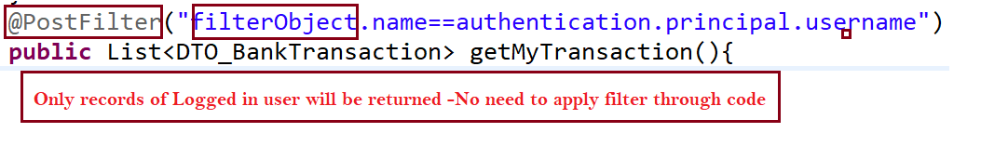
@PostFilter
This helps filter returned Collection based on some criteria that is returned

Slide 12

Other Approaches- @Secured
@Secured annotation doesn’t support Spring Expression Language
What’ll be the @PreAuthorize equivalent of the above code snippet?

Slide 13
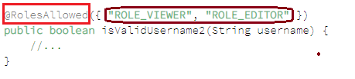
Another Approach- @RoleAllowed
What’ll be the @PreAuthorize equivalent of the above code snippet?

Slide 14
Combining @’s together
We can put multiple annotations together on a method.
I want a method
To be available to ADMIN only
Then, I want to return Collection of records of logged-in user only

Slide 15
Important Notes-
By default, Spring AOP proxy-ing is used to apply method security
Security will be ignored fora secure method m1() called by another method m2() in the same class
Thread-bound Security Context-
security context isn’t propagated to child-threads
We can use @PreAuthroize or similar annotations at class-level to ensure ROLE_BASED access to that class.

Slide 16


