Slide 1
Operating System Laboratory
Lecture 2: Kernel Static Analysis
Yong XIANG
Dept. of Computer Sci. & Tech., Tsinghua Univ.

Slide 2
Outline
Background
LINT: A Programming Tool
The Problem
Compiler
Static Analysis
Concept
Buffer Overrun
Pitfalls of Privileges
Untrusted Data
A Perfect Work

Slide 3
DOUBLE-CHECKING PROGRAMS: LINT
• Checks your program more thoroughly than cc does:
Utility : lint { fileName }*
lint scans the specified source files and displays any potential
errors that it finds.
$ lint reverse.c ---> check “reverse.c”.
reverse defined ( reverse.c(12) ), but never used
$ lint palindrome.c ---> check “palindrome.c”.
palindrome defined ( palindrome.c ( 12 ) ), but never used
reverse used ( palindrome.c(14) ), but not defined
Notes:
http://www.csun.edu/~andrzej/COMP421/lectures/tools.ppt
Since 1978
https://en.wikipedia.org/wiki/Lint_(software)

Slide 4
DOUBLE-CHECKING PROGRAMS: LINT
$ lint main2.c ---> check “main2.c”.
main2.c(11) : warning: main() returns random value to invocation
environment
printf returns value which is always ignored
palindrome used ( main2.c(9) ), but not defined
$ lint main2.c reverse.c palindrome.c ---> check all modules together.
main2.c:
min2.c(11): warning: main() returns random value to invocation
environment
reverse.c:
palindrome.c:
Lint pass2:
printf returns value which is always ignored
$ _

Slide 5
Outline
Background
LINT: A Programming Tool
The Problem
Compiler
Static Analysis
Concept
Buffer Overrun
Pitfalls of Privileges
Untrusted Data
A Perfect Work

Slide 6
Possible Programming Bugs
Application
Programming Language
User lib & Syscall
Compiler
Hardware

Slide 7
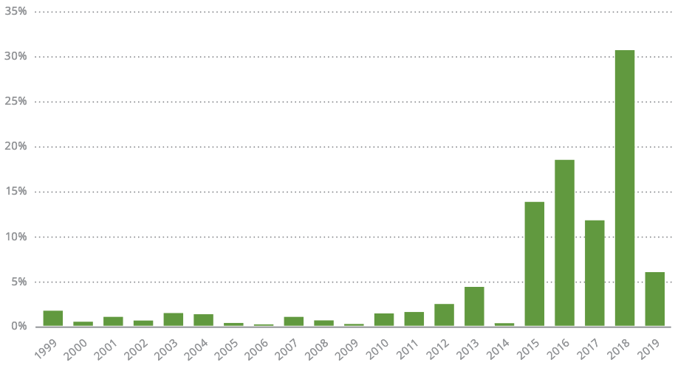
Landscape for all discovered CVE in 2019
Source: https://landing.edgescan.com/hubfs/BCC030%20Vulnerability%20Stats%20Report%20(2020)_WEB.pdf
Notes:
https://landing.edgescan.com/hubfs/BCC030%20Vulnerability%20Stats%20Report%20(2020)_WEB.pdf
这是2019年所有发现的CVE的已存在时间统计结果。

Slide 8
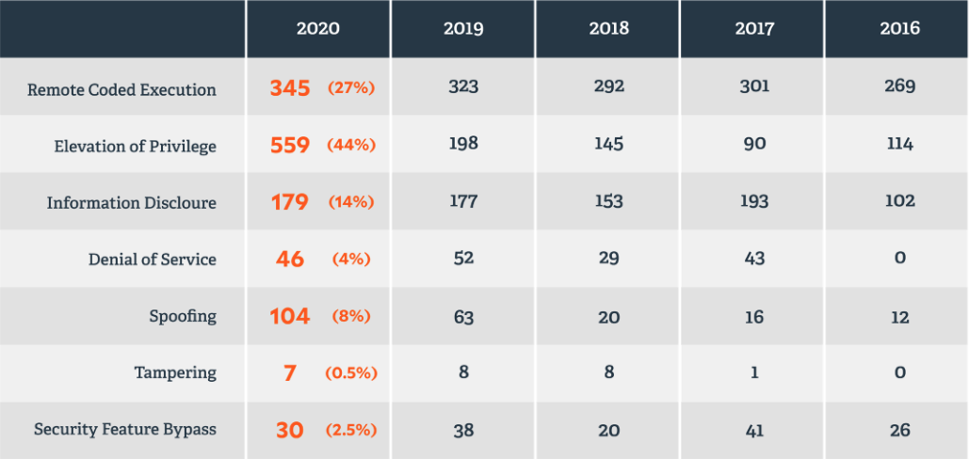
Vulnerabilities by Category (2016-2020)
Source： https://www.beyondtrust.com/assets/documents/BeyondTrust-Microsoft-Vulnerabilities-Report-2021.pdf

Slide 9
The Problem
Building secure systems is hard
2/3 of Internet servers have gaping security holes
The problem is buggy software
And a few pitfalls account for many vulnerabilities
Challenge: Improve programming technology
Need way to gain assurance in our software
Static analysis can help!
List of tools for static code analysis
Notes:
http://www.cs.berkeley.edu/~daw/talks/sas01.ppt
Static Analysis and Software Assurance
https://en.wikipedia.org/wiki/List_of_tools_for_static_code_analysis#C,_C++

Slide 10
Existing Paradigms
high
Formal verification
(sweet spot?)
Assurance
Testing
low
cheap
Cost
expensive

Slide 11
What Makes Security Hard?
Security is hard because of…
buffer overruns
privilege pitfalls
untrusted data
…

Slide 12
Outline
Background
LINT: A Programming Tool
The Problem
Compiler
Static Analysis
Concept
Buffer Overrun
Pitfalls of Privileges
Untrusted Data
A Perfect Work

Slide 13
What is a compiler?
A program that translates a program in one language to another language
The essential interface between applications & architectures
Typically lowers the level of abstraction
analyzes and reasons about the program & architecture
We expect the program to be optimized, i.e., better than the original
ideally exploiting architectural strengths and hiding weaknesses
Notes:
http://www.cs.utexas.edu/users/mckinley/380C/lecs/01.ppt
compiler

Slide 14
Role of compilers
Bridge complexity and evolution in architecture, languages, & applications
Help programmers with correctness, reliability, program understanding
Compiler optimizations can significantly improve performance
1 to 10x on conventional processors
Performance stability: one line change can dramatically alter performance
unfortunate, but true

Slide 15
Optimization
What should it do?
improve running time, or
decrease space requirements
decrease power consumption
How does it do it?

Slide 16
Example optimizations
Division of optimizations
Machine independent
Machine dependent
Faster code optimizations
common subexpression elimination
constant folding
dead code elimination
register allocation
scheduling
loop transformations

Slide 17
Analysis
Scope of program analysis
within a basic block (local)
within a method (global)
across methods (interprocedural)
Analysis
control flow graph - dominators, loops, etc.
dataflow analysis - flow of values
static-single-assignment – transform programs such that each variable has a unique definition
alias analysis - pointer memory usage
dependence analysis - array memory usage

Slide 18
Basic Compiler Structure
Higher to lower level
representations, analyses, & transformations
Program
Machine
code
Structural
inlining
unrolling
loop perm
Scalar
cse
constants
expressions
Memory
scalar repl
ptrs
Reg.
Alloc
Scheduling
peephole

Slide 19
Outline
Background
LINT: A Programming Tool
The Problem
Compiler
Static Analysis
Concept
Buffer Overrun
Pitfalls of Privileges
Untrusted Data
A Perfect Work

Slide 20
Static Analysis - Concept
Examples: compiler optimizations, program verifiers
Examine program text (no execution)
Build a model of program state
An abstraction of the run-time state
Reason over possible behaviors
E.g., “run” the program over the abstract state
Notes:
http://courses.cs.washington.edu/courses/cse503/10wi/lectures/lecture1-static-dynamic.ppt
Static and dynamic analysis: synergy and duality

Slide 21
Abstract interpretation
Typically implemented via dataflow analysis
Each program statement’s transfer function indicates how it transforms state
Example: What is the transfer function for
y = x++;
?

Slide 22
Selecting an abstract domain
⟨ x = { 3, 5, 7 }; y = { 9, 11, 13 } ⟩
y = x++;
⟨ x = { 4, 6, 8 }; y = { 3, 5, 7 } ⟩
⟨ x is odd; y is odd ⟩
y = x++;
⟨ x is even; y is odd ⟩
⟨x=3, y=11⟩, ⟨x=5, y=9⟩, ⟨x=7, y=13⟩
y = x++;
⟨x=4, y=3⟩, ⟨x=6, y=5⟩, ⟨x=8, y=7⟩
⟨ x is prime; y is prime ⟩
y = x++;
⟨ x is anything; y is prime ⟩
⟨ x_{n} = f(a_{n-1},…,z_{n-1}); y_{n} = f(a_{n-1},…,z_{n-1}) ⟩
y = x++;
⟨ x_{n+1} = x_{n}+1; y_{n+1} = x_{n} ⟩

Slide 23
Research challenge: Choose good abstractions
The abstraction determines the expense (in time and space)
The abstraction determines the accuracy (what information is lost)
Less accurate results are poor for applications that require precision
Cannot conclude all true properties in the grammar
Notes:
Challenge: choose good abstractions and transfer functions. (I am lumping in the transfer function with the abstraction.)
Selecting summaries is important, too.

Slide 24
Static analysis: Characteristic
Slow to analyze large models of state, so use abstraction
Conservative: account for abstracted-away state
Sound: (weak) properties are guaranteed to be true
*Some static analyses are not sound

Slide 25
Outline
Background
LINT: A Programming Tool
The Problem
Compiler
Static Analysis
Concept
Buffer Overrun
Pitfalls of Privileges
Untrusted Data
A Perfect Work

Slide 26
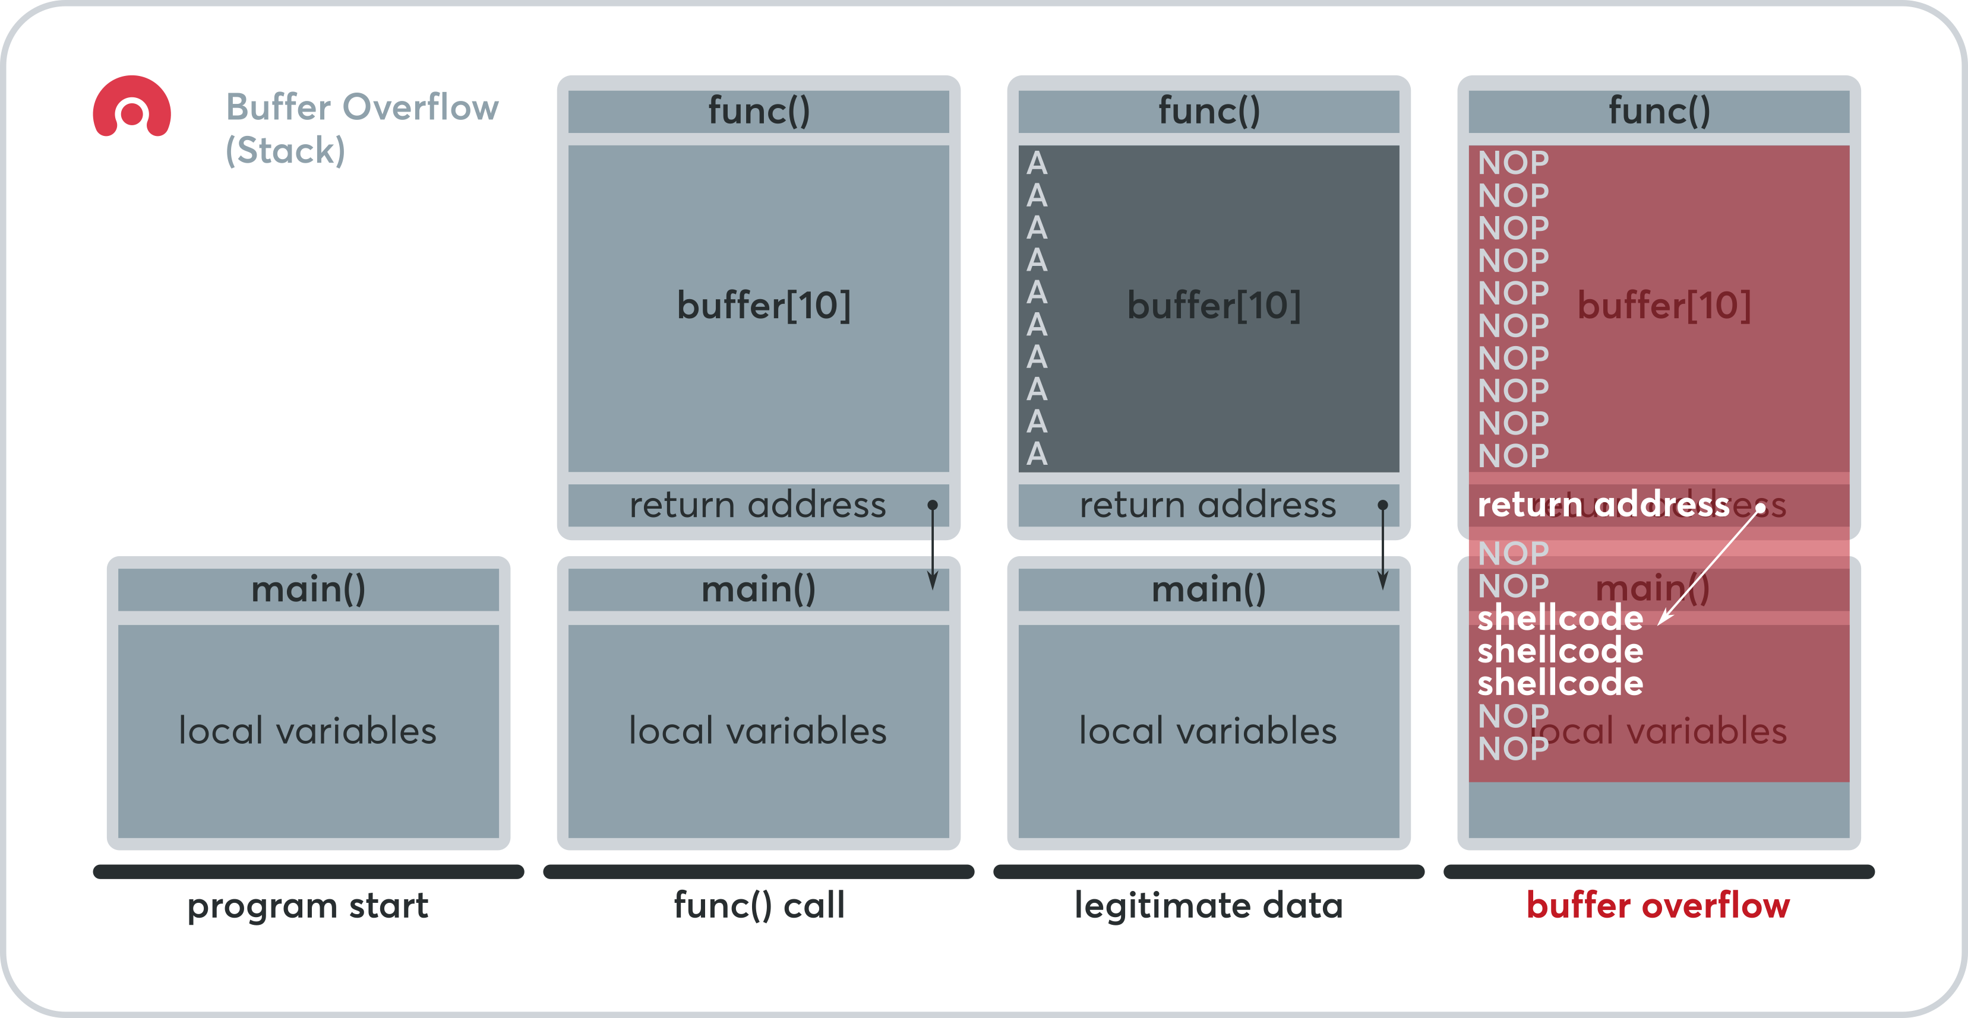
Buffer Overruns
An example bug:
Command line：
main(int argc, char *argv[]) {
func(argv[1]);
}
void func(char *v) {
char buffer[10];
strcpy(buffer, v);
}
$ vulnprog AAAAAAAAAAAAAAAAAAAAAAAAAAAAAAAA
Source: https://www.acunetix.com/blog/web-security-zone/what-is-buffer-overflow/
Notes:
https://us-cert.cisa.gov/ncas/bulletins

Slide 27
Static Detection of Overruns
Introduce implicit variables:
alloc(buf) = # bytes allocated for buf
len(buf) = # bytes stored in buf
Safety condition: len(buf) ≤ alloc(buf)

Slide 28
Current Status
Experimental results
Found new bugs in sendmail (30k LOC), others
Analysis is fast, but many false alarms (1/kLOC)
see also Dor, Rodeh, Sagiv
Research challenges
Pointer analysis (support strong updates)
Integer analysis (infer linear relations, flow-sensitivity)
Soundness, scalability, real-world programs
Notes:
LOC: the number of lines of code

Slide 29
Outline
Background
LINT: A Programming Tool
The Problem
Compiler
Static Analysis
Concept
Buffer Overrun
Pitfalls of Privileges
Untrusted Data
A Perfect Work

Slide 30
Pitfalls of Privileges
Spot the bug:
setuid(0);
rv = bind(...);
if (rv < 0) return rv;
seteuid(getuid());
enablePriv()
checkPriv()
Bug! Leaks privilege
disablePriv()

Slide 31
A Common Language
Various interpretations are possible
C: enablePriv(p) lasts until next disablePriv(p)
Java: … or until containing stack frame is popped
checkPriv(p) throws fatal error if p not enabled

Slide 32
Static Privilege Analysis
Some problems in privilege analysis:
Privilege inference (auditing, bug-finding)
Find all privileges reaching a given program point
Enforcing privilege-safety (cleanliness of new code)
Verify statically that no checkPriv() operation can fail
… or that program behaves same under C & Java styles

Slide 33
Future Directions
Research challenges
Experimental studies on real programs
Handling data-directed privilege properties
Other access control models

Slide 34
Outline
Background
LINT: A Programming Tool
The Problem
Compiler
Static Analysis
Concept
Buffer Overrun
Pitfalls of Privileges
Untrusted Data
A Perfect Work

Slide 35
Manipulating Untrusted Data
Spot the bug:
hp = gethostbyaddr(...);
printf(hp->hp_hname);
untrusted source of data
Bug! printf() trusts its first argument

Slide 36
Trust Analysis
Security involves much mental “bookkeeping”
Problem: Help programmer keep track of which values can be trusted
One approach: static taint analysis
Extend the C type system
Qualified types express annotations: e.g., tainted char * is an untrusted string
Typechecking enforces safe usage
Type inference reduces annotation burden

Slide 37
A Tiny Example
a trust annotation
void printf(untainted char *, ...); tainted char * read_from_network(void);
char *s = read_from_network(); printf(s);
… where untainted T ≤ tainted T

Slide 38
After Type Inference…
void printf(untainted char *, ...); tainted char * read_from_network(void);
tainted char *s = read_from_network(); printf(s);
an inferred type
tainted
Doesn’t type-check! Indicates vulnerability
… where untainted T ≤ tainted T

Slide 39
Current Status
Experimental results
Successful on real programs
Able to find many previously-known format string bugs
Cost: 10-15 minutes per application
Type theory seems useful for security engineering
Research challenges
Richer theory to support real programming idioms
More broadly-applicable discipline of good coding
Finer-grained notions of trust

Slide 40
Concluding Remarks
Static analysis can help secure our software
Buffer overruns, privilege bugs, format string bugs
Hits a sweet spot: cheap and proactive
Security as a source of interesting problems?
Motivations for better pointer, integer analysis
New problems: privilege analysis, trust analysis

Slide 41
Outline
Background
LINT: A Programming Tool
The Problem
Compiler
Static Analysis
Concept
Buffer Overrun
Pitfalls of Privileges
Untrusted Data
A Perfect Work

Slide 42
A Perfect Example
Improving Integer Security for Systems with KINT
https://www.usenix.org/conference/osdi12/technical-sessions/presentation/wang
Towards Optimization-Safe Systems: Analyzing the Impact of Undefined Behavior
http://sigops.org/sosp/sosp13/program.html

Slide 43
References
Lint, a C Program Checker
http://files.cnblogs.com/bangerlee/10.1.1.56.1841.pdf
Towards Optimization-Safe Systems: Analyzing the Impact of Undefined Behavior
http://adl.csie.ncu.edu.tw/adlab/ppt/553_Towards%20Optimization-Safe%20Systems%20%E2%80%94%20Analyzing%20the%20Impact%20of%20Undefined%20Behavior.pptx
Improving Integer Security for Systems with KINT
http://pdos.csail.mit.edu/~xi/papers/kint-osdi12-slides.pptx
Static Analysis and Software Assurance
http://www.cs.berkeley.edu/~daw/talks/sas01.ppt
Static and dynamic analysis: synergy and duality
http://courses.cs.washington.edu/courses/cse503/10wi/lectures/lecture1-static-dynamic.ppt
compiler
http://www.cs.utexas.edu/users/mckinley/380C/lecs/01.ppt
Static/Dynamic Analysis Tools
http://www.csl.sri.com/users/shankar/VGC05/Aiken.ppt
C Programming Tools
http://www.csun.edu/~andrzej/COMP421/lectures/tools.ppt

Slide 44
Q&A

