Slide 1
Operating System Laboratory
Lecture 3: Kernel Dynamic Analysis
Yong XIANG
Dept. of Computer Sci. & Tech., Tsinghua Univ.

Slide 2
Outline
Background
gprof
DTrace
SystemTap
ftrace
S2E
Vmxice
eBPF

Slide 3
Dynamic analysis
Execute program (over some inputs)
The compiler provides the semantics
Observe executions
Requires instrumentation infrastructure
Must choose what to measure, and what test runs
Notes:
Example of speed: pointer analysis
http://courses.cs.washington.edu/courses/cse503/10wi/lectures/lecture1-static-dynamic.ppt
Static and dynamic analysis: synergy and duality

Slide 4
Research challenge: What to measure?
Coverage or frequency
Statements, branches, paths, procedure calls, types, method dispatch
Values computed
Parameters, array indices
Run time, memory usage
Like abstraction, determines what is reported

Slide 5
Research challenge: Choose good tests
The test suite determines the expense (in time and space)
The test suite determines the accuracy (what executions are never seen)
Less accurate results are poor for applications that require correctness

Slide 6
Linux故障分析实例
谢宝友： Linux故障分析方法
上： https://mp.weixin.qq.com/s/Z9WOmH8f8XXmD5itAFHeFw
中： https://mp.weixin.qq.com/s/tGzftejTYi-TWcLq84D7jQ
下： https://mp.weixin.qq.com/s/Aw6ELkuQWIJPm9IP3mG_4w
linux2.6.1内核源码注释
https://download.csdn.net/download/xiebaoyou/7017755
线程引用计数故障
堆栈溢出故障
IP转发邻居表溢出故障
SMP调度死机故障
内存故障

Slide 7
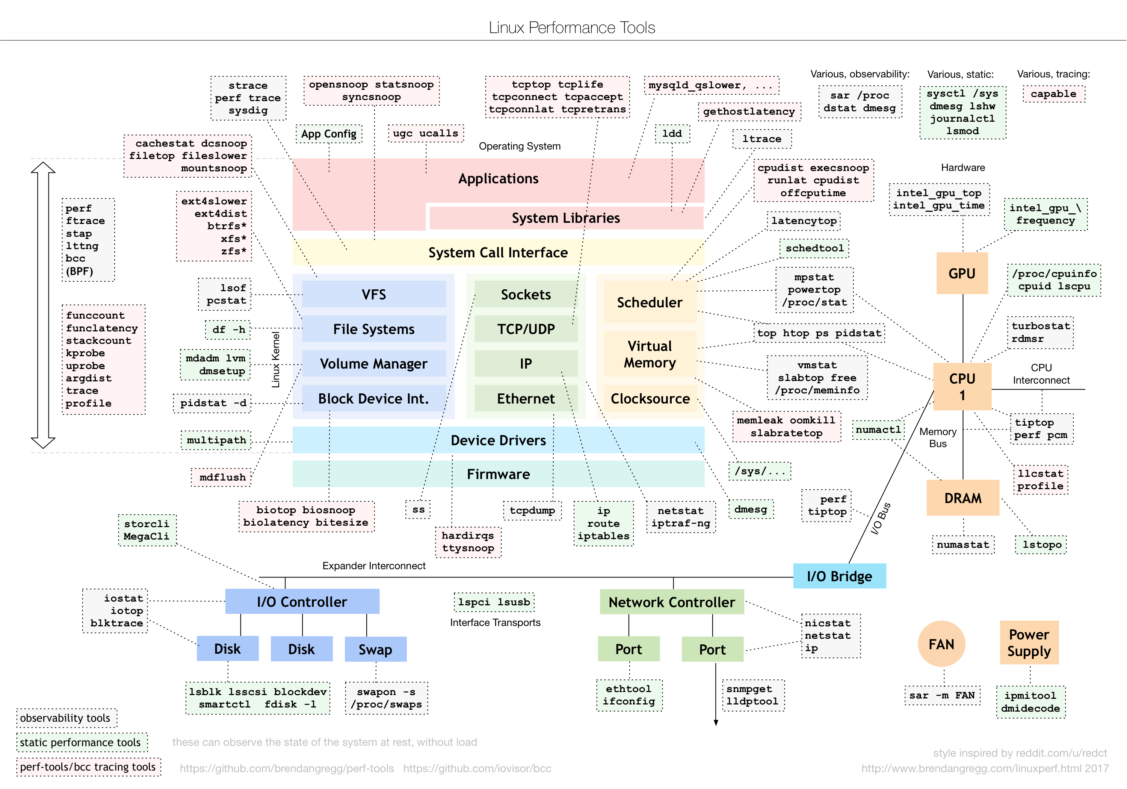
Notes:
http://www.brendangregg.com/Perf/linux_perf_tools_full.png
http://www.brendangregg.com/linuxperf.html

Slide 8
Outline
Background
gprof
DTrace
SystemTap
ftrace
S2E
Vmxice
eBPF

Slide 9
GNU gprof time profiler
Detail time statistics for each subroutine.
Create relative graph for all subroutines.
Analysis the program bottleneck.
Increase about 30% extra time cost.
Notes:
Profile
noun
1 an outline of something, esp. a person's face, as seen from one

Slide 10
Steps for Profiling a program with gprof
Compile and link a program with profiling enabled
Program is compiled with ‘-pg’ option
Every function to call mcount as one of its first operations
mcount routine records in an in-memory call graph table
profil() system call examines the user's program counter (PC) every virtual 10 milliseconds
Execute a program to generate its profile data
Generating the file ‘gmon.out’
Run gprof to analyze the profile data
gprof’s symbol table, an array of Sym structures, is built

Slide 11
GNU gprof time profiler
Recompile the original source code
-pg: This option affects both compiling and linking.
Add additional commands into source code when
compiling code in order to trace all subroutines.
Add essential initial settings and statistical processes
when linking the objects.
gcc –pg SourceCode –o ExecutableFile [ykhong@vangogh home]$ gcc –pg test2.c –o test2

Slide 12
GNU gprof time profiler
Convert produced profile data into text file
- ListOfOptions can be omitted.
- ExecuteFile can be omitted when the file name is a.out.
- StatFiles can be omitted when the file name is gmon.out.
gprof ListOfOptions ExecuteFile StatFiles > OutputFile [ykhong@vangogh home]$ gprof –b test2 gmon.out > output.txt

Slide 13
Tracing method of gprof
Notes:
http://os.cs.tsinghua.edu.cn/hgj/Interface/analysis/PaperList#head-4f9d1b3fa37f96cf79230e31ee571c85c14839ff
基于硬件虚拟化的内核动态追踪系统

Slide 14
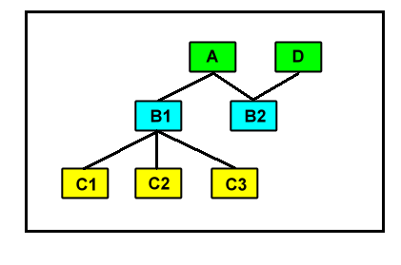
GNU gprof time profiler
Example Program
subroutine relative graph

Slide 15
GNU gprof time profiler
Example Program
[ykhong@vangogh home]$ gcc –pg test.c –o test [ykhong@vangogh home]$ ./test [ykhong@vangogh home]$ gprof –b test gmon.out > output [ykhong@vangogh home]$ more output

Slide 16
GNU gprof time profiler
Example Program
Each sample counts as 0.01 seconds. % cumulative self self total time seconds seconds calls s/call s/call name 71.90 30.17 30.17 1 30.17 30.17 C3 19.42 38.32 8.15 2 4.07 4.07 B2 7.99 41.67 3.35 1 3.35 3.35 C2 0.00 41.67 0.00 1 0.00 37.60 A 0.00 41.67 0.00 1 0.00 33.52 B1 0.00 41.67 0.00 1 0.00 0.00 C1 0.00 41.67 0.00 1 0.00 4.07 D
Notes:
% time: the percent of self seconds from total program elapsed time.
cumulative seconds: the seconds cumulate from self seconds.
self seconds: total elapsed time called by its parents, not
including its children’s elapsed time.
equal to (self s/call)*(calls)
calls: total number for each subroutine called by its parents.
self s/call: elapsed time for each time called by its parents,
not including its children’s elapsed time.
total s/call: total elapsed time called by its parents,
including its children’s elapsed time.
name: subroutine name.

Slide 17
GNU gprof time profiler
Example Program
Call graph index %time self children called name <spontaneous> [1] 100.0 0.00 41.67 main[1] 0.00 37.60 1/1 A[2] 0.00 4.07 1/1 D[6] ------------------------------------------------------------------ 0.00 37.60 1/1 main[1] [2] 90.2 0.00 37.60 1 A[2] 0.00 33.52 1/1 B1[3] 4.07 0.00 1/2 B2[5] ------------------------------------------------------------------

Slide 18
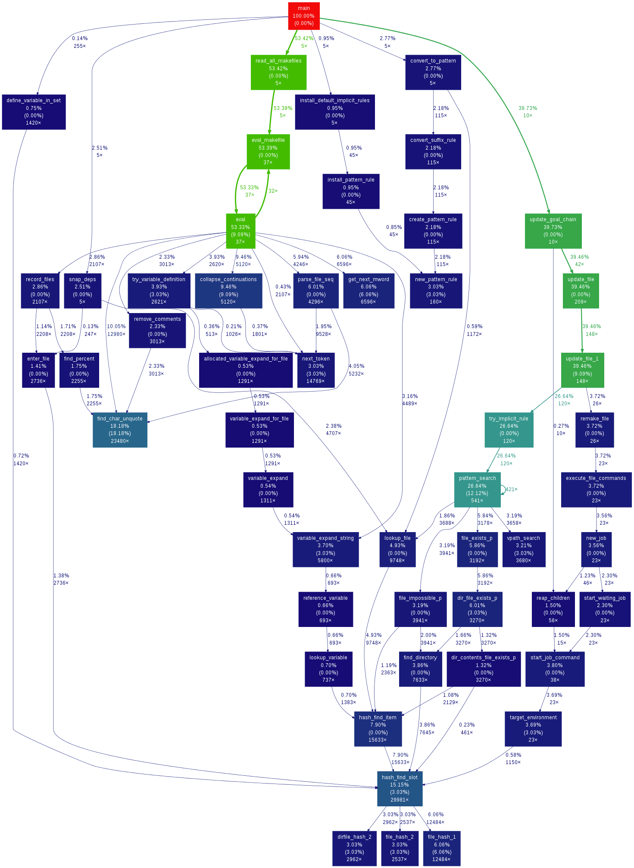
grof2dot
Notes:
https://github.com/jrfonseca/gprof2dot

Slide 19
Outline
Background
gprof
DTrace
SystemTap
ftrace
S2E
Vmxice
eBPF

Slide 20
Overview of DTrace
DTrace – a dynamic tracing environment for Solaris
Can be used to troubleshoot performance and logic problems in user applications
Features of tracing
Uses dynamic binary instrumentation
Inserts instrumentation code in running processes
Has specialized C-like language, D
Terminology
Probes: points of instrumentation
Providers: make probes available
Specific to Solaris (requires extensive OS kernel modification)
Notes:
Designed for use on production systems to find performance bottlenecks
Provides a single view of the software stack - from kernel to application, leading to rapid identification of performance bottlenecks
Dynamically instruments the kernel and instructions in any application with a near-infinite number of probe points, improving ability to service software
Enables maximum resource utilization and application performance, as well as precise quantification of resource requirements
Fast and easy to use, even on complex systems with multiple layers of software
http://www.oracle.com/technetwork/server-storage/solaris/overview/dtrace-jsp-138890.html

Slide 21
DTrace: History
1996: conceived of by Bryan Cantrill while an undergrad at Brown
2001: Started work on Dtrace wth Michael W. Shapiro
2002: Early prototype, Adam H. Leventhal joined development
2004: Appears in Solaris
2005: Sun releases DTrace source code, initial java support (dvm)
2006: Ported to FreeBSD by John Birrell
2007: To be released in MacOSX 10.5 “Leopard” and basis of Xray

Slide 22
DTrace Usage
Users write D programs that collect information at runtime
Users invoke dtrace to insert instrumentation code in kernel and user processes
Security mechanism ensures code can be inserted only by authorized users
When events occur at runtime, user’s D code is executed by the DTrace providers, which causes
Information to be recorded
Data to be printed
Whatever else users defines in their D programs!
Many, many providers exist for getting lots of different data from running programs

Slide 23
Dtrace features
Provides (>30k) instrumentation points…
…in the kernel
…in the C runtime library (libc.so)
…in the Java VM (libjvm.so)
…in Java itself (starting with Java 1.6)
Safe (probes not allowed to crash system)
Extensible (users can implement their own instrumentation points)
Predicates avoid retaining (copying, and storing) unneeded data
Provides scalable aggregation (sum, min, avg, quantize, count, etc.)
High level awk-like language, called D
Notes:
Retain
(continue to have)保留 ‹property, salary, right›; 保持 ‹control, dignity, independence›

Slide 24
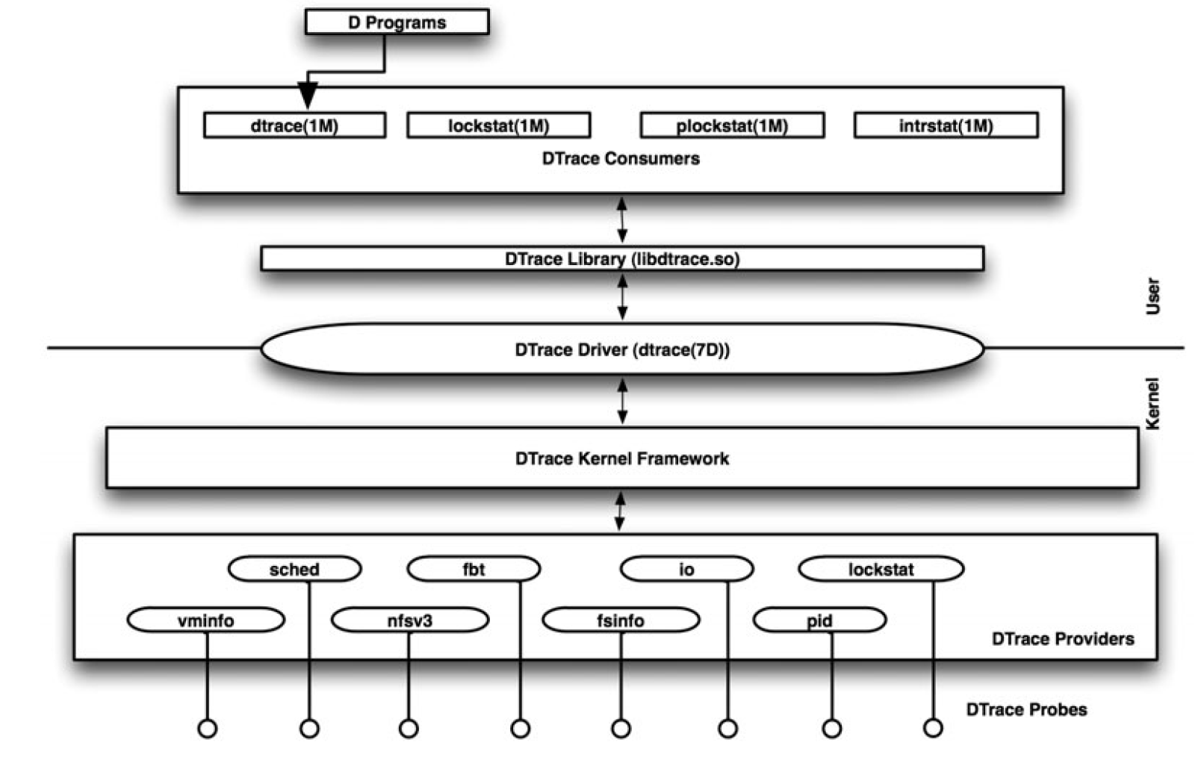
DTrace Architecture
Notes:
http://58.205.212.28/9/ishare.down.sina.com.cn/19508880.pdf?ssig=ZlYsfmL5fc&Expires=1381248000&KID=sina,ishare&ip=1381155946,59.66.61.&fn=dtrace-dynamic-tracing-in-oracle-solaris-mac-os-x-and-freebsd-oracle-solaris-series.9780132091510.54816.pdf

Slide 25
D Language
Simplified C-like language
Uses C formatting conventions
No conditionals or functions/methods/classes
The D language provides convenient features for
Gathering and statistical information
Aggregating data
Displaying function arguments or timing information (printf-like syntax)
Speculative tracing
Structure of a D program
Probe description that tells which provider to use
Predicate that says when this probe should be executed
Action statements that make up the body of the probe
Notes:
Speculative
(of an investment) involving a high risk of loss.

Slide 26
Example DTrace Providers
syscall: makes a probe available at the entry to and return from every system call
vminfo: makes a probe available on VM activity (page out, page faults, etc)
profile: makes a probe available that can run every X milliseconds
fpuinfo: makes a probe available when hardware floating point operations are emulated in software
Users can also create their own providers by using the DTrace API
Ex: provide probes before/after a request is serviced in a web server or database server

Slide 27
Example one-liners
System call count, by process
dtrace -n 'syscall:::entry { @num[pid,execname] = count(); }'
Files opened by process
dtrace -n 'syscall::open*:entry { printf("%s %s",execname,copyinstr(arg0)); }'
Number of bytes read, by process
dtrace -n 'sysinfo:::readch { @bytes[execname] = sum(arg0); }'
Write size distribution, by process
dtrace -n 'sysinfo:::writech { @dist[execname] = quantize(arg0); }'
Sample java stack at 1001 Hertz (aka profile)
dtrace -n 'profile-1001 /pid == $target/ { @num[jstack()] = count(); }' -p PID

Slide 28
Example Toy D Program
D code
Output
/*
Count off and report the
number of seconds elapsed
*/
dtrace:::BEGIN
{
i = 0;
}
profile:::tick-1sec
{
i = i + 1;
trace(i);
}
dtrace:::END
{
trace(i);
}
# dtrace -s counter.d
dtrace: script ’counter.d’ matched 3 probes
CPU ID FUNCTION:NAME
0 25499 :tick-1sec 1
0 25499 :tick-1sec 2
0 25499 :tick-1sec 3
0 25499 :tick-1sec 4
0 25499 :tick-1sec 5
0 25499 :tick-1sec 6
^C
0 2 :END 6
#

Slide 29
More Realistic Program
D code to time read() and write() syscalls
Output
# dtrace -s rwtime.d ‘pgrep -n ksh‘
dtrace: script ’rwtime.d’ matched 4 probes
CPU ID FUNCTION:NAME
0 33 read:return 22644 nsecs
0 33 read:return 3382 nsecs
0 35 write:return 25952 nsecs
0 33 read:return 916875239 nsecs
0 35 write:return 27320 nsecs
0 33 read:return 9022 nsecs
0 33 read:return 3776 nsecs
0 35 write:return 17164 nsecs
...
syscall::read:entry,
syscall::write:entry
/pid == $1/
{
ts[probefunc] = timestamp;
}
syscall::read:return,
syscall::write:return
/pid == $1 && ts[probefunc] != 0/
{
printf("%d nsecs", timestamp - ts[probefunc]);
}

Slide 30
DTrace Comments
Good points
Does not require application modification, can trace any PID on the system
Can use on production Solaris systems
Can add and remove probes without having to restart applications
Authors claim low overhead when a handful of probes are enabled
D code provides a bit of flexibility when tracking down problems
Uses simple ASCII output (good for sed/awk/grep/perl support)
Bad points
Users must learn new D language
Tied very closely to Solaris kernel
Only low-level (OS-level) information provided
Users have to write a lot of D code for operations that are much easier to get in other tools
E.g., using prof/gprof vs. dtrace alone
Can’t easily track time spent by user code
Poor source code correlation
Best case: function name and byte offset from stack dumps

Slide 31
Outline
Background
gprof
DTrace
SystemTap
ftrace
S2E
Vmxice
eBPF

Slide 32
SystemTap
Can examine or modify any parameters and local variables visible at the probe point
Statistics gathering capabilities built in
A number of safety features make it far harder to crash a running kernel
Automatically communicates with a user-level process
Previous example can be expressed far easier:
global count
probe kernel.function("generic_make_request") { count++; }
probe begin { log("starting probe") }
probe end { printf("generic_make_request() called %d times.",count); }

Slide 33
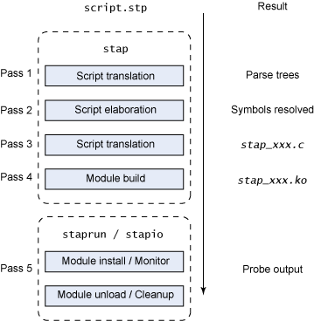
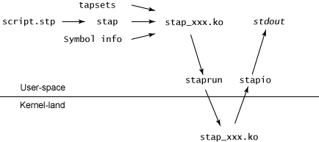
SystemTap process

Slide 34
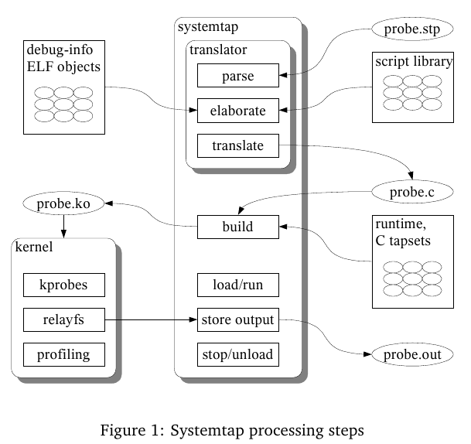
Systemtap processing steps
Notes:
http://dirlt.com/systemtap.html

Slide 35
How it works
SystemTap parses your code and identifies probe points and identifiers using the kernel debug info
The script is translated into C code
The C code is compiled into a KProbe module
A root-privileged deamon called “stpd” is started
The compiled kernel module is inserted
The module exports output via the “relayfs” virtual file system to stpd
The stpd service delivers this data to the user process to output

Slide 36
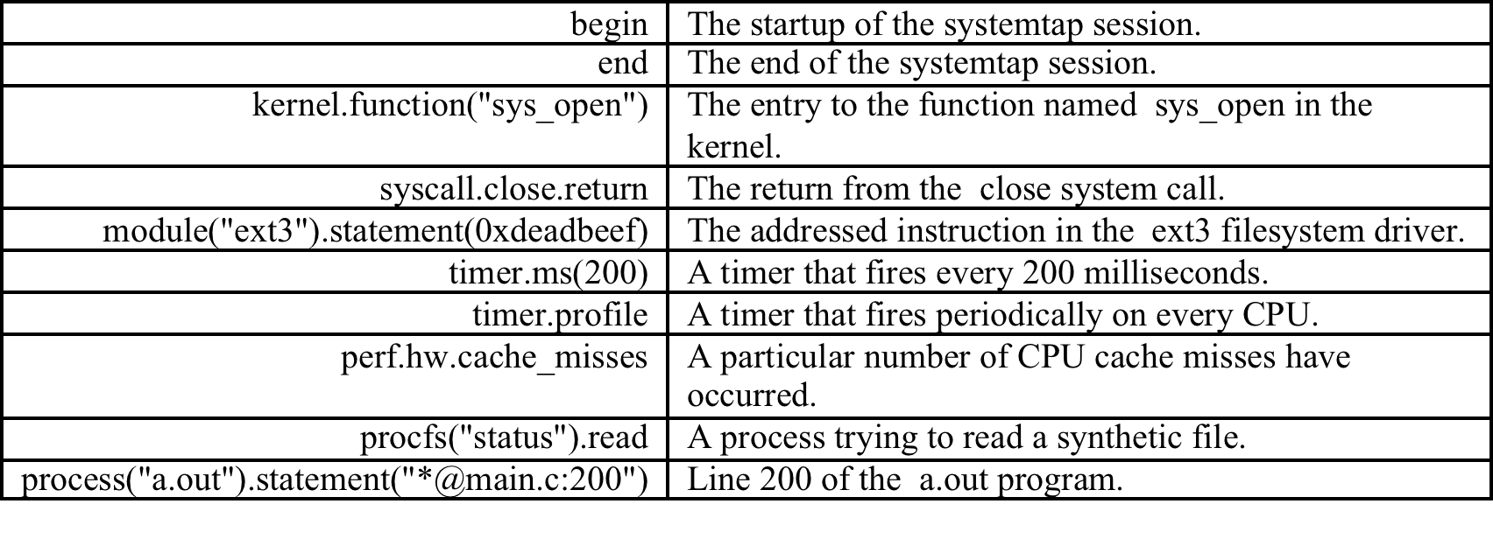
Where to probe
Systemtap supports a number of built-in events.
Notes:
https://sourceware.org/systemtap/tutorial.pdf
Synthetic (not genuine or natural)假的

Slide 37
What to do with it?
Use SystemTap-derived data to make real-time decisions about CPU scaling
Two approachs:
Statistical
Given a set of kernel metrics x₁..x_{n}, find a function f(x₁..x_{n}) that yields the ideal CPU frequency
Algorithmic
Given a performance metric p(x₁..x_{n}), adjust the CPU frequency tentatively while observing feedback from p.

Slide 38
Outline
Background
gprof
DTrace
SystemTap
ftrace
S2E
Vmxice
eBPF

Slide 39
What is Ftrace?
Provides a generic framework for tracing
Infrastructure for defining tracepoints
Ability to register different kinds of tracers
Specialized data structure (ring buffer) for trace data storage
Notes:
SystemTap 设计比较复杂
不当的使用和 SystemTap 自身的不完善都有可能导致系统崩溃
ftrace 代码量很小，稳定可靠。
ftrace 有定义良好的 ASCII 接口，可以直接阅读
ftrace 对所有 tracer 都采用同一个 ring buffer
Ftrace 的实现依赖于其他很多内核特性，比如 tracepoint[3]，debugfs[2]，kprobe[4]，IRQ-Flags[5] 等。

Slide 40
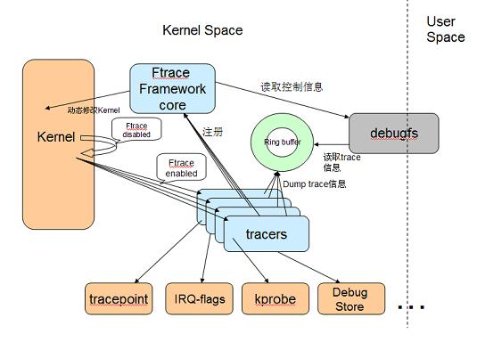
Ftrace Components

Slide 41
mcount Routine
‘mcount’ is called by every kernel function
Except inlines and a few special functions
Must be a low-overhead routine
Incompatible with some compiler optimizations
E.g. cannot omit frame-pointers on ARM
Compiler disables some optimizations automatically
Analysis of assembly indicates that mcount callers have well-defined frames
Notes:
Deficiency in current mcount routine is being addressed with a new mcount (gnu_mcout) with slightly difference call semantics

Slide 42
Diagram of Trampoline
Caller
Thead_info
struct ret_stack
mcount
caller 1
Function
caller 2
Func entry
Tracer
Stack
Func exit
Tracer
ret addr

Slide 43
Code to Call mcount
00000570 <sys_sync>:
570: e1a0c00d mov ip, sp
574: e92dd800 stmdb sp!, {fp, ip, lr, pc}
578: e24cb004 sub fp, ip, #4 ; 0x4
57c: e3a00001 mov r0, #1 ; 0x1
580: ebffffa0 bl 408 <do_sync>
584: e3a00000 mov r0, #0 ; 0x0
588: e89da800 ldmia sp, {fp, sp, pc}
00000570 <sys_sync>:
570: e1a0c00d mov ip, sp
574: e92dd800 stmdb sp!, {fp, ip, lr, pc}
578: e24cb004 sub fp, ip, #4 ; 0x4
57c: e1a0c00e mov ip, lr
580: ebfffffe bl 0 <mcount>
584: 00000028 andeq r0, r0, r8, lsr #32
588: e3a00001 mov r0, #1 ; 0x1
58c: ebffff9d bl 408 <do_sync>
590: e3a00000 mov r0, #0 ; 0x0
594: e89da800 ldmia sp, {fp, sp, pc}
Ref: Function tracer的实现

Slide 44
Trace setup at run-time
Pseudo-files in debugfs
e.g. mount debugfs –t debugfs /debug
Select a tracer
e.g. echo function_duration >current_tracer
Set tracing parameters
e.g. echo 100 >tracing_threshhold
echo duration-proc >trace_options

Slide 45
Trace Data Capture
Ring Buffer
Specialized structure for collecting trace data
Manages buffer as list of pages
Latest version is lockless for writing
Ability to atomically reserve space for an event
Automatic timestamp management
Per-cpu buffers
Avoids requiring cross-CPU synchronization
Also avoids cache collisions
Very important for performance

Slide 46
Filtering by Duration
Created new 'function_duration' tracer
Method:
Don't save function entries to trace log at all
Only save call time on function return stack
At function exit, compare duration to threshhold
Omit exit entry events for short duration functions
Results in simpler, and faster code
Only issue is that log is displayed in order of function exit (not function entry)
Can be solved with a simple sort on trace output

Slide 47
Trace Output
Output is human readable text
No special tools required to collect trace data
Examples:
cat trace
Returns EOF at end of trace data
cat trace_pipe | grep foo >log.txt
Blocks at end of trace data
Quick enable/disable
echo 0 >tracing_enabled

Slide 48
Example of Use
$ mount debugfs -t debugfs /debug
$ cd /debug/tracing
$ cat available_tracers
function_graph function_duration function sched_switch nop
$ echo 0 >tracing_enabled
$ echo 100 >tracing_thresh
$ echo function_duration >current_tracer
$ echo 1 >tracing_enabled ; do \
ls /bin | sed s/a/z/g ; done ; echo 0 >tracing_enabled
$ echo duration-proc >trace_options
$ cat trace >/tmp/trace.txt
$ cat /tmp/trace.txt | sort –k3 > /tmp/trace.txt.sorted

Slide 49
Function Duration Results (sorted)
# tracer: function_duration
#
# CPU TASK/PID CALLTIME DURATION FUNCTION CALLS
# | | | | | | | | | |
0) sed-562 | 502.854252393 | ! 436.833 us | bprm_mm_init
0) sed-562 | 502.854254893 | ! 321.500 us | mm_alloc
0) sed-562 | 502.854270893 | ! 296.500 us | mm_init
0) sed-562 | 502.854279393 | ! 266.166 us | get_pgd_slow
0) sed-562 | 502.854744059 | ! 229.500 us | prepare_binprm
0) sed-562 | 502.854765393 | ! 198.666 us | kernel_read
0) sed-562 | 502.854769226 | ! 183.333 us | vfs_read
0) sed-562 | 502.854780393 | ! 142.000 us | do_sync_read
0) sed-562 | 502.854785559 | ! 120.667 us | nfs_file_read
0) sed-562 | 502.854982393 | ! 538.000 us | copy_strings_kernel
0) sed-562 | 502.854985726 | ! 521.667 us | copy_strings
0) sed-562 | 502.854993893 | ! 470.000 us | get_arg_page
0) sed-562 | 502.854997226 | ! 455.500 us | get_user_pages
0) sed-562 | 502.855000059 | ! 421.667 us | __get_user_pages
0) sed-562 | 502.855031393 | ! 285.666 us | handle_mm_fault
0) sed-562 | 502.855037726 | ! 101.833 us | __pte_alloc

Slide 50
Post-trace analysis
fdd tool is provided to analyze data
What fdd shows:
function counts, total time, average duration
sub-routine with the longest duration, how many times it was called
Local time = total time minus sub-routine total time
Is approximately the cost of the local execution of a function
Notes:
Total time may be wrong if process is scheduled out or if a filter was active
May need an option to subtract time that function was scheduled out
You can filter, sort, select output columns,etc.

Slide 51
fdd Output
$ fdd /tmp/trace.txt –n 15
Function Count Time Average Local
----------------------------------- ----- ---------- -------- ----------
schedule 59 1497735270 25385343 1476642939
sys_write 56 1373722663 24530761 2892665
vfs_write 56 1367969833 24428032 3473173
tty_write 54 1342476332 24860672 1212301170
do_path_lookup 95 1076524931 11331841 34682198
__link_path_walk 99 1051351737 10619714 6702507
rpc_call_sync 87 1033211085 11875989 1700178
path_walk 94 1019263902 10843233 3425163
rpc_run_task 87 960080412 11035407 2292360
rpc_execute 87 936049887 10759194 2316635
__rpc_execute 87 932779083 10721598 11383353
do_lookup 191 875826405 4585478 9510659
call_transmit 100 785408085 7854080 5871339
__nfs_revalidate_inode 38 696216223 18321479 1652173
nfs_proc_getattr 38 690552053 18172422 1234634

Slide 52
Performance issues
Overhead of tracing can be big
Average function duration = 3.22 μs
Overhead = 11.4 microseconds per function
Use a CPU-bound test to measure overhead
“find /sys >/dev/null”
With an I/O-bound test (or a real-workload), the ratio of overhead to average function duration should be lower
With ftrace compiled into kernel, but the 'NOP' tracer selected, the overhead in my test was about 12%

Slide 53
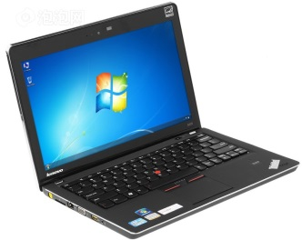
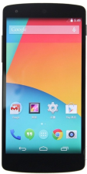
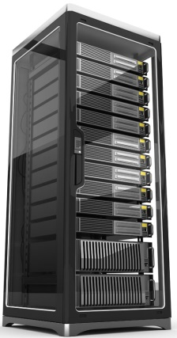

真实手机Nexus5上的动态跟踪数据获取
输出跟踪数据
输出跟踪中间数据
1.通过USB连接更新内核
2.控制重启
…...
输入需求
数据解析、
格式转换
全自动的内核编译、下载、运行、跟踪
通过adb和fastboot实现自动刷机与重启
脚本控制手机开启USB替代网络
通过USB输出中间数据至服务器
特 点
跟踪所有的内核函数调用情况
用户选择内核版本、提供测试代码，后台返回数据

Slide 54
全面跟踪函数调用的问题和解决方法
中间数据压缩输出
事后解析中间数据
问题
效果
使用USB替代wifi输出数据
更高的速度30MB/s
不影响其他应用使用wifi
跟踪数据量太大
完整跟踪3~4分钟数据（无丢失情况）
降低追踪数据生成速率
限制CPU频率
限制CPU运行核数
优化Ftrace数据输出代码
运行更加稳定
输出能力更强
Notes:
为什么只有3~5分钟：
Ftrace影响了网络输出速度，不能充分使用网络带宽
当缓冲区满后，即停止ftrace运行（不停止的话会产生数据丢失）
Ftrace停止后，剩余数据继续输出

Slide 55

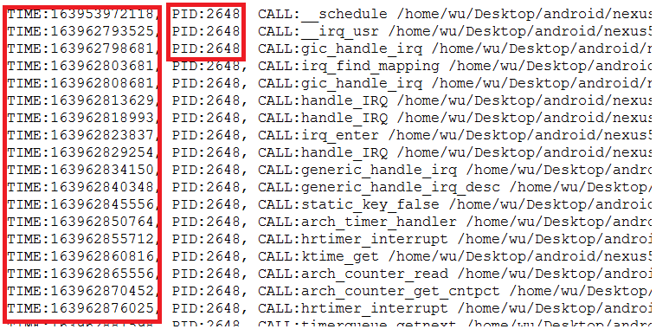
运用实例
能耗监测数据
和功耗测试结合
实现内核函数级别的能耗测试
Ftrace跟踪数据：利用时间和进程号进行对应
测试功耗应用统计每个时间段的功耗
和Ftrace数据进行整合

Slide 56
Outline
Background
gprof
DTrace
SystemTap
ftrace
S2E
Vmxice
eBPF

Slide 57
QEMU Overview
Created by Fabrice Bellard in 2003
Function-level emulation
Faster than “cycle-accurate” simulators.
Good enough to use applications written for another CPU.
Just-in-time (JIT) compilation support to achieve high performance (400 ~ 500 MIPS)
Lots of peripherals support (VGA, serial, and Ethernet, etc…)
Lots of target hosts and targets support (full system emulation)
x86, arm, mips, sh4, cris, sparc, powerpc, nds32, …
qemu/hw/* contain all of the supported boards.
Good enough to use applications written for another CPU.
User mode emulation: can run applications compiled for another CPU.

Slide 58
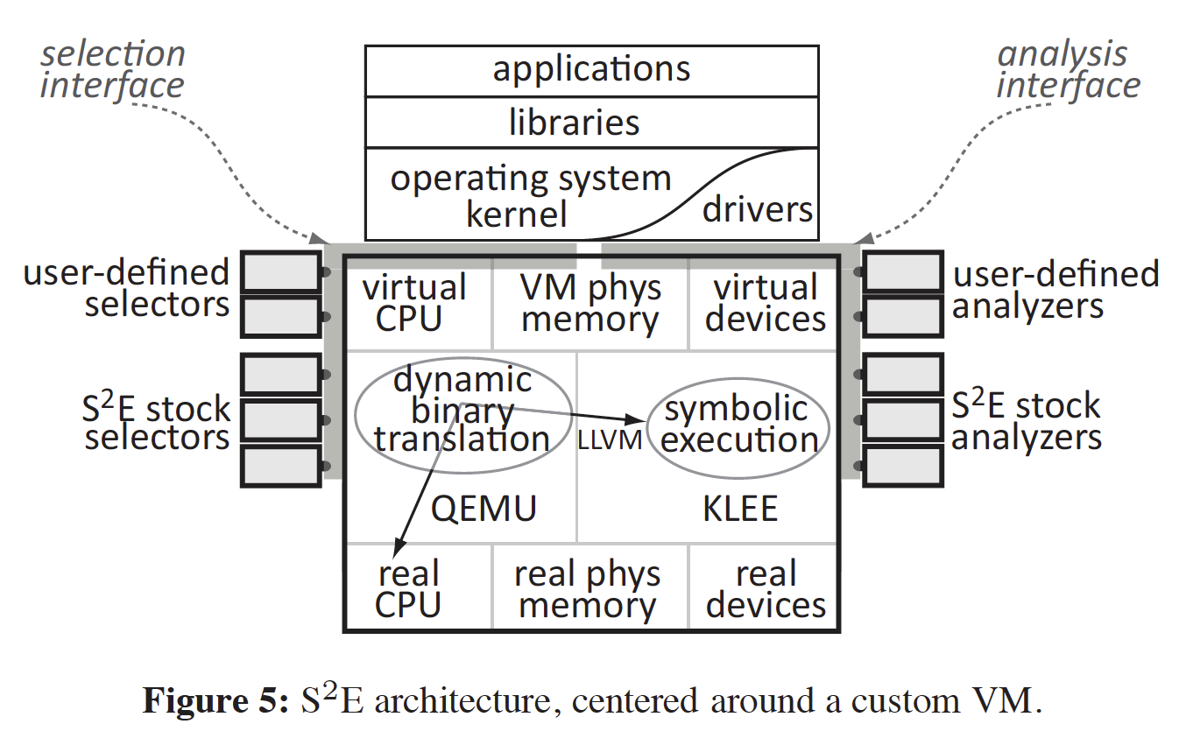
S2E: platform for analyzing software systems
Notes:
http://infoscience.epfl.ch/record/163071/files/s2e.pdf
S2E: A Platform for In-Vivo Multi-Path Analysis of Software Systems
ACM SIGARCH Computer Architecture News - ASPLOS '11
Volume 39 Issue 1, March 2011
Pages 265-278

Slide 59
DBCG-RTL: A Database-based online Call Graph Tool
内核动态函数调用图工具DCG-RTL

Slide 60
Outline
Background
gprof
DTrace
SystemTap
ftrace
S2E
Vmxice
eBPF

Slide 61
Intel VT

Slide 62
BTF(Branch Trace Flag) in IA32 DebugCtrl MSR

Slide 63
vmxice: 基于IntelVT技术的Linux内核调试器
Hyperdbg
2012年西安邮电大学 本科毕业设计孟学政
2013年操作系统课程设计-VMXICE
Notes:
https://github.com/rmusser01/hyperdbg
http://www.zeuux.com/blog/content/4617/
http://os.cs.tsinghua.edu.cn/oscourse/OS2013/projects/U17

Slide 64
Outline
Background
gprof
DTrace
SystemTap
ftrace
S2E
Vmxice
eBPF

Slide 65
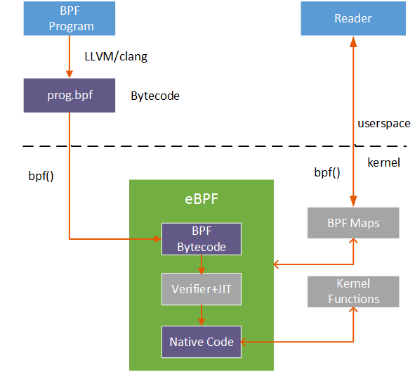
BPF -打通用户态与内核态的机制
https://gitee.com/oscomp/seminar16-20210808/blob/main/README.md#2021操作系统大赛决赛阶段第三次技术报告和交流

Slide 66
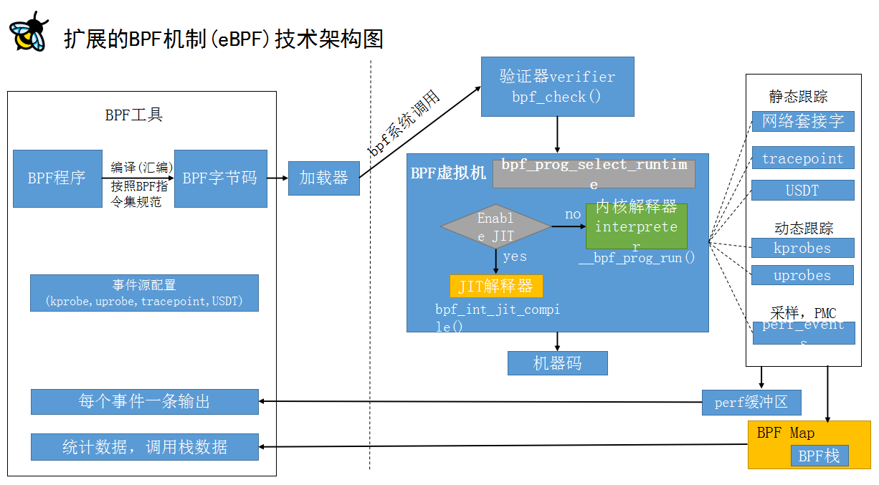
用BPF观测内核

Slide 67
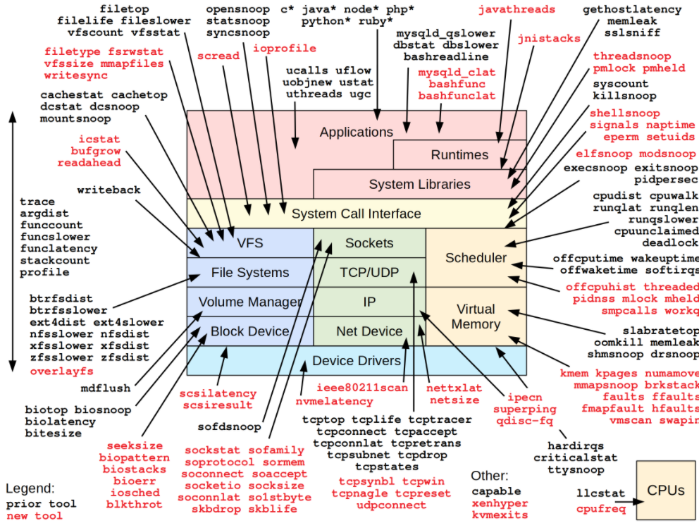
用BPF观测内核

Slide 68
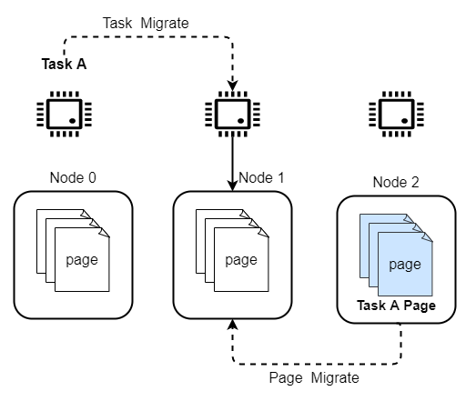
监控NUMA Balancing
NUMA Balancing原理
进程迁移
内存迁移
监控的意义
迁移内存对内存密集型程序影响较重
可通过监控迁移的次数和时间对性能影响进行量化分析

Slide 69
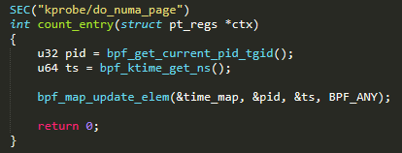
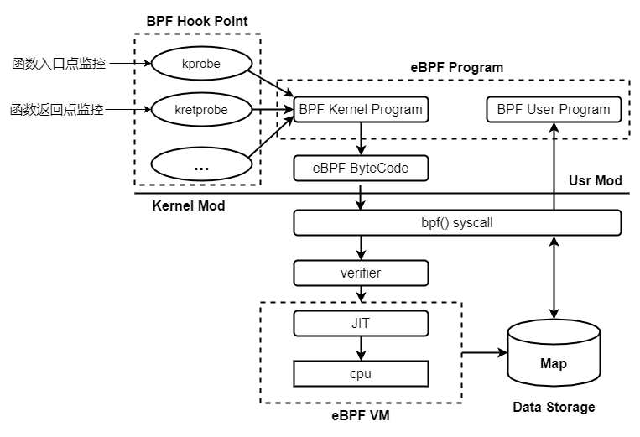
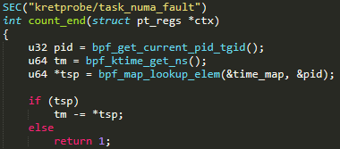
eBPF应用举例

Slide 70
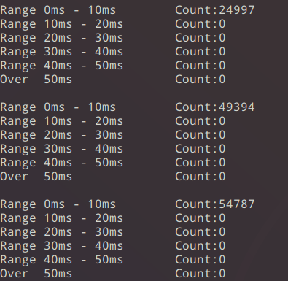
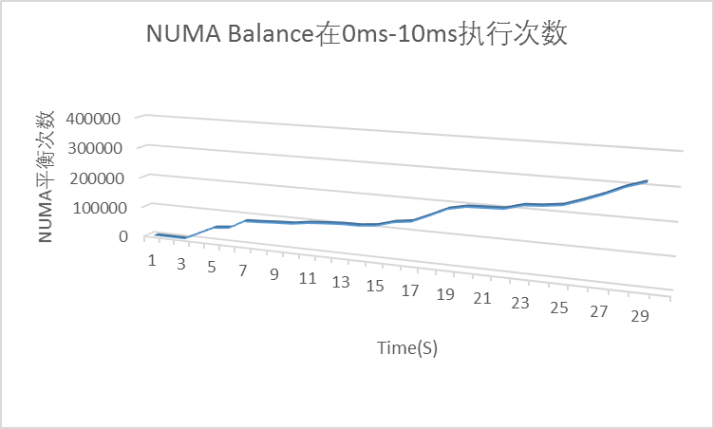
BPF监控程序运行结果
BPF程序数据输出示例

Slide 71
Reference
Dynamic Analysis
http://courses.cs.washington.edu/courses/cse503/10wi/lectures/lecture1-static-dynamic.ppt
gprof
http://www.skyfree.org/linux/references/gprof.pdf
GNU gprof Profiler
Dtrace
http://www.geo.uzh.ch/~jbrazile/jazoon07-dtrace-conference.ppt
http://www.hcs.ufl.edu/upc/archive/toolevals/Overviews/dtraceOverview.ppt
SystemTap
http://fortknox.csc.ncsu.edu/files/Applying-SystemTap.ppt
http://www.redbooks.ibm.com/redpapers/pdfs/redp4469.pdf
http://dirlt.com/systemtap.html
ftrace
http://elinux.org/images/e/e8/Bird-Ftrace.ppt
S2E
http://os.cs.tsinghua.edu.cn/oscourse/CallGraph2012/ReadMe
http://infoscience.epfl.ch/record/163071/files/s2e.pdf
http://people.cs.nctu.edu.tw/~chenwj/slide/QEMU/Introduction%20to%20QEMU.pptx
Notes:
Applying the SystemTap Kernel Instrumentation Tool to CPU Frequency Scaling
http://fortknox.csc.ncsu.edu/files/Applying-SystemTap.ppt
SystemTap: Instrumenting the Linux Kernel for Analyzing Performance and Functional Problems
http://www.redbooks.ibm.com/redpapers/pdfs/redp4469.pdf
Systemtap
http://dirlt.com/systemtap.html

Slide 72
Q&A

