Slide 1
Practice in Operating System
Lecture 6: Microkernel
Yong XIANG
Dept. of Computer Sci.&Tech.

Slide 2
Questions
What’s OS?
What’s OS kernel?
Which function must be involved in OS kernel?

Slide 3
Outline
Definition of Microkernel
Background
Microkernel Concept
Mach
L4
L4Linux

Slide 4
Definition of Kernel
The fundamental part of an Operating System.
Responsible for providing secure access to the machine’s hardware for various programs.
Responsible for deciding when and how long a program can use a certain hardware (multiplexing).

Slide 5
Microkernel System Structure
Microkernel structure:
Moves bunch of functionalities from the kernel into "user" space.
Tend to have more frequent kernel/user crossings.
What should be in the kernel and what should be in user space?
Protection mechanisms
protecting hardware;
protecting user processes from each other
Resource management policies.
Benefits:
Modular design
More reliable/secure (less code is running in kernel mode)
Notes:
http://www.cs.rochester.edu/~kshen/csc256-spring2004/lectures/lecture22-microkernel.pdf

Slide 6
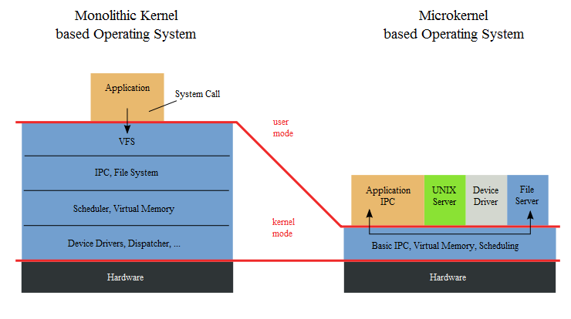
Microkernels
The microkernel is the only software executing at the most privileged level (supervisor or kernel mode).
Actual operating system services, such as device drivers, protocol stacks, file systems and user interface code are contained in user space.
Notes:
a microkernel is a computer kernel which provides the mechanisms needed to implement an operating system, such as low-level address space management, thread management, and inter-process communication.
http://www.cse.iitd.ac.in/~mcs082803/Working%20of%20L4%20Microkernel.ppt
Page 60;

Slide 7
Essential features & Minimality
A Microkernel must include some core features
some mechanisms for dealing with address spaces
managing memory protection
execution abstraction to manage CPU allocation
typically threads or scheduler activations
inter-process communication
required to invoke servers running in their own address spaces.
Liedtke's minimality principle
A concept is tolerated inside the microkernel only if moving it outside the kernel, i.e., permitting competing implementations, would prevent the implementation of the system's required functionality.

Slide 8
Outline
Definition of Microkernel
Background
Microkernel Concept
Mach
L4
L4Linux

Slide 9
Essential Concepts in Microkernel
Address space
Virtual message passing
Inter-process communication (IPC)
Interrupt Handling
Unique Identifiers (UID)

Slide 10
Address Spaces
Definition: A mapping which associates each virtual page to a physical page. (Liedtke)
The microkernel provides 3 operations:
Map
Adds a page from one address space to another.
Grant
Transfers a page from the granter’s address space to the grantee’s.
Flush
Deletes the flushed page from all addresses except the flusher’s.
Notes:
http://www.cs.ucf.edu/courses/cop5611/spring05/item/micro-kernels.pdf
Page 5 to 12
Map：映射
Grant：转让
Flush：删除

Slide 11
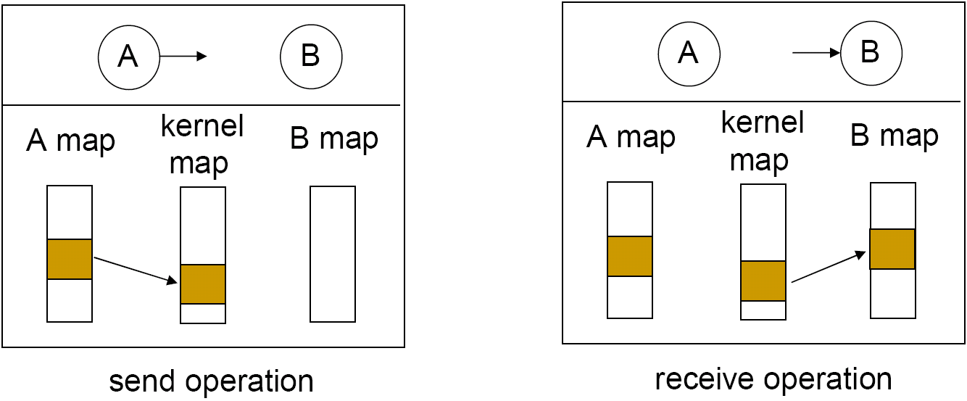
Virtual Message Passing
Due to frequent message passing in micro-kernel systems, it is important to optimize its performance
Virtual message passing
mess around with memory map tables (page tables)

Slide 12
Inter-process Communication (IPC)
Definition: Exchange of data between 2 process.
IPC is one way communication
RPC (remote procedure call) is round trip communication
The microkernel handles message transfers between threads.
Grant and Map operations rely on IPC.

Slide 13
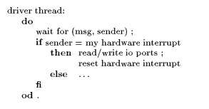
Interrupt Handling
Hardware interrupts are done by IPC Messaging.
The microkernel transfers the interrupts into messages, but does not handle them.
Instead, the driver software handles them.

Slide 14
Unique Identifiers (UID)
The microkernel must supply UIDs for secure and reliable communication.
Sender wants to know whether the correct recipient received the message.
Receiver wants to know whether the message came from the correct sender.
Less expensive than cryptography!

Slide 15
Outline
Definition of Microkernel
Mach
Overview
Mach Structure
Process Management
Interprocess Communication
Memory Management
Interrupt
Mach I/O System
First Generation Microkernel Problems
L4
L4Linux

Slide 16
Overall Mach
Mach
developed at CMU in 1985
predecessor to NeXT, the foundation of Mac OS X
Micro-kernel design
Transparent multiprocessing
Protected message passing
Better than Unix message messaging.
“extensible” Microkernel
Multiple levels of operating system
Other O/S’s implemented as “applications”

Slide 17
Goals of Mach
“Simple” kernel
Only one way to accomplish kernel programming tasks
Diverse hardware support
“Multiprocessing”: Tightly coupled or loosely coupled
Varying degrees of shared memory access
One to thousands of processors
Heterogeneous system support
Distributed & object-oriented
All objects within the system are location independent
Integrated memory management & interprocess communication (IPC)
Varying network speeds
Extensible microkernel
Notes:
17

Slide 18
Outline
Definition of Microkernel
Mach
Overview
Mach Structure
Process Management
Interprocess Communication
Memory Management
Interrupt
Mach I/O System
First Generation Microkernel Problems
L4
L4Linux

Slide 19
Mach Structure
IPC – RPC messages.
Send and receive.
When the message queue is full, the senders block; when it is empty, the receivers block.
Indirect communication.
Heavy weight context switching.
Speed is compromised ; but protection is ensured.
User process
UNIX
Task’s address space
send
rec
Abstractions
port
Layer 1
Portable
Layer 0
Machine Dependent
Notes:
compromise
vi.退让

Slide 20
Mach Structure (cont’d)
Additional, middle, layer of operating system
Other OS’s typically implemented as user level OS’s
User application
application level OS (e.g., UNIX)
Mach microkernel
Notes:
http://www.duluth.umn.edu/~cprince/courses/cs5631spring06/lectures/Mach.ppt

Slide 21
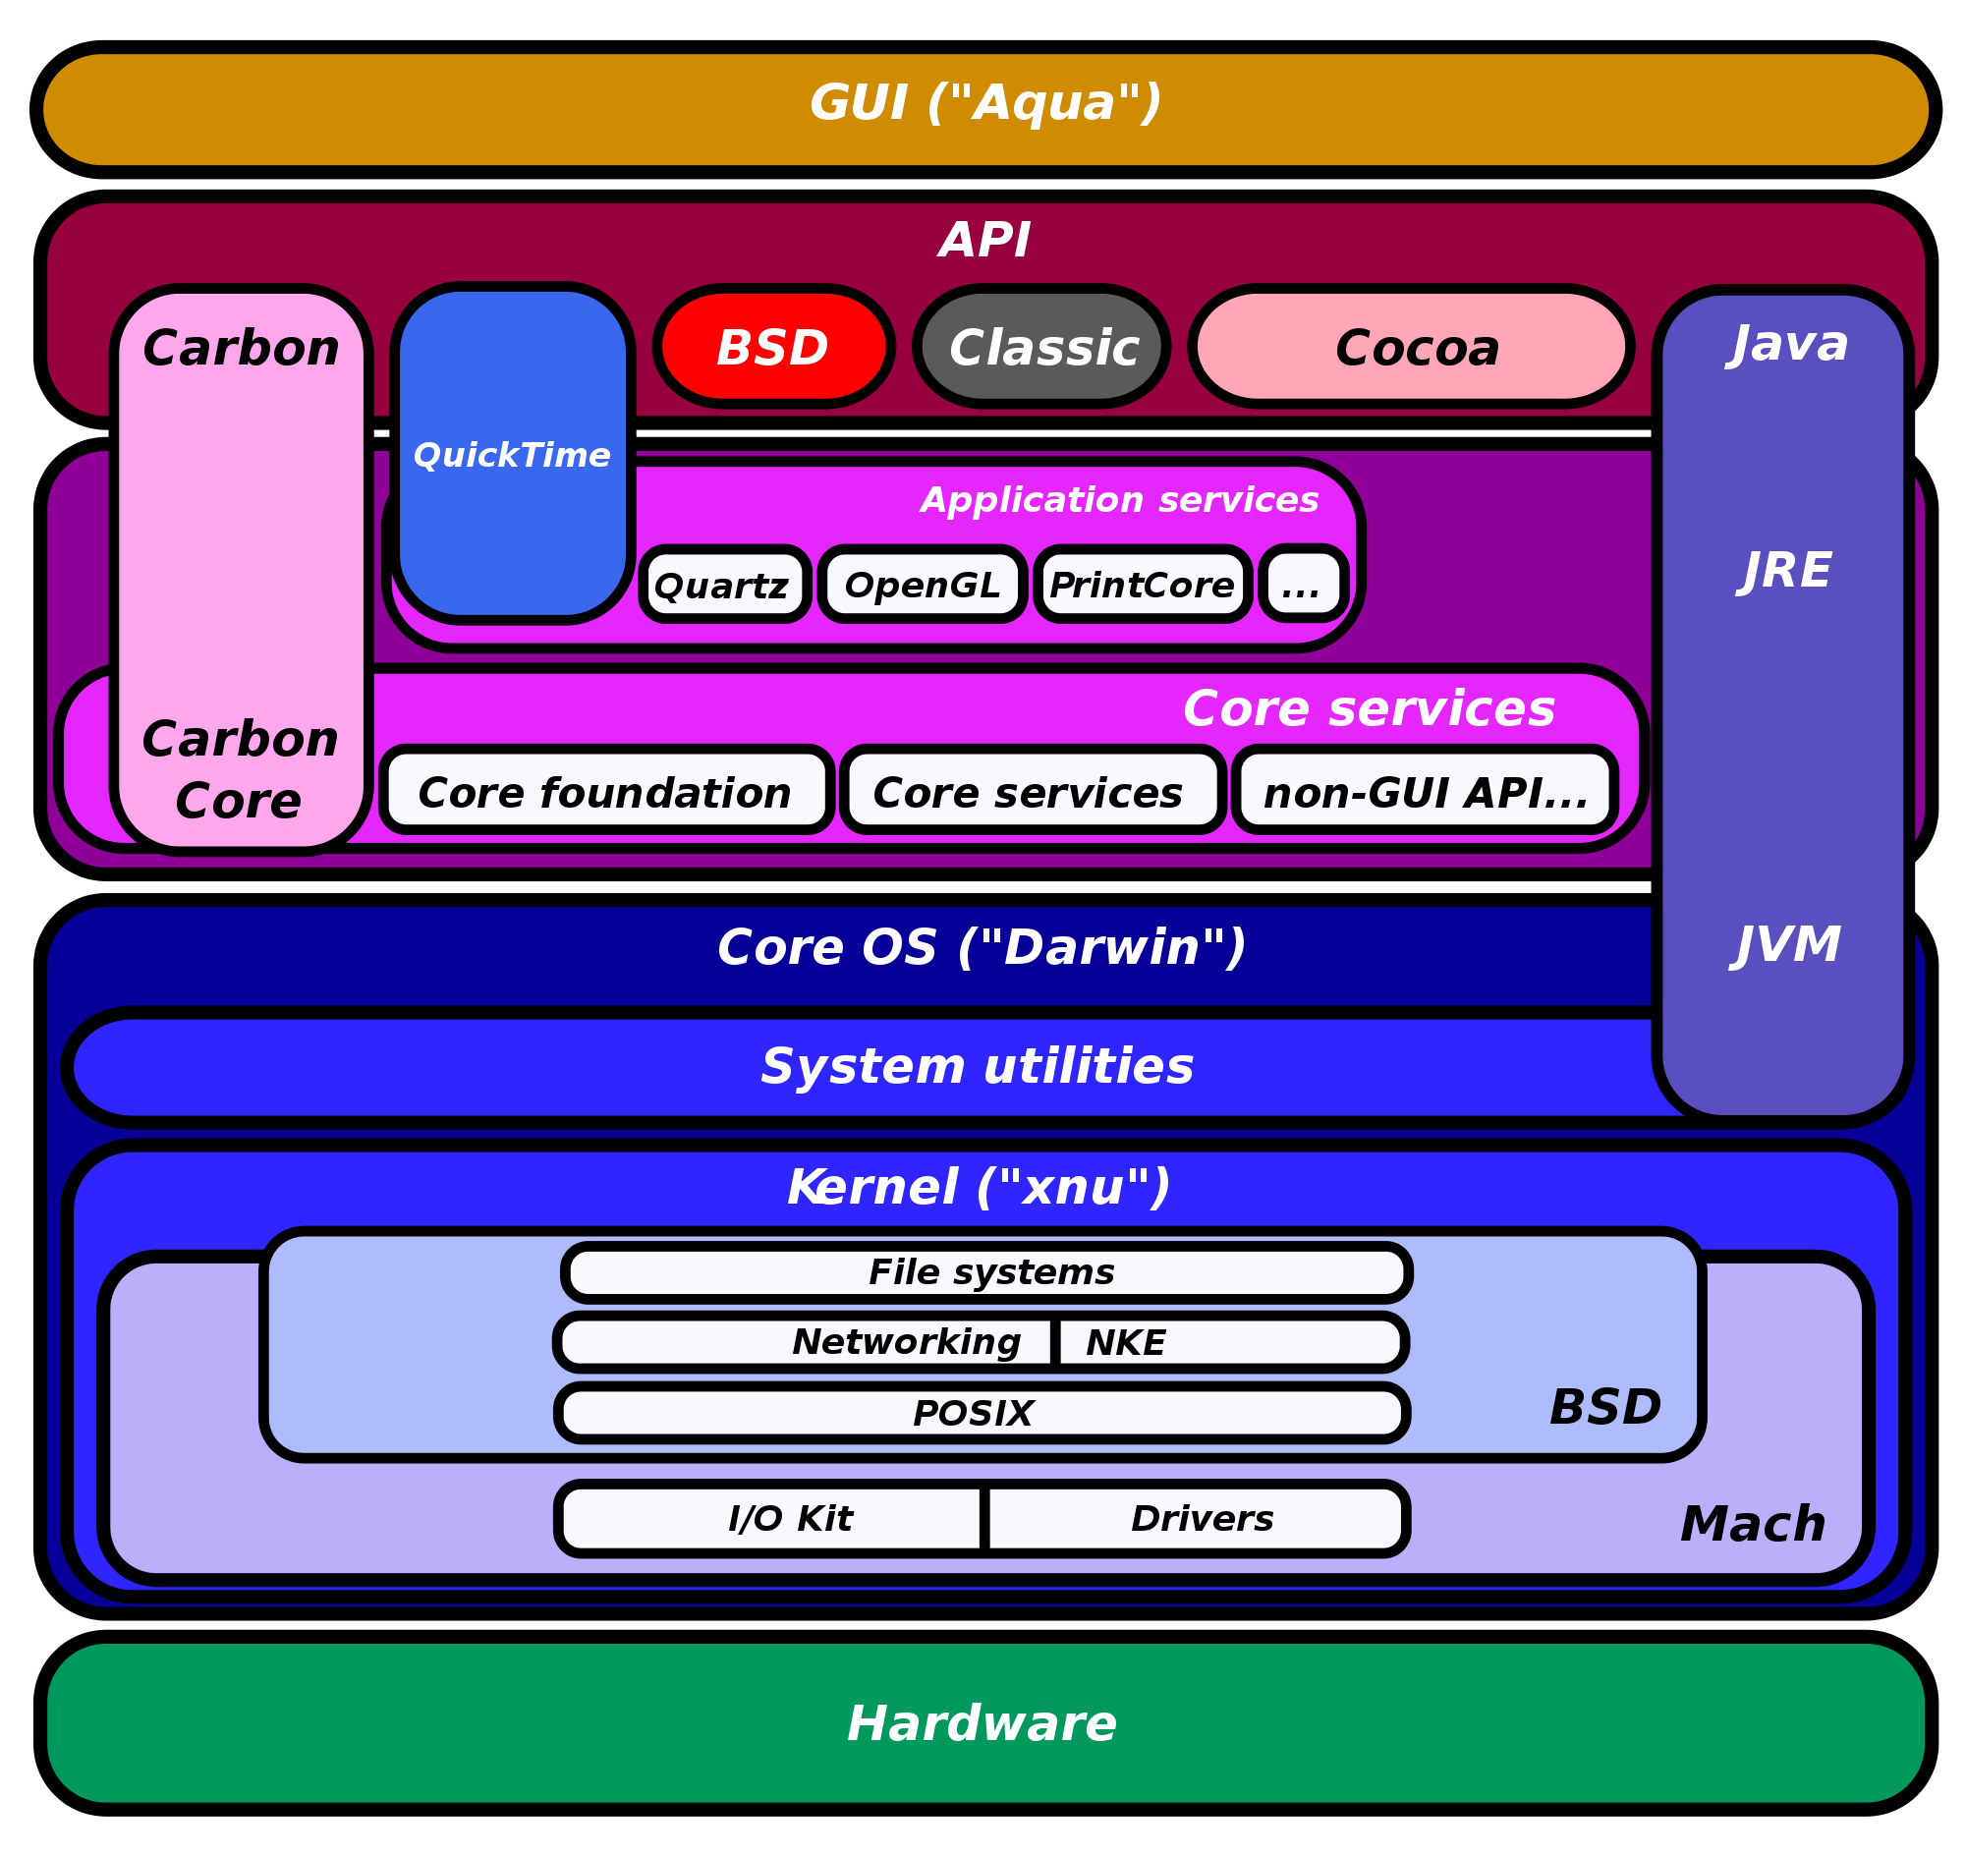
Diagram of Mac OS X architecture
https://opensource.apple.com
https://github.com/apple/darwin-xnu
Notes:
http://commons.wikimedia.org/wiki/File:Diagram_of_Mac_OS_X_architecture.svg

Slide 22
Outline
Definition of Microkernel
Mach
Overview
Mach Structure
Process Management
Interprocess Communication
Memory Management
Interrupt
Mach I/O System
First Generation Microkernel Problems
L4
L4Linux

Slide 23
Process Management
Task
Contains threads
Virtual address space + Port rights (capability)
Threads
Running: executing or waiting to be allocated to a processor
Considered to be running even when blocked within kernel (e.g., on a page fault)
Suspended: Neither executing on a processor nor waiting to be allocated to a processor.
Used to achieve a type of thread-level synchronization

Slide 24
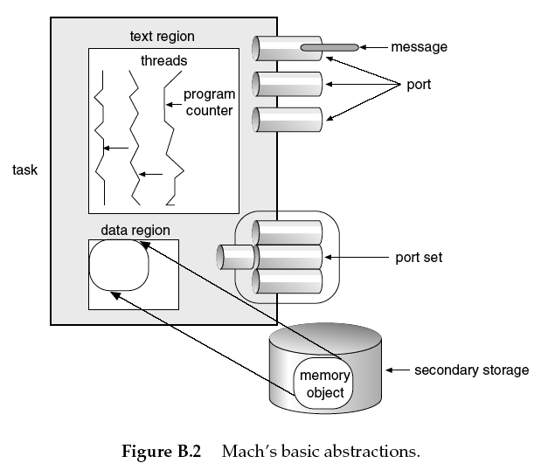
Process Management (cont’d)

Slide 25
Mach CPU Scheduling
Global & local (single CPU) run queues
Thread assigned to processor from a run queue
Only threads are scheduled; compete equally for CPU
Threads have dynamic priorities 0-127
Generally equal competition for resources
Priority based on exponential average of CPU usage
Reduces priority with increasing CPU usage
Threads can be “bound” to a CPU
Thread will only run on that CPU
E.g., for a thread that handles a device associated with that CPU
Variable time quantum (processor time per process)
Dependent on # processors & # processes

Slide 26
Outline
Definition of Microkernel
Mach
Overview
Mach Structure
Process Management
Interprocess Communication
Memory Management
Interrupt
Mach I/O System
First Generation Microkernel Problems
L4
L4Linux

Slide 27
Interprocess Communication
Ports
Microkernel protected communication channel
Communication occurs by sending messages to ports
Microkernel object reference mechanism
Allow objects to transparently reside anywhere in network
Threads have port rights (send & receive)
Port sets
Group of ports sharing a common message queue
By receiving messages for a port set, a thread can service multiple ports
Similar to select call in BSD Unix
Messages
Typed collection of data objects

Slide 28
“User-Level” Message Server: NetMsgServer
Networking daemon
Enables location-independent naming of ports
Does not matter which computer a port is on
NetMsgServer dynamically resolves the addresses
Services
Forwards message between computers
Network wide name service
Tasks can register ports for lookup by tasks on any other computer on network
Distributed database of port rights
Tracks all rights & out-of-line memory passed in intercomputer messages & arranges for transfers
Data conversions (different computer architectures)
Proxy ports for passing port rights between computers

Slide 29
Typed Messages
Data in messages: typed
Simple types (integer, float etc)
In-line and out-of-line data
Out-of-line data: Pointers
Kernel interprets these pointers as part of message passing
Receiver on same computer
Don’t want to necessarily copy message from sender to receiver
Takes time to copy messages
Instead, when message contents unchanged, use virtual memory-based technique for improving efficiency
A kind of shared memory solution
“copy-on-write”
Receiver on different computer
Need to copy data referred to by pointer

Slide 30
Outline
Definition of Microkernel
Mach
Overview
Mach Structure
Process Management
Interprocess Communication
Memory Management
Interrupt
Mach I/O System
First Generation Microkernel Problems
L4
L4Linux

Slide 31
Memory Management: Memory Objects
“a source of memory”
Used to
manage secondary storage (disk)
represent data mapped to virtual memory: files, pipes, address space components
E.g., disk space mapped to memory
Also used to map other devices to memory
Accessed via ports

Slide 32
Mach Memory Objects
Memory objects: objects in memory mapped from devices
Ports provide operations
Transparent remote & shared access
For user processes (i.e., not OS user-level processes), usually mapped from a disk device
Can implement access to files in this way
Map a series of disk blocks onto memory
Can also map other devices to memory
Gives “memory mapped I/O”, E.g.,
Writing to a memory address writes to the control register of a device;
reading from a memory address reads from the control register of a device

Slide 33
Outline
Definition of Microkernel
Mach
Overview
Mach Structure
Process Management
Interprocess Communication
Memory Management
Interrupt
Mach I/O System
First Generation Microkernel Problems
L4
L4Linux

Slide 34
Interrupt support for devices
Memory mapping
Direct microkernel support

Slide 35
Exceptions
Handlers for exceptions are implemented as additional threads in the task in which the exception occurs
RPC messages are used to communicate between thread causing exception and handler

Slide 36
Outline
Definition of Microkernel
Mach
Overview
Mach Structure
Process Management
Interprocess Communication
Memory Management
Interrupt
Mach I/O System
First Generation Microkernel Problems
L4
L4Linux

Slide 37
Mach I/O System
Device management
Memory Objects used for memory mapped devices
handled in ‘user level’ processes
Non-memory mapped devices handled in microkernel
Microkernel
Basic handling of interrupt before passing data to user level OS
Location-transparent device management
Devices are Memory Objects
Ports on these devices can be accessed by any task with appropriate rights
“User level” I/O can increase performance
Avoid data copy between kernel memory space and user level memory space
In experiments, performance with “user level” device management at least as good as kernel-level
In some cases performance increased

Slide 38
Mach I/O System (cont’d)
Functionally grouped device drivers
Screen, console, disk, tape, serial line, Ethernet
e.g., Instead of character & block devices
Each driver
layer(s) of chip independent code
minimal device dependent code: in microkernel
Example: serial line driver
Device independent components
open, close, read, write
start, stop
modem controls
interrupt handlers for devices that operate on one-interrupt per character basis
send/receive char– polling mode
Device dependent components
Only operations that manipulate device registers directly
User-level device management
Microkernel
saves some register state in shared page
disables interrupt for device
vectors device interrupts to an applications thread
User-level thread
when it runs, it invokes driver’s interrupt routine
after processing, thread re-enables interrupt in device
Notes:
Interrupt management seems like a version of the Linux two-part device driver-- top half and bottom half

Slide 39
Outline
Definition of Microkernel
Mach
Overview
Mach Structure
Process Management
Interprocess Communication
Memory Management
Interrupt
Mach I/O System
First Generation Microkernel Problems
L4
L4Linux

Slide 40
Microkernel Advantages
Good Flexibility
Many applications can be implemented on top of the microkernel.
Good Security
Low level user processes = restricted access to system resources.
Robustness/Configurability
A problematic application can be reconfigured without rebooting OS.

Slide 41
First Generation Microkernel Problems
Expensive Switching Overhead
Expensive Memory Overhead
Lack of Portability
Having portability meant losing performance and flexibility.
This also applies to second generation micro-kernels.
Notes:
http://www.cs.ucf.edu/courses/cop5611/spring05/item/micro-kernels.pdf
Page 19 to 24;

Slide 42
Expensive Switching Overhead
Kernel-User Switches
Cost of Kernel Overhead can be up to 800 cycles.
Address Space Switches
Expensive Page Table and Segment Switch Overhead
Untagged TLBS = BAD performance
IPC Cost
First Generation Microkernels IPC required about 115 microseconds.
Unix System Call only required 18 microseconds!

Slide 43
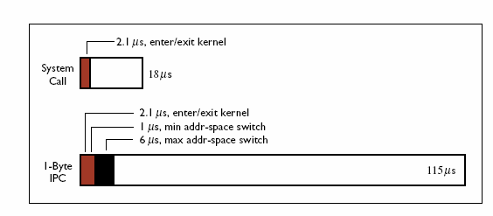
Expensive IPC

Slide 44
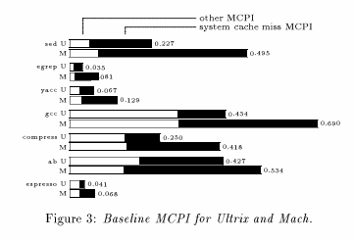
Expensive Memory Overhead
Claim (In a 486 – 50MHZ Computer):
MACH had noticeably higher Memory Cycle overhead Per Instruction (MIPS) than Untrix (a monolithic kernel).
Notes:
memory cycles per instruction (MCPI) for Mach and Ultrix

Slide 45
Outline
Definition of Microkernel
Mach
L4
Concept
Features
System call
Interrupt
Thread
IPC
Memory Management
L4Linux

Slide 46
Questions
Challenges
Mach’s poor performance
What can we do next?
Improvement?
Design new system?

Slide 47
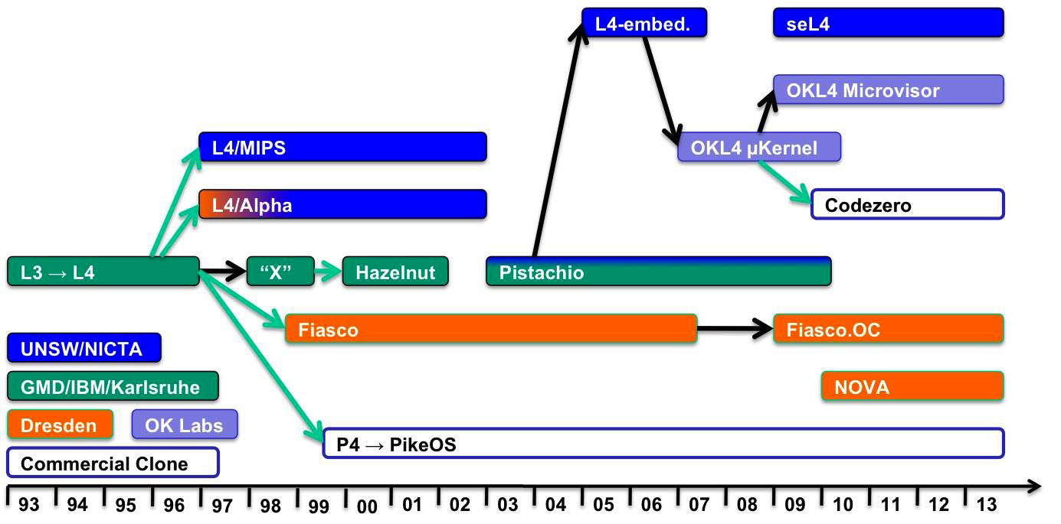
L4 Kernel Family Tree
Ref: Elphinstone & Heiser, SOSP 2013
https://en.wikipedia.org/wiki/L4_microkernel_family

Slide 48
L4 Advantages
Recursive construction of memory spaces
Allows construction of memory managers in userspace that just use memory mapping
Kernel provides map, grant, and flush
Blazing fast IPC
Passes short messages in registers
Avoids copying large messages and thus avoids TLB flushes and cache misses
Lazy scheduling of thread queues improves small message IPC around 25%

Slide 49
L4Ka::Pistachio
Written in C++
Focus on Performance, Portability and Reusability
Supports Alpha, AMD64, ARM, IA-32, IA-64, Mips64, PowerPC-32, PowerPC-64 and SPARCv9
Notes:
http://www.cse.iitd.ac.in/~mcs082803/Working%20of%20L4%20Microkernel.ppt
Developed at University of Karlsruhe
http://l4hq.org/arch/

Slide 50
Outline
Definition of Microkernel
Mach
L4
Concept
Features
System call
Interrupt
Thread
IPC
Memory Management
L4Linux

Slide 51
Features
Separation of API and ABI
Earlier L4 Kernels’ ABIs were defined by specific implementation, inherently non-portable
Version 4 strictly separates API & ABI, specifies a set of HLL bindings which are generic across all architectures.
Virtual Registers
Notion of a Virtual Register File per thread
These map to memory or to actual processor registers, allowing optimal use of hardware registers on all architectures.
Notes:
L4 kernels have been implemented for multiple architectures, usually in an ad-hoc way, and often purely in assembly. Thus application binary interfaces (ABIs) were dened by the specic implementation, leading to different behavior and kernel features loosely following the initial IA32 reference implementation. As a result, system software was very specialized for one particular kernel implementation and therefore inherently non-portable
Today's widely used processor architectures have very different register sets, featuring as few as seven general purpose registers on IA32 up to 128 integer and 128 oating point registers on IA64.
L4's IPC performance is achieved by strictly avoiding unnecessary memory references, thereby reducing cache and TLB footprint. However, having a single generic API for such very different architectures as IA32 and IA64 would have sacriced performance for one or the other.
Version 4 therefore introduces the notion of a virtual register le per thread. Depending on processor characteristics, these registers map either to memory or to actual processor registers, allowing optimal use of hardware registers on all architectures.
应用二进制接口（英语：application binary interface，縮寫為 ABI）

Slide 52
Features Contd.
Address Spaces & Threads
In Version 4 the fixed relation between address spaces and threads is removed.
Kernel Interface Page
Contains function entry points for all system calls as well as frequently accessed system information.
New architectural features added to next generation processors can be directly utilized by replacing the page.
Overhead is negligible when using an optimized dynamic linker.
Notes:
Any thread can be a member of any address space and threads can be transparently migrated between spaces. On 32 bit architectures up to 218 and on 64 bit architectures up to 232 concurrent threads are supported.
Rapidly increasing processor clock speeds require architectural extensions and modifications from one processor generation to the next. A recent example is the introduction of the SYSENTER/SYSEXIT instructions for IA32, which allow up to 10 faster kernel entry and exit compared to the original software interrupt method. However, to utilize this new feature all legacy code has to be recompiled. This methodology also allows for system calls which do not necessarily enter the kernel, e.g., the system clock or super-fast local IPC.

Slide 53
Features Contd.
SuperFast IPC
L4 provides Very Limited, Extremely Flexible and Powerful set of mechanisms
Threads, Address Spaces, IPC, Mapping
Other primitives built upon these four
Still limited by the hardware architecture
Invocation of IPC requires change of privilege mode
However, IPC is mainly used for synchronization and signalling of threads executing within the same address space. IPC can then be performed completely in user mode avoiding the overhead induced by the two unnecessary privilege level changes.
Notes:
All other primitives are built upon these four basic abstractions, including synchronization primitives.
The invocation of an IPC requires a change of the privilege mode, a costly operation on most hardware architectures.
First experiments have shown that it is possible to achieve an order of magnitude higher IPC performance.

Slide 54
Features-Interrupts
Abstracts system interrupts as kernel threads and interrupt delivery as IPC.
V4 completely abstracts the first-level interrupt controller and only provides basic primitives for interrupt association
Allows for a higher level of parallelism, more efficient synchronization, and caching of interrupt controller state thereby increasing overall performance
Abstracting interrupt hardware was also a portability requirement, since some architectures allow access to interrupt controllers only in privileged mode

Slide 55
Features-Multiprocessor Support
Load balancing, Scheduling decisions are purely user-level based, thus supports implementation of arbitrary processor allocation policies.
Prerequisite for SMP scalability is the preservation of parallelism of user applications within the kernel. This design rule is strictly followed by providing powerful orthogonal interfaces.
L4Ka::Pistachio's SMP support is experimental and not fully scalable yet due to a few coarse-grained locks, in particular in the memory subsystem.
However, the critical IPC path is fully lock-free giving a good first performance indication.
Multiprocessor support exists for IA32, IA64 systems.
Notes:
Symmetric Multiprocessing (SMP)
Orthogonal - Statistically unrelated
The Version 4 API has integral support for multi-processor systems, with its main focus on scalability.
NUMA systems are supported with the aforementioned exible thread allocation primitives. Thread migration allows use of node local memory and thus increases overall system performance. Similar optimizations are possible for simultaneous multi-threaded architectures, such as Intel's Hyper-Threading technology.
prerequisite
A.noun
先决条件
to be a prerequisite for [something]
是某事的前提
B.adjective
必备的

Slide 56
Outline
Definition of Microkernel
Mach
L4
Concept
Features
System call
Interrupt
Thread
IPC
Memory Management
L4Linux

Slide 57
L4 Privileged Systemcall
L4_space_control
A privileged thread, e.g., the root server, can configure address spaces through this function.
L4_memory_control
Set the page attributes of the fpages (MR 0...k) to the attribute specified with the fpage.
L4_thread_control
A privileged thread, e.g., the root server, can delete and create threads through this function. It can also modify the global thread ID (version field only) of an existing thread.
L4_processor_control
Control the internal frequency, external frequency, or voltage for a system processor.

Slide 58
L4 Systemcall
L4_kernel_interface
Return the pointer to the kernel interface page, the API version, the API flags, and the kernel ID.
L4_exchange_registers
Exchanges or reads a thread’s FLAGS, SP, and IP hardware registers as well as pager and UserDefinedHandle TCRs. Furthermore, thread execution can be suspended or resumed.
L4_system_clock
Delivers the current system clock. Typically, the operation does not enter kernel mode.
L4_thread_switch
The invoking thread releases the processor (non-preemptively) so that another ready thread can be processed.
L4_schedule
The system call can be used by schedulers to define the priority, timeslice length, and other scheduling parameters of threads. Furthermore, it delivers thread states.
L4_unmap
The specified fpages (located in MR0...) are unmapped. Fpages are mapped as part of the IPC operation.
L4_ipc, L4_lipc
IPC is the fundamental operation for inter-process communication and synchronization. It can be used for intra- and inter-address-space communication. All communication is synchronous and unbuffered.
Notes:
http://code.metager.de/source/xref/hurd/viengoos/libl4/ia32/l4/bits/syscall.h

Slide 59
Outline
Definition of Microkernel
Mach
L4
Concept
Features
System call
Interrupt
Thread
IPC
Memory Management
L4Linux

Slide 60
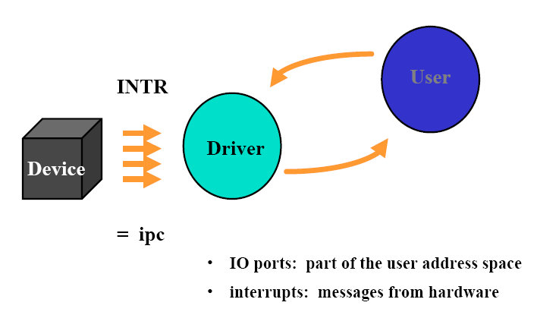
Drivers at User Level

Slide 61
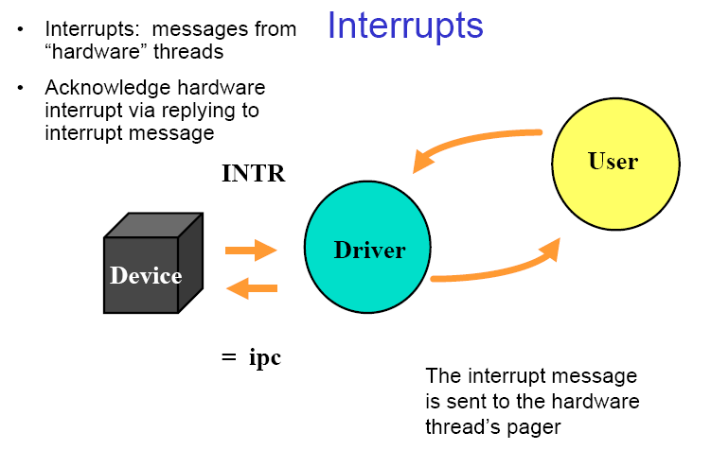

Slide 62
Interrupt Association
Association is done via the privileged thread (root task) using ThreadControl.
To associate a thread to an interrupt
Set the pager of the hardware thread ID to the thread ID of the interrupt handler
To disassociate the thread from an interrupt
Set the pager of the hardware thread ID to the hardware thread ID itself

Slide 63
Outline
Definition of Microkernel
Mach
L4
Concept
Features
System call
Interrupt
Thread
IPC
Memory Management
L4Linux

Slide 64
Kernel Interface Page
Contains API and Kernel Version data, system descriptors including memory descriptors, and system-call links.
A microkernel object
Directly mapped through microkernel into each address space upon address space creation
Can’t be granted to another space, or unmapped
Creator of address space can specify where KIP is to be mapped, this address will remain same throughout the lifetime of that address space
Any thread can obtain KIP’s address though the KERNELINTERFACE system call

Slide 65
Virtual Registers
Static per-thread objects.
3 Classes
Thread Control Registers (TCRs)
Used to share information about threads between the kernel and user level
Message Registers (MRs)
Used to send messages between threads. Contains the message
Buffer Registers (BRs)
Used to specify where messages (other than MRs themselves) are received
Safe from kernel’s point of view
Illegal Accesses, Programming Bugs can only compromise the originator’s address space
Generic API offers no operations for indirect virtual-register access

Slide 66
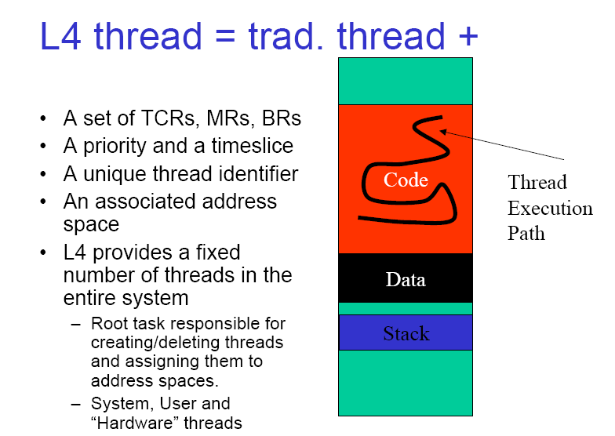

Slide 67
Thread Control Blocks (TCBs)
State of a thread is stored in its thread control block
Some state can only be modified via a controlled interface (system calls) (e.g. address space associated with the thread)
Some state can be freely visible and modifiable by user-level applications without compromising the system
For efficiency of access this information is put in a user-level TCB (UTCB)

Slide 68
Thread Control System Call
Used to create, destroy, and modify threads
Determines:
The global thread identifier associated with the thread
The address space the thread is associated with
The thread permitted to control scheduling parameters of the new thread
The pager
Location of the UTCB within the address spaces allotted UTCB area (See SpaceControl later)
Threads can be created active or inactive.
Inactive is used to create and manipulate a new address space, or allocate a new thread to an existing address space.

Slide 69
Task
Task = Address Space + Thread
A Task has
Thread
Identifier, IP, SP, Pager, Scheduler, UTCB Location
Address Space
UTCB Area, Kernel Info Page Area, Redirector
Code, Data and Stack mapped to address space

Slide 70
Outline
Definition of Microkernel
Mach
L4
Concept
Features
System call
Interrupt
Thread
IPC
Memory Management
L4Linux

Slide 71
IPC
Messages
Sent and received using the IPC system call
Sender writes into its MR and receiver reads from its MR. Each Thread has 64 MRs
A message can use some or all MRs to transfer untyped words, can include memory strings and fpages

Slide 72
L4 IPC
Message passing is the basic IPC mechanism in L4.
All L4 IPC is Synchronous & Unbuffered
Synchronous IPC requires an agreement between both the sender and the receiver. The main implications of this agreement is that the receiver is expecting an IPC and provides the necessary buffers. If either the sender or the receiver is not ready, then the other party must wait.
Unbuffered IPC reduces the amount of copying involved and is thus the key to high performance IPC.

Slide 73
L4 IPC Messages
Data can be transferred in three ways using L4 IPC.
In-line by-value data. A limited amount of such data is passed directly in registers (first 8 words in MIPS R4k) with any remainder in a message buffer.
Strings. Arbitrary out-of-line buffers which are copied to the receiver.
Virtual memory mappings (by-reference data).
Data transfer via mappings is described by flex-pages (a contiguous region of virtual address space). Alternatively, virtual memory can be granted: mapped to the receiver and unmapped from the sender simultaneously.

Slide 74
IPC Registers
Message Registers
64 “registers”
Form a message
Used to transfer typed items and untyped words
Typed items
MapItem
GrantItem
StringItem
Buffer Registers
34 “registers”
Specify where
MapItems and GrantItems are received
StringItems are received
if any are permitted to be in the message

Slide 75
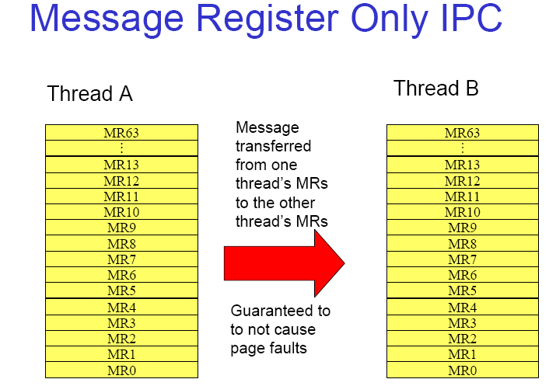

Slide 76
Outline
Definition of Microkernel
Mach
L4
Concept
Features
System call
Interrupt
Thread
IPC
Memory Management
L4Linux

Slide 77
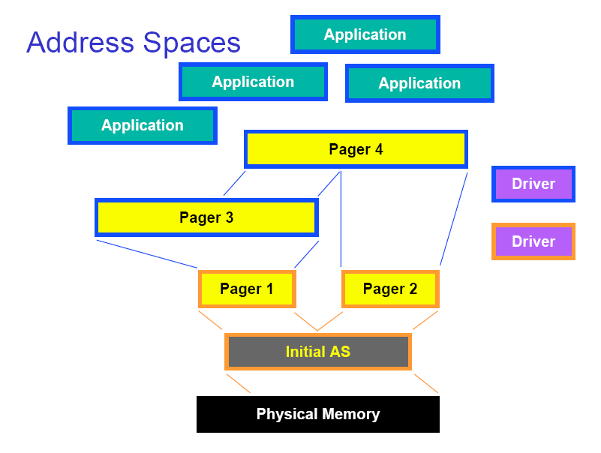

Slide 78
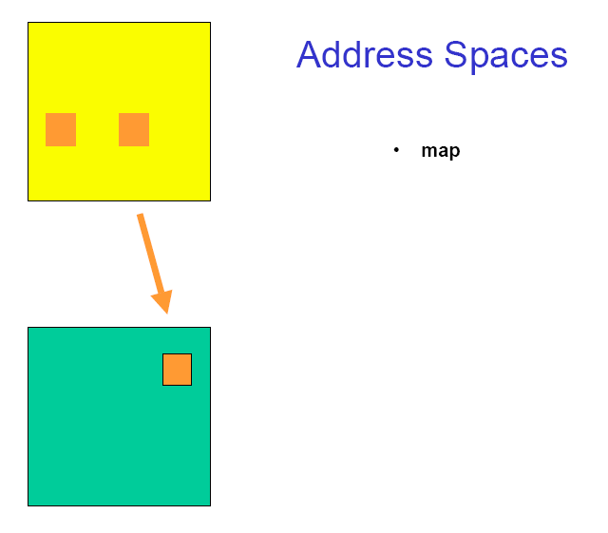
Map

Slide 79
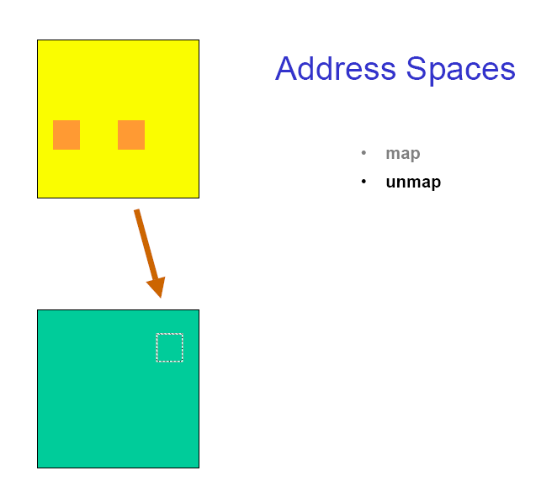

Slide 80
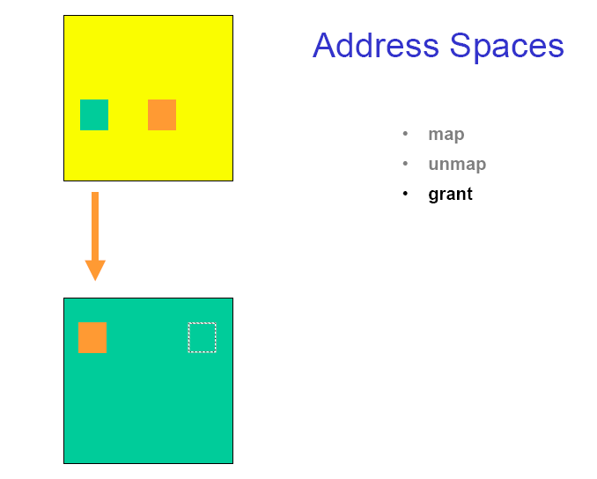
Notes:
Grant 许可

Slide 81
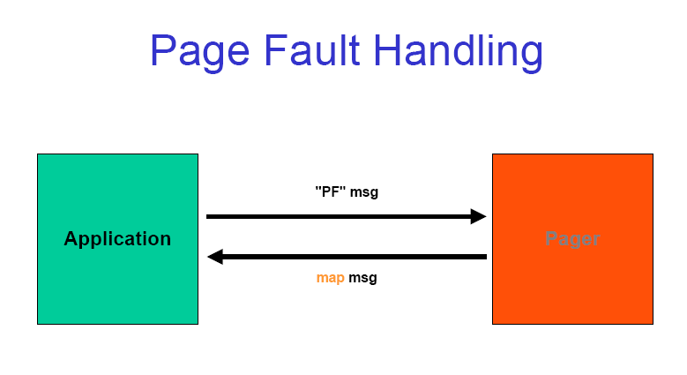

Slide 82
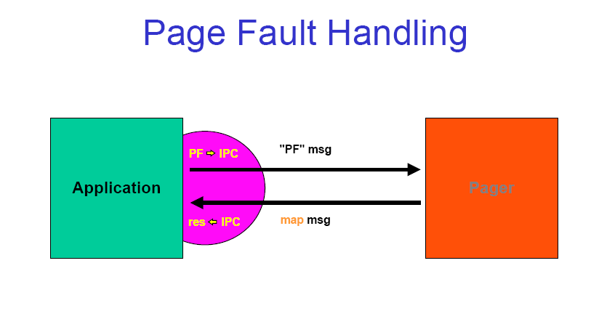

Slide 83
Outline
Definition of Microkernel
Mach
L4
L4Linux
Implementation
Performance

Slide 84
Implementation of L4Linux
develop L4Linux, a linux “personality” on top of the L4 microkernel
due to time restrictions the linux kernel was not fine tuned in L4Linux, so results are only an upper bound on the performance penalty

Slide 85
L4Linux
linux 2.0.21 on top of L4 (Last version is 5.13)
linux kernel is a user level server
100% binary compatible
modified versions of shared C library libc.so and libc.a
user level “trampoline” exception
14 engineer months and 6500 rewritten lines out of a total of ~340,000
Notes:
trampoline
蹦床;(杂技表演中翻筋斗用的)蹦床,弹床
https://github.com/ssumpf/l4linux
L4Linux: Upstream Linux l4box 3.9.0-l4-svn37
http://www.inf.tu-dresden.de/index.php?node_id=2654&ln=en
https://l4linux.org/
L4Linux 5.13
July 2021
https://www.kernel.org/
stable: 5.14.8

Slide 86
Trampoline
100% binary compatible means that a program statically linked against the native Linux library must run, unmodified, on L4Linux
the trampoline “bounces” the system-call trap that on native Linux went into the kernel back into the modified shared library on L4Linux
Microkernel upcalls into user level handler, handler then makes an RPC (read, invokes kernel again) to OS personality to invoke system call
Notes:
Trampoline 蹦床;(杂技表演中翻筋斗用的)蹦床,弹床

Slide 87
L4Linux (cont’d)
L4 maps the entire initial address space to kernel server
Single thread in L4, acts as a single virtual processor to the Linux server
Linux server occupies a small memory region, which utilizes Pentium’s segment feature to protect its TLB entries, so the TLB always has the Linux server’s translations (small-address-space optimization)

Slide 88
L4Linux (cont)
L4 allows user level processes to disable interrupts, so uniprocessor version of linux did not need modification of critical sections

Slide 89
L4Linux (cont)
Interrupt threads have a priority above the server itself, so they don’t execute concurrently
Signals are forwarded to a co-located signal handler inside each user process, since only a thread in the same address space can manipulate another thread’s state

Slide 90
L4Linux (cont)
Scheduling is mostly done by L4 scheduler
Four priority levels: top half interrupts, bottom half interrupts, the linux server, user processes. No priority decay.
So L4 interrupts the linux server in the same way the hardware would interrupt a native linux kernel

Slide 91
Outline
Definition of Microkernel
Mach
L4
L4Linux
Implementation
Performance

Slide 92
Experiments
Micro- and macro- benchmarks used to compare native Linux and MkLinux (Mach derived variant) to L4Linux
Linux vs L4Linux demonstrates performance penalty for using microkernel
L4Linux vs MkLinux demonstrates influence of mircokernel on overall system including the influence of colocation
Extensibility experiments
functionality specialized for L4Linux

Slide 93
Pipes and RPC
 | Latency (us) | Bandwidth(MB/s)
Linux pipe | 29 | 41
L4Linux pipe | 46 | 40
L4Linux trampoline pipe | 56 | 38
MkLinux (user) pipe | 722 | 10
MkLinux (in-kernel) pipe | 316 | 13
L4 pipe | 22 | 47-10
Synchronous L4 RPC | 5 | 65-105
Synchronous mapping RPC | 12 | 2480-2900

Slide 94
Conclusions
At application level there is a 5%-10% performance penalty for using L4Linux vs bare linux
The particular microkernel used matters

Slide 95
Reference
Microkernel
http://www.cs.ucf.edu/courses/cop5611/spring05/item/micro-kernels.pdf
http://www.cs.uiuc.edu/class/sp06/cs523/lectures/09-10/l4.pdf
http://www.cse.iitd.ac.in/~mcs082803/Working%20of%20L4%20Microkernel.ppt
http://www.cs.rochester.edu/~kshen/csc256-spring2004/lectures/lecture22-microkernel.pdf
http://www.adeli.ir/courses/os_fall2008/Chapter%204%20-%20Threads,%20Multiprocessors%20and%20Microkernel.pdf
http://web.cecs.pdx.edu/~walpole/class/cs533/winter2005/slides/122.ppt
http://community.qnx.com/sf/wiki/do/viewAttachment/projects.core_os/wiki/Oct27_Microkernel_Innovation/Webinar_kernel_oct07_final.ppt
Mach
http://web.cecs.pdx.edu/~walpole/class/cs533/spring2005/slides/121.ppt
http://www.duluth.umn.edu/~cprince/courses/cs5631spring06/lectures/Mach.ppt
L4
http://www.ok-labs.com/blog/entry/microkernels-101/
http://www.cse.unsw.edu.au/~cs9242/current/
http://www.cse.unsw.edu.au/~kleing/papers/sosp09.html
http://sigops.org/sosp/sosp13/talks/elphinstone_l3sel4_se03_03.pdf
http://www.cse.iitd.ac.in/~mcs082803/Working%20of%20L4%20Microkernel.ppt
http://www.cs.uiuc.edu/class/sp06/cs523/lectures/09-10/l4.pdf

Slide 96
Q&A

