Slide 1
Practice in Operating System
Lecture 7: Exokernel
Yong XIANG
Dept. of Computer Sci.&Tech.
Tsinghua University

Slide 2
Questions
Challenges
Poor performance of Mach
What can we do next?
Improvement?
Design new system?

Slide 3
Outline
Exokernel Overview
Concept
Design
LibOS
Xen

Slide 4
Exokernel
Developed at MIT in early 90s
Micro-kernel design
Server functionalities are pushed to library OSes linked with individual user-level processes
Communication takes place between user/kernel modules using message passing
Benefits:
Modular design
More reliable/secure
Less code is running in kernel mode
More flexibility
Different user program can use different VM page replacement policies

Slide 5
Traditional OS
Only privileged servers and the kernel can manage system resources
Both resource management and protection are done by kernel
Centralized control
Untrusted applications are limited to the interface
Limited functionality
Hurt application performance
Hide information (page fault etc.)
Notes:
http://courses.cs.vt.edu/cs5204/fall11-butt/lectures/Exokernel.ppt

Slide 6
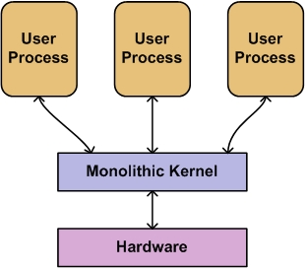
Monolithic Kernel
Kernel takes care of almost all the system tasks
Applications do not have control over resources
Example:
Windows 9x series: Windows 95, 98
BSD: FreeBSD, OpenBSD
Linux
Ref: Kaashoek et al.

Slide 7
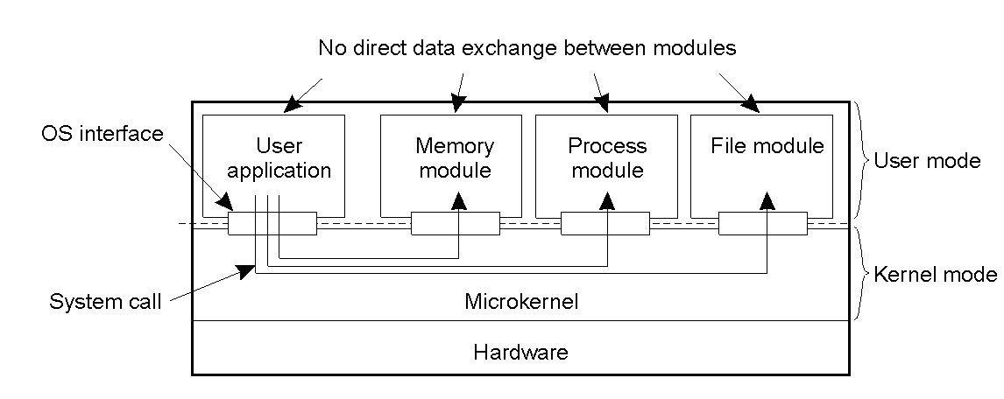
Microkernel
Runs most of the operating system services at the user space
Parts that require privilege (IPC, etc) are in kernel mode
Other critical parts (FS, Network Stack) in user mode
Performance issue !
Ref: Tanenbaum’s distributed systems.

Slide 8
Exokernel
Separates resource management from protection
Normal kernel does both
Kernel
protect the resources
Application
Manage the resources
Virtual memory, file system etc. are in application libraries
Gives untrusted software as much control over hardware and software resources as possible
Specialized applications can gain high performance without sacrificing the unmodified UNIX program

Slide 9
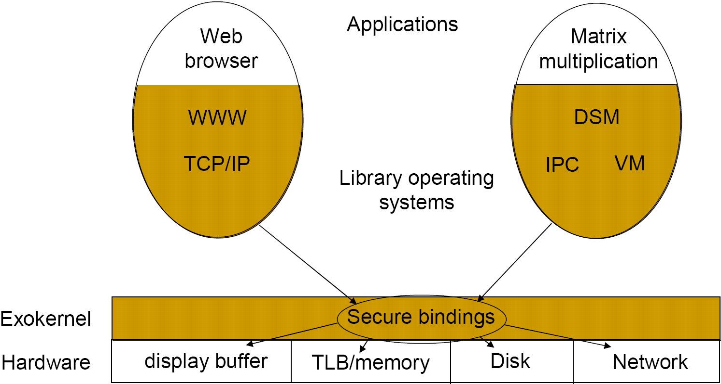
Architecture of Exokernel
It includes an exokernel and untrusted (application-level) library OS
Exokernel defines low-level interface &multiplexes(not emulate but exports) available HW resources
Lib OS implements higher-level OS

Slide 10
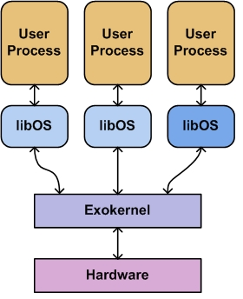
Microkernel vs. Exokernel
Microkernel
Exokernel
No direct data exchange between modules
Microkernel
User process
Memory module
Process module
File module
User space
User
Kernel
Microkernel
Kernel space
Hardware
System Call

Slide 11
Advantages of the architecture
High functionality & Flexibility
Allows extension, specialization, and replacement of abstraction
High performance
Conflict between the applications can be resolved without intervention of the kernel architects
Easy to implement
Simplicity
Easy to port
High portability & compatibility
Notes:
Intervention
n.介入

Slide 12
Outline
Exokernel Overview
Concept
Design
LibOS
Xen

Slide 13
Exokernel Design
Exokernel separates protection from management through a low-level interface
Exokernel avoids resource management
Design principles
Securely expose hardware
Expose Allocation
Expose Names
Expose Revocation
Resource policy decision by library OS
Competing is allowed as traditional OS

Slide 14
Exokernel Design: Secure Binding
Primary task that is protection mechanism decouples authorization
Simple operation
Authorization only at bind time(low management overhead)
No need to understand semantics at bind time
Needs set of primitives application can use to express protection check by H/W or S/W
H/W mechanism, S/W caching, Downloading application code

Slide 15
Exokernel Design(cont’d)
Visible Resource Revocation
Higher latency but library OS can guide deallocation and have knowledge that resources are scarce
Frequent revoked modules can be invisible
The Abort protocol
When library OS fails to response quickly in fail state, secure binding must be broken by force
Using repossession vector
Notes:
Revocation 废止;撤回
Scarce 缺乏的, 罕见的

Slide 16
Multiplexing resources
Utilize hardware, software, both
Let applications specify exception/interrupt handlers
Processor context per application to include exception and interrupt handling info (+ other stuff…)
=> visible revocation
CPU
Maintain time vector; use timer interrupts to tell application of imminent context switch so “right” resources can be saved
Memory
Rely on hardware address translation; add software TLB to expand set of fast VA->PA checks
Network
Trickier; to parse a packet, need higher-level info to parse it;
Allow dynamic packet filters (DPFs) to be dynamically generated and inserted into kernel; checked for safety and sandboxed
ASHs – Application-specific Handlers – addition additional functionality in kernel
Forceful revocation – abort protocol

Slide 17
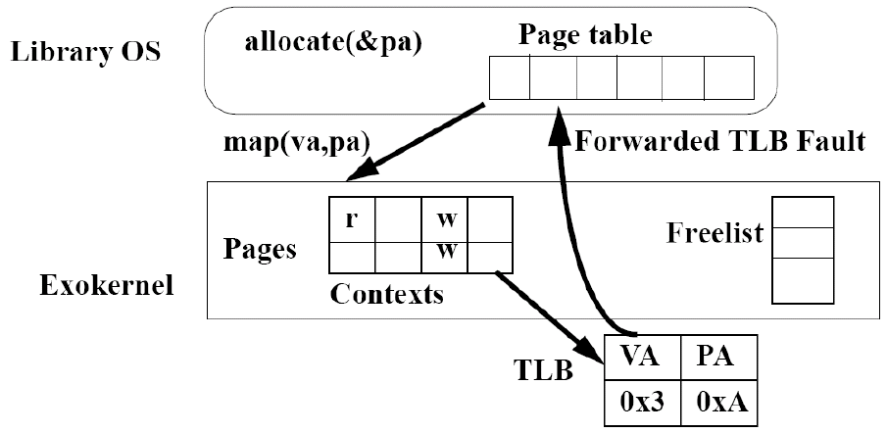
Virtual Memory example
When binding established authentication, etc. take place
When binding is used, page accessed, no added overheads
Notes:
http://www.cc.gatech.edu/classes/AY2009/cs6210_fall/lectures/02-Exokernel.pdf

Slide 18
Memory – Address translation
Application AS partitioned in two regions
Normal app data/code
“guaranteed” mapping: exception code and page tables
TLB miss steps
1) Exokernel
Check software TLB cache (4K entries)
First region: dispatched to app directly
Second: load guaranteed mapping to TLB
2) App
Fault
Construct TLB entry and capability
Call exokernel system call
3) exokernel
Check capability
If ok, load TLB

Slide 19
How To Multiplex the Disk?
Goal: libFS as powerful as privileged FS
Hardest problem: who can use a disk block?
Issue 1: access control ≈ file system
Sol’n: reuse libFS’ own data structures
Issue 2: must understand metadata
Fixed set of components would be infeasible

Slide 20
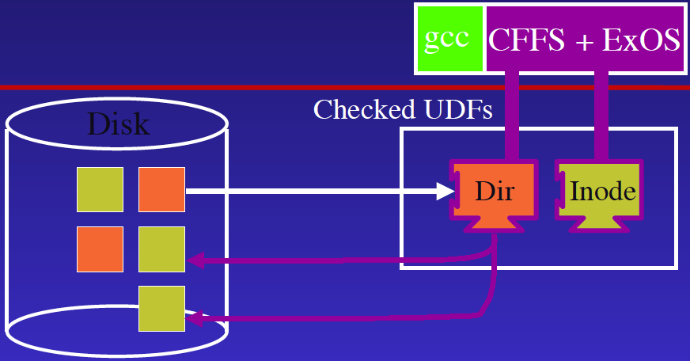
UDFs: untrusted deterministic functions
libFS metadata tracks what it owns without kernel understanding how

Slide 21
C-FFS: A Fast LibFS
Faster than in-kernel file systems (e.g. FFS)
Uses exokernel control to:
Embed inodes in directories
Co-locate related files together on disk
Fetch large chunks of disk on every read
To guarantee metadata integrity:
Use “protected methods” (specified along with UDFs) to guard modifications

Slide 22
Outline
Exokernel Overview
LibOS
Library OS Concept
Dynamic Packet Filters
Performance of LibOS
Xen

Slide 23
Library OS
The kernel does not trust the library OS
The library OS trusts the user program; so the library OS can be implemented without the concern of protection
The library OS and the user program are linked together
low cost interaction between them
particularly helpful when applications and the OS interact frequently (application-assisted VM page replacement)
Applications can link with customized library OS
flexibility
e.g., one process can use LRU page replacement and another can use MRU

Slide 24
Exokernels
User process
User process
Exokernel protects but
does not manage
system resources

Slide 25
LibOSes
User-level library of functions emulating conventional system call interface
Manages resources for applications that do not want to do it themselves
Can have different libOSes coexisting on the top of same exokernel
Allows system to emulate behaviors of several conventional operating systems

Slide 26
LibOSes
User process
User process
Exokernel
libOS
libOS

Slide 27
LibOSes
Same interface between application and libOS as between application and a conventional kernel
libOS runs as part of application
Cannot be trusted by the kernel or other user processes

Slide 28
Five Principles
Separate protection and management.
Letting applications allocate resources explicitly.
Using physical names whenever possible.
Expose revocation: let applications choose which instance of a resource to give up.
Expose all kernel information.

Slide 29
Outline
Exokernel Overview
LibOS
Library OS Concept
Dynamic Packet Filters
Performance of LibOS
Xen

Slide 30
Problem
Goal: speed + flexibility
Packet filters:
tradeoff: extensible but slow
result: speed freaks don’t use them
Hard-wired C/asm:
tradeoff: fast but inflexible
result: cannot interoperate with new protocols
Notes:
freak out colloquial
A. intransitive verb
发飙
B. transitive verb[freak somebody out, freak out somebody]
使发飙

Slide 31
DPFs: Dynamic Packet Filters
Extensibility:
DPF filters downloaded into kernel
Speed:
Main trick: filters are dynamically compiled
Compilation enables further optimizations
Result:
10 - 50 x faster than best PF in literature
Speed rivals (or surpasses) hand-crafted asm

Slide 32
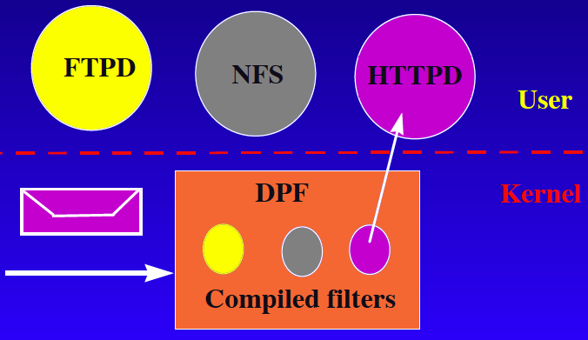
DPF: Operational Overview
Notes:
https://pdos.csail.mit.edu/~engler/dpf.html
https://pdos.csail.mit.edu/~engler/dpf-talk.ps
DPF: Fast, Flexible Message Demultiplexing using Dynamic Code Generation

Slide 33
DPF: Operational View
Filters:
written by clients
downloaded into DPF (in kernel)
checked for validity
merged into trie of filters, and then compiled
Usage:
jam message through compiled trie
“first longest” match wins

Slide 34
DPF Language
Syntax: C-style boolean expression
Extensions:
load message values using “:”
move pointer into message using “shift”
Example: demux using TCP ports
(0:16 ==1234) && (2:16 = 4321) && shift(20)
Rest of talk: making filters fast

Slide 35
Dynamic code generation
Executable code:
sequence of bits corresponding to machine inst
Dynamic code generation (DCG):
generation of executable code at runtime
Why?
eliminate interpretation overhead
runtime = more information = faster code

Slide 36
Making Filters Fast
Optimizations exploiting DCG
runtime constants
fast disjunctions
Optimizations exploiting compilation
atom coalescing
alignment optimization
bounds-check aggregation
Notes:
coalesce
intransitive verb
formal «substances, groups» 合并
disjunction
noun
formal 分离

Slide 37
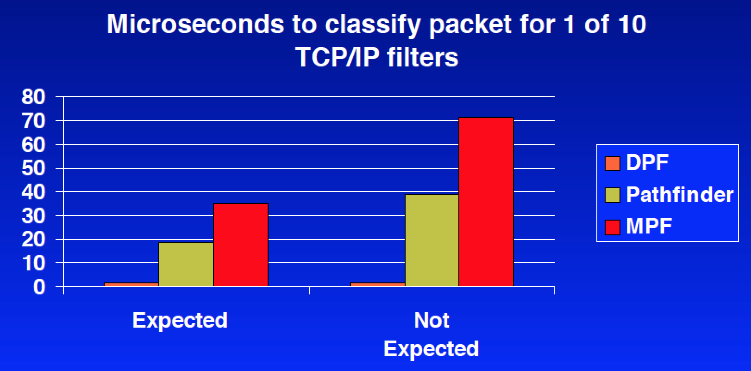
Classification Overhead
Notes:
DPF is 25–50 times faster than MPF and 13–26 times faster than PATHFINDER, depending on whether or not the filter was cached (“expected”).

Slide 38
Outline
Exokernel Overview
LibOS
Library OS Concept
Dynamic Packet Filters
Performance of LibOS
Xen

Slide 39
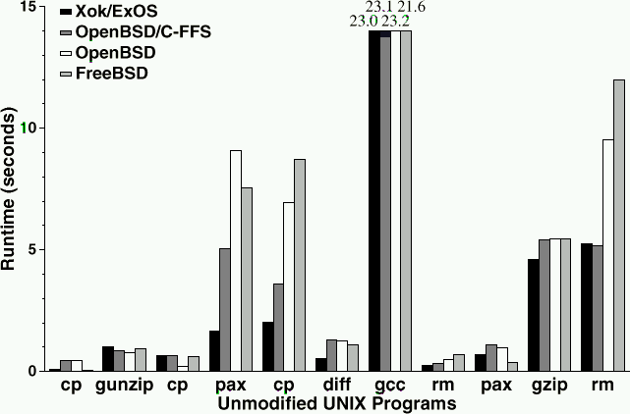
Performance of unmodified UNIX applications
Xok/ExOS is the first bar
Better
Comparable
Notes:
http://courses.cs.vt.edu/cs5204/fall11-butt/lectures/Exokernel.ppt

Slide 40
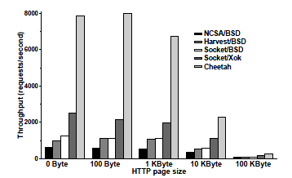
Performance of modified HTTP Server
Cheetah uses a file system and a TCP implementation customized for the properties of HTTP traffic.
Exokernel is well suited to building fast servers

Slide 41
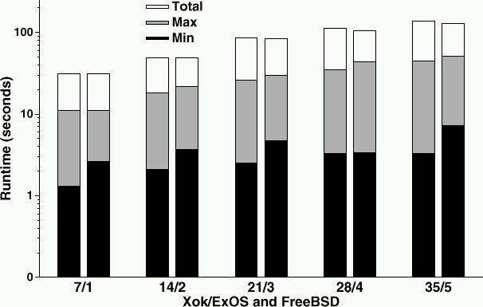
Global Performance
Compared to FreeBSD and as good as FreeBSD.
A specific application is pool is used here.

Slide 42
Advantages and Disadvantages
Benefits
Performance
Isolation and Stability
Flexibility (In terms of abstraction level)
Drawbacks
Space Requirement
Development Resources (General case)
Complexity (General case)
Flexibility (In terms of program mobility)

Slide 43
Outline
Exokernel Overview
LibOS
Xen
Xen Architecture
Virtualization of MMU
SMP support
Xen I/O Architecture
Unikernel & MirageOS

Slide 44
Xen Today :
Secure isolation between VMs
Resource control and QoS
Only guest kernel needs to be ported
User-level apps and libraries run unmodified
Linux 2.4/2.6, NetBSD, FreeBSD, Plan9, Solaris
Execution performance close to native
Broad x86 hardware support
Live Relocation of VMs between Xen nodes
Notes:
Commercial / production use
Released under the GPL; Guest OSes can be any licensce
Source: http://www.cl.cam.ac.uk/research/srg/netos/papers/2005-xen-ols.ppt

Slide 45
Para-Virtualization in Xen
Xen extensions to x86 arch
Like x86, but Xen invoked for privileged ops
Avoids binary rewriting
Minimize number of privilege transitions into Xen
Modifications relatively simple and self-contained
Modify kernel to understand virtualised env.
Wall-clock time vs. virtual processor time
Desire both types of alarm timer
Expose real resource availability
Enables OS to optimise its own behaviour
Notes:
X86 hard to virtualize so benefits from more modifications than is necessary for IA64/PPC
popf
Avoiding fault trapping : cli/sti can be handled at guest level

Slide 46
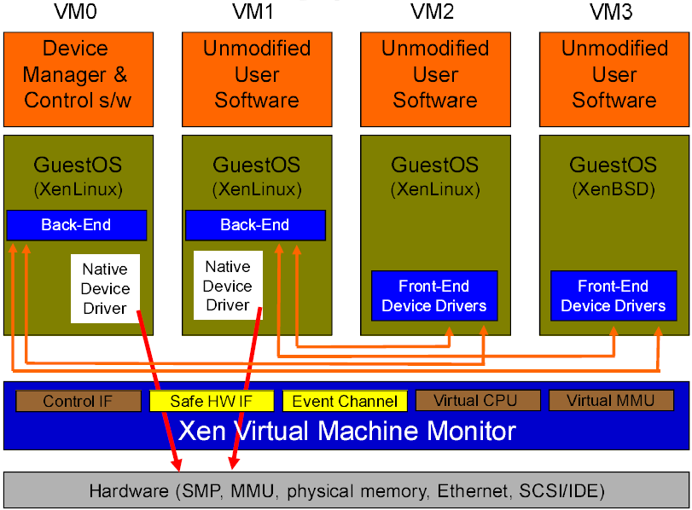
Xen 2.0 Architecture

Slide 47
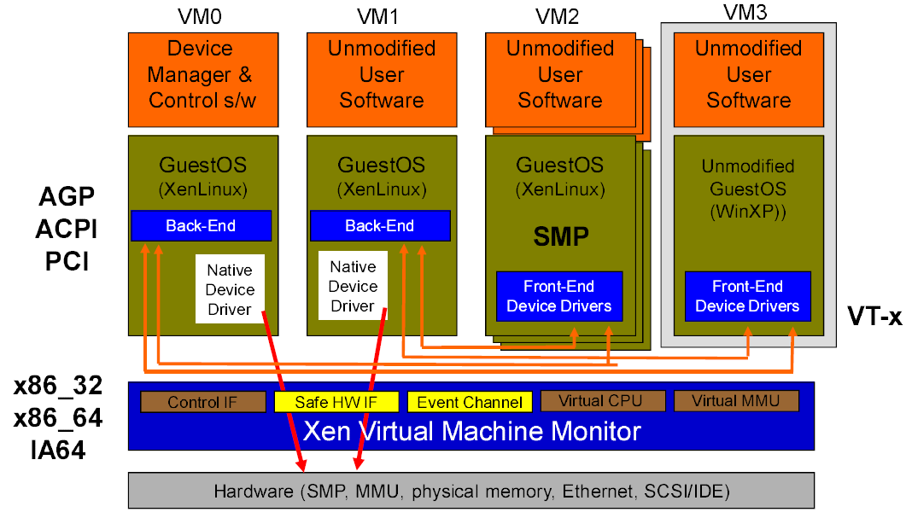
Xen 3.0 Architecture

Slide 48
x86_32
Xen reserves top of VA space
Segmentation protects Xen from kernel
System call speed unchanged
Xen 3 now supports PAE for >4GB mem
4GB
S
Xen
Kernel
S
3GB
ring 0
ring 1
User
ring 3
U
0GB

Slide 49
x86_64
2⁶⁴
Large VA space makes life a lot easier, but:
No segment limit support
Need to use page-level protection to protect hypervisor
Kernel
U
Xen
S
2⁶⁴-2⁴⁷
Reserved
2⁴⁷
User
U
0

Slide 50
x86_64
Run user-space and kernel in ring 3 using different pagetables
Two PGD’s (PML4’s): one with user entries; one with user plus kernel entries
System calls require an additional syscall/ret via Xen
Per-CPU trampoline to avoid needing GS in Xen
r3
User
U
r3
Kernel
U
syscall/sysret
r0
Xen
S
Notes:
Page Global Directory
Page Upper Directory
Page Middle Directory
Page Table
Page offset

Slide 51
Outline
Exokernel Overview
LibOS
Xen
Xen Architecture
Virtualization of MMU
SMP support
Xen I/O Architecture
Unikernel & MirageOS

Slide 52
Para-Virtualizing the MMU
Guest OSes allocate and manage own PTs
Hypercall to change PT base
Xen must validate PT updates before use
Allows incremental updates, avoids revalidation
Validation rules applied to each PTE:
1. Guest may only map pages it owns*
2. Pagetable pages may only be mapped RO
Xen traps PTE updates and emulates, or ‘unhooks’ PTE page for bulk updates
Notes:
Important for fork

Slide 53
MMU Micro-Benchmarks
1.1
1.0
0.9
0.8
0.7
0.6
0.5
0.4
0.3
0.2
0.1
0.0
L
X
V
U
L
X
V
U
Page fault (µs)
Process fork (µs)
lmbench results on Linux (L), Xen (X), VMWare Workstation (V), and UML (U)
Notes:
Most benchmark results identical. In addition to these, some slight slowdown

Slide 54
Outline
Exokernel Overview
LibOS
Xen
Xen Architecture
Virtualization of MMU
SMP support
Xen I/O Architecture
Unikernel & MirageOS

Slide 55
SMP Guest Kernels
Xen extended to support multiple VCPUs
Virtual IPI’s sent via Xen event channels
Currently up to 32 VCPUs supported
Simple hotplug/unplug of VCPUs
From within VM or via control tools
Optimize one active VCPU case by binary patching spinlocks
Notes:
Xen has always supported SMP hosts
Important to make virtualization ubiquitous, enterprise

Slide 56
SMP Guest Kernels
Takes great care to get good SMP performance while remaining secure
Requires extra TLB syncronization IPIs
Paravirtualized approach enables several important benefits
Avoids many virtual IPIs
Allows ‘bad preemption’ avoidance
Auto hot plug/unplug of CPUs
SMP scheduling is a tricky problem
Strict gang scheduling leads to wasted cycles
Notes:
Xen has always supported SMP hosts
Important to make virtualization ubiquitous, enterprise

Slide 57
Outline
Exokernel Overview
LibOS
Xen
Xen Architecture
Virtualization of MMU
SMP support
Xen I/O Architecture
Unikernel & MirageOS

Slide 58
I/O Architecture
Xen I/O-Spaces delegate guest OSes protected access to specified h/w devices
Virtual PCI configuration space
Virtual interrupts
(Need IOMMU for full DMA protection)
Devices are virtualised and exported to other VMs via Device Channels
Safe asynchronous shared memory transport
‘Backend’ drivers export to ‘frontend’ drivers
Net: use normal bridging, routing, iptables
Block: export any blk dev e.g. sda4,loop0,vg3
(Infiniband / Smart NICs for direct guest I/O)

Slide 59
VT-x / (Pacifica)
Enable Guest OSes to be run without para-virtualization modifications
E.g. legacy Linux, Windows XP/2003
CPU provides traps for certain privileged instrs
Shadow page tables used to provide MMU virtualization
Xen provides simple platform emulation
BIOS, Ethernet (ne2k), IDE emulation
(Install paravirtualized drivers after booting for high-performance I/O)
Notes:
Pacifica
VT-x技术是CPU的硬件虚拟化技术

Slide 60

Domain 0
Domain N
Guest VM (VMX)
(32-bit)
Guest VM (VMX)
(64-bit)
Linux xen64
3P
Control Panel (xm/xend)
Device Models
Unmodified OS
Unmodified OS
3D
Linux xen64
FE Virtual Drivers
FE Virtual Drivers
Backend
Virtual driver
Front end Virtual Drivers
Guest BIOS
Guest BIOS
Native
Device Drivers
Native Device Drivers
0D
1/3P
Virtual Platform
Virtual Platform
Callback / Hypercall
VMExit
VMExit
Event channel
0P
Control Interface
Scheduler
Event Channel
Hypercalls
Processor
Memory
I/O: PIT, APIC, PIC, IOAPIC
Xen Hypervisor

Slide 61
Outline
Exokernel Overview
LibOS
Xen
Xen Architecture
Virtualization of MMU
SMP support
Xen I/O Architecture
Unikernel & MirageOS

Slide 62
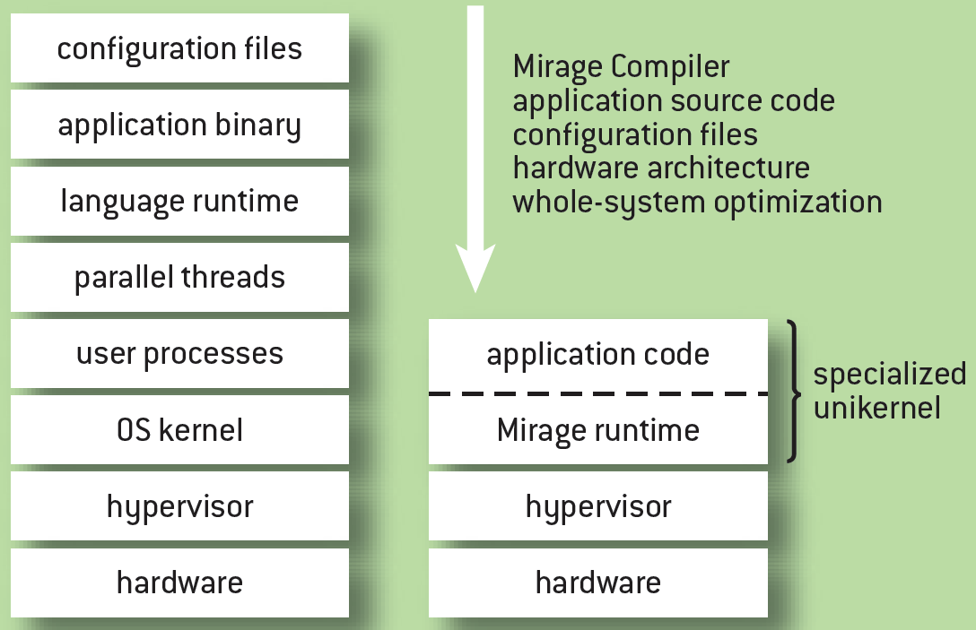
Unikernel
A unikernel is a specialised, single address space machine image constructed by using library operating systems.
Enterprise Component for A Highly Re-configurable Architectural Style
Notes:
https://en.wikipedia.org/wiki/Unikernel
http://queue.acm.org/detail.cfm?id=2566628
Unikernels: Rise of the Virtual Library Operating System

Slide 63
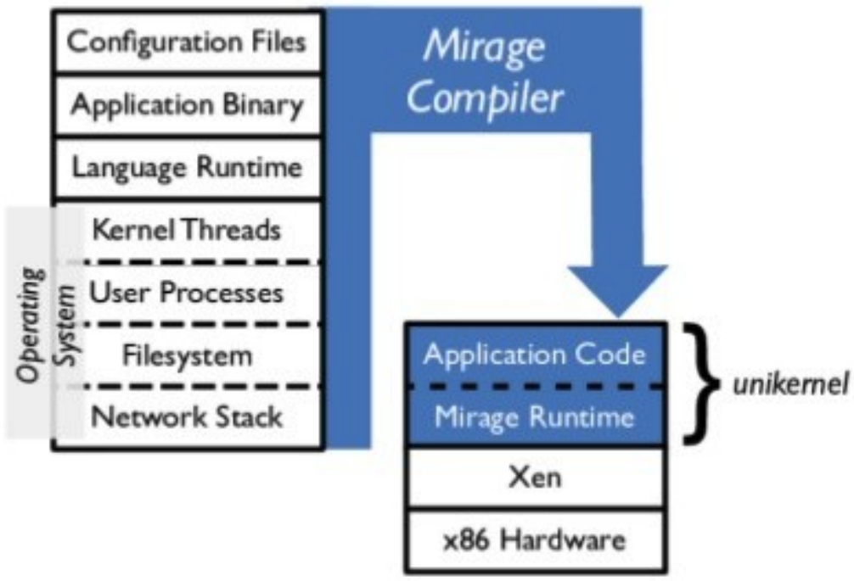
MirageOS
A library operating system that constructs unikernels for secure, high-performance network applications
A fully-standalone, specialised unikernel that runs under a Xen or KVM hypervisor.
Notes:
https://www.socallinuxexpo.org/sites/default/files/presentations/SCALE13X-Next%20Generation%20Cloud-Rise%20of%20the%20Unikernel-1_2.pdf

Slide 64
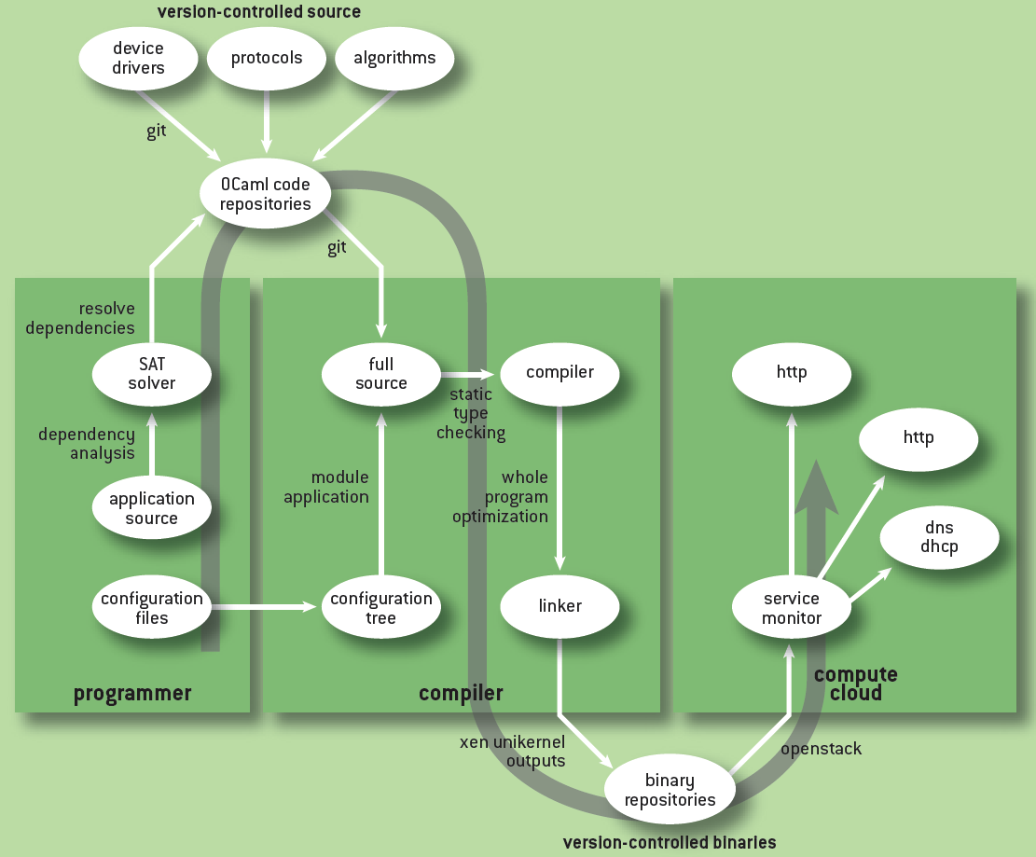
Logical Workflow in MirageOS

Slide 65
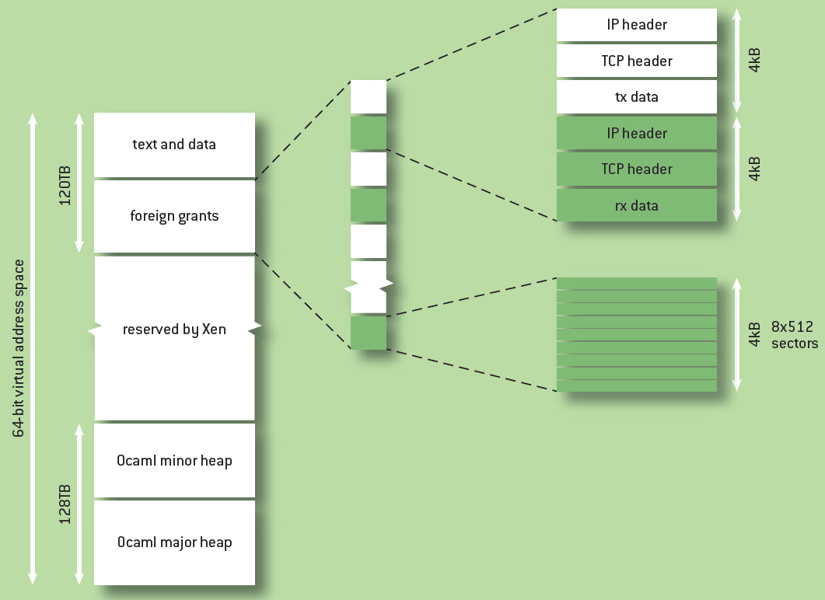
Virtual Address Space of the MirageOS Xen Unikernel Target

Slide 66
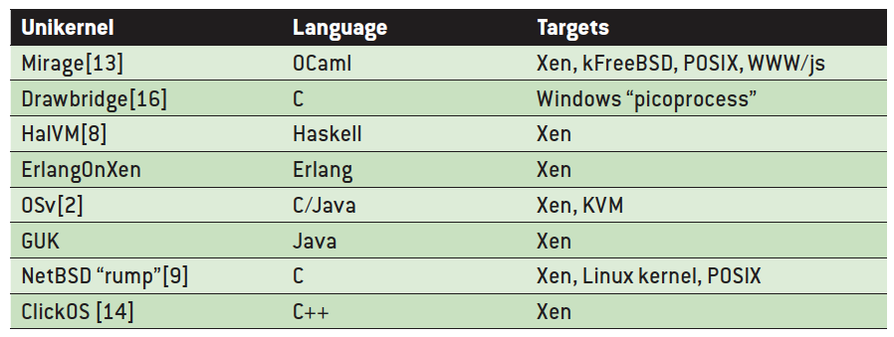
Other unikernel implementations

Slide 67
Reference
http://pages.cs.wisc.edu/~remzi/Classes/736/Papers/exo-sosp97.pdf
https://pdos.csail.mit.edu/~engler/sosp97-talk.ps
https://pdos.csail.mit.edu/~engler/dpf.html
http://www.cc.gatech.edu/classes/AY2009/cs6210_fall/lectures/02-Exokernel.pdf
http://web.cecs.pdx.edu/~walpole/class/cs533/spring2005/slides/161.ppt
http://dcslab.snu.ac.kr/research/sig-net/presentation/0427_shahn.ppt
http://os.korea.ac.kr/course_papers/2009_AOS/2009_nos_slide_03.pdf
https://agora.cs.illinois.edu/download/attachments/7340110/Exokernel+presentation.ppt?version=1&modificationDate=1204401253000
http://www.cs.ucf.edu/courses/cop5611/spring05/item/exokernel.pdf
http://www2.cs.uh.edu/~paris/6360/PowerPoint/Xok.ppt
http://www.cl.cam.ac.uk/research/srg/netos/papers/2005-xen-ols.ppt
Unikernels: Rise of the Virtual Library Operating System
http://queue.acm.org/detail.cfm?id=2566628

