Slide 1
RVM: Rcore Virtual Machine
清华大学计算机系
陈渝
2021/10/25

Slide 2
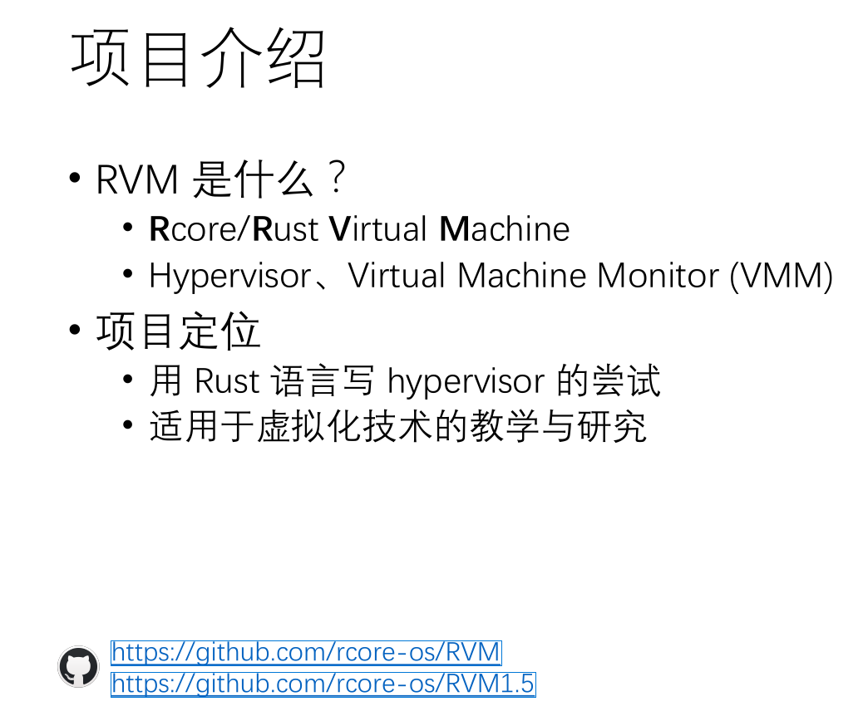

Slide 3
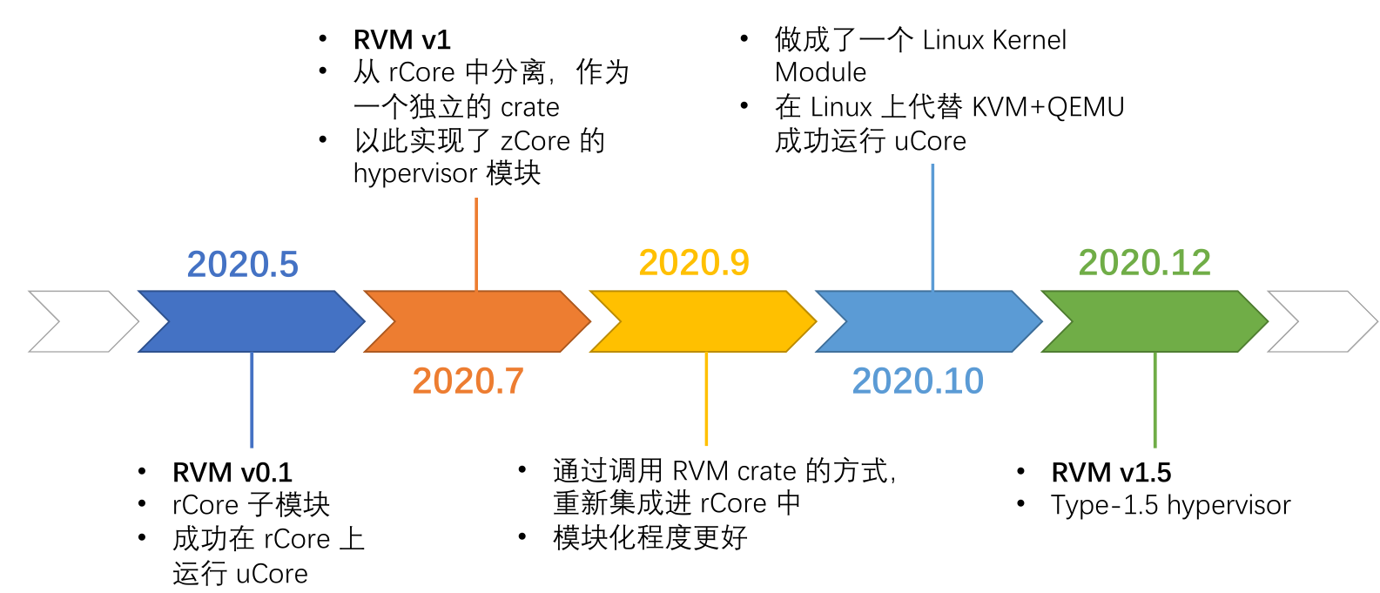
项目历史
初步支持RISC-V的H-mode
能在QEMU for RISC-V上运行
Type-1 hypervisor
2020年.6

Slide 4
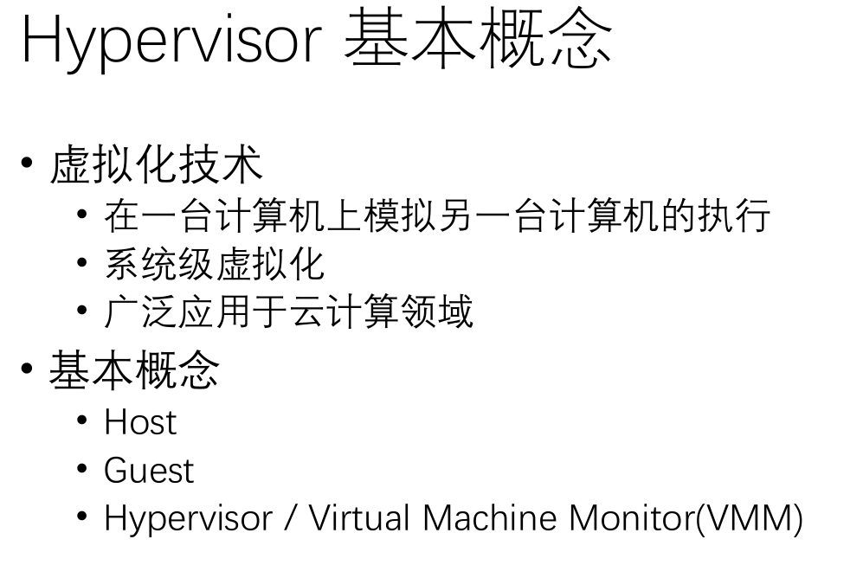

Slide 5
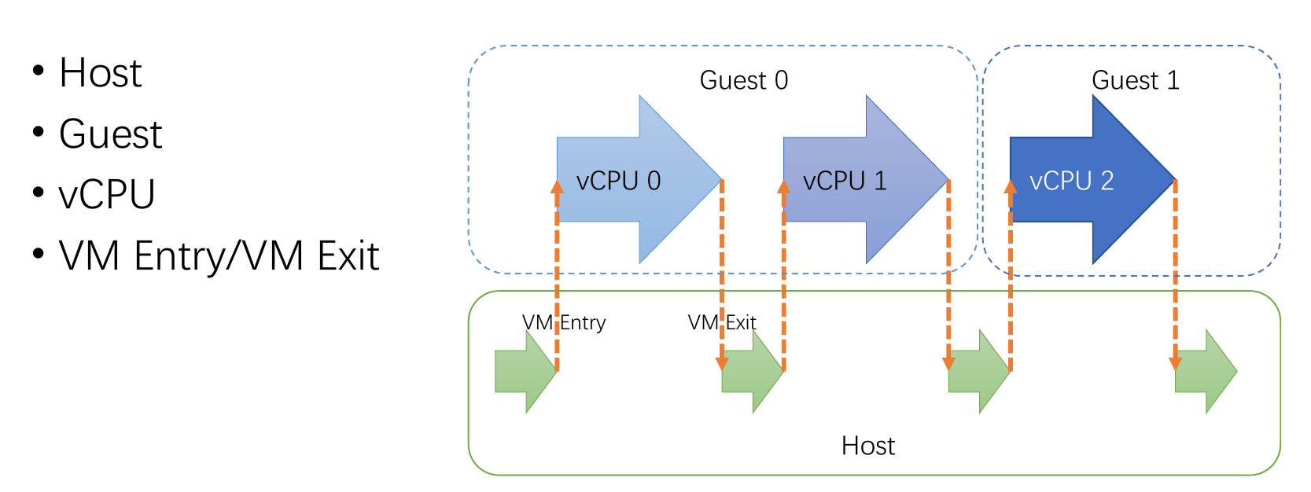
Hypervisor 基本概念

Slide 6
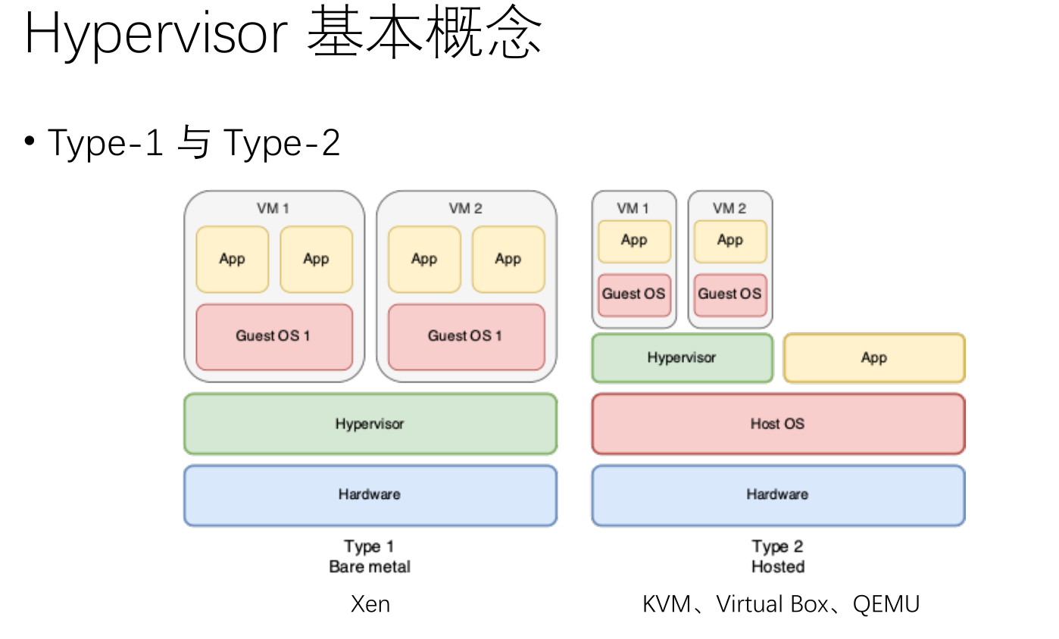

Slide 7
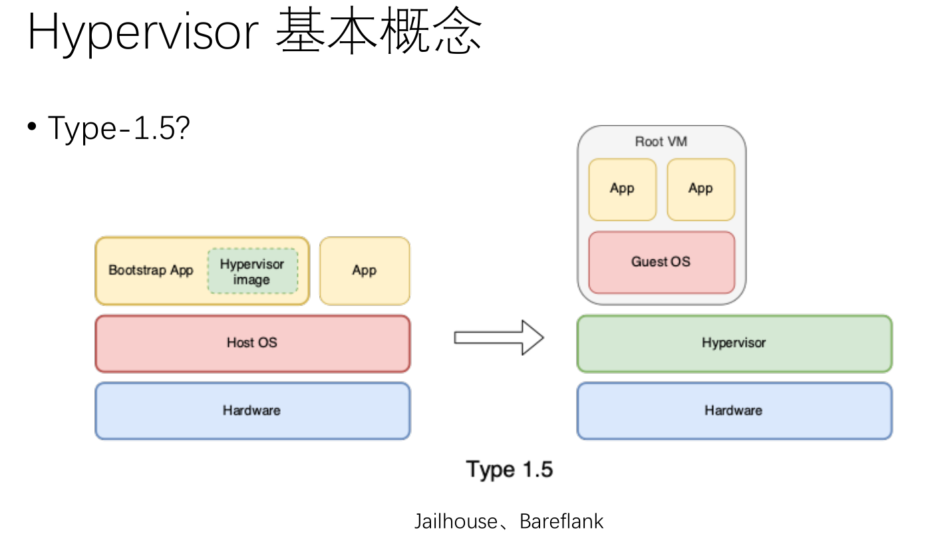

Slide 8
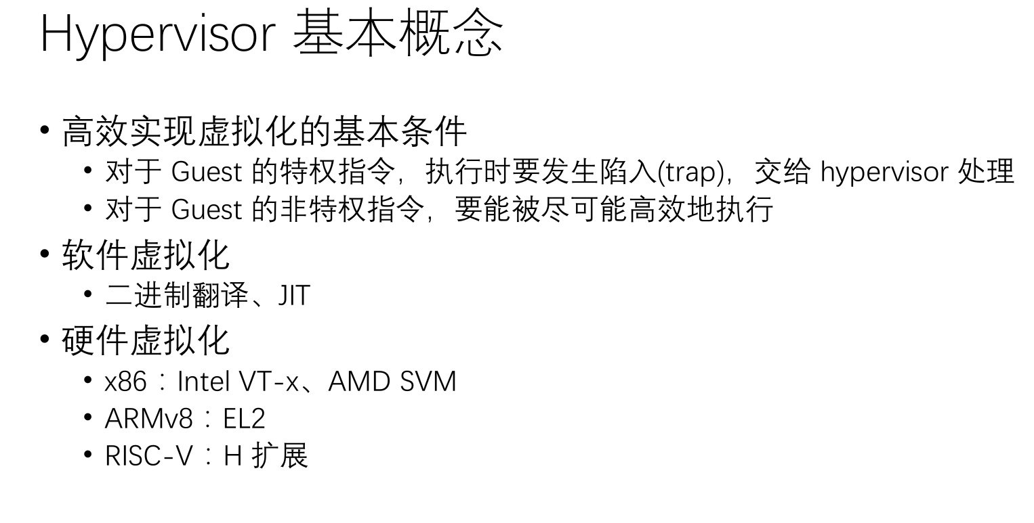

Slide 9
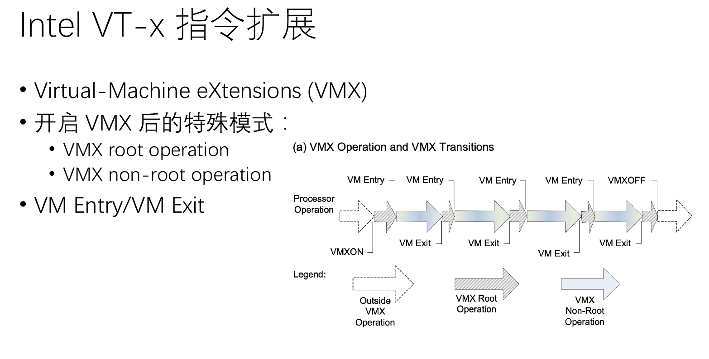

Slide 10
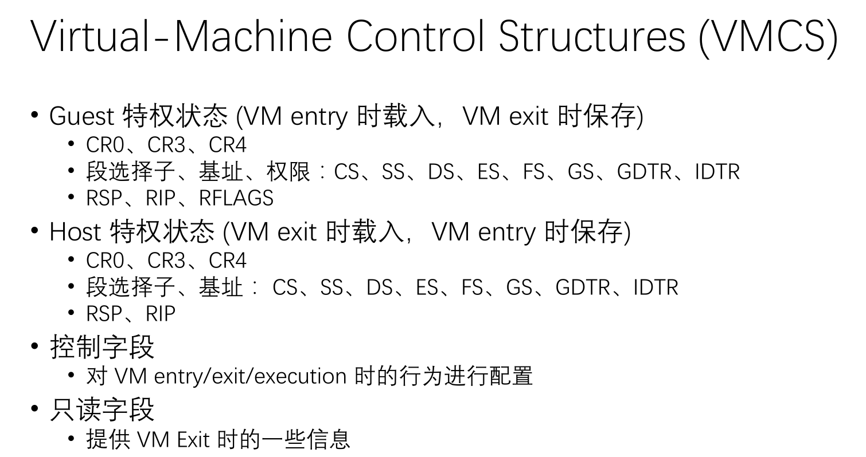

Slide 11
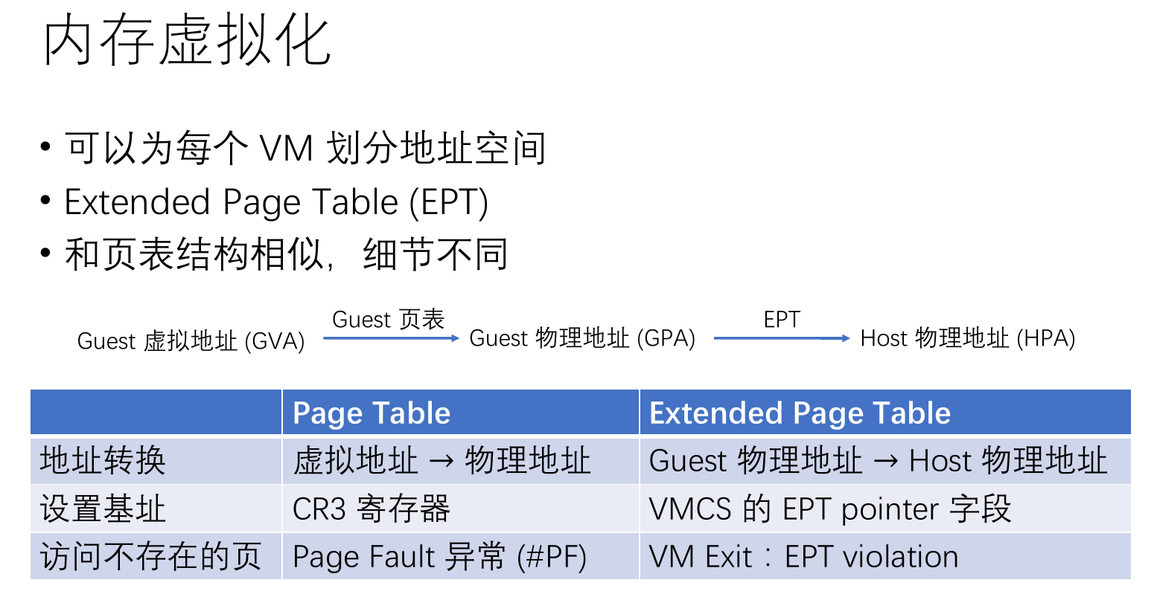

Slide 12
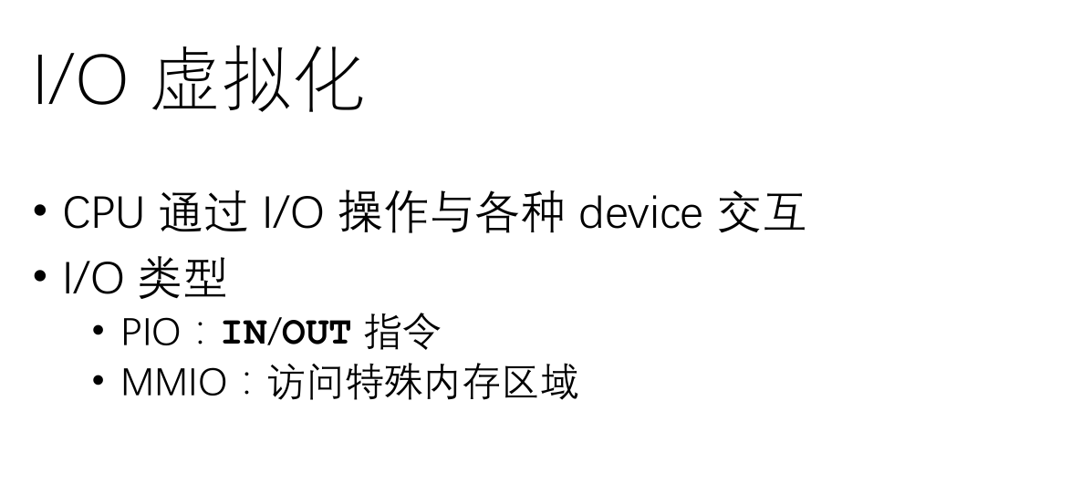

Slide 13
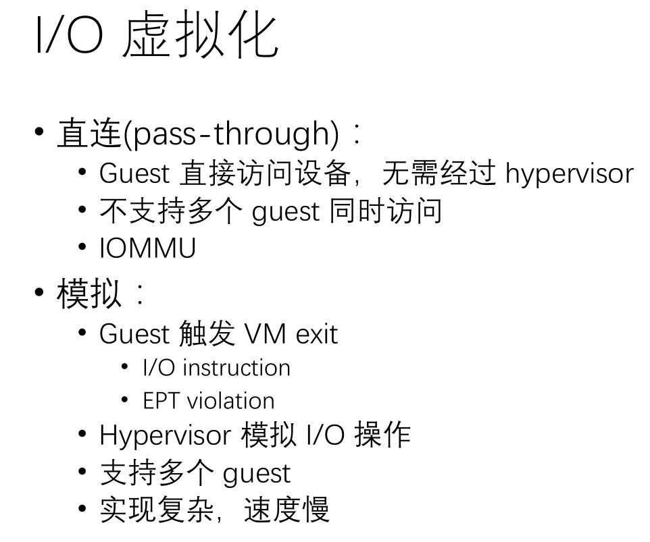

Slide 14
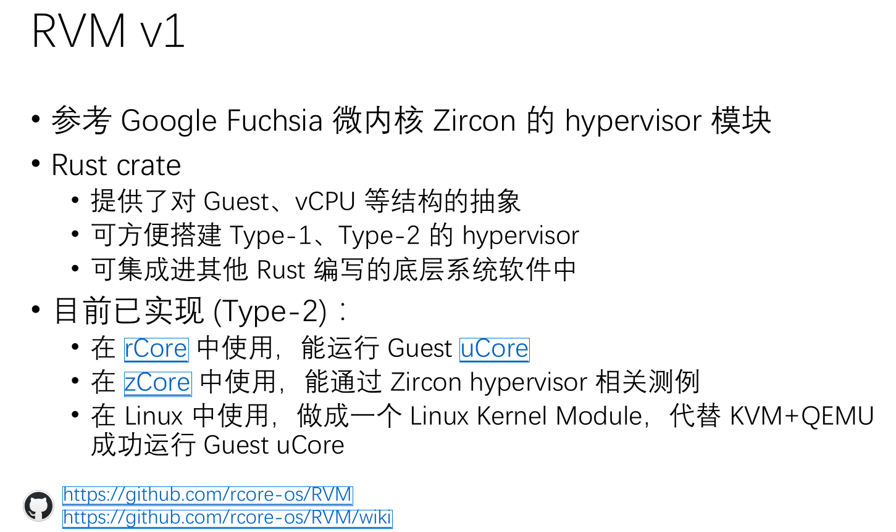

Slide 15
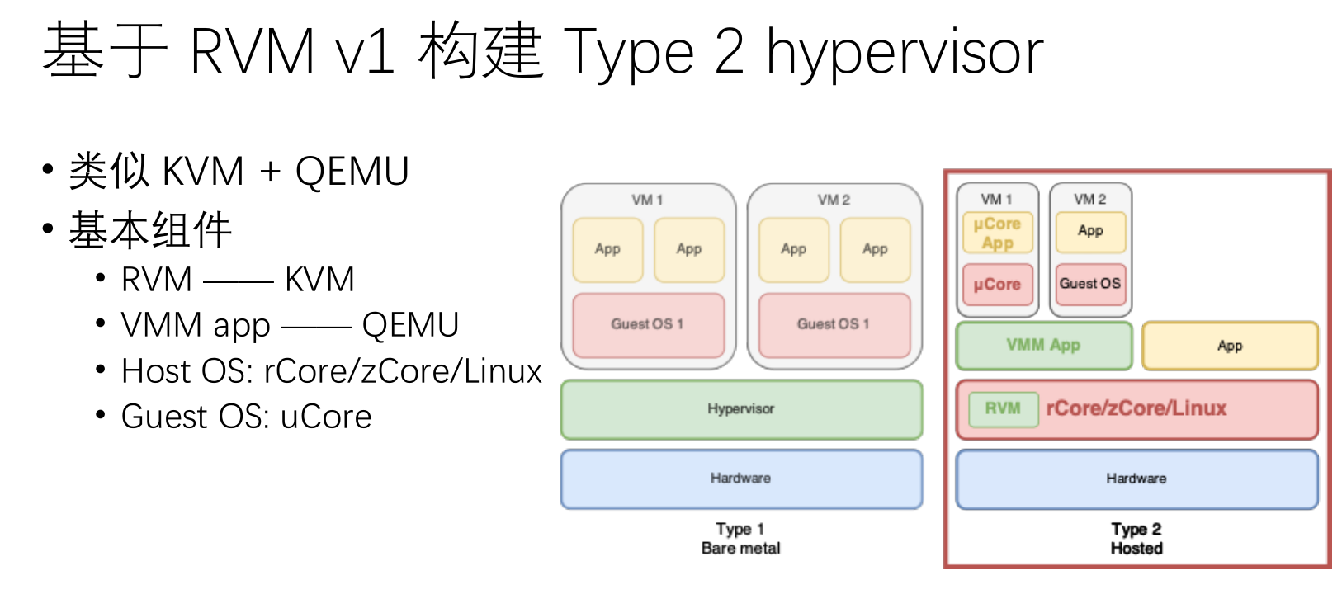

Slide 16
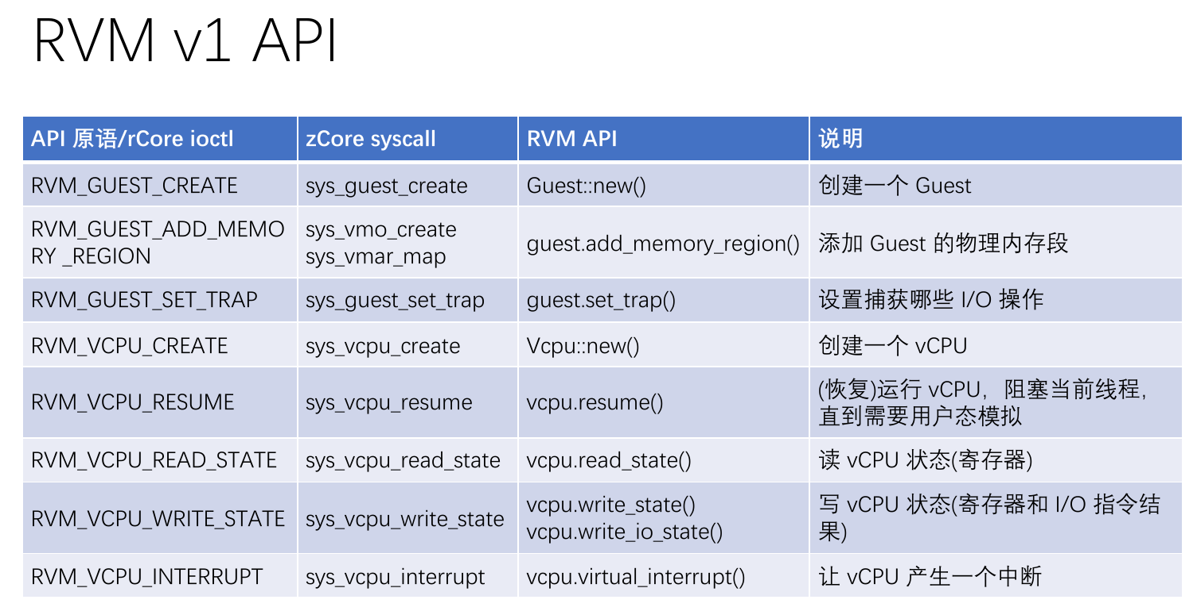

Slide 17
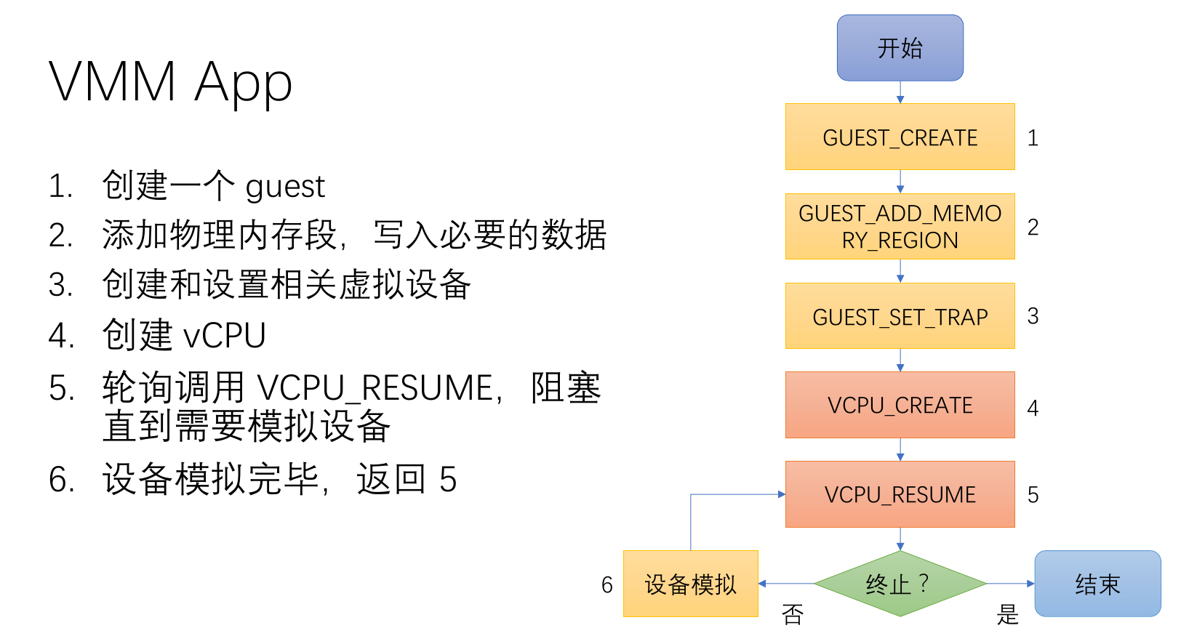

Slide 18
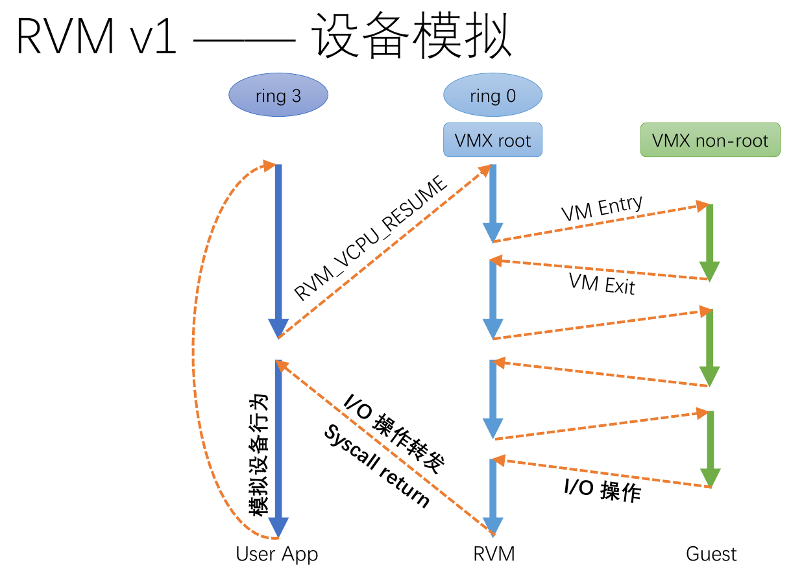

Slide 19
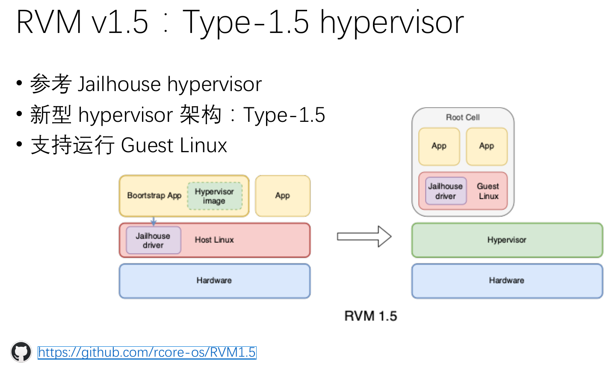

Slide 20
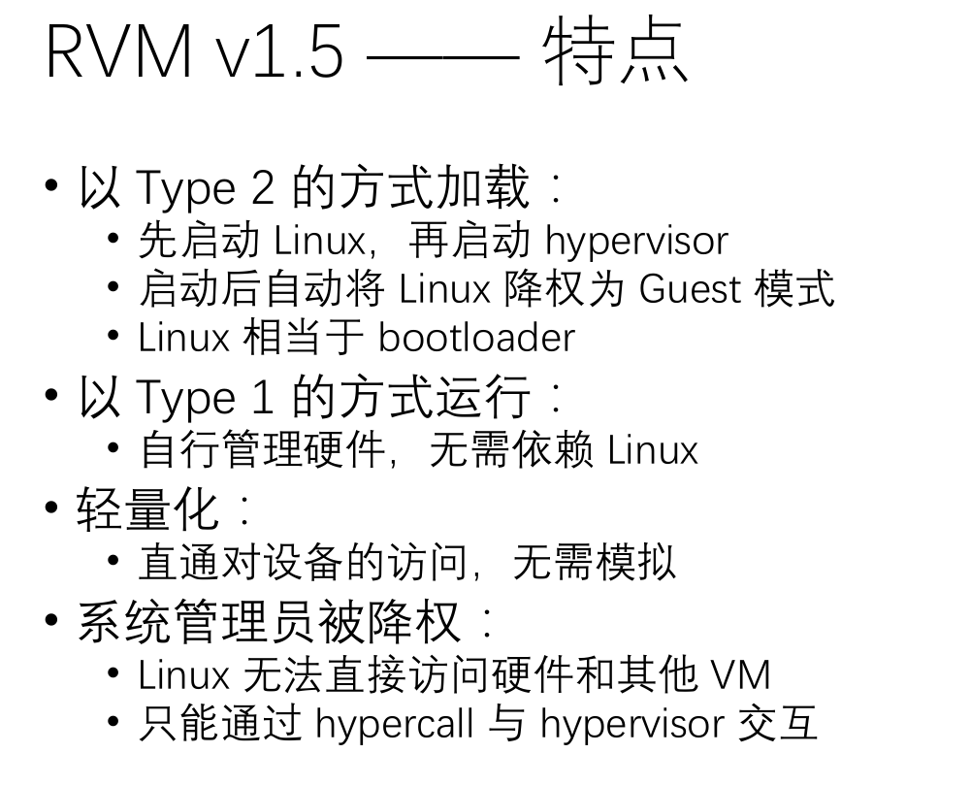

Slide 21
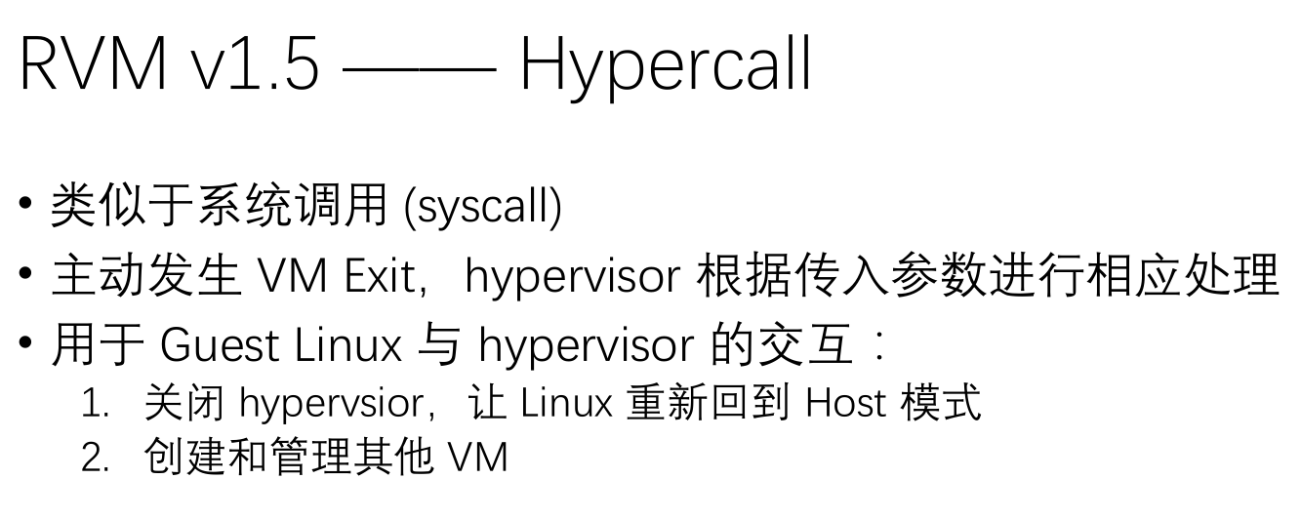

Slide 22
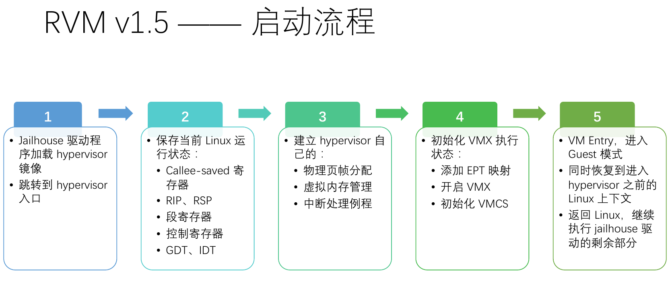

Slide 23
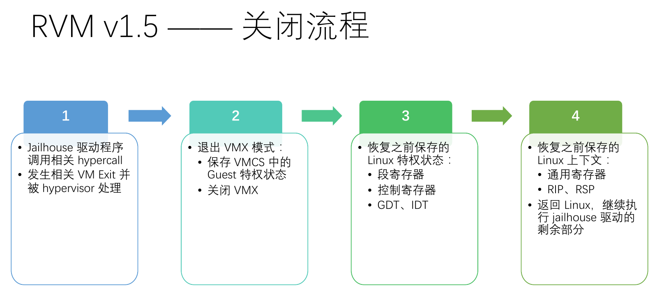

Slide 24
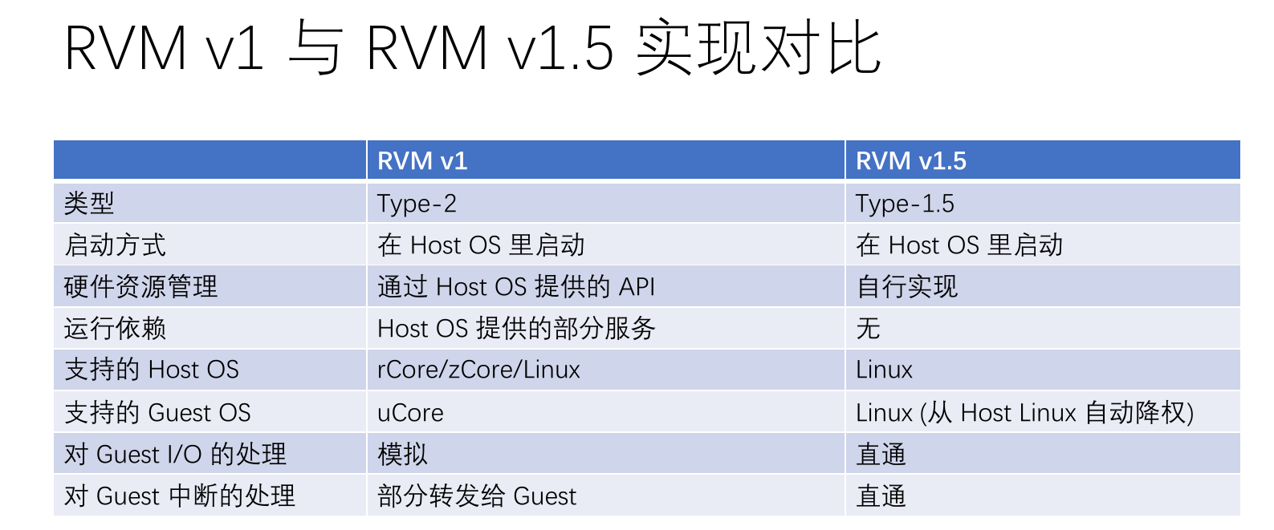

Slide 25
RISC-V Virtualization
RISC-V Hypervisor Extension

Slide 26
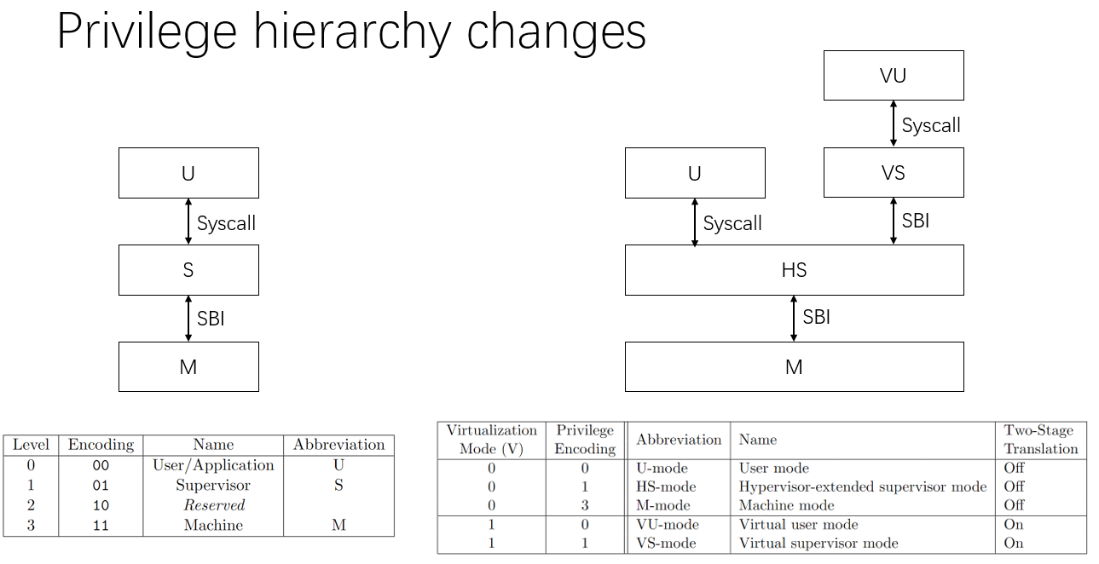
RISC-V Virtualization

Slide 27
RISC-V Virtualization
Software implementations
Spike
Spec emulator.
Always comforting to the latest spec.
Slow.
Qemu
FAST.
Lagging behind the latest spec.
Some features (like tinst) unimplemented.
Hardware implementations
Rocket core
Soft processor on FPGA.

