Slide 1
DAWNBench
An End-to-End Deep Learning Benchmark and Competition
Cody Coleman, Deepak Narayanan, Daniel Kang, Tian Zhao, Jian Zhang,
Luigi Nardi, Peter Bailis, Kunle Olukotun, Chris Ré, Matei Zaharia
Stanford University
dawn.cs.stanford.edu/benchmark
Notes:
DAWNBench
An End-to-End Deep Learning Benchmark and Competition
that focuses on time and cost to achieve state-of-the-art accuracy

Slide 2
To address the growing computational demands
Notes:
In recent years, we have seen an explosion in interest deep learning
And as a result, we have also seen massive growth in computational demands
Fortunately, there have been a number of novel innvoations to address these growing computational demands
Including

Slide 3
To address the growing computational demands
New software systems
Training algorithms
Communication methods
Hardware
TensorFlow
PyTorch
CNTK
MXNet
Notes:
That aim to make designing and training deep learning models faster and easier

Slide 4
To address the growing computational demands
New software systems
Training decisions
Communication methods
Hardware
Adam
RMSprop
Stochastic Depth
Batch normalization
Notes:
- Such as choice of optimizer to make more efficient use of data and architecture choices to provide regularization

Slide 5
To address the growing computational demands
New software systems
Training decisions
Communication methods
Hardware
HogWild
Synthetic Gradients
DimmWitted
Notes:
For asynchronous and synchronous training
As well as reduced communication and shared state

Slide 6
To address the growing computational demands
New software systems
Training decisions
Communication methods
Hardware
Google TPU
Nvidia GPUs
Microsoft Brainwave
Intel Xeon Phi
Notes:
- Many advances in hardware from existing technologies like CPUs and GPUs to new architectures like Google’s TPU
- This represents a tremendous effort from the community to reduced the cost both in terms of time and money to create state-of-the-art deep learning systems

Slide 7
To address the growing computational demands
New software systems
Training decisions
Communication methods
Hardware
Google TPU
Nvidia GPUs
Microsoft Brainwave
Intel Xeon Phi
No standard evaluation criteria for
end-to-end training and inference
Notes:
This represents a tremendous effort from the community to reduced the cost in terms of both time and money to create state-of-the-art deep learning systems

Slide 8
Many existing deep learning benchmarks
Notes:
Number of existing benchmarks

Slide 9
Many existing deep learning benchmarks
Accuracy
ImageNet
CIFAR10
MS COCO
SQuAD
WMT Machine Translation
Notes:
On one side there are benchmarks that focus on accuracy

Slide 10
Many existing deep learning benchmarks
Accuracy
ImageNet
CIFAR10
MS COCO
SQuAD
WMT Machine Translation
Throughput (examples/second)
Baidu DeepBench
TensorFlow Benchmarks
“Benchmarking state-of-the-art Deep Learning Software Tools”
jcjohnson/cnn-benchmarks
soumith/convnet-benchmarks
Notes:
On the other side, there are benchmarks that focus on throughput, where throughput is normally defined as examples / seconds when processing a single mini-batch of data
These benchmarks have had a huge impact on deep learning so far

Slide 11
Many existing deep learning benchmarks
Accuracy
ImageNet
CIFAR10
MS COCO
SQuAD
WMT Machine Translation
Throughput (examples/second)
Baidu DeepBench
TensorFlow Benchmarks
“Benchmarking state-of-the-art Deep Learning Software Tools”
jcjohnson/cnn-benchmarks
soumith/convnet-benchmarks
Not time to accuracy
Notes:
On the other side, there are benchmarks that focus on throughput, where throughput is normally defined as examples / seconds when processing a single mini-batch of data
These benchmarks have had a huge impact on deep learning so far

Slide 12
Example: batch size affects accuracy
End-to-end training of a ResNet56 CIFAR10 model on a Nvidia P100 machine with 512 GB of memory and 28 CPU cores, using TensorFlow 1.2 compiled from source with CUDA 8.0 and CuDNN 5.1.
Notes:
Mention configuration in soundtrack

Slide 13
Example: batch size affects accuracy
End-to-end training of a ResNet56 CIFAR10 model on a Nvidia P100 machine with 512 GB of memory and 28 CPU cores, using TensorFlow 1.2 compiled from source with CUDA 8.0 and CuDNN 5.1.

Slide 14
Example: batch size affects accuracy
A batch size of 32 achieves
the highest accuracy
End-to-end training of a ResNet56 CIFAR10 model on a Nvidia P100 machine with 512 GB of memory and 28 CPU cores, using TensorFlow 1.2 compiled from source with CUDA 8.0 and CuDNN 5.1.

Slide 15
Example: batch size affects accuracy and throughput
End-to-end training of a ResNet56 CIFAR10 model on a Nvidia P100 machine with 512 GB of memory and 28 CPU cores, using TensorFlow 1.2 compiled from source with CUDA 8.0 and CuDNN 5.1.

Slide 16
Example: batch size affects accuracy and throughput
A batch size of 2048 achieves
the highest throughput
End-to-end training of a ResNet56 CIFAR10 model on a Nvidia P100 machine with 512 GB of memory and 28 CPU cores, using TensorFlow 1.2 compiled from source with CUDA 8.0 and CuDNN 5.1.

Slide 17
Example: batch size affects accuracy and throughput
End-to-end training of a ResNet56 CIFAR10 model on a Nvidia P100 machine with 512 GB of memory and 28 CPU cores, using TensorFlow 1.2 compiled from source with CUDA 8.0 and CuDNN 5.1.

Slide 18
A batch size of 256 represents a reasonable trade-off between convergence rate and throughput
End-to-end training of a ResNet56 CIFAR10 model on a Nvidia P100 machine with 512 GB of memory and 28 CPU cores, using TensorFlow 1.2 compiled from source with CUDA 8.0 and CuDNN 5.1.

Slide 19
What if we combine optimizations?

Slide 20
What if we combine optimizations?
1.25x Stochastic depth
3.1x Minimal effort backpropagation
3x Reduced precision
29x Accurate, large minibatch SGD
3x Nvidia V100 vs Nvidia P100

Slide 21
What if we combine optimizations?
1.25x Stochastic depth
3.1x Minimal effort backpropagation
3x Reduced precision
29x Accurate, large minibatch SGD
3x Nvidia V100 vs Nvidia P100
Does that give us a combined speed-up of 1011x?

Slide 22
What if we combine optimizations?
End-to-end training of ResNet110 on CIFAR10 in PyTorch, where the baseline is on machine with a single K80 and a batch size of 128.

Slide 23
What if we combine optimizations?
End-to-end training of ResNet110 on CIFAR10 in PyTorch, where the baseline is on machine with a single K80 and a batch size of 128.

Slide 24
What if we combine optimizations?
End-to-end training of ResNet110 on CIFAR10 in PyTorch, where the baseline is on machine with a single K80 and a batch size of 128.

Slide 25
What if we combine optimizations?
End-to-end training of ResNet110 on CIFAR10 in PyTorch, where the baseline is on machine with a single K80 and a batch size of 128.

Slide 26
What if we combine optimizations?
Optimizations interact in non-trivial ways
End-to-end training of ResNet110 on CIFAR10 in PyTorch, where the baseline is on machine with a single K80 and a batch size of 128.

Slide 27
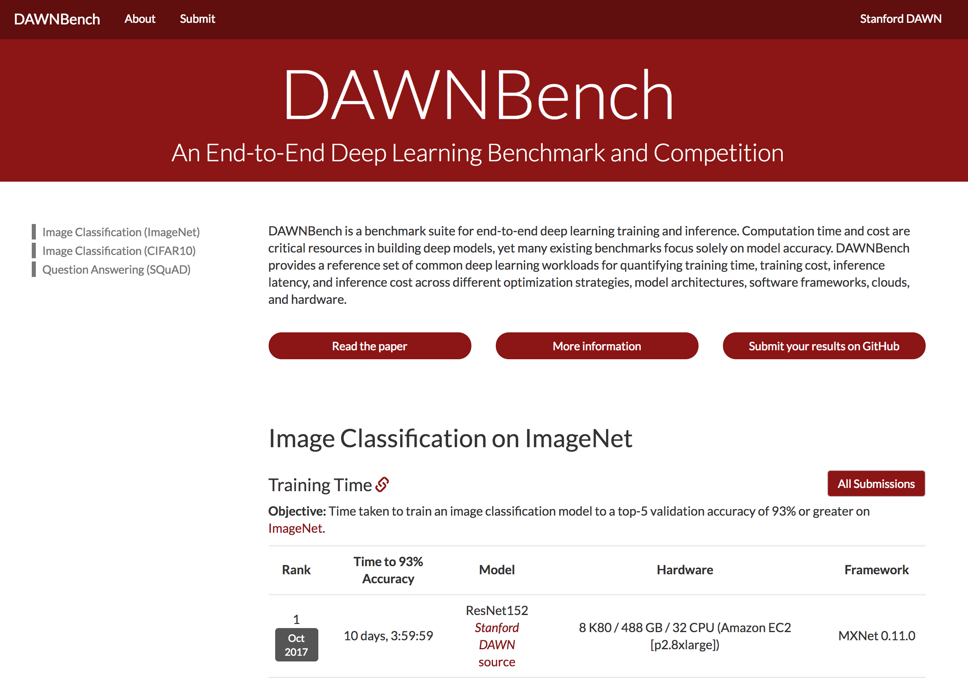
First benchmark to measure time and cost to get a state-of-the-art accuracy

Slide 28
First benchmark to measure time and cost to get a state-of-the-art accuracy
Our goal: measure end-to-end throughput subject to accuracy

Slide 29
As an initial release

Slide 30
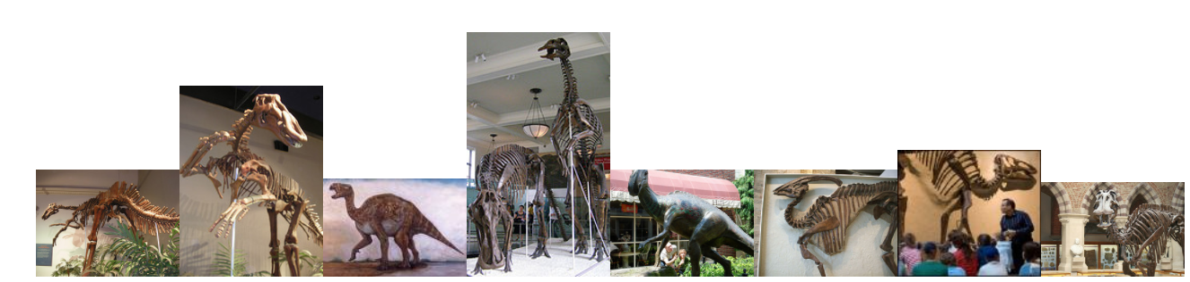
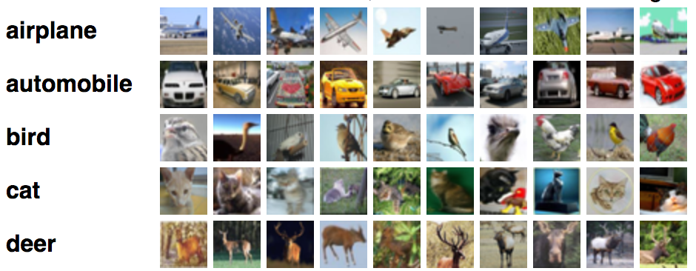
As an initial release
Tasks
Image classification
ImageNet
CIFAR10

Slide 31

As an initial release
Tasks
Image classification
ImageNet
CIFAR10
Question answering
SQuAD

Slide 32
For each task
Accuracy threshold
close to the state-of-the-art

Slide 33
For each task
Metrics
Training time
Training cost (USD)
Inference latency
Inference cost (USD)
Accuracy threshold
close to the state-of-the-art
Notes:
- Make line nice

Slide 34
The Competition
Deadline: April 20th, 2018 at 11:59 PM PST

Slide 35
The Competition
Deadline: April 20th, 2018 at 11:59 PM PST
Decide the winners for each metric on each task

Slide 36
The Competition
Deadline: April 20th, 2018 at 11:59 PM PST
Decide the winners for each metric on each task
Define the next set of tasks, thresholds, and metrics

Slide 37
dawn.cs.stanford.edu/benchmark

Slide 38
A first step, with more to follow
More tasks (e.g. machine translation, video classification)
More metrics (e.g. sample complexity, energy)
Join the discussion: bit.ly/dawnbench-community
Notes:
- Add website link

Slide 39

Conclusion
Deep learning methods are effective but computationally expensive, leading to a great deal of work to optimize their computational performance. Yet there is no standard evaluation criteria for end-to-end training and inference.
DAWNBench
End-to-End training and inference
Open to community submissions
Evolving tasks, thresholds, and metrics
Join the competition: dawn.cs.stanford.edu/benchmark

