Slide 1

Day 2:
To-Do App with Local Storage

Slide 2

DOM Elements :

Slide 3
Load tasks from
Local Storage :

Slide 4
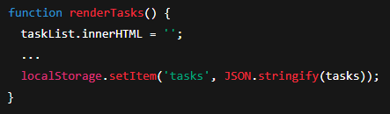
Display tasks :

Slide 5

Inside renderTasks() :
forEach loop

Slide 6
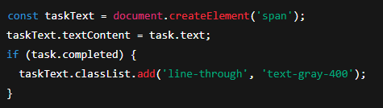
Inside renderTasks() :
task.text

Slide 7
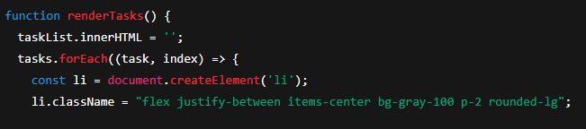
Inside renderTasks() :

Slide 8
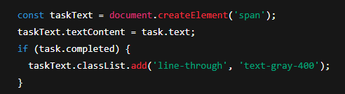
Inside renderTasks() :

Slide 9
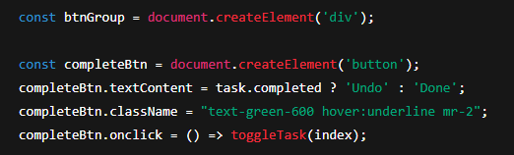
Inside renderTasks() :

Slide 10
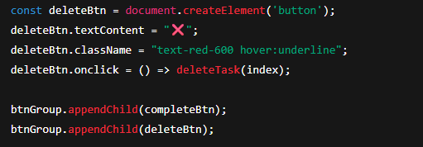
Inside renderTasks() :

Slide 11
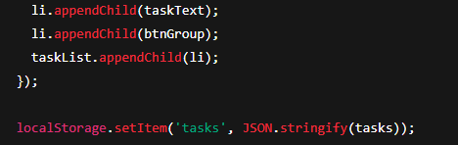
Inside renderTasks() :

Slide 12

Button creation :

Slide 13
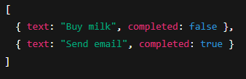
Save to LocalStorage :

Slide 14
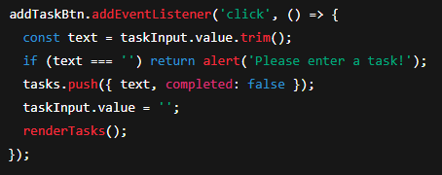
Add Task Button :

Slide 15
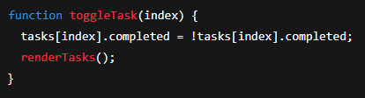
Toggle Task :

Slide 16
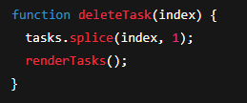
Delete Task :

Slide 17
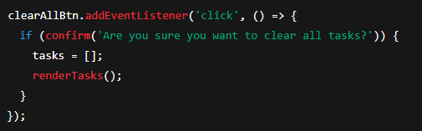
Clear All Button :

Slide 18

Initial Render :

