Slide 1













Emergence of Artificial Intelligence
Seminar by Namish Kumar

Slide 2
Introduction to AI
Artificial Intelligence (AI) means machines simulating human intelligence
AI is becoming a part of our daily lives and industries
It is changing how we work, learn, and interact
The future of AI promises more powerful and smarter systems
It’s important to understand both its possibilities and risks
This esentation explores key advancements and ethical concerns

Slide 3
Natural Language Processing
01.
Recent advancements in AI
Image and Speech recognition
02.
Autonomous Vehicles, advanced robotics
03.

Slide 4
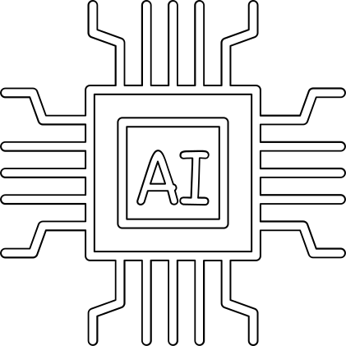
Emerging AI Technologies
★ Artificial General Intelligence (AGI)
★ AI powered drug - discovery
★ Brain - Computer Interfaces (BCI)
★ Quantum computing in AI.
★ Emotion and sentiment recognition

Slide 5
AI In Daily Life
01
02
03
04
Virtual Assistants (e.g. Siri, Alexa)
Personalised
recommendations
(Netflix, Amazon)
Smart home devices
AI in navigation and maps, language translation

Slide 6






Healthcare, disease detection, virtual health assistance, Increasing life expectancy of people
Education, AI Tutors, Adaptive Learning
AI in Industries
Finance, risk analysis, automated trading
Manufacturing, Robotics, process optimization
Agriculture, Smart Farming, Pest detection

Slide 7
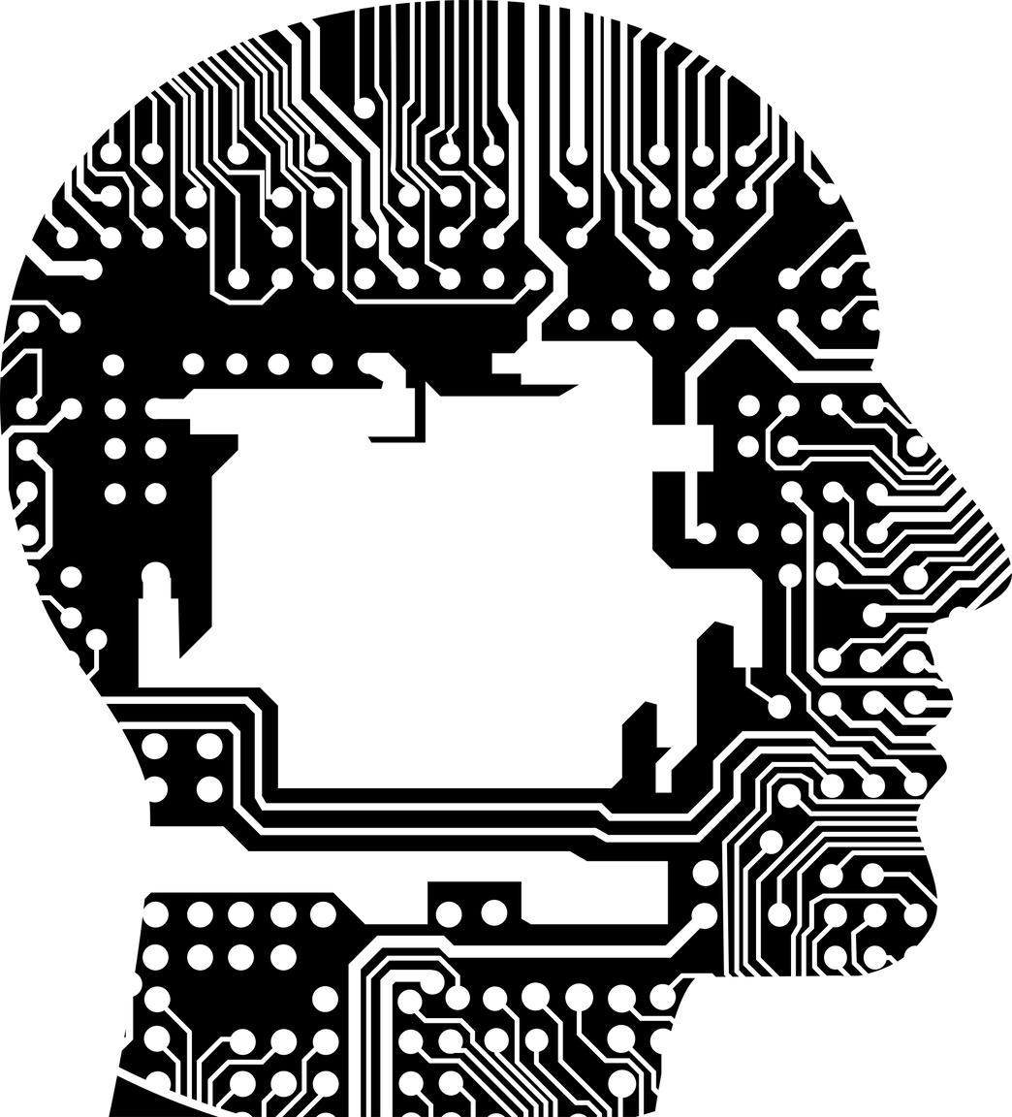
Vulnerabilities of AI
★ Can produce Biased / unfair results
★ Easily Manipulated with incorrect data
★ Lack of transparency in decision making
★ Dependence on AI will reduce human skills

Slide 8

Risks possessed by AI
★ Job displacement and unemployment
★ Misuse in welfare (e.g. Autonomous weapons)
★Ethical concerns in decision making
★ Uncontrolled AI surpassing human intelligence

Slide 9
Thank you very much!

