Slide 1

Note: The data and information in this document is reflective of a hypothetical situation and client. This document is to be used for KPMG Virtual Internship purposes only.
Sprocket Central Pty Ltd
Data analytics approach
Ravi Kumar

Slide 2
Note: The data and information in this document is reflective of a hypothetical situation and client. This document is to be used for KPMG Virtual Internship purposes only.
Agenda
Introduction
Data Exploration
Model Development
Interpretation

Slide 3
Note: The data and information in this document is reflective of a hypothetical situation and client. This document is to be used for KPMG Virtual Internship purposes only.
Introduction
Recommendation of Top 1000 Customers to Target
Outline of Problem
Sprocket Central is a company that specializes in high-quality bikes and cycling accessories.
Their marketing team is looking to boost business sales by analysing provided datasets.
Using these 3 datasets we have to analyse and recommend 1000 customers that the company should target.
What we have to Analyze :
‘New’ and ‘Old’ Customer Age Distribution
Bike related purchases over the last 3 years by gender
Job industry distributions
Wealth segmentation by age category
Number of cars owned and not owned by state
RFM analysis and customer classification

Slide 4
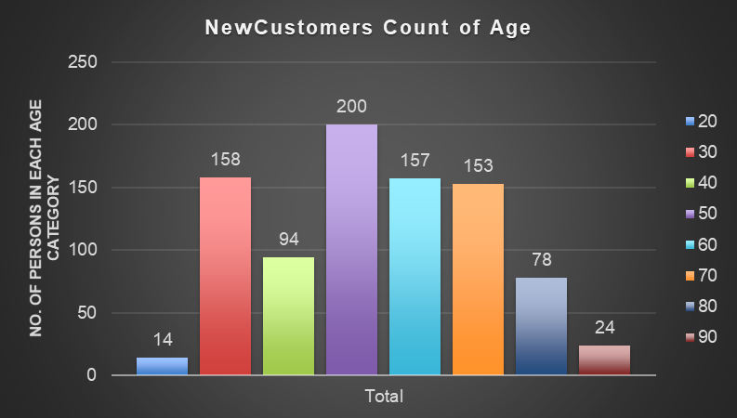
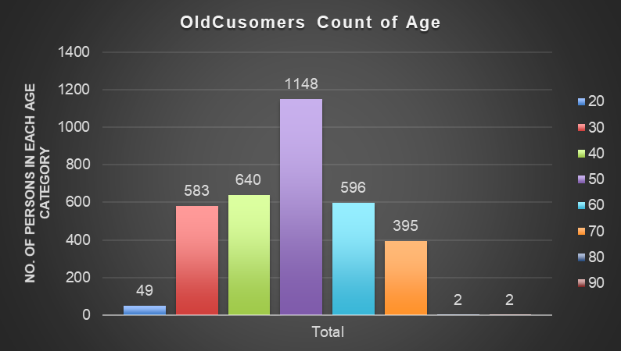
Note: The data and information in this document is reflective of a hypothetical situation and client. This document is to be used for KPMG Virtual Internship purposes only.
Data Exploration
‘New’ and ‘Old’ Customer Age Distributions
The lowest age groups are under 20 and 80+ for both ‘New’ and ‘Old’ customer lists.
The ‘New’ customer list suggests that age groups 20-29 and 40-69 are most populated.
Most customers are aged between 40-49 in ‘New’. In ‘Old’ majority customers are aged between 40-49 also.
There is a steep drop of customers in the 30-39 age group in ‘New’

Slide 5
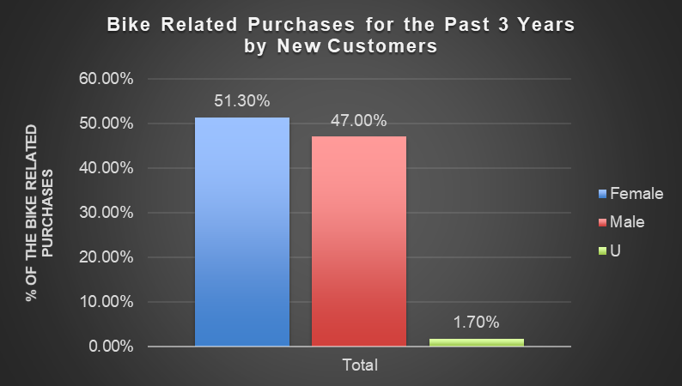
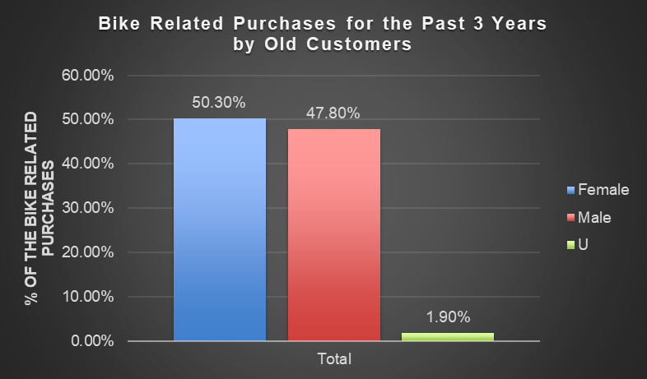
Note: The data and information in this document is reflective of a hypothetical situation and client. This document is to be used for KPMG Virtual Internship purposes only.
Data Exploration
Bike related purchases over last 3 years by gender
Over the last 3 years about 50% of bike related purchases were made by females to 47% of purchases made by males. Approx 1.70% were made by unknown gender.
Females make up majority of the bike related sales.

Slide 6
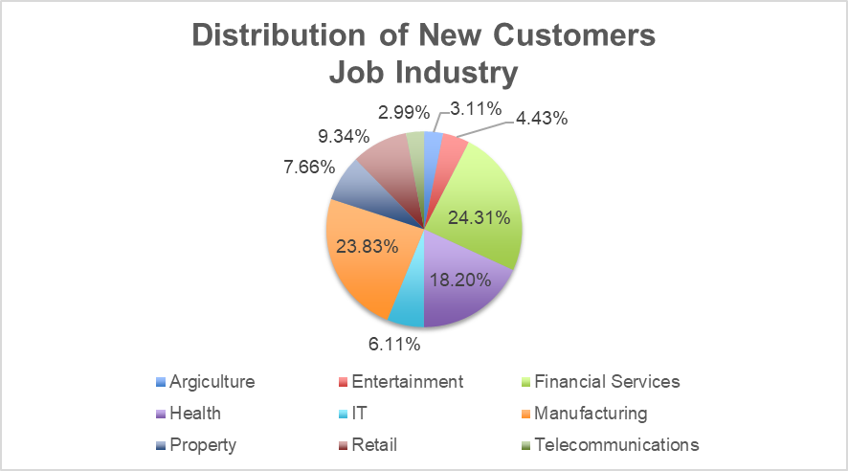
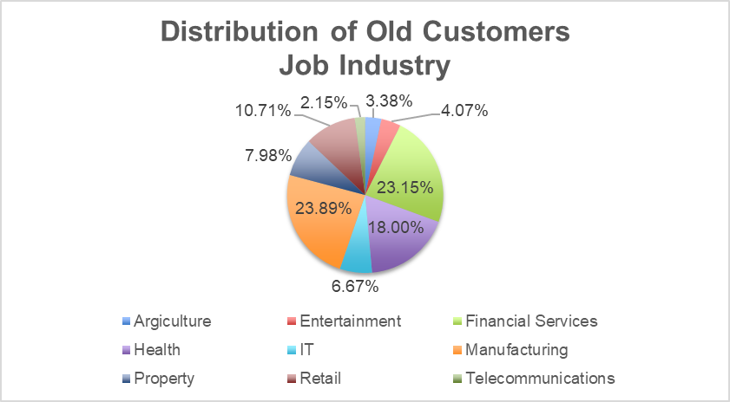
Note: The data and information in this document is reflective of a hypothetical situation and client. This document is to be used for KPMG Virtual Internship purposes only.
Data Exploration
Job Industry Distribution
24% of ‘New’ Customers are in Manufacturing and Financial Services.
The lowest no. of customers are in Agriculture and Telecommunication at 3%
Similarly pattern in ‘Old’ customer list, at 24% and 23% in Manufacturing and Financial Services respectively

Slide 7
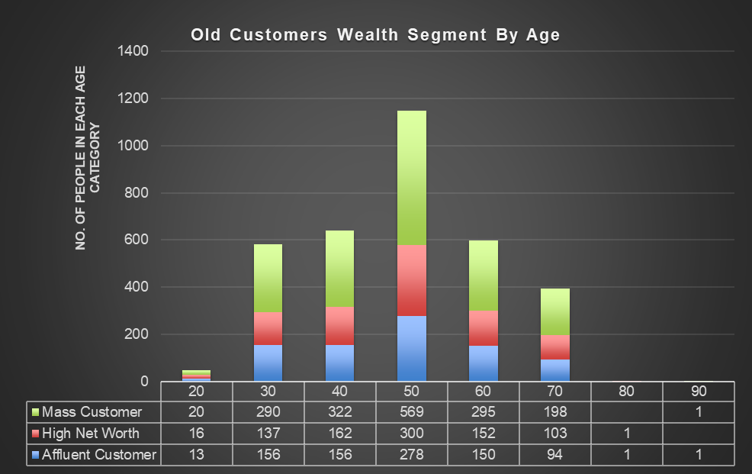
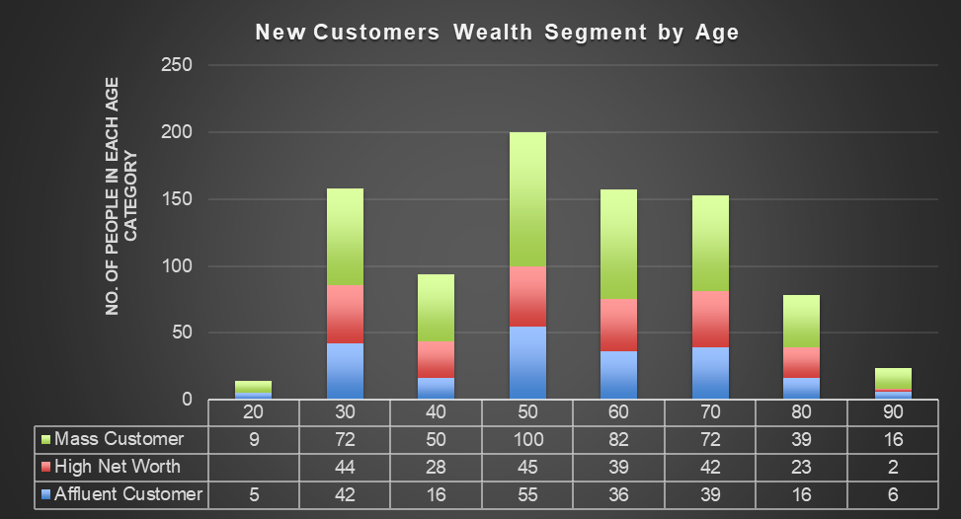
Note: The data and information in this document is reflective of a hypothetical situation and client. This document is to be used for KPMG Virtual Internship purposes only.
Data Exploration
Wealth Segmentation by age category
The next category is the ‘High Net Worth’ customers
In all age categories the largest no. of customers are classified as ‘Mass Customr’
The ‘Affluent Customer’ can outperforms the ‘High net Worth’ customer in the 40-49 age group.

Slide 8
Note: The data and information in this document is reflective of a hypothetical situation and client. This document is to be used for KPMG Virtual Internship purposes only.
Data Exploration
Number of cars owned and not owned by state
NSW has the largest amount of people the do not own a car. NSW seems to have higher number of people from which data was collected.
Victoria is also split quite evenly. But both numbers are significantly lower than those of NSW.
QLD has a relatively high number of customers that own a car.

Slide 9
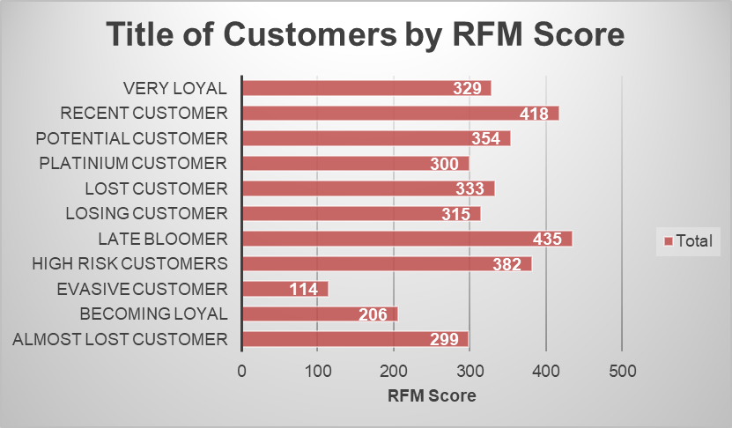
Note: The data and information in this document is reflective of a hypothetical situation and client. This document is to be used for KPMG Virtual Internship purposes only.
Model Development
RFM Analysis and Customer Classification
RFM analysis is used to determine which customers , a business should target to increase its revenue and value.
The RFM ( Recency, Frequency and Monetary) model shows customers that have displayed high levels of engagement with the business in the three categories mentioned.

Slide 10
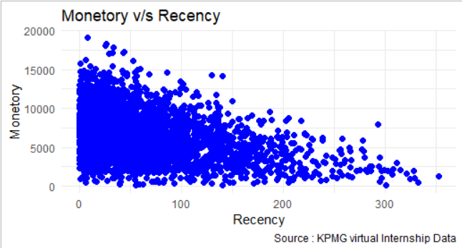
Note: The data and information in this document is reflective of a hypothetical situation and client. This document is to be used for KPMG Virtual Internship purposes only.
Model Development
Scatter-Plot based on RFM Analysis
Customers from recent past (50-100 days) also show to generate a moderate amount of revenue.
The chart shows that customers who purchased more recently have generated more revenue, than customer who visited a while ago.
Those who visited more than 200 days ago generate low revenue.

Slide 11
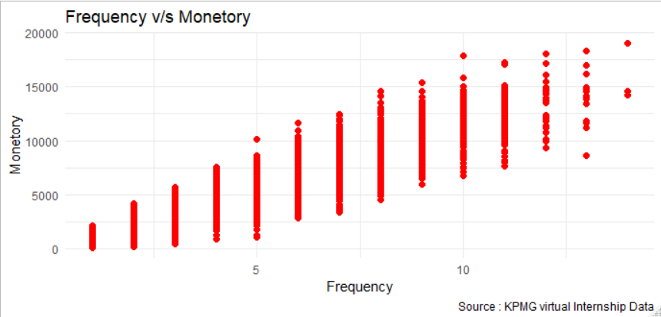
Note: The data and information in this document is reflective of a hypothetical situation and client. This document is to be used for KPMG Virtual Internship purposes only.
Model Development
Scatter-Plot between Frequency and Monetary
There is a positive relationship between frequency and monetary gain for the business.
Customer classified as “Platinum Customer”, ”Very Loyal,” and “Becoming Loyal” visit frequently which correlated with increased revenue for the business

Slide 12
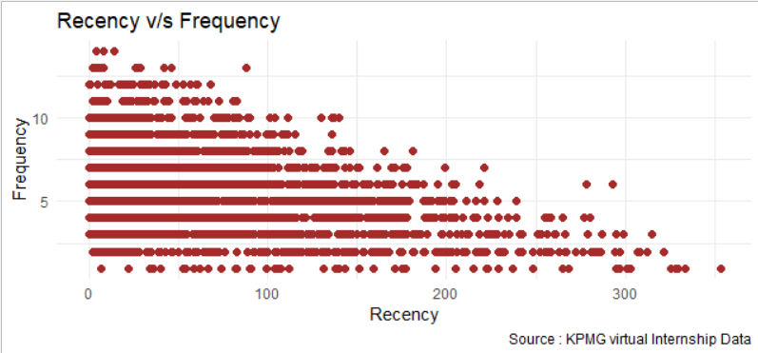
Note: The data and information in this document is reflective of a hypothetical situation and client. This document is to be used for KPMG Virtual Internship purposes only.
Model Development
Scatter-Plot between Frequency and Recency
Higher frequency has a negative relationship with recency values. Such that very recent customers are also frequent customers.
Very low frequency of 0-2 correlated with high recency values i.e More than 250 days ago.
Customers that have visited more recently (0-50 days) have a higher chance of visiting more frequently.

Slide 13
Note: The data and information in this document is reflective of a hypothetical situation and client. This document is to be used for KPMG Virtual Internship purposes only.
Interpretation
Table Summary of top 1000 Customers to Target
Rank | Customer Title | Description | No. of Customers | Cumulative | Customer Selection
1 | Platinum Customer | Most recent buy, buys often, most spent | 176 | 176 | 176
2 | Very Loyal | most recent, buys often, spends large amount of money | 184 | 360 | 184
3 | Becoming Loyal | relatively recent, bought more than once, spends large amt of money | 344 | 704 | 344
4 | Recent Customer | bought recently, not very often, avg. amt spent | 368 | 1072 | 296
5 | Potential Customer | bought recently, never bought before, spent small amt | 355 | 1427 | 0
6 | Late Bloomer | no purchase recently, but RFM value is large than avg. | 333 | 1760 | 0
7 | Losing Customer | purchases was a while ago, below avg. RFM value | 356 | 2116 | 0
8 | High Risk Customer | purchases was long time ago, frequency is quite high, amt spent is high | 360 | 2476 | 0
9 | Almost Lost Customer | very low recency, low freq. but high amt spent | 326 | 2802 | 0
10 | Evasive Customer | very low recency, very low frequency, small amount spent | 401 | 3203 | 0
11 | Lost Customer | very low RFM | 290 | 3493 | 0

Slide 14
Note: The data and information in this document is reflective of a hypothetical situation and client. This document is to be used for KPMG Virtual Internship purposes only.
Interpretation
Customer Target And Methodology
Rank | Customer Title | Description | No. of Customers | Cumulative | Customer Selection
1 | Platinum Customer | Most recent buy, buys often, most spent | 176 | 176 | 176
2 | Very Loyal | most recent, buys often, spends large amount of money | 184 | 360 | 184
3 | Becoming Loyal | relatively recent, bought more than once, spends large amt of money | 344 | 704 | 344
4 | Recent Customer | bought recently, not very often, avg. amt spent | 368 | 1072 | 296
Filter through the top 1000 customers by assigning the conditions discussed in the table above.
The 1000 customers discovered would have bought recently, they have bought very frequently in the past and tend to spend more than other customers.

Slide 15
Note: The data and information in this document is reflective of a hypothetical situation and client. This document is to be used for KPMG Virtual Internship purposes only.
Appendix

Slide 16
Note: The data and information in this document is reflective of a hypothetical situation and client. This document is to be used for KPMG Virtual Internship purposes only.
Appendix
This is an optional slide where you may place any supporting items.

