Slide 1

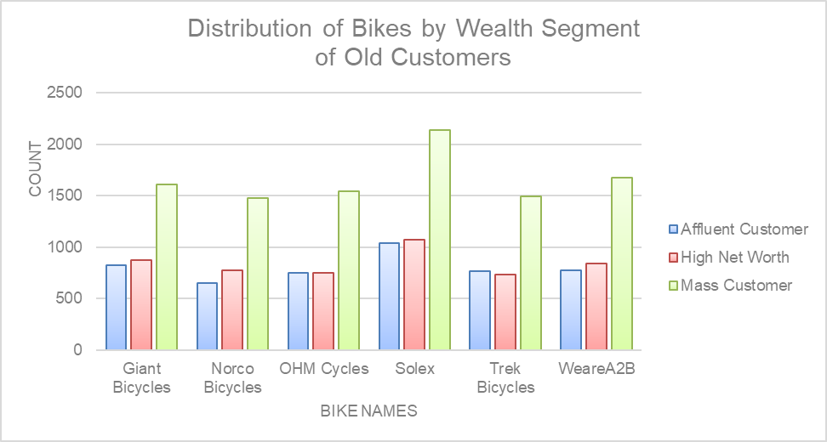
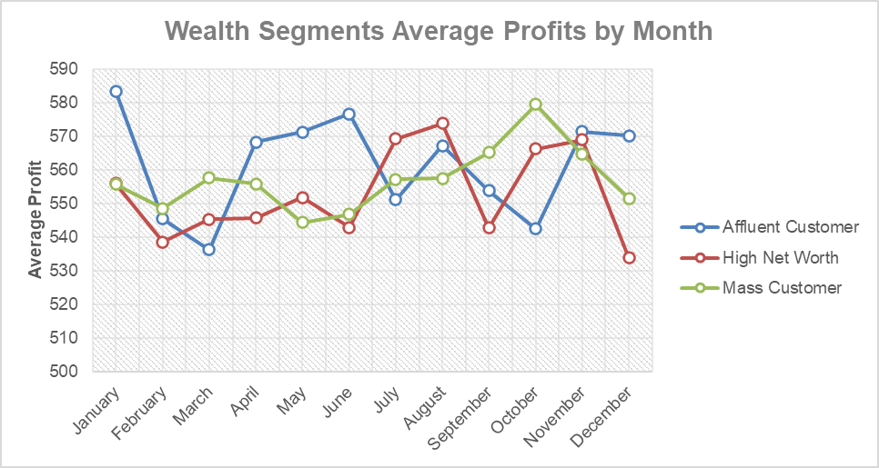
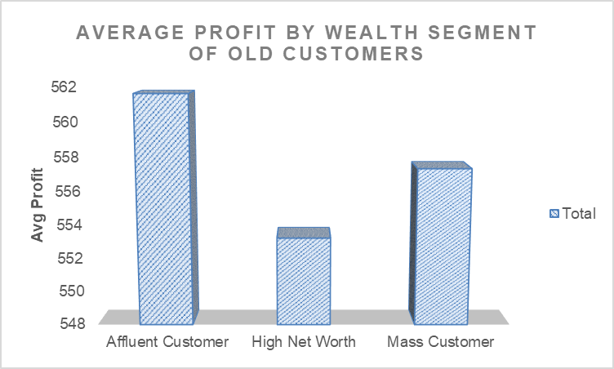
We can note the months in which the avg profit is high i.e January, June, October etc
Mass Customer are the most frequent buyers.
Affluent Customer don’t buy that frequently but gives the highest Avg profit.

Slide 2
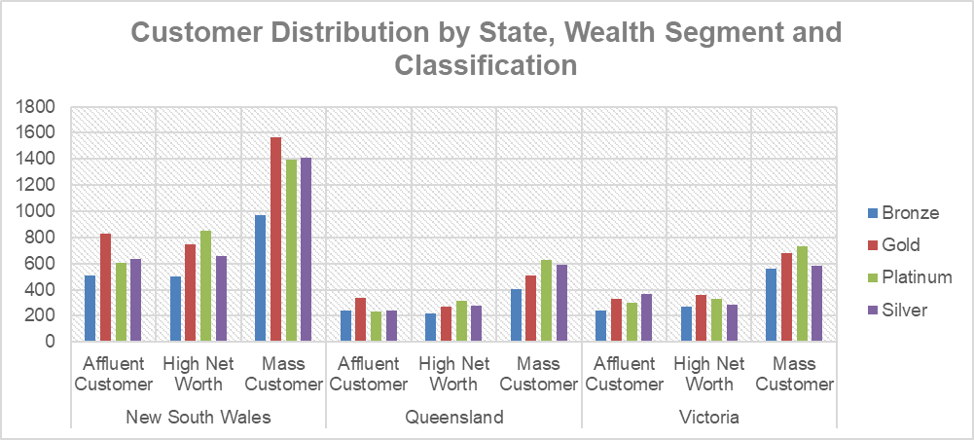
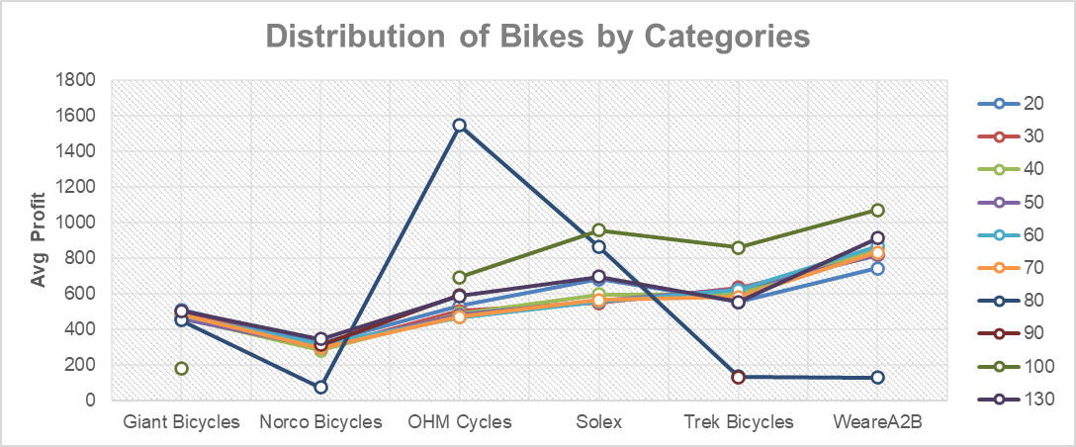
Focus Areas :
The highest no. of customers comes from New south wales .
Customers from Queensland are the least among the 3.
The customers that come under the Gold category are the most frequent buyers.
OHM Cycles which are most bought mainly by the 80 age category & Norco Bicycles, Trek Bicycles WeareA2B are among the least.
The customers in the 40 age category like Solex, Trek Bicycles, WeareA2B the most.
The profit on WeareA2B bikes is the maximum among the others.

