Slide 1
Group 3: eval-consensus-py
Radhika Dhawan, Jatin Sood, Rohit Aich
Performance Comparison Framework for Consensus Algorithms
Problem Statement:
Take the most used distributed consensus algorithms (e.g. vrPaxos, Raft) implementations in distalgo and compare their latency, throughput and memory requirements by a central performance logging system.
Analyze the data both statistically and visually, and draw inferences using the shiviz visualizations.
Performance comparison ideas based on the paper: “Performance Comparison Between the Paxos and Chandra-Toueg Consensus Algorithms” By Naohiro Hayashibara, Peter Urban and Andre Schiper”.

Slide 2
Solutions & Implementation
We calculated various performance metrics such as latency, throughput, CPU time and memory; consumed for both Multi-Paxos and Raft consensus algorithms under following empirical scenarios:
Experiments:
Servers: We observed patterns in performance metrics on changing number of servers (in case of raft) and number of acceptors (in case of Paxos) in the range of (3 to 11).
Operations: We also observed variations in performance of both paxos and raft by changing the number of requests per client..
Process Failure: We also tried to gather variations in performance metrics by failing one leader process in both the distalgo implementations of Paxos and Raft.

Slide 3
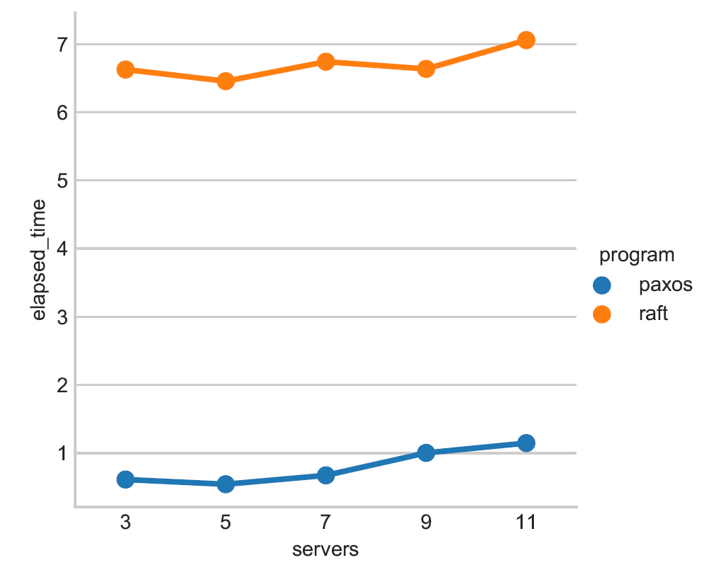
Few Interesting Results & Inferences
Latency: Raft has much more latency as compared to Paxos. Latency increases on increasing the number of processes (Servers in case of Raft & Acceptors in case of Paxos).

Slide 4
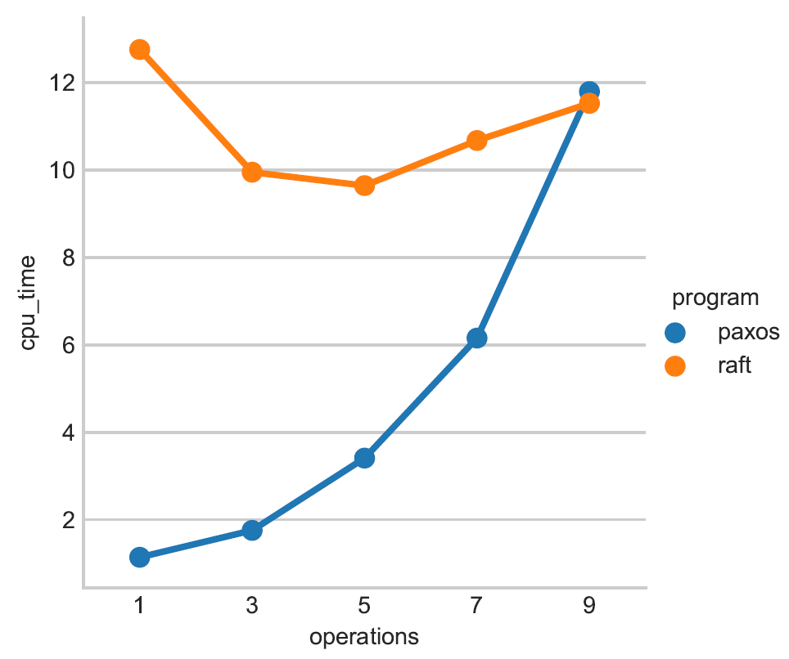
Few Interesting Results & Inferences
Throughput: Our results show that for higher number of operations, CPU time for Paxos increases at a steeper rate. The rate of increase of elapsed time is not so high in case of Raft.

Slide 5
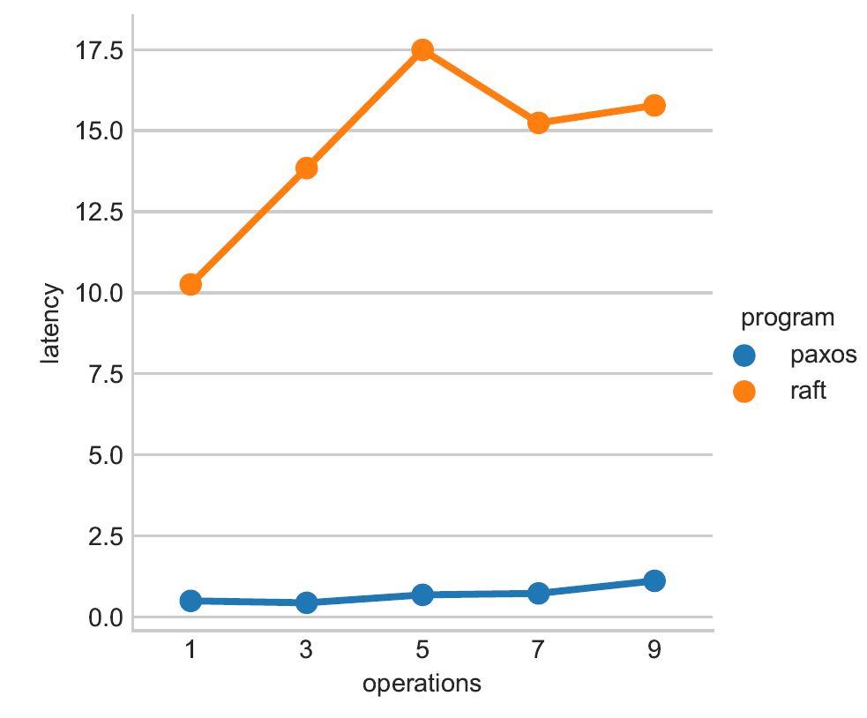
Few Interesting Results & Inferences
Process Failures: We checked how raft and paxos algorithms behave in case of process failures. Our performance graphs show that after killing a leader, Raft takes a lot of time to reach consensus.

Slide 6
Visual representation of multi-paxos based on our logs
As a demo, we present the visual representation of multi-paxos, generated by Shiviz based on our logging system.
Here we can see the interactions between different clients, acceptors, replicas, commanders and scouts.

