Slide 1
Email Traffic Forensics
SMTP
Traffic files: https://github.com/frankwxu/digital-forensics-lab/tree/main/Illegal_Possession_Images/lab_files/smtp.pcap
Notes:
https://www.youtube.com/watch?v=6G3qm60dfA8&ab_channel=PrashantThombre

Slide 2
Overview
Simple Mail Transfer Protocol
Hands-on lab
A .pcap file contains MS Outlook email traffic
Assume the traffic is decreased

Slide 3
Simple Mail Transfer Protocol

Slide 4







Simple Mail Transfer Protocol (SMTP)
It is a protocol used for sending and receiving email messages over the Internet.
SMTP
SMTP
IMAP
SMTP (Simple Mail Transfer Protocol): sending emails
IMAP (Internet Access Message Protocol): download emails

Slide 5
Simple Mail Transfer Protocol
SMTP operates on port 25 by default, but other ports such as 587 and 465 may also be used.
SMTP uses a set of commands and responses to transfer email messages between clients and servers.
SMTP is a plain text protocol
data transmitted between clients and servers is not encrypted by default.
SMTPS for secure email transmissions
SMTP over SSL/TLS
STARTTLS

Slide 6
SSL/TLS
SSL (Secure Sockets Layer) and TLS (Transport Layer Security) are cryptographic protocols that provide secure communication over the internet.
SSL is the predecessor to TLS, and is no longer considered secure.
Key security features
Authentication: SSL and TLS provide mechanisms for authenticating the identity of the client and server, so that both parties can be sure they are communicating with the intended party.
Data encryption: SSL and TLS encrypt data transmitted over the internet, so that it cannot be intercepted and read by unauthorized parties.
Data integrity: SSL and TLS ensure the integrity of data transmitted over the internet, so that it cannot be modified in transit without detection.

Slide 7
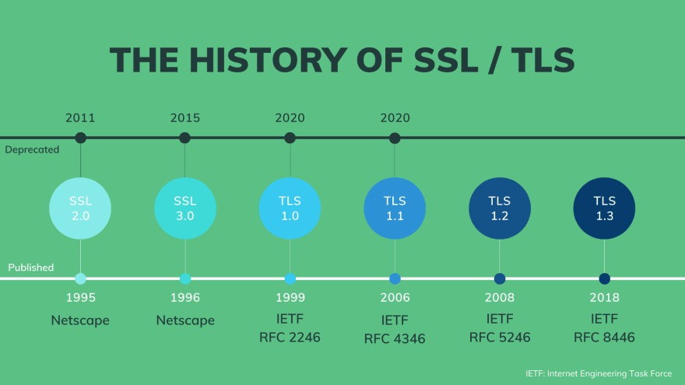
https://dev.to/techschoolguru/a-complete-overview-of-ssl-tls-and-its-cryptographic-system-36pd

Slide 8
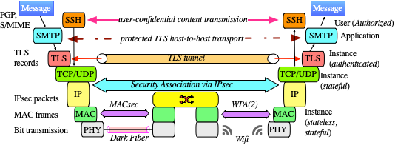
SMTP is an application layer protocol
https://www.fehcom.de/qmail/smtptls.html

Slide 9
Hands-on Lab

Slide 10
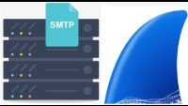
Capture Emails traffic With Wireshark

Slide 11
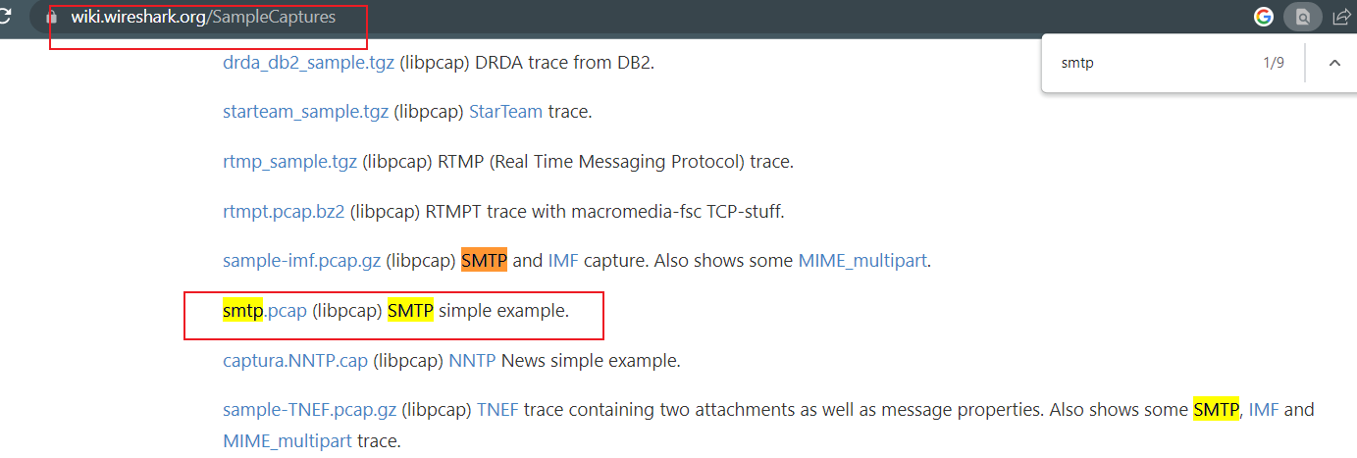
Lab Files
https://wiki.wireshark.org/SampleCaptures

Slide 12
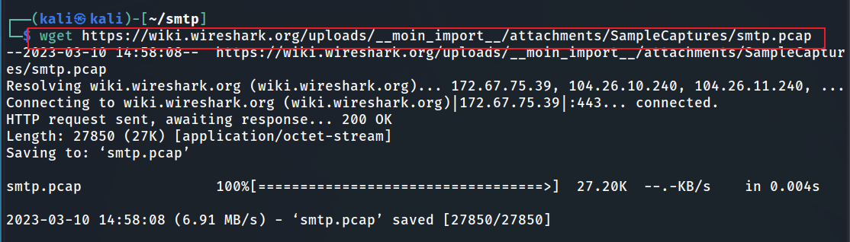
Download smtp.pcap
Notes:
wget https://wiki.wireshark.org/uploads/__moin_import__/attachments/SampleCaptures/smtp.pcap
https://raw.githubusercontent.com/frankwxu/digital-forensics-lab/main/Networking_Forensics/lab_files/smtp/smtp/pcap

Slide 13
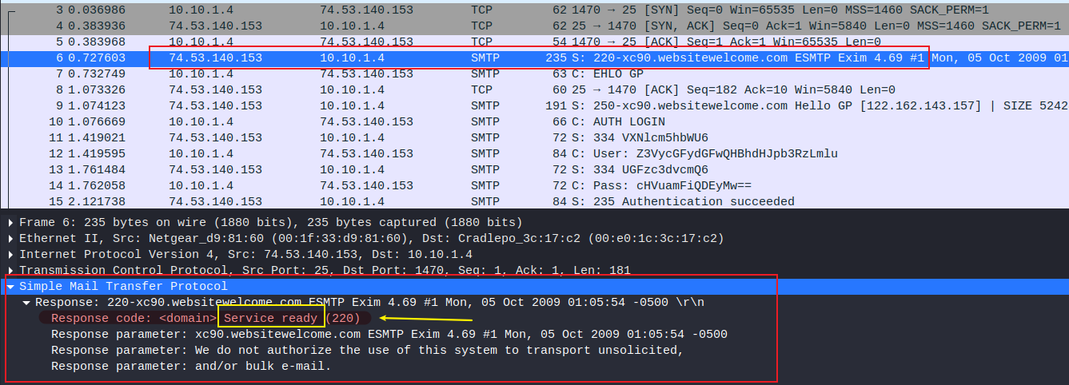
SMTP first response “service ready”
indicates that
the device is running an SMTP server and is ready to receive email messages.
additional information about the server and a warning that the server does not authorize the use of its system to send unsolicited or bulk emails.

Slide 14
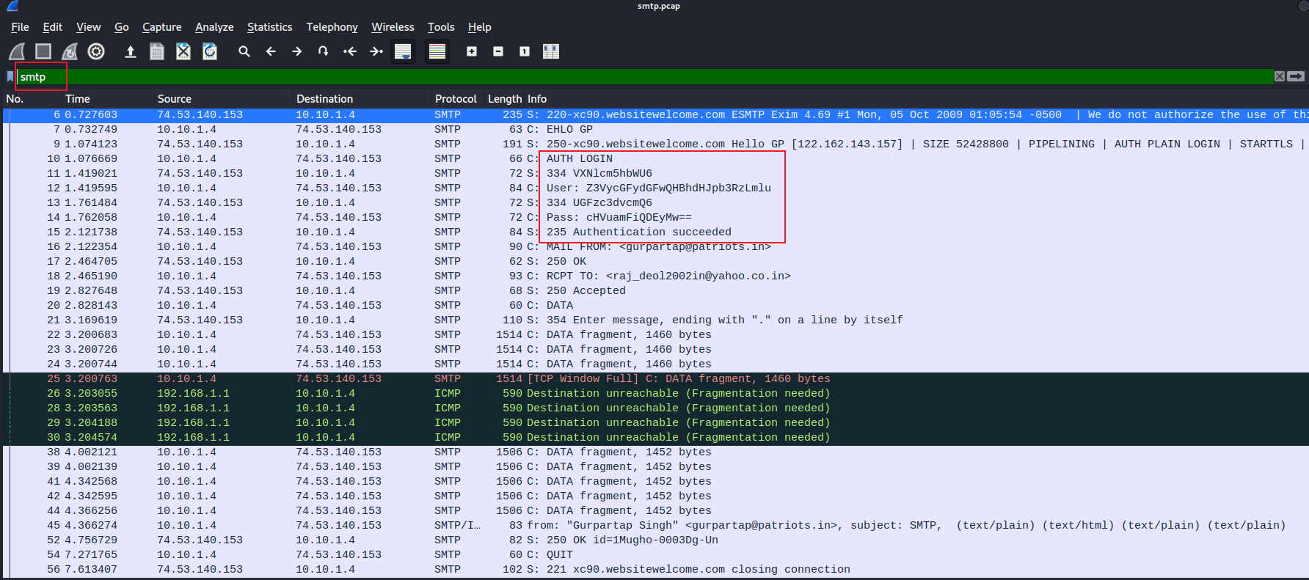
Username and password are base64 encoded

Slide 15
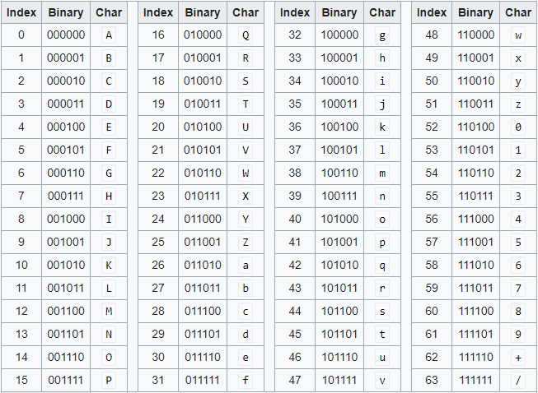
What is Base64 encoding
Base64 encoding is a way to represent binary data in a text format.
It is often used in email messages, HTML pages, and other types of text-based communication to transfer binary data such as images, audio files, or other types of non-text data.

Slide 16
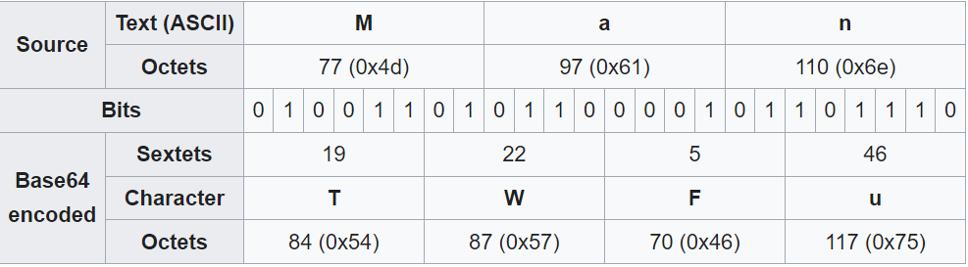
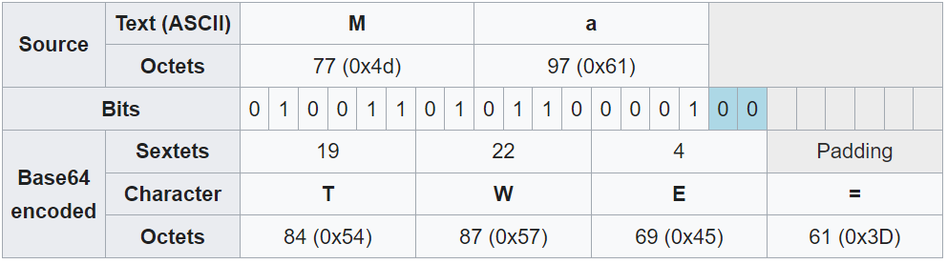
Conversion

Slide 17
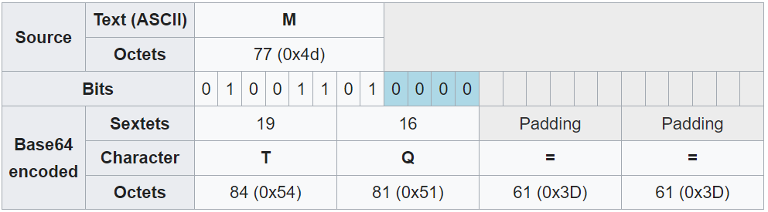

Slide 18
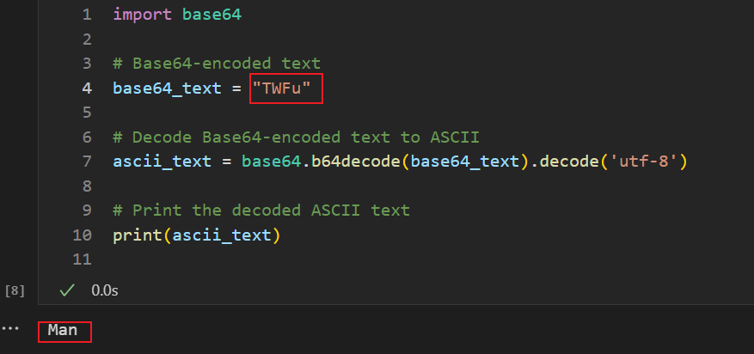
Decoding Based64 to text

Slide 19
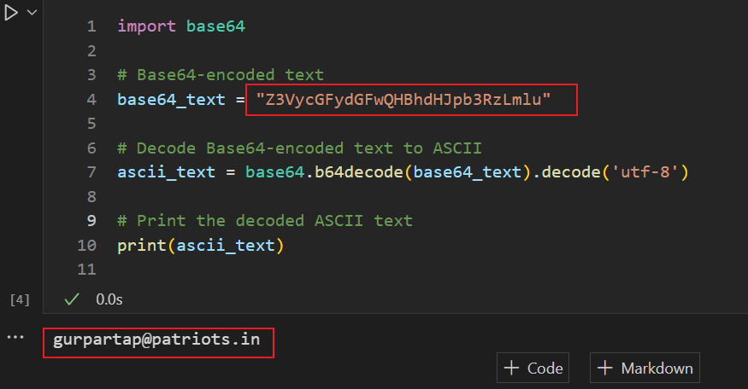
Decoding username
Notes:
import base64
# Base64-encoded text
base64_text = "Z3VycGFydGFwQHBhdHJpb3RzLmlu"
# Decode Base64-encoded text to ASCII
ascii_text = base64.b64decode(base64_text).decode('utf-8')
# Print the decoded ASCII text
print(ascii_text)

Slide 20
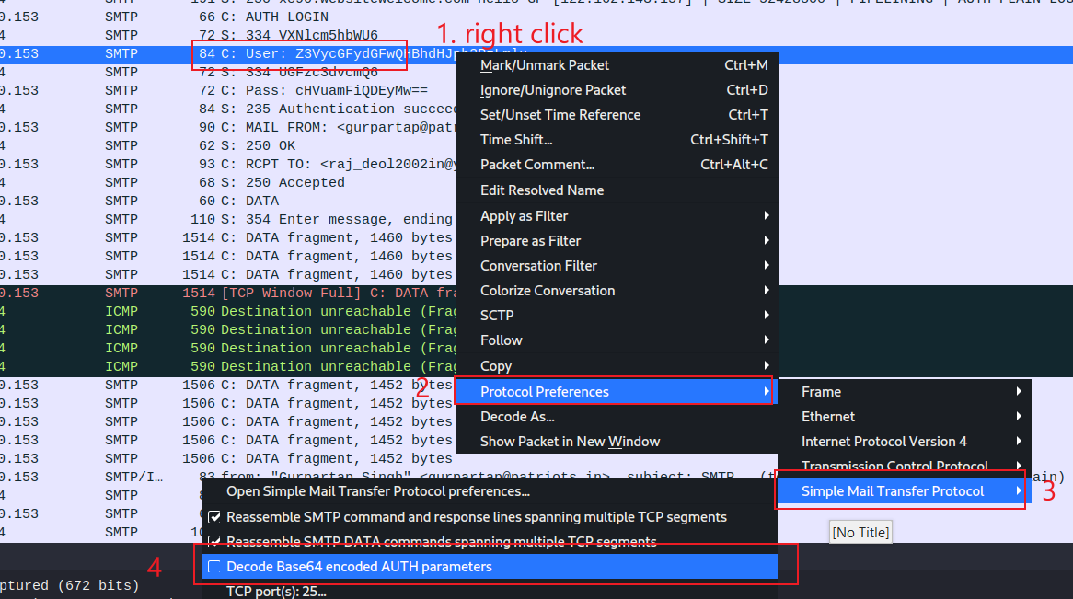

Slide 21
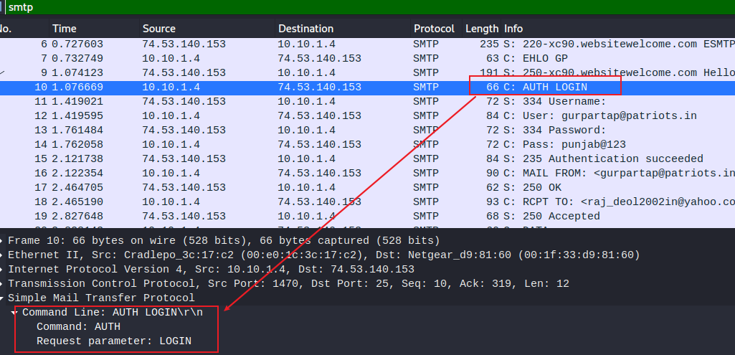

Slide 22
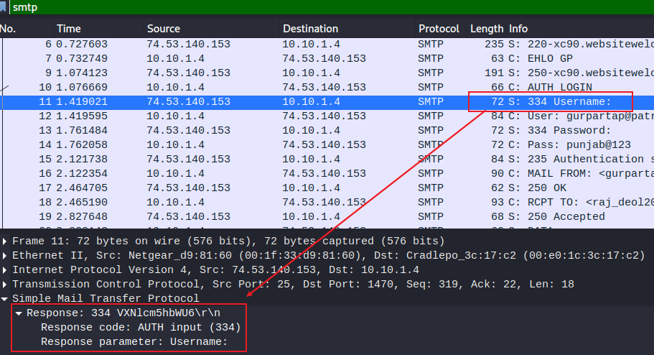

Slide 23
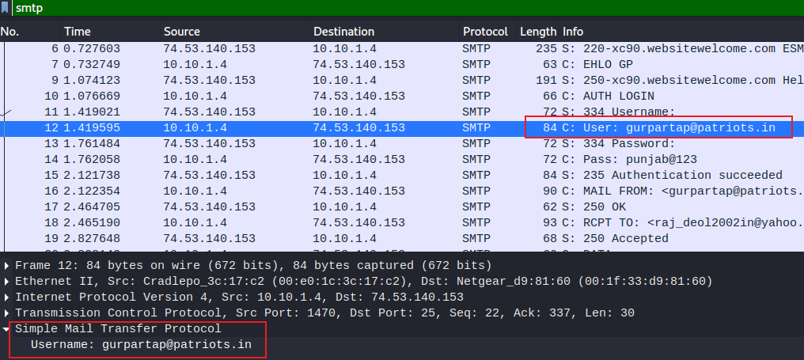

Slide 24
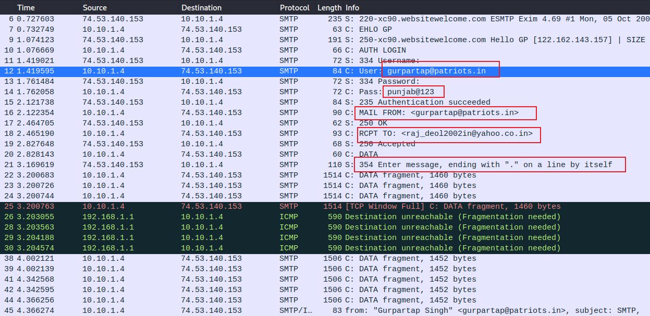
ignore them

Slide 25
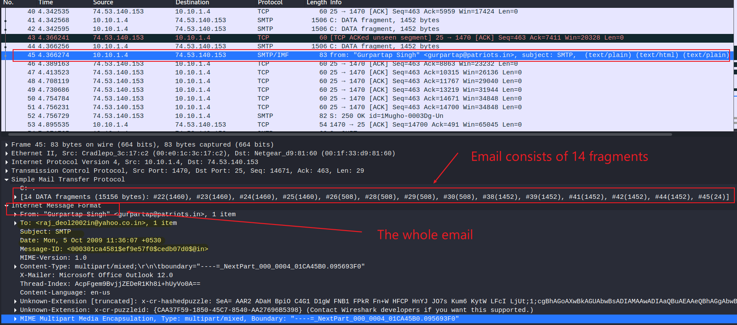
Show email content (14 fragments, Wireshark reassemble them at 45)
email client: office outlook 12.0

Slide 26
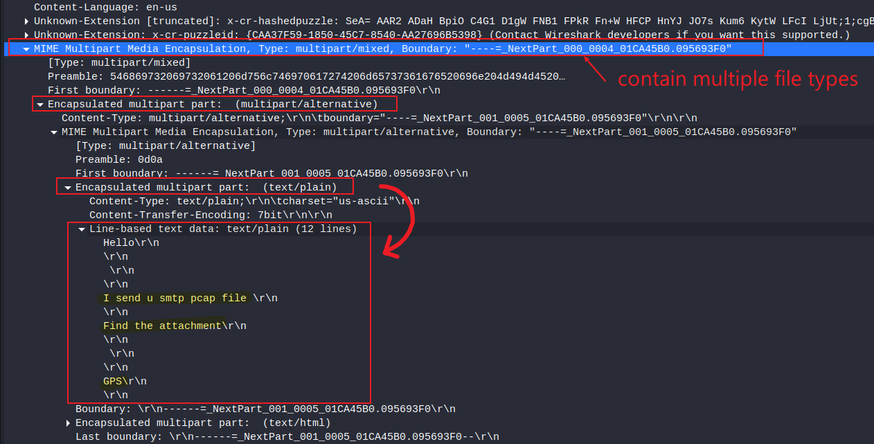
Show email content (text content)
first part

Slide 27
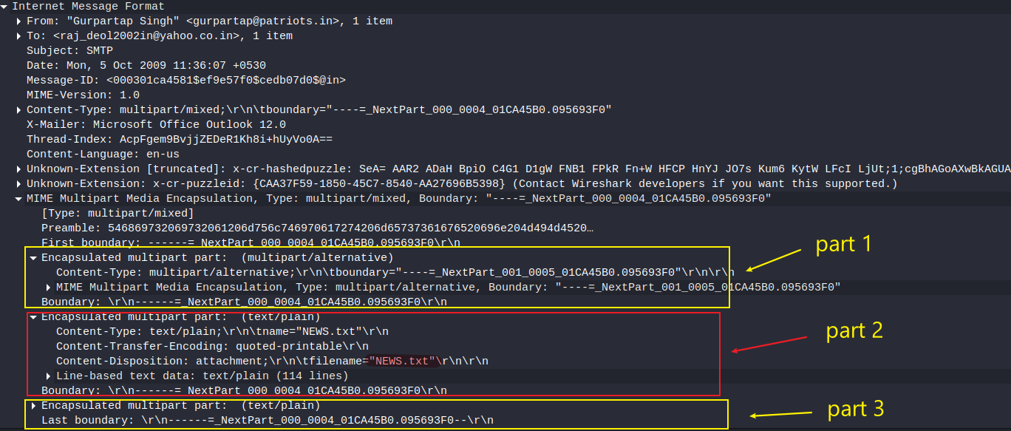

Slide 28
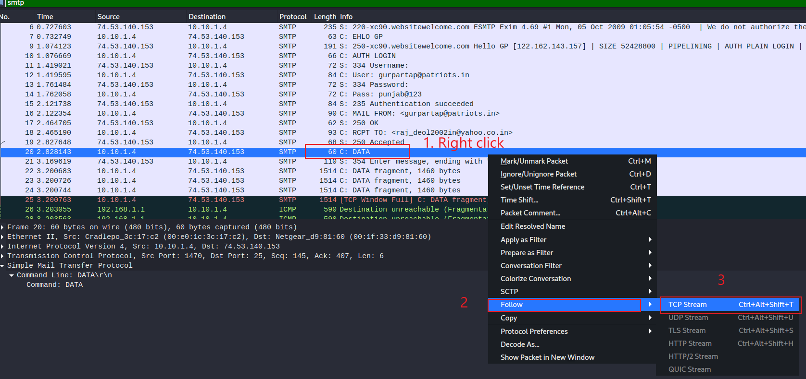
Show email content (Alternative approach: follow TCP)

Slide 29
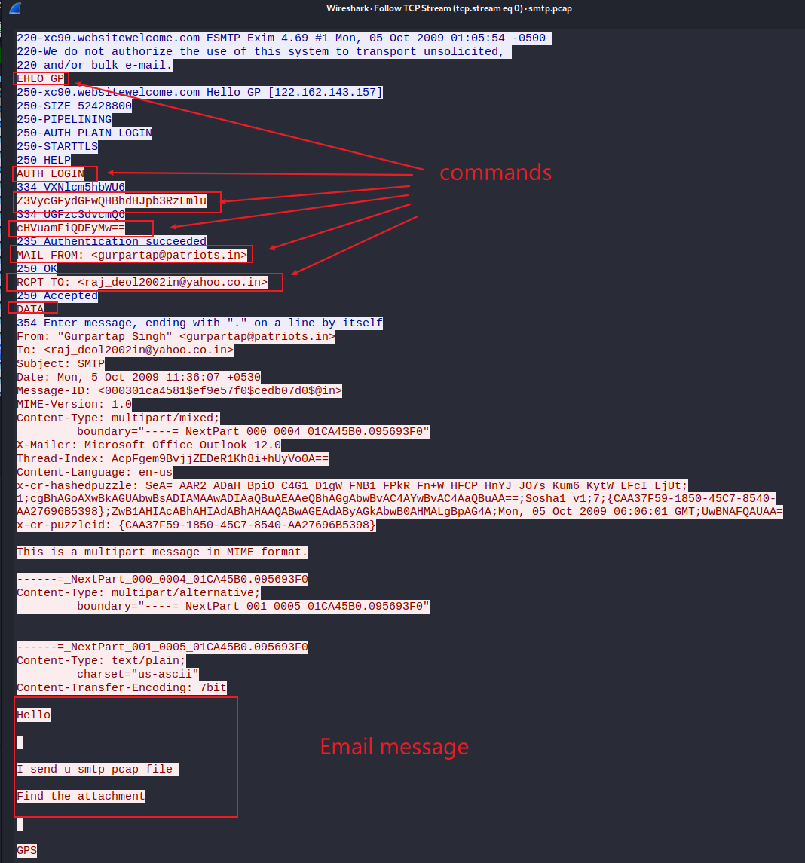

Slide 30
Questions you need to answer
When did it happen?
the timestamps email
The email client
outlook
The content of the email
multiple parts
What was the approach?
ports (sender and receiver)
IP addresses (sender and receiver)
Mac addresses (sender and receiver)

Slide 31
Extra credits
Sniff SMTP traffic

