Slide 1
Decentralized Storage
Daniel Maliro

Slide 2
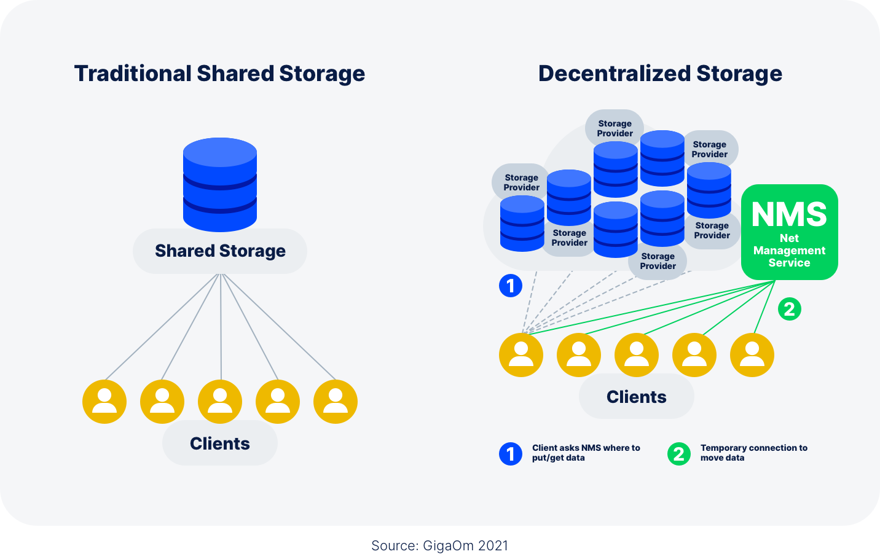
Introduction
Most information online:
Stored on big servers
Controlled by a single company
Risk of Censorship
Easy to block access

Slide 3
Advantages & Disadvantages of Centralized Storage
Advantages:
Centralized Servers are fast
Low latency
Disadvantages:
Location based addressing
If server is down you won’t get that file
Hackers always target big companies

Slide 4

Solution

Slide 5
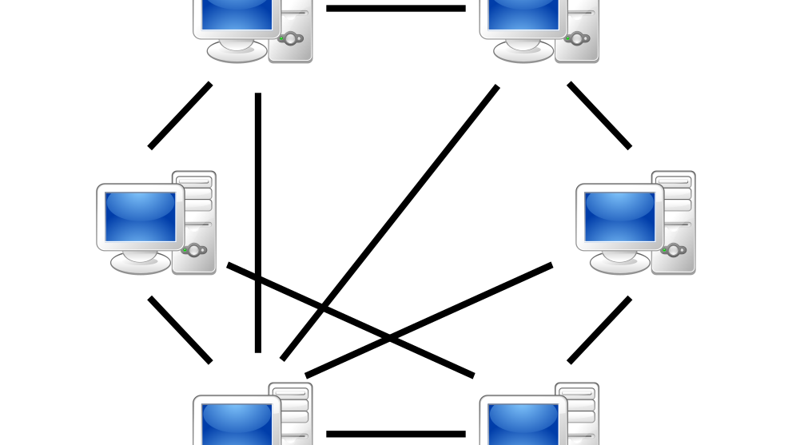
P2P Network
File sharing between different people across the web

Slide 6
P2P Networks
The intended system from the start of networks
There are no third-party your data has to go to, to get to its intended destination
Each device in a P2P acts like its own server
You are in control on where your data is sent and how its used

Slide 7
P2P Usage
Instead of using one big server we can use storage from peers to hold blocks of our data
Peers can partition or rent out storage just for having it be used like a server

Slide 8
Limitations
Keeping files available
If nodes go offline, it is unavailable

Slide 9
Blockchain
A chain of blocks that contain information
BitCoin
Distributed Ledger
Open to everyone
It is very difficult to change data once it is in a blockchain
Block
Data
Hash
Always unique
Changing something would change the hash
Hash of previous
Creates a chain of blocks
Tracks progress

Slide 10

Content-Based Addressing
Moves from location-based to Content-Based Addressing
Instead of Where you want to find something, you ask what you want to find

Slide 11

Data
Data
Data

Slide 12

Uses

Slide 13

Uses
BitCoin
IPFS
Block-Chain for IPFS (Filecoin)
Rent out storage and store nodes
Has to keep files online otherwise you won’t be reimbursed
Incentivize storing nodes
Proactively distribute files
Multiple copies of the same nodes will be on multiple places just in case the one person has their files offline

Slide 14
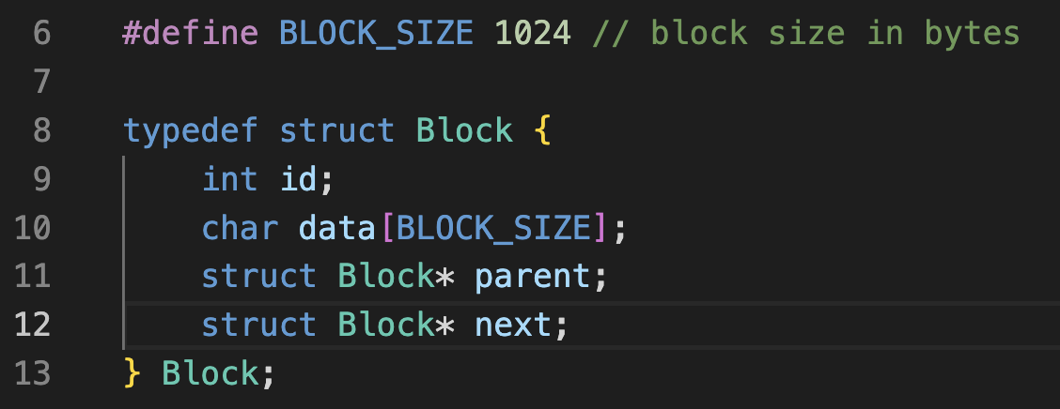
Code

Slide 15
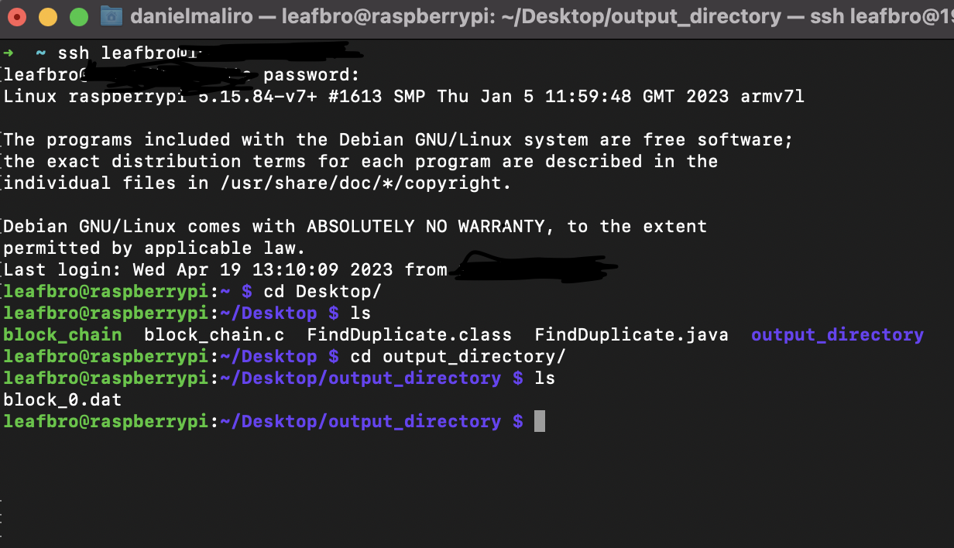
Connecting to another Computer

Slide 16
Future Work
Better Hashing Algorithm
Implement transfers with the Network
Encrypt Files and have the files contain the data needed to be identified

