Slide 1

Containers for Windows Developers
Cloud Develop - 2016
Presented By: someone that still plays with cars
Notes:
Do introduction

Slide 2
“If you could only sense how important you are to the lives of those you meet; how important you can be to the people you may never even dream of. There is something of yourself that you leave at every meeting with another person.”
FRED ROGERS
Notes:
Obligatory quote from someone famous. This seemed as good as anything else.

Slide 3

Setting Expectations
We’re going to focus on Windows Server 2016
Containers are specific to Server 2016
We’re not going to make you an expert
If you already know containers on Linux…
Notes:
We’re going to focus on Windows Server 2016
Over the last few years, Docker has popularized Linux containers, but Windows developers have been left out in the cold This changes with Windows Server 2016. At this session we'll cover the basics of the new Windows Server container model and how to develop applications/services that can take advantage of this exciting new advancement, for cloud, for on-prem, and for the future.
We’re not going to make you an expert
It’s a big topic and more than can be covered in an hour. And its also still evolving (Windows containers are still in preview).
If you already know containers on Linux…
If you’re familiar with containers on Linux, you can check email for the next 10-15 minutes, pay attention for 5-10 minutes (when I talk about Windows Server 2016), then go find another session if you like. ☺
image from: https://thetechbench.wordpress.com/category/client-expectations/

Slide 4

A Breakdown of containers
Started in Linux in 2003/2004
present, but not very usable
Docker made them popular starting June 2014
ease of use
Notes:
Started in Linux in 2003/2004.
Linux Containers (LXC) are an operating-system-level virtualization method for running multiple isolated Linux systems (containers) on a single control host (LXC host). It does not provide a virtual machine, but rather provides a virtual environment that has its own CPU, memory, block I/O, network, etc. space and the resource control mechanism.
Became popular around 2013
Docker provides an additional layer of abstraction and automation of operating-system-level virtualization on Linux. Docker uses the resource isolation features of the Linux kernel such as cgroups and kernel namespaces, and a union-capable file system such as aufs and others to allow independent "containers" to run within a single Linux instance, avoiding the overhead of starting and maintaining virtual machines.
Image Source: http://www.freefoto.com/preview/13-73-32/Southampton-Container-Terminal

Slide 5
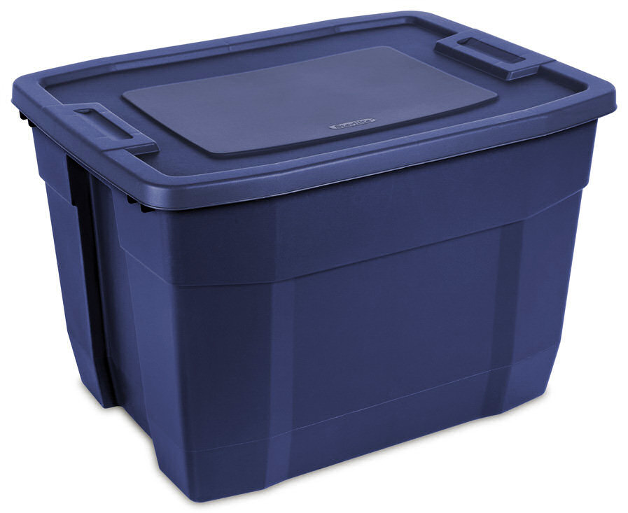
Docker Additions to Containers
Docker Container Image
layer, upon layer, upon layer, …
Image Repositories
hub.hub.docker.com
Notes:
Images
Docker introduced the notion of a “composable”, layered image. This allowed you to reuse other images to compose an image specific to your needs. Its follows a “configuration as code” approach using a simple syntax.
from: https://wiki.archlinux.org/index.php/Linux_Containers
Repositories
A library of reusable images. Repositories can be public (like http://hub.docker.com) or private. You’ll likely use a combination of repositories for your company workloads. i.e. a private repository for your organization’s images which builds upon images pulled from public repositories.
Image Source: http://www.sterilite.com/SelectProduct.html?id=772&picture=1&tab=Uses&ProductCategory=181&section=1

Slide 6

Key Components
Host OS
Where the container will run
Container Engine
How the container is run
Orchestrations
How multiple containers are managed
Notes:
Host OS
Where the containers will be run. This can be a physical or virtual machine. The Host OS has to have container technology present.
from: https://wiki.archlinux.org/index.php/Linux_Containers
Container Engine
Used to create, manage, and run your container images. Acts as an abstraction on top of the Host OS container features.
Orchestrations
Manage/coordinate individual containers across multiple hosts. This is how you “scale out”.
Image Source: http://jimenapulse.blogspot.com/2012/04/bunch-of-keys-found.html

Slide 7
Containers Offer
Fast Iteration
Resource Controls
Rapid Deployment
Defined State Separation
Immutability

Slide 8

Making Them Ideal For
Distributed Compute
Database
Web
$$f\left(x\right)$$
Scale Out
Tasks

Slide 9
Windows Server Container Hosts
Nano Server
Server Core
Highly Compatible
Highly Optimized
Born in the cloud applications
Traditional Applications

Slide 10
Nano Server: just enough OS
Optimized for next-gen distributed applications
Higher density and Reduced attack surface and servicing requirements
Next-gen distributed app frameworks
Interoperate with existing server applications
Third-party applications
RDS experience
Traditional VM workloads
Containers and next-gen applications
Full GUI
Specialized workloads
Server Core
Lower maintenance server environment
Nano Server
Just enough OS
Content © Microsoft
Notes:
Nano Server centers around the concept of “just enough OS”. Its been striped of as many dependencies as possible and optimized for next-gen applications and containers.
#click (show first column)
This gives you higher density and fewer patches while also reducing the attack footprint by removing unnecessary services. A secure, minimal environment for running applications. Its about 400mb on disk with no extra roles/features added. It is 64bit only.
#click (show second column)
Further up “the stack” is Server Core where you can run traditional workloads or container based applications.
#click (show third column)
And finally is the “full GUI” server with a desktop experience where you can host applications that require a GUI experience or perhaps need to host remote desktop services.

Slide 11
Windows Server Containers
Container Host
System Processes
Session Manager
Container Management
Local Security Authority
Windows Server Container
Windows Server Container
Docker Engine
Event Manager…
System Processes
Application Processes
System Processes
Application Processes
Compute Services
Etc…
Windows Kernel
Content © Microsoft
Notes:
One of the things that kind of interesting is that we have a couple of container runtimes. We’ll start with Windows Server Containers. These are very similar to the Linux container model. We have our Windows Kernel…
#click (container host box)
And a container host which has…
#click (system processes)
Set of system processes that you’re likely to see on any windows server.
#click (container management)
And then we have container management. Our compute services which is our layer of containers in the operating system. And the Docker engine.
#click (Windows Server Container)
When we actually start a container, what we’re doing is starting up a new “user mode” and put copies of each of those system processes in.
#click (Application Processes)
And then the application process, whatever you put on the “docker run” line. If it was an IIS web server, it would have it own w3wp process. The reason for this model is that without these processes, we couldn’t have isolation between containers. You couldn’t make your own user name as it would be shared by the host. This way its specific to the container. Now you’d think this would be somewhat heavy with all these extra processes. But we’ve actually done a great deal of optimization around memory and startup time such that we can start up a Nano Server container in about 1.15 seconds right now and our goal is to get this down to a second by the time Windows Server 2016 ships later this year. We think this is a pretty amazing startup time. We also haven’t seen much memory overhead from these processes, and they give us that high degree of isolation folks expect from containers.
#click (second Server Container)
And of course we can have multiple of these containers running side by side. Each representing their own set of “user mode” processes. This is a fairly traditional container model, but being Microsoft, we really aren’t satisfied with being traditional. So we came up with another model.

Slide 12
Hyper-V Containers
Container Host
System Processes
Virtual Machine Specifically Optimized To Run a Container
Session Manager
Hyper-V Container
Container Management
Local Security Authority
Windows Server Container
Docker Engine
Guest Compute Service
Event Manager…
System Processes
Application Processes
Compute Services
Basic System Processes
Etc…
Windows Kernel
Windows Kernel
Hyper-V Hypervisor
Content © Microsoft
Notes:
Hyper-V containers differ from Server Containers in that they start with the Hyper-V HyperVisor.
#click (Container Host)
Then we add a container host.
#click (Windows Kernel)
This contains the Windows Kernel
#click (System Processes)
The same set of System processes
#click (container management)
And our compute services and dicker engine. Much like we have with a Server Container Host.
#click (hyper-V Container)
But when we start a Hyper-V container, things starts to look different.
#click (Window Kernel)
The hyper-V container has its own copy of the Windows Kernel
#click (Basic System processes)
It has its own set of Basic System Process. This is a minimal set, just enough to launch
#click (Guest Compute Service)
The Guest Compute Service.
#click (Windows Server Container)
And a Windows Server Container.
#click (System Processes)
Which in turn then has its own set of System Processes
#click (Application Processes)
And application processes.
#click (Virtual Machine)
All this happens with a specially purposed Virtual Machine. This virtual machine has only one purpose in being, to run a container. We did this so that we get the same isolation boundaries that a traditional virtual machine has. If, unbelievably, someone were figure out some weird way to get outside of the container and mess with the kernel, they could crash themselves, but would be unable to hurt anyone else. This also means we have kernel independence, we could run different versions of the kernel. We could run the app on different versions of the operating system and all sorts of interesting things we’ll get into later.

Slide 13

Operating System Deployment Modes
Windows Server Containers
Container must match host (i.e. Nano on Nano) will be relaxed in the future…
Hyper-V Containers
Container must be Nano Server. Server Core support coming…
Host can be Nano Server, Windows Server Core or Windows Server w/Desktop
Container
Container Host
Nested Virtual Machine
Container
Container Host
Virtual Machine Host
Physical Server
Physical Server
Content © Microsoft
Notes:
So a couple notes on the deployment model…
With Windows Server Container, the container must be matching the host. If I’m running a Nano Container, it must be running on a Nano Container Host. Server Core must be on Server Core. We’re working to relax this for the General Availability of Windows Server 2016, but at least through Technical Preview 5, this will be the case.
With Hyper-V containers, we currently only support Nano Server containers, at least through TP5. Server Core support will arrive by the time Server 2016 GA’s. However, the host can be anything we want… Nano Server, Server Core, or even Windows Server/Desktop. This is because the hyper-v container has its own, independent copy of the kernel.

Slide 14


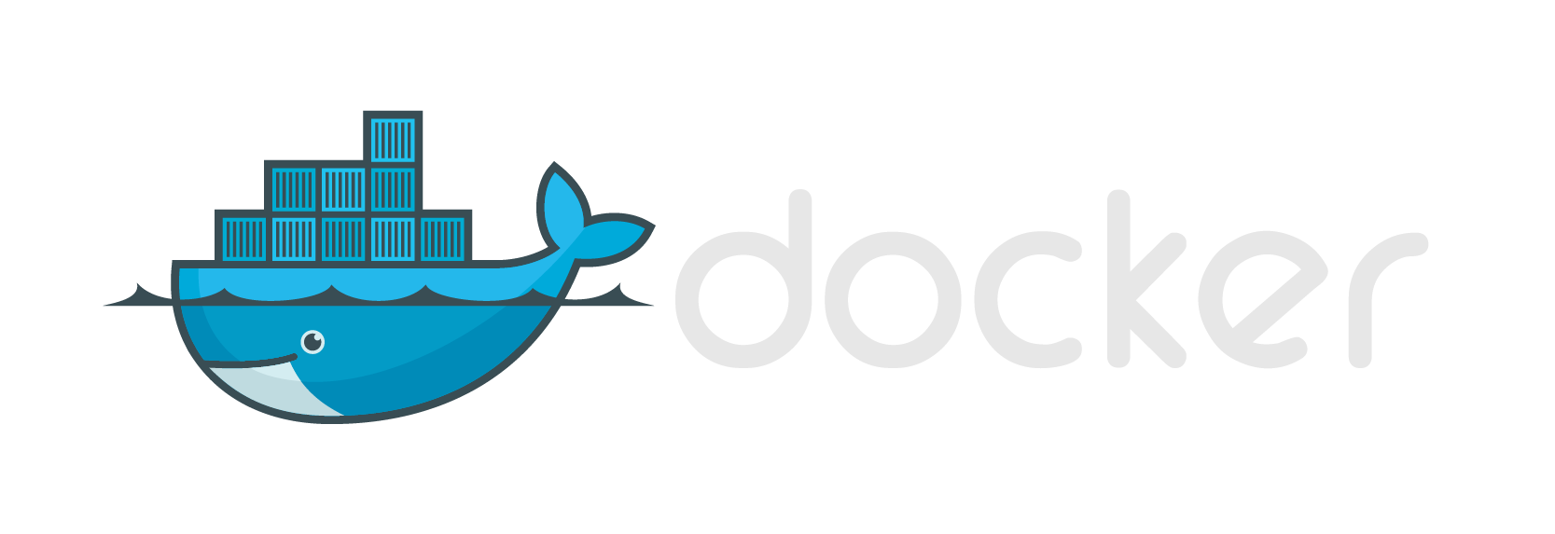






Modern App Development, Flexible Isolation
Windows Container Images
Container Run-Times
Container Management
Docker
Hyper-V Container
PowerShell
Application
Framework
Application
Framework
Others
Windows Server Container
Write once, deploy anywhere

Slide 15
Tell and Show
Enough talking, show me!
Notes:
docker build clouddevelop2016 -t 'myimage:latest'

Slide 16
Installing Docker on Windows
Available Hosts
Windows Server 2016 (>= TP5), Windows 10 Anniversary (not home)
Add Features
Hyper-V & Containers
Installing Docker (don’t use GUI)
http://aka.ms/containers
Content © Microsoft
Notes:
Image from: https://docs.docker.com/docker-for-windows/

Slide 17
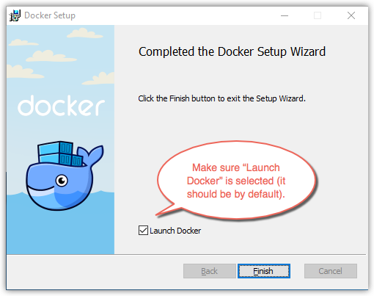
Disclaimer: Forget the GUI
Get comfortable with the command line!
(--help is your friend)
Content © Microsoft
Notes:
Image from: https://docs.docker.com/docker-for-windows/

Slide 18
Managing Images
hub.docker.com
VERSION! VERSION! VERSION!
Pulling images
docker pull <image>
Listing our local (on host) images
docker images
Removing images
docker rm <imageId>
Content © Microsoft
Notes:
Pull dotnet sample: docker pull microsoft/sample-dotnet:latest

Slide 19
Running our first Container/Image
Create a container from an image (first time)
docker create <image>
Create and run a container from an image (first time)
docker run <image>
Run an existing container
Docker start (-ia for interactive sessions, -a just for output)
Stop a running container
docker stop
Attach to an existing, running container
docker attach (use crtl-0 + crtl-1 to detach)
Content © Microsoft
Notes:
Run dotnet sample: docker run microsoft/sample-dotnet:latest

Slide 20
Managing Containers
List containers
docker ps –a (‘-a’ says to include stopped containers)
Remove an existing container
docker rm <container> (add a –f to remove ‘force’)
Remove all containers
docker ps –a –format “{{.ID}}” | %{docker rm $_}
Content © Microsoft
Notes:
Lets take a closer look at a Dockerfile as this is really the preferred method if you can’t pull an existing image from a registry.
#click (method for automated creation)
read
#click (consumed when running docker build)
Its consumed when we say “docker build”. The build process reads this file
#click (automated builds via docker hub)
It can also be used as part of automation. You can upload your dockerfile to the docker hub, it will help perform automated, triggered builds. So if an image (layer) that you’re dependent on changes, your image will also be updated. This includes a web hook that you can use to start any CI testing or even a redeployment of your image.
#click (cache unchanged commands)
Anything that’s unchanged, just gets cached and reused.
#click (IIS Image)
If we take an example of a dockerfile to build an IIS image.
From – we start with where we’re starting from, in this case a base Nano Server image. Then we have two ‘adds’
Unattended – the first is an unintended install file and this is how you’d install IIS with nano server technical preview 4
Packages – then we add in this case, the “packages” folder where those optional roles/features are stored as we discussed earlier.
Run – then within the container we’re going to use DISM to apply the unattend file we added.
When its all done, we’ll have the layers we see on the right with the base image at the bottom, and our layers added on. Mysite depends on IIS, which depends on the Container image. Now if I wanted to share this with you, and you already have the container base image, all I’d need to ship him is the IIS image, and web image. If he had the IIS image, I’d just send him the web image. I only need to give him enough to provision what he needs to get started.
This makes this approach very handy for sharing work.
And there’s the 4 basic steps to build your own IIS container image.
So lets talk about what “unchanged values are cached”. Lets say I made an mistake and I need to change the folder where my attend file was. Docker’s build process will look at it and say “I’ll keep the first three layers, and only throw away the last one”. So it’s the only one that gets re-run. It doesn’t have to re-add the unattend file, or the packages. It just updates the run layer.
#click (WebApp image)
Now IIS is pretty useless without a web site, so lets create a new image that add this
From – we’ll use the image we created previously
Add – and I’m going to add mysite.htm to the image in the /inetpub folder

Slide 21


Building our own Images - Dockerfile
Method for automated container image creation
Consumed when running “docker build”
Enables automated builds via docker hub
Caches unchanged commands
Mysite.html
Sandbox
Layer 2
microsoft/iis
Sandbox
Layer 1
Container OS
Image
Content © Microsoft
Notes:
Lets take a closer look at a Dockerfile as this is really the preferred method if you can’t pull an existing image from a registry.
#click (method for automated creation)
read
#click (consumed when running docker build)
Its consumed when we say “docker build”. The build process reads this file
#click (automated builds via docker hub)
It can also be used as part of automation. You can upload your dockerfile to the docker hub, it will help perform automated, triggered builds. So if an image (layer) that you’re dependent on changes, your image will also be updated. This includes a web hook that you can use to start any CI testing or even a redeployment of your image.
#click (cache unchanged commands)
Anything that’s unchanged, just gets cached and reused.
#click (IIS Image)
If we take an example of a dockerfile to build an IIS image.
From – we start with where we’re starting from, in this case a base Nano Server image. Then we have two ‘adds’
Unattended – the first is an unintended install file and this is how you’d install IIS with nano server technical preview 4
Packages – then we add in this case, the “packages” folder where those optional roles/features are stored as we discussed earlier.
Run – then within the container we’re going to use DISM to apply the unattend file we added.
When its all done, we’ll have the layers we see on the right with the base image at the bottom, and our layers added on. Mysite depends on IIS, which depends on the Container image. Now if I wanted to share this with you, and you already have the container base image, all I’d need to ship him is the IIS image, and web image. If he had the IIS image, I’d just send him the web image. I only need to give him enough to provision what he needs to get started.
This makes this approach very handy for sharing work.
And there’s the 4 basic steps to build your own IIS container image.
So lets talk about what “unchanged values are cached”. Lets say I made an mistake and I need to change the folder where my attend file was. Docker’s build process will look at it and say “I’ll keep the first three layers, and only throw away the last one”. So it’s the only one that gets re-run. It doesn’t have to re-add the unattend file, or the packages. It just updates the run layer.
#click (WebApp image)
Now IIS is pretty useless without a web site, so lets create a new image that add this
From – we’ll use the image we created previously
Add – and I’m going to add mysite.htm to the image in the /inetpub folder

Slide 22
Private Image Repositories
hub.docker.com
Allows you to create public or private organizational repositories
Host your own
Requires linux
Avoid custom base images
Creates problems with sharing images (missing underlying layers)
Notes:
Lets take a closer look at a Dockerfile as this is really the preferred method if you can’t pull an existing image from a registry.
#click (method for automated creation)
read
#click (consumed when running docker build)
Its consumed when we say “docker build”. The build process reads this file
#click (automated builds via docker hub)
It can also be used as part of automation. You can upload your dockerfile to the docker hub, it will help perform automated, triggered builds. So if an image (layer) that you’re dependent on changes, your image will also be updated. This includes a web hook that you can use to start any CI testing or even a redeployment of your image.
#click (cache unchanged commands)
Anything that’s unchanged, just gets cached and reused.
#click (IIS Image)
If we take an example of a dockerfile to build an IIS image.
From – we start with where we’re starting from, in this case a base Nano Server image. Then we have two ‘adds’
Unattended – the first is an unintended install file and this is how you’d install IIS with nano server technical preview 4
Packages – then we add in this case, the “packages” folder where those optional roles/features are stored as we discussed earlier.
Run – then within the container we’re going to use DISM to apply the unattend file we added.
When its all done, we’ll have the layers we see on the right with the base image at the bottom, and our layers added on. Mysite depends on IIS, which depends on the Container image. Now if I wanted to share this with you, and you already have the container base image, all I’d need to ship him is the IIS image, and web image. If he had the IIS image, I’d just send him the web image. I only need to give him enough to provision what he needs to get started.
This makes this approach very handy for sharing work.
And there’s the 4 basic steps to build your own IIS container image.
So lets talk about what “unchanged values are cached”. Lets say I made an mistake and I need to change the folder where my attend file was. Docker’s build process will look at it and say “I’ll keep the first three layers, and only throw away the last one”. So it’s the only one that gets re-run. It doesn’t have to re-add the unattend file, or the packages. It just updates the run layer.
#click (WebApp image)
Now IIS is pretty useless without a web site, so lets create a new image that add this
From – we’ll use the image we created previously
Add – and I’m going to add mysite.htm to the image in the /inetpub folder

Slide 23

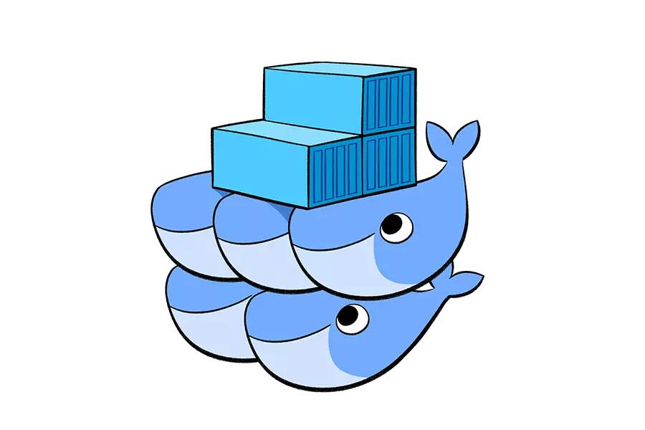
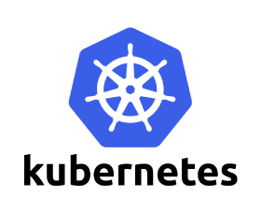
Orchestrations – multiple hosts
https://mesosphere.com/
https://www.docker.com/products/docker-swarm
http://kubernetes.io/
Notes:
Lets take a closer look at a Dockerfile as this is really the preferred method if you can’t pull an existing image from a registry.
#click (method for automated creation)
read
#click (consumed when running docker build)
Its consumed when we say “docker build”. The build process reads this file
#click (automated builds via docker hub)
It can also be used as part of automation. You can upload your dockerfile to the docker hub, it will help perform automated, triggered builds. So if an image (layer) that you’re dependent on changes, your image will also be updated. This includes a web hook that you can use to start any CI testing or even a redeployment of your image.
#click (cache unchanged commands)
Anything that’s unchanged, just gets cached and reused.
#click (IIS Image)
If we take an example of a dockerfile to build an IIS image.
From – we start with where we’re starting from, in this case a base Nano Server image. Then we have two ‘adds’
Unattended – the first is an unintended install file and this is how you’d install IIS with nano server technical preview 4
Packages – then we add in this case, the “packages” folder where those optional roles/features are stored as we discussed earlier.
Run – then within the container we’re going to use DISM to apply the unattend file we added.
When its all done, we’ll have the layers we see on the right with the base image at the bottom, and our layers added on. Mysite depends on IIS, which depends on the Container image. Now if I wanted to share this with you, and you already have the container base image, all I’d need to ship him is the IIS image, and web image. If he had the IIS image, I’d just send him the web image. I only need to give him enough to provision what he needs to get started.
This makes this approach very handy for sharing work.
And there’s the 4 basic steps to build your own IIS container image.
So lets talk about what “unchanged values are cached”. Lets say I made an mistake and I need to change the folder where my attend file was. Docker’s build process will look at it and say “I’ll keep the first three layers, and only throw away the last one”. So it’s the only one that gets re-run. It doesn’t have to re-add the unattend file, or the packages. It just updates the run layer.
#click (WebApp image)
Now IIS is pretty useless without a web site, so lets create a new image that add this
From – we’ll use the image we created previously
Add – and I’m going to add mysite.htm to the image in the /inetpub folder

Slide 24

Azure Container Service
We are excited to announce a limited preview of Azure Container Service for Windows Server containers. To join the preview, please register here. We look forward to receiving your feedback!
Azure Container Service is designed for enterprises, ISVs and startups looking to put containers into production, quickly and simply. It combines Azure’s infrastructure with a choice of open source container orchestration technology: DC/OS or Docker Swarm. To provision your container service, you simply select the VM cluster size, DC/OS or Swarm, and the Azure region, and the container service handles everything else. This preview of Windows Server containers under the Azure Container Service currently only supports Docker Swarm as the orchestrator.
Azure is founded on maximum choice for all developers and ITPros. With this preview, we’re opening the Azure Container Service to Windows Server developers for the first time.
https://azure.microsoft.com/en-us/blog/windows-server-containers-using-docker-swarm-on-azure-container-service-private-preview/
Notes:
Lets take a closer look at a Dockerfile as this is really the preferred method if you can’t pull an existing image from a registry.
#click (method for automated creation)
read
#click (consumed when running docker build)
Its consumed when we say “docker build”. The build process reads this file
#click (automated builds via docker hub)
It can also be used as part of automation. You can upload your dockerfile to the docker hub, it will help perform automated, triggered builds. So if an image (layer) that you’re dependent on changes, your image will also be updated. This includes a web hook that you can use to start any CI testing or even a redeployment of your image.
#click (cache unchanged commands)
Anything that’s unchanged, just gets cached and reused.
#click (IIS Image)
If we take an example of a dockerfile to build an IIS image.
From – we start with where we’re starting from, in this case a base Nano Server image. Then we have two ‘adds’
Unattended – the first is an unintended install file and this is how you’d install IIS with nano server technical preview 4
Packages – then we add in this case, the “packages” folder where those optional roles/features are stored as we discussed earlier.
Run – then within the container we’re going to use DISM to apply the unattend file we added.
When its all done, we’ll have the layers we see on the right with the base image at the bottom, and our layers added on. Mysite depends on IIS, which depends on the Container image. Now if I wanted to share this with you, and you already have the container base image, all I’d need to ship him is the IIS image, and web image. If he had the IIS image, I’d just send him the web image. I only need to give him enough to provision what he needs to get started.
This makes this approach very handy for sharing work.
And there’s the 4 basic steps to build your own IIS container image.
So lets talk about what “unchanged values are cached”. Lets say I made an mistake and I need to change the folder where my attend file was. Docker’s build process will look at it and say “I’ll keep the first three layers, and only throw away the last one”. So it’s the only one that gets re-run. It doesn’t have to re-add the unattend file, or the packages. It just updates the run layer.
#click (WebApp image)
Now IIS is pretty useless without a web site, so lets create a new image that add this
From – we’ll use the image we created previously
Add – and I’m going to add mysite.htm to the image in the /inetpub folder

Slide 25
Interested in More?
https://aka.ms/brent-clouddevelop2016
Content © Microsoft
Notes:
Lets take a closer look at a Dockerfile as this is really the preferred method if you can’t pull an existing image from a registry.
#click (method for automated creation)
read
#click (consumed when running docker build)
Its consumed when we say “docker build”. The build process reads this file
#click (automated builds via docker hub)
It can also be used as part of automation. You can upload your dockerfile to the docker hub, it will help perform automated, triggered builds. So if an image (layer) that you’re dependent on changes, your image will also be updated. This includes a web hook that you can use to start any CI testing or even a redeployment of your image.
#click (cache unchanged commands)
Anything that’s unchanged, just gets cached and reused.
#click (IIS Image)
If we take an example of a dockerfile to build an IIS image.
From – we start with where we’re starting from, in this case a base Nano Server image. Then we have two ‘adds’
Unattended – the first is an unintended install file and this is how you’d install IIS with nano server technical preview 4
Packages – then we add in this case, the “packages” folder where those optional roles/features are stored as we discussed earlier.
Run – then within the container we’re going to use DISM to apply the unattend file we added.
When its all done, we’ll have the layers we see on the right with the base image at the bottom, and our layers added on. Mysite depends on IIS, which depends on the Container image. Now if I wanted to share this with you, and you already have the container base image, all I’d need to ship him is the IIS image, and web image. If he had the IIS image, I’d just send him the web image. I only need to give him enough to provision what he needs to get started.
This makes this approach very handy for sharing work.
And there’s the 4 basic steps to build your own IIS container image.
So lets talk about what “unchanged values are cached”. Lets say I made an mistake and I need to change the folder where my attend file was. Docker’s build process will look at it and say “I’ll keep the first three layers, and only throw away the last one”. So it’s the only one that gets re-run. It doesn’t have to re-add the unattend file, or the packages. It just updates the run layer.
#click (WebApp image)
Now IIS is pretty useless without a web site, so lets create a new image that add this
From – we’ll use the image we created previously
Add – and I’m going to add mysite.htm to the image in the /inetpub folder

Slide 26

Thank you!
https://aka.ms/brent-clouddevelop2016
Brent Stineman
DX/TED, Azure Specialist, Cloud Evangelist
Email: brestin@microsoft.com
Twitter: @brentcodemonkey
Web: http://brentdacodemonkey.wordpress.com
→
Creating quality bugs since 1992!

