Slide 1
An Approach for Simultaneous Finding of Multiple Efficient Decisions in Multi-objective Optimization Problems
Konstantin Barkalov, Victor Gergel, Vladimir Grishagin and Evgeniy Kozinov
{konstantin.barkalov,evgeny.kozinov}@itmm.unn.ru,
{gergel,vagris}@unn.ru

Slide 2
Content
Multi-objective optimization problem.
Reduction of the multi-objective optimization problem to the scalar one-dimensional global optimization problems.
An Approach for Simultaneous Finding of Multiple Efficient Decisions in Multi-objective Optimization Problems.
Step-by-step solution of a set of global optimization problems.
Simultaneous solution of a set of global optimization problems.
Results of numerical experiments.

Slide 3
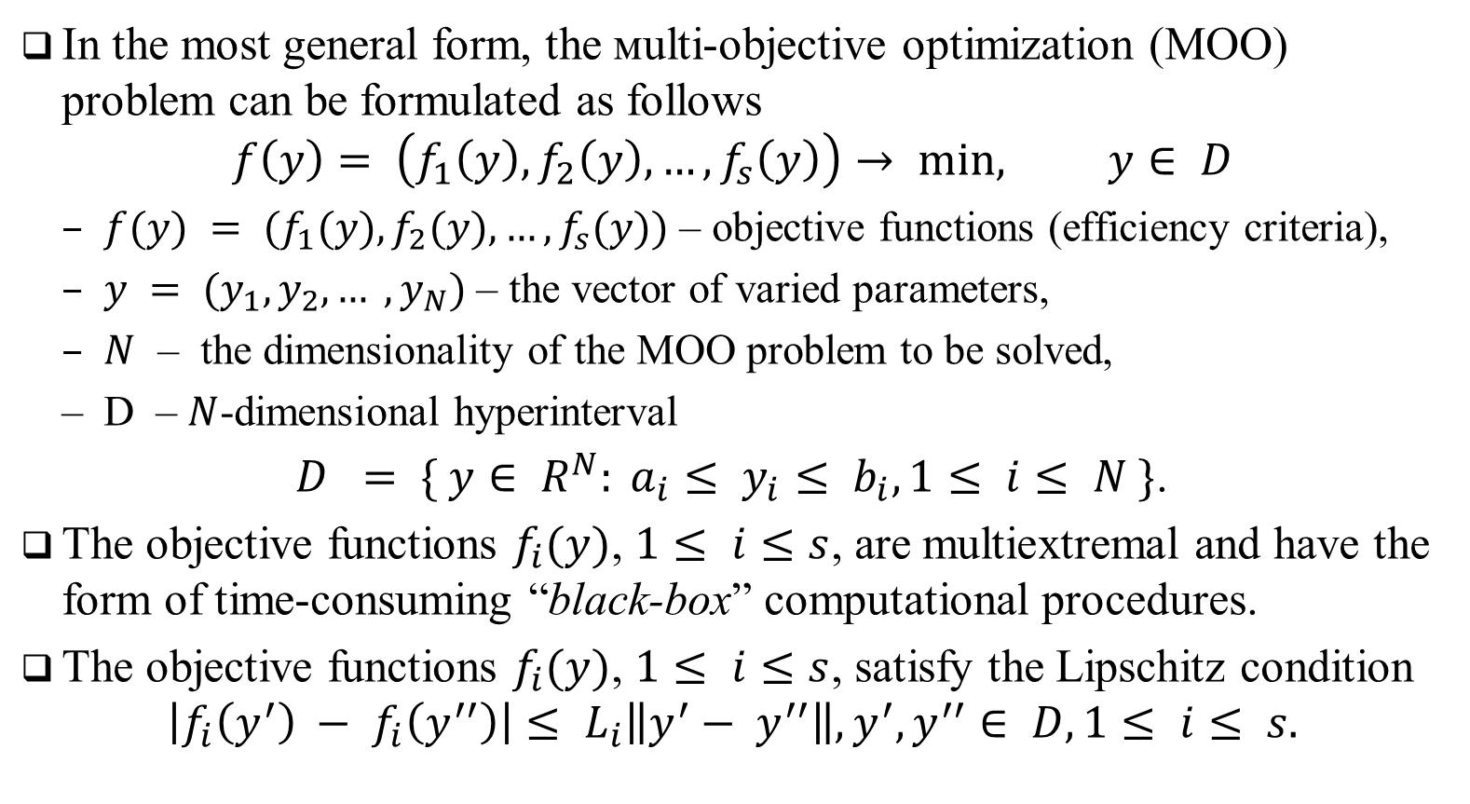
Multi-objective optimization problem
In the most general form, the мulti-objective optimization (MOO) problem can be formulated as follows
$$f\left(y\right)= \left(f_{1}\left(y\right), f_{2}\left(y\right), …,f_{s}\left(y\right)\right)→ min, y∈ D$$
$f(y) = (f_{1}(y), f_{2}(y), …, f_{s}(y))$ – objective functions (efficiency criteria),
$y = (y_{1}, y_{2}, … , y_{N})$ – the vector of varied parameters,
$N$ – the dimensionality of the MOO problem to be solved,
D – $N$-dimensional hyperinterval
$D = \{ y∈ R^{N}: a_{i}≤ y_{i}≤ b_{i}, 1≤ i≤ N \}$.
The objective functions $f_{i}(y)$, $1≤ i≤s$, are multiextremal and have the form of time-consuming “black-box” computational procedures.
The objective functions $f_{i}(y)$, $1≤ i≤s$, satisfy the Lipschitz condition
$$\left|f_{i}\left(y^{′}\right) − f_{i}\left(y^{′′}\right)\right|≤ L_{i}\left\|y^{′}− y^{′′}\right\|, y^{′}, y^{′′}∈ D, 1≤ i≤ s.$$

Slide 4
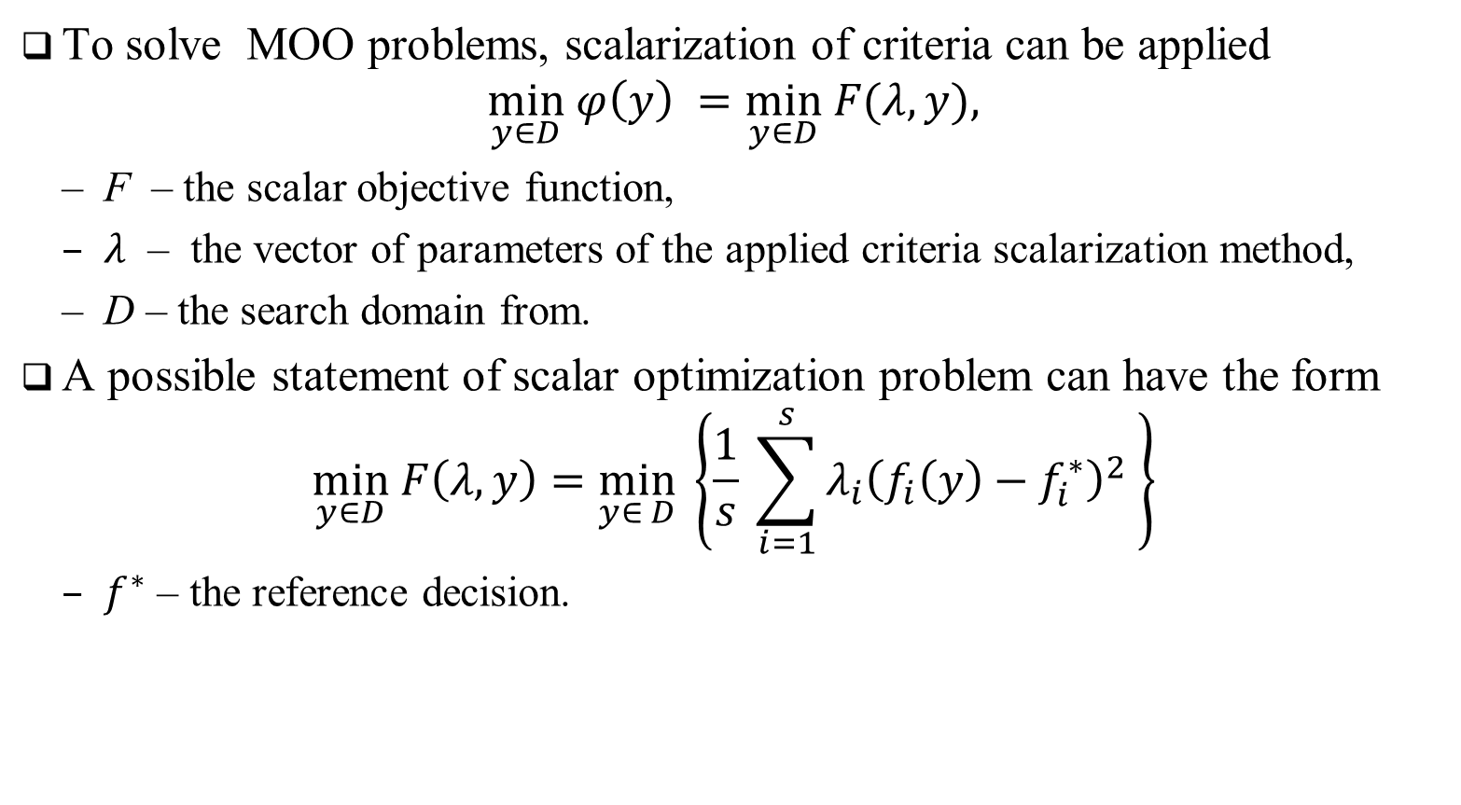
Scalarization of multiple objective functions
To solve MOO problems, scalarization of criteria can be applied
$$\min_{y∈D} φ\left(y\right) =\min_{y∈D} F(λ, y),$$
F – the scalar objective function,
$λ$ – the vector of parameters of the applied criteria scalarization method,
D – the search domain from.
A possible statement of scalar optimization problem can have the form
$$\min_{y∈D} F\left(λ,y\right)=\min_{y∈ D} \left\{\frac{1}{s} \sum_{i=1}^{s}{λ_{i}{\left(f_{i}\left(y\right)−f_{i}^{∗}\right)}^{2}} \right\}$$
$f^{∗}$ – the reference decision.

Slide 5
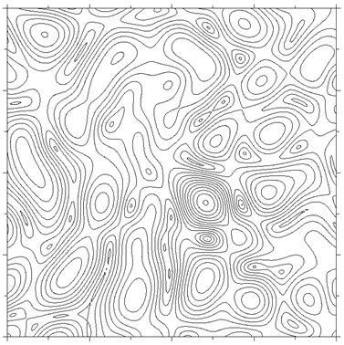
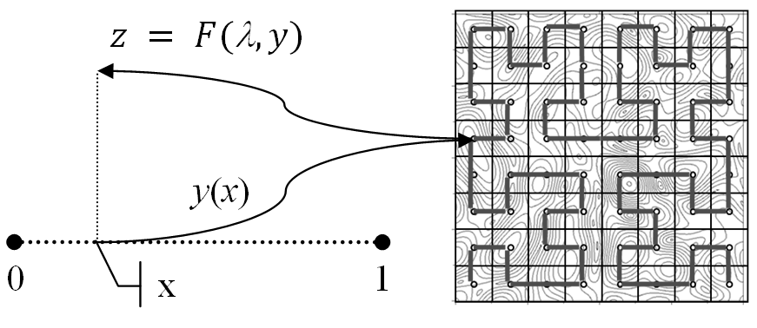

Dimensionality reduction
The computational complexity of global optimization algorithms can be reduced by dimensionality reduction based on the use of a Peano space-filling curve (or evolvent)
$$\min_{x∈\left[0,1\right]} φ \left(y\left(x\right)\right)=\min_{y∈D} φ\left(y\right)$$
y(x) that uniquely and continuously maps the segment [0; 1] on an N-dimensional domain D

Slide 6
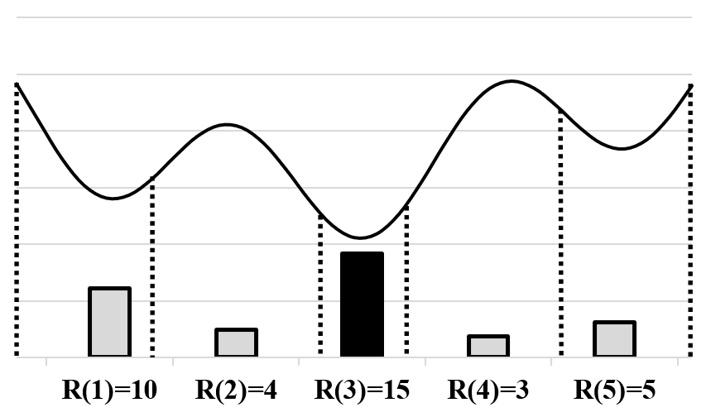
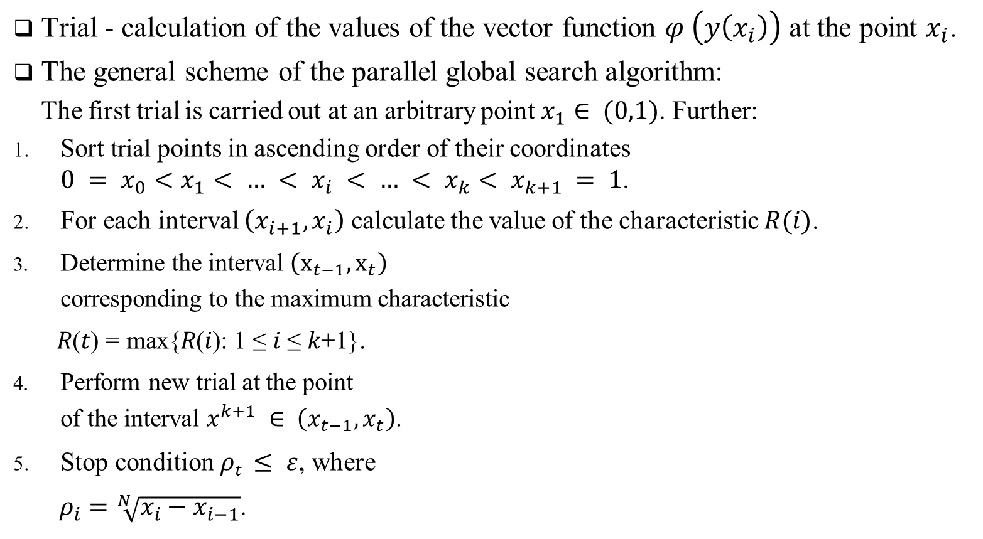
Global search algorithm
Trial - calculation of the values of the vector function $φ \left(y\left(x_{i}\right)\right)$ at the point $x_{i}$.
The general scheme of the parallel global search algorithm:
The first trial is carried out at an arbitrary point $x_{1}∈ (0,1)$. Further:
Sort trial points in ascending order of their coordinates $0 = x_{0}<x_{1}< … < x_{i} < … < x_{k}< x_{k+1} = 1$.
For each interval $\left(x_{i+1}, x_{i}\right)$ calculate the value of the characteristic $R(i)$.
Determine the interval $\left(x_{t−1}, x_{t}\right)$ corresponding to the maximum characteristic
$\text{R}\text{(}\text{t}\text{)} \text{=} \text{max}\text{\{}\text{R}\text{(}\text{i}\text{): 1} \text{≤} \text{i} \text{≤} \text{k}\text{+1\}.}$
Perform new trial at the point of the interval $x^{k+1} ∈ \left(x_{t−1}, x_{t}\right)$.
Stop condition $ρt ≤ ε$, where
$ρ_{i}=\sqrt[N]{x_{i}−x_{i−1}}$.

Slide 7


Computational complexity reduction of the multistage multicriteria search
The numerical solving of the global optimization problems – the successive computing the values of characteristics w(y) at the points y^{i}.
The data obtained as a result of computations can be represented in the form of the matrix of the search information
As a result of scalarization and the use of the dimensionality reduction, the set Ω_{k} can be transformed into the form of the matrix of the search state
The set Ω_{k} allows reducing the results of all preceding computations z_{i}, 1 ≤ i ≤ k from the matrix A_{k} to the values of the next optimization problem F(α, y (x)), i. e.

Slide 8
Results of numerical experiments…
The numerical experiments have been carried out using the computational nodes of Lobachevsky supercomputer at Nizhni Novgorod State University.
The peak perfor-mance of the supercomputer was 573 Tflops,
Each computational node was equipped with Intel Sandy Bridge E5-2660, processor 2.2 GHz, 64 Gb RAM.

Slide 9
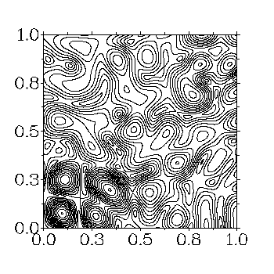
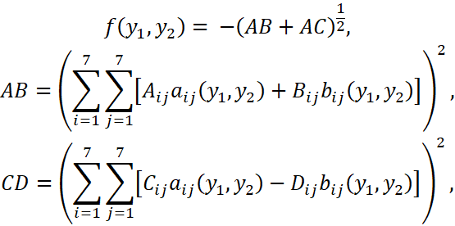
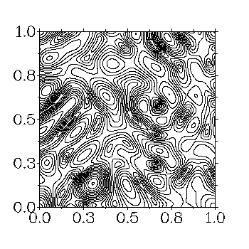


Results of numerical experiments…
Within the executed experiments, the two-dimensional bi-criterial MCO problems were used, the criteria of which were defined with the use of the next family of multiextremal functions:
where the expressions

Slide 10
Results of numerical experiments…
The global search algorithm was applied different methods of scalarization:
The minimax convolution of the criteria (MMC).
The method of successive concessions (MSC).
The reference point method (RPM).
In order to draw more justified conclusions on the efficiency of the developed approach, the solving of 100 multicriteria problems.
For each method mentioned above, 50 subproblems with various values of the parameters λ, δ and θ correspondingly have been solved.

Slide 11
Results of numerical experiments…
Averaged number of iterations and the speedup of the parallel computations in solving a single MCO problem without the reuse of the search information
MMC – the minimax convolution of the criteria.
MSC – the method of successive concessions.
RPM – the reference point method.
 | Number of cores
Convolution | 1 |  | 2 |  | 4 |  | 8 |  | 16
 | K | S | K | S | K | S | K | S | K | S
MMC | 13 221 | 1 | 7 187 | 1,8 | 3 456 | 3,8 | 1 897 | 7,0 | 1 058 | 12,5
MSC | 16 002 | 1 | 9 458 | 1,7 | 4 113 | 3,9 | 2 356 | 6,8 | 1 204 | 13,3
RPM | 14 041 | 1 | 7 866 | 1,8 | 3 558 | 3,9 | 1 982 | 7,1 | 1 068 | 13,2

Slide 12
Results of numerical experiments…
Averaged number of iterations and the speedup of the parallel computations in solving a single MCO problem with the reuse of the search information
MMC – the minimax convolution of the criteria.
MSC – the method of successive concessions.
RPM – the reference point method.
 | Number of cores
Convolution | 1 |  | 2 |  | 4 |  | 8 |  | 16
 | K | S | K | S | K | S | K | S | K | S
MMC | 1 193 | 1 | 595 | 2,0 | 300 | 4,0 | 173 | 6,9 | 103 | 11,5
MSC | 2 021 | 1 | 934 | 2,2 | 475 | 4,3 | 272 | 7,4 | 147 | 13,7
RPM | 990 | 1 | 491 | 2,0 | 249 | 4,0 | 145 | 6,8 | 90 | 10,9

Slide 13
Results of numerical experiments…
Overall speedup of parallel computations based on the developed approach for solving a MCO problem
MMC – the minimax convolution of the criteria.
MSC – the method of successive concessions.
RPM – the reference point method.
 | Number of cores
Convolution | 1 | 2 | 4 | 8 | 16
MMC | 11,1 | 22,2 | 44,1 | 76,2 | 127,5
MSC | 7,9 | 17,1 | 33,7 | 58,7 | 108,2
RPM | 14,2 | 28,6 | 56,3 | 96,3 | 154,9

Slide 14
Thanks for attention! Questions?
This research was supported by the Russian Science Foundation, project No 16-11-10150 “Novel efficient methods and software tools for time-consuming decision making problems using supercomputers of superior performance.”
Lobachevsky State University of Nizhni Novgorod, Nizhni Novgorod, Russia
Victor Gergel, gergel@unn.ru
Evgeniy Kozinov, evgeny.kozinov@itmm.unn.ru

