Slide 1
An Approach for Simultaneous Finding of Multiple Efficient Decisions in Multi-objective Optimization Problems
Konstantin Barkalov, Victor Gergel, Vladimir Grishagin and Evgeniy Kozinov
{konstantin.barkalov,evgeny.kozinov}@itmm.unn.ru,
{gergel,vagris}@unn.ru

Slide 2
Content
Multi-objective optimization problem.
Reduction of the multi-objective optimization problem to the scalar one-dimensional global optimization problems.
An Approach for Simultaneous Finding of Multiple Efficient Decisions in Multi-objective Optimization Problems.
Step-by-step solution of a set of global optimization problems.
Simultaneous solution of a set of global optimization problems.
Results of numerical experiments.

Slide 3
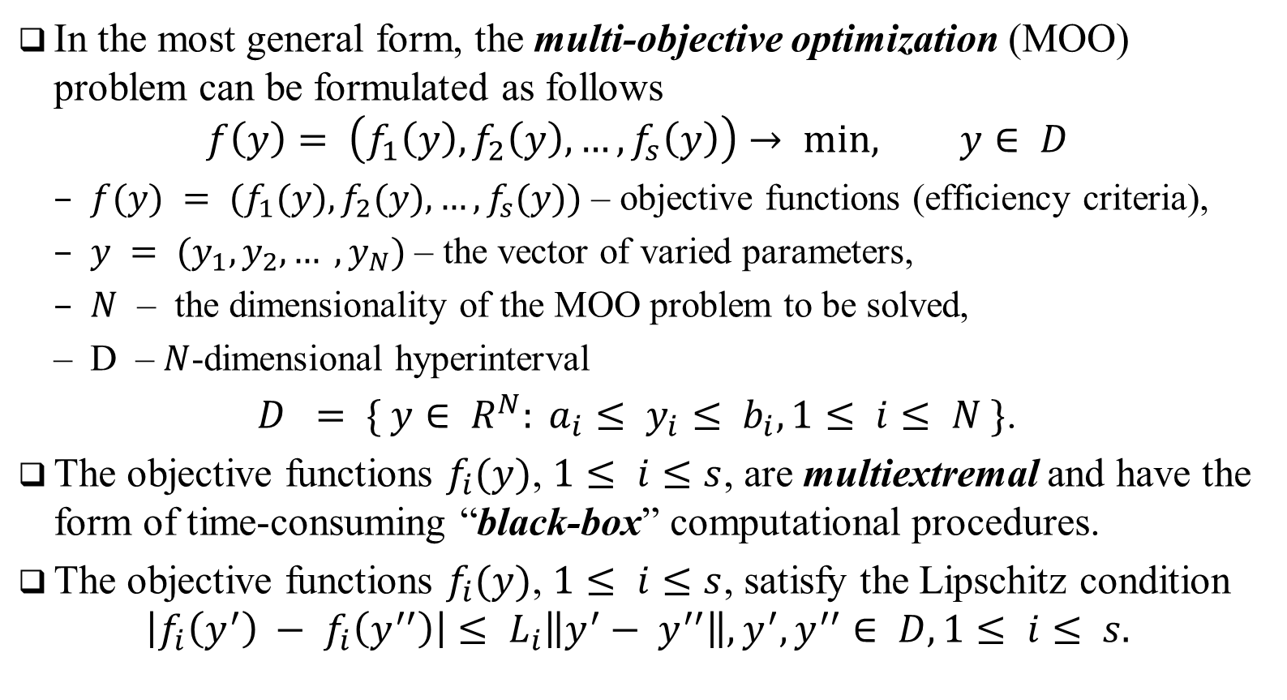
Multi-objective optimization problem
In the most general form, the multi-objective optimization (MOO) problem can be formulated as follows
$$f\left(y\right)= \left(f_{1}\left(y\right), f_{2}\left(y\right), …,f_{s}\left(y\right)\right)→ min, y∈ D$$
$f(y) = (f_{1}(y), f_{2}(y), …, f_{s}(y))$ – objective functions (efficiency criteria),
$y = (y_{1}, y_{2}, … , y_{N})$ – the vector of varied parameters,
$N$ – the dimensionality of the MOO problem to be solved,
D – $N$-dimensional hyperinterval
$D = \{ y∈ R^{N}: a_{i}≤ y_{i}≤ b_{i}, 1≤ i≤ N \}$.
The objective functions $f_{i}(y)$, $1≤ i≤s$, are multiextremal and have the form of time-consuming “black-box” computational procedures.
The objective functions $f_{i}(y)$, $1≤ i≤s$, satisfy the Lipschitz condition
$$\left|f_{i}\left(y^{′}\right) − f_{i}\left(y^{′′}\right)\right|≤ L_{i}\left\|y^{′}− y^{′′}\right\|, y^{′}, y^{′′}∈ D, 1≤ i≤ s.$$

Slide 4
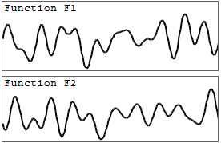
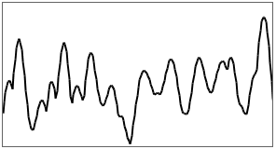

Scalarization of multiple objective functions
To solve MOO problems, scalarization of criteria can be applied
$$\min_{y∈D} φ\left(y\right) =\min_{y∈D} F(λ, y),$$
F – the scalar objective function,
$λ$ – the vector of parameters of the applied criteria scalarization method.
A possible statement of scalar optimization problem can have the form
$$\min_{y∈D} F\left(λ,y\right)=\min_{y∈ D} \left\{\frac{1}{s} \sum_{i=1}^{s}{λ_{i}{\left(f_{i}\left(y\right)−f_{i}^{∗}\right)}^{2}} \right\}$$
$f^{∗}$ – the reference decision.

Slide 5
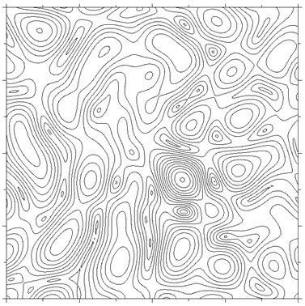
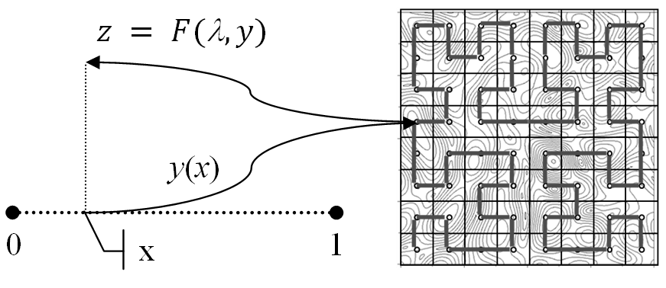

Dimensionality reduction
The computational complexity of global optimization algorithms can be reduced by dimensionality reduction based on the use of a Peano space-filling curve (or evolvent)
$$\min_{x∈\left[0,1\right]} φ \left(y\left(x\right)\right)=\min_{y∈D} φ\left(y\right)$$
$y(x)$ that uniquely and continuously maps the segment [0; 1] on an $N$-dimensional domain $D$

Slide 6
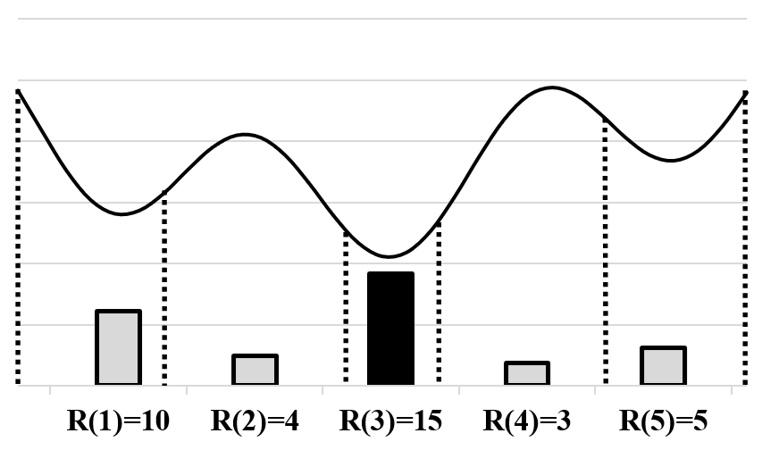
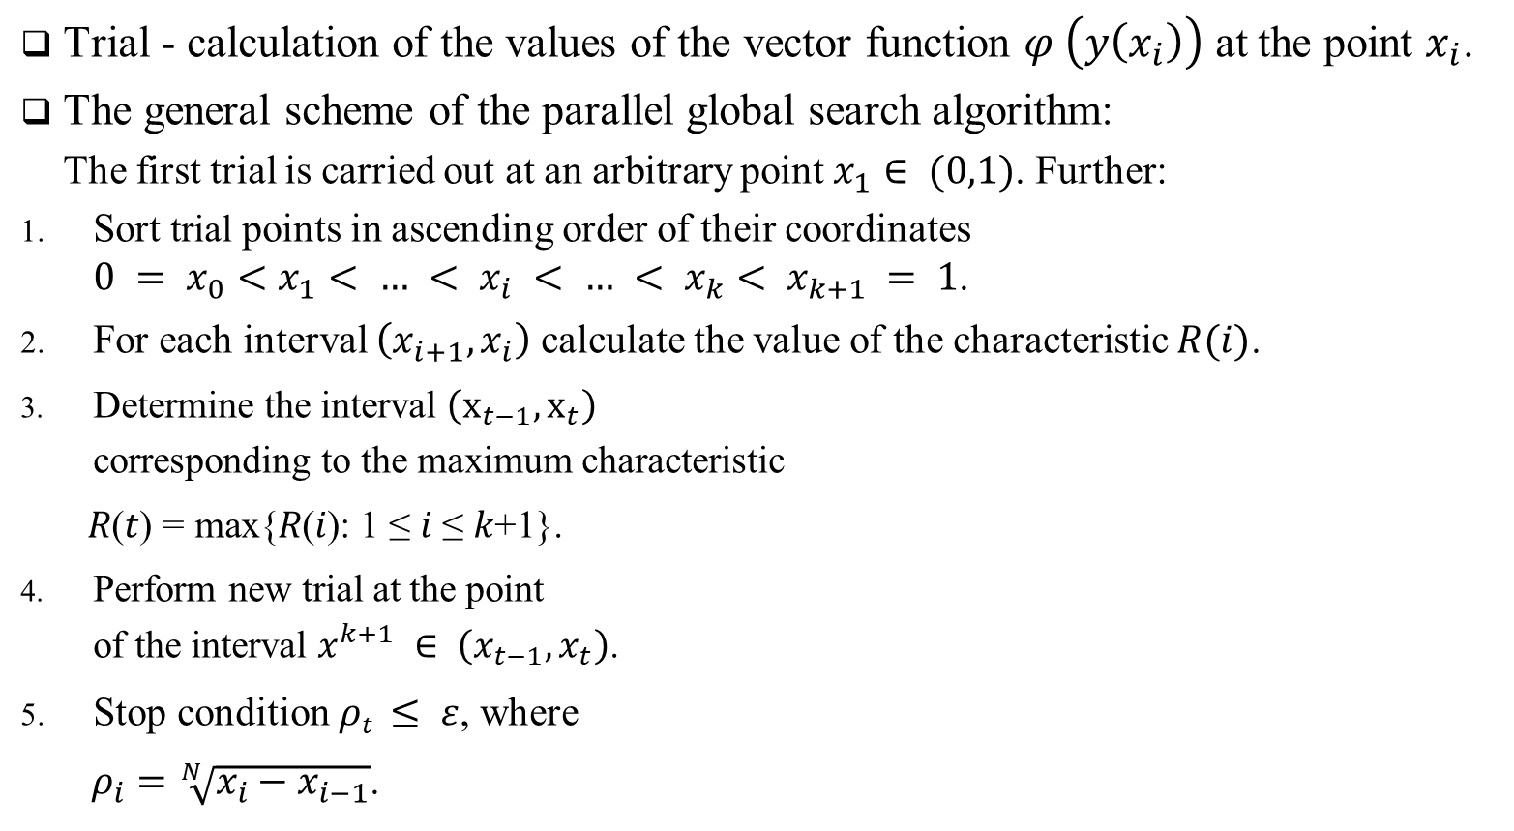
Global search algorithm
Trial - calculation of the values of the vector function $φ \left(y\left(x_{i}\right)\right)$ at the point $x_{i}$.
The general scheme of the parallel global search algorithm:
The first trial is carried out at an arbitrary point $x_{1}∈ (0,1)$. Further:
Sort trial points in ascending order of their coordinates $0 = x_{0}<x_{1}< … < x_{i} < … < x_{k}< x_{k+1} = 1$.
For each interval $\left(x_{i+1}, x_{i}\right)$ calculate the value of the characteristic $R(i)$.
Determine the interval $\left(x_{t−1}, x_{t}\right)$ corresponding to the maximum characteristic
$\text{R}\text{(}\text{t}\text{)} \text{=} \text{max}\text{\{}\text{R}\text{(}\text{i}\text{): 1} \text{≤} \text{i} \text{≤} \text{k}\text{+1\}.}$
Perform new trial at the point of the interval $x^{k+1} ∈ \left(x_{t−1}, x_{t}\right)$.
Stop condition $ρt ≤ ε$, where
$ρ_{i}=\sqrt[N]{x_{i}−x_{i−1}}$.

Slide 7
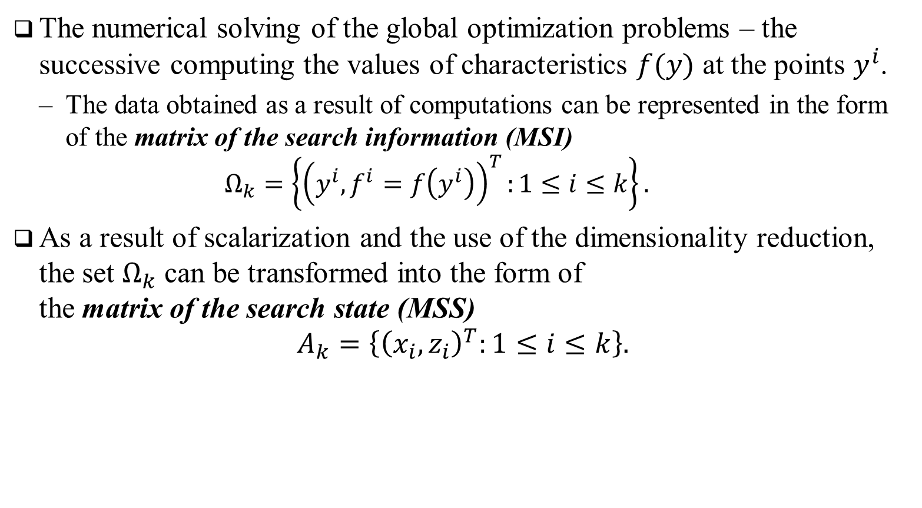
Multiple Global Search Algorithm…
The numerical solving of the global optimization problems – the successive computing the values of characteristics $f(y)$ at the points $y^{i}$.
The data obtained as a result of computations can be represented in the form of the matrix of the search information (MSI)
$$Ω_{k}=\left\{{\left(y^{i}, f^{i}=f\left(y^{i}\right)\right)}^{T}:1≤i≤k\right\}.$$
As a result of scalarization and the use of the dimensionality reduction, the set $Ω_{k}$ can be transformed into the form of the matrix of the search state (MSS)
$$A_{k}=\left\{{\left(x_{i}, z_{i}\right)}^{T}:1≤i≤k\right\}.$$

Slide 8
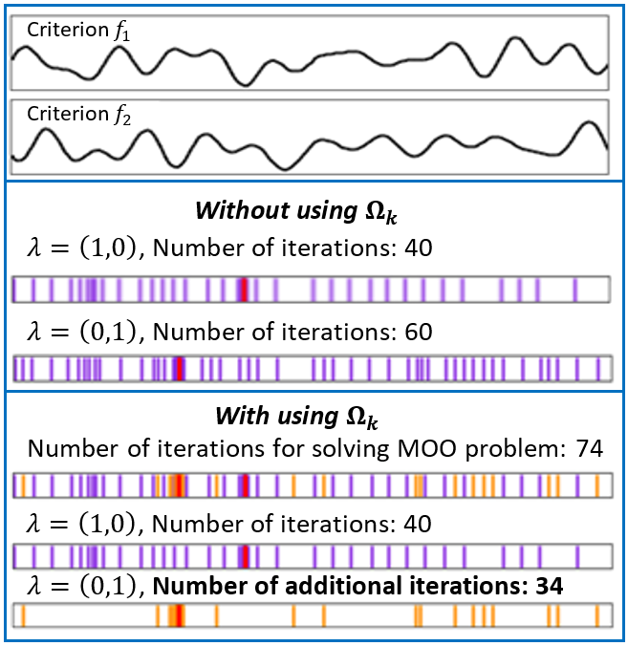
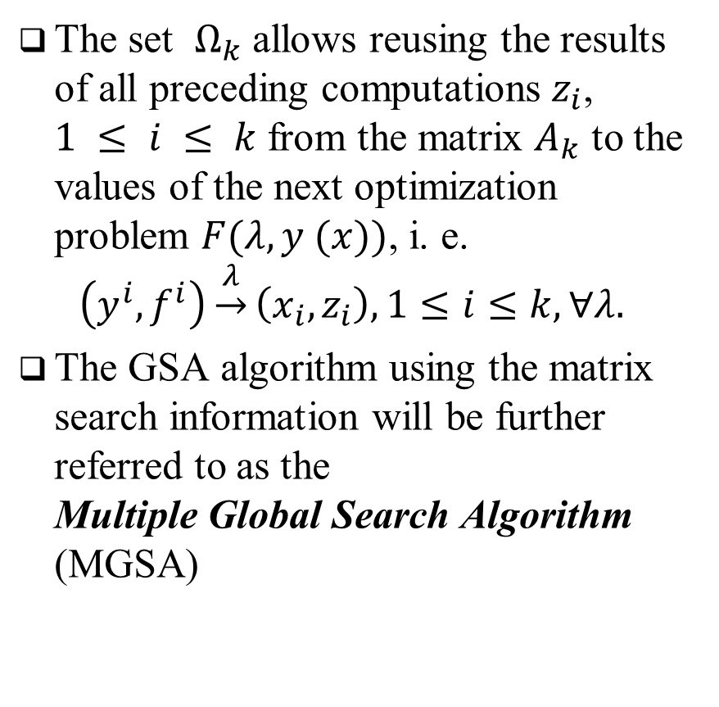
Multiple Global Search Algorithm
The set $Ω_{k}$ allows reusing the results of all preceding computations $z_{i}$, $1 ≤ i ≤ k$ from the matrix $A_{k}$ to the values of the next optimization problem $F(λ, y (x))$, i. e.
$$\left(y^{i}, f^{i}\right)\underset{→}{λ}\left(x_{i},z_{i}\right),1≤i≤k, ∀λ.$$
The GSA algorithm using the matrix search information will be further referred to as the Multiple Global Search Algorithm (MGSA)

Slide 9
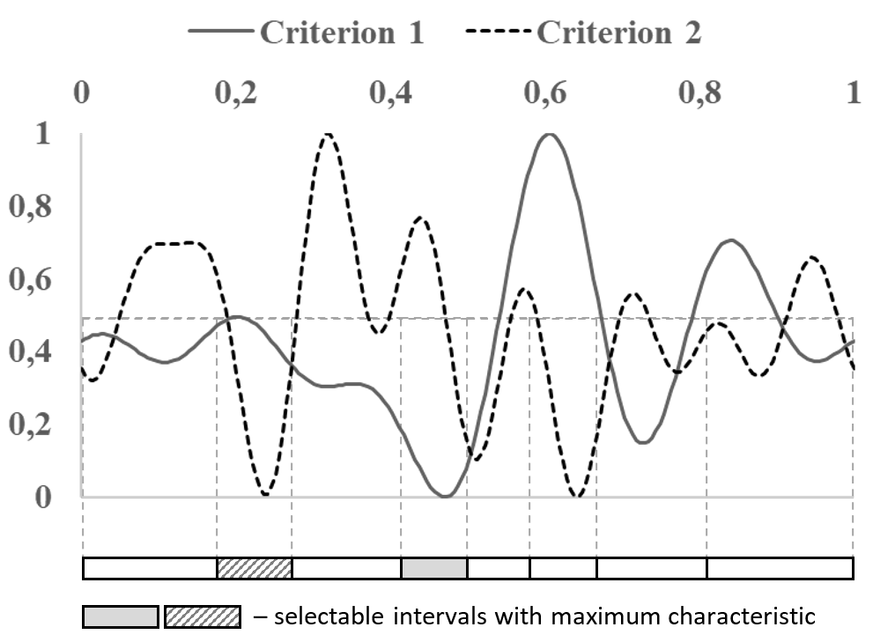
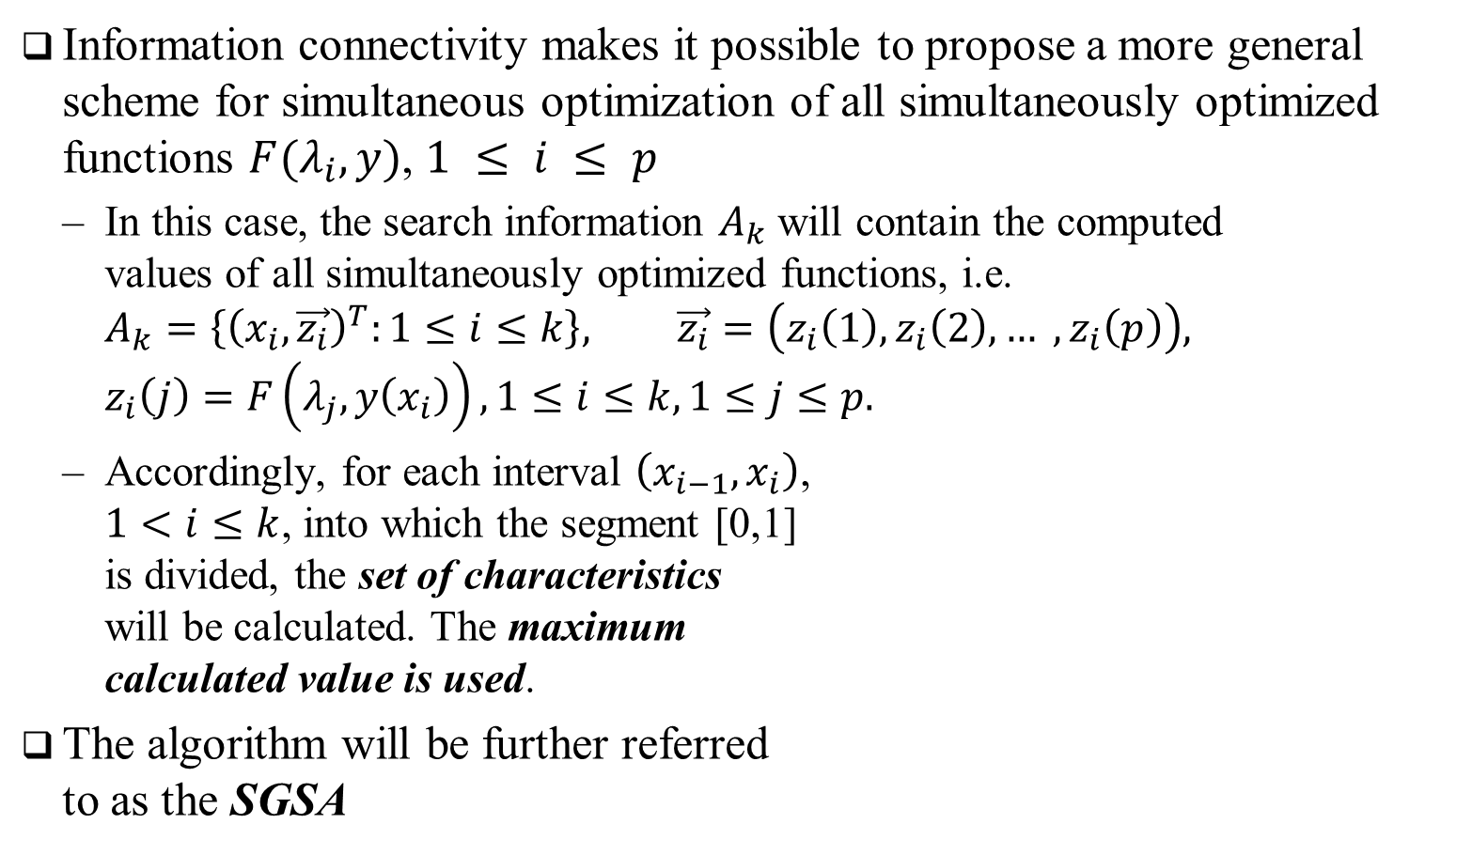
Simultaneous solution of a set of global optimization problems
Information connectivity makes it possible to propose a more general scheme for simultaneous optimization of all simultaneously optimized functions $F(λ_{i},y)$, $1 ≤ i ≤ p$
In this case, the search information $A_{k}$ will contain the computed values of all simultaneously optimized functions, i.e. $A_{k}=\left\{{\left(x_{i}, \vec{z_{i}}\right)}^{T}:1≤i≤k\right\}, \vec{z_{i}}=\left(z_{i}\left(1\right),z_{i}\left(2\right),… ,z_{i}\left(p\right)\right),$ $z_{i}\left(j\right)=F\left(λ_{j},y\left(x_{i}\right)\right),1≤i≤k, 1≤j≤p.$
Accordingly, for each interval $\left(x_{i−1},x_{i}\right)$, $1<i≤k$, into which the segment [0,1] is divided, the set of characteristics will be calculated. The maximum calculated value is used.
The algorithm will be further referred to as the SGSA

Slide 10
Results of numerical experiments…
The numerical experiments have been carried out using the computational nodes of Lobachevsky supercomputer at Nizhni Novgorod State University.
The peak perfor-mance of the supercomputer was 573 Tflops,
Each computational node was equipped with Intel Sandy Bridge E5-2660, processor 2.2 GHz, 64 Gb RAM.

Slide 11
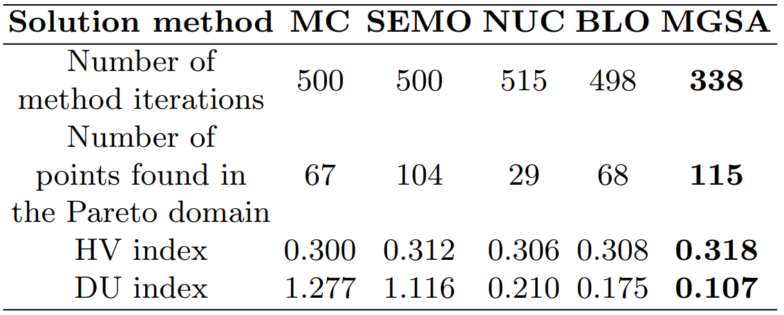
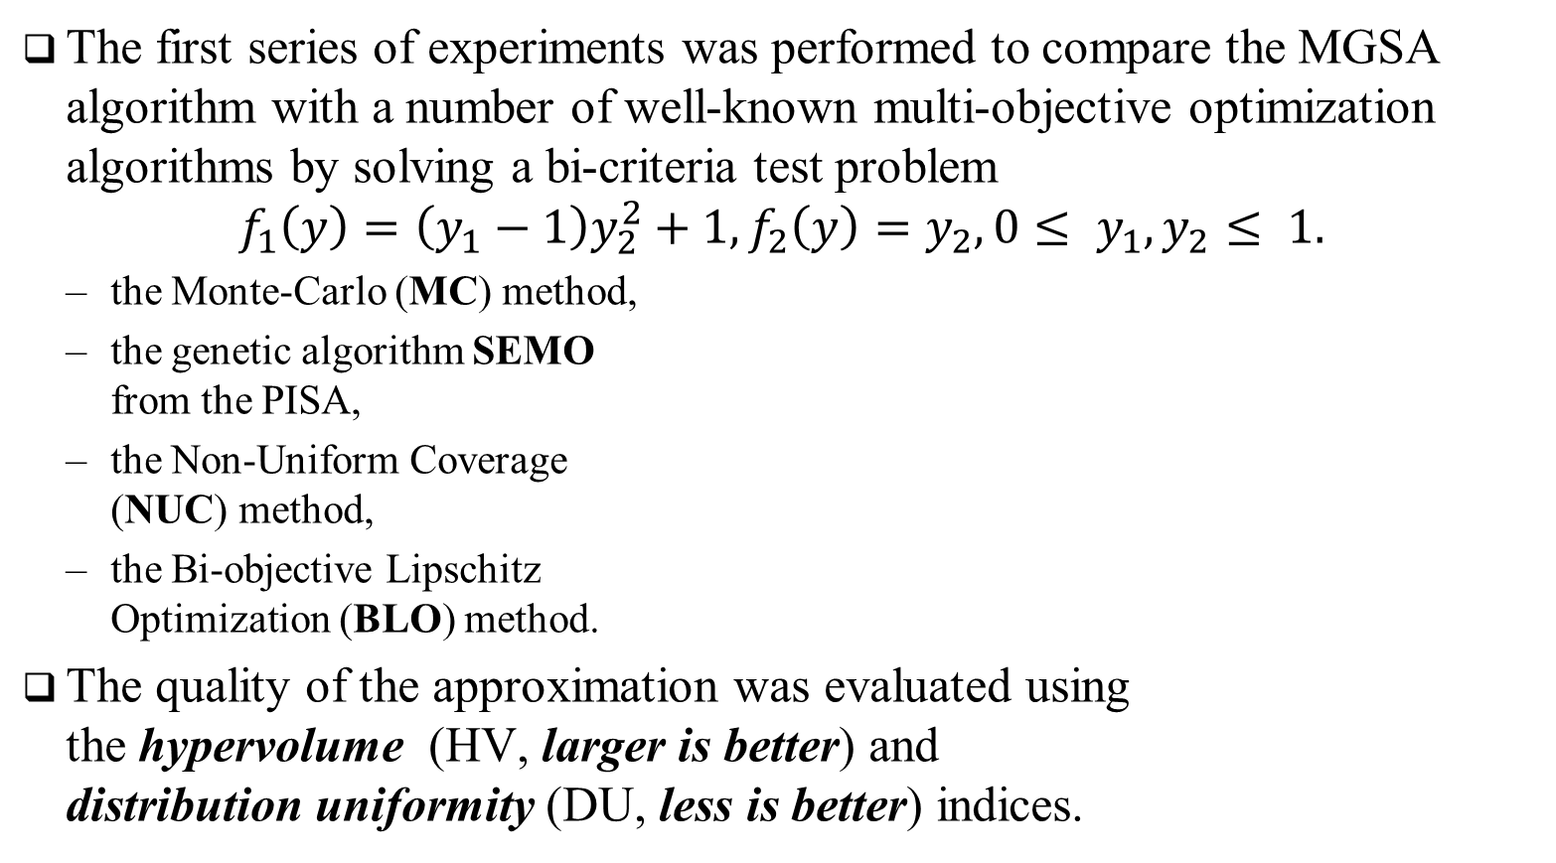
Results of numerical experiments…
The first series of experiments was performed to compare the MGSA algorithm with a number of well-known multi-objective optimization algorithms by solving a bi-criteria test problem
$$f_{1}\left(y\right)=\left(y_{1}−1\right)y_{2}^{2}+1,f_{2}\left(y\right)=y_{2}, 0≤ y_{1}, y_{2}≤ 1.$$
the Monte-Carlo (MC) method,
the genetic algorithm SEMO from the PISA,
the Non-Uniform Coverage (NUC) method,
the Bi-objective Lipschitz Optimization (BLO) method.
The quality of the approximation was evaluated using the hypervolume (HV, larger is better) and distribution uniformity (DU, less is better) indices.

Slide 12
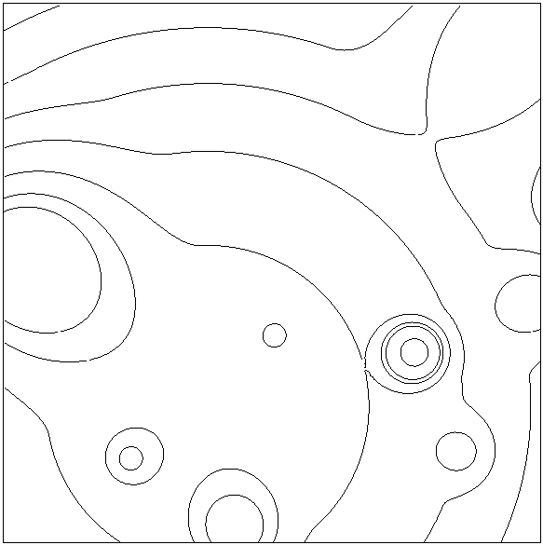
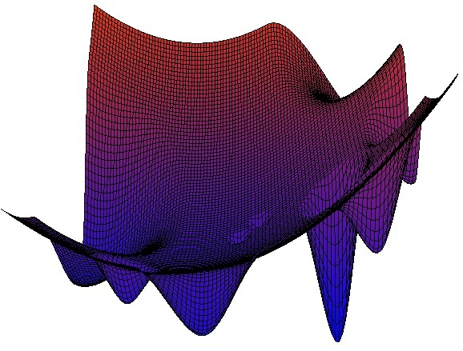

Results of numerical experiments…
In the second series of numerical experiments, we solved bi-criteria two-dimensional MOO problems, i.e. with $N = 2$, $s = 2$.
We used multiextremal functions obtained with the help of the GKLS generator

Slide 13
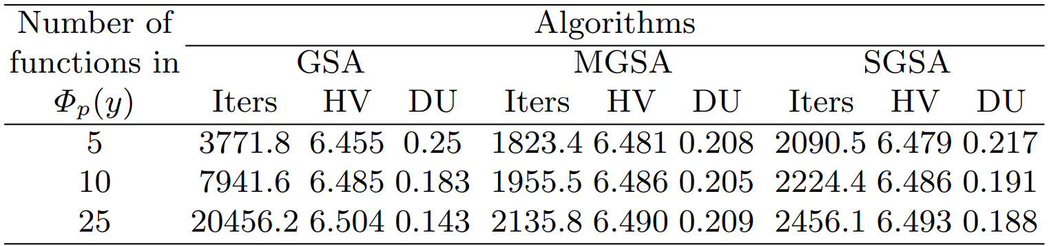
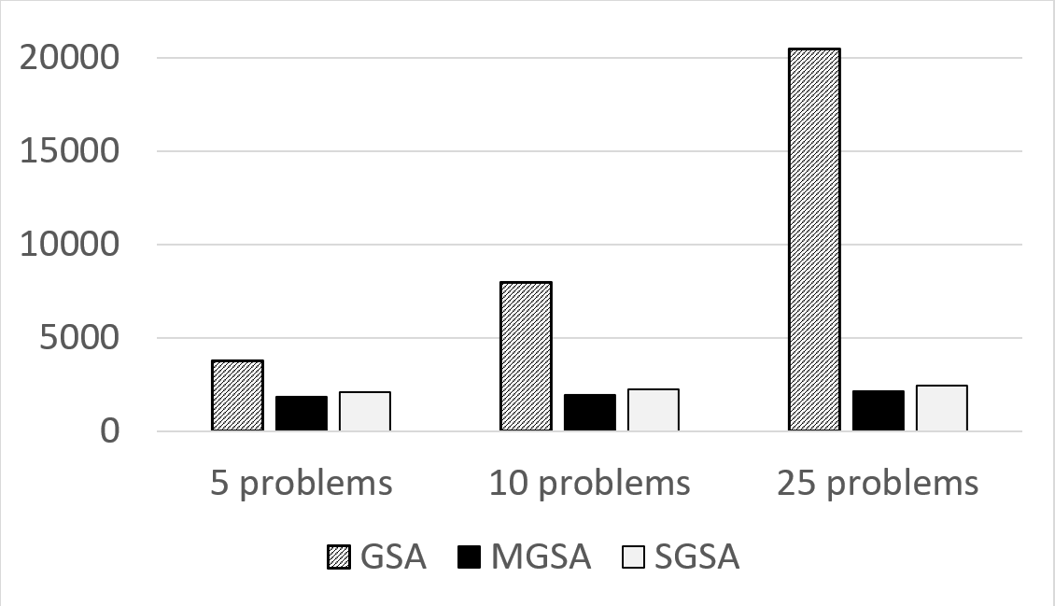

Results of numerical experiments…
In the second series of numerical experiments, we solved bi-criteria two-dimensional MOO problems, i.e. with $N = 2$, $s = 2$.

Slide 14
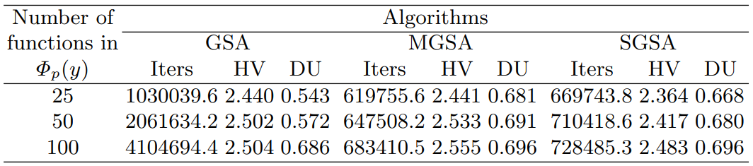
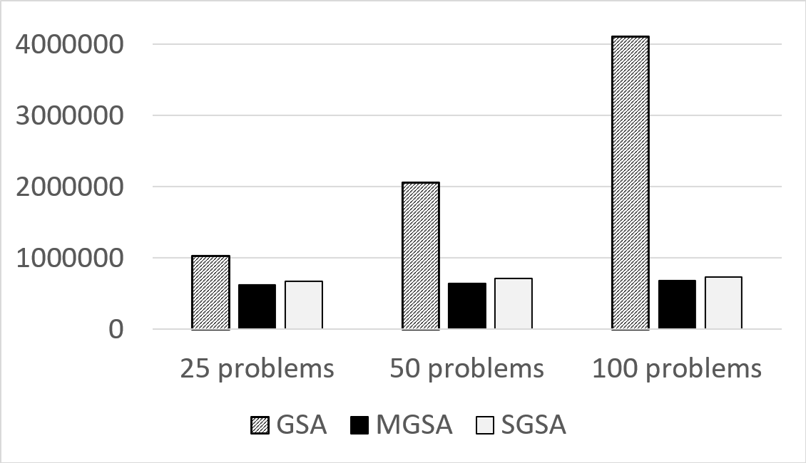
Results of numerical experiments…
In the third series of numerical experiments, we solved bi-criteria five-dimensional MOO problems, i.e. N = 5, s = 2.

Slide 15
Thanks for attention! Questions?
This work was supported by the Ministry of Science and Higher Education of the Russian Federation, project no.0729-2020-0055, and by the Research and Education Mathematical Center, project no. 075-02-2020-1483/1.
Lobachevsky State University of Nizhni Novgorod, Nizhni Novgorod, Russia
Konstantin Barkalov konstantin.barkalov@itmm.unn.ru
Victor Gergel gergel@unn.ru
Vladimir Grishagin vagris@unn.ru
Evgeniy Kozinov evgeny.kozinov@itmm.unn.ru

