Slide 1
Multistage Global Search Using Various Scalarization Schemes in Multicriteria Optimization Problems
Victor Gergel and Evgeniy Kozinov
Lobachevsky State University of Nizhni Novgorod, Nizhni Novgorod, Russia
gergel@unn.ru

Slide 2
Content
Multistage multicriteria optimization problem statement.
Reduction of the multistage multicriteria search to the scalar one-dimensional global optimization problems.
Computational complexity reduction of the multistage multicriteria search on the basis of the reuse of the search information.
Efficient solving the multistage multicriteria optimization problems with nonlinear constraints.
Results of numerical experiments.

Slide 3




Multistage multicriteria optimization problem statement
The object of decision making problem
w ( y ) = (w₁ ( y ), w₂ ( y ) ,…, w_{M} ( y )) – vector of characteristics,
y = (y₁, y₂,…, y_{s}) ∈ D – vector of varied parameters,
D = { y ∈ R^{N}: a_{i} ≤ y_{i} ≤ b_{i}, 1 ≤ i ≤ N } – search domain.
Requirements for optimization problem
f ( y ) = (f ₁ ( y ), f₂ ( y ),…, f_{s} ( y )), – vector criterion,
, – vector of constraints,
– are the allowances on the feasible values of characteristics.
Multicriteria optimization problem
The formulated set of requirements allow to define a set of multicriteria optimization problem

Slide 4
Reduction of the multistage multicriteria search to the scalar global optimization problems…
To solve problems of multicriteria optimization, scalarization of criteria can be applied:
F is the scalar objective function,
α is the vector of parameters of the applied criteria scalarization method,
g(y) are the constraints of the multicriteria optimization problem from,
D is the search domain from.

Slide 5




Reduction of the multistage multicriteria search to the scalar global optimization problems…
The following scalarization methods are possible:
The minimax convolution scheme (MMC)
The method of successive concessions (MSC)
The reference point method (RPM)

Slide 6


Reduction of the multistage multicriteria search to the scalar global optimization problems
Within the framework of the developed approach, it is possible to change the used scalarization methods and/or altering the parameters of convolutions λ, δ and θ.
Such variations expand the set of the MCO problems P necessary for solving the initial decision making problem into a wider set of the scalar global optimization problems
in which each problem from can correspond to several global optimization problems.
In our approach the multidimensional global optimization problem additionally is reduced to a one-dimensional problem

Slide 7
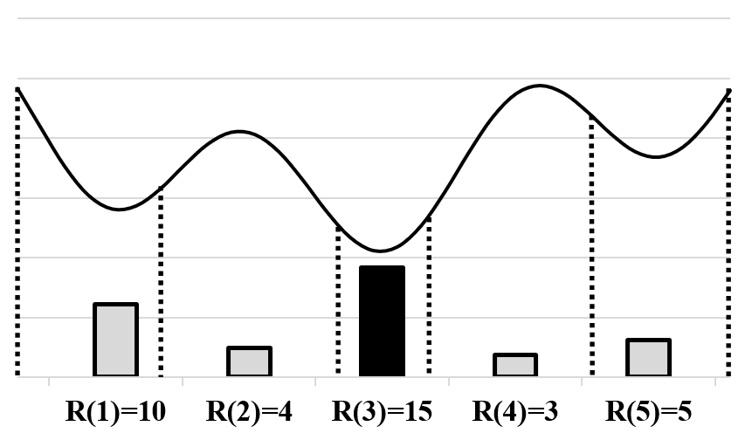

Global search algorithm
Trial - calculation of the values of the vector function 𝑤(𝑦(𝑥_{i})) at the point 𝑥_{i}.
The general scheme of the global search algorithm:
The first trial is carried out at an arbitrary point 𝑥₁ ∈ (0,1). Further:
Sort trial points in ascending order of their coordinates 0 = 𝑥₀ < 𝑥₁ < … < 𝑥_{𝑖} < … < 𝑥_{𝑘} < 𝑥_{𝑘+1} = 1.
For each interval (𝑥_{𝑖+1}, 𝑥_{𝑖}) calculate the value of the characteristic 𝑅(𝑖).
Find the interval (x_{𝑡−1}, x_{𝑡}), to which the maximum characteristic corresponds 𝑅(𝑡) = max {𝑅(𝑖): 1 ≤ 𝑖 ≤ 𝑘+1}.
Carry out another trial at the interval 𝑥^{𝑘+1} ∈ (𝑥_{𝑡−1}, 𝑥_{𝑡} ).
Stop condition 𝜌_{𝑡} ≤ 𝜀, where
*Стронгин, Р.Г. Численные методы в многоэкстремальных задач. – М.: Наука, 1978.

Slide 8


Computational complexity reduction of the multistage multicriteria search
The numerical solving of the global optimization problems – the successive computing the values of characteristics w(y) at the points y^{i}.
The data obtained as a result of computations can be represented in the form of the matrix of the search information
As a result of scalarization and the use of the dimensionality reduction, the set Ω_{k} can be transformed into the form of the matrix of the search state
The set Ω_{k} allows reducing the results of all preceding computations z_{i}, 1 ≤ i ≤ k from the matrix A_{k} to the values of the next optimization problem F(α, y (x)), i. e.

Slide 9
Results of numerical experiments…
The numerical experiments have been carried out using the computational nodes of Lobachevsky supercomputer at Nizhni Novgorod State University.
The peak perfor-mance of the supercomputer was 573 Tflops,
Each computational node was equipped with Intel Sandy Bridge E5-2660, processor 2.2 GHz, 64 Gb RAM.

Slide 10
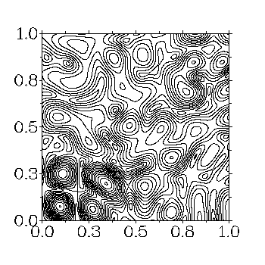
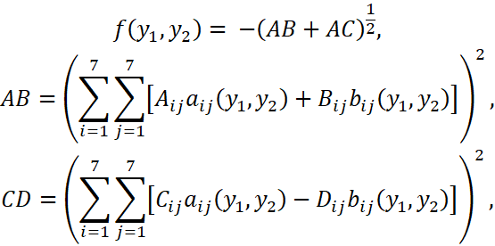
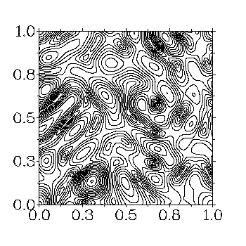


Results of numerical experiments…
Within the executed experiments, the two-dimensional bi-criterial MCO problems were used, the criteria of which were defined with the use of the next family of multiextremal functions:
where the expressions

Slide 11
Results of numerical experiments…
The initial series of the numerical experiments was performed to evaluate the positive effect (the reducing of the number of the executed iterations) due to the reuse of the search information.
The global search algorithm was applied different methods of scalarization:
The minimax convolution of the criteria (MMC).
The method of successive concessions (MSC).
The reference point method (RPM).
For each method mentioned above, 50 subproblems with various values of the parameters λ, δ and θ correspondingly have been solved.

Slide 12
Results of numerical experiments…
The construction of a numerical approximation (PDA) of the Pareto domain (PD) was understood as a solution of a MCO problem.
In order to evaluate the efficiency of constructing the PDA applied widely used indexes:
The completeness of coverage of the Pareto domain (hypervolume index, HV).
The uniformity of distribution of the numerical estimates of the efficient decisions (distribution uniformity index, DU).
The higher values of the index HV and the lower values of the index DU corresponds to the better approximation.
In order to evaluate the indicator HV of the completeness of the PDA approximation, the reference point (-4,-4) was used.

Slide 13
Results of numerical experiments…
Efficiency of the reuse of the search information in solving the MCO problem using various criteria scalarization methods.
MMC – the minimax convolution of the criteria.
MSC – the method of successive concessions.
RPM – the reference point method.
Scalarization Method | Search information |  |  |  |  |  |  |  | S
 | Not used |  |  |  | Used
 | Iters | PDA | HV | DU | Iters | PDA | HV | DU
MMC | 9124 | 152 | 53.4 | 0.64 | 922 | 44 | 52.7 | 0.91 | 9.9
MSC | 12802 | 88 | 52.8 | 1.16 | 1402 | 40 | 52.4 | 1.09 | 9.1
RPM | 12881 | 240 | 53.6 | 0.51 | 1323 | 56 | 53.0 | 0.83 | 9.7

Slide 14
Results of numerical experiments…
In the next experiment, solving a test MCO problem has been conducted with a use of the search information but the applied criteria scalarization methods varied in the course of computations.
In this experiment:
At the first stage of computations, the minimax criteria convolution was used in solving three subproblems (10) with the convolution coefficients (1,0), (0.5,0.5), and (0,1), correspondingly.
At the second stage, the scalarization method was changed to the reference point method, where the estimate (-14,-7) was used as the reference point with the weighting coefficients (0.5,0.5).
At the third stage, the method of successive concessions was applied with the concession with respect to the first criterion δ = 0.5.

Slide 15
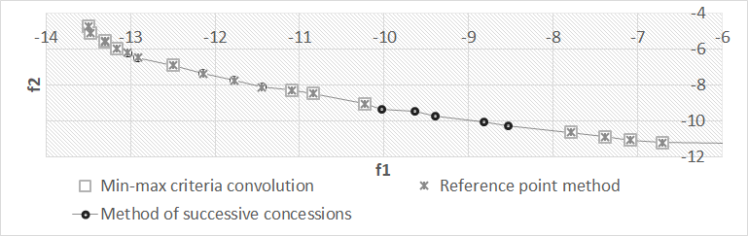
Results of numerical experiments
Results of solving the MCO problem with altering the criteria scalarization methods in the course of computations
Stage of computations, criteria scalarization method | Total iters. | New iters. | PDA
1. MMC, three subproblems | 304 | 304 | 14
2. RPM | 402 | 98 | 19
3. MSC | 437 | 35 | 24

Slide 16
Thanks for attention! Questions?
Lobachevsky State University of Nizhni Novgorod, Nizhni Novgorod, Russia
Victor Gergel, gergel@unn.ru
Evgeniy Kozinov, evgeny.kozinov@itmm.unn.ru

