Slide 1
An Approach for Simultaneous Finding of Multiple Efficient Decisions in Multi-objective Optimization Problems
Konstantin Barkalov, , Vladimir Grishagin and Evgeniy Kozinov
{konstantin.barkalov,evgeny.kozinov}@itmm.unn.ru,
{gergel,vagris}@unn.ru
Victor Gergel

Slide 2

Victor Gergel
14.01.1955 – 29.06.2021

Slide 3
Content
Multi-objective optimization problem
Reduction of the multi-objective optimization problem to the scalar one-dimensional global optimization problems
An approach for simultaneous finding of multiple efficient decisions in multi-objective optimization problems
Step-by-step solving a set of scalar optimization problems
Simultaneous solving a set of scalar optimization problems
Results of numerical experiments

Slide 4
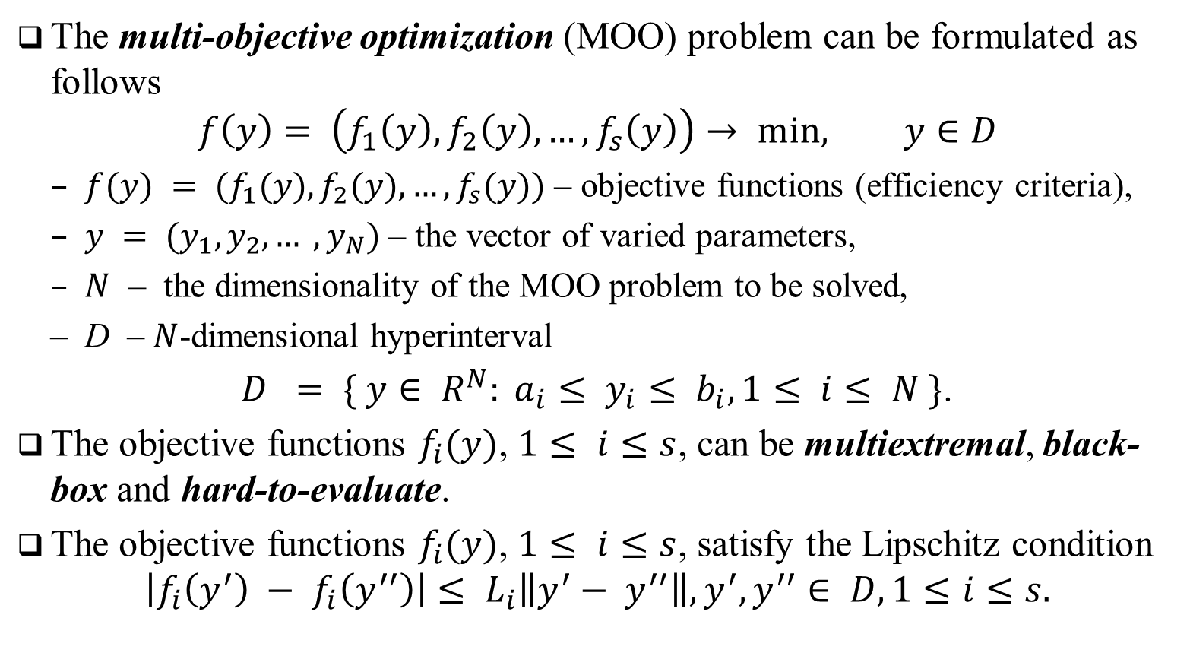
Multi-objective optimization problem
The multi-objective optimization (MOO) problem can be formulated as follows
$$f\left(y\right)= \left(f_{1}\left(y\right), f_{2}\left(y\right), …,f_{s}\left(y\right)\right)→ min, y∈D$$
$f(y) = (f_{1}(y), f_{2}(y), …, f_{s}(y))$ – objective functions (efficiency criteria),
$y = (y_{1}, y_{2}, … , y_{N})$ – the vector of varied parameters,
$N$ – the dimensionality of the MOO problem to be solved,
D – $N$-dimensional hyperinterval
$D = \{ y∈ R^{N}: a_{i}≤ y_{i}≤ b_{i}, 1≤ i≤ N \}$.
The objective functions $f_{i}(y)$, $1≤ i≤s$, can be multiextremal, black-box and hard-to-evaluate.
The objective functions $f_{i}(y)$, $1≤ i≤s$, satisfy the Lipschitz condition
$$\left|f_{i}\left(y^{′}\right) − f_{i}\left(y^{′′}\right)\right|≤ L_{i}\left\|y^{′}− y^{′′}\right\|, y^{′}, y^{′′}∈ D, 1≤i≤s.$$

Slide 5
Общий процесс построения оценки области Парето
1. Задача многокритериальной оптимизации
2. Скаляризация критериев эффективности и редукция размерности
3. Выбор точки испытания на основе АГП
6. Построение оценки области Парето
4. Проведение испытаний
5. Накопление информации

Slide 6
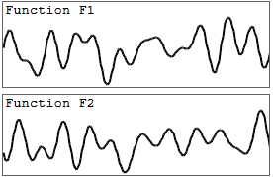
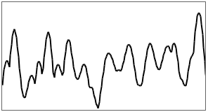

1. Scalarization of multiple objective functions
To solve MOO problems, scalarization of criteria can be applied
$$\min_{y∈D} φ\left(y\right) =\min_{y∈D} F(λ, y),$$
F – the scalar objective function,
$λ$ – the vector of parameters of the applied criteria scalarization method.
A possible scalarization method can be as follows
$$\min_{y∈D} F\left(λ,y\right)=\min_{y∈ D} \left\{\frac{1}{s} \sum_{i=1}^{s}{λ_{i}{\left(f_{i}\left(y\right)−f_{i}^{∗}\right)}^{2}} \right\}$$
$f^{∗}$ – the reference decision.

Slide 7
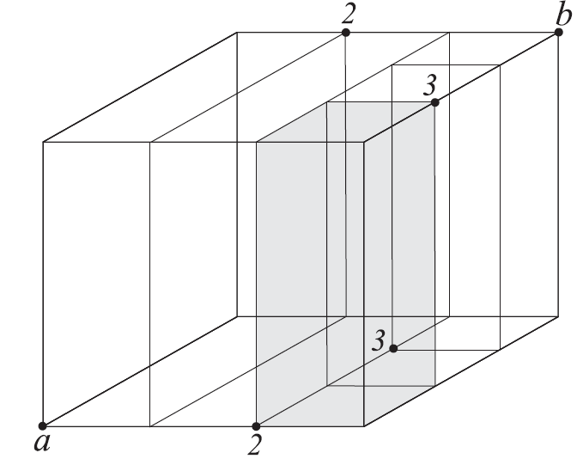
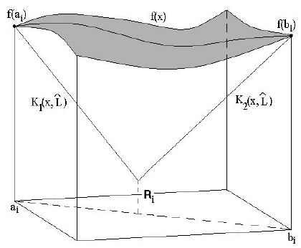
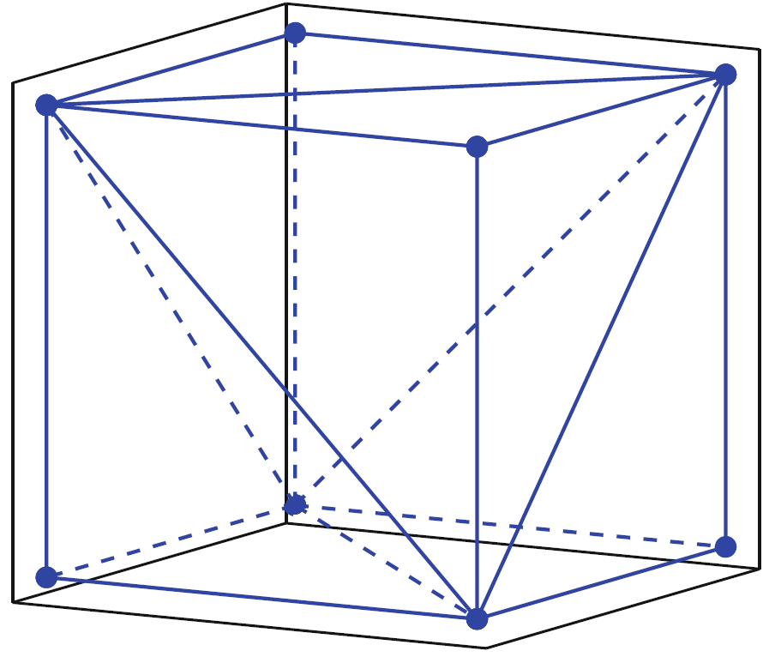
2. Dimensionality reduction
There are several ways to adapt efficient one-dimensional algorithms for solving multidimensional problems: the diagonal partitions method (Sergeyev, Kvasov 2017 ); the simplicial partitions method (Žilinskas, Paulavičius 2014) …

Slide 8
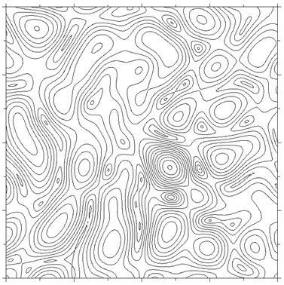
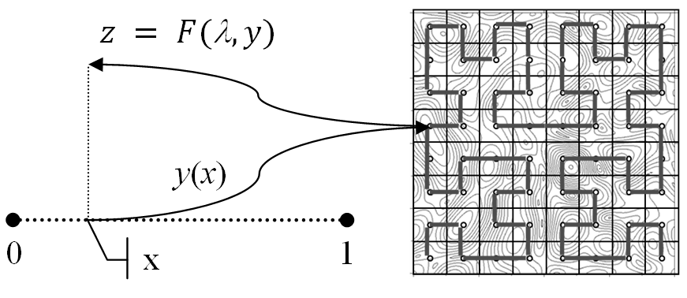



2. Dimensionality reduction
In our study, we used an approach based on the use of Peano space-filling curve $y(x)$ that uniquely and continuously maps the interval [0,1] onto an $N$-dimensional domain $D$
$$\min_{y∈D} φ\left(y\right)=\min_{x∈\left[0,1\right]} φ \left(y\left(x\right)\right)$$
$$z=φ\left(y\left(x\right)\right)$$
$$x$$

Slide 9
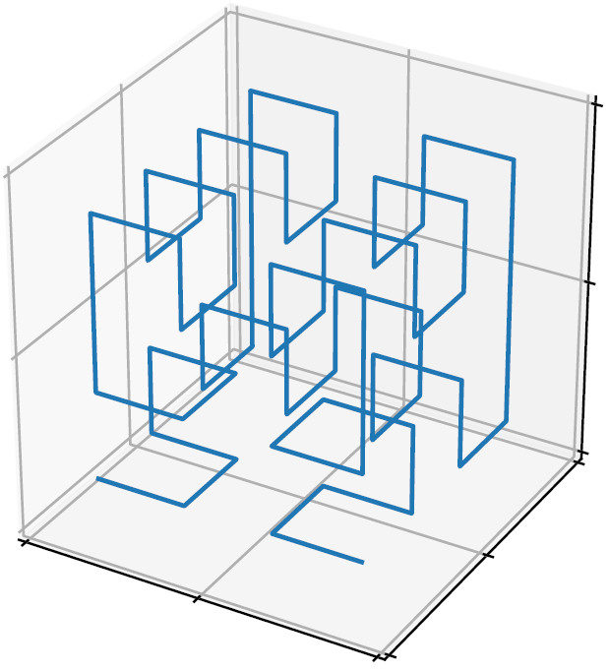
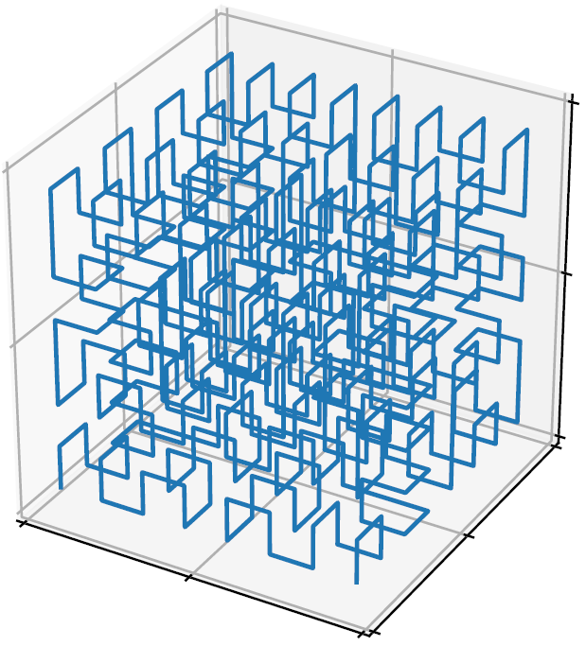
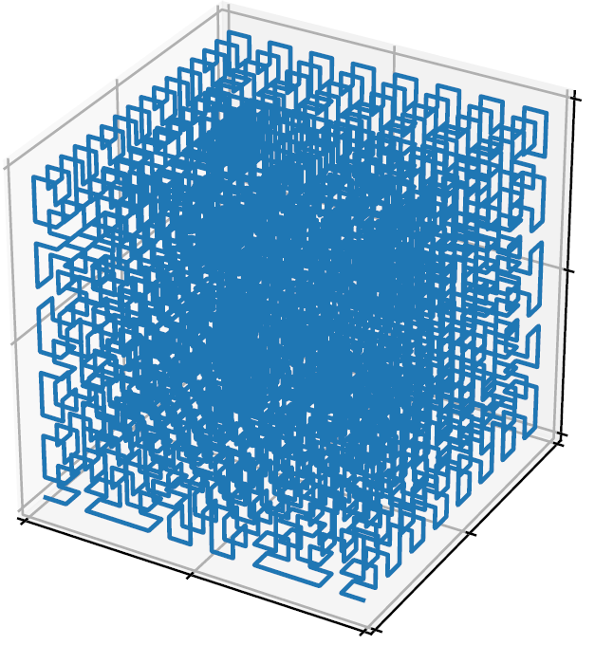
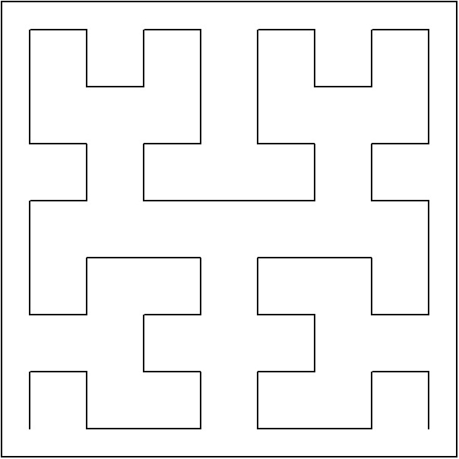
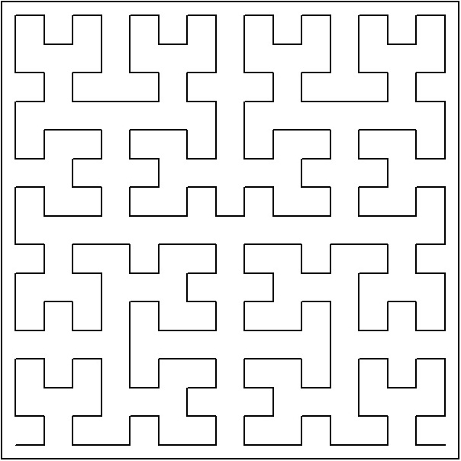
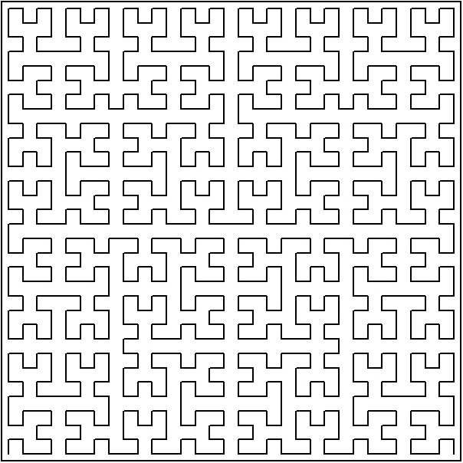

2. Dimensionality reduction
Numerical methods for building approximations of Peano curves with predefined accuracy (evolvents) are considered in Strongin, Sergeyev (2000) and Sergeyev, Strongin, Lera (2013)
If ϕ(y) is Lipschitzian with some constant L then the univariate function ϕ(y(x)) satisfies Hölder condition
where x₁, x₂∈[0,1]

Slide 10
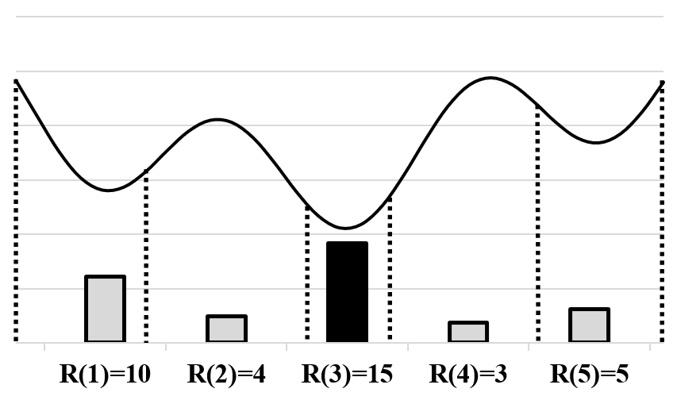
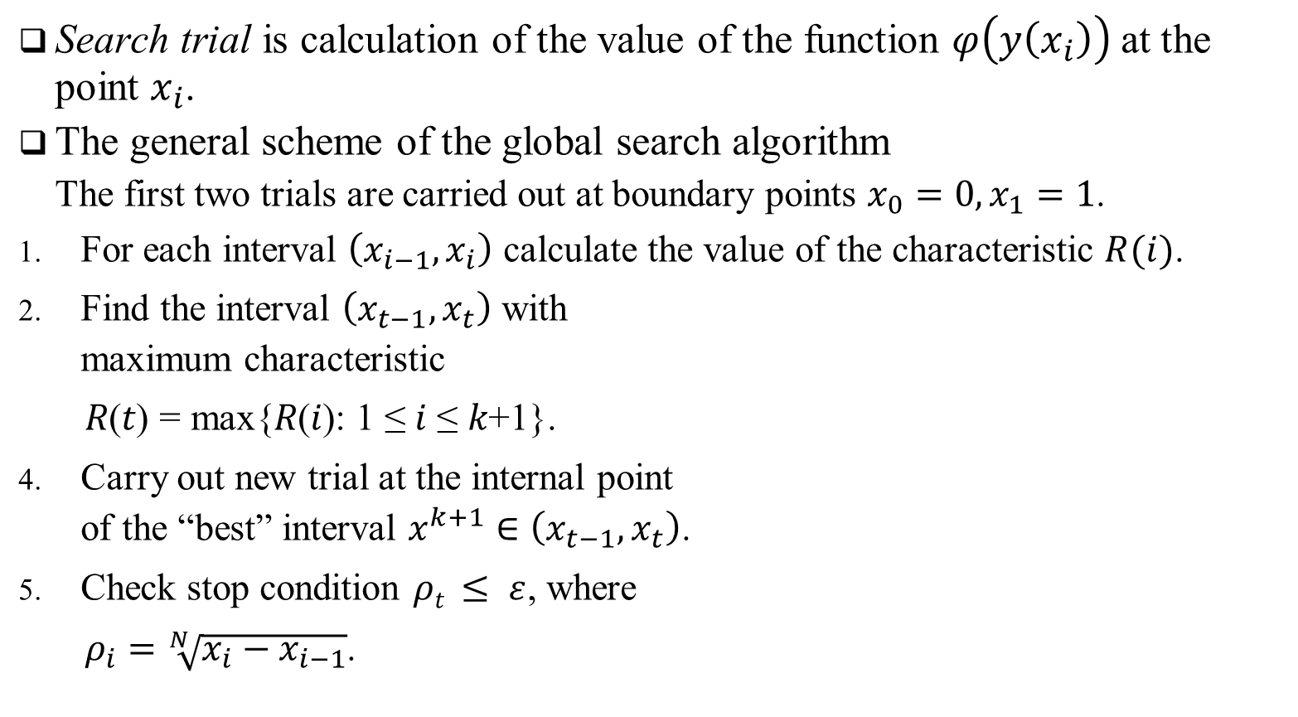
3. Global search algorithm
Search trial is calculation of the value of the function $φ\left(y\left(x_{i}\right)\right)$ at the point $x_{i}$.
The general scheme of the global search algorithm
The first two trials are carried out at boundary points $x_{0}=0,x_{1}=1$.
For each interval $\left(x_{i−1}, x_{i}\right)$ calculate the value of the characteristic $R(i)$.
Find the interval $\left(x_{t−1}, x_{t}\right)$ with maximum characteristic
$\text{R}\text{(}\text{t}\text{)} \text{=} \text{max}\text{\{}\text{R}\text{(}\text{i}\text{): 1} \text{≤} \text{i} \text{≤} \text{k}\text{+1\}.}$
Carry out new trial at the internal point of the “best” interval $x^{k+1}∈\left(x_{t−1}, x_{t}\right)$.
Check stop condition $ρt ≤ ε$, where
$ρ_{i}=\sqrt[N]{x_{i}−x_{i−1}}$.

Slide 11
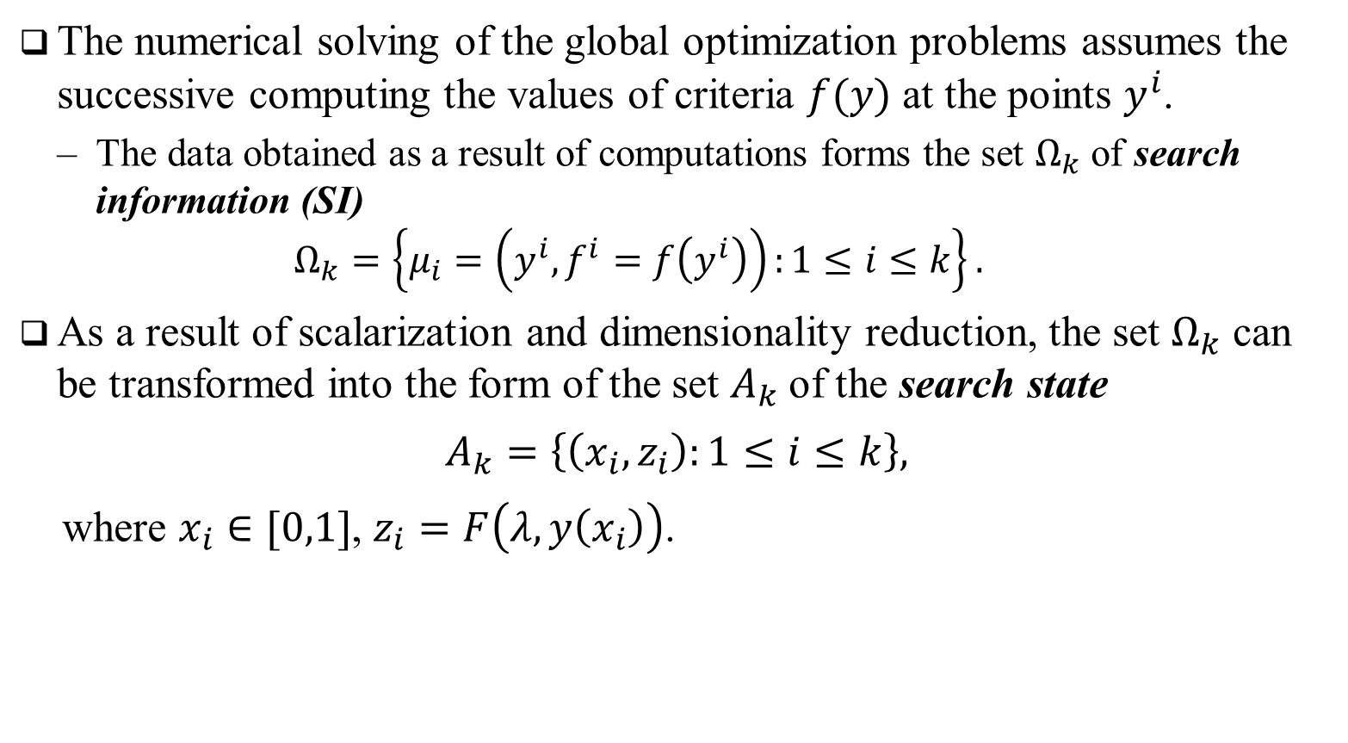
5. Multiple Global Search Algorithm…
The numerical solving of the global optimization problems assumes the successive computing the values of criteria $f(y)$ at the points $y^{i}$.
The data obtained as a result of computations forms the set $Ω_{k}$ of search information (SI)
$$Ω_{k}=\left\{μ_{i}=\left(y^{i}, f^{i}=f\left(y^{i}\right)\right):1≤i≤k\right\}.$$
As a result of scalarization and dimensionality reduction, the set $Ω_{k}$ can be transformed into the form of the set $A_{k}$of the search state
$$A_{k}=\left\{\left(x_{i}, z_{i}\right):1≤i≤k\right\},$$
where $x_{i}∈[0,1]$, $z_{i}=F\left(λ,y\left(x_{i}\right)\right)$.

Slide 12
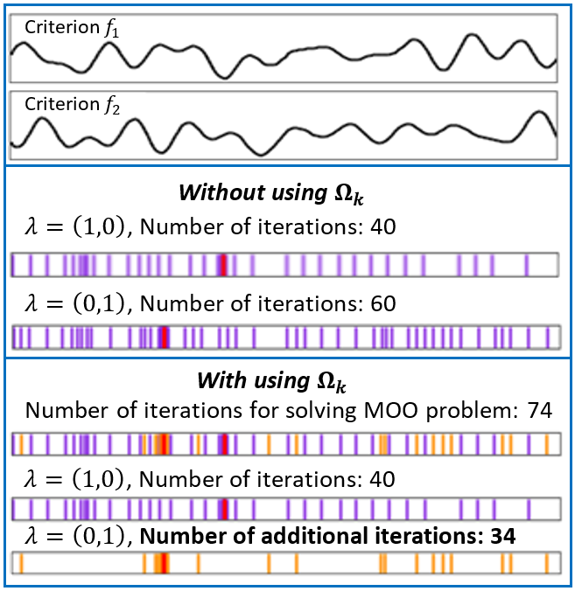
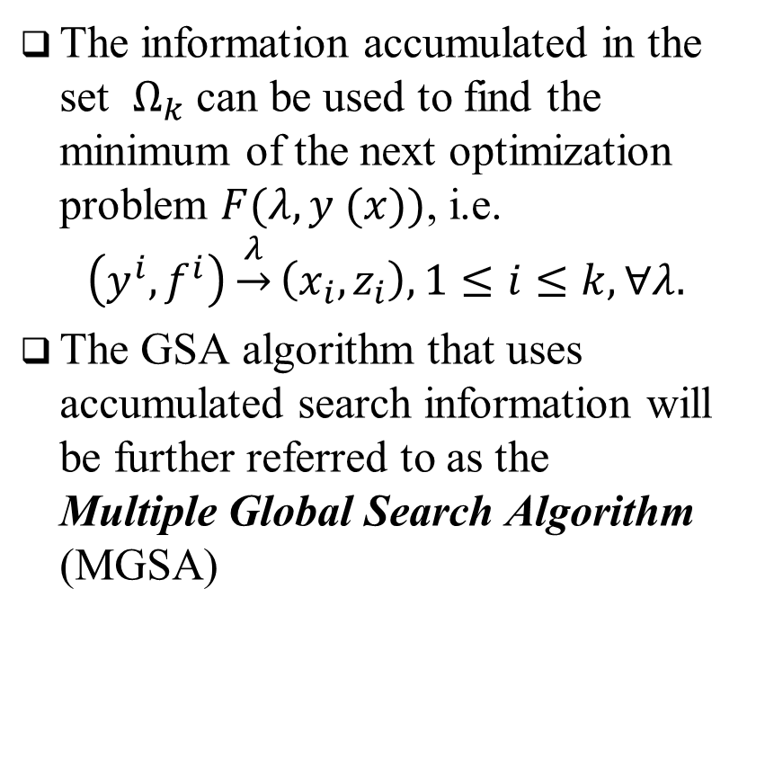
5. Multiple Global Search Algorithm
The information accumulated in the set $Ω_{k}$ can be used to find the minimum of the next optimization problem $F(λ, y (x))$, i.e.
$$\left(y^{i}, f^{i}\right)\underset{→}{λ}\left(x_{i},z_{i}\right),1≤i≤k, ∀λ.$$
The GSA algorithm that uses accumulated search information will be further referred to as the Multiple Global Search Algorithm (MGSA)

Slide 13
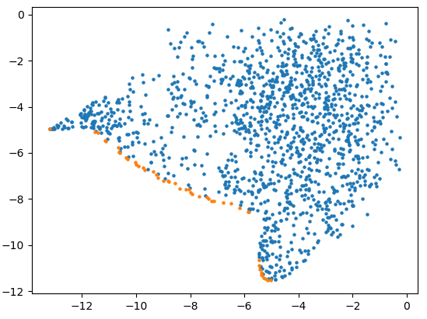
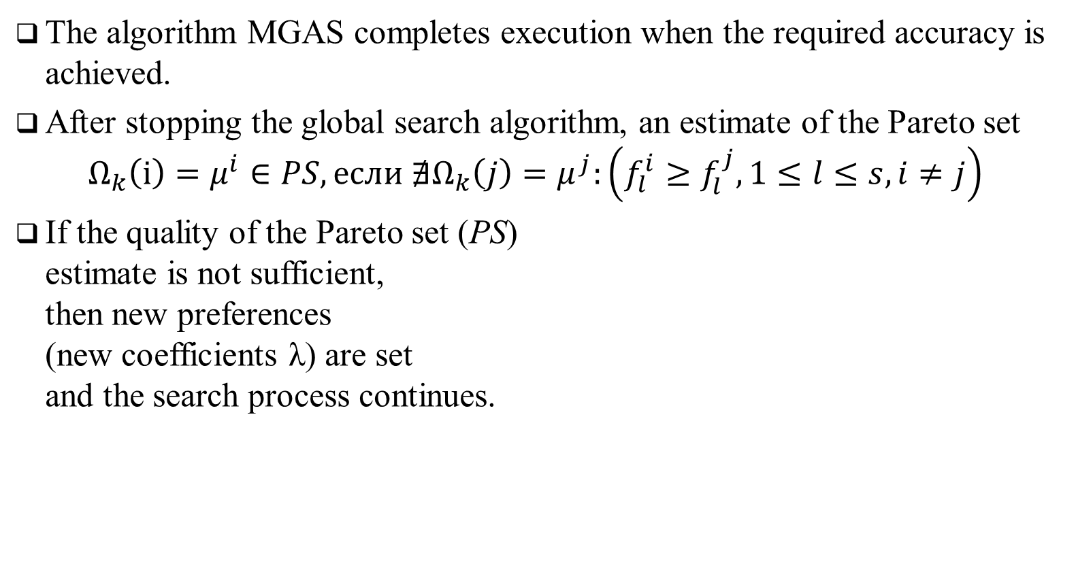
6. Построение оценки области Парето
The algorithm MGAS completes execution when the required accuracy is achieved.
After stopping the global search algorithm, an estimate of the Pareto set
$$Ω_{k}\left(i\right)=μ^{i}∈PS, если ∄Ω_{k}\left(j\right)=μ^{j}:\left(f_{l}^{i}≥f_{l}^{j}, 1≤l≤s,i≠j\right)$$
If the quality of the Pareto set (PS) estimate is not sufficient, then new preferences (new coefficients λ) are set and the search process continues.

Slide 14
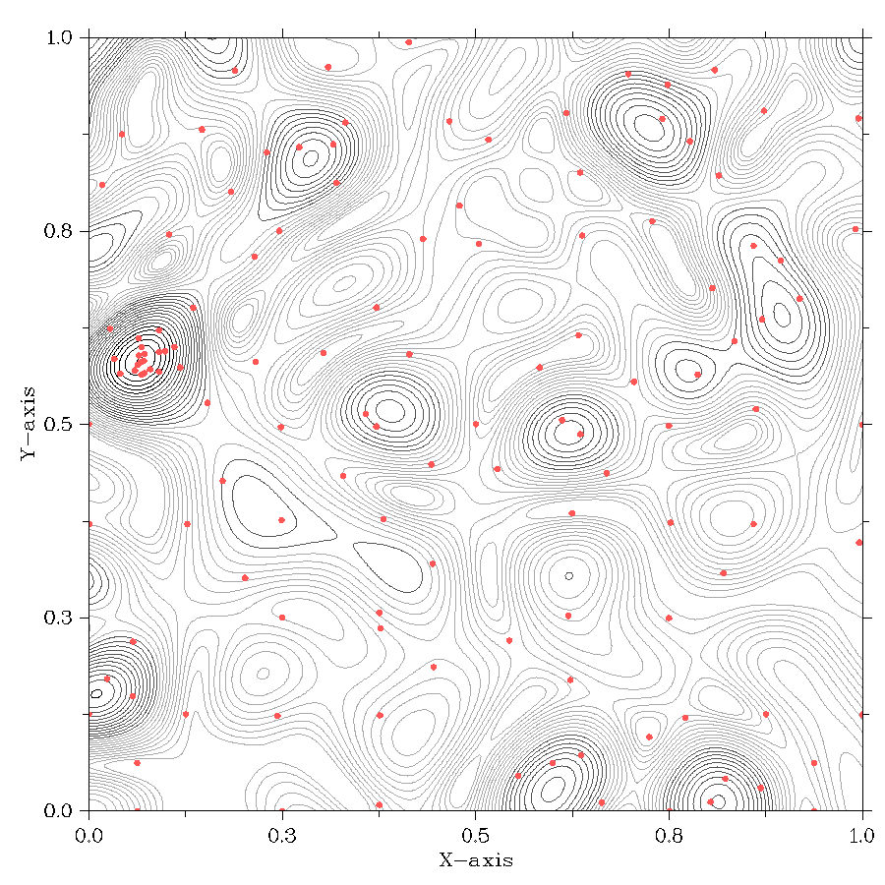
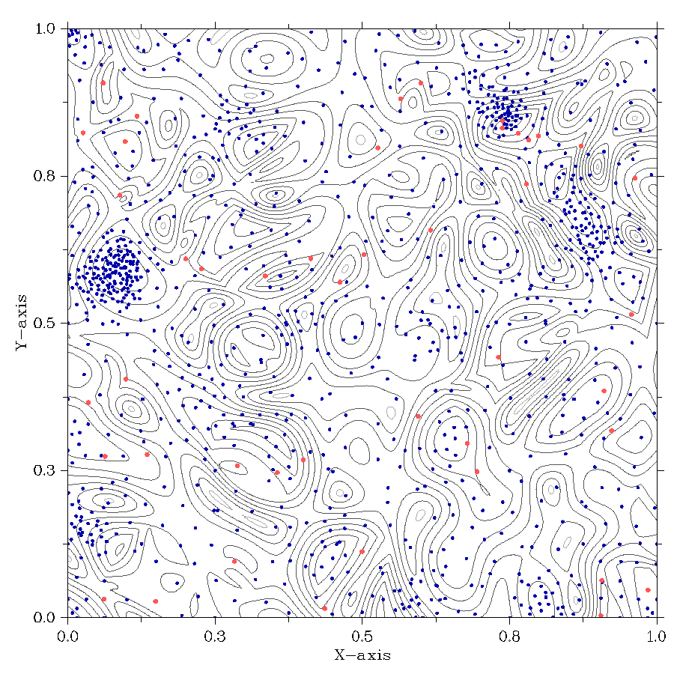
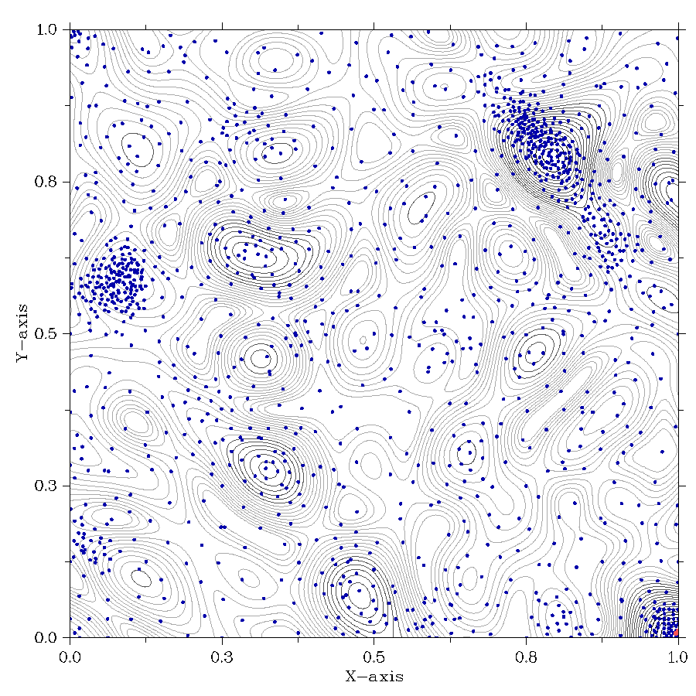
Пример исследования области поиска при решении двумерной задачи МКО
Пример исследования области поиска при решении двумерной задачи МКО
Состояние области поиска при решении серий подзадач (1, 25, 50)
Рыжие точки – новые испытания при решении очередной подзадачи
Решение серии подзадач уточняет оценку области Парето
Точки испытаний концентрируются вблизи к области Парето

Slide 15
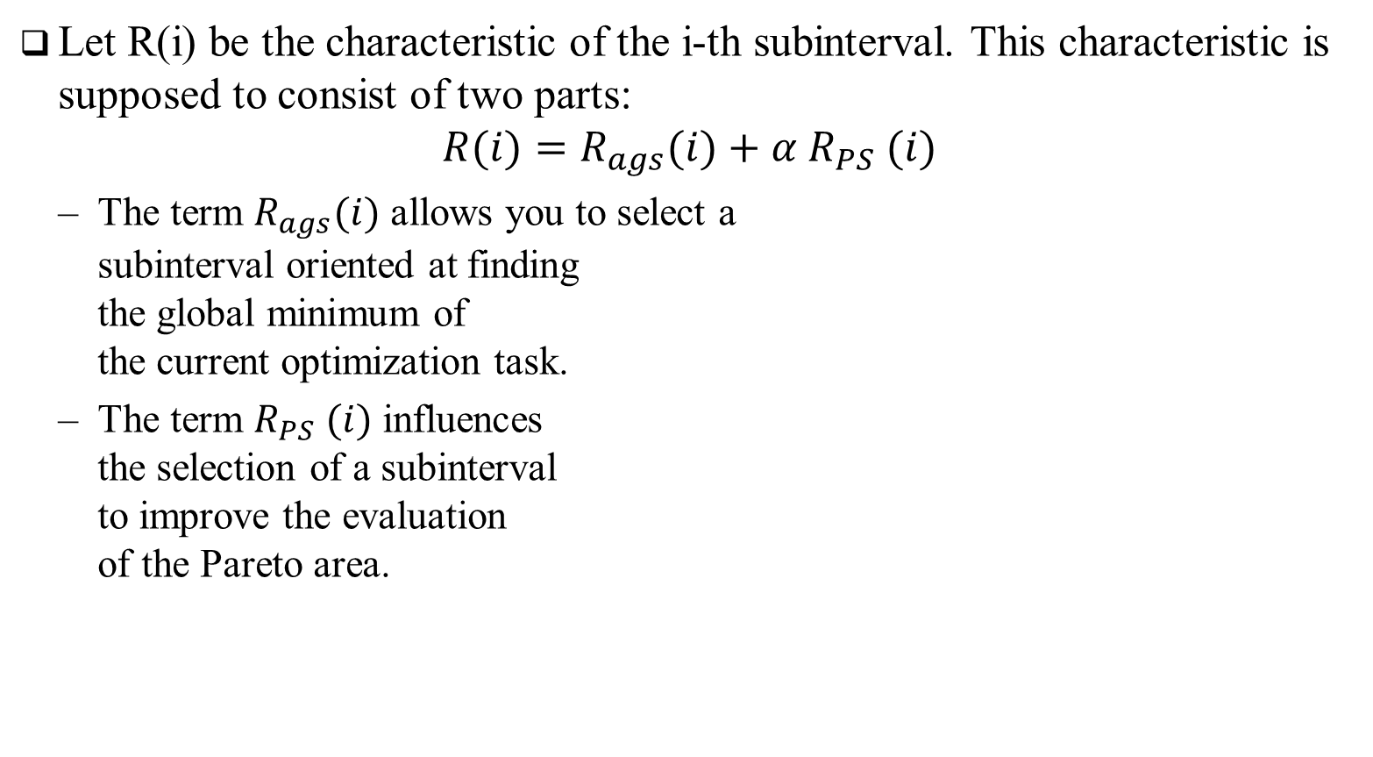
Approaches to improving search efficiency
Let R(i) be the characteristic of the i-th subinterval. This characteristic is supposed to consist of two parts:
$$R(i)=R_{ags}(i)+α R_{PS} (i)$$
The term $R_{ags}(i)$ allows you to select a subinterval oriented at finding the global minimum of the current optimization task.
The term $R_{PS} (i)$ influences the selection of a subinterval to improve the evaluation of the Pareto area.

Slide 16
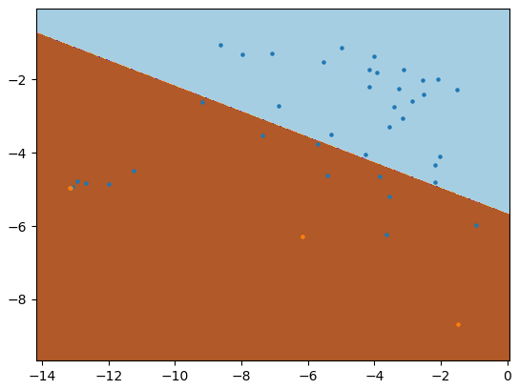
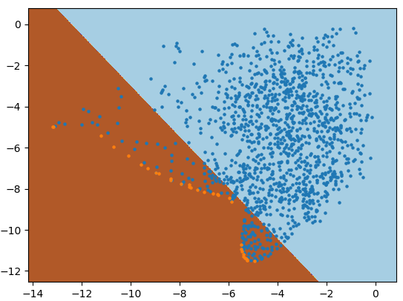
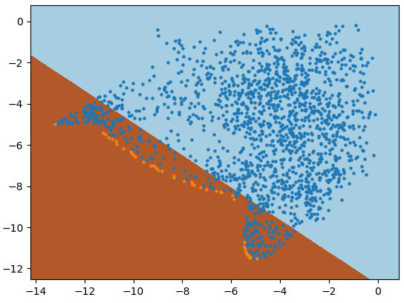

Approaches to improving search efficiency
Для каждого элемента множества поисковой информации ставиться соответствие метка принадлежности классу
$$Ω_{k}→\overline{Ω_{k}}=\left\{{\left(μ^{i}, L_{i}\right)}^{T}:0≤i≤k\right\},L=\left\{\begin{aligned}1,Ω_{k}\left(i\right)∈PS \\ 0,Ω_{k}\left(i\right)∉PS\end{aligned}\right.$$
На основе размеченной информации строится разделяющая гиперплоскость
Точки испытаний области Парето имеют больший вес при обучении

Slide 17




Approaches to improving search efficiency
Для каждой точки проведенных испытаний вычислить расстояние со знаком до разделяющей гиперплоскости $L_{PS}$
$$d_{i}=Θ(L_{PS},μ_{i})$$
Правило вычисления значения характеристик $R_{PD} (i)$
$$R_{PS} (i)= (d_{i}+d_{i−1})$$
$$d_{i}<0$$
$$d_{j}>0$$
$$L_{PS}$$

Slide 18
Results of numerical experiments…
The numerical experiments have been carried out using the computational nodes of Lobachevsky supercomputer at Nizhni Novgorod State University.
The peak performance of the supercomputer was 573 Tflops,
Each computational node was equipped with Intel Sandy Bridge E5-2660, processor 2.2 GHz, 64 Gb RAM.

Slide 19
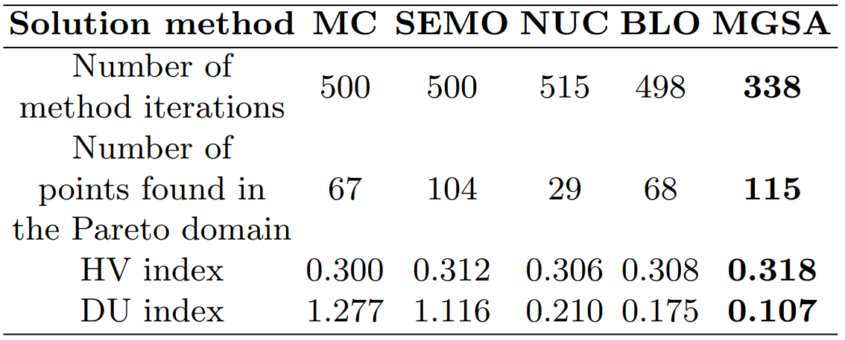
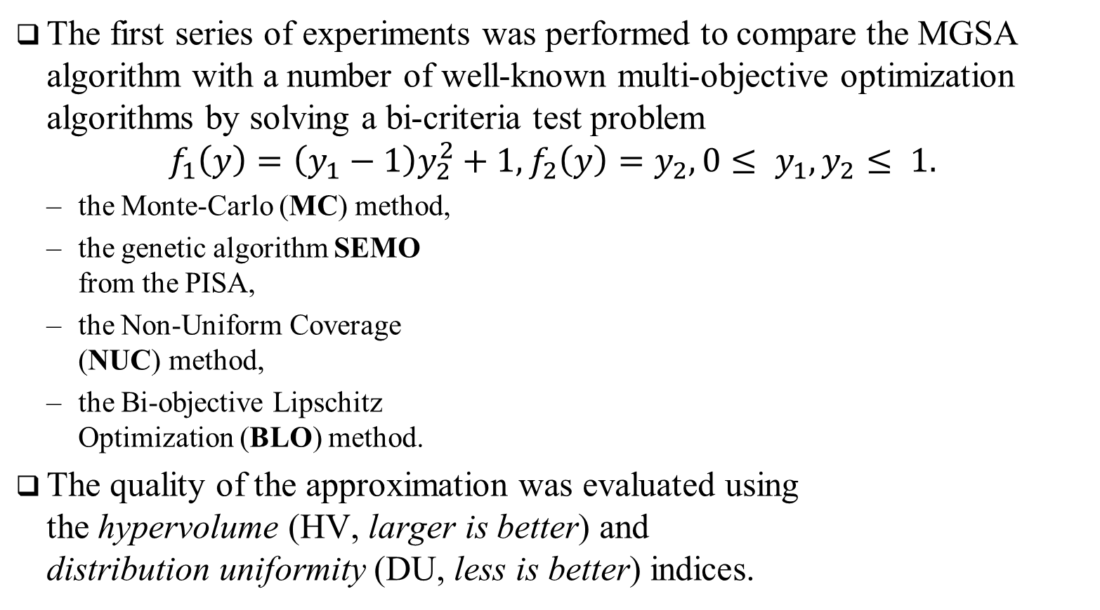
Results of numerical experiments…
The first series of experiments was performed to compare the MGSA algorithm with a number of well-known multi-objective optimization algorithms by solving a bi-criteria test problem
$$f_{1}\left(y\right)=\left(y_{1}−1\right)y_{2}^{2}+1,f_{2}\left(y\right)=y_{2}, 0≤ y_{1}, y_{2}≤ 1.$$
the Monte-Carlo (MC) method,
the genetic algorithm SEMO from the PISA,
the Non-Uniform Coverage (NUC) method,
the Bi-objective Lipschitz Optimization (BLO) method.
The quality of the approximation was evaluated using the hypervolume (HV, larger is better) and distribution uniformity (DU, less is better) indices.

Slide 20
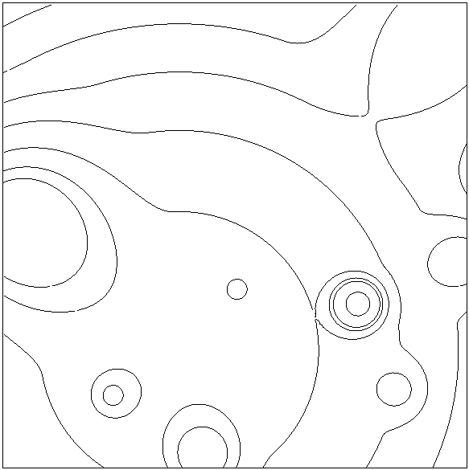
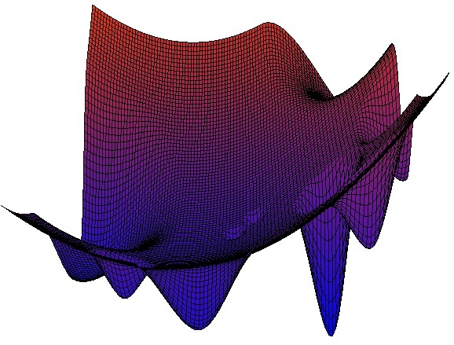

Results of numerical experiments…
In the second series of numerical experiments, we solved bi-criteria two-dimensional MOO problems, i.e. with $N = 2$, $s = 2$.
We used multiextremal functions obtained with the help of the GKLS generator

Slide 21
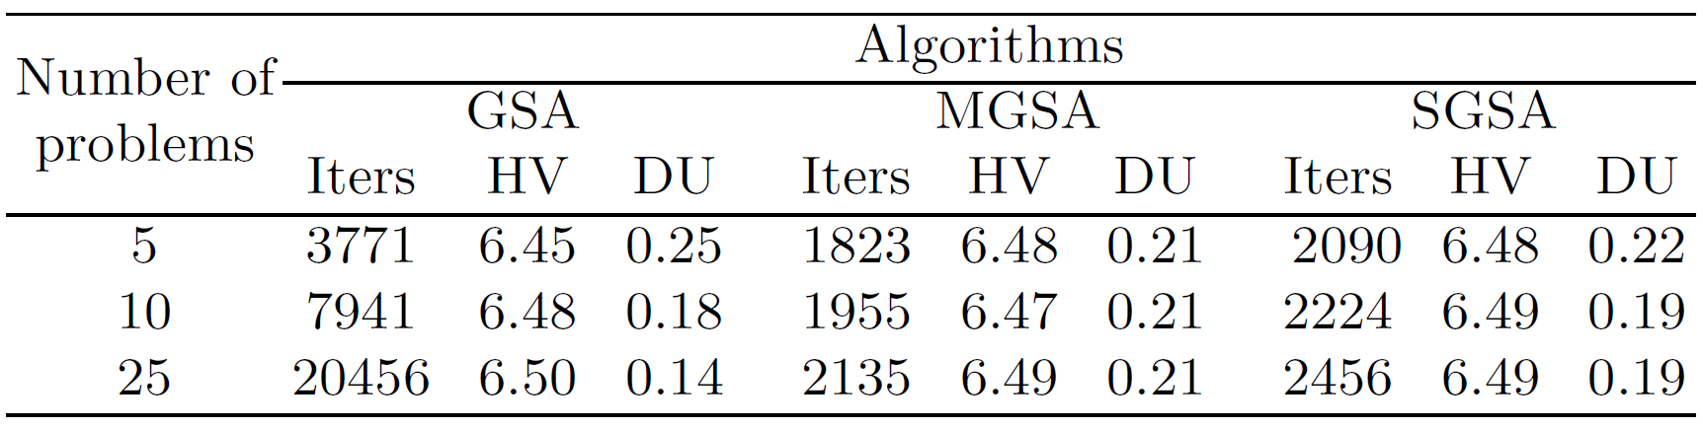
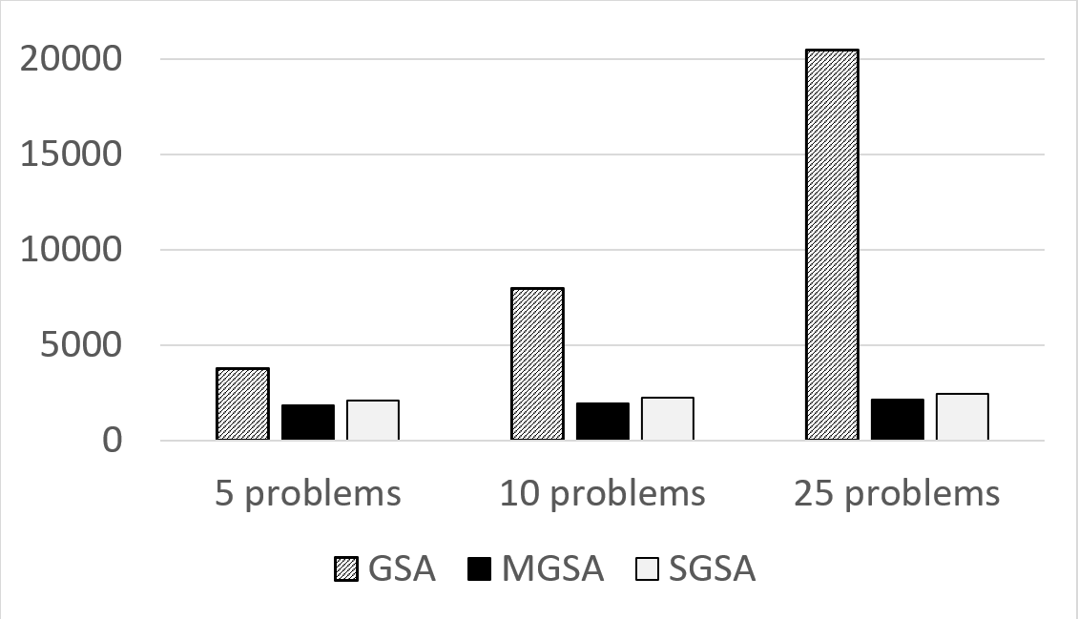

Results of numerical experiments…
In the second series of numerical experiments, we solved bi-criteria two-dimensional MOO problems, i.e. $N = 2$, $s = 2$.

Slide 22
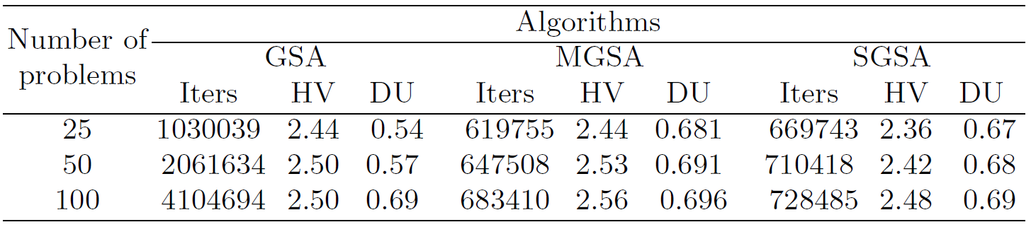
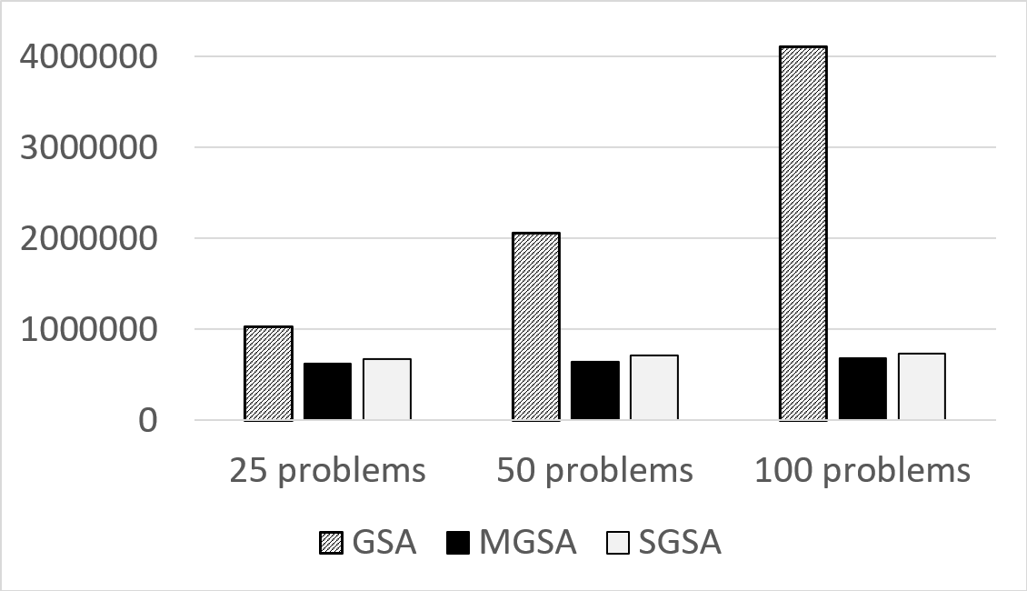

Results of numerical experiments…
In the third series of numerical experiments, we solved bi-criteria five-dimensional MOO problems, i.e. $N=5, s=2$.

Slide 23
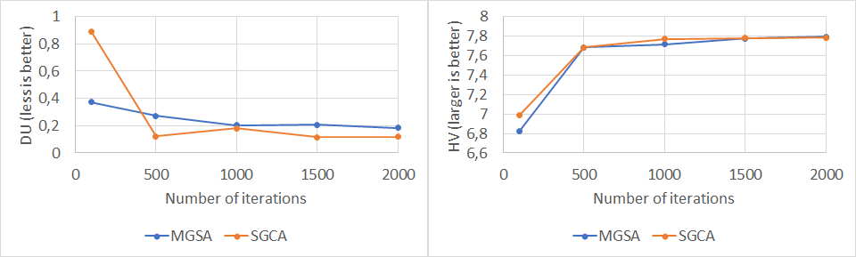
Results of numerical experiments…
In the second series of numerical experiments, we solved bi-criteria two-dimensional MOO problems, i.e. $N = 2$, $s = 2$.

Slide 24
Thank you for attention
This work was supported by the Ministry of Science and Higher Education of the Russian Federation, project no.0729-2020-0055, and by the Research and Education Mathematical Center, project no. 075-02-2020-1483/1.
Lobachevsky State University of Nizhni Novgorod, Nizhni Novgorod, Russia
Konstantin Barkalov konstantin.barkalov@itmm.unn.ru
gergel@unn.ru
Vladimir Grishagin vagris@unn.ru
Evgeniy Kozinov evgeny.kozinov@itmm.unn.ru
Victor Gergel

Slide 25
