Slide 1
01
Presentation:
MOVIE RECOMMENDER SYSTEM

Slide 2

"For me, it is all about the big picture. Because of this, I have developed a passion for using data and common sense to generate simple, implementable solutions to complex problems."
INTRODUCTION
02
Lebo Lamola, Data Scientist

Slide 3
Introduction
Summary
Problem Statement
Data Imports
Exploratory Data Ananlysis
Base Model Testing
Data Trimming
Strategy
Timeline
Methods
02
15
04
50
05
54
06
61
08
72
CONTENTS

Slide 4
SUMMARY
04
—Recommender systems are used to predict the “rating” or “preference” that a user will give an item.
THE PAST YEAR
CLASSIFICATION
KEY ACHIEVEMENTS
Almost every tech company has applied them in some form, such as:
  Amazon- to suggest products to customers
  Youtube- to decide which video to play next on autoplay
  Facebook- to suggest which pages to like and people to follow
  Content based recommenders
  Collaborative Filters
  And Simple recommenders
To create a stunning presentation, it's best to simplify your thoughts. Start with an outline of topics and identify highlights, which can be applied to whatever subject you plan on discussing. You can then organize them into your introduction, your main content, and your conclusion.

Slide 5
PROBLEM STATEMENT
Construct a recommendation algorithm based on content or collaborative filtering, that can predict users’ ratings for movies they have not yet viewed based on historical preference.
APPROACH 1
  Made use of Content based recommendation algorithm
  Using Cosine similarity metrics as weights and similarity metrics
APPROACH 2
  Made use of Collaborative Filltering sytem by using Matrix Factorization
05

Slide 6
DATA IMPORTS
06
Movie
imdb
links
genomescores
What are you doing well? What sets you apart? What are your good qualities?
Additional movie metadata scraped from IMDB
File providing a mapping between a MovieLens ID and associated IMDB and TMDB IDs
a score mapping the strength between movies and tag-related properties.

Slide 7
07
Genome Tags
imdb
Training Set
Test Set
user assigned tags for genome-related scores
Additional movie metadata scraped from IMDB
The test split of the dataset. Contains user and movie IDs with no rating data
The training split of the dataset. Contains user and movie IDs with associated rating data

Slide 8
08
BASIC DATA ANALYSIS
  facilitate the identification of missing data and data types
  From the assessment we see that our dataset consists of a combination of numeric and non-numeric data types.
  The imdb dataset is has 36% - 71% missing data across all the columns. This data set will therefore not be considered going forward in this exercise
IN-DEPTH DATA ANALYSIS
EXPLORATORY DATA ANALYSIS
  Consists of graphs and interpretations

Slide 9
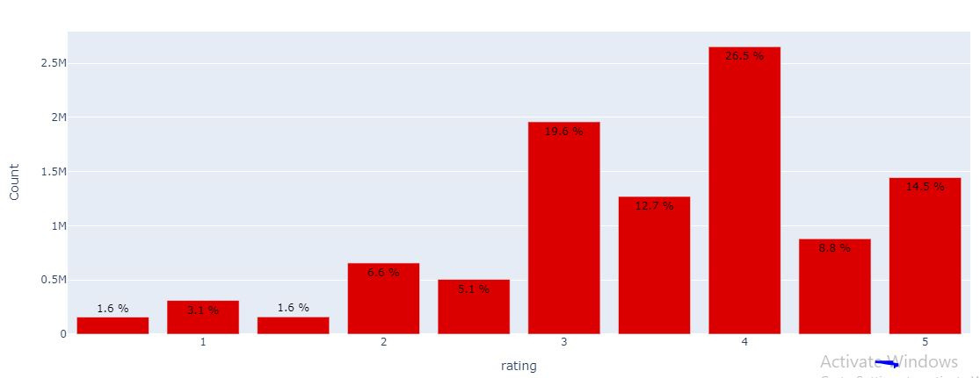
DISTRIBUTION OF MOVIE RATINGS
09

Slide 10
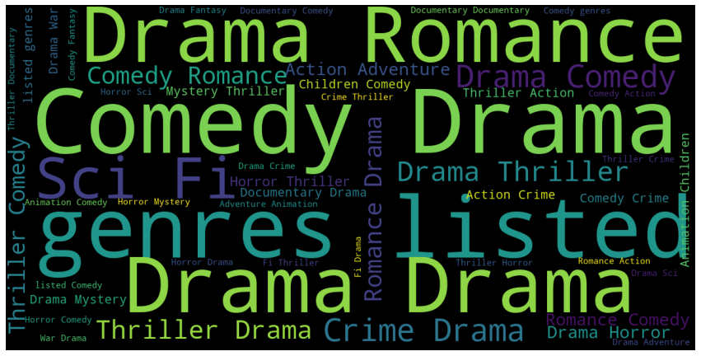
GENRE WORD CLOUD
10
  THE GENRES DATA INCLUDES A COMBINATION OF DIFFERENT GENRES, THIS CAN NORMALISED TO 1NF TO MAKE THE DATA EASIER TO ANALYSE

Slide 11
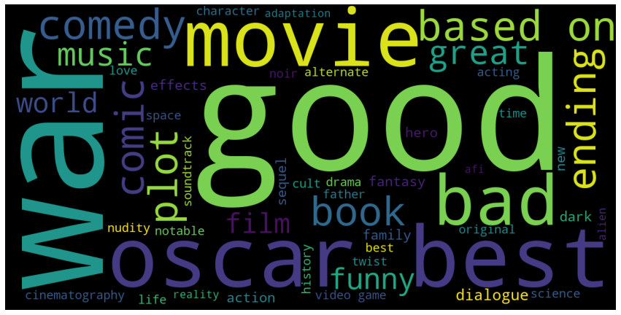
GENOME TAG CLOUD
11

Slide 12
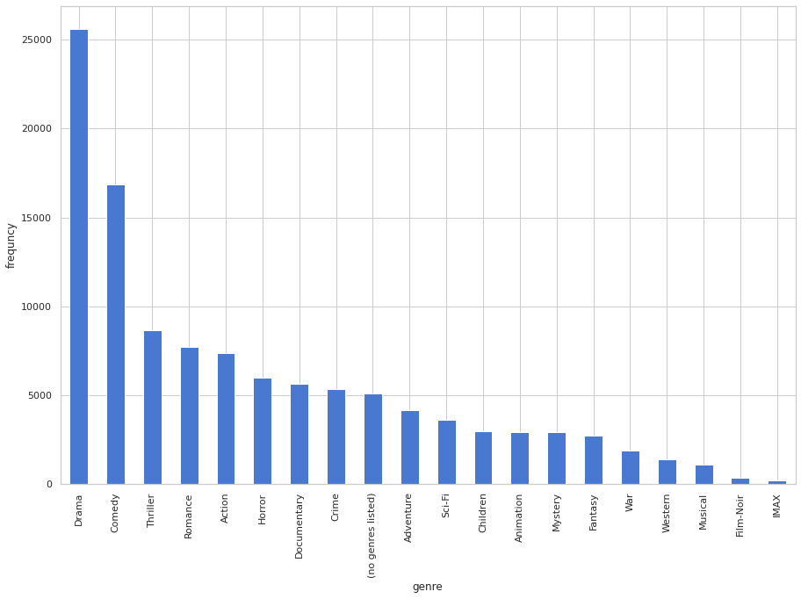
NUMBER OF GENRE RATINGS
12

Slide 13
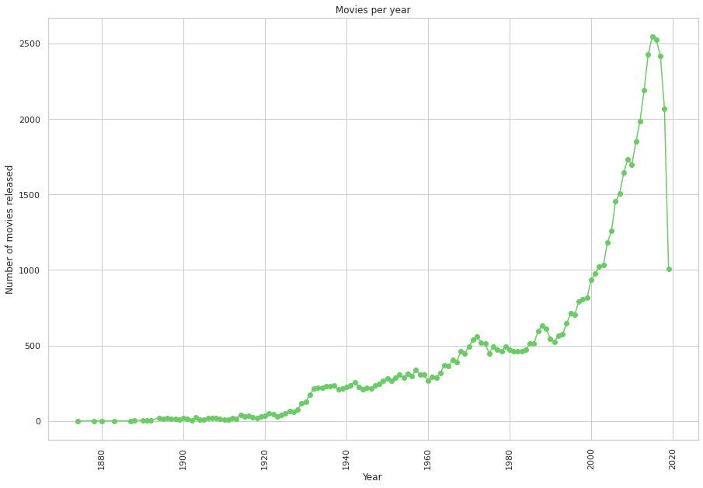
NUMBER OF MOVIES PER YEAR
13

Slide 14
NUMBER OF MOVIES PER YEAR
14

Slide 15

15
BASE MODEL TESTING

Slide 16
CROSS-VALIDATION TESTING
Benchmark
0.934430
20%
70%
SVD
NMF
NORMAL PREDICTOR
0.931745
50%
45%
0.932065
BASELINE ONLY
SLOPE ONE
CO-CLUSTERING
SVD++
16

Slide 17
TRAIN-TEST-SPLIT TESTING OF TOP 2 MODELS (TEST SET)
0.8380
0.8680
SVD
BASELINE ONLY
17

Slide 18
MODEL TESTING WITH HYPER PARAMETERS TUNED
0.8461
0.8643
SVD
BASELINE ONLY
18

Slide 19
19
DATA TRIMMING

Slide 20
REMOVING DATA FOR MOVIES < 25 RATINGS & USERS <10 RATINGS
20
LOGIC 1
LOGIC 2
  excluding movies with few reviews we protentially exclude volatility
  train our models on trustworthy data representative of the population data
Old
New
(10000038, 4)
(9660216, 4)

Slide 21
TESTING MODELS ON TRIMMED DATASET - I
0.8321
0.8606
SVD
BASELINE ONLY
21

Slide 22
TESTING MODELS ON TRIMMED DATASET - I
0.8321
0.8606
SVD
BASELINE ONLY
22

Slide 23
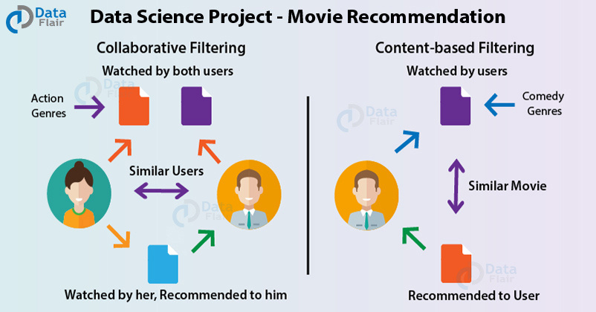
RECOMMENDER SYSTEM
23
05

Slide 24
CONTENT-BASED RECOMMENDER SYSTEM
  This technique attempts to figure OUT WHAT A USER'S FAVOURITE ASPECTS OF AN ITEM ARE, AND THEN RECOMMENDS ITEMS THAT PRESENT THOSE ASPECTS.
  IN OUR CASE, WE'RE GOING TO TRY TO FIGURE OUT THE TOP 10 MOVIES THAT ARE SIMILAR TO THE THREE INPUT MOVIES OF A SPECIFIC USER.
  IN ORDER TO MAKE THE RECOMMENDATIONS, WE COMPUTE THE SIMILARITY MATRIX OF THE MOVIES.
  MAP THE INPUT MOVIES TO SIMILARITY VECTORS
  SORT THE VECTOR IN DESCENDING ORDER
  SELECT THE TOP 10 SIMILARITIES
  USE THE SIMILARITY INDEXES TO MAP THE SIMILARITIES TO MOVIE TITLES.
05

Slide 25
CONTENT-BASED RECOMMENDER SYSTEM
  This technique attempts to figure OUT WHAT A USER'S FAVOURITE ASPECTS OF AN ITEM ARE, AND THEN RECOMMENDS ITEMS THAT PRESENT THOSE ASPECTS.
  IN OUR CASE, WE'RE GOING TO TRY TO FIGURE OUT THE TOP 10 MOVIES THAT ARE SIMILAR TO THE THREE INPUT MOVIES OF A SPECIFIC USER.
  IN ORDER TO MAKE THE RECOMMENDATIONS, WE COMPUTE THE SIMILARITY MATRIX OF THE MOVIES.
  MAP THE INPUT MOVIES TO SIMILARITY VECTORS
  SORT THE VECTOR IN DESCENDING ORDER
  SELECT THE TOP 10 SIMILARITIES
  USE THE SIMILARITY INDEXES TO MAP THE SIMILARITIES TO MOVIE TITLES.
05

Slide 26
CONTENT-BASED RECOMMENDER SYSTEM
FIGHT CLUB (1999)
AMADEUS (1984)
GOODFELLAS (1990)
GOOD WILL HUNTING (1997)
BLACK SWAN (2010)
PIRATES OF THE CARIBBEAN: THE CURSE OF THE BLACK PEARL (2003)
WHIPLASH (2014)
THE DEPARTED (2006)
FUGITIVE, THE (1993)
WALLACE & GROMIT: THE WRONG TROUSERS (1993)
DIVO, IL (2008)
AMERICAN HISTORY X (1998)
WELFARE (1975)
2001: A SPACE ODYSSEY (1968)
THE DOG OF FLANDERS (1997)
CLOCKWORK ORANGE, A (1971)
05
POLLYANNA (1960)
THE LAW (1990)

