Slide 1

StudAcomo
Smart Student Accommodation Finder
Student Name: Lebopo
Programme: BSc Computer Systems Engineering
Module: CSE201 – Mobile Application Development
Institution: Botswana Accountancy College
Academic Year: Jan – Jun 2026
Repository: https://github.com/LebopoMogorosi/Student_Accom_SmartStay_APP.git

Slide 2




Challenges in Student Accommodation
Problem Statement
Impact
Students in Gaborone struggle to find affordable, safe, and proximal housing.
Inefficiency
Countless hours spent visiting properties that don't
meet basic needs.
Traditional search methods are slow, unreliable, and prone to scams.
Financial Risk
High susceptibility to fraudulent "landlords" and
deposit scams.
High demand leads to difficulty in managing available room listings within budget.
Academic Stress
Housing instability negatively impacts student focus
and performance.

Slide 3





The StudAcomo Solution
Smart Search
Reservation System
Advanced filtering by price, location, and availability ensures students find exactly what they need in seconds.
Secure rooms instantly with a simulated deposit payment workflow, providing peace of mind for both students and landlords.
Direct Chat
Real-time Alerts
Integrated communication channel allows direct coordination between students and property providers within the app.
Automated notifications alert users as soon as new accommodations matching their specific criteria are listed.

Slide 4





System Architecture: MVVM Pattern
VIEW
VIEWMODEL
REPOSITORY
MODEL
UI Layer
Logic Layer
Data Access
Data Layer
Activities and Fragments that display data.
Prepares data and handles business logic.
Coordinates data flow between sources.
Defines data structures and entities.
User Interaction
State Management
Source Selection
Room Entities
Data Observation
Data Processing
Data Syncing
Data Access Objects
Navigation Logic
Lifecycle Awareness
Clean API for VM
Local Persistence

Slide 5




Key Functional Features
Authentication
Accommodation Listings
■
Secure registration and login system
■
Comprehensive property details and images
■
Role-based access for Students and Landlords
■
Dynamic pricing displayed in BWP
■
Robust input validation and error handling
■
Real-time availability and status tracking
Smart Filtering
Simulated Payments
■
Location-based real-time search
■
End-to-end room reservation workflow
■
Advanced price range and date filters
■
Secure deposit payment simulation
■
Seamless RecyclerView data updates
■
Automatic receipt and reference generation

Slide 6
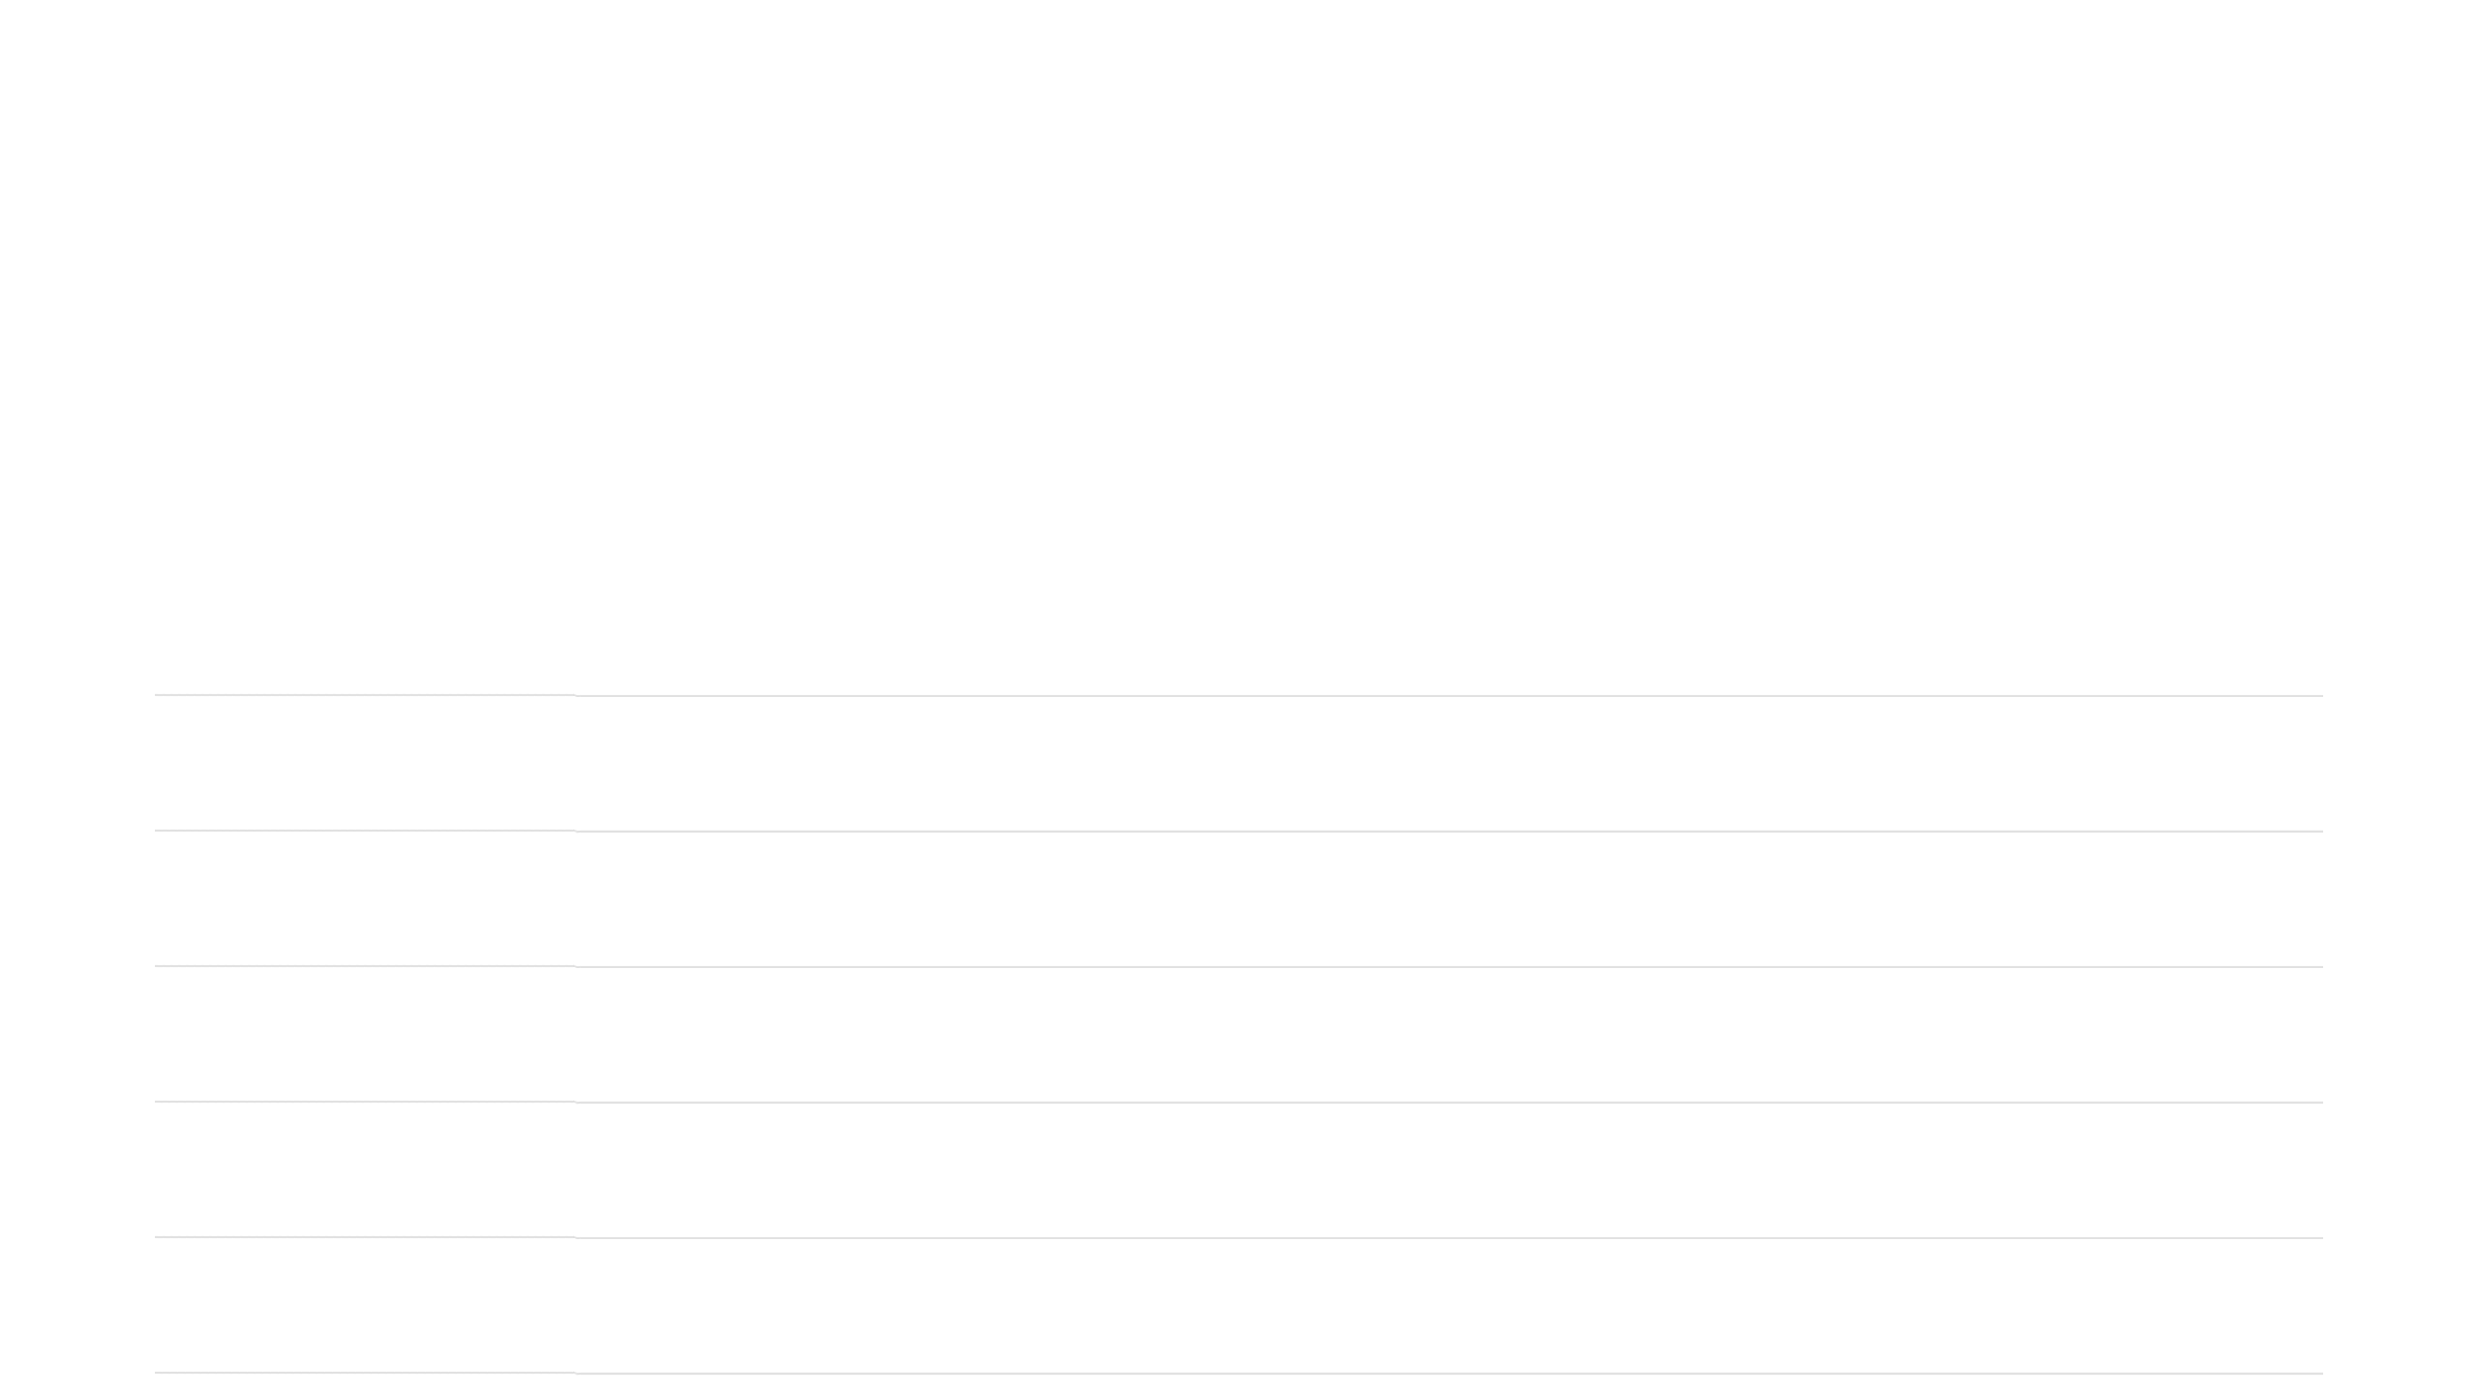






Technology Stack
Component
Technology
Purpose
Kotlin
Primary language with Coroutines & Flow for async tasks
Language
Android Studio
Official development environment for Android
IDE
Room (SQLite)
Local persistence layer for offline data access
Database
Material Design 3
Modern design system and responsive components
UI/UX
Coil
Lightweight image loading library for property photos
Media
Jetpack Navigation
Standardized screen flow and fragment management
Navigation

Slide 7




Database Schema & Relationships
Core Entities
Data Relationships
One-to-Many: One user can manage multiple reservations.
UserEntity
ListingEntity
ID, Full Name, Email, Password, Role
Title, Price, Location, Amenities, ImageURL, Status
One-to-One: Each reservation maps to a specific listing.
Many-to-Many: Users exchange messages across listings.
ReservationEntity
MessageEntity
UserID, ListingID, Status, Timestamp
SenderID, ReceiverID, Content, Timestamp
Room Persistence Library
Local SQLite storage ensures offline functionality and high-performance data retrieval for a seamless mobile experience.

Slide 8






References
Android Developers. (2026). Architecture Components: MVVM Guide. developer.android.com
Kotlin Documentation. (2026). Coroutines and Asynchronous Programming. kotlinlang.org
Google Material Design. (2026). Material 3 Design Guidelines. m3.material.io
SQLite. (2026). SQL Database Engine Documentation. sqlite.org
Botswana Accountancy College. (2026). CSE201 Module Specification.
THANK YOU FOR YOUR ATTENTION!

