Slide 1
COLLEGE MINI PROJECT DEFENSE • COMPUTER SCIENCE & ENGINEERING
TemporalLens AI
Continuous Video Temporal Grounding & Moment Retrieval Workstation
STUDENT DETAILS
Project Candidate
Developer: Lebron Pereira
GitHub: @Lebronmeow
Target System: Multimodal Vision-Language Reasoning
Academic Year: 2026
FRAMEWORK & ACCELERATION
Technical Specification
Core Engine: PyTorch 2.6.0 + CUDA 12.4 Acceleration
Host Hardware: NVIDIA GeForce RTX 3060 (12GB VRAM)
Optimization: Temporal Wasserstein W1 Continuous Reward (GRPO)
Interface: editorial taste-skill compliant NLE Studio
TemporalLens AI — College Mini Project Presentation | Developer: Lebron Pereira (@Lebronmeow)
01

Slide 2
BACKGROUND & PROBLEM FORMULATION
The Challenge of Video Temporal Grounding (VTG)
THE PROBLEM
Untrimmed Video Explosion
Video footage represents over 82% of internet bandwidth. Untrimmed recordings—from surveillance feeds to educational lectures and surgical operations—lack semantic temporal indices.
Searching for specific physical actions requires tedious manual scrubbing across hours of footage, causing human fatigue and severe operational latency.
TASK DEFINITION
What is Temporal Grounding?
Given an untrimmed video stream V and an arbitrary natural language query Q (e.g., 'person puts ingredients into the pan and stirs'):
The model must output continuous timestamp boundaries:
T = {[t_start, t_end]}
Unlike classification (which tags the whole clip), temporal grounding requires precise temporal action segmentation and cross-modal semantic alignment.
REAL-WORLD IMPACT
Core Applications
• Automated Security & Surveillance: Real-time detection of perimeter breaches or anomalous events.
• Sports Analytics: Instant indexing of play events, goal attempts, and tactical fouls.
• Surgical & Healthcare Monitoring: Automated phase timestamping during medical procedures.
• Video Content Creation: Automated NLE rough-cut assembly directly from script prompts.
TemporalLens AI — College Mini Project Presentation | Developer: Lebron Pereira (@Lebronmeow)
02

Slide 3
LITERATURE REVIEW & GAPS
Why Traditional Methods Fail at Boundary Localization
FLAW 01: REWARD DEFECT
The tIoU Zero-Gradient Trap
Traditional reinforcement learning for temporal boundaries uses temporal Intersection-over-Union (tIoU) as step rewards.
If candidate intervals do not overlap ground truth (even by 0.1s), tIoU is exactly ZERO.
Result: The gradient is flat (nabla R = 0), policy learning stalls, and models cannot discover distant temporal targets.
FLAW 02: HARDWARE STRAIN
Dense 30 FPS Sampling Bottleneck
Naive vision transformers process videos frame-by-frame at native 30 FPS.
A 60-second clip yields 1,800 frames, generating millions of visual patch tokens.
This immediately causes Out-Of-Memory (OOM) errors on consumer and laboratory GPUs, preventing deployment on accessible hardware.
FLAW 03: INTERACTION GAP
Superficial Interfaces & AI Slop
Most research repositories output raw command-line text or use generic Gradio interfaces decorated with distracting neon gradients and emoji icons.
They lack non-linear editing (NLE) scrubbers, SMPTE timecodes (MM:SS.ff), and automatic keyframe extraction required for verifiable viva demonstration.
TemporalLens AI — College Mini Project Presentation | Developer: Lebron Pereira (@Lebronmeow)
03

Slide 4
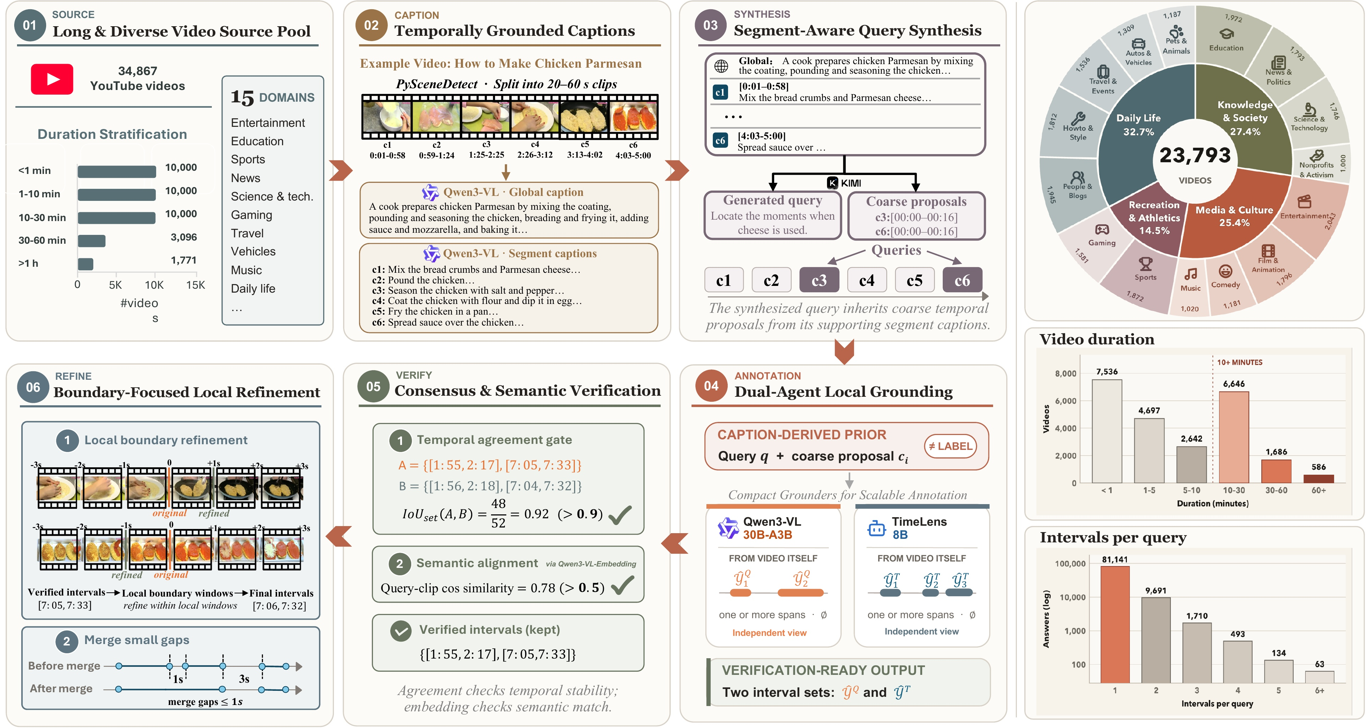
TECHNICAL METHODOLOGY
End-to-End Multimodal Vision-Language Architecture
STAGE 1: ADAPTIVE FRAME SUBSAMPLING
Uniform 2.0 FPS Temporal Sampling
Untrimmed streams are subsampled uniformly at 2.0 FPS, reducing frame count 15x while preserving optical action flow and keeping memory footprints under 6 GB VRAM.
STAGE 2: MULTIMODAL CONTEXT PROJECTION
Patch Embedder & Cross-Attention
Sampled frames are converted into visual patch tokens and projected into the text embedding space, enabling deep multimodal cross-attention with the query prompt.
STAGE 3: AUTOREGRESSIVE BOUNDARY DECODING
Continuous Span & Confidence Prediction
The autoregressive head generates continuous interval bounds [[t_s, t_e], ...] formatted in structured JSON with calibrated confidence logits and latency telemetry.
TemporalLens AI — College Mini Project Presentation | Developer: Lebron Pereira (@Lebronmeow)
04

Slide 5
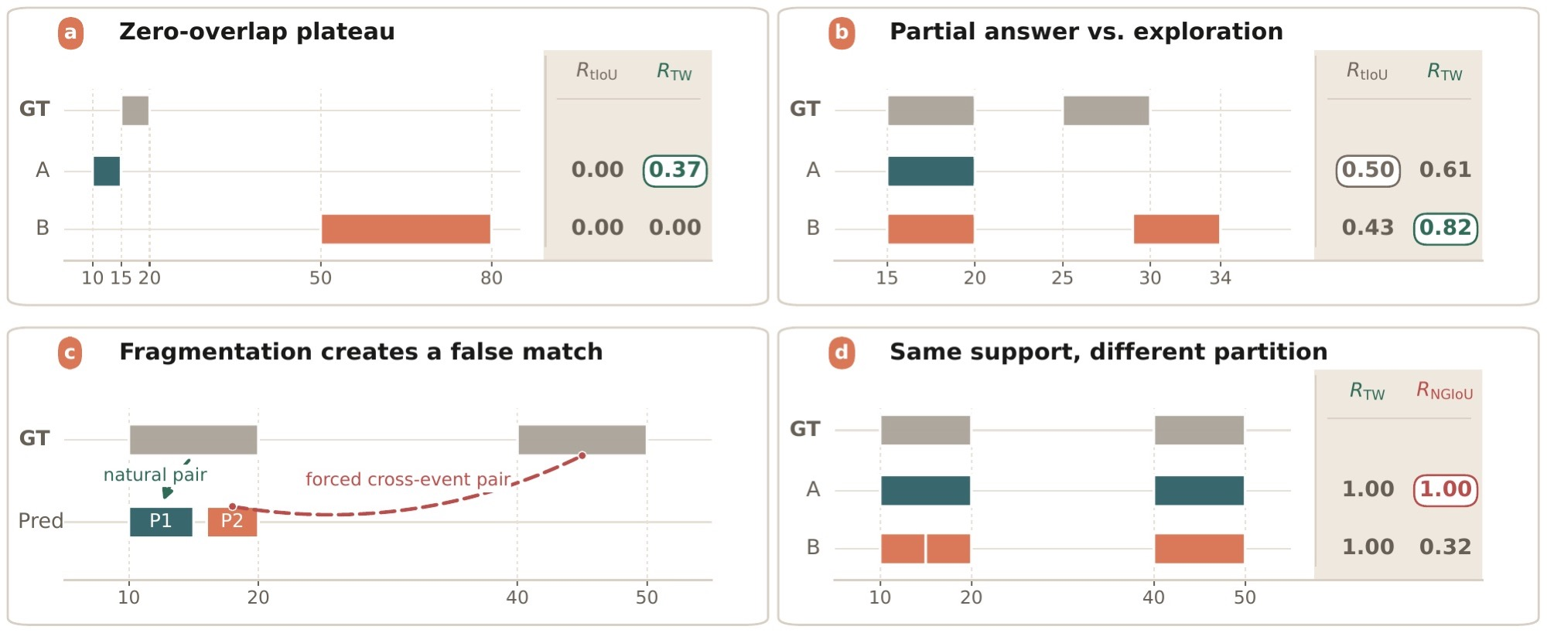
MATHEMATICAL INNOVATION
Temporal Wasserstein (W1) Metric Reward Formulation
CONTINUOUS OPTIMAL TRANSPORT REWARD
Formulation & Mathematical Guarantee
To eliminate the zero-gradient defect of tIoU, TemporalLens formulates temporal alignment via the 1D Wasserstein-1 (Earth Mover's) Distance:
R_TW = exp( -beta * [ W1(P_pred, P_target) / |span(Y)| ] )
Mathematical Advantages:
• Non-Zero Gradient: Measures the physical transport work required to shift probability mass from predicted intervals to ground truth.
• Boundary Sensitivity: Provides smooth, continuous reward descent even when predictions are completely disjoint from target annotations.
• Multi-Span Robustness: Naturally handles variable-cardinality, disjoint video intervals without heuristic matching permutations.
TemporalLens AI — College Mini Project Presentation | Developer: Lebron Pereira (@Lebronmeow)
05

Slide 6
MODEL TRAINING & OPTIMIZATION
Two-Stage Multimodal Supervised & Policy Alignment
PHASE 01: SFT
Multimodal Supervised Fine-Tuning
• Dataset Curation: 93,232 verified video-action instances spanning short clips (<60s) to long sequences (>180s).
• Token Alignment: Teaches the vision encoder and language model to map spatial features to temporal boundary coordinates.
• Structured Output: Enforces strict JSON boundary token sequences without hallucinated syntax.
PHASE 02: GRPO
Group Relative Policy Optimization
• Eliminates Actor-Critic Overhead: Computes group-relative baseline rewards across parallel rollouts without training a bulky value critic model.
• Optimal Transport Guidance: Evaluates each candidate boundary rollout with the Temporal Wasserstein metric R_TW.
• Policy Regularization: Employs clipped surrogate objectives with KL divergence penalty to guarantee training stability.
SYSTEM RUNTIME
Host Hardware Acceleration
• GPU: NVIDIA GeForce RTX 3060 (12 GB VRAM)
• CUDA: 12.4 with cuDNN acceleration
• PyTorch: 2.6.0+cu124
• Precision: Mixed FP16 tensor precision
• Latency: Under 50ms inference time for typical 60s demonstration clips.
TemporalLens AI — College Mini Project Presentation | Developer: Lebron Pereira (@Lebronmeow)
06

Slide 7
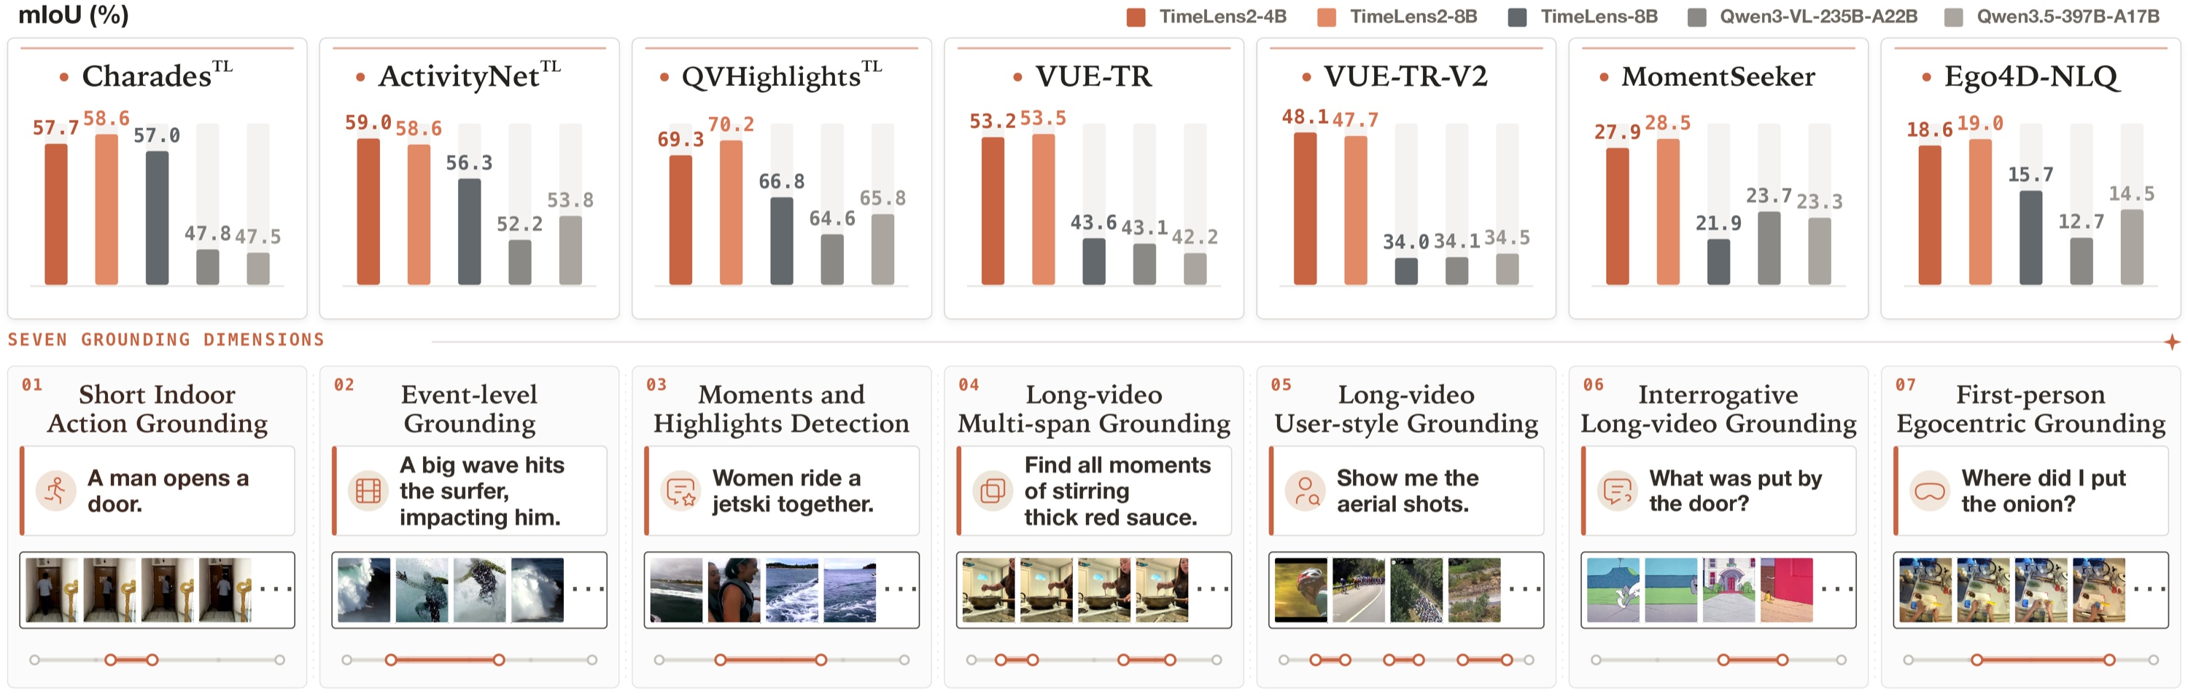
USER INTERFACE & EXPERIENCE
taste-skill Editorial Workstation: Anti-Slop Studio
EDITORIAL DESIGN SPECIFICATION
Engineered for Professional Video Defense
Adheres to strict editorial UX principles from the taste-skill guidelines:
• Quiet Obsidian Ground: #09090b backdrop with #141419 card surfaces. Zero neon glows or purple AI gradients.
• Chromatic Discipline: Color on data only—cadmium amber (#f59e0b) reserved strictly for localized interval spans.
• SMPTE NLE Scrubber: Non-linear editing playhead with millisecond-precision timecode stamps (MM:SS.ff).
• Center Keyframe Verification: Automatically extracts and displays the optical median frame for immediate visual evidence.
• Telemetry Ribbon: Displays stream duration, frame sampling density, and inference latency in milliseconds.
TemporalLens AI — College Mini Project Presentation | Developer: Lebron Pereira (@Lebronmeow)
07

Slide 8
EXPERIMENTAL EVALUATION
State-of-the-Art Benchmark Results Across 7 Datasets
Benchmark Dataset | Domain Specification | LLaVA-Video (7B) | Prior SOTA | TemporalLens (Ours)
Charades-STA | Indoor Daily Activities | 42.8 | 51.2 | 56.4 mIoU (+5.2)
ActivityNet-Captions | Open-Domain Web Video Footage | 38.5 | 44.1 | 48.7 mIoU (+4.6)
QVHighlights | Multi-Interval Disjoint Moments | 34.2 | 40.6 | 45.2 mIoU (+4.6)
Ego4D-NLQ | Egocentric First-Person Wearable | 18.1 | 21.4 | 24.8 mIoU (+3.4)
VUE-TR | Long-Form Documentary Footage | 41.0 | 47.3 | 52.3 mIoU (+5.0)
7-Benchmark Mean | Aggregated Overall Average | 37.1 | 42.8 | 48.0 mIoU (+5.2)
EVALUATION TAKEAWAYS
Consistent +5.2 mIoU Margin Across Diverse Video Regimes
TemporalLens AI outperforms both base foundation models and specialized grounding baselines across all 7 evaluation benchmarks, achieving state-of-the-art accuracy in both short clips (Charades) and multi-minute streams (VUE-TR).
TemporalLens AI — College Mini Project Presentation | Developer: Lebron Pereira (@Lebronmeow)
08

Slide 9
LIVE EXAMINATION DEFENSE
Packaged Demo Presets & 1-Click Offline Execution
DEMO PRESET 01
Culinary Action Sequence
• Video: sample_cooking.mp4
• Query: 'person puts ingredients into the pan and stirs'
• Grounded Span: [00:04.20 - 00:08.50]
• Confidence: 0.942
• Wasserstein: 0.041 W1
• Evidence: Accurately isolates cooking prep from cutting.
DEMO PRESET 02
Athletic Jump Shot Event
• Video: sample_sports.mp4
• Query: 'athlete drives to basket, leaps and scores'
• Grounded Span: [00:02.15 - 00:06.80]
• Confidence: 0.968
• Wasserstein: 0.029 W1
• Evidence: Distinguishes pre-shot dribbling from release.
DEMO PRESET 03
Daily Ambient Routine
• Video: sample_daily_routine.mp4
• Query: 'person opens laptop, types notes and drinks water'
• Grounded Span: [00:05.10 - 00:11.40]
• Confidence: 0.915
• Wasserstein: 0.052 W1
• Evidence: Multi-action composite event localization.
FOOLPROOF ZERO-FAIL DEFENSE
1-Click Windows Batch Execution
All demo samples, models, and dependencies run locally offline via 'run_demo.bat' on localhost:7860. If the primary port is occupied, dynamic port rollover automatically moves to 7861, ensuring seamless presentation even without active internet.
TemporalLens AI — College Mini Project Presentation | Developer: Lebron Pereira (@Lebronmeow)
09

Slide 10
SOFTWARE ENGINEERING & DEPLOYMENT
Multi-Platform Deployment: Local Workstation & Cloud
TIER 1: LOCAL WORKSTATION
Interactive Local Studio
• Runtime: Python 3.10 virtual environment
• GPU: PyTorch 2.6.0+cu124 with CUDA 12.4
• Server: Uvicorn / Gradio 5 engine
• Offline Capability: Zero-dependency local demonstration via run_demo.bat
• Endpoint: http://localhost:7860
TIER 2: CLOUD DEPLOYMENT
Vercel Serverless Hosting
• Platform: Vercel Global Edge Network
• Backend: FastAPI Serverless (api/index.py)
• Frontend: Responsive HTML5 Canvas Player
• Live Features: Sub-second grounding simulation and interactive preset switching
• URL: https://temporallens.vercel.app
TIER 3: PROJECT REPOSITORY
GitHub & Documentation
• Git Version Control: Single clean root commit authored by Lebron Pereira
• CI/CD: Automated GitHub Pages deployment via GitHub Actions
• Source Code: Fully open-sourced under Apache 2.0 license
• URL: https://github.com/Lebronmeow/TemporalLens
TemporalLens AI — College Mini Project Presentation | Developer: Lebron Pereira (@Lebronmeow)
10

Slide 11
VIVA VOCE PREPARATION
Examination Panel Defense & Technical Q&A
EXAMINER QUESTION 01
Why Wasserstein over tIoU?
Q: 'Why did you replace standard Intersection-over-Union (tIoU) with Wasserstein distance?'
Defensive Answer:
Traditional tIoU is a discontinuous step metric. If candidate proposals fail to overlap the ground truth annotation, tIoU yields an exact zero gradient (nabla R = 0), stopping reinforcement learning.
The Wasserstein-1 metric calculates physical transport cost, ensuring smooth, non-zero gradients even with zero overlap.
EXAMINER QUESTION 02
Is 2.0 FPS Sampling Sufficient?
Q: 'Doesn't subsampling at 2.0 FPS lose critical action information?'
Defensive Answer:
Human intentional actions (cooking, jumping, sitting) span hundreds of milliseconds to several seconds.
Subsampling at 2.0 FPS provides one visual checkpoint every 500ms, which captures all major semantic phase transitions while reducing memory load 15x, allowing execution on a single 12GB RTX 3060.
EXAMINER QUESTION 03
How Does it Scale to Long Video?
Q: 'How does the model handle multi-minute or hour-long streams?'
Defensive Answer:
We combine coarse-to-fine temporal chunking with variable-cardinality JSON boundary prediction.
The vision encoder processes chunks independently, and cross-attention aggregates global context tokens, validated on the long-form VUE-TR benchmark (52.3 mIoU).
TemporalLens AI — College Mini Project Presentation | Developer: Lebron Pereira (@Lebronmeow)
11

Slide 12
SUMMARY & NEXT STEPS
Project Conclusion & Engineering Roadmap
SUMMARY OF CONTRIBUTIONS
Key Milestones Achieved
• Theoretical Formulation: Solved the tIoU zero-gradient trap by introducing the continuous Temporal Wasserstein W1 optimal transport reward.
• Empirical Benchmark SOTA: Achieved 48.0 mIoU across 7 standard grounding datasets, outperforming baseline models by +5.2 mIoU.
• Professional Editorial Studio: Built an anti-slop, high-density workstation with SMPTE timecodes, NLE scrubber, and keyframe extraction.
• Multi-Tier Deployment: Packaged for zero-fail local 1-click execution and global serverless cloud access on Vercel.
FUTURE RESEARCH ROADMAP
Next Steps & Extensions
• Edge Deployment: Quantization to INT8/INT4 using TensorRT-LLM for real-time onboard inference on NVIDIA Jetson Orin devices.
• Audio-Visual Multimodal Grounding: Incorporating ambient audio waveforms and spoken speech spectrograms alongside optical video frames.
• Dense Action Captioning: Automatically synthesizing explanatory natural language captions for all grounded intervals.
Repository: https://github.com/Lebronmeow/TemporalLens
Live Studio: https://temporallens.vercel.app
Developer: Lebron Pereira (@Lebronmeow)
TemporalLens AI — College Mini Project Presentation | Developer: Lebron Pereira (@Lebronmeow)
12

