Slide 1



Hydrological modelling
Introduction
Precipitation in hydrological modeling
Evapotranspiration in hydrological modeling
Model calibration and validation methods
Discussion on HBV model
Discussion on Wasmodel
Statistical analysis of model parameters and residuals
Introduction to physically based distributed model structure
Regionalization methods
Hydrological modelsin climate change studies
Model Applications
Summary of the course

Slide 2
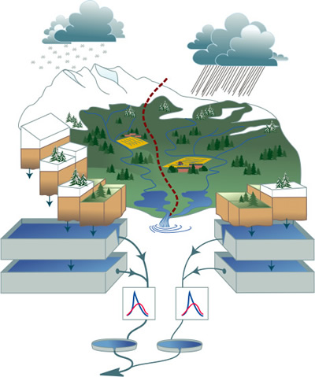
Introduction to HBV model
Chongyu Xu

Slide 3
Introduction to HBV model
The HBV model was developed at SMHI by Sten Bergström (Bergström, 1976).
HBV = "Hydrologiska Byråns Vattenbalansavdelning"
The HBV model ...
... is a conceptual model
... has a simple structure, easy to understand, learn and apply
... is semi-distributed, i.e., allows to divide the catchment into subbasins, elevation and vegetation zones
... has been applied to many catchments in Sweden and abroad
... provided good results in most applications
... has become a standard tool for runoff studies in the Nordic countries
... needs a moderate amount of input data
... exists in different versions (Swedish, Norwegian, Finnish, Swiss, ...)
Chongyu Xu
This lecture note is modified from Jan Seibert (1998)

Slide 4
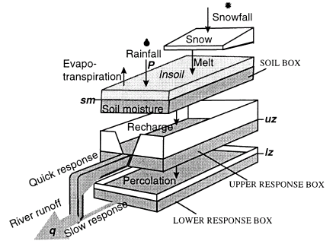
General structure of HBV model
Chongyu Xu

Slide 5
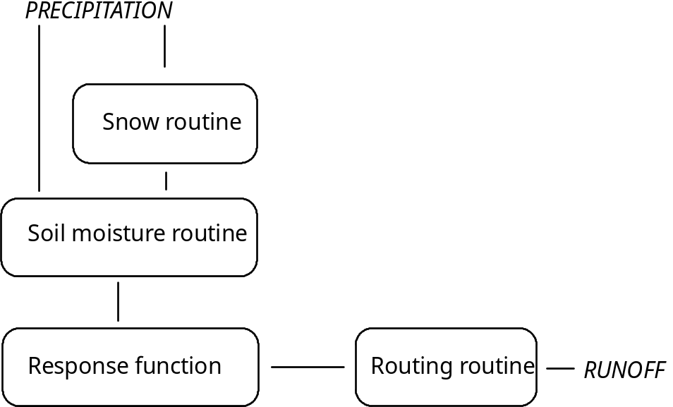
Schematic structure of HBV model - simplified

Slide 6
Input and output in each submodels
Submodel | Input data | Output data
Snow routine | Precip., Temp. | Snow pack, snow-melt
Soil routine | Pot.Evap., precip., snowmelt | Act.Evap., 'soil moisture', groundwater recharge
Response function | Groundwater recharge, (pot.ET) | Runoff, 'Groundwater level'
Routing routine | Runoff | Simulated runoff
Chongyu Xu

Slide 7
Schematic structure of HBV model - simplified
Snow Routine

Slide 8
Snow routine
Parameters:
CFMAX = degree-day factor (mm oC-1 day-1)
CFR = refreezing coefficient
TT = threshold temperature (oC)
Procedure:
1. Accumulation of precipitation as snow if temperature<TT (TT is normally close to 0 oC)
2. Melt of snow starts if temperatures are above TT calculated with a simple degree-day method.
meltwater = CFMAX (T-TT) (mm day-1)
CFMAX varies normally between 1.5 and 4 mm /oC /day (in Sweden), with lower values for forested areas. As approximation the values 2 and 3.5 can be used for CFMAX in forested and open landscape respectively.
3. The snow pack retains melt water until the amount exceeds a certain portion (CWH, usually 0.1) of the water equivalent of the snow pack. When temperatures decreases below TT this meltwater refreezes again.
refreezing meltwater = CFR CFMAX (TT-T)
(CFR 0.05)
Chongyu Xu

Slide 9
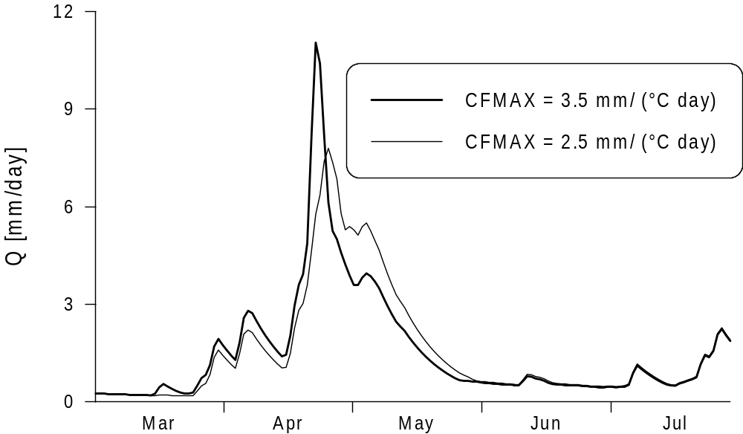
Effect of degree day parameter
Chongyu Xu

Slide 10
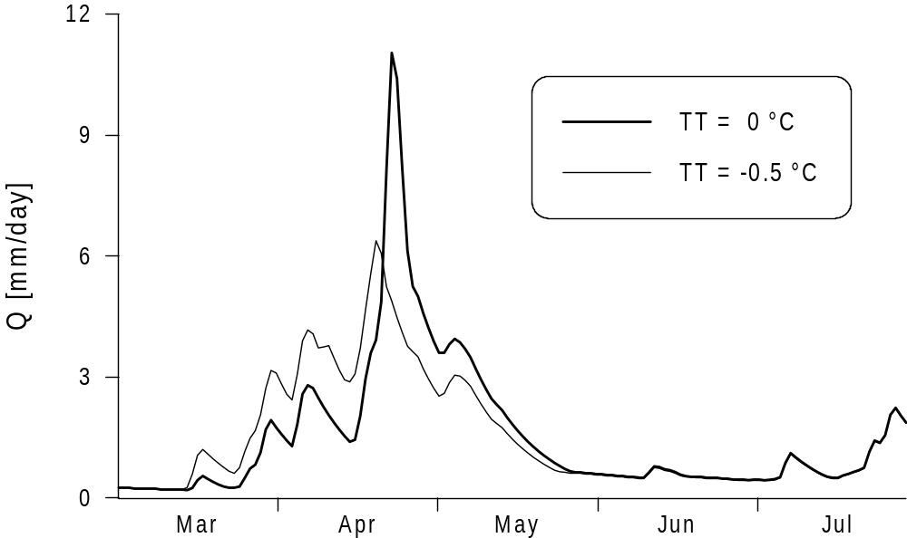
Effect of threshold parameter
Chongyu Xu

Slide 11
Schematic structure of HBV model - simplified
Soil moisture routine

Slide 12
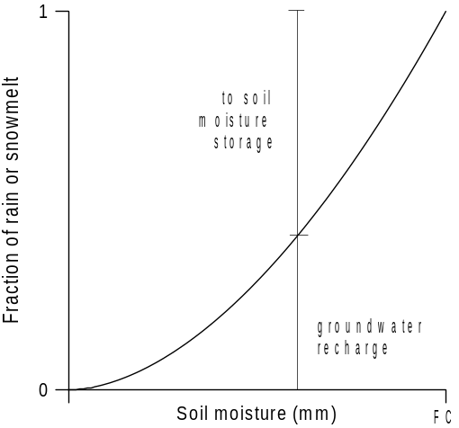
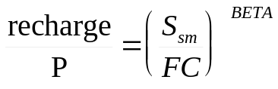
Soil moisture routine
FC = maximum soil moisture storage (mm)
LP = soil moisture value above which ETact reaches ETpot
BETA= parameter that determines the relative contribution to runoff from rain or snowmelt (-)
Figure 4. Contributions from rainfall or snowmelt to the soil moisture storage and to the upper groundwater zone
Chongyu Xu

Slide 13
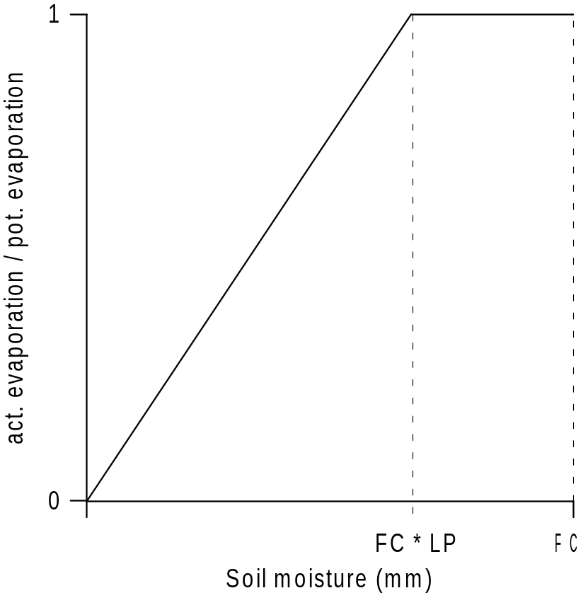
Soil moisture routine
Figure 1. Reduction of potential evaporation depending on soil moisture storage
Chongyu Xu

Slide 14
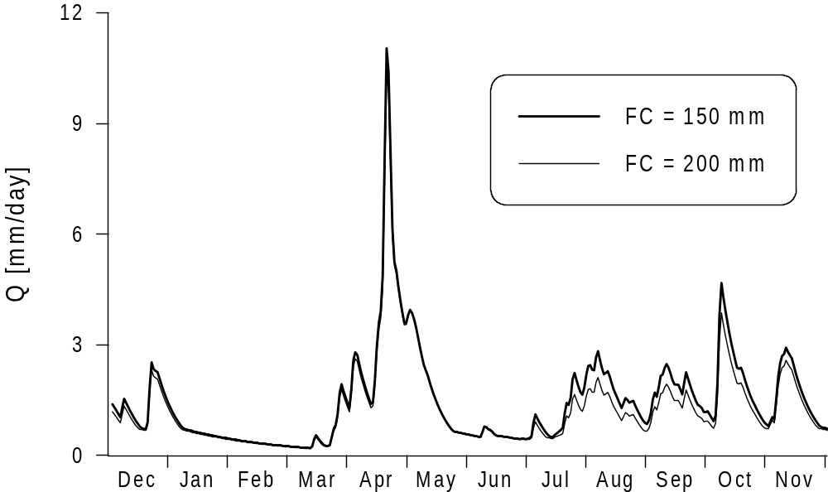
Effect of field capacity parameter
Chongyu Xu

Slide 15
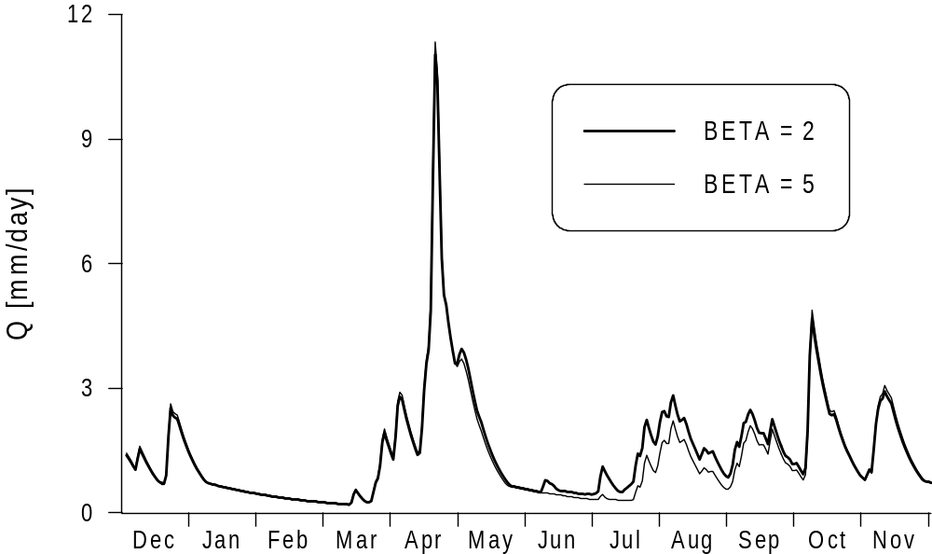
Effect of β parameter
Chongyu Xu

Slide 16
Schematic structure of HBV model - simplified
Response function

Slide 17
Response function
Linear reservoir concept
The model of a single linear reservoir is a simple description of a catchment where the runoff Q(t) at time t is supposed to be proportional to the water storage S(t).
S
Q = k S
Chongyu Xu

Slide 18
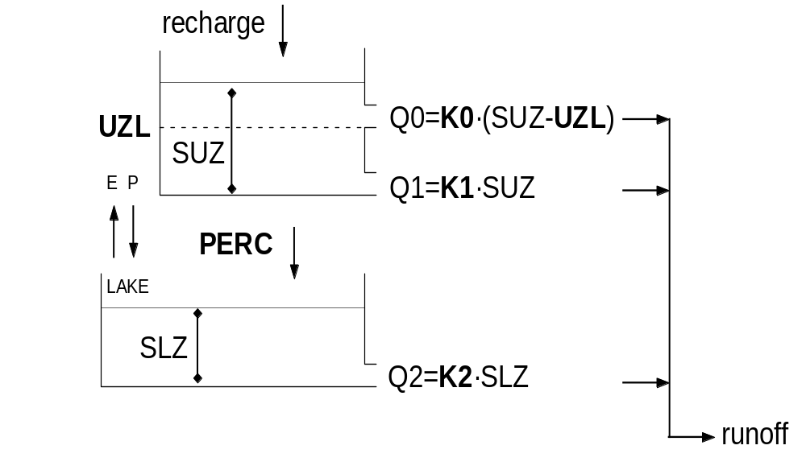
Response routine of the HBV model

Slide 19
Response routine of the HBV model
Where:
recharge = input from soil routine (mm day-1)
SUZ = storage in upper zone (mm)
SLZ = storage in lower zone (mm)
UZL = threshold parameter (mm)
PERC = max. percolation to lower zone (mm day-1)
Ki = Recession coefficient (day-1)
Qi = runoff component (mm day-1)
NOTE:
- SUZ has no upper limit
- Q2 can never exceed PERC SLZ can never exceed PERC/K2

Slide 20
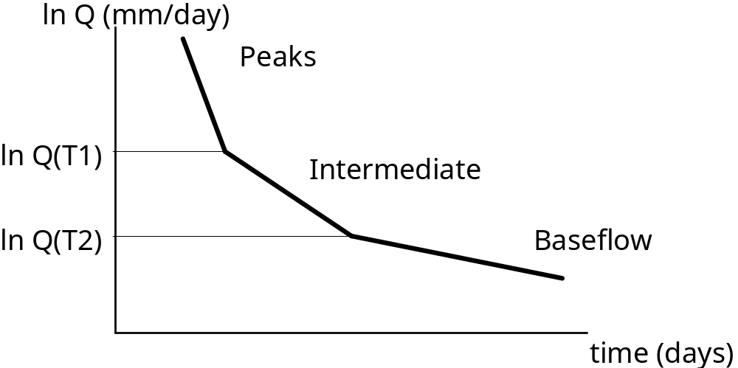
Recession analysis
If lnQ is plotted against time during a dry period, the slopes of the hydrograph at different runoff values provide good first estimates of the response-function parameter.
Figure 1. Schematic shape of recession in relation to the different parameter
    Slope of the recession:
    Peaks: ≈K0
    Intermediate: ≈K1
    Baseflow: =K2
Lecture 5
GEO4320
Chongyu Xu

Slide 21
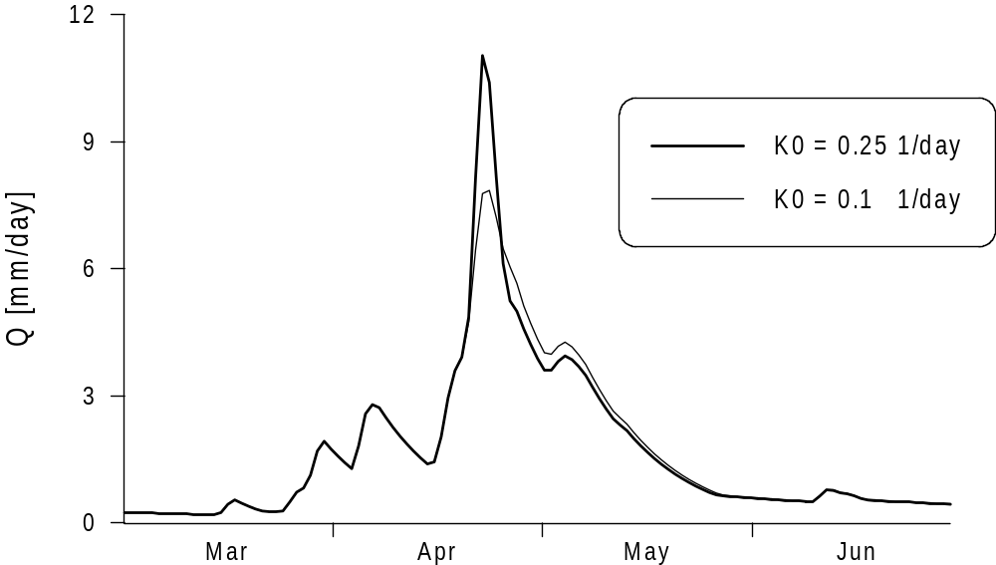
Effect of peak flow parameter k0
Q0 = K0 (SUZ-ULZ)
Chongyu Xu

Slide 22
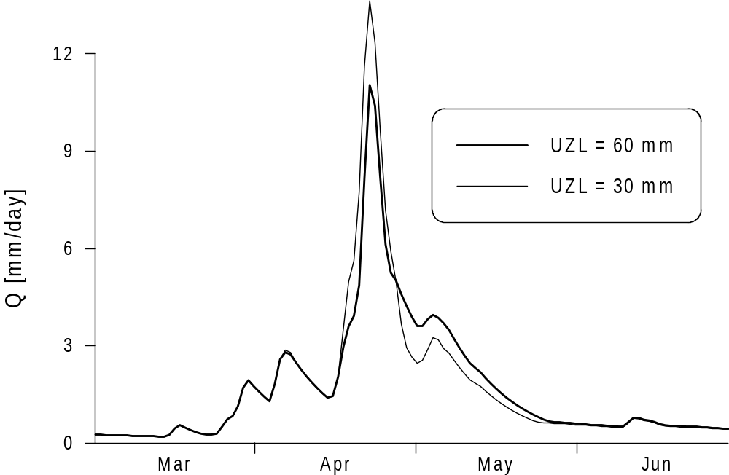
Effect of up zone maximum storage parameter ULZ
Chongyu Xu

Slide 23
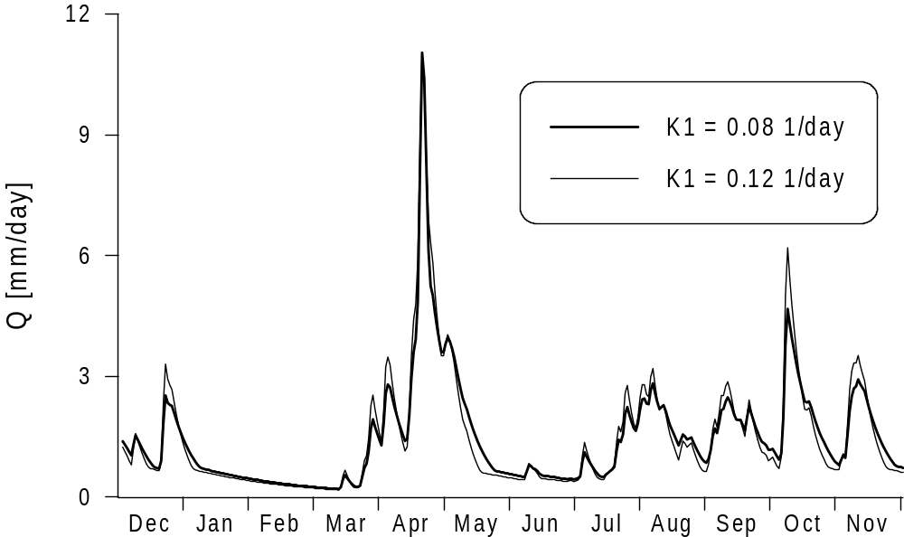
Effect of intermediate parameter K1
Chongyu Xu

Slide 24
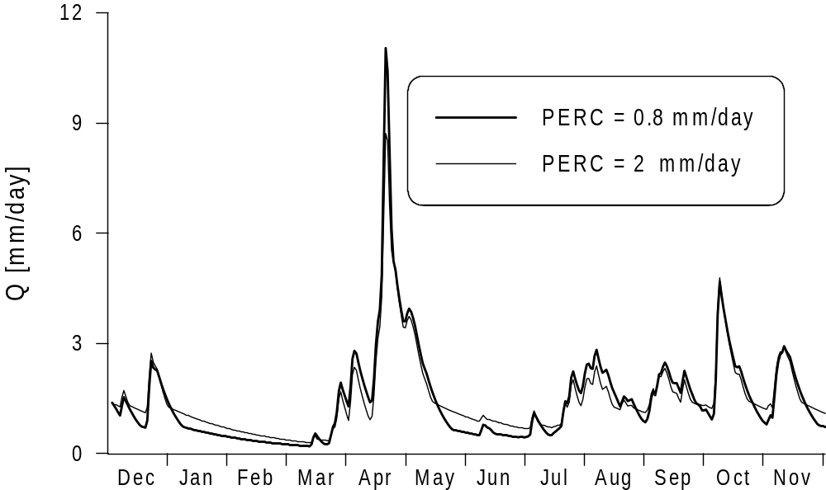
Effect of percolation parameter PERC
Chongyu Xu

Slide 25
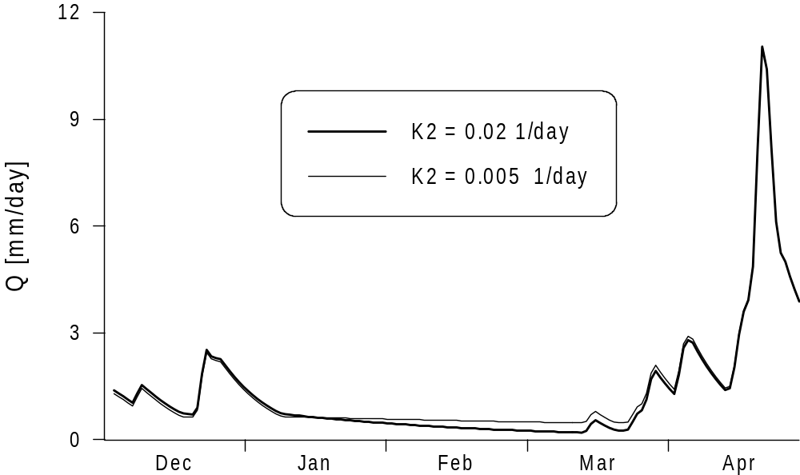
Effect of base flow parameter K2
Chongyu Xu

Slide 26
Schematic structure of HBV model - simplified
Routing routine

Slide 27
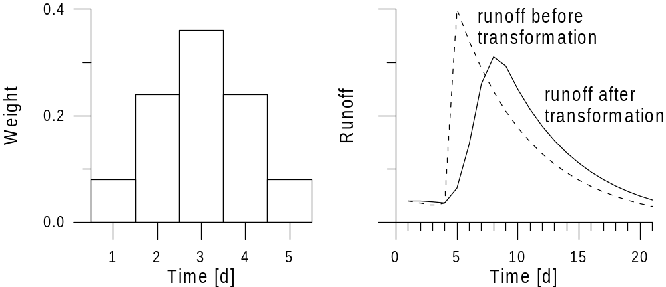
Routing routine
Transformation function
The generated runoff of one time step is distributed on the following days using one free parameter, MAXBAS, which determines the base in a equilateral triangular weighting function.
Chongyu Xu

Slide 28
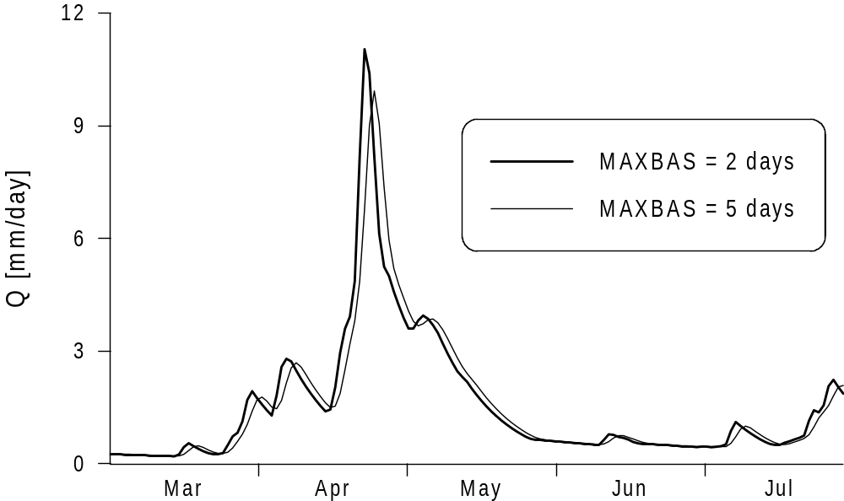
Effect of flow routing parameter
Chongyu Xu

Slide 29
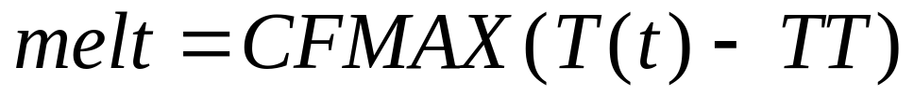
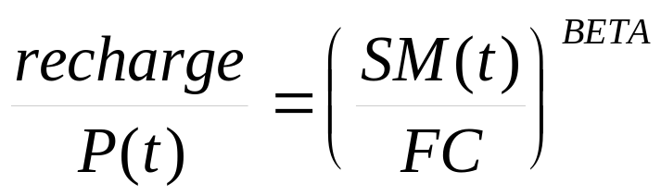
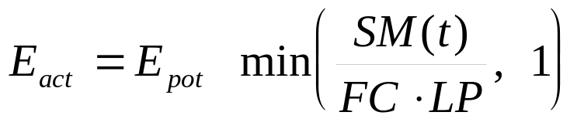
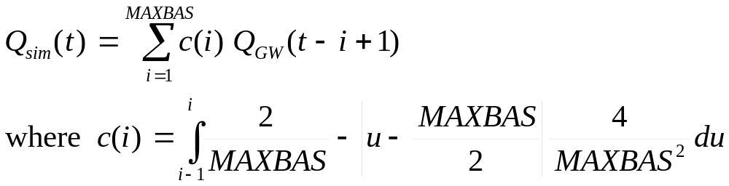
Summary of major equations of HBV model
Chongyu Xu

Slide 30
Applications of the HBV model
The HBV model can be used ...
  to extend runoff data series (or filling gaps)
  for data quality control
  for water balance studies
  for runoff forecasting (flood warning and reservoir operation)
  to compute design floods for dam safety
  to investigate the effects of changes within the catchment
  to simulate discharge from ungauged catchments (?)
  to simulate climate change effects (?)
Chongyu Xu

Slide 31
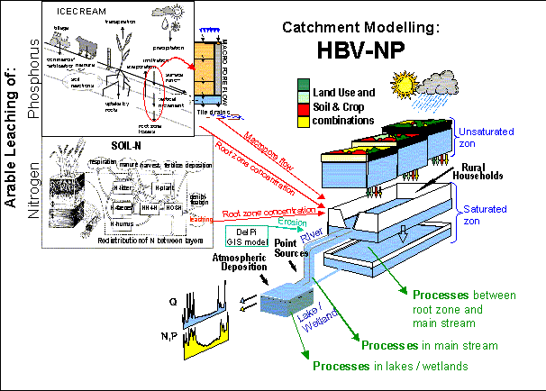
Extensions of the HBV model
HBV-NP simulates nitrogen (N) and phosphorus (P) transport and transformation at the catchment scale (up to the Baltic scale)
source: www.smhi.se

