Slide 1
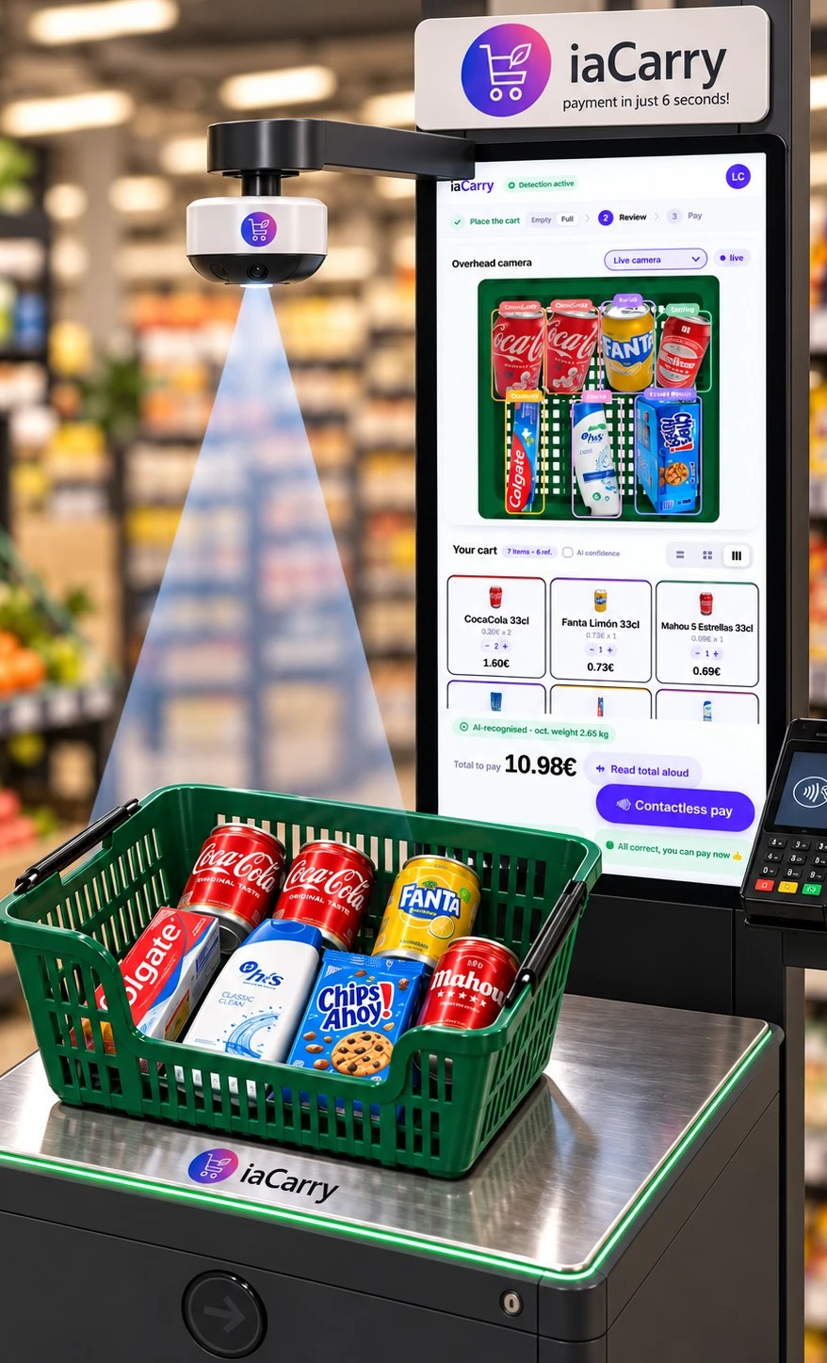

JANUARY 2024
iaCarry
payment in just 6 seconds!
Funding
Pitch Deck

Slide 2
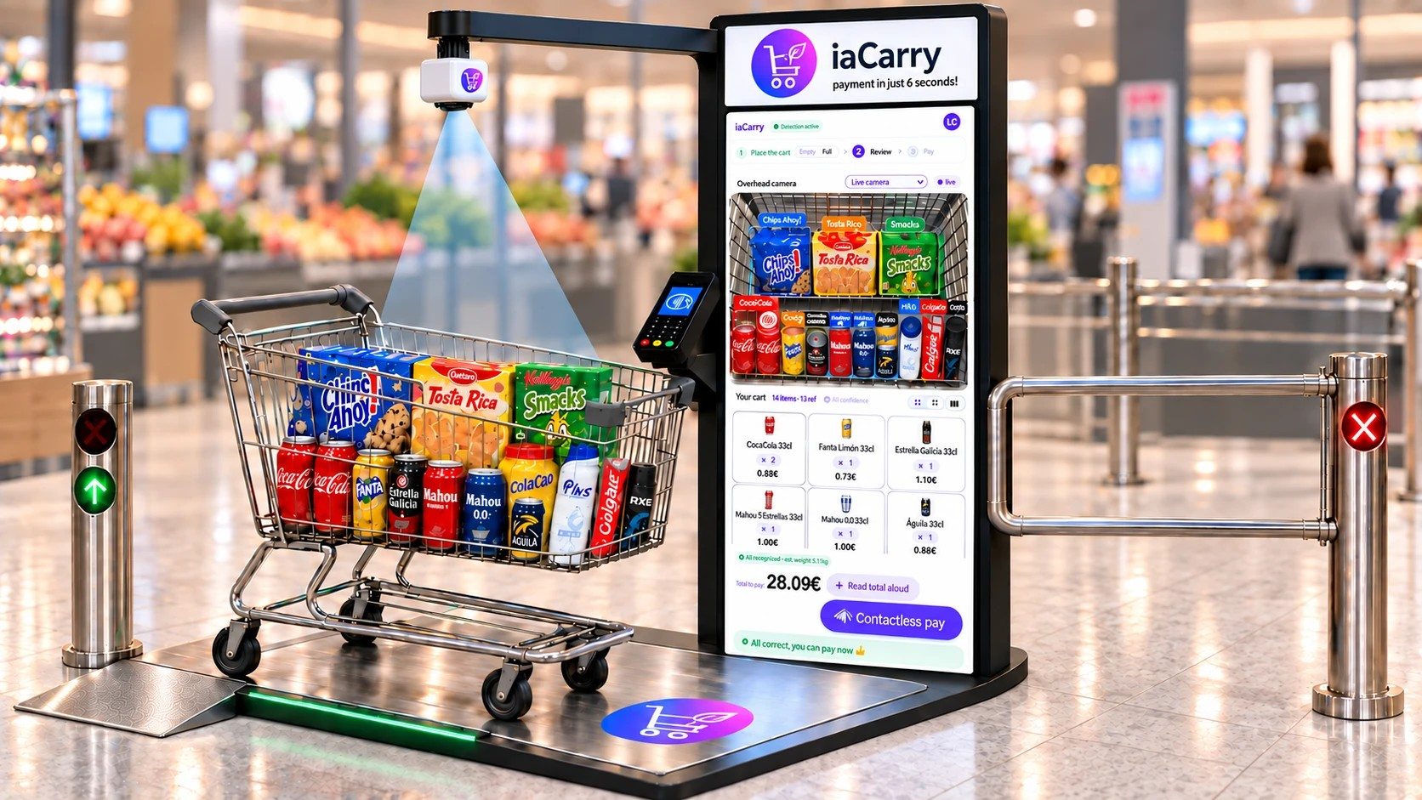
iaCarry-Station Components
Shopping Trolley – Positioned on the weighing platform, filled with items.
Weighing Platform – Base unit that detects total weight.
Overhead Camera System – Captures top-down view of cart contents
Interactive Display Screen – Shows recognized items and prices.
Electronic Payment Terminal – Enables quick and accessible checkout.
Exit Turnstile (Post-Checkout) – Opens after successful payment.
Internal / Not Directly Visible:
AI-Powered Recognition Software – Analyzes visuals and weight data in real-time
https://youtu.be/Sj-IvGnjODE?si=jpAaLexO_-1qCau7

Slide 3
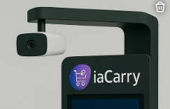


Revenue Model
Note: Figures € are estimates
01
02
03
Installation and sale of optimal trolley
Software licence
Maintenance and updates
Installation of the iaCarry-Station (scale, camera, screen, etc) (18000€) and associated trolleys (25€ per unit).
Training course for shop employees
Licence fee 900€ per month per station.
Also available on a per recognition basis, on purchases of less than 8€ charge 0,01€. On purchases over €0.04 (5000 purchases per month for €200).
Maintenance plan for 45€ per month for each iaCarry-Station

Slide 4
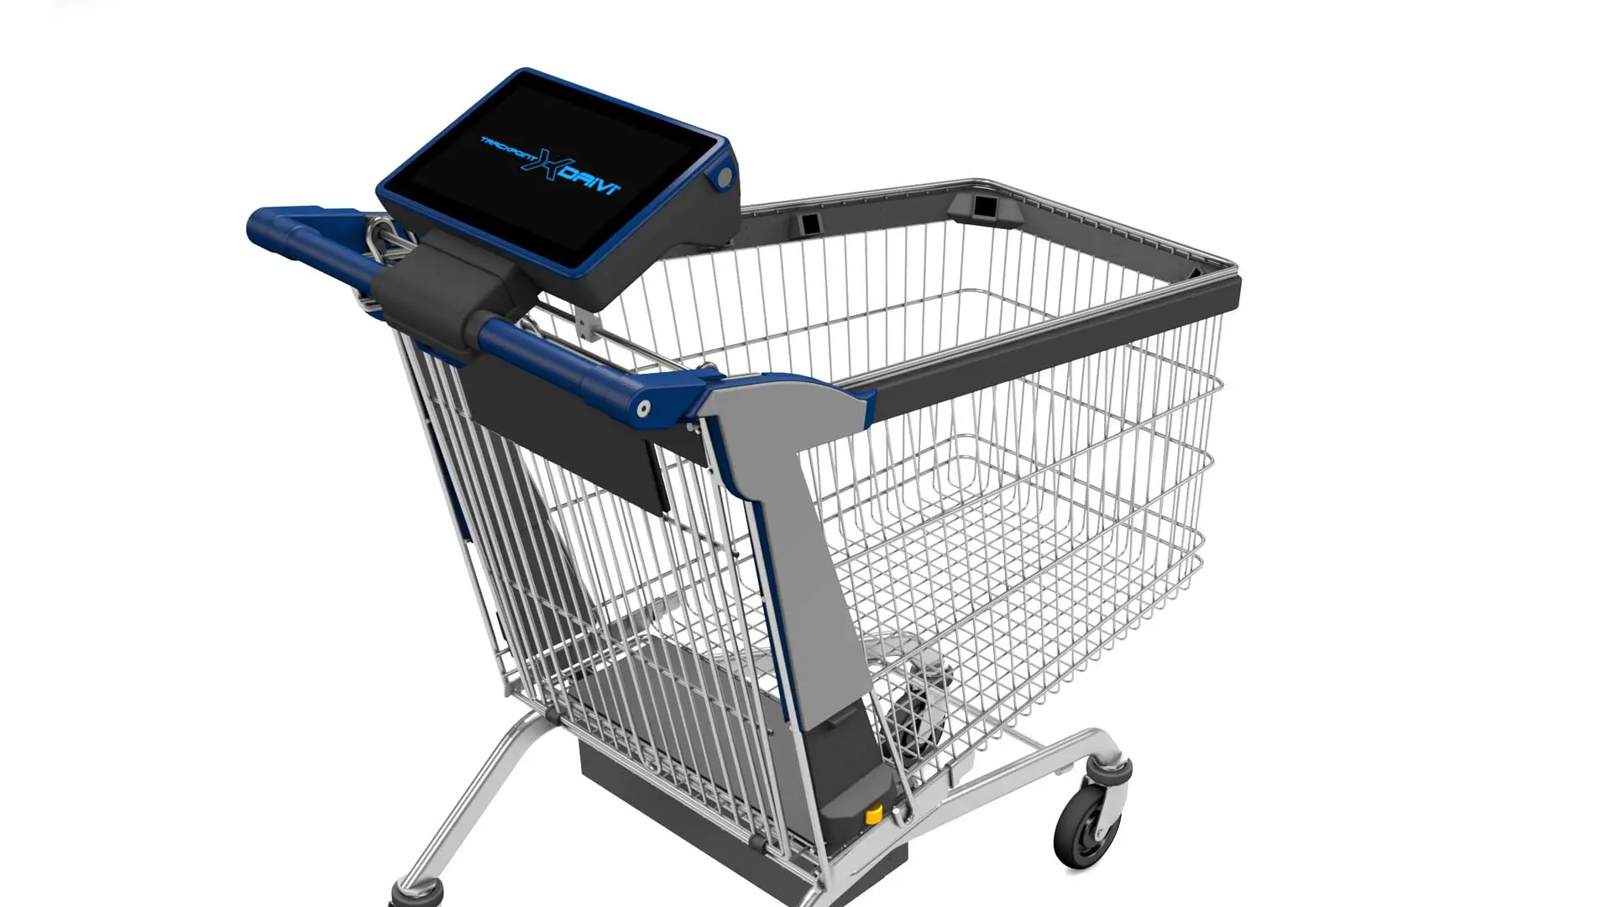
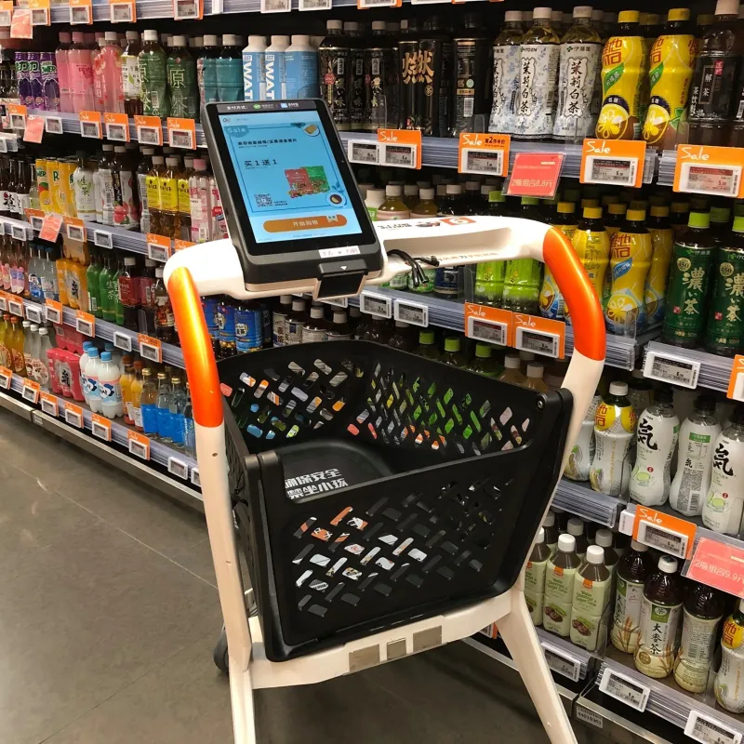
1. Shopic – Tel Aviv (~70 employees)
Clip-on device for traditional carts, detects products in real-time, enables fast checkout.
🔗 Web | 💼 LinkedIn | 🎥 Demo
2. Tracxpoint – Haifa (~30 employees)
Full smart cart with sensors and screen; adds items as you shop, charges on exit.
🔗 Web | 💼 LinkedIn | 🎥 Demo
3. Caper AI (Instacart) – New York (~1200 employees)
Smart cart with embedded sensors and display, owned by Instacart. 🔗 Web | 💼 LinkedIn | 🎥 Demo
4. SuperHii – China (Xi’an & Jiaxing)
Smart carts and autonomous retail solutions with high efficiency and seamless UX. 🔗 Web | 💼 LinkedIn | 🎥 Demo

Slide 5
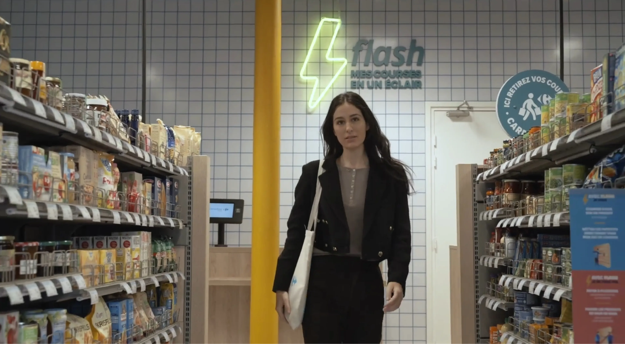
5. MagiQeye – Milan (~5 employees)
AI + RFID checkout solution focused on clothing and apparel.
🔗 Web | 💼 LinkedIn | 🎥 Demo
6. Instacart – California (~1200 employees)
Mobile self-scanning app; scan items during shopping and pay from phone.
🔗 Web | 💼 LinkedIn | 🎥 Demo
7. Carrefour Flash – Paris (staffed store)
"Just Walk Out"-style store with 60 cameras and shelf sensors for seamless checkout.
🎥 Demo
8. Amazon Go – Various US cities (~several thousand in Amazon retail)
Pioneered "Just Walk Out" tech: entry via app, items auto-detected, exit without checkout.
🎥 Demo

Slide 6
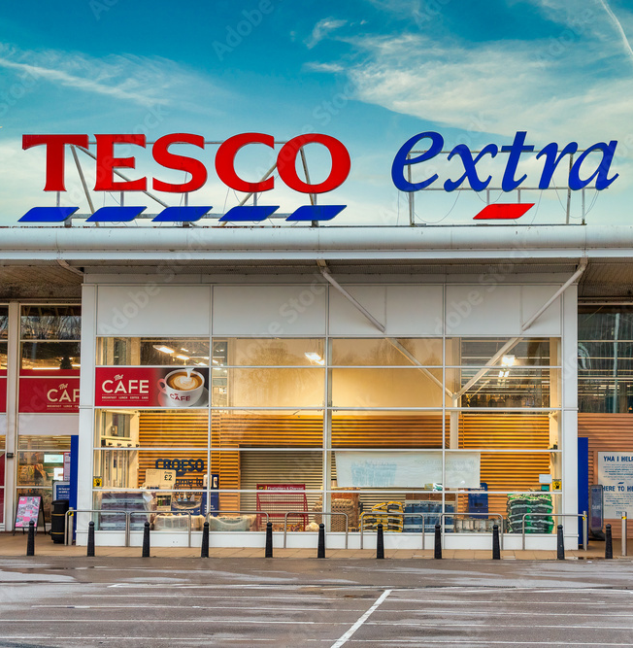
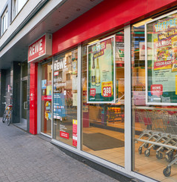
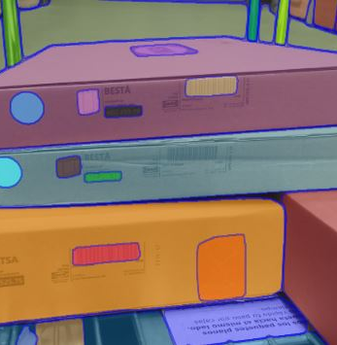
Target market: Large-Small Stores
Large Supermarkets
Small Supermarkets
Clothing or Furniture Stores
Reserve a specific area in the supermarket to install the iaCarry-Station. This area must be at least 4.5 square meters .
Efficiently use the available space to ensure that the iaCarry-Station integrates seamlessly into the supermarket design.
Incorporate specialized cameras for recognition of clothing items, or packers, considering details such as colors, sizes and styles. QR label implementation

Slide 7
JANUARY 2024
iaCarry
payment in just 6 seconds!
The end

Slide 8
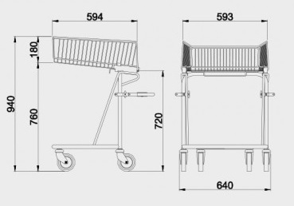
Competitive Advantages
01
Conventional trolley: iaCarry takes advantage of conventional trolleys without the need for additional software.
02
iaCarry-Station easy to install: iaCarry-Station is as simple as a scale, a camera, display and a dataphone, minimising disruption to the shop's operation, allowing for easy scalability.
Minimal store adaptation
03
Managing picaresque through weighing validation: iaCarry addresses picaresque by validating the weighing of products, detecting potential irregularities and providing alerts to maintain the integrity of the purchasing process.
04
Bulk product management simply with the camera: iaCarry's powerful camera facilitates bulk product management, enabling accurate identification and validation without the need for additional weighing, improving the user experience.

Slide 9
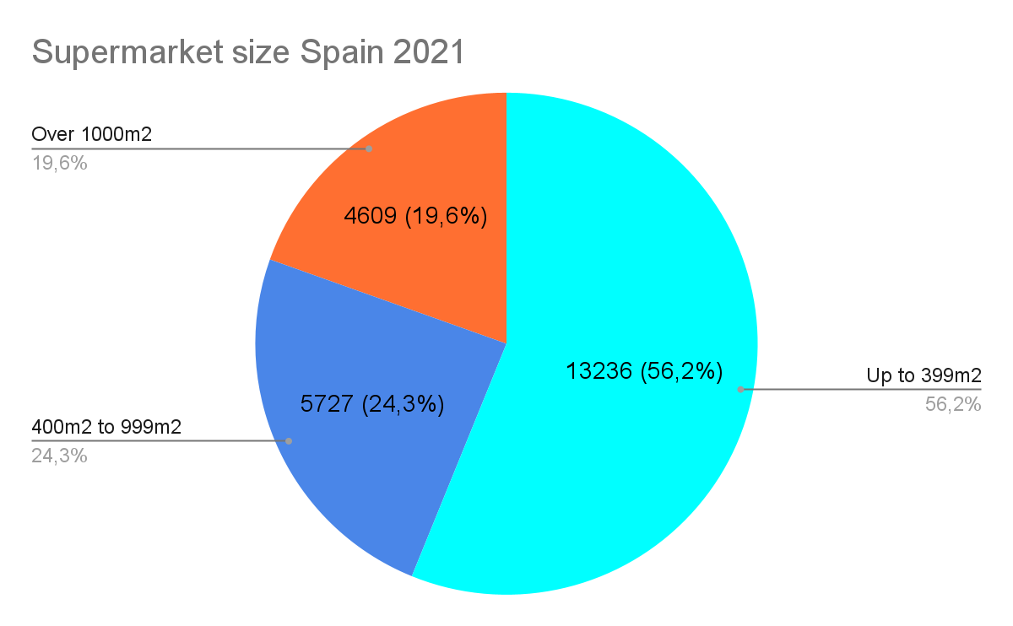
23,572 supermarkets in Spain, all of which require barcode scanning.
Only Europe the figure rises to 234,000 establishments, which need a cash register.
The current market

Slide 10



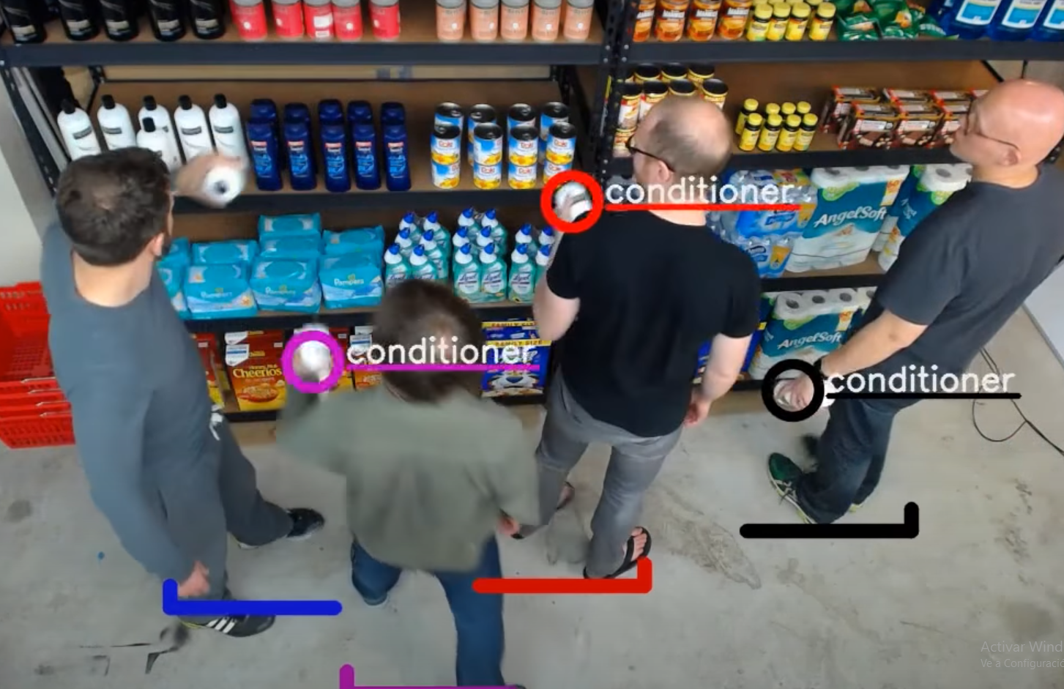
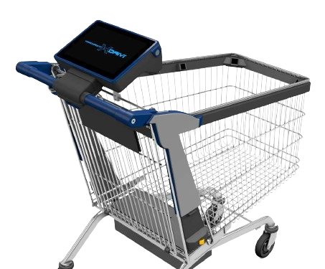
The competitors
Haifa Israel
2000€ per trolley unit. Multiple cameras inside the trolley
Installation of charging points for the trolleys.
Installation of high capacity wifi network.
Each trolley is a computer to maintain.
Expensive implementation.
Demo:https://www.youtube.com/watch?v=kS9gWH5fypY
Carrefour and amazon, same concept, take and go.
Each square metre requires one camera.
It requires a huge computer capacity for processing.
Difficult scalability needs to redo entire shops.
Still needs the trolley. Not licensable, exclusive
Bad picaresque management, no post-purchase validation.
Demo:https://www.youtube.com/watch?v=NrmMk1Myrxc

Slide 11
Milestones
OTC 2023
FEB 2024
Foundation of tuisku.eu for the creation of iaCarry.tuisku.eu
First test runs and installations at end-customers
iaRecycle, taking advantage of iaCarry kernel
DIC 2023
JUN 2024
Presentation of iaCarry-Station and iaCarry kernel
Presentation of the other product iaRecycle.tuisku.eu
Full launch of the first 10 stations in operation
Strong expansion of employees

Slide 12
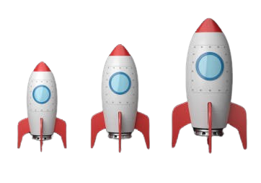

Scalability
Once you have 10 iaCarry-Stations up and running without errors, scalability is global.
For all shops (supermarkets, clothing, technology, etc.) and for all countries.

Slide 13
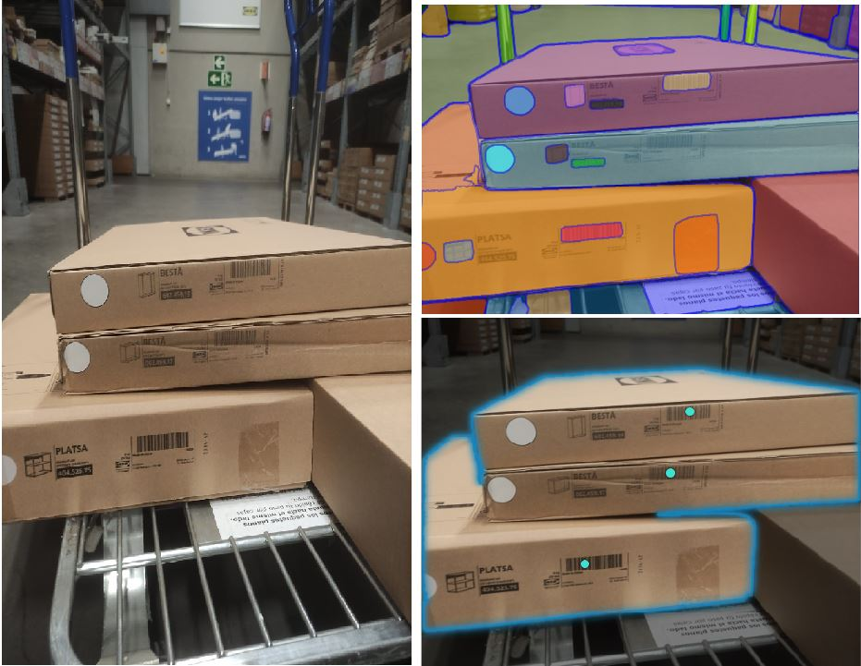
Business Scalability
Clothing or furniture shops
iaCarry in clothing or furniture stores involves customizing the technology to address the specific characteristics of these sectors, providing customers with a more efficient and personalized purchasing.
Smart Labeling System: Use QR smart labels on clothing or furniture with barcodes or unique identifiers to facilitate identification by iaCarry.
Specialized Cameras: Incorporate specialized cameras for recognition of clothing items, considering details such as colors, sizes and styles. QR label implementation

Slide 14
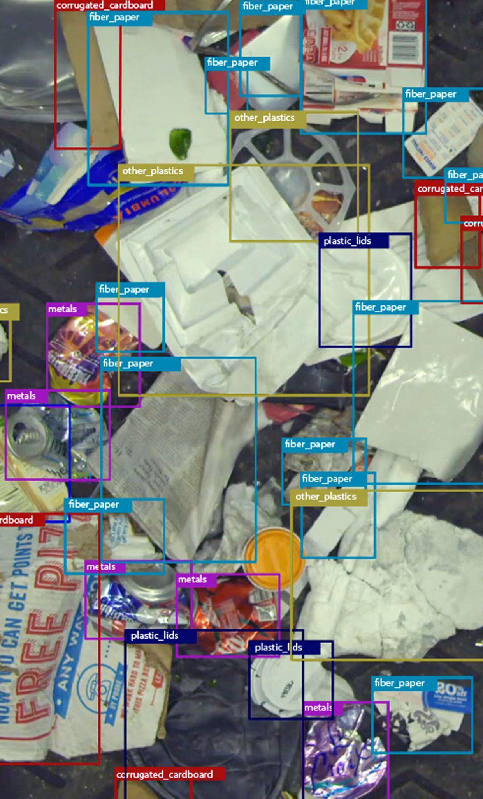

Kernel scalability
The iaCarry kernel is powerful, scalable and implementable in other products.
With it tuisku.eu, presents:
iaRecycle automatic recycling with AI
https://iarecycle.tuisku.eu/
iaRecycle
zero-waste technologies

Slide 15

The Investment
The needs of iaCarry.tuisku.eu
Renting of calculation servers for the resolution of models
Increase of 2 persons in the development department (implementations with more customers, development of iaRecycle)
One person in quality, for our management of the preventive maintenance of the vital bug, with basic bugs there is no scalability of the code.
Strong policy of expansion of national (2 people) and foreign (5 people) commercials.

Slide 16

Questions? Let’s get talking.
Know More:
https://tuisku.eu/
https://iacarry.tuisku.eu/
https://iarecycle.tuisku.eu/
E-MAIL
ADDRESS
PHONE
info​@tuisku.eu
sales​@tuisku.eu
l.castillo@tuisku.eu
Bilbao ​Spain Calle la Fanderia, 2, 48901 Barakaldo, Biscay
+34653288969

Slide 17
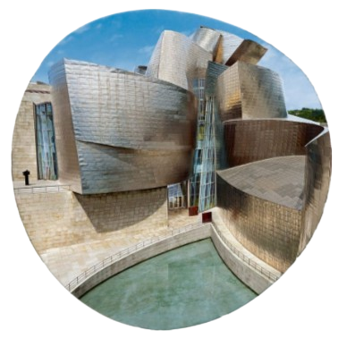
Contact
E-MAIL
ADDRESS
PHONE
info​@tuisku.eu
sales​@tuisku.eu
l.castillo@tuisku.eu
Bilbao ​Spain Calle la Fanderia, 2, 48901 Barakaldo, Biscay
+34653288969

