Slide 1

TEXT CLASSIFICATION
Subject: Cs114.k11

Slide 2
Introduction:
What is Text Classification?
Dataset
Support Vector Machine
How to build a Text Classification model?
Conclusion

Slide 3
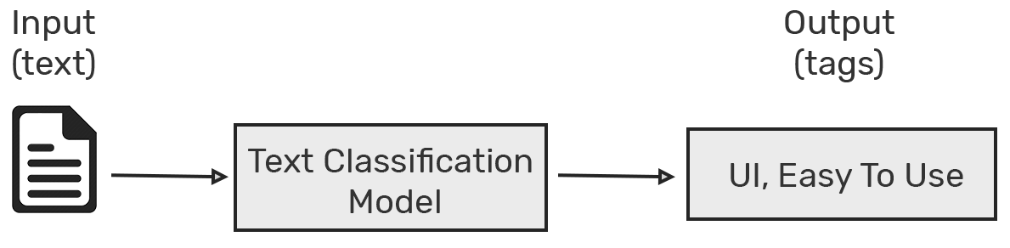
Text Classification

Slide 4
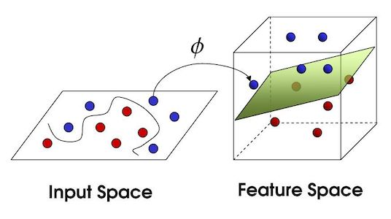
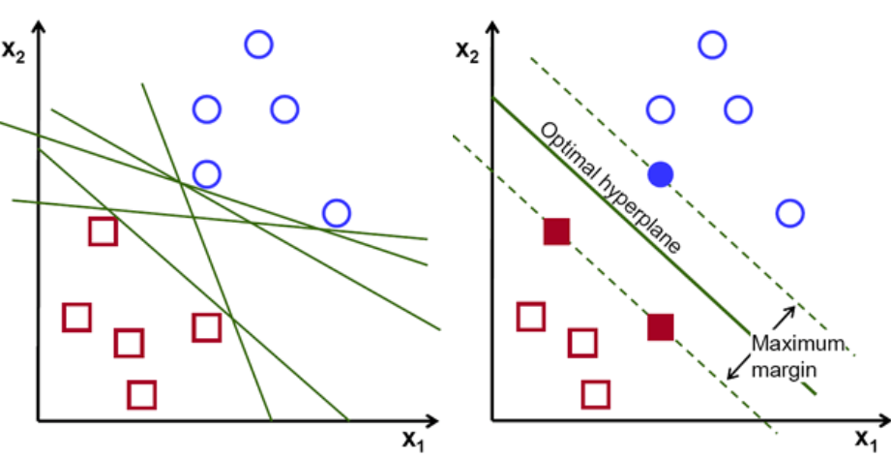
Support Vector Machine (SVM)

Slide 5
Dataset

Slide 6
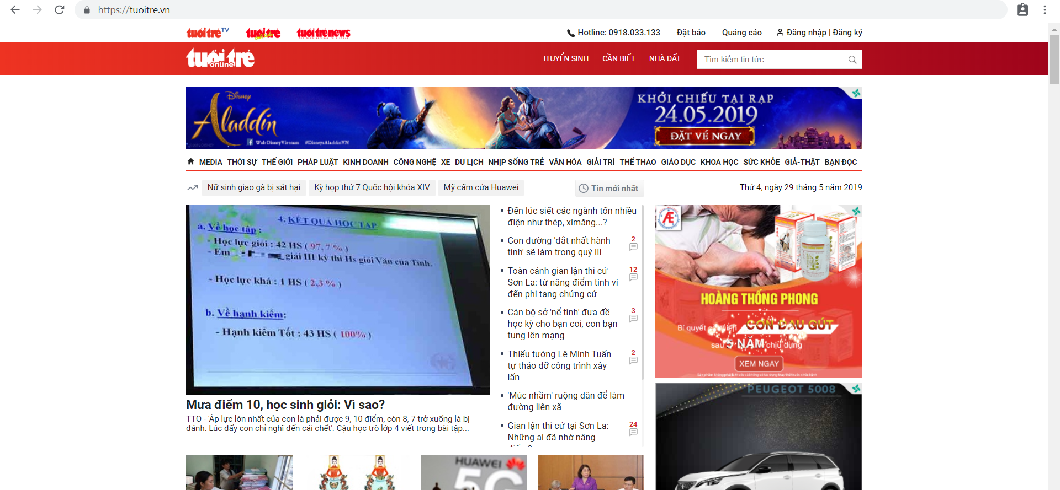

Slide 7
