Slide 1
How to interface a C++ API to a
Reverse Polish Notation script
(ie Forth interpreter) ?

Slide 2
Why ?
API can be huge, coming from different langages, have complex syntax …
Forth is Reverse Polish Notation (RPN) interpreter. Forth scripts are very compact.
RPN has no syntax, no parenthesis : 2 3 + 4 * instead of : (2 + 3) * 4 It uses a stack to store operands (push) and operators consums operands (pop)
RPN makes all API easier to understand to beginers and uniformize their syntax.

Slide 3
Table of Content
Step 1 : download a project, compile and test it
Step 2 : adapt the example:
  Create a generic stack class
  Create a basic Forth interpreter
  Read a Forth script from command line
Step 3 : run your script

Slide 4
Warnings
This demo shows simplified code.
For complete instructrions and code source :
https://github.com/Lecrapouille/BacASable/tree/master/
Cpp/ForthWrapper/CppSymbolicEngine/

Slide 5
Step 1
Step 1 : download a project, compile and run
https://www.ginac.de

Slide 6
Step 1 : download and compile

Slide 7
Step 2
Create and edit the file RPN.cpp

Slide 8
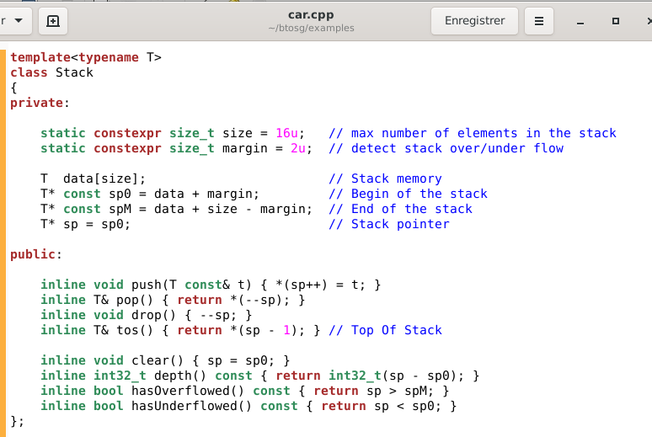
Step 2.1 : Edit the file RPN.cpp
Implement a template Stack<T> class
Similar to
std::stack

Slide 9
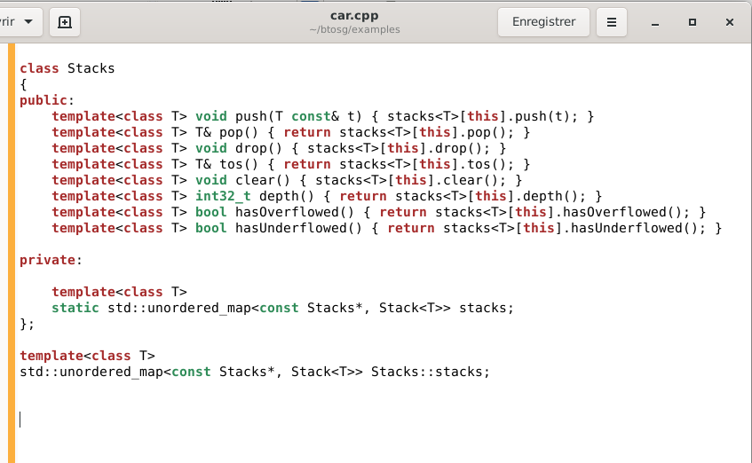
Step 2.2 : Edit the file btosg/examples/car.cpp
Implement an heterogeneous Stack
C++14 template variable :
Create static member variable
Same interface than
Stack<T>
Since stacks are static member variables
They are shared by other Stacks instance.
Add a std :: map to separate them.

Slide 10
Step 2.3 : Edit the file btosg/examples/car.cpp
Implement a basic Forth interprter
using Dictionary = std::map<std::string, std::function<void()>>;
Dictionary dictionary;
int IP; // Interpretation Pointer.
int g_argc = 0; // input stream
Stacks stacks;
static void times()
{
stacks.tos<double>() *= stacks.pop<double>();
}
static void add()
{
stacks.tos<double>() += stacks.pop<double>();
}
1.5 2.7 +
1.5 2.7 *

Slide 11
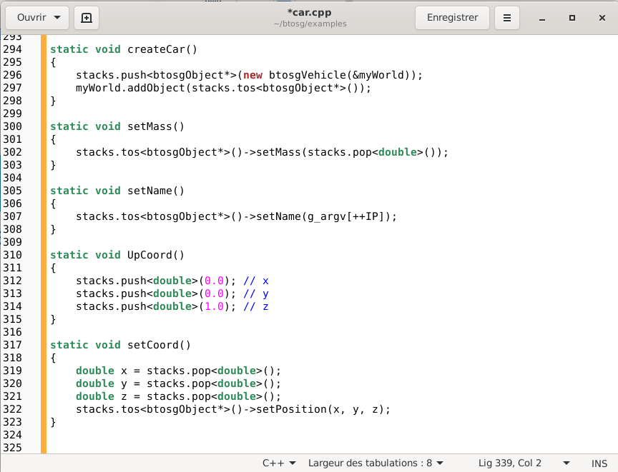
Step 2.4 : Edit the file btosg/examples/car.cpp
Implement Forth primitives : definition

Slide 12
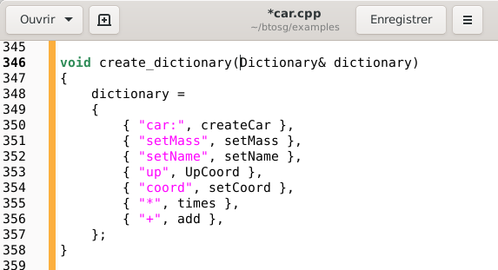
Step 2.5 : Edit the file btosg/examples/car.cpp
Implement Forth primitives : dictionary entries

Slide 13
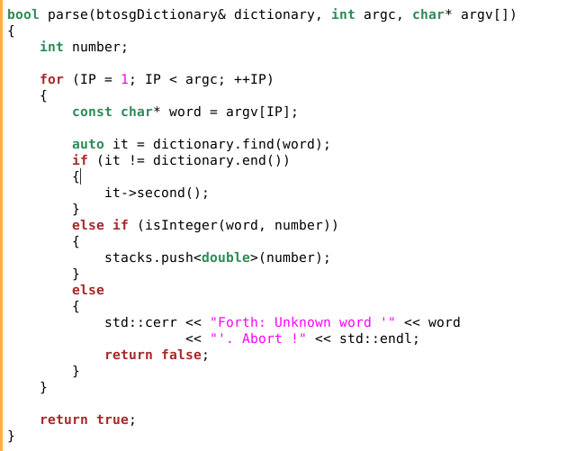
Step 2.6 : Edit the file btosg/examples/car.cpp
Forth parser : read form main(int argc, char*argv[])
IP :
Interpretation
pointer
Execute
known word
Else push
number on the
stack
Else unknown
word and not
a number

Slide 14
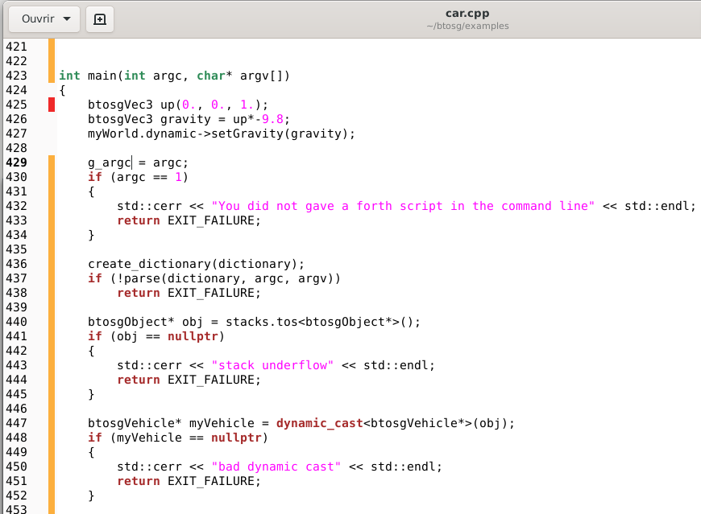
Step 2.7 : Edit the file btosg/examples/car.cpp
Forth parser : read form main(int argc, char*argv[])
Car example
Partially modified
Create a Forth
and read the
script
If wanted
reuse
Object in stacks

Slide 15
Step 3 : Call your script
Read a Forth script from command line

Slide 16
Thank you !
https://github.com/Lecrapouille

