Slide 1
C++ API wrapping in Forth :
How to manipulate symbols for your RPN script ?

Slide 2
Why wrapping C++ lib into RPN?
API can be huge, coming from different langages, have complex syntax …
Forth is Reverse Polish Notation (RPN) interpreter. Forth scripts are very compact.
RPN has no syntax, no parenthesis : 2 3 + 4 * instead of : (2 + 3) * 4. It uses a stack to store parameters (push) and operators consums them (pop) and push result.
RPN makes all API easier to understand to beginers and uniformize their syntax.

Slide 3
Goal ?
Extend your Forth with symbolic expressions : instead of 1 2 + we want : x y +
Compute : d/dx(x² + 2y) then apply : x = 4

Slide 4
On this video
Step 1 : download a symbolic C++ lib, compile it and install it
Step 2 : Create a basic Forth application:
Create a generic stack class
Create a basic Forth interpreter manipulating symbols
Read a Forth script from command line
Step 3 : run your script

Slide 5
Warnings
This demo shows simplified code.
For complete instructrions and code source :
https://github.com/Lecrapouille/BacASable/tree/master/
Cpp/ForthWrapper/CppSymbolicEngine/

Slide 6
Step 1
Step 1 : download Ginac, compile and install it https://www.ginac.de
git clone git://www.ginac.de/ginac.git –depth=1
cd ginac; mkdir build; cd build
cmake .. && make -j4 && sudo make install

Slide 7
Step 1 : download, compile, install

Slide 8
Step 2
Create your file RPN.cpp and let’s code

Slide 9
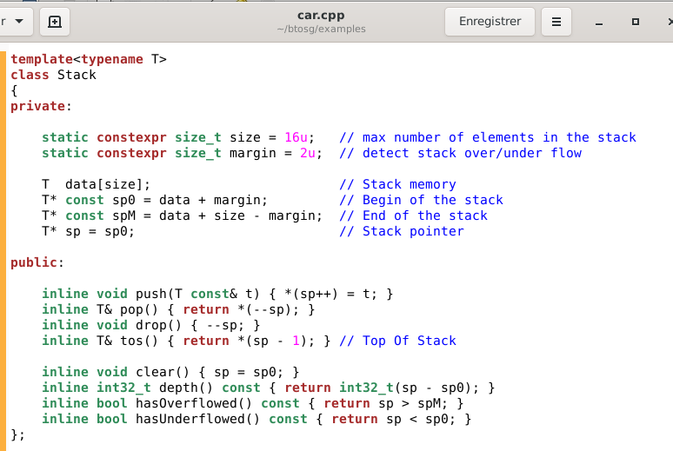
Step 2.1 : Edit the file RPN.cpp
Implement a template Stack<T> class
Mimic the
std::stack
Internally
fixed size
memory
Actions :
Push, pop
Top Of Stack

Slide 10
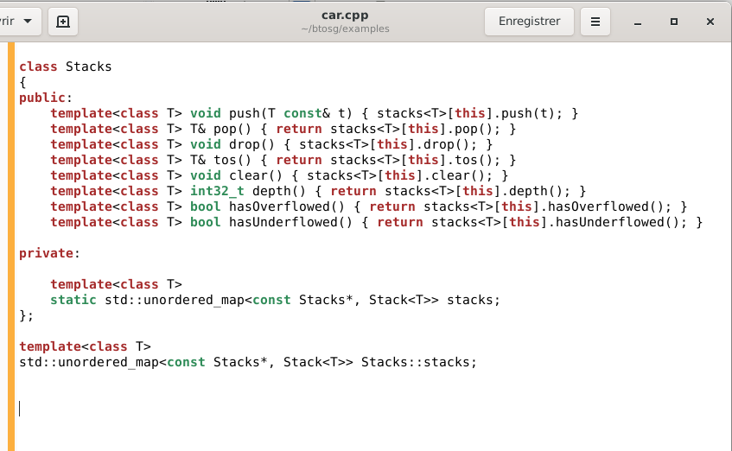
Step 2.2 : Edit the file RPN.cpp
Implement an heterogeneous container of Stack class
C++14 template variable :
Create static member variable
Same
interface
than
Stack<T>
Since stacks is a static member
variables all stacks are shared.
Add a std::map to separate them.

Slide 11
Step 2.3 : Edit the file RPN.cpp
Implement a basic Forth interprter
using Symbols = std::map<std::string, GiNaC::symbol>;
using Dictionary = std::map<std::string, std::function<void()>>;
Symbols symbols; // Store symbols (x, y ...)
Dictionary dictionary; // Store Forth words (times ...)
int IP; // Interpretation Pointer.
int g_argc = 0; // input stream
Stacks stacks; // Parameters stack
std::function<void()>
stack
static void times()
{
GiNaC::ex e1 = stacks.pop<GiNaC::ex>();
GiNaC::ex e2 = stacks.pop<GiNaC::ex>();
std::cout << " times: " << (e1 * e2) << std::endl;
stacks.push<GiNaC::ex>(e1 * e2);
}
GiNaC::ex e1 = stacks.pop<GiNaC::ex>();
x
x y *

Slide 12
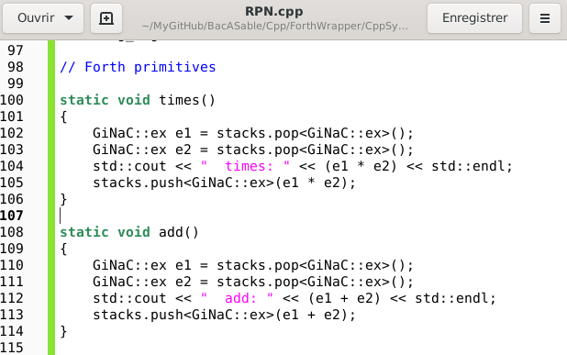
Step 2.4 : Edit the file RPN.cpp
Implement Forth primitives : definitions
Example :
x y *
Example :
x y +

Slide 13
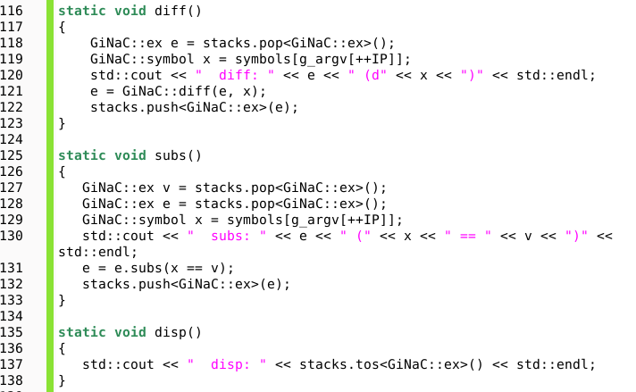
Step 2.4 : Edit the file btosg/examples/car.cpp
Implement Forth primitives : definitions
Derivative operator.
Example d/dx(x²):
x x * diff x
Substitution.
Example : set 4 to x
4 = x
Display an expression

Slide 14
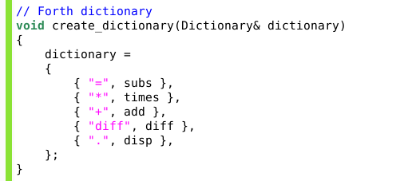
Step 2.5 : Edit the file RPN.cpp
Implement Forth primitives : dictionary entries
using Dictionary = std::map<std::string, std::function<void()>>;
Dictionary dictionary;

Slide 15
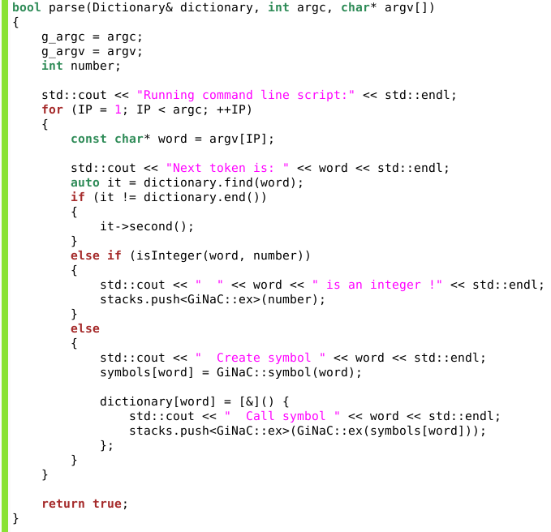
Step 2.6 : Edit the file RPN.cpp
Forth parser : read form main(int argc, char*argv[])
IP :
Interpretation
pointer
Execute
known word
(add, diff ...)
Else push the
expression on
the stack
Else unknown
word and not
a number :
Create a new symbol

Slide 16
Step 2.7 : Edit the file RPN.cpp
Forth parser : read form main(int argc, char*argv[])
int main(int argc, char* argv[])
{
create_dictionary(dictionary);
if (!parse(dictionary, argc, argv))
return EXIT_FAILURE;
}
Example : Derivate d/dx(x² + 2y) then set x := 4
Expected results :
d/dx(x² + 2y) will give 2x
2x with x := 4 will give 8

Slide 17
Step 3 : Call your script
Read a Forth script from command line

Slide 18
Thank you !
https://github.com/Lecrapouille

