Slide 1

Chapter 6
Wireless Networks
Computer Networking: A Top Down Approach
6th edition
Jim Kurose, Keith Ross
Addison-Wesley
March 2012
Wireless, Mobile Networks
6-<number>

Slide 2
Wireless and Mobile Networks
Background:
# wireless (mobile) phone subscribers now exceeds # wired phone subscribers (5-to-1)!
# wireless Internet-connected devices equals # wireline Internet-connected devices
  laptops, Internet-enabled phones promise anytime untethered Internet access
two important (but different) challenges
  wireless: communication over wireless link
  mobility: handling the mobile user who changes point of attachment to network
Wireless, Mobile Networks
6-<number>
Notes:
无线和移动网络
背景：
@ 无线（移动）电话用户超过有线电话用户（5:1）
@ 无线接入因特网设备和有线接入因特网设备数量基本一样
@ 两个重要挑战
# 无线接入：无线链路的通信
# 移动性：移动用户在接入点之间切换

Slide 3
Chapter 6 outline
1. Introduction
2. Wireless links, characteristics
  CDMA
3. IEEE 802.11 wireless LANs (“Wi-Fi”)
4. Cellular and mobility
Wireless, Mobile Networks
6-<number>

Slide 4



















Elements of a wireless network
network
infrastructure
Wireless, Mobile Networks
6-<number>
Notes:
无线网络组成

Slide 5



Elements of a wireless network
wireless hosts
laptop, smartphone
run applications
may be stationary (non-mobile) or mobile
  wireless does not always mean mobility
network
infrastructure
Wireless, Mobile Networks
6-<number>
Notes:
无线网络组成
无线主机：

Slide 6

Elements of a wireless network
base station
typically connected to wired network
relay - responsible for sending packets between wired network and wireless host(s) in its “area”
  e.g., cell towers, 802.11 access points
network
infrastructure
Wireless, Mobile Networks
6-<number>
Notes:
无线网络组成
基站：有线网络的接入点-有线网络和无线主机之间数据推送：蜂窝塔和无线AP

Slide 7
Elements of a wireless network
wireless link
typically used to connect mobile(s) to base station
also used as backbone link
multiple access protocol coordinates link access
various data rates, transmission distance
network
infrastructure
Wireless, Mobile Networks
6-<number>
Notes:
无线网络组成
无线链路：主要应用在网络边缘（移动设备接入），也可以应该在主干连接中（较少）
链路访问的多路访问控制；覆盖区域和速度

Slide 8
Elements of a wireless network
infrastructure mode
base station connects mobiles into wired network
handoff: mobile changes base station providing connection into wired network
network
infrastructure
Wireless, Mobile Networks
6-<number>
Notes:
无线网络组成
基础设施模式

Slide 9


Elements of a wireless network
ad hoc mode
no base stations
nodes can only transmit to other nodes within link coverage
nodes organize themselves into a network: route among themselves
Wireless, Mobile Networks
6-<number>
Notes:
无线网络组成
自组织网络

Slide 10
Chapter 6 outline
1. Introduction
2. Wireless links, characteristics
  CDMA
3. IEEE 802.11 wireless LANs (“Wi-Fi”)
4. Cellular and mobility
Wireless, Mobile Networks
6-<number>

Slide 11
Wireless Link Characteristics (1)
important differences from wired link ….
  decreased signal strength: radio signal attenuates as it propagates through matter (path loss).
    Hidden terminal problem
  interference from other sources: standardized wireless network frequencies (e.g., 2.4 GHz) shared by other devices (e.g., phone); devices (motors) interfere as well
    Exposed terminal problem
  multipath propagation: radio signal reflects off objects ground, arriving ad destination at slightly different times
…. make communication across (even a point to point) wireless link much more “difficult”
Wireless, Mobile Networks
6-<number>
Notes:
无线网络特征
不同于有线网络……
# 信号衰减：电磁波波在穿过物体时强度减弱
# 来自其他源干扰：2.4G无线电话和802.11b，频段相同
# 多径传播。电磁波受反射，用不同时间到达接收方，使得接收方信号变得模糊

Slide 12
Wireless Link Characteristics (2)
SINR: signal to interference plus noise ratio
  larger SINR – easier to extract signal from interference and noise (a “good thing”)
SINR versus BER tradeoffs
  given physical layer: increase power/decrease interference -> increase SINR->decrease BER
  given SINR: choose physical layer that meets BER requirement, giving highest thruput
    SINR may change with mobility: dynamically adapt physical layer (modulation technique, rate)
10⁻¹
10⁻²
10⁻³
BER
10⁻⁴
10⁻⁵
10⁻⁶
10⁻⁷
10
20
30
40
SNR(dB)
QAM256 (8 Mbps)
QAM16 (4 Mbps)
BPSK (1 Mbps)
Wireless, Mobile Networks
6-<number>
Notes:
无线链路特征
SNR：信噪比– 信号与噪声强度的相对测量。分贝（dB）
BER：比特差错率—接收到的有错传输比特的概率
#对于给定的调制方案，SNR越高，BER越低
#对于给定的SNR，具有较高比特传输率的调制技术将具有较高的BER
#SNR会因移动性改变

Slide 13
Code Division Multiple Access (CDMA)
unique “code” assigned to each user; i.e., code set partitioning
  all users share same frequency, but each user has own “chipping” sequence (i.e., code) to encode data
  allows multiple users to “coexist” and transmit simultaneously with minimal interference (if codes are “orthogonal”)
encoded signal = (original data) X (chipping sequence)
decoding: inner-product of encoded signal and chipping sequence
Wireless, Mobile Networks
6-<number>
Notes:
CDMA---码分多址

Slide 14
CDMA encode/decode
channel output Z_{i,m}
Z_{i,m}= d_{i}.c_{m}
data
bits
d₀ = 1
1
1
1
1
1
d₁ = -1
1
1
1
-
-
-
-
1
-
-
-
1
-
1
1
1
1
1
sender
1
1
slot 1
channel
output
slot 0
channel
output
1
1
1
1
1
code
1
1
-
-
-
1
-
1
1
1
-
-
-
1
-
1
1
1
slot 1
slot 0
M
D_{i} = Σ Z_{i,m}.c_{m}
m=1
M
received
input
1
1
1
1
1
1
1
1
d₀ = 1
-
-
-
-
1
-
-
-
1
-
1
1
1
1
1
1
d₁ = -1
1
slot 1
channel
output
slot 0
channel
output
1
1
1
1
1
code
1
1
-
-
-
1
-
1
1
1
-
-
-
1
-
1
1
1
receiver
slot 1
slot 0
Wireless, Mobile Networks
6-<number>

Slide 15

CDMA: two-sender interference
channel sums together transmissions by sender 1 and 2
Sender 1
Sender 2
using same code as sender 1, receiver recovers sender 1’s original data from summed channel data!
Wireless, Mobile Networks
6-<number>

Slide 16
Characteristics of selected wireless links
200
802.11n
54
802.11a,g
802.11a,g point-to-point
5-11
802.11b
4G: LTE WIMAX
4
3G: UMTS/WCDMA-HSPDA, CDMA2000-1xEVDO
Data rate (Mbps)
1
802.15
.384
2.5G: UMTS/WCDMA, CDMA2000
.056
2G: IS-95, CDMA, GSM
Indoor
10-30m
Outdoor
50-200m
Mid-range
outdoor
200m – 4 Km
Long-range
outdoor
5Km – 20 Km
Wireless, Mobile Networks
6-<number>
Notes:
部分无线网络标准的链路特性

Slide 17
Chapter 6 outline
1. Introduction
2. Wireless links, characteristics
  CDMA
3. IEEE 802.11 wireless LANs (“Wi-Fi”)
4. Cellular and mobility
Wireless, Mobile Networks
6-<number>

Slide 18
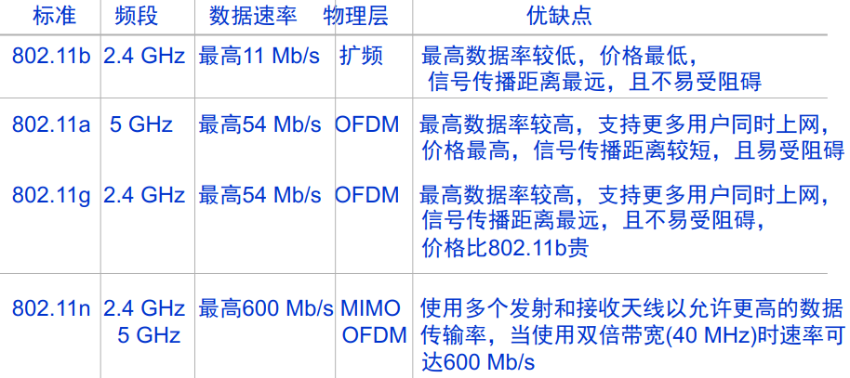
IEEE 802.11 Wireless LAN
802.11b
2.4-5 GHz unlicensed spectrum
rate up to 11 Mbps
direct sequence spread spectrum (DSSS) in physical layer
  all hosts use same chipping code
802.11a
  5-6 GHz range
  up to 54 Mbps
802.11g
  2.4-5 GHz range
  up to 54 Mbps
802.11n: multiple antennae
  2.4-5 GHz range
  up to 200 Mbps
all use CSMA/CA for multiple access
all have base-station and ad-hoc network versions
Wireless, Mobile Networks
6-<number>
Notes:
802.11 无线局域网
都使用CSMA/CA 进行多路访问
都使用

Slide 19




802.11 LAN architecture
wireless host communicates with base station
  base station = access point (AP)
Basic Service Set (BSS) (aka “cell”) in infrastructure mode contains:
  wireless hosts
  access point (AP): base station
ad hoc mode: hosts only
Internet
hub, switch
or router
BSS 1
BSS 2
Wireless, Mobile Networks
6-<number>

Slide 20
802.11: Channels, association
802.11b: 2.4GHz-2.485GHz spectrum divided into 11 channels at different frequencies
  AP admin chooses frequency for AP
  interference possible: channel can be same as that chosen by neighboring AP!
host: must associate with an AP
  scans channels, listening for beacon frames containing AP’s name (SSID) and MAC address
  selects AP to associate with
  may perform authentication [Chapter 8]
  will typically run DHCP to get IP address in AP’s subnet
Wireless, Mobile Networks
6-<number>

Slide 21
802.11: passive/active scanning
BBS 1
BBS 2
BBS 1
BBS 2
1
AP 2
AP 1
1
1
AP 2
AP 1
2
2
2
3
3
4
H1
H1
passive scanning:
beacon frames sent from APs
association Request frame sent: H1 to selected AP
association Response frame sent from selected AP to H1
active scanning:
Probe Request frame broadcast from H1
Probe Response frames sent from APs
Association Request frame sent: H1 to selected AP
Association Response frame sent from selected AP to H1
Wireless, Mobile Networks
6-<number>

Slide 22




IEEE 802.11: multiple access
avoid collisions: 2⁺ nodes transmitting at same time
802.11: CSMA - sense before transmitting
  don’t collide with ongoing transmission by other node
802.11: no collision detection!
  difficult to receive (sense collisions) when transmitting due to weak received signals (fading)
  can’t sense all collisions in any case: hidden terminal, fading
  goal: avoid collisions: CSMA/C(ollision)A(voidance)
A
B
C
C
B
A’s signal
strength
C’s signal
strength
A
space
Wireless, Mobile Networks
6-<number>
Notes:
IEEE802.11：多路访问
@冲突避免：当2个以上的结点同时发送的时候
@802.11：CSMA 载波帧听
@802.11：不需要进行冲突检测
#当传输过程中信号衰减，难以检测到冲突
#不是所有的情况都能检测到冲突：终端隐藏，衰减
#目标：冲突避免

Slide 23
IEEE 802.11 MAC Protocol: CSMA/CA
802.11 sender
1 if sense channel idle for DIFS then
  transmit entire frame (no CD)
2 if sense channel busy then
  start random backoff time
  timer counts down while channel idle
  transmit when timer expires
  if no ACK, increase random backoff interval, repeat 2
802.11 receiver
- if frame received OK
return ACK after SIFS (ACK needed due to hidden terminal problem)
sender
receiver
DIFS
data
SIFS
ACK
Wireless, Mobile Networks
6-<number>
Notes:
CSMA/CA
发送端
1.如果帧听到信道空闲，在一个分布式帧间间隔的短时间后发送该帧
2.否则，该结点选择一个随机回退值，计时器倒计时直到信道空闲则发送/忙时计数值不变；
如果计时器超时，站点发送整个数据帧并等待确认
如果收到ACK，发送端知道被目的端正确收到了。如果未收到ack，则增加回退随机值，重复2
接收端
如果成功的接收到帧
等待SIFS后返回ack（ack 是为了解决隐藏终端问题)

Slide 24
Avoiding collisions (more)
idea: allow sender to “reserve” channel rather than random access of data frames: avoid collisions of long data frames
sender first transmits small request-to-send (RTS) packets to BS using CSMA
  RTSs may still collide with each other (but they’re short)
BS broadcasts clear-to-send CTS in response to RTS
CTS heard by all nodes
  sender transmits data frame
  other stations defer transmissions
avoid data frame collisions completely
using small reservation packets!
Wireless, Mobile Networks
6-<number>
Notes:
冲突避免
理想情况：允许所有发送端预定信道而不是随机访问：避免较长的数据帧发生碰撞
@发送端首先发送小的RTS packet 到基站 采用CSMA- RTS 彼此存在碰撞
@基站广播CTS 作为RTS的回应
@CTS 被所有结点收到（广播)
# 仅有一个发送方开始传输数据帧
# 其他结点推迟发送

Slide 25

Collision Avoidance: RTS-CTS exchange
A
B
AP
RTS(B)
RTS(A)
reservation collision
RTS(A)
CTS(A)
CTS(A)
DATA (A)
defer
time
ACK(A)
ACK(A)
Wireless, Mobile Networks
6-<number>

Slide 26
802.11 frame: addressing
2
2
6
6
6
2
6
0 - 2312
4
frame
control
duration
address
1
address
2
address
3
seq
control
address
4
payload
CRC
Address 4: used only in ad hoc mode
Address 1: MAC address
of wireless host or AP
to receive this frame
Address 3: MAC address
of router interface to which AP is attached
Address 2: MAC address
of wireless host or AP
transmitting this frame
Wireless, Mobile Networks
6-<number>
Notes:
802.11 帧：寻址
地址1：接收该帧的主机或者AP MAC地址
地址2：发送该帧的主机货值AP MAC地址
地址3： 和AP相连的路由接口 MAC地址
地址4：在自组织模式的使用

Slide 27
802.11 frame: addressing
Internet
H1
R1
router
R1 MAC addr H1 MAC addr
dest. address
source address
802.3 frame
AP MAC addr H1 MAC addr R1 MAC addr
address 1
address 2
address 3
802.11 frame
Wireless, Mobile Networks
6-<number>

Slide 28
802.11 frame: more
frame seq #
(for RDT)
duration of reserved
transmission time (RTS/CTS)
2
2
6
6
6
2
6
0 - 2312
4
frame
control
duration
address
1
address
2
address
3
seq
control
address
4
payload
CRC
2
2
4
1
1
1
1
1
1
1
1
Protocol
version
Type
Subtype
To
AP
From
AP
More
frag
Retry
Power
mgt
More
data
WEP
Rsvd
frame type
(RTS, CTS, ACK, data)
Wireless, Mobile Networks
6-<number>

Slide 29

802.11: mobility within same subnet
H1 remains in same IP subnet: IP address can remain same
switch: which AP is associated with H1?
  self-learning (Ch. 5): switch will see frame from H1 and “remember” which switch port can be used to reach H1
BBS 1
H1
BBS 2
Wireless, Mobile Networks
6-<number>
Notes:
在相同子网内的移动性
@ H1 保留在相同的IP子网内：ip地址会保持不变
@交换机：那个AP和H1相连
#信号的强度变化会使得H1从BBS1-》BBS2
#交换机会自学习来自H1的帧，并记住所对应的端口

Slide 30
802.11: advanced capabilities
Rate adaptation
base station, mobile dynamically change transmission rate (physical layer modulation technique) as mobile moves, SNR varies
10⁻¹
10⁻²
10⁻³
BER
10⁻⁴
10⁻⁵
10⁻⁶
10⁻⁷
10
20
30
40
SNR(dB)
1. SNR decreases, BER increase as node moves away from base station
QAM256 (8 Mbps)
QAM16 (4 Mbps)
2. When BER becomes too high, switch to lower transmission rate but with lower BER
BPSK (1 Mbps)
operating point
Wireless, Mobile Networks
6-<number>
Notes:
802.11 高级特性
速率适应
@

Slide 31
802.11: advanced capabilities
power management
node-to-AP: “I am going to sleep until next beacon frame”
  AP knows not to transmit frames to this node
  node wakes up before next beacon frame
beacon frame: contains list of mobiles with AP-to-mobile frames waiting to be sent
  node will stay awake if AP-to-mobile frames to be sent; otherwise sleep again until next beacon frame
Wireless, Mobile Networks
6-<number>
Notes:
功率管理
@

Slide 32
802.15: personal area network
less than 10 m diameter
replacement for cables (mouse, keyboard, headphones)
ad hoc: no infrastructure
master/slaves:
  slaves request permission to send (to master)
  master grants requests
802.15: evolved from Bluetooth specification
  2.4-2.5 GHz radio band
  up to 721 kbps
S
P
P
radius of
coverage
M
S
S
P
P
M
Master device
Slave device
Parked device (inactive)
S
P
Wireless, Mobile Networks
6-<number>
Notes:
802.11外标准：802.15
@工作范围：10米内
@取代电缆（鼠标，键盘，耳机）
@自组织：无基础设施
@主从式
@802.15：从蓝牙规范开始发展 802.15.1 蓝牙 802.15.4 zigbee
# 2.4g-2.5g 带宽内
# 最高能到721kbps

Slide 33
Wireless-Summary
Wireless
wireless links:
  capacity, distance
  channel impairments
  CDMA
IEEE 802.11 (“Wi-Fi”)
  CSMA/CA reflects wireless channel characteristics
Wireless, Mobile Networks
6-<number>

Slide 34
Chapter 6 outline
1. Introduction
2. Wireless links, characteristics
  CDMA
3. IEEE 802.11 wireless LANs (“Wi-Fi”)
4. Cellular and mobility
Wireless, Mobile Networks
6-<number>

Slide 35
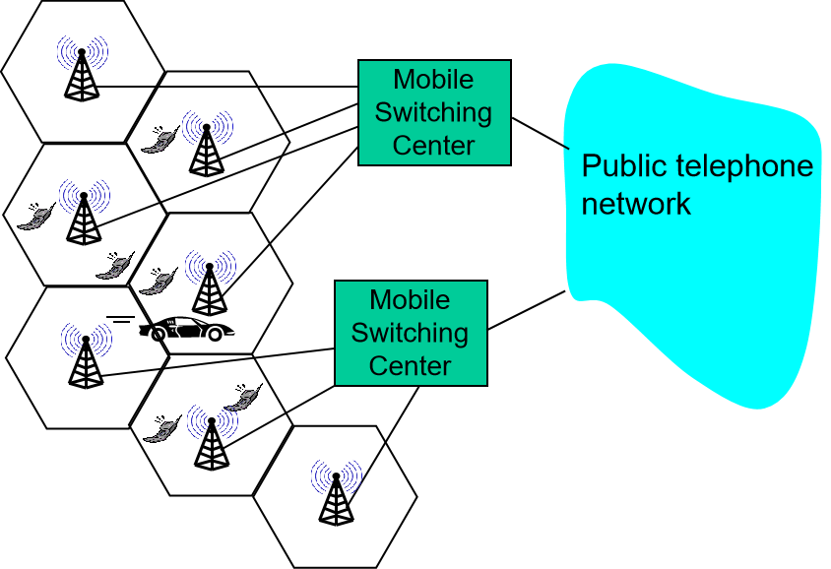
Development of Cellular Network
2G(voice)
  GSM, IS-95
2.5G(voice+data)
  GPRS, EDGE, CDMA-2000(Stage 1)
3G(voice+data)
  UMTS, TD-SCDMA, WCDMA, CDMA-2000
Beyond 4G(data+voice)
  LTE, LTE-A, 5G, B5G, 6G…
Wireless and Mobile Networks
7-<number>

Slide 36



Mobility via indirect routing
foreign agent receives packets, forwards to mobile
home agent intercepts packets, forwards to foreign agent
visited
network
home
network
3
wide area network
2
1
correspondent addresses packets using home address of mobile
4
mobile replies directly to correspondent
Wireless and Mobile Networks
7-<number>

Slide 37


Mobility via direct routing
foreign agent receives packets, forwards to mobile
correspondent forwards to foreign agent
visited
network
home
network
3
1
2
4
correspondent requests, receives foreign address of mobile
mobile replies directly to correspondent
Wireless and Mobile Networks
7-<number>

Slide 38
The End
Wish you success in the exams!
Wireless and Mobile Networks
7-<number>

