Slide 1

Chapter 3
Transport Layer
Computer Networking: A Top Down Approach
6th edition
Jim Kurose, Keith Ross
Addison-Wesley
March 2012
Transport Layer
3-<number>

Slide 2
Chapter 3: Transport Layer
our goals:
understand principles behind transport layer services:
  multiplexing, demultiplexing
  reliable data transfer
  flow control
  congestion control
learn about Internet transport layer protocols:
  UDP: connectionless transport
  TCP: connection-oriented
  TCP: reliable transport
  TCP: congestion control
Transport Layer
3-<number>
Notes:
第三章 传输层
本讲目的:
@ 理解传输层服务的原理:
# 多路复用/多路分解
# 可靠数据传输
# 流量控制
# 拥塞控制
@ 传输层协议
# UDP 面向无连接的传输
# TCP 面向可靠连接的传输
# TCP 拥塞控制

Slide 3
Chapter 3 outline
3.1 transport-layer services
3.2 multiplexing and demultiplexing
3.3 connectionless transport: UDP
3.4 principles of reliable data transfer
3.5 connection-oriented transport: TCP
  segment structure
  reliable data transfer
  flow control
  connection management
3.6 principles of congestion control
3.7 TCP congestion control
Transport Layer
3-<number>
Notes:
*3.1 传输层服务
3.2 多路复用和多路分解
3.3 无连接运输：UDP
3.4 可靠运输原理
3.5 面向连接的运输：TCP
3.6 拥塞控制原理
3.7 TCP的拥塞控制

Slide 4

















Transport services and protocols
application
transport
network
data link
physical
provide logical communication between app processes running on different hosts
transport protocols run in end systems
  send side: breaks app messages into segments, passes to network layer
  rcv side: reassembles segments into messages, passes to app layer
more than one transport protocol available to apps
  Internet: TCP and UDP
network
data link
physical
network
data link
physical
network
data link
physical
network
data link
physical
logical end-end transport
network
data link
physical
network
data link
physical
network
data link
physical
application
transport
network
data link
physical
Transport Layer
3-<number>
Notes:
3.1 传输层服务
@ 提供运行在不同主机中进程间的逻辑通信
@ 传输层协议仅运行在端系统中
# 发送端将应用层报文分解成数据报传至网络层
# 接收端重组数据报为应用层报文并传至应用层
@ 传输层协议：TCP UDP

Slide 5
Transport vs. network layer
network layer: logical communication between hosts
transport layer: logical communication between processes
  relies on, enhances, network layer services
household analogy:
12 kids in Ann’s house sending letters to 12 kids in Bill’s house:
hosts = houses
processes = kids
app messages = letters in envelopes
transport protocol = Ann and Bob who demux to in-house siblings
network-layer protocol = postal service
Transport Layer
3-<number>
Notes:
3.1.1 传输层和网络层关系
@ 网络层：主机间（端系统间）的逻辑通信
@ 传输层：进程间的逻辑通信
# 依赖网络层服务，提升了网络层服务

Slide 6
Internet network-layer protocols
internet protocol (IP)
“best effort delivery”
  an unreliable service
  does not guarantee segment delivery
  does not guarantee orderly delivery
  does not guarantee the integrity of the data
datagram: name of packets in network layer
application
transport
network
data link
physical
Logical Communication
application
transport
network
data link
physical
Transport Layer
3-<number>
Notes:
3.1.2 因特网传输层概述
@ 可靠, 按序点对点递交 (TCP)
# 拥塞控制
# 流量控制
# 连接建立
@ 不可靠的 (“尽力而为”), 无序的点对点或广播递交: UDP
@ 不能提供的服务（受限于网络层）:
# 实时性
# 带宽承诺
# 可靠的广播通信

Slide 7
Chapter 3 outline
3.1 transport-layer services
3.2 multiplexing and demultiplexing
3.3 connectionless transport: UDP
3.4 principles of reliable data transfer
3.5 connection-oriented transport: TCP
  segment structure
  reliable data transfer
  flow control
  connection management
3.6 principles of congestion control
3.7 TCP congestion control
Transport Layer
3-<number>
Notes:
3.1 传输层服务
*3.2 多路复用和多路分解
3.3 无连接运输：UDP
3.4 可靠运输原理
3.5 面向连接的运输：TCP
3.6 拥塞控制原理
3.7 TCP的拥塞控制

Slide 8

Multiplexing/demultiplexing
multiplexing at sender:
demultiplexing at receiver:
handle data from multiple
sockets, add transport header (later used for demultiplexing)
use header info to deliver
received segments to correct
socket
application
application
P1
P2
application
socket
P3
transport
P4
process
transport
network
transport
network
link
network
link
physical
link
physical
physical
Transport Layer
3-<number>
Notes:
3.2 多路复用与多路分解
@ 复用发生在发送端
将来自多个socket的的数据，添加传输层头（用于分解）
@ 分解发生在接收端
利用传输层头部信息将接受到的报文段投递给正确的socket

Slide 9
How demultiplexing works
host uses IP addresses & port numbers to direct segment to appropriate socket
host receives IP datagrams
  each datagram has source IP address, destination IP address
  each datagram carries one transport-layer segment
  each segment has source, destination port number
32 bits
source port #
dest port #
other header fields
application
data
(payload)
TCP/UDP segment format
Transport Layer
3-<number>
Notes:
3.2 多路复用与多路分解
@ 主机接受IP数据报
# 每个数据报有源IP地址和目的IP地址
# 每个数据报都携带一个传输层报文段
# 每个报文段有源和目的端口号
@ 主机利用IP地址和端口号指示报文段对应的socket

Slide 10
Connectionless demultiplexing
when creating datagram to send into UDP socket, must specify
  destination IP address
  destination port #
created socket has host-local port #:
DatagramSocket mySocket1 = new DatagramSocket(12534);
DatagramPacket mypacket1
= new DatagramPacket(data, data.length,…)
when host receives UDP segment:
  checks destination port # in segment
  directs UDP segment to socket with that port #
IP datagrams with same dest. port #, but different source IP addresses and/or source port numbers will be directed to same socket at dest
Transport Layer
3-<number>
Notes:
3.2 多路复用与多路分解
无连接的多路分解
@ 回顾：
创建一个本地端口的socket
DatagramSocket mySocket1 = new DatagramSocket(12534);
当生产的数据报向UDP socket发去，必须明确 目的IP和目的端口
@ 当主机收到UDP 报文段，需要
检查数据报中目的端口，并将报文段指向该端口号对应的socket
UDP 的多路分解 均指向同一端口的Socket，但是数据来自不同IP

Slide 11
Connectionless demux: example
DatagramSocket serverSocket = new DatagramSocket
(6428);
DatagramSocket mySocket2 = new DatagramSocket
(9157);
DatagramSocket mySocket1 = new DatagramSocket (5775);
application
application
P1
application
P2
P3
transport
transport
network
transport
network
link
network
link
physical
link
physical
physical
source port: 6428
dest port: 9157
source port: ?
dest port: ?
source port: 9157
dest port: 6428
source port: ?
dest port: ?
Transport Layer
3-<number>

Slide 12
Connection-oriented demux
TCP socket identified by 4-tuple:
  source IP address
  source port number
  dest IP address
  dest port number
demux: receiver uses all four values to direct segment to appropriate socket
server host may support many simultaneous TCP sockets:
  each socket identified by its own 4-tuple
web servers have different sockets for each connecting client
  non-persistent HTTP will have different socket for each request
Transport Layer
3-<number>
Notes:
3.2 多路复用与多路分解
面向连接的多路分解
@ TCP Socket由4元组定义
# 源IP地址
# 源端口号
# 目的IP地址
# 目的端口号
@ 多路分解：接收端通过四个值来确定合适的socket
@ 服务器段要维持多个并行的TCPsocket（4元组确定）
@ Web服务器对每个连接的Client都有不同socket维持连接

Slide 13
Connection-oriented demux: example
application
application
P1
P2
P3
application
P4
P5
P4
transport
transport
network
transport
network
link
network
link
physical
link
physical
server: IP address B
physical
host: IP address A
source IP,port: B,80
dest IP,port: A,9157
host: IP address C
source IP,port: C,5775
dest IP,port: B,80
source IP,port: A,9157
dest IP, port: B,80
source IP,port: C,9157
dest IP,port: B,80
three segments, all destined to IP address: B,
dest port: 80 are demultiplexed to different sockets
Transport Layer
3-<number>
Notes:
多个进程情况

Slide 14
Connection-oriented demux: example
threaded server
application
application
application
P1
P4
P4
P5
transport
transport
network
transport
network
link
network
link
physical
link
physical
server: IP address B
physical
host: IP address A
source IP,port: B,80
dest IP,port: A,9157
host: IP address C
source IP,port: C,5775
dest IP,port: B,80
source IP,port: A,9157
dest IP, port: B,80
source IP,port: C,9157
dest IP,port: B,80
Transport Layer
3-<number>
Notes:
线程化处理

Slide 15
Chapter 3 outline
3.1 transport-layer services
3.2 multiplexing and demultiplexing
3.3 connectionless transport: UDP
3.4 principles of reliable data transfer
3.5 connection-oriented transport: TCP
  segment structure
  reliable data transfer
  flow control
  connection management
3.6 principles of congestion control
3.7 TCP congestion control
Transport Layer
3-<number>
Notes:
3.1 传输层服务
3.2 多路复用和多路分解
*3.3 无连接运输：UDP
3.4 可靠运输原理
3.5 面向连接的运输：TCP
3.6 拥塞控制原理
3.7 TCP的拥塞控制

Slide 16
UDP: User Datagram Protocol [RFC 768]
simple protocol:
  basic function
  error detect
“best effort” service, UDP segments may be:
  lost, error
  delivered out-of-order
connectionless:
  no handshaking between UDP sender, receiver
  each UDP segment handled independently of others
UDP used in:
  streaming multimedia apps (real-time, loss tolerant)
  DNS, SNMP
reliable transfer over UDP:
  add reliability at application layer
  application-specific error recovery!
Transport Layer
3-<number>
Notes:
3.3 无连接运输：UDP
@“最简约的” Internet 传输协议
@“尽力而为的” 服务, UDP 数据段可以:
# 丢失
# 应用数据不按序到达
@ 无连接表现:
# 在UDP收发双方之间, 无需握手信号
# 每个 UDP 数据段的操作都互相独立
@ UDP应用场合
# 流媒体应用（允许丢失，但传输速率敏感）
# DNS
# SNMP
@ UDP的可靠性传输
# 在应用层增加可靠传输机制
# 尤其是出错重传机制

Slide 17
UDP: segment header
length, in bytes of UDP segment, including header
32 bits
source port #
dest port #
length
checksum
why is there a UDP?
no connection establishment (which can add delay)
simple: no connection state at sender, receiver
small header size
no congestion control: UDP can blast away as fast as desired
application
data
(payload)
UDP segment format
Transport Layer
3-<number>
Notes:
3.3.1 UDP 报文段结构
Length—UDP端的字节数（包括UDP头部）
为什么需要UDP
@ 无需建立连接 (会增加延迟)
@ 简单: 在收发双方之间没有连接状态
@ 段首较短
@ 无拥塞控制: UDP 可按需要随时发送

Slide 18
UDP checksum
Goal: detect “errors” (e.g., flipped bits) in transmitted segment
sender:
treat segment contents, including header fields, as sequence of 16-bit integers
checksum: addition (one’s complement sum) of segment contents
sender puts checksum value into UDP checksum field
receiver:
compute checksum of received segment
check if computed checksum equals checksum field value:
  NO - error detected
  YES - no error detected. But maybe errors nonetheless? More later ….
Transport Layer
3-<number>
Notes:
3.3.2 UDP校验和（checksum）
目的：检测传输段中“错误”
@发送方:
# 将段的内容看作一串16位整数
# checksum: 作段内容的加法(补码和)
# 发送方将补码和放入 UDP checksum 字段
@ 接收方:
# 对接收到的段内容进行补码和计算
# 检查计算结果是否与收到的校验和相等:
$ NO – 查出错误
$ YES – 没查出错误. 但是仍有可能存在错误?

Slide 19
Internet checksum: example
example: add two 16-bit integers
1 1 1 1 0 0 1 1 0 0 1 1 0 0 1 1 0
1 1 1 0 1 0 1 0 1 0 1 0 1 0 1 0 1
1 1 0 1 1 1 0 1 1 1 0 1 1 1 0 1 1
1 1 0 1 1 1 0 1 1 1 0 1 1 1 1 0 0
1 0 1 0 0 0 1 0 0 0 1 0 0 0 0 1 1
wraparound
sum
checksum
Note: when adding numbers, a carryout from the most significant bit needs to be added to the result
Transport Layer
3-<number>
Notes:
3.3.2 UDP校验和（checksum）
sum + checksum = 11111111111111111111111(如果有一位为0，则出错）

Slide 20
Chapter 3 outline
3.1 transport-layer services
3.2 multiplexing and demultiplexing
3.3 connectionless transport: UDP
3.4 principles of reliable data transfer
3.5 connection-oriented transport: TCP
  segment structure
  reliable data transfer
  flow control
  connection management
3.6 principles of congestion control
3.7 TCP congestion control
Transport Layer
3-<number>
Notes:
3.1 传输层服务
3.2 多路复用和多路分解
3.3 无连接运输：UDP
*3.4 可靠运输原理
3.5 面向连接的运输：TCP
3.6 拥塞控制原理
3.7 TCP的拥塞控制

Slide 21

Principles of reliable data transfer
important in application, transport, link layers
  top-10 list of important networking topics!
characteristics of unreliable channel will determine complexity of reliable data transfer protocol (rdt)
Transport Layer
3-<number>
Notes:
3.4 可靠数据传输原理
@ 在应用、传输、链路层都十分重要
@ 属于网络工程的top-10 课题之一!
@ 不可靠传输通道的特性将决定可靠传输协议(rdt)的复杂性

Slide 22
Principles of reliable data transfer
important in application, transport, link layers
  top-10 list of important networking topics!
characteristics of unreliable channel will determine complexity of reliable data transfer protocol (rdt)
Transport Layer
3-<number>
Notes:
3.4 可靠数据传输原理
@ 在应用、传输、链路层都十分重要
@ 属于网络工程的top-10 课题之一!
@ 不可靠传输通道的特性将决定可靠传输协议(rdt)的复杂性

Slide 23
Principles of reliable data transfer
important in application, transport, link layers
  top-10 list of important networking topics!
characteristics of unreliable channel will determine complexity of reliable data transfer protocol (rdt)
Transport Layer
3-<number>
Notes:
3.4 可靠数据传输原理
@ 在应用、传输、链路层都十分重要
# 属于网络工程的top-10 课题之一!
@不可靠传输通道的特性将决定可靠传输协议(rdt)的复杂性

Slide 24

Reliable data transfer: getting started
rdt_send(): called from above, (e.g., by app.). Passed data to
deliver to receiver upper layer
deliver_data(): called by rdt to deliver data to upper
send
side
receive
side
udt_send(): called by rdt,
to transfer packet over
unreliable channel to receiver
rdt_rcv(): called when packet arrives on rcv-side of channel
Transport Layer
3-<number>
Notes:
3.4 可靠数据传输原理
发送方：
@ rdt_send(): 由上层进行调用, (e.g., 应用进程.). 将数据传入发送方并由其传给接收方的上层
@ udt_send(): 由rdt调用,将分组通过不可靠的信道传到接收方
接收方：
@ deliver_data(): 由 rdt调用 将数据递交给上层
@ rdt_rcv(): 当数据到达接受方时调用

Slide 25
Reliable data transfer: getting started
we’ll:
incrementally develop sender, receiver sides of reliable data transfer protocol (rdt)
consider only unidirectional data transfer
  but control info will flow on both directions!
use finite state machines (FSM) to specify sender, receiver
event causing state transition
actions taken on state transition
state: when in this “state” next state uniquely determined by next event
state
1
state
2
event
actions
Transport Layer
3-<number>
Notes:
3.4 可靠数据传输原理
我们将要:
@ 逐步发展收发双方的可靠数据传输协议 (rdt)
@ 仅考虑单向的数据传输
# 但控制信息将双向流动!
@使用有限状态机 (FSM) 来定义发送方, 接收方

Slide 26
rdt1.0: reliable transfer over a reliable channel
underlying channel perfectly reliable
  no bit errors
  no loss of packets
separate FSMs for sender, receiver:
  sender sends data into underlying channel
  receiver reads data from underlying channel
Wait for call from above
rdt_send(data)
Wait for call from below
rdt_rcv(packet)
extract (packet,data)
deliver_data(data)
packet = make_pkt(data)
udt_send(packet)
sender
receiver
Transport Layer
3-<number>
Notes:
3.4.1 构造可靠数据传输协议
经完全可靠信道的可靠数据传输 Rdt1.0
@ 所依赖的信道非常可靠
# 不可能有位错
# 不会丢失数据
@ 分别为发送方和接收方建立 FSMs :
# 发送方将数据送入所依赖的信道
# 接收方从所依赖的信道读出数据

Slide 27
rdt2.0: channel with bit errors
underlying channel may flip bits in packet
  checksum to detect bit errors
the question: how to recover from errors:
  acknowledgements (ACKs): receiver explicitly tells sender that pkt received OK
  negative acknowledgements (NAKs): receiver explicitly tells sender that pkt had errors
  sender retransmits pkt on receipt of NAK
new mechanisms in rdt2.0 (beyond rdt1.0):
  error detection
  receiver feedback: control msgs (ACK,NAK) rcvr->sender
How do humans recover from “errors”
during conversation?
Transport Layer
3-<number>
Notes:
3.4.1 构造可靠的数据传输协议
经具有比特差错信道的可靠数据传输 rdt2.0
@ 所依赖的信道有可能在分组数据中出现位错
#回顾: UDP checksum 可发现位错
@ 问题: 如何从错误中恢复 : 人类在交谈中如何纠错呢？

Slide 28
rdt2.0: channel with bit errors
underlying channel may flip bits in packet
  checksum to detect bit errors
the question: how to recover from errors:
  acknowledgements (ACKs): receiver explicitly tells sender that pkt received OK
  negative acknowledgements (NAKs): receiver explicitly tells sender that pkt had errors
  sender retransmits pkt on receipt of NAK
new mechanisms in rdt2.0 (beyond rdt1.0):
  error detection
  feedback: control msgs (ACK,NAK) from receiver to sender
Transport Layer
3-<number>
Notes:
3.4.1 构造可靠的数据传输协议
经具有比特差错信道的可靠数据传输 rdt2.0
@所依赖的信道有可能在分组数据中出现比特位错误
# 回顾: UDP checksum 可发现比特位错误
@ 问题: 如何从错误中恢复 :
# 进行确认 (ACKs): 由接收方法送报文向发送方进行确认
# 发送否认 (NAKs):由接收方法送报文向发送方进行否认，说明分组有错
# 发送方在收到NAK后进行分组重传
# 在人类交往中是不是也有 ACKs, NAKs?
@ rdt2.0的新机制 (在 rdt1.0基础之上):
# 错误检测
# 接收方的反馈: 控制信息 (ACK,NAK) rcvr->sender

Slide 29
rdt2.0: FSM specification
rdt_send(data)
sndpkt = make_pkt(data, checksum)
udt_send(sndpkt)
receiver
rdt_rcv(rcvpkt) &&
isNAK(rcvpkt)
Wait for call from above
Wait for ACK or NAK
rdt_rcv(rcvpkt) &&
corrupt(rcvpkt)
udt_send(sndpkt)
udt_send(NAK)
rdt_rcv(rcvpkt) && isACK(rcvpkt)
Λ
Wait for call from below
sender
rdt_rcv(rcvpkt) &&
notcorrupt(rcvpkt)
extract(rcvpkt,data)
deliver_data(data)
udt_send(ACK)
Transport Layer
3-<number>
Notes:
3.4.1 构造可靠的数据传输协议
经具有比特差错信道的可靠数据传输 rdt2.0（FSM定义）
发送的FSM 接收方FSM

Slide 30
rdt2.0: operation with no errors
rdt_send(data)
snkpkt = make_pkt(data, checksum)
udt_send(sndpkt)
rdt_rcv(rcvpkt) &&
isNAK(rcvpkt)
Wait for call from above
Wait for ACK or NAK
rdt_rcv(rcvpkt) &&
corrupt(rcvpkt)
udt_send(sndpkt)
udt_send(NAK)
rdt_rcv(rcvpkt) && isACK(rcvpkt)
Wait for call from below
Λ
rdt_rcv(rcvpkt) &&
notcorrupt(rcvpkt)
extract(rcvpkt,data)
deliver_data(data)
udt_send(ACK)
Transport Layer
3-<number>
Notes:
3.4.1 构造可靠的数据传输协议
rdt2.0（无错误出现）

Slide 31
rdt2.0: error scenario
rdt_send(data)
snkpkt = make_pkt(data, checksum)
udt_send(sndpkt)
rdt_rcv(rcvpkt) &&
isNAK(rcvpkt)
Wait for call from above
Wait for ACK or NAK
rdt_rcv(rcvpkt) &&
corrupt(rcvpkt)
udt_send(sndpkt)
udt_send(NAK)
rdt_rcv(rcvpkt) && isACK(rcvpkt)
Wait for call from below
Λ
rdt_rcv(rcvpkt) &&
notcorrupt(rcvpkt)
extract(rcvpkt,data)
deliver_data(data)
udt_send(ACK)
Transport Layer
3-<number>
Notes:
3.4.1 构造可靠的数据传输协议
rdt2.0（出错）场景

Slide 32
rdt2.0 has a fatal flaw!
what happens if ACK/NAK corrupted?
sender doesn’t know what happened at receiver!
can’t just retransmit: possible duplicate
handling duplicates:
sender retransmits current pkt if ACK/NAK corrupted
sender adds sequence number to each pkt
receiver discards (doesn’t deliver up) duplicate pkt
stop and wait
sender sends one packet,
then waits for receiver
response
Transport Layer
3-<number>
Notes:
3.4.1 构造可靠的数据传输协议
rdt2.0（有一个致命缺点）
@ 若ACK/NAK 报文丢失?
# 发送方将不会知道接收端发生了什么!
# 假如进行重传 : 可能发生数据重复
@ 管理重复的问题:
# 发送方给每个分组加上sequence number （序号）
# 如果ACK/NAK丢失，发送方则重传正确的分组
# 接收方丢弃重复的分组 (不向上递交)
等停协议：发送端发一个分组，然后等待接收方的响应

Slide 33
rdt2.1: sender, handles garbled ACK/NAKs
rdt_send(data)
sndpkt = make_pkt(0, data, checksum)
udt_send(sndpkt)
rdt_rcv(rcvpkt) &&
( corrupt(rcvpkt) ||
isNAK(rcvpkt) )
Wait for call 0 from above
Wait for ACK or NAK 0
udt_send(sndpkt)
rdt_rcv(rcvpkt)
&& notcorrupt(rcvpkt)
&& isACK(rcvpkt)
rdt_rcv(rcvpkt)
&& notcorrupt(rcvpkt)
&& isACK(rcvpkt)
Λ
Λ
Wait for ACK or NAK 1
Wait for
call 1 from above
rdt_rcv(rcvpkt) &&
( corrupt(rcvpkt) ||
isNAK(rcvpkt) )
rdt_send(data)
udt_send(sndpkt)
sndpkt = make_pkt(1, data, checksum)
udt_send(sndpkt)
Transport Layer
3-<number>
Notes:
3.4.1 构造可靠的数据传输协议
rdt2.1 发送方, 管理丢失的 ACK/NAK

Slide 34
rdt2.1: receiver, handles garbled ACK/NAKs
rdt_rcv(rcvpkt) && notcorrupt(rcvpkt)
&& has_seq0(rcvpkt)
extract(rcvpkt,data)
deliver_data(data)
sndpkt = make_pkt(ACK, chksum)
udt_send(sndpkt)
rdt_rcv(rcvpkt) && (corrupt(rcvpkt)
rdt_rcv(rcvpkt) && (corrupt(rcvpkt)
sndpkt = make_pkt(NAK, chksum)
udt_send(sndpkt)
sndpkt = make_pkt(NAK, chksum)
udt_send(sndpkt)
Wait for
0 from below
Wait for
1 from below
rdt_rcv(rcvpkt) &&
not corrupt(rcvpkt) &&
has_seq1(rcvpkt)
rdt_rcv(rcvpkt) &&
not corrupt(rcvpkt) &&
has_seq0(rcvpkt)
sndpkt = make_pkt(ACK, chksum)
udt_send(sndpkt)
sndpkt = make_pkt(ACK, chksum)
udt_send(sndpkt)
rdt_rcv(rcvpkt) && notcorrupt(rcvpkt)
&& has_seq1(rcvpkt)
extract(rcvpkt,data)
deliver_data(data)
sndpkt = make_pkt(ACK, chksum)
udt_send(sndpkt)
Transport Layer
3-<number>
Notes:
3.4.1 构造可靠的数据传输协议
rdt2.1 发送方, 管理丢失的 ACK/NAK

Slide 35
rdt2.1: discussion
sender:
seq # added to pkt
two seq. #’s (0,1) will suffice. Why?
twice as many states
  state must “remember” whether “expected” pkt should have seq # of 0 or 1
must check if received ACK/NAK corrupted
receiver:
note: receiver can not know if its last ACK/NAK received OK at sender
must check if received packet is duplicate
  state indicates whether 0 or 1 is expected pkt seq #
Transport Layer
3-<number>
Notes:
3.4.1 构造可靠的数据传输协议
rdt2.1 发送方, 管理丢失的 ACK/NAK
@ 发送方：
# 给分组加序列号
# 两个序列号 (0,1) 够否，为什么?
# 必须查收ACK/NAK
# 两倍的状态
-必须“ 记忆” 状态，是否 “正确的”分组具有序列号 0 或 1
@ 接收方：
# 必须查验接收到的分组 是否重复
- 状态可以指出0 或 1 是期望中的序列号
# 注意: 接收方不会知道最后的ACK/NAK 是否为发送方正确接收

Slide 36
rdt2.2: a NAK-free protocol
same functionality as rdt2.1, using ACKs only
instead of NAK, receiver sends ACK for last pkt received OK
  receiver must explicitly include seq # of pkt being ACKed
duplicate ACK at sender results in same action as NAK: retransmit current pkt
Transport Layer
3-<number>
Notes:
3.4.1 构造可靠的数据传输协议
rdt2.2 无NAK的协议
@ 其功能等同 rdt2.1, 但仅使用 ACK
@ 不使用 NAK, 接受方只为最后正确接受的报文发送 ACK
# 接收方必须显式表明ACK 的分组 序列号
@ 发送方得到双重ACK导致 NAK的相同结果: 重传正确的分组

Slide 37
rdt2.2: sender
rdt_send(data)
sndpkt = make_pkt(0, data, checksum)
udt_send(sndpkt)
rdt_rcv(rcvpkt) &&
( corrupt(rcvpkt) ||
isACK(rcvpkt,1))
Wait for call 0 from above
Wait for ACK 0
udt_send(sndpkt)
rdt_rcv(rcvpkt)
&& notcorrupt(rcvpkt)
&& isACK(rcvpkt,1)
rdt_rcv(rcvpkt)
&& notcorrupt(rcvpkt)
&& isACK(rcvpkt,0)
Λ
Λ
Wait for ACK 1
Wait for
call 1 from above
rdt_rcv(rcvpkt) &&
( corrupt(rcvpkt) ||
isACK(rcvpkt,0) )
rdt_send(data)
udt_send(sndpkt)
sndpkt = make_pkt(1, data, checksum)
udt_send(sndpkt)
Transport Layer
3-<number>
Notes:
Rdt2.2：发送方FSM

Slide 38
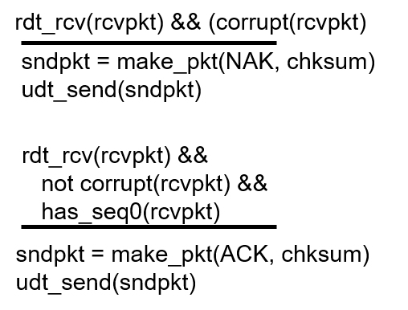
rdt2.2: receiver
rdt_rcv(rcvpkt) && notcorrupt(rcvpkt)
&& has_seq0(rcvpkt)
extract(rcvpkt,data)
deliver_data(data)
sndpkt = make_pkt(ACK, 0, chksum)
udt_send(sndpkt)
rdt_rcv(rcvpkt) &&
(corrupt(rcvpkt) ||
has_seq1(rcvpkt))
Wait for
0 from below
rdt_rcv(rcvpkt) &&
(corrupt(rcvpkt) ||
has_seq0(rcvpkt))
Wait for
1 from below
sndpkt = make_pkt(ACK,1,chksum)
udt_send(sndpkt)
sndpkt = make_pkt(ACK,0, chksum)
udt_send(sndpkt)
rdt_rcv(rcvpkt) && notcorrupt(rcvpkt)
&& has_seq1(rcvpkt)
extract(rcvpkt,data)
deliver_data(data)
sndpkt = make_pkt(ACK,1, chksum)
udt_send(sndpkt)
Transport Layer
3-<number>
Notes:
Rdt2.2：接收方FSM

Slide 39
rdt3.0: channels with errors and loss
new assumption: underlying channel can also lose packets (data, ACKs)
  checksum, seq. #, ACKs, retransmissions will be of help … but not enough
approach: sender waits “reasonable” amount of time for ACK
requires countdown timer
retransmits if no ACK received in this time
if pkt (or ACK) just delayed (not lost):
  retransmission will be duplicate, but seq. #’s already handles this
  receiver must specify seq # of pkt being ACKed
Transport Layer
3-<number>
Notes:
3.4.1 构造可靠的数据传输协议
Rdt3.0 通道上可能出错和丢失数据
@ 新的假设: 所依赖的信道会丢失数据 (数据或 ACK)
# checksum, seq. #, ACK, 重发机制会有帮助，但还远远不够
@ Q: 如何处理数据丢失?
# 发送方可以等待，当某些数据或ACK 丢失时, 进行重传
# 想一想: 缺点?
方法: 发送方等待ACK一段 “适当的” 时间
@ 如果在这段时间里没有收到则进行重传
@ 如果分组(或 ACK)仅仅被延迟了 (没有丢失):
# 重传将导致重复, 但使用seq. #’s 可以控制
# 接收方必须定义被 ACK分组的 seq #
@ 需要进行倒计时

Slide 40
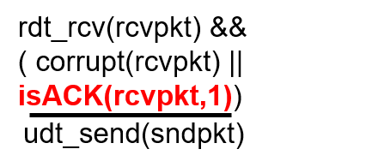
rdt3.0 sender
rdt_send(data)
rdt_rcv(rcvpkt) &&
( corrupt(rcvpkt) ||
isACK(rcvpkt,1) )
sndpkt = make_pkt(0, data, checksum)
udt_send(sndpkt)
start_timer
rdt_rcv(rcvpkt)
Λ
Λ
Wait for
call 0from above
Wait for ACK0
timeout
udt_send(sndpkt)
start_timer
rdt_rcv(rcvpkt)
&& notcorrupt(rcvpkt)
&& isACK(rcvpkt,1)
rdt_rcv(rcvpkt)
&& notcorrupt(rcvpkt)
&& isACK(rcvpkt,0)
stop_timer
stop_timer
Wait for ACK1
Wait for
call 1 from above
timeout
udt_send(sndpkt)
start_timer
rdt_rcv(rcvpkt)
rdt_send(data)
Λ
rdt_rcv(rcvpkt) &&
( corrupt(rcvpkt) ||
isACK(rcvpkt,0) )
sndpkt = make_pkt(1, data, checksum)
udt_send(sndpkt)
start_timer
Λ
Transport Layer
3-<number>
Notes:
3.4.1 构造可靠的数据传输协议
Rdt3.0 发送端FSM

Slide 41

rdt3.0 in action
sender
receiver
sender
receiver
send pkt0
pkt0
send pkt0
pkt0
rcv pkt0
rcv pkt0
ack0
send ack0
ack0
send ack0
rcv ack0
rcv ack0
send pkt1
pkt1
send pkt1
pkt1
rcv pkt1
X
ack1
send ack1
loss
rcv ack1
send pkt0
pkt0
rcv pkt0
ack0
send ack0
timeout
resend pkt1
pkt1
rcv pkt1
ack1
send ack1
rcv ack1
send pkt0
pkt0
(a) no loss
rcv pkt0
ack0
send ack0
(b) packet loss
Transport Layer
3-<number>
Notes:
3.4.1 构造可靠的数据传输协议
Rdt3.0 的运行
a. 无丢包操作 b.分组丢失

Slide 42
rdt3.0 in action
sender
receiver
sender
receiver
send pkt0
pkt0
send pkt0
pkt0
rcv pkt0
rcv pkt0
ack0
send ack0
send ack0
rcv ack0
ack0
send pkt1
pkt1
rcv ack0
rcv pkt1
send pkt1
pkt1
send ack1
rcv pkt1
ack1
send ack1
ack1
X
loss
timeout
resend pkt1
pkt1
rcv pkt1
timeout
resend pkt1
pkt1
rcv pkt1
rcv ack1
(detect duplicate)
send pkt0
pkt0
ack1
send ack1
ack1
(detect duplicate)
rcv ack1
send ack1
rcv ack1
rcv pkt0
pkt0
do nothing
ack0
send ack0
send pkt0
rcv pkt0
ack0
send ack0
(c) ACK loss
(d) premature timeout/ delayed ACK
Transport Layer
3-<number>
Notes:
3.4.1 构造可靠的数据传输协议
Rdt3.0 的运行
c ACK丢失 d 过早超时

Slide 43
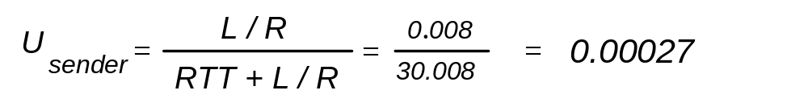
Performance of rdt3.0
rdt3.0 is correct, but performance stinks
e.g.: 1 Gbps link, 30 ms RTT delay, 8000 bit packet:
L
8000 bits/pkt
D_{trans} =
=
=
8 microsecs
R
10 ⁹ bits/sec
  U _{sender}: utilization – fraction of time sender busy sending
  0.008ms trans. (8Kb pkt), every 30.008 ms
  267Kb/sec thruput over 1 Gbps link
network protocol limits use of physical resources!
Transport Layer
3-<number>
Notes:
3.4.2 流水线可靠数据传输协议
问题：rdt3.0 的性能分析
@ rdt3.0 可用, 不过性能很糟
@ 例如: 1 Gb/s 链路, 15 ms 端对端的延迟, 1KB 分组:
传输延时为8微妙
# 1KB分组 RTT30ms下 分组每 30 ms -> 33kBps吞吐量 在 1 Gb/s 链路上
# 网络协议限制了物理资源的利用!

Slide 44

rdt3.0: stop-and-wait operation
sender
receiver
first packet bit transmitted, t = 0
last packet bit transmitted, t = L / R
first packet bit arrives
RTT
last packet bit arrives, send ACK
ACK arrives, send next
packet, t = RTT + L / R
Transport Layer
3-<number>
Notes:
3.4.2 流水线可靠数据传输协议
rdt3.0 的等停操作导致发送方利用率非常低
Usender =0.008/30.008= 0.00027

Slide 45
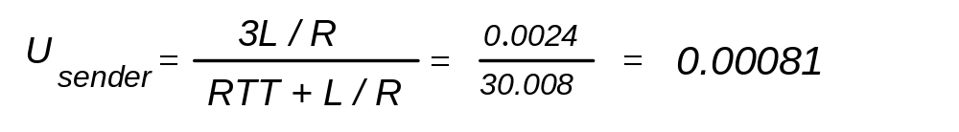
Pipelining: increased utilization
sender
receiver
first packet bit transmitted, t = 0
last bit transmitted, t = L / R
first packet bit arrives
RTT
last packet bit arrives, send ACK
last bit of 2nd packet arrives, send ACK
last bit of 3rd packet arrives, send ACK
ACK arrives, send next
packet, t = RTT + L / R
3-packet pipelining increases
utilization by a factor of 3!
Transport Layer
3-<number>
Notes:
3.4.2 流水线可靠数据传输协议
流水线发送
Usender = 3L/R/(RTT+L/R) = 0.0024/30.008 = 0.00081
发送方使用率增加

Slide 46


Pipelined protocols
pipelining: sender allows multiple, “in-flight”, yet-to-be-acknowledged pkts
  range of sequence numbers must be increased
  buffering at sender and/or receiver
  method: deal with loss, corrupt, over delay
two generic forms of pipelined protocols: go-Back-N, selective repeat
Transport Layer
3-<number>
Notes:
3.4.2 流水线可靠数据传输协议
解决rdt3.0中问题，不采用等停方式运行
@ 流水作业: 发送端允许发送多个, “悬在空中”, 等待应答的分组
# 必须增加顺序号的位数
# 在发送和接收端增加缓存
@ 两种常用的流水线协议: 第N个分组重发(go-Back-N)；选择应答

Slide 47
Pipelined protocols: overview
Go-back-N:
sender can have up to N unack’ed packets in pipeline
receiver only sends cumulative ack
  doesn’t ack packet if there’s a gap
sender has timer for oldest unacked packet
  when timer expires, retransmit all unacked packets
Selective Repeat:
sender can have up to N unack’ed packets in pipeline
rcvr sends individual ack for each packet
sender maintains timer for each unacked packet
  when timer expires, retransmit only that unacked packet
Transport Layer
3-<number>
Notes:
3.4.2 流水线可靠数据传输协议
Go-back-N（回退N步）
发送发可以发送N个未确认的分组到管道线上
接收方必须递增的发送ACK反馈
如果确认的分组出现间断则不发送ACK反馈
发送方为最旧发送的分组启动计时器
若超时，则重发所有未确认的分组
选择重发
发送发可以发送N个未确认的分组到管道线上
接收方为每一个收到的分组分别发送ACK反馈
发送方为每一个未确认的分组维护各自的计时器
若超时，则仅重传该未确认的分组

Slide 48

Go-Back-N: sender
k-bit seq # in pkt header
“window” of up to N, consecutive unack’ed pkts allowed
ACK(n): ACKs all pkts up to, including seq # n - “cumulative ACK”
  may receive duplicate ACKs (see receiver)
timer for oldest in-flight pkt
timeout(n): retransmit packet n and all higher seq # pkts in window
Transport Layer
3-<number>
Notes:
3.4.3 回退N步
@ 在分组首部设置k位 seq #
@ 使用尺寸为N的“滑动窗口(p148)”, 允许连续的多个分组不被应答
@ ACK(n): ACK所有n号之前，包括n号在内的分组-- “积累式ACK”
@ 为每个未应答（in-flight）的分组设置计时器（timer）
@ 当n个超时发生：重传分组n和分组n以后的所有分组

Slide 49
GBN: sender extended FSM
rdt_send(data)
if (nextseqnum < base+N) {
sndpkt[nextseqnum] = make_pkt(nextseqnum,data,chksum)
udt_send(sndpkt[nextseqnum])
if (base == nextseqnum)
start_timer
nextseqnum++
}
else
refuse_data(data)
Λ
base=1
nextseqnum=1
timeout
Wait
start_timer
udt_send(sndpkt[base])
udt_send(sndpkt[base+1])
…
udt_send(sndpkt[nextseqnum-1])
rdt_rcv(rcvpkt)
&& corrupt(rcvpkt)
Λ
rdt_rcv(rcvpkt) &&
notcorrupt(rcvpkt)
base = getacknum(rcvpkt)+1
If (base == nextseqnum)
stop_timer
else
start_timer
Transport Layer
3-<number>
Notes:
3.4.3 回退N步
接收方扩展的FSM
上层调用
超时处理
ACK的接收

Slide 50
GBN: receiver extended FSM
default
udt_send(sndpkt)
rdt_rcv(rcvpkt)
&& notcurrupt(rcvpkt)
&& hasseqnum(rcvpkt,expectedseqnum)
Wait
extract(rcvpkt,data)
deliver_data(data)
sndpkt = make_pkt(expectedseqnum, ACK, chksum)
udt_send(sndpkt)
expectedseqnum++
Λ
expectedseqnum=1
sndpkt = make_pkt(0 ,ACK, chksum)
ACK-only: always send ACK for correctly-received pkt with highest in-order seq #
  may generate duplicate ACKs
  need only remember expectedseqnum
out-of-order pkt:
  discard (don’t buffer): no receiver buffering!
  re-ACK pkt with highest in-order seq #
Transport Layer
3-<number>
Notes:
3.4.3 回退N步
接收方扩展的FSM
@ACK-only：总是对正确接收到的分组中按次序对最高seq#进行ACK
# 可以产生重复的ACKs
# 只需要记住expectedseqnum（预期的序号）
@ 失序分组：
# 丢弃（不缓存）-》不进入接收端缓存
# 接收到的分组中按序对最高seq#进行ACK

Slide 51
GBN in action
sender window (N=4)
sender
receiver
0 1 2 3 4 5 6 7 8
send pkt0
send pkt1
send pkt2
send pkt3
(wait)
0 1 2 3 4 5 6 7 8
receive pkt0, send ack0
receive pkt1, send ack1
receive pkt3, discard,
(re)send ack1
0 1 2 3 4 5 6 7 8
X
0 1 2 3 4 5 6 7 8
loss
0 1 2 3 4 5 6 7 8
rcv ack0, send pkt4
rcv ack1, send pkt5
0 1 2 3 4 5 6 7 8
receive pkt4, discard,
(re)send ack1
ignore duplicate ACK
receive pkt5, discard,
(re)send ack1
pkt 2 timeout
0 1 2 3 4 5 6 7 8
send pkt2
send pkt3
send pkt4
send pkt5
0 1 2 3 4 5 6 7 8
0 1 2 3 4 5 6 7 8
rcv pkt2, deliver, send ack2
rcv pkt3, deliver, send ack3
rcv pkt4, deliver, send ack4
rcv pkt5, deliver, send ack5
0 1 2 3 4 5 6 7 8
Transport Layer
3-<number>
Notes:
3.4.3 回退N步
GBN的运行

Slide 52
Selective repeat
receiver individually acknowledges all correctly received pkts
  buffers pkts, as needed, for eventual in-order delivery to upper layer
sender only retransmit pkts for which ACK not received in time
  sender timer for each unACKed pkt
sender window
  N consecutive seq #’s
  limits seq #s of
  1） sent and unACKed pkts
  2） permitted and unsent pkts
Transport Layer
3-<number>
Notes:
3.4.4 选择性重传
SR通过让发送方仅重传那些它怀疑在接收方出错（丢失或受损）的分组，从而避免不必要的重传。
@ 接收端分别对所有正确收到的分组进行应答
@ 发送方仅对未收到应答的分组进行重发
#发送方对每个没有确认的分组定时
@ 发送方的窗口
# N个连续的 seq#’s
#同样对已发送的seq #s, unACKed分组进行限制

Slide 53

Selective repeat: sender, receiver windows
Transport Layer
3-<number>

Slide 54
Selective repeat
sender
receiver
data from above:
if next available seq # in window, send pkt
timeout(n):
resend pkt n, restart timer
ACK(n) in [sendbase,sendbase+N]:
mark pkt n as received
if n smallest unACKed pkt, advance window base to next unACKed seq #
pkt n in [rcvbase, rcvbase+N-1]
send ACK(n)
out-of-order: buffer
in-order: deliver (also deliver buffered, in-order pkts), advance window to next not-yet-received pkt
pkt n in [rcvbase-N,rcvbase-1]
ACK(n)
otherwise:
ignore
Transport Layer
3-<number>
Notes:
发送方：
上层数据到达 :
@ 如果窗口中的下一个序号可用，发送分组
timeout(n):第n个计时器跳
@ 重发分组n, 计时器复位
ACK(n) 到达
[sendbase,sendbase+N]:
@ 标记分组 n 已经收到
@ 如n为unACKed分组中的最小值, 将窗口下沿前推倒下一个unACKed seq #
接收方：
分组n到达[rcvbase, rcvbase+N-1]
@ 发送 ACK(n)
@ 失序: 缓存
@ 有序: 递交到上层 (同时递交缓存中的其他有序分组), 将窗口前推倒下一个尚未收到的分组
分组n到达 [rcvbase-N,rcvbase-1]
@ 虽然接收方曾经确认，但仍然需要ACK(n)
其他情况:
@ 忽略分组

Slide 55
Selective repeat in action
sender window (N=4)
sender
receiver
0 1 2 3 4 5 6 7 8
send pkt0
send pkt1
send pkt2
send pkt3
(wait)
0 1 2 3 4 5 6 7 8
receive pkt0, send ack0
receive pkt1, send ack1
receive pkt3, buffer,
send ack3
0 1 2 3 4 5 6 7 8
X
0 1 2 3 4 5 6 7 8
loss
0 1 2 3 4 5 6 7 8
rcv ack0, send pkt4
rcv ack1, send pkt5
0 1 2 3 4 5 6 7 8
receive pkt4, buffer,
send ack4
record ack3 arrived
receive pkt5, buffer,
send ack5
pkt 2 timeout
0 1 2 3 4 5 6 7 8
send pkt2
0 1 2 3 4 5 6 7 8
record ack4 arrived
0 1 2 3 4 5 6 7 8
rcv pkt2; deliver pkt2,
pkt3, pkt4, pkt5; send ack2
record ack5 arrived
0 1 2 3 4 5 6 7 8
Q: what happens when ack2 arrives?
Transport Layer
3-<number>

Slide 56

Selective repeat: dilemma
sender window
(after receipt)
receiver window
(after receipt)
0 1 2 3 0 1 2
pkt0
0 1 2 3 0 1 2
pkt1
0 1 2 3 0 1 2
example:
seq #’s: 0, 1, 2, 3
window size=3
0 1 2 3 0 1 2
pkt2
0 1 2 3 0 1 2
0 1 2 3 0 1 2
0 1 2 3 0 1 2
pkt3
X
0 1 2 3 0 1 2
pkt0
will accept packet
with seq number 0
receiver sees no difference in two scenarios!
duplicate data accepted as new in (b)
Q: what relationship between seq # size and window size to avoid problem in (b)?
(a) no problem
receiver can’t see sender side.
receiver behavior identical in both cases!
something’s (very) wrong!
0 1 2 3 0 1 2
pkt0
0 1 2 3 0 1 2
pkt1
0 1 2 3 0 1 2
0 1 2 3 0 1 2
pkt2
0 1 2 3 0 1 2
X
0 1 2 3 0 1 2
X
timeout
retransmit pkt0
X
0 1 2 3 0 1 2
pkt0
will accept packet
with seq number 0
(b) oops!
Transport Layer
3-<number>

Slide 57
Chapter 3 outline
3.1 transport-layer services
3.2 multiplexing and demultiplexing
3.3 connectionless transport: UDP
3.4 principles of reliable data transfer
3.5 connection-oriented transport: TCP
  segment structure
  reliable data transfer
  flow control
  connection management
3.6 principles of congestion control
3.7 TCP congestion control
Transport Layer
3-<number>
Notes:
3.1 传输层服务
3.2 多路复用和多路分解
3.3 无连接运输：UDP
3.4 可靠运输原理
*3.5 面向连接的运输：TCP
**TCP段格式
3.6 拥塞控制原理
3.7 TCP的拥塞控制

Slide 58
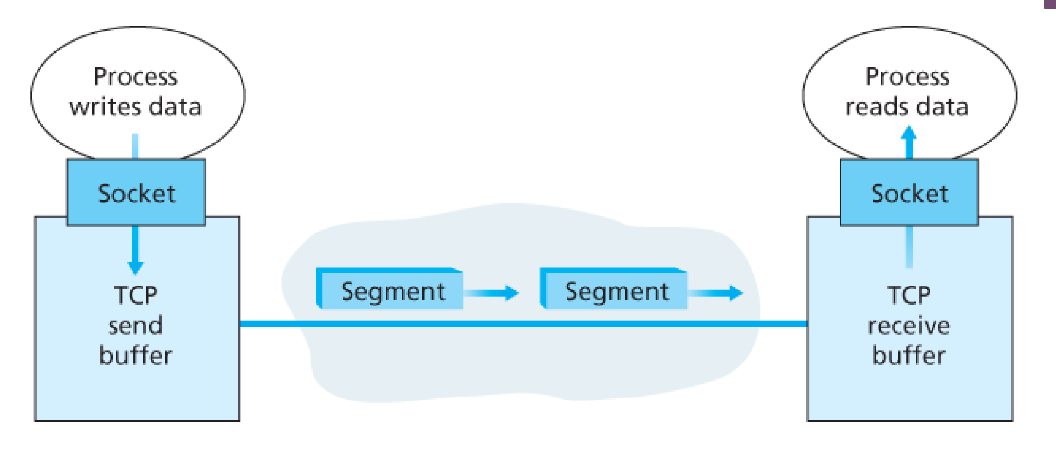
TCP: Overview RFCs: 793,1122,1323, 2018, 2581
connection-oriented:
  handshaking
  buffers, variables, sockets
  unicast (one sender, one receiver)
reliable data transfer:
  in-order byte stream
  pipelined (window size related to congestion and flow control)
flow&congestion control:
  sender will not overwhelm receiver
full duplex data:
  bi-directional data flow in the same connection and at the same time
  MSS: maximum segment size (determined by MTU)
Transport Layer
3-<number>
Notes:
3.5.1 TCP连接
@ 点对点 一个发送方，一个接收方
@ 可靠，按序的字节流 。无报文边界。
@ 流水式控制
# TCP拥塞控制和流量控制，设置窗口大小
@ 全双工数据传输
# 在同一连接上双向传输
# MSS: maximum segment size（最大段字节数1460，对应MTU1500，以太网和PPP链路）
@ 面向连接：握手过程 (交换控制信息) 在交换数据前初始化收发双方的状态,“三次握手”
@ 流量控制：发送方的发送速度不得超过接收方的处理速度

Slide 59
TCP segment structure
32 bits
URG: urgent data
(generally not used)
counting
by bytes
of data
(not segments!)
source port #
dest port #
sequence number
ACK: ACK #
valid
acknowledgement number
head
len
not
used
U
receive window
A
PSH: push data now
(generally not used)
P
R
S
F
# bytes
rcvr willing
to accept
checksum
Urg data pointer
RST, SYN, FIN:
connection estab
(setup, teardown
commands)
options (variable length)
application
data
(variable length)
Transport Layer
3-<number>
Notes:
3.5.2 TCP段格式
源端口和目的端口号
32比特序号（seq#)和确认号(ACK)字段
4比特首部长度：以32bit的字为单位的TCP首部长度
U 紧急字段
A ACK#
P PSH
R S F ：RST，SYN，FIN
#bytes 接收方愿意接受的
校验和
紧急数据指针
可选与变长的选项字段

Slide 60
TCP seq. numbers, ACKs
outgoing segment from sender
sequence numbers:
  byte stream “number” of first byte in segment’s data
  randomly initiated
acknowledgements:
  seq # of next byte expected from other side
  cumulative ACK
Q: how receiver handles out-of-order segments
  A: TCP spec doesn’t say, - up to implementor
source port #
dest port #
sequence number
acknowledgement number
rwnd
checksum
urg pointer
window size
N
  sender sequence number space
sent
ACKed
sent, not-yet ACKed
(“in-flight”)
usable
but not
yet sent
not
usable
incoming segment to sender
source port #
dest port #
sequence number
acknowledgement number
A
rwnd
checksum
urg pointer
Transport Layer
3-<number>
Notes:
3.5.2 TCP段格式
序号与确认号
@ 序号 seq#’s 该数据段第一个字节在整个报文字节流中“编号”
@ 确认号
# seq#为预期从对方发来的“下一个”字节的编号
# 积累的ACK
Q：接受方如何接收方如何接受失序的数据段
A: TCP 没有定义, 由程序设计者决定

Slide 61
TCP seq. numbers, ACKs
Host A
Host B
User
types
‘C’
Seq=42, ACK=79, data = ‘C’
host ACKs
receipt of
‘C’, echoes
back ‘C’
Seq=79, ACK=43, data = ‘C’
host ACKs
receipt
of echoed
‘C’
Seq=43, ACK=80
simple telnet scenario
Transport Layer
3-<number>
Notes:
3.5.2 TCP段格式
序号与确认号
@ telnet案例

Slide 62
TCP round trip time, timeout
Q: how to set TCP timeout value?
longer than RTT
  but RTT varies
too short: premature timeout, unnecessary retransmissions
too long: slow reaction to segment loss
Q: how to estimate RTT?
SampleRTT: measured time from segment transmission until ACK receipt
  ignore retransmissions
SampleRTT will vary, want estimated RTT “smoother”
  average several recent measurements, not just current SampleRTT
Transport Layer
3-<number>
Notes:
3.5.3 往返时间的估计和超时
Q: 如何设置 TCP 超时的值?
@ 应较RTT长一点 ！！注意: RTT 会变
@ 太短了: 过早出现超时，造成不必要的重传
@ 太长了: 减缓了对数据段丢失的反应
Q: 如何估算 RTT?
@ SampleRTT: 对数据段发送到收到ACK 回应的时间进行测量
# 忽略重传, 积欠 ACKed 数据段
@SampleRTT 是会变化的, 要使得估算的 RTT “更平滑”
# 使用若干新近的测量结果, 而不仅仅是最近一次的 SampleRTT

Slide 63

TCP round trip time, timeout
EstimatedRTT = (1- α)*EstimatedRTT + α*SampleRTT
exponential weighted moving average
influence of past sample decreases exponentially fast
typical value: α = 0.125
RTT: gaia.cs.umass.edu to fantasia.eurecom.fr
RTT (milliseconds)
sampleRTT
EstimatedRTT
time (seconds)
Transport Layer
3-<number>
Notes:
3.5.3 往返时间的估计和超时
EstimatedRTT = (1-α)*EstimatedRTT + α*SampleRTT
@ 指数加权移动平均（EWMA）
@ 给定样本的影响随指数形式快速递减
@ X的典型量值: 0.125或1/8

Slide 64

TCP round trip time, timeout
estimate SampleRTT deviation from EstimatedRTT:
timeout interval: EstimatedRTT plus “safety margin”
  large variation in EstimatedRTT -> larger safety margin
  1sec recommended as the initial
  doubled when timeout occurs
DevRTT = (1-β)*DevRTT + β*|SampleRTT-EstimatedRTT|
(typically, β = 0.25)
TimeoutInterval = EstimatedRTT + 4*DevRTT
estimated RTT
“safety margin”
Transport Layer
3-<number>
Notes:
3.5.3 往返时间的估计和超时
@ 超时间隔：imtedRTT 加上 “安全边际(safety margin)”
# 如果 EstimatedRTT变化较大 -> 加大安全边际
@估计 SampleRTT和EstimatedRTT的偏差
Deviation(偏差) = (1-β)*Deviation +
β*|SampleRTT-EstimatedRTT|
Timeout = EstimatedRTT + 4*Deviation

Slide 65
Chapter 3 outline
3.1 transport-layer services
3.2 multiplexing and demultiplexing
3.3 connectionless transport: UDP
3.4 principles of reliable data transfer
3.5 connection-oriented transport: TCP
  segment structure
  reliable data transfer
  flow control
  connection management
3.6 principles of congestion control
3.7 TCP congestion control
Transport Layer
3-<number>
Notes:
3.1 传输层服务
3.2 多路复用和多路分解
3.3 无连接运输：UDP
3.4 可靠运输原理
*3.5 面向连接的运输：TCP
**可靠数据传输
3.6 拥塞控制原理
3.7 TCP的拥塞控制

Slide 66
TCP reliable data transfer
TCP creates rdt service on top of IP’s unreliable service
  pipelined segments
  cumulative acks
  single retransmission timer
retransmissions triggered by:
  timeout events
  duplicate acks
let’s initially consider simplified TCP sender:
  ignore duplicate acks
  ignore flow control, congestion control
Transport Layer
3-<number>
Notes:
3.5.4 可靠数据传输
@ TCP在IP不可靠服务之上建立可靠数据传输
#
#累积ACK
#单一重传计时器
@ 重发的触发
# 超时事件
# 冗余确认事件
简化的发送方，假设：
#单向数据传输
#无流量, 拥塞控制

Slide 67
TCP sender events:
data rcvd from app:
create segment with seq #
  seq # is byte-stream number of first data byte in segment
start timer if not already running
  think of timer as for oldest unacked segment
  expiration interval: TimeOutInterval
timeout:
retransmit segment that caused timeout
restart timer
ack rcvd:
if ack acknowledges previously unacked segments
  update what is known to be ACKed
  start timer if there are still unacked segments
Transport Layer
3-<number>

Slide 68
TCP sender (simplified)
data received from application above
create segment, seq. #: NextSeqNum
pass segment to IP (i.e., “send”)
NextSeqNum = NextSeqNum + length(data)
if (timer currently not running)
start timer
Λ
NextSeqNum = InitialSeqNum
SendBase = InitialSeqNum
wait
for
event
timeout
retransmit not-yet-acked segment with smallest seq. #
start timer
ACK received, with ACK field value y
if (y > SendBase) {
SendBase = y
/* SendBase–1: last cumulatively ACKed byte */
if (there are currently not-yet-acked segments)
start timer
else stop timer
}
Transport Layer
3-<number>

Slide 69
TCP: retransmission scenarios
Host A
Host B
Host A
Host B
SendBase=92
Seq=92, 8 bytes of data
Seq=92, 8 bytes of data
timeout
timeout
Seq=100, 20 bytes of data
ACK=100
X
ACK=100
ACK=120
Seq=92, 8 bytes of data
Seq=92, 8
bytes of data
SendBase=100
SendBase=120
ACK=100
ACK=120
SendBase=120
lost ACK scenario
premature timeout
Transport Layer
3-<number>
Notes:
3.5.4 可靠数据传输
TCP：重传场景之一
丢失确认，重传
TCP：重传场景之二
过早超时，累积确认，避免seq100重传

Slide 70
TCP: retransmission scenarios
Host A
Host B
Seq=92, 8 bytes of data
Seq=100, 20 bytes of data
timeout
ACK=100
X
ACK=120
Seq=120, 15 bytes of data
cumulative ACK
Transport Layer
3-<number>
Notes:
3.5.4 可靠数据传输
TCP：重传场景之三
累积确认，避免第一个报文段的重传

Slide 71
TCP ACK generation [RFC 1122, RFC 2581]
event at receiver
arrival of in-order segment with
expected seq #. All data up to
expected seq # already ACKed
arrival of in-order segment with
expected seq #. One other
segment has ACK pending
arrival of segment that
partially or completely fills gap
arrival of out-of-order segment
higher-than-expect seq. # .
Gap detected
TCP receiver action
delayed ACK. Wait up to 500ms
for next segment. If no next segment,
send ACK
immediately send single cumulative
ACK, ACKing both in-order segments
immediately send updated ACK, given
that segment starts at lower end of gap
immediately send duplicate ACK,
indicating seq. # of next expected byte
Transport Layer
3-<number>
Notes:
TCP ACK生成策略
接收端事件 | 接收端的动作
-------------------------------------------------------------------
有序数据段到达, | 延迟ACK， 等待500ms
没有缺失的段, | 看是否还有数据段到达，如果没有
所有其他数据段已经 ACKed | 发送ACK
--------------------------------------------------------------------
有序数据段到达， | 立即发送一个累积ACK，以确认两个
没有缺失的段， | 按序报文段
有一个延迟ACK等待 |
---------------------------------------------------------------------
失序数据段到达 | 发送重复的ACK，说明seq#为下一个
Seq# 高于预测值 | 期望的字节
测到间隔 |
-----------------------------------------------------------------------
到达的数据段部分或全部填满了缺失 | 立即ACK，如果数据段处于缺失的段较
的段 | 的较低端

Slide 72
TCP fast retransmit
time-out period often relatively long:
  long delay before resending lost packet
detect lost segments via duplicate ACKs.
  sender often sends many segments back-to-back
  if segment is lost, there will likely be many duplicate ACKs.
TCP fast retransmit
if sender receives 3 ACKs for same data
(“triple duplicate ACKs”), resend unacked segment with smallest seq #
  likely that unacked segment lost, so don’t wait for timeout
Transport Layer
3-<number>
Notes:
3.5.4 可靠数据传输
快速重传
@ 超时周期通常相对较长
@ 通过重复的ACK来判定是否有丢失的报文
TCP快速重传：如果发送方收到同一报文段的3个ACK，说明在这个被
确认过3次的报文段之后的报文段已经丢失

Slide 73
TCP fast retransmit
Host A
Host B
Seq=92, 8 bytes of data
Seq=100, 20 bytes of data
X
ACK=100
timeout
ACK=100
ACK=100
ACK=100
Seq=100, 20 bytes of data
fast retransmit after sender
receipt of triple duplicate ACK
Transport Layer
3-<number>
Notes:
3.5.4 可靠数据传输
快速重传场景

Slide 74
Chapter 3 outline
3.1 transport-layer services
3.2 multiplexing and demultiplexing
3.3 connectionless transport: UDP
3.4 principles of reliable data transfer
3.5 connection-oriented transport: TCP
  segment structure
  reliable data transfer
  flow control
  connection management
3.6 principles of congestion control
3.7 TCP congestion control
Transport Layer
3-<number>
Notes:
3.1 传输层服务
3.2 多路复用和多路分解
3.3 无连接运输：UDP
3.4 可靠运输原理
*3.5 面向连接的运输：TCP
**流量控制
3.6 拥塞控制原理
3.7 TCP的拥塞控制

Slide 75
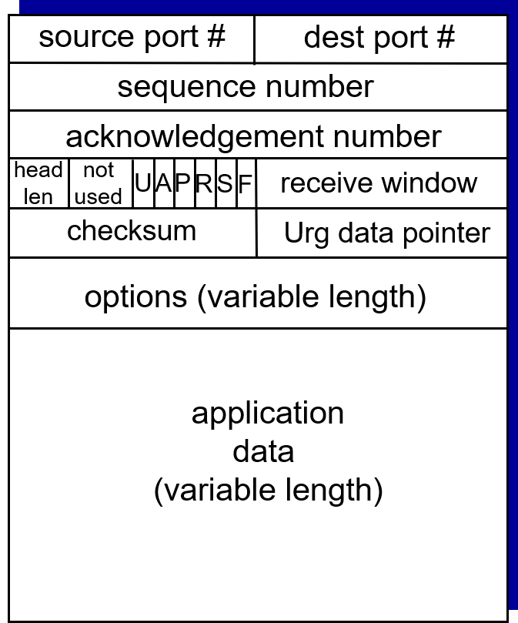
TCP flow control
application
process
application may
remove data from
TCP socket buffers ….
application
TCP socket
receiver buffers
OS
… slower than TCP
receiver is delivering
(sender is sending)
TCP
code
rwnd
flow control
IP
code
receiver controls sender, so sender won’t overflow receiver’s buffer by transmitting too much, too fast
from sender
receiver protocol stack
Transport Layer
3-<number>
Notes:
3.5.5 流量控制
接收方控制发送方，发送不可发送的太多、太快以至于使得接收端的缓存溢出

Slide 76
TCP flow control
receiver “advertises” free buffer space by including rwnd value in TCP header of receiver-to-sender segments
  RcvBuffer size set via socket options (typical default is 4096 bytes)
  many operating systems autoadjust RcvBuffer
sender limits amount of unacked (“in-flight”) data to receiver’s rwnd value
guarantees receive buffer will not overflow
to application process
RcvBuffer
buffered data
rwnd
free buffer space
TCP segment payloads
receiver-side buffering
Transport Layer
3-<number>
Notes:
3.5.5 流量控制
@ 接收端通过TCP头部的rwnd字段告知自由缓存空间
# RcvBuffer 大小可通过socket选项来设定（缺省为4096字节）
# 许多操作系统可自动调整RcvBuffer大小
@ 发送端通过接收端rwnd值限制了unacked数据的数量
@ 确保接收端的缓存区域不溢出

Slide 77
Chapter 3 outline
3.1 transport-layer services
3.2 multiplexing and demultiplexing
3.3 connectionless transport: UDP
3.4 principles of reliable data transfer
3.5 connection-oriented transport: TCP
  segment structure
  reliable data transfer
  flow control
  connection management
3.6 principles of congestion control
3.7 TCP congestion control
Transport Layer
3-<number>
Notes:
3.1 传输层服务
3.2 多路复用和多路分解
3.3 无连接运输：UDP
3.4 可靠运输原理
*3.5 面向连接的运输：TCP
**连接管理
3.6 拥塞控制原理
3.7 TCP的拥塞控制

Slide 78
Connection Management
before exchanging data, sender/receiver “handshake”:
agree to establish connection (each knowing the other willing to establish connection)
agree on connection parameters
application
application
connection state: ESTAB
connection variables:
  seq # client-to-server
  server-to-client
  rcvBuffer size
  at server,client
connection state: ESTAB
connection Variables:
  seq # client-to-server
  server-to-client
  rcvBuffer size
  at server,client
network
network
Socket clientSocket =
newSocket("hostname","port number");
Socket connectionSocket = welcomeSocket.accept();
Transport Layer
3-<number>
Notes:
3.5.6 TCP连接管理
TCP 收发双方在数据交换开始之前需要建立连接（握手）
@ 同意建立连接（互相知道建立连接的意愿）
@ 连接参数的协商

Slide 79



Agreeing to establish a connection
2-way handshake:
Q: will 2-way handshake always work in network?
can’t “see” other side
variable delays
retransmitted messages (e.g. req_conn(x)) due to message loss
message reordering
Let’s talk
ESTAB
OK
ESTAB
choose x
req_conn(x)
ESTAB
acc_conn(x)
ESTAB
Transport Layer
3-<number>
Notes:
3.5.6 TCP连接管理
2次握手
Q：网络中两次握手是否能解决所有连接问题？
@ 时延变化
@ 重发报文由于报文丢失
@ 报文重排
@ 无法判断对方在不在

Slide 80
Agreeing to establish a connection
2-way handshake failure scenarios:
choose x
choose x
req_conn(x)
req_conn(x)
ESTAB
ESTAB
retransmit
req_conn(x)
acc_conn(x)
retransmit
req_conn(x)
acc_conn(x)
ESTAB
ESTAB
data(x+1)
accept
data(x+1)
req_conn(x)
retransmit
data(x+1)
connection
x completes
connection
x completes
client terminates
server
forgets x
client terminates
server
forgets x
req_conn(x)
ESTAB
data(x+1)
ESTAB
half open connection!
(no client!)
accept
data(x+1)
Transport Layer
3-<number>
Notes:
3.5.6 TCP连接管理
2次握手失效的场景
# 连接失效
# 数据重复

Slide 81
TCP 3-way handshake
client state
server state
LISTEN
LISTEN
random init seq num, x
send TCP SYN msg
SYNSENT
SYNbit=1, Seq=x
random init seq num, y
send TCP SYNACK msg
SYN RCVD
SYNbit=1, Seq=y
ACKbit=1; ACKnum=x+1
send ACK for SYNACK;
allocate bufs. & vars.
may contain payload
ESTAB
ACKbit=1, ACKnum=y+1
indicate client is live
allocate bufs. & vars.
ESTAB
Transport Layer
3-<number>
Notes:
3.5.6 TCP连接管理
三次握手
Step 1: 客户端的end system向服务器发送 TCP SYN（synchronous） 控制数据段
定义并初始化 seq #
Step 2: 服务器的end system接收 SYN, 用SYNACK控制数据段回答
ACKs 接收到的 SYN
分配缓存
定义 server-> receiver 初始化 seq. #
Step 3:客户端的end system向服务器发送ACK
ACKs 接收到的连接承诺
分配缓存

Slide 82
TCP 3-way handshake: FSM
server
closed
client
Socket connectionSocket = welcomeSocket.accept();
Λ
Socket clientSocket =
newSocket("hostname","port number");
SYN(x)
SYNACK(seq=y,ACKnum=x+1)
create new socket for
communication back to client
listen
SYN(seq=x)
SYN
rcvd
SYN
sent
SYNACK(seq=y,ACKnum=x+1)
ACK(ACKnum=y+1)
ESTAB
ACK(ACKnum=y+1)
Λ
Transport Layer
3-<number>
Notes:
3.5.6 TCP连接管理
TCP三次握手FSM

Slide 83
TCP: closing a connection
close connection
  either client or server can terminate
  each side close their side of connection
  send TCP segment with FIN bit = 1
respond to received FIN with ACK
  on receiving FIN, ACK can be combined with own FIN
simultaneous FIN exchanges can be handled
Transport Layer
3-<number>
Notes:
3.5.6 TCP连接管理
TCP：连接关闭（三次握手）
@ 客户端、服务器各自关闭己方连接
# 发送FIN bit = 1 的报文段
@ 接收方收到FIN后返回ACK
# 一方收到FIN，返回ACK中包含自己的FIN

Slide 84
TCP: closing a connection
client state
server state
ESTAB
ESTAB
clientSocket.close()
FIN_WAIT_1
can no longer
send but can
receive data
FINbit=1, seq=x
CLOSE_WAIT
ACKbit=1; ACKnum=x+1
can still
send data
FIN_WAIT_2
wait for server
close
LAST_ACK
FINbit=1, seq=y
TIMED_WAIT
can no longer
send data
ACKbit=1; ACKnum=y+1
timed wait
for 2*max
segment lifetime
CLOSED
CLOSED
Transport Layer
3-<number>
Notes:
3.5.6 TCP连接管理
TCP：连接关闭过程（三次）
客户端关闭插口: clientSocket.close();
Step 1: 客户端 end system 发送 TCP FIN 控制段给服务器
Step 2: 服务器 收到 FIN, 用 ACK应答. 关闭连接, 发送 FIN.
Step 3: 客户端 收到 FIN, 用 ACK进行应答.
随着对接收到的FIN发送ACK-同时进入 “timed wait（计时等待）”
Step 4: 服务器, 接收 ACK. 连接关闭.

Slide 85
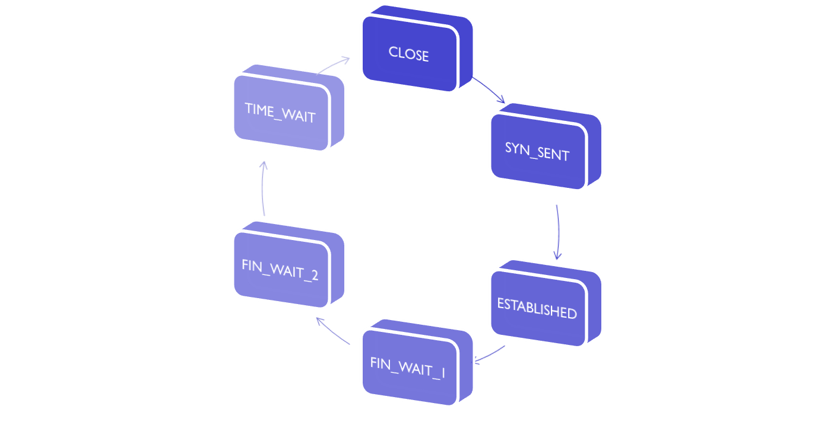
A typical sequence of TCP states visited by a client TCP
Client application
initiates a TCP connection
Wait 30 seconds
Send SYN
Receive FIN,
send ACK
Receive SYN & ACK,
send ACK
Receive ACK,
send nothing
Send FIN
Client application
initiates close connection
Transport Layer
3-<number>

Slide 86
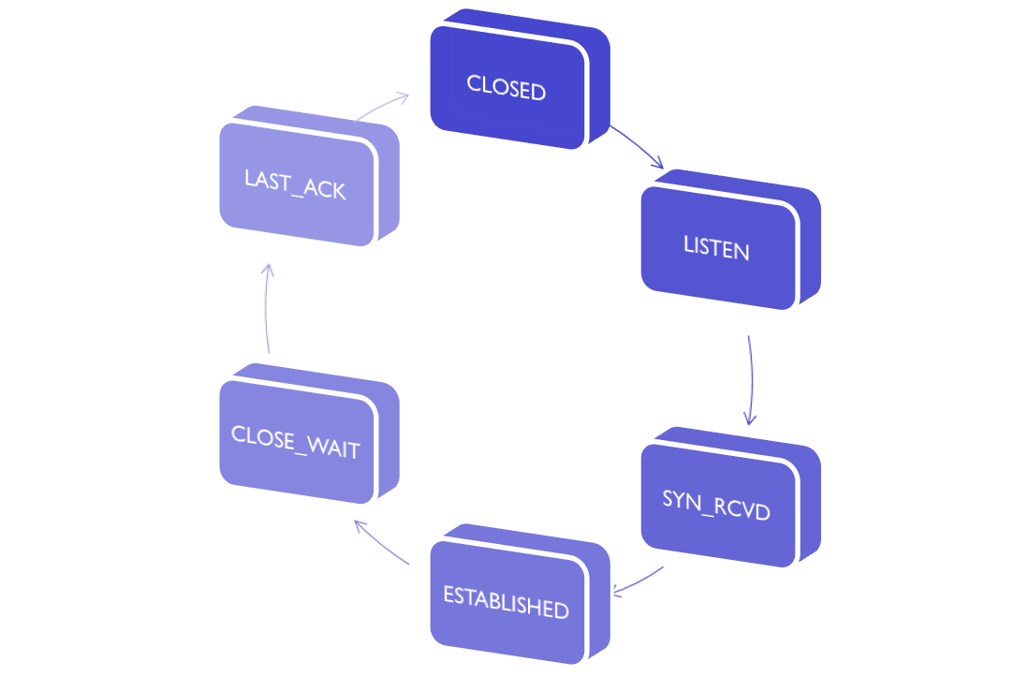
A typical sequence of TCP states visited by a server-side TCP
Receive ACK,
send nothing
Server application
creates a listen socket
Send FIN
Receive SYN
send SYN & ACK
Receive FIN,
send ACK
Receive ACK,
send nothing
Transport Layer
3-<number>

Slide 87
Chapter 3 outline
3.1 transport-layer services
3.2 multiplexing and demultiplexing
3.3 connectionless transport: UDP
3.4 principles of reliable data transfer
3.5 connection-oriented transport: TCP
  segment structure
  reliable data transfer
  flow control
  connection management
3.6 principles of congestion control
3.7 TCP congestion control
Transport Layer
3-<number>
Notes:
3.1 传输层服务
3.2 多路复用和多路分解
3.3 无连接运输：UDP
3.4 可靠运输原理
3.5 面向连接的运输：TCP
*3.6 拥塞控制原理
3.7 TCP的拥塞控制

Slide 88
Principles of congestion control
congestion:
a top-10 problem!
different from flow control!
informally: “too many sources sending too much data too fast for network to handle”
manifestations:
  lost packets (buffer overflow at routers)
  long delays (queueing in router buffers)
Transport Layer
3-<number>
Notes:
3.6 拥塞控制原理
拥塞:
@ 非正式的说法: “过多信源以过快的速率发送了过多的数据、导致网络穷于应付”
@ 不同于流量控制!
@ 后果:
#丢失数据分组 (路由器缓存溢出)
#长时间的延迟 (在路由器的缓存中排队)
@ 在网络发展的技术中的a top-10 problem!

Slide 89

Causes/costs of congestion: scenario 1
original data: λ_{in}
throughput: λ_{out}
two senders, two receivers
one router, infinite buffers
output link capacity: R
no retransmission
Host A
unlimited shared output link buffers
Host B
R/2
λ_{out}
delay
λ_{in}
R/2
λ_{in}
R/2
maximum per-connection throughput: R/2
large delays as arrival rate, λ_{in}, approaches capacity
Transport Layer
3-<number>
Notes:
3.6.1 拥塞原理和代价
场景1：
@ 两个发送端, 两个接收端
@ 一个路由器, 有限缓存
@ 输出链路带宽 R 共享式输出
@ 无重传机制
主机A连接性能：
0<λin< R/2 λout = λin
λin > R/2 λout = R/2
当λin接近 R/2时，时延急速变大

Slide 90
Causes/costs of congestion: scenario 2
one router, finite buffers
sender retransmission of timed-out packet
  transport-layer input includes retransmissions : λ’_{in} λ_{in}
  application-layer output = application-layer input : λ_{out}=λ_{in}
λ_{in} : original data
λ'_{in}: original data, plus retransmitted data
λ_{out}
Host A
finite shared output link buffers
Host B
Transport Layer
3-<number>
Notes:
3.6.1 拥塞原理和代价
场景2：
@ 一个路由器, 有限 缓存
@ 发送端重传丢失的分组
# 设计期望：λin = λout
# 重传 λ’in >= λout
重传被延迟的分组造成大量无意义的λ’in （对同样的λout来说）

Slide 91
Causes/costs of congestion: scenario 2
R/2
idealization: perfect knowledge
sender sends only when router buffers available
λ_{out}
λ_{in}
R/2
λ_{in} : original data
copy
λ'_{in}: original data, plus retransmitted data
λ_{out}
A
free buffer space!
finite shared output link buffers
Host B
Transport Layer
3-<number>
Notes:
3.6.1 拥塞原理和代价
场景2：理想情况
#发送方只在有缓存的情况下发送
见图3-46（a）

Slide 92

Causes/costs of congestion: scenario 2
Idealization: known loss packets can be lost, dropped at router due to full buffers
sender only resends if packet known to be lost
λ_{in} : original data
copy
λ'_{in}: original data, plus retransmitted data
λ_{out}
A
no buffer space!
Host B
Transport Layer
3-<number>
Notes:
3.6.1 拥塞原理和代价
场景2：理想情况-
#发送方只在分组丢失情况下重传

Slide 93
Causes/costs of congestion: scenario 2
Idealization: known loss packets can be lost, dropped at router due to full buffers
sender only resends if packet known to be lost
R/2
when sending at R/2, some packets are retransmissions but asymptotic goodput is still R/2 (why?)
λ_{out}
λ_{in}
R/2
λ_{in} : original data
λ'_{in}: original data, plus retransmitted data
λ_{out}
A
free buffer space!
Host B
Transport Layer
3-<number>
Notes:
3.6.1 拥塞原理和代价
场景2：理想情况-
#发送方只在分组丢失情况下重传
见图3-46（b）
拥塞的代价：即发送方必须实行重传以补偿因为缓存溢出而丢失的分组

Slide 94


Causes/costs of congestion: scenario 2
Realistic: duplicates
packets can be lost, dropped at router due to full buffers
sender times out prematurely, sending two copies, both of which are delivered
R/2
when sending at R/2, some packets are retransmissions including duplicated that are delivered!
λ_{out}
λ_{in}
R/2
λ_{in}
copy
λ'_{in}
λ_{out}
timeout
A
free buffer space!
Host B
Transport Layer
3-<number>
Notes:
3.6.1 拥塞原理和代价
场景2：实际情况是
# 分组由于缓存满而被路由器丢弃
# 发送方过早超时，使得原始分组（只是推迟但未丢弃）和重发的分组都被送至接收方
假定每个分组都被路由器转发（平均）两次，见图3-46（c）

Slide 95
Causes/costs of congestion: scenario 3
Q: what happens as λ_{in} and λ_{in}’ increase ?
four senders
multihop paths
timeout/retransmit
A: as red λ_{in}’ increases, all arriving blue pkts at upper queue are dropped, blue throughput  0
Host A
λ_{in} : original data
λ_{out}
Host B
λ'_{in}: original data, plus retransmitted data
finite shared output link buffers
Host D
R1
Host C
R4
R2
R3
Transport Layer
3-<number>
Notes:
3.6.1 拥塞原理和代价
场景3：4个主机，每台通过交叠两跳路径传输
每台主机采用超时/重传来实现可靠数据传输服务
λin 相同，链路带宽R
Q:当λin和λ’in增加时发生了什么?
红色λin 增加，蓝色的分组会被丢弃，直到变为0

Slide 96
Causes/costs of congestion: scenario 3
R/2
λ_{out}
λ_{in}’
another “cost” of congestion:
when packet dropped, any “upstream transmission capacity used for that packet was wasted!
Transport Layer
3-<number>
Notes:
3.6.1 拥塞原理和代价
场景3：4个主机，每台通过交叠两跳路径传输
每台主机采用超时/重传来实现可靠数据传输服务
λin 相同，链路带宽R
代价3：当分组被丢弃时, 所有“上游”信道为该分组所作的工作统统被浪费了!

Slide 97
Causes/costs of congestion: scenario 3
“costs” of congestion:
scen1 : queuing delay
scen2 : retransmission (more work) for given “goodput”
scen2 : unneeded link bandwidth (retrans.) for duplicated pkt
  decreasing goodput
scen3 : upstream transmission
Transport Layer
3-<number>
Notes:
3.6.1 拥塞原理和代价
场景2：实际情况是
# 分组由于缓存满而被路由器丢弃
# 发送方过早超时，使得原始分组（只是推迟但未丢弃）和重发的分组都被送至接收方
拥塞的代价：
# 重传保证了有效传输
# 不必要的重传导致路由器转发不必要的分组副本，降低了有效传输的效率

Slide 98
Approaches towards congestion control
two broad approaches towards congestion control:
end-end congestion control:
no explicit feedback from network
congestion inferred from end-system observed loss, delay
approach taken by TCP
network-assisted congestion control:
routers provide feedback to end systems
  single bit indicating congestion (SNA, DECbit, TCP/IP ECN, ATM)
  explicit rate for sender to send at
Transport Layer
3-<number>
Notes:
3.6.2 拥塞控制方法
端对端的拥塞控制:
@ 没有来自网络的反馈信息
@ 对拥塞问题的了解来自于对数据丢失和延迟的推断
@ 由TCP来解决
网络辅助的拥塞控制:
@ 路由器向端系统提供反馈
# 一个比特位的说明 (IBM SNA, DECNet, TCP/IP ECN, ATM)
# 显式告知发送方所应采用的数据速率

Slide 99
Case study: ATM ABR congestion control
ABR: available bit rate:
“elastic service”
if sender’s path “underloaded”:
  sender should use available bandwidth
if sender’s path congested:
  sender throttled to minimum guaranteed rate
RM (resource management) cells:
sent by sender, interspersed with data cells
bits in RM cell set by switches (“network-assisted”)
  NI bit: no increase in rate (mild congestion)
  CI bit: congestion indication
RM cells returned to sender by receiver, with bits intact
Transport Layer
3-<number>
Notes:
3.6.3 网络辅助的拥塞控制例子：ATM ABR拥塞控制
ABR: available bit rate（可用数据速率）:
@ “弹性服务”
@ 如果发送方的路径“欠负载” ，发送端应该把带宽用足
@ 如果发送端路径拥塞，发送端将其数据速率约束到最小承诺速率
RM (resource management) cells（资源管理信元）:
@ 由发送端发送, 掺和在数据信元一起
@ 在 RM 信元中的数据位由交换机设定 (“网络辅助”)
NI bit: 不得增加发送速率 (轻微拥塞)
CI bit: 拥塞指示
@ RM信元由接收端返回给发送端, 所有数据位保持原样

Slide 100
Case study: ATM ABR congestion control
RM cell
data cell
EFCI(Explicit Forward Congestion Indication) bit in data cells: set to 1 in congested switch
  if data cell preceding RM cell has EFCI set, receiver sets CI bit in returned RM cell
two-byte ER (Explicit Rate) field in RM cell
  congested switch may lower ER value in cell
  senders’ send rate thus max supportable rate on path
Transport Layer
3-<number>
Notes:
3.6.3 网络辅助的拥塞控制例子：ATM ABR拥塞控制
@ 在RM信元中有2字节的 ER (explicit rate) 字段
# 处于拥塞的交换机可降低信元中的ER 值
# 发送端的发送速率可以在路径上得到最低程度的支持
@ 数据信元的EFCI 位: 在拥塞的交换机中被设成 1
如果在RM信元之前的数据信元的EFCI置1, 发送端将在返回的 RM的RM信元中将CI置1

Slide 101
Chapter 3 outline
3.1 transport-layer services
3.2 multiplexing and demultiplexing
3.3 connectionless transport: UDP
3.4 principles of reliable data transfer
3.5 connection-oriented transport: TCP
  segment structure
  reliable data transfer
  flow control
  connection management
3.6 principles of congestion control
3.7 TCP congestion control
Transport Layer
3-<number>
Notes:
3.1 传输层服务
3.2 多路复用和多路分解
3.3 无连接运输：UDP
3.4 可靠运输原理
3.5 面向连接的运输：TCP
3.6 拥塞控制原理
*3.7 TCP的拥塞控制

Slide 102
TCP congestion control: additive increase multiplicative decrease
approach: sender increases transmission rate (window size), probing for usable bandwidth, until loss occurs
  additive increase: increase cwnd by 1 MSS every RTT until loss detected
  multiplicative decrease: cut cwnd in half after loss
additively increase window size …
…. until loss occurs (then cut window in half)
AIMD saw tooth
behavior: probing
for bandwidth
cwnd: TCP sender
congestion window size
time
Transport Layer
3-<number>
Notes:
3.7 TCP拥塞控制：加增 乘减 AIMD
@ 方法： 发送方逐步增加传输速率（window size），刺探可用带宽，直到分组丢失
# 加法增加：每一个RTT后cwnd增加1MSS（最大报文长度）长度，直到分组丢失检测到
# 乘法减少：分组丢失检测到后，cwnd减半
AIMD 呈现锯齿状---刺探带宽

Slide 103
TCP Congestion Control: details
sender sequence number space
TCP sending rate:
roughly: send cwnd bytes, wait RTT for ACKS, then send more bytes
cwnd
last byte
ACKed
last byte sent
sent, not-yet ACKed
(“in-flight”)
rate
cwnd
cwnd is dynamic, function of perceived network congestion
sender limits transmission:
~
bytes/sec
~
RTT
LastByteSent-
LastByteAcked
<
cwnd
Transport Layer
3-<number>
Notes:
3.7 TCP拥塞控制：详细情况
@ 发送端限制传输流量
LastByteSent – LastByteAcked <=min{ cwnd, rwnd}
@ 拥塞窗口是动态的，对网络拥塞具有感知功能
@ TCP发送速率 rate = cwnd/RTT Bps

Slide 104
TCP Slow Start
Host A
Host B
when connection begins, increase rate exponentially until first loss event:
  initially cwnd = 1 MSS
  double cwnd every RTT
  done by incrementing cwnd for every ACK received
summary: initial rate is slow but ramps up exponentially fast
one segment
RTT
two segments
four segments
time
Transport Layer
3-<number>
Notes:
3.7 TCP拥塞控制：1.慢启动
@ 连接开始，速率以指数增长直到出现分组丢失
# 初始 拥塞窗口 为1MSS
# 每个RTT后 拥塞窗口增倍
# 即每个ACK确认后，拥塞窗口增加
@ 初始速率慢，但指数增长快

Slide 105
TCP: detecting, reacting to loss
exponential increase switch to linear
  variable ssthresh
loss - TCP Tahoe (timeout or 3 duplicate acks)
  cwnd set to 1 MSS;
  ssthresh is set to 1/2 of cwnd just before loss;
  window then grows exponentially (as in slow start) to threshold, then grows linearly
Transport Layer
3-<number>
Notes:
3.7 TCP拥塞控制：慢启动-》拥塞避免
Q：什么时候指数增加变为线性增加？
A：当cwnd在超时前变为原来值一半的时候
实现
# 设置变量ssthres
# 丢包检测到，ssthres 值设置为1/2 cwnd
快速恢复不是必要的（注意Tahoe和Reno的区别）

Slide 106

TCP: detecting, reacting to loss
loss indicated by 3 duplicate ACKs: TCP RENO
  dup ACKs indicate network capable of delivering some segments
  cwnd is cut in half window then grows linearly
  ssthresh is set to 1/2 of cwnd just before loss
Transport Layer
3-<number>
Notes:
3.7 TCP拥塞控制：丢包检测
@ 超时指示丢包事件（Tahoe TCP)
# cwnd 重新设置为1MSS
# cwnd 仍然以慢启动方式增加，ssthread 设为cwnd的一半 -》》》》拥塞避免模式
@ 三次重复 ACKs指示丢包事件（Reno TCP）
# 重复的ACKs 表明网络仍然有传输能力（因为无超时）
# cwnd 减半 ，线性增加
@ TCP Tahoe （无论超时和重复ACKs都是 cwnd to 1）

Slide 107

Summary: TCP Congestion Control
New
ACK!
New
ACK!
.
duplicate ACK
new ACK
dupACKcount++
new ACK
cwnd = cwnd + MSS (MSS/cwnd)
dupACKcount = 0
transmit new segment(s), as allowed
cwnd = cwnd+MSS
dupACKcount = 0
transmit new segment(s), as allowed
Λ
cwnd = 1 MSS
ssthresh = 64 KB
dupACKcount = 0
cwnd > ssthresh
slow
start
Λ
congestion
avoidance
timeout
ssthresh = cwnd/2
cwnd = 1 MSS
dupACKcount = 0
retransmit missing segment
duplicate ACK
timeout
dupACKcount++
ssthresh = cwnd/2
cwnd = 1 MSS
dupACKcount = 0
retransmit missing segment
timeout
New
ACK!
ssthresh = cwnd/2
cwnd = 1
dupACKcount = 0
retransmit missing segment
New ACK
dupACKcount == 3
cwnd = ssthresh
dupACKcount = 0
dupACKcount == 3
ssthresh= cwnd/2
cwnd = ssthresh + 3
retransmit missing segment
ssthresh= cwnd/2
cwnd = ssthresh + 3
retransmit missing segment
fast
recovery
duplicate ACK
cwnd = cwnd + MSS
transmit new segment(s), as allowed
Transport Layer
3-<number>
Notes:
3.7 TCP拥塞控制
回顾：FSM
加性增，乘性减 AIMD
Reno算法绝大部分TCP版本中，相关的变种Vegas（检测RTT变化）

Slide 108
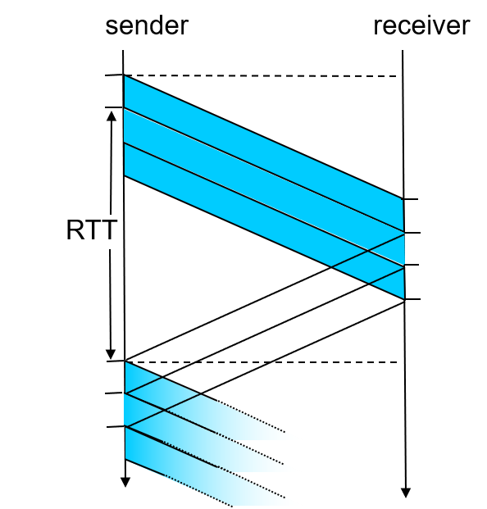
TCP throughput
avg. TCP thruput as function of window size, RTT?
  ignore slow start, assume always data to send
W: window size (measured in bytes) where loss occurs
  avg. window size (# in-flight bytes) is ¾ W
  avg. thruput is 3/4W per RTT
avg TCP thruput =
3
W
W
4
RTT
bytes/sec
W/2
Transport Layer
3-<number>
Notes:
3.7 TCP拥塞控制
TCP吞吐量
@ TCP平均吞吐量是窗口大小和RTT的函数：忽略慢启动
@ TCP平均吞吐量 = 3/4* W/RTT Bps

Slide 109
TCP Futures: TCP over “long, fat pipes”
example: 1500 byte segments, 100ms RTT, want 10 Gbps throughput
throughput in terms of segment loss probability, L [Mathis 1997]:
  ➜ to achieve 10 Gbps throughput, need a loss rate of L = 2·10⁻¹⁰ – a very small loss rate!
requires W = 83,333 in-flight segments
new versions of TCP for high-speed
1.22
.
MSS
TCP throughput =
RTT
L
Transport Layer
3-<number>
Notes:
3.7 TCP拥塞控制
TCP 特征：高带宽路径
@ 例子：1500字节报文段，100msRTT，10G发送速率
@ 需要拥塞窗口大小为83333个报文段
@ 吞吐量和包丢失概率关系
T = 1.22*MSS/RTT*sqt（L）
T-》10Gbps 则L = 2*10 -10次方 非常小的概率
@ 新版本高速TCP被设计

Slide 110
TCP Fairness
fairness goal: if K TCP sessions share same bottleneck link of bandwidth R, each should have average rate of R/K
TCP connection 1
bottleneck
router
capacity R
TCP connection 2
Transport Layer
3-<number>
Notes:
3.7 TCP拥塞控制
TCP公平性
公平性目标: 如果 K TCP 会话共享瓶颈链路带宽R, 每个应该分得 R/K链路传输能力

Slide 111
Why is TCP fair?
two competing sessions:
additive increase gives slope of 1, as throughout increases
multiplicative decrease decreases throughput proportionally
R
equal bandwidth share
loss: decrease window by factor of 2
congestion avoidance: additive increase
Connection 2 throughput
congestion avoidance: additive increase
loss: decrease window by factor of 2
Connection 1 throughput
R
Transport Layer
3-<number>
Notes:
3.7 TCP拥塞控制
TCP公平性?
两个竞争性的会话:
@ 当吞吐量增加时，加法的结果斜率为 1
@ 而成倍递减则会等比减少连接的吞吐量

Slide 112
Fairness (more)
Fairness and UDP
multimedia apps often do not use TCP
  do not want rate throttled by congestion control
instead use UDP:
  send audio/video at constant rate, tolerate packet loss
Fairness, parallel TCP connections
application can open multiple parallel connections between two hosts
web browsers do this
e.g., link of rate R with 9 existing connections:
  new app asks for 1 TCP, gets rate R/10
  new app asks for 11 TCPs, gets R/2
Transport Layer
3-<number>
Notes:
3.7 TCP拥塞控制
公平性和UDP
@ 多媒体应用通常不用TCP：不希望速率受限于拥塞控制
@ 转而使用UDP：可以恒定速率发送音视频，可以接受丢包
公平性和TCP连接
@ 主机间应用存在多个并行的连接
@ 如浏览器
@ 9个连接在R的链路上：增加1个TCP，可获得R/10；如果增加11个，可获得R/2

Slide 113
Chapter 3: summary
principles behind transport layer services:
  multiplexing, demultiplexing
  reliable data transfer
  flow control
  connection management
  congestion control
implementation in Internet
  UDP
  TCP
next:
leaving the network “edge” (application, transport layers)
into the network “core”
Transport Layer
3-<number>

Slide 114
Chapter 3: homework
R6、R8、R12、R13、R15、R17
P27、P40、P42
Transport Layer
3-<number>

