Slide 1
Negotiation & Prioritization
Based on slides from Steve Easterbrook and Nan Niu, Artem Katasonov, Gregor v. Bochmann, Gunter Mussbacher, with material from:
K.E. Wiegers, D. Leffingwell & D. Widrig, M. Jackson, I.K. Bray, B. Selic,
Volere, Telelogic, D. Damian, S. Somé 2008, and D. Amyot 2008-2009

Slide 2
Agreeing on a Specification
➲ Two key problems for getting agreement:
1) the problem of validation
If we build to this spec, will the customer’s expectations be met?
2) the problem of negotiation
How do you reconcile conflicting goals in a complex socio-cognitive
setting?
➲ Validating Requirements
 Inspections and Reviews
 Prototyping
➲ Negotiating Requirements
 Requirements Prioritization
 Conflict and Conflict Resolution
 Requirements Negotiation Techniques
3

Slide 3
Requirements Negotiation (1)
Possible conflicts to be resolved among stakeholders
  Between supplier and customers about costs, benefits, risks
  Power struggle within customer organization
  Conflicts with other projects about resources
  Conflicting goals, features, requirements
  ...
Conflict resolution involves negotiation
  Negotiating a coherent set of requirements is not easy
  But it is one task of the requirements analyst
  Difficult to satisfy everyone, to achieve all goals, make good decisions!
  Involves a lot of (group) discussions

Slide 4
Requirements Negotiation (2)
First, detect when requirements are inconsistent
Then, convince all stakeholders to understand the essential point of view of each other
  Have each party explain what they believe the other party wants and why
Finally, reach an agreement on a coherent set of requirements that meets the needs of as many stakeholders as possible
  Analyze each party’s goals, find solutions that do not conflict but ideally support everybody’s goals

Slide 5
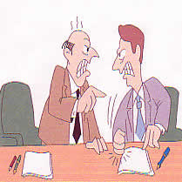
Let Schedule Drive Requirements (Not the Reverse)
“It Will Take Us 9 Months”
“Okay, Here Are Our Requirements By When Can You Build Them?”
“Sorry, They Must Be Completed in 6 Months”
Typical Scenario
NOW WHAT?
Source: Davis, A.: “Just Enough Requirements Management”, Dorset House, 2005; “The art of requirements triage”, IEEE Computer, 03/2003

Slide 6

Let Schedule Drive Requirements (Better Scenario)
“Let’s see. If we build reqts 1 through 9 and 12, we’ll be able to do them in 3 months”
“Okay, we’re going to build in a series of 3 month increments. Here are all the requirements.”
“But we really need reqt 17 in that first release.”
“Okay. How about if we add reqt 17 and drop reqt 12?”
Source: Davis, A.: “Just Enough Requirements Management”, Dorset House, 2005; “The art of requirements triage”, IEEE Computer, 03/2003

Slide 7
Let Schedule Drive Requirements (Better Scenario)
“Well if we drop requirements 3 and 4, we could do it.”
“Hmmm. I really liked reqt 12. Can we drop reqt 3 instead?.”
“Okay”
“Okay. How about if we add reqt 17 and drop reqt 12?”
Teamwork!!!
Source: Davis, A.: “Just Enough Requirements Management”, Dorset House, 2005; “The art of requirements triage”, IEEE Computer, 03/2003

Slide 8
Requirements Negotiation – Key Aspects (1)
(by analogy with land negotiations)
  Territory: desired requirements
    The real requirements are those in the head of each stakeholder
  Map: requirements document
    An abstract model of intentions/requirements, imperfect and incomplete
  Interpretation of the map: included requirements
    May vary from one session to the next → need to be clear, precise, and unambiguous
  Looking at the map through the magnifying glass: importance
    Each stakeholder has such a view about its requirements in the project
    For each stakeholder, see if a documented requirement is important, conflicting, or optional

Slide 9
Requirements Negotiation – Key Aspects (2)
  Negotiating boundaries: counterproposals of stakeholders
    Reaction of a stakeholder (open, opposed, cooperative...) to a documented requirement may indicate how far it is open for compromise
    Helps optimize the requirements of all stakeholders
Can we be consistent? See techniques later on!

Slide 10
Difficulties (1)
There are too many requirements!
From many different sources
Resources are limited (budget, time…)
Establishing priorities is important, but
  Which requirements are important, and to whom?
  How to prioritize them? On what basis? What to minimize/maximize?
  In which iteration should the requirement be considered?
Developers may not know the business value of some requirements, and clients may not know the implementation complexity of some requirements

Slide 11
Difficulties (2)
Different stakeholders have different goals and different priorities
Some stakeholders’ decisions carry more weight than others
Companies often lack systematic data, metrics, and technologies to support the prioritization process
  Often done manually, informally, on an ad-hoc basis
  Difficult to establish and communicate
Attitude!
  "No need for priorities, we can do everything in the specification!“
    Yes, but when and at what cost?
  Suddenly, when the deadline is fast approaching, some requirements are put aside in order to deliver something on time...

Slide 12
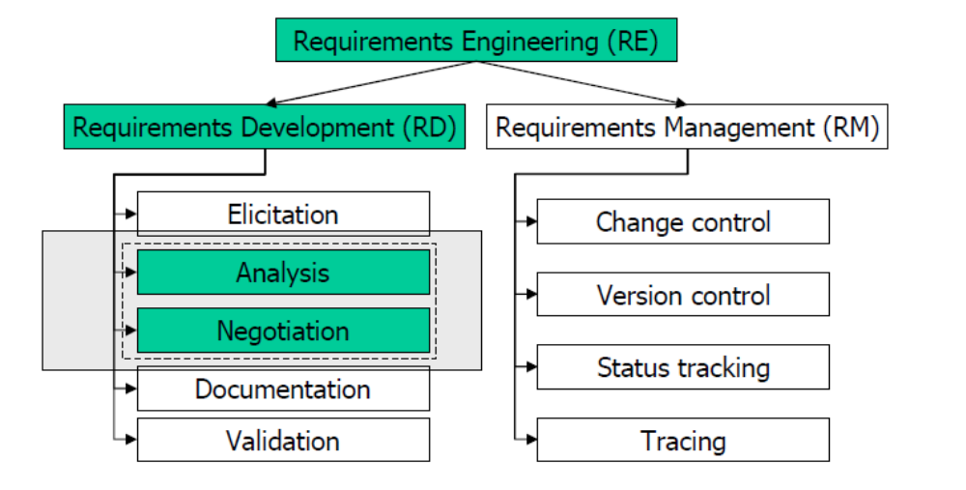
Analysis and Negotiation
Analysis – the process of evaluating value/cost of different requirements, identifying dependencies between requirements, etc.
Negotiation – the process of resolving conflicts between requirements, deciding which to accept, setting priorities.

Slide 13
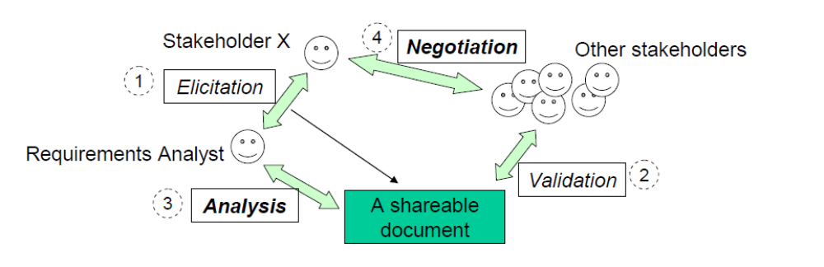
Analysis and Negotiation
The main goal of requirements analysis is to support negotiation:
  – To make the negotiation decision making process better informed
  – To reduce the emotional charge
Note that is many books “analysis” means also early validation and verification. However, here we follow a more narrow view.

Slide 14
Negotiation goals
Three basic goals of requirements negotiation (Pohl, 1996):
  – To make the conflicts explicit.
  – To make explicit, for each conflict, the relevant alternatives, the argumentations, and the underlying rationales.
  – To facilitate in that “right” decisions are made.
“Right” decision here denotes a decision made rationally, decision made based by evaluating the alternatives and selecting the best one.
In practice, this means that either:
  – One of the conflicting parties is educated to the level when it changes its mind,
  – Or a compromise is found.

Slide 15
Garbage can model
Especially in complex projects, requirements decisions are seldom discrete events in which pros and cons are systematically weighted in an effort to achieve optimal decisions.
Rather, decision-making occurs through what have been called the “garbage can model”, a protracted process, in which
  – problems are searching for solutions,
  – solutions are searching for problems,
  – and decision-makers are searching for decisions to be made (Bergman et al., 2002).
In addition to goal incongruence, when stakeholders disagree on functional goals or at least the means of achieving goals, some of proposed requirements are not based on any functional goals, but on political ones.

Slide 16
Political ecology of requirements
Especially in complex projects, requirements engineering is a largely political process.
In addition to functional ecology, requirements have political ecology.
  – What goals different stakeholders pursue.
  – Who of them has power to make (or influence) what kind of decisions.
The functional ecology is ultimately dependent upon the political ecology, and the latter must be fixed and stable before the former can be.
On the other hand, functional decisions may change the balance in the political ecology.
It is common for problems of political ecology to appear on the surface as functional problems, triggering continuous changes in requirements, notsolving the actual – political – problem.

Slide 17
Types of politics in RE
Two types:
  – Functional politics – which of problems deserve attention, whose interests will be served – concerns about the functional intent of the system.
  – Resource politics – to solving which of problems to allocate the available resources – concerns about the flow of resources going into the system.
Resource politics is often hidden, as proponents of a new system deliberately downplay the expected costs in order to improve the chances that the system will be funded.

Slide 18
Decision models
Common decision models:
Autocracy – an individual or close-knit group decides the political question and all others comply.
  • Is often assumed, but real autocracy is relatively rare.
Pluralism - the diverse interests of various stakeholders with standing are considered on their individual merits, and efforts are made to accommodate all reasonable interests in the solution (weights of interests are not necessarily equal).
  • Negotiation can be very difficult
Two-party contest - diverse interests come together behind either a proponent or opponent position on a particular set of requirements.

Slide 19
Two party-contests
Many if not most system development efforts devolve to two-party contests even if they start out as pluralistic.
This is because pluralistic coalitions tend to be less stable in handling controversial political issues over time than two-party structures.
In a two-party contest:
  The proponent coalition proposes a thesis
  The opponent coalition challenges the thesis with an antithesis
  Either thesis or antithesis wins and “winner-takes-all”, or a synthesis of the thesis and antithesis is created and agreed upon
The sides may use various political techniques including e.g. control of the agenda, display of charisma, establishment and execution of quid pro quo, control of the decision criteria, rationalization, legitimization of control, incurring of obligation, dispensing of rewards, use of outside experts, and coopting of the opposition members.

Slide 20
By the way…
Many projects do not allow enough time to resolve requirements conflicts. The reason is, perhaps, that conflicts are considered as some kind of ‘failure’ and it is not acceptable to plan a failure. This view is completely wrong. Conflicts are natural and inevitable. (Kotonya and Sommerville, 1998)
One source of opposition to explicit engagement of the political side of RE is the sense that politics is somehow in opposition to rationality. This is a misconception. Political action embodies a vital form of rationality that is required to reach socially important decisions in conditions of incomplete information about the relationship between actions and outcomes. Political solutions are used simply because no other solutions are available. (Bergman et al, 2002).
  Acquiring additional information may reduce the need for political decisions

Slide 21
Negotiation meetings
RE tradition assumes that the requirements analyst is the person who is responsible to be the mediator who controls the negotiation process.
Especially in complex projects, it is unclear however whether the requirements analysts has sufficient political power even for that – e.g. for calling a negotiation meeting.
Anyway, he cannot stay out of the political process.
Use first some analysis techniques to make explicit the pros and cons of the alternatives, then
(Attempt to) Organize a meeting, conducted in three stages (Kotonya and Sommerville, 1998):
  Information from the analyst about the nature of the problem
  Discussion between the sides
  Resolution

Slide 22
Requirements Analysis
Benefit/penalty/cost/risk analysis. Rate for each alternative or requirement:
  The relative benefit of the requirement, e.g. from 1 (useless) to 9 (extremely valuable).
  The relative penalty that will be suffered if the requirement is not included, e.g. from 1 (no one is upset) to 9 (very serious consequences).
  The relative cost of implementing the requirement, e.g. from 1 (quick and easy) to 9 (very time consuming and expensive).
  The relative risk of not getting the requirement implemented right, e.g. form 1 (no risk) to 9 (significant risks exist related to available expertise, reliability of tools, technology or partners).
Interaction analysis. Analyze interaction between different requirements, what impact on other parts of the system will be when a particular alternative is selected, etc.

Slide 23
Requirements Prioritization and Triage
Requirements prioritization is also referred to as triage
Need to decide which requirements really matter or on those that need to be implemented in the current release
Need for compromise, negotiation, priorities
Prioritization is needed because there will almost always be the need for trade-offs (e.g., required functionality vs. time and resources)
Must help:
  Make acceptable tradeoffs among goals of value, cost, time-to-market
  Allocate resources based on importance of requirements to the project as a whole (project planning)
  Determine when a requirements should become part of the product
  Offer the right product!

Slide 24
80-20 Rule
20% of functionalities provide 80% of revenues
  Think of MS Word…
The remaining 80% of functionalities offer a lower return on investment while adding delays, development costs, maintenance costs...
How to find the most useful and beneficial 20% of functionalities?

Slide 25
Which Sector Should We Focus On?
A lot!
R11
R10
R6
R9
R13
Value
R7
R3
R15
R8
R14
R1
R2
R12
R4
R5
To avoid!
R16
0
Cost
A lot!

Slide 26
Requirements Triage Process
Must be simple and fast, for industry adoption
Must yield accurate and trustworthy results
Must consider issues such as
  The value of requirements to stakeholder (maximize)
  The cost of implementation (minimize)
  Time to market (to minimize)
Important to agree on requirements granularity
  E.g., use cases, features, detailed functional requirements

Slide 27
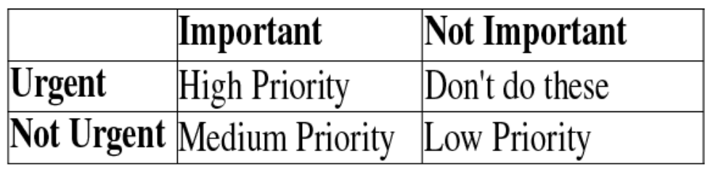
Technique – Prioritization Scales
Determine criteria, granularity, scale dimensions
Frequently used:
  Urgency
    High (mission critical requirement; required for next release)
    Medium (supports necessary system operations; required eventually but could wait until a later release if necessary)
    Low (a functional or quality enhancement; would be nice to have someday if resources permit)
  Importance
    Essential (product unacceptable unless these requirements are satisfied)
    Conditional (would enhance the product, but the product is acceptable if absent)
    Optional (functions that may
    or may not be worthwhile)

Slide 28
A Cost-Value Approach
Source: Adapted from Karlsson & Ryan 1997
Calculate return on investment
Assess each requirement’s importance to the project as a whole
Assess the relative cost of each requirement
Compute the cost-value trade-off:
30
High
priority
25
20
Medium
priority
Value (percent)
15
10
5
Low priority
5
10
15
20
25
30
Cost (percent)

Slide 29
Estimating Cost & Value
Two approaches:
  Absolute scale (e.g. dollar values)
    Requires much domain experience
  Relative values (e.g. less/more; a little, somewhat, very)
    Much easier to elicit
    Prioritization becomes a sorting problem
Comparison Process - options
  Basic sorting - for every pair of requirements (i,j), ask if i>j?
    E.g. bubblesort - start in random order, and swap each pair if out of order
    requires n*(n-1)/2 comparisons
  Construct a Binary Sort Tree
    Requires O(n log n) comparisons
  Contruct a Minimal Spanning Tree
    for each pair (Ri, Ri+1) get the distance between them
    Requires n-1 comparisons

Slide 30
Some complications
Hard to quantify differences
  easier to say “x is more important than y”…
  …than to estimate by how much.
Not all requirements comparable
  E.g. different level of abstraction
  E.g. core functionality vs. customer enhancements
Requirements may not be independent
  No point selecting between X and Y if they are mutually dependent
Stakeholders may not be consistent
  E.g. If X > Y, and Y > Z, then presumably X > Z?
Stakeholders might not agree
  Different cost/value assessments for different types of stakeholder

Slide 31
Technique – Wiegers’ Prioritization
Semi-quantitative analytical approach to requirements prioritization based on value, cost, and risk
Relies on estimation of relative priorities of requirements
  Dimensions
    Relative benefit (for having requirement)
    Relative penalty to stakeholder (if requirement is not included)
    Relative cost (to implement requirement)
    Relative risk (technical and other risks)
  Each dimension is given a value on a given scale (e.g., 0..9)
  Dimensions have relative weights
Formula used to derive overall priority
  priority = (value%) / ((cost% * cost weight) + (risk% * risk weight))
Still limited by ability to properly estimate
  Requires adaptation and calibration

Slide 32
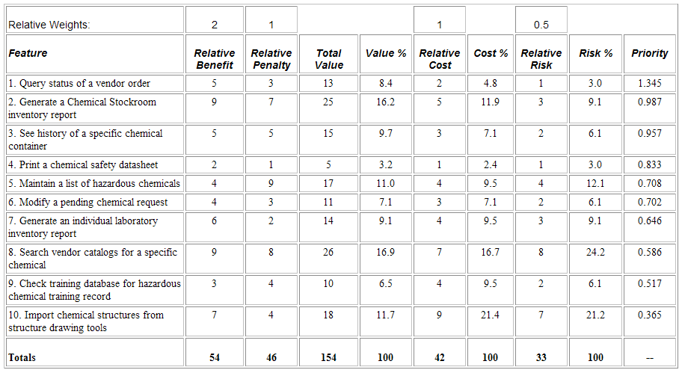
Wiegers’ Prioritization Example
Chemical tracking system
Source: Wiegers, Karl E., First Things First: Prioritizing Requirements, http://www.processimpact.com/articles/prioritizing.html

Slide 33
Other Criteria to Consider
Costs/benefits approach is good but sometimes insufficient
The following criteria are not all applicable to all projects, but they are there to be considered:
  Cost of implementation (how much does it cost to develop?)
  Value to customer (how much does the customer want it?)
  Time to implement (how much time does it take to deliver?)
  Ease of implementation at technical level
  Ease of implementation at the organizational level (business process)
  Value to company (how much will the business benefit?)
  Obligation to some external authority (laws, standards, patents…)

Slide 34
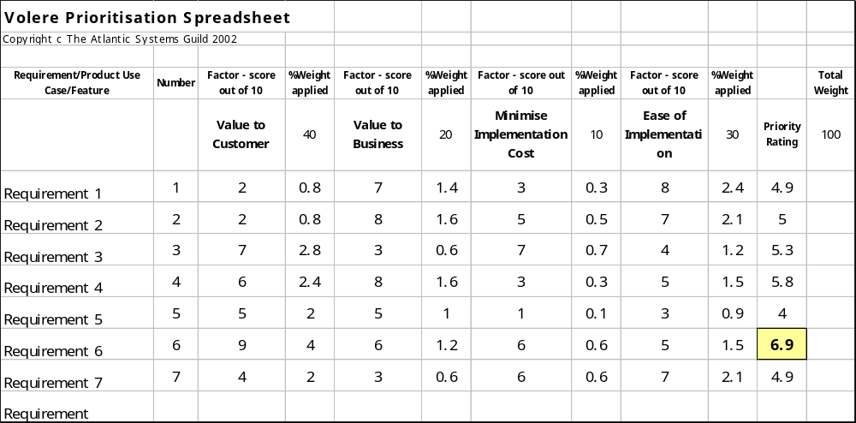
Technique – Volere Prioritisation
Editable Excel document
Source: Volere Prioritisation Analysis, http://www.volere.co.uk/prioritisationdownload.htm

Slide 35
Pairwise Comparisons (1)
Finding scores and weights is difficult and subjective
Potential solution: pairwise comparison
  Which requirements (A or B) is more important:
  A << < = > >> B
Benefits
  Indicates what is important to the client
  Identifies requirements of high value and low cost (priority!)
  Identifies requirements of low value and high cost (likely to be removed)
  Has already been used to assist numerous corporate and government decision makers
    Choosing a telecommunication system, formulating a drug policy, choosing a product marketing strategy

Slide 36
Pairwise Comparisons (2)
New problems
  Large number of pairs – pairwise comparison can be tedious
    Solved using transitivity and other tricks!
    Mathematical optimization of the number of pairs to be considered (no need to cover all)
  Many dependencies between requirements
    Can actually be used to further reduce the # of pairs
    E.g., group many requirements as features, use cases, services…
Example approach
  Analytic Hierarchy Process¹
[1] Karlsson, J. and Ryan, K. A cost-value approach for prioritizing requirements, IEEE Software, Sept/Oct 1997

Slide 37
Hierarchical Prioritization
Group Requirements into a hierarchy
  E.g. A goal tree
  E.g. A NFR tree
Only make comparisons between branches of a single node:
Better
train system
Comparison set 1
serve more
passengers
minimize
costs
improve
safety
add new
tracks
Comparison set 2
increase
safe distance
minimize
operation
costs
minimize
development
costs
clearer
signalling
increase
train speed
more
frequent
trains
Comparison set 4
Comparison set 3

Slide 38
Technique – Analytic Hierarchy Process (AHP)
Developed by Karlsson and Ryan (1997) based on work by Saaty (early 1970)
  see also http://en.wikipedia.org/wiki/Analytic_Hierarchy_Process
Use cost-value diagrams to analyze and discuss candidate requirements
Useful for requirements triage and release planning (but also applicable in many other situations where complex decisions are to be made)
Basic procedure for rating a set of criteria
  Develop pairwise comparison matrix of each criterion
  Normalize the matrix
  Average the value of each row to get corresponding rating
Criterion ratings are then used to evaluate different potential decisions

Slide 39
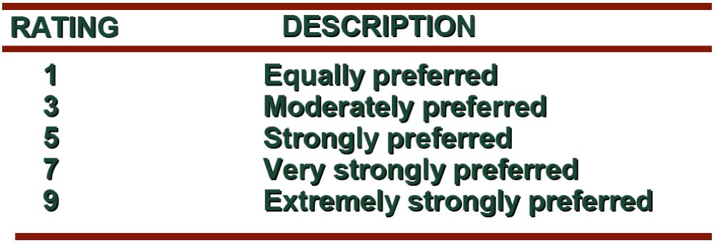
Basic Rating Procedure (1)
Pairwise comparison rating scale
Values 2, 4, 6, or 8 represent preferences halfway between the integers on either side

Slide 40
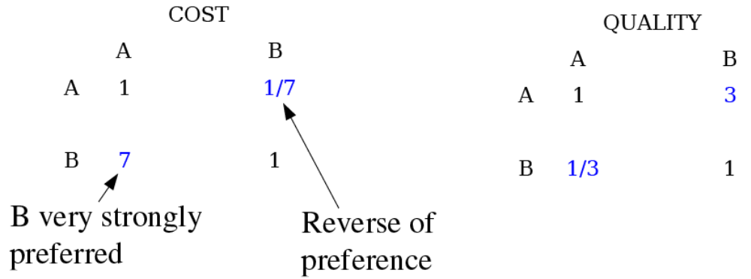
Basic Rating Procedure (2)
Suppose two criteria, cost and quality, for product A & B
  The cost for A is $60 and the quality is above average.
  The cost for B is $15 and the quality is right at average.
Which product do you choose?
The matrix describes that the price of B is very strongly preferred over A and A is only moderately preferred over B

Slide 41
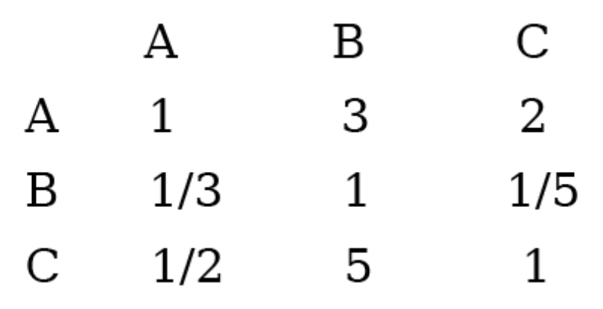
Basic Rating Procedure (3)
Suppose three products with the following pairwise comparison (for one given criteria)

Slide 42
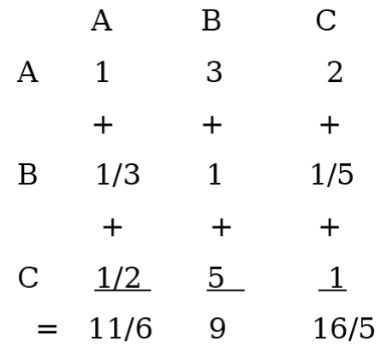
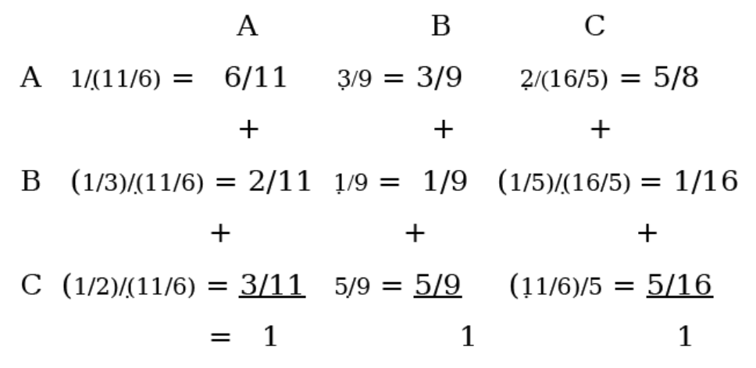
Basic Rating Procedure (4)
Normalize the matrix
  First add up all the
  values in each
  column
  Next the values in
  each column are
  divided by the
  corresponding
  column sums
  Note: the values
  in each column
  add up to 1

Slide 43
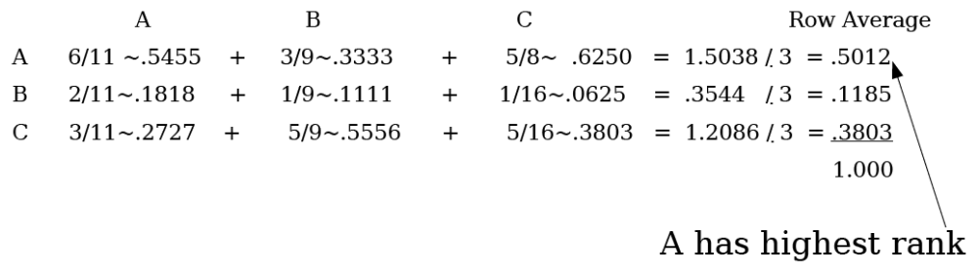
Basic Rating Procedure (5)
Average the value of each row to get corresponding rating

Slide 44
Analytic Hierarchy Process – Steps
Requirements engineers check individual requirements for ambiguities, completeness…
Apply AHP’s pairwise comparison to estimate the relative value of candidate requirements
Experienced software engineers use AHP’s pairwise comparison to estimate the cost of candidate requirements
Plot these values on a cost-value diagram
Stakeholders use this diagram for analysis and to make trade-offs

Slide 45
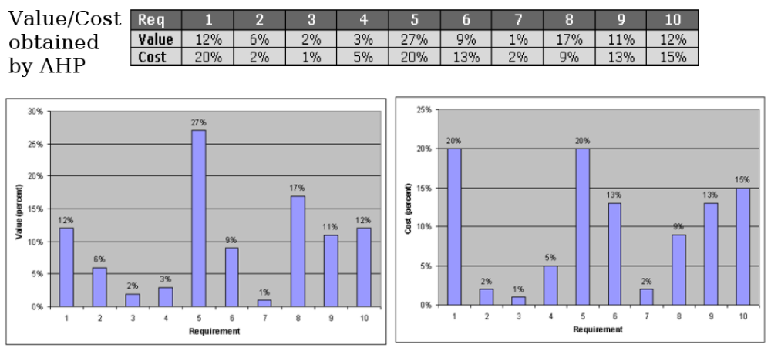
Analytic Hierarchy Process – Example (1)

Slide 46
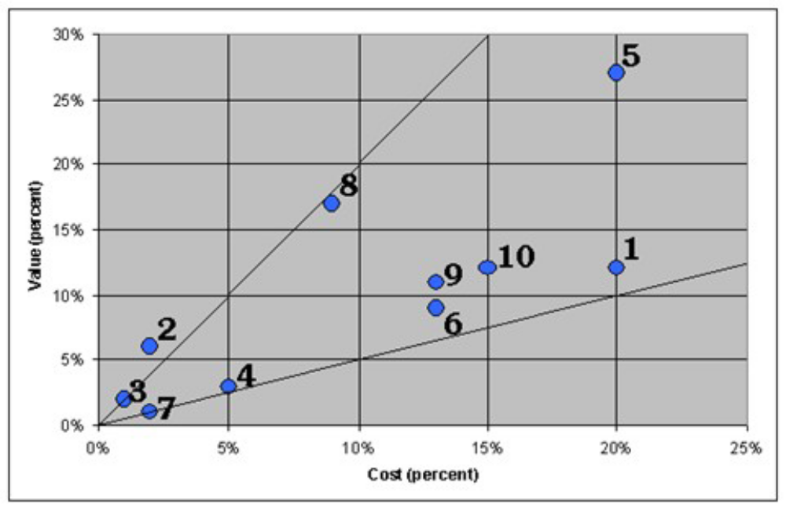
Analytic Hierarchy Process – Example (2)
Cost-value diagram

Slide 47
Analytic Hierarchy Process – Stakeholders (1)
Each client is unique!
Each stakeholder group may have a different weight
  Process uses a weighting criteria to consider each individual stakeholder group
Example (stakeholders M1 to M10 are different markets)
  Revenue last release
  Profit last release
  Number of sold licenses last release
  Predictions of the above criteria for the coming release
  Number of contracts lost to competitors
  Number of potential customer with nil licenses to date
  Size of total market segment
  Growth potential

Slide 48
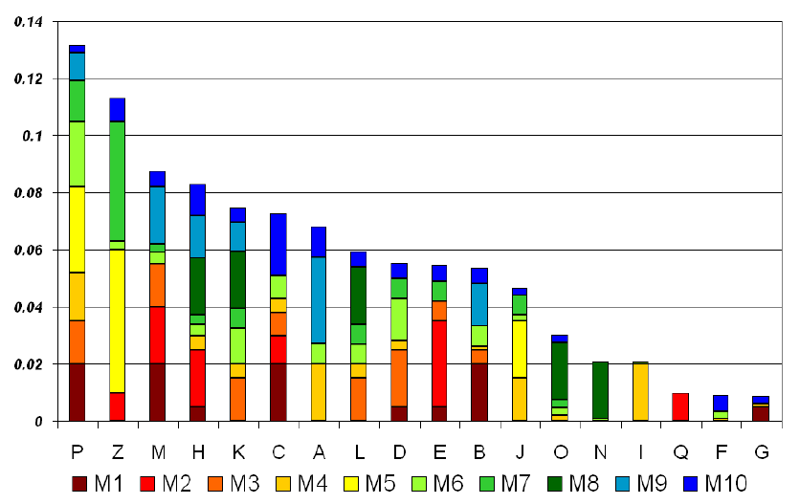
Analytic Hierarchy Process – Stakeholders (2)
Before adjustment based on stakeholders importance
Source: Damian, 2005

Slide 49
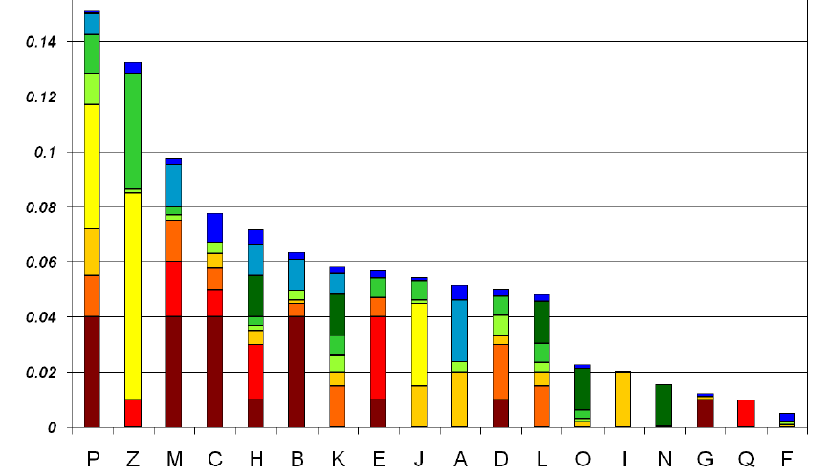
Analytic Hierarchy Process – Stakeholders (3)
After adjustment based on stakeholders importance
Source: Damian, 2005

Slide 50
Example of Commercial Tool
IBM Rational (formerly Telelogic) Focal Point
  Decision support, portfolio management
  Pairwise comparisons of features
    Creation and validation of web questionnaires
  Dynamic algorithm for reducing the number of pairs, according to the responses
  Detection of inconsistency between the answers
  Priorities
    For different markets
  Represented in various different ways
  Integration with DOORS
  http://www-01.ibm.com/software/awdtools/focalpoint/

Slide 51
The problem of validation
➲ logical positivist view:
➢ “there is an objective world that can be modeled by building a consistent body of
knowledge grounded in empirical observation”
 In RE, assumes there is an objective problem that exists in the world
➢ Build a consistent model; make sufficient empirical observations to check validity
➢ Use tools that test consistency and completeness of the model
➢ Use reviews, prototyping, etc to demonstrate the model is “valid”
➲ Popper’s modification to logical positivism:
➢ “theories can’t be proven correct, they can only be refuted by finding exceptions”
 In RE, design your requirements models to be refutable
➢ Look for evidence that the model is wrong
➢ E.g. collect scenarios and check the model supports them
➲ post-modernist view:
➢ “there is no privileged viewpoint; all observation is value-laden; scientific
investigation is culturally embedded”
➢ E.g. Kuhn: science moves through paradigms
➢ E.g. Toulmin: scientific theories are judged with respect to a weltanschauung
 In RE, validation is always subjective and contextualised
➢ Use stakeholder involvement so that they ‘own’ the requirements models
➢ Use ethnographic techniques to understand the weltanschauungen
4

Slide 52
Prototyping
➲ Definitions
 “A software prototype is a partial implementation constructed primarily to
enable customers, users, or developers to learn more about a problem or its
solution.” [Davis 1990]
 “Prototyping is the process of building a working model of the system”
[Agresti 1986]
➲ Approaches to prototyping
 Presentation Prototypes
➢ explain, demonstrate and inform - then throw away
➢ e.g. used for proof of concept; explaining design features; etc.
 Exploratory Prototypes
➢ used to determine problems, elicit needs, clarify goals, compare design options
➢ informal, unstructured and thrown away.
 Breadboards or Experimental Prototypes
➢ explore technical feasibility; test suitability of a technology
➢ Typically no user/customer involvement
 Evolutionary (e.g. “operational prototypes”, “pilot systems”):
➢ development seen as continuous process of adapting the system
➢ “prototype” is an early deliverable, to be continually improved.
5

Slide 53
Throwaway or Evolve?
➲ Throwaway Prototyping
➲ Evolutionary Prototyping
Purpose:
Purpose
➢ to learn more about the problem or its
➢ to learn more about the problem or its
solution…
solution…
➢ hence discard after the desired knowledge
➢ …and to reduce risk by building parts of
is gained.
the system early
Use:
Use:
➢ early or late
➢ incremental; evolutionary
Approach:
Approach:
➢ horizontal - build only one layer (e.g. UI)
➢ vertical - partial implementation of all
➢ “quick and dirty”
layers;
Advantages:
➢ designed to be extended/adapted
➢ Learning medium for better convergence
Advantages:
➢ Early delivery → early testing → less cost
➢ Requirements not frozen
➢ Successful even if it fails!
➢ Return to last increment if error is found
Disadvantages:
➢ Flexible(?)
➢ Wasted effort if requirements change
Disadvantages:
rapidly
➢ Can end up with complex, unstructured
➢ Often replaces proper documentation of
system which is hard to maintain
the requirements
➢ early architectural choice may be poor
➢ May set customers’ expectations too high
➢ Optimal solutions not guaranteed
➢ Can get developed into final product
➢ Lacks control and direction
Brooks: “Plan to throw one away - you will anyway!”
6

Slide 54
Reviews, Inspections, Walkthroughs…
Source: Adapted from Blum, 1992, pp369-373
➲ Note: these terms are not widely agreed
 formality
➢ informal: from meetings over coffee, to team get-togethers
➢ formal: scheduled meetings, prepared participants, defined agenda, specific
format, documented output
 “Management reviews”
➢ E.g. preliminary design review (PDR), critical design review (CDR), …
➢ Used to provide confidence that the design is sound
➢ Attended by management and sponsors (customers)
➢ Usually a “dog-and-pony show”
 “Walkthroughs”
➢ developer technique (usually informal)
➢ used by development teams to improve quality of product
➢ focus is on finding defects
 “(Fagan) Inspections”
➢ a process management tool (always formal)
➢ used to improve quality of the development process
➢ collect defect data to analyze the quality of the process
➢ written output is important
➢ major role in training junior staff and transferring expertise
7

Slide 55
Benefits of formal inspection
Source: Adapted from Blum, 1992, pp369-373 & Freedman and Weinberg, 1990.
➲ Formal inspection works well for programming:
 For applications programming:
➢ more effective than testing
➢ most reviewed programs run correctly first time
➢ compare: 10-50 attempts for test/debug approach
 Data from large projects
➢ error reduction by a factor of 5; (10 in some reported cases)
➢ improvement in productivity: 14% to 25%
➢ percentage of errors found by inspection: 58% to 82%
➢ cost reduction of 50%-80% for V&V (even including cost of inspection)
 Effects on staff competence:
➢ increased morale, reduced turnover
➢ better estimation and scheduling (more knowledge about defect profiles)
➢ better management recognition of staff ability
➲ These benefits also apply to requirements inspections
 e.g. See studies by Porter et. al.; Regnell et. al.;…
8

Slide 56
Inspection Roles
➲ Roles
 Author
➢ The person who created the work product being inspected
 Moderator
➢ This is the leader of the inspection. The moderator plans the inspection
and coordinates it
 Reader
➢ The person reading through the documents, one item at a time. The
other inspectors then point out defects
 Recorder/Scribe
➢ The person that documents the defects that are found during the
inspection
 Inspector
➢ The person that examines the work product to identify possible detects
9

Slide 57
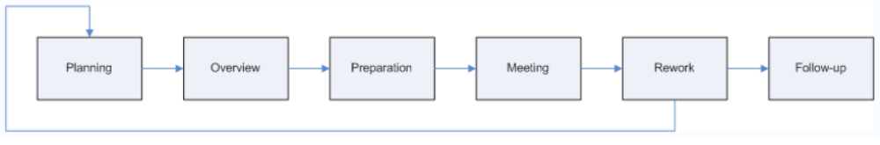
Inspection Process
Process
 Planning
➢ The inspection is planned by the moderator
 Overview meeting
➢ The author describes the background of the work product
 Preparation
➢ Each inspector examines the work product to identify possible defects
 Inspection meeting
➢ During this meeting, the reader reads through the work product, part
by part and the inspectors point out the defects for every part
 (Rework
➢ The author makes change to the work product according to the action
plans from the inspection meeting
 Follow-up
➢ The changes by the author are checked to make sure everything is
correct)
10

Slide 58
Inspection Constraints
Source: Adapted from Blum, 1992, pp369-373 & Freedman and Weinberg, 1990.
➲ Size
➲ Scope
 “enough people so that all the
relevant expertise is available”
 min: 3 (4 if author is present)
 max: 7 (less if leader is
 focus on small part of a design,
not the whole thing
➲ Timing
inexperienced)
 Examines a product once its
author has finished it
➲ Duration
 not too soon
 never more than 2 hours
➢product not ready - find
problems the author is already
aware of
➢concentration will flag if longer
➲ Outputs
 not too late
 all reviewers must agree on the
result
➢product in use - errors are now
very costly to fix
➢accept; re-work; re-inspect;
➲ Purpose
 all findings should be documented
 Remember the biggest gains
come from fixing the process
➢summary report (for management)
➢detailed list of issues
➢collect data to help you not to
make the same errors next time
11

Slide 59
Inspection Guidelines
Source: Adapted from Freedman and Weinberg, 1990.
➲ Prior to the review
 schedule Formal Reviews into the project planning
 train all reviewers
 ensure all attendees prepare in advance
➲ During the review
 review the product, not its author
➢ keep comments constructive, professional and task-focussed
 stick to the agenda
➢ leader must prevent drift
 limit debate and rebuttal
➢ record issues for later discussion/resolution
 identify problems but don’t try to solve them
 take written notes
➲ After the review
 review the review process
12

Slide 60
Sample Inspection Checklist for SRS’s
Source:www.processimpact.com
➲ Organization and Completeness
 Are all internal cross-references to other requirements correct?
 Does the SRS include all of the known customer or system needs?
 …
➲ Correctness
 Do any requirements conflict with or duplicate other requirements?
 Is each requirement verifiable by testing, demonstration, review, or
analysis?
 …
➲ Quality Attributes
 Are all performance objectives properly specified?
 …
➲ Special Issues
 Are all requirements actually requirements, not design or implmentation
solutions?
 Have internationalization issues been adequately addressed?
 …
16

