Slide 1
Requirements Inception
Based on presentations by G. Mussbacher, G.V Bochmann, N. Niu, with material from: Wiegers: Software Requirements, Chapter 5, Leffingwell & Widrig: Managing Software Requirements…, Chapter 5, Amyot 2008-2009, Somé 2008

Slide 2
Overview
Problem Analysis
Business Requirements
Five Steps for Problem Analysis
  Gain Agreement on the Problem Definition
  Understand the Root Causes
  Identify the Stakeholders
  Product Vision and Project Scope
  Identify the Constraints
Vision and Scope Document
The important thing is not to stop questioning. Curiosity has its own reason for existing.¹
[1] Albert Einstein (1879 - 1955)

Slide 3
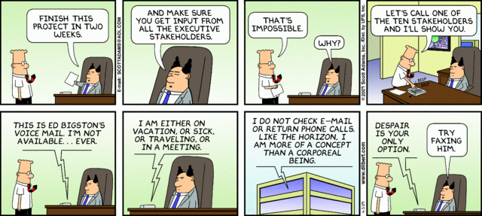

Slide 4
Problem Analysis
Goal: gain a better understanding of the problem being solved before development begins
  Identify root cause
  Identify stakeholders and their needs (or problems)
  Identify solution boundary
Uses business requirements obtained from stakeholders
Results in Product Vision and Project Scope

Slide 5
Business Requirements (1)
Business Opportunity
  Description of market opportunity, competing market, business problem being solved or improved, advantage of proposed solution, problems that will be solved...
Business Objective and Success Criteria
  Important business benefits the product will provide in a quantitative and measurable way, how success will be measured, factors that have great impact on success...
Customer or Market Needs
  Problems that customers currently encounter that will be addressed
Business Risks
  Major risks associated with developing or not developing the product (marketplace competition, timing, user acceptance, implementation issues...)

Slide 6
Business Requirements – Example
Business Opportunity
  Exploit the poor security record of a competing product
Business Objective and Success Criteria
  Capture a market share of 80 percent by being recognized as the most secure product in the market through trade journal reviews and consumer surveys
  Achieve positive cash flow on the product within 6 months

Slide 7
Business Requirements (2)
Important for:
  Ensuring that all project participants work for the same reasons
  Getting stakeholders agreement on requirements
User and software requirements must align with the context and objective defined by business requirements
Requirements that do not help achieve business objective should not be included

Slide 8
Problem Analysis – Five Steps
Five steps for problem analysis (Leffingwell and Widrig )
Gain agreement on the problem definition
Understand the root causes – the problem behind the problem
Identify the stakeholders
Define the solution system vision and boundary
Identify the constraints to be imposed on the solution

Slide 9
Problem Analysis – Gain Agreement
Document the problem and seek agreement
Ask stakeholders to write a problem statement in an agreed format
Statement should include
  What the problem is
  Who is affected by it?
  What is the impact?
  Is there a proposed solution?
  What are key benefits?

Slide 10
Problem Analysis – Understand Root Causes (1)
There is often a problem behind the problem
Root cause analysis consists of finding underlying causes that may not be immediately apparent
Example: Our e­commerce site is not profitable
  Why is it not profitable?
  Poor site design?
  Bad pricing?
  Poor customer management after the sale?
  Some or all of the above?

Slide 11
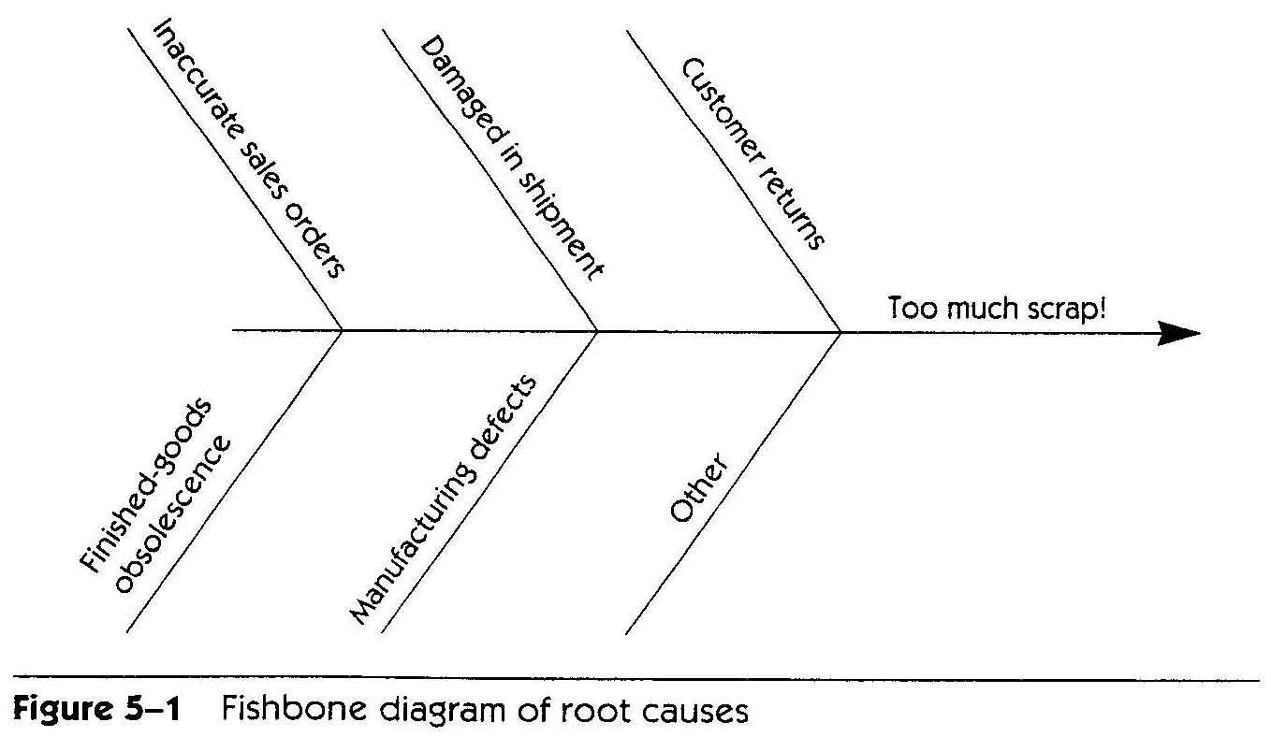
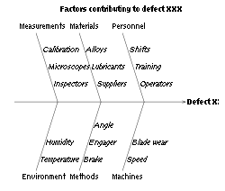
Problem Analysis – Understand Root Causes (2)
Root cause analysis can be used to understand root causes
  Determine what factors contribute to the problem (sub­problems)
  Recursively determine what factors contribute to these problems
Decompose until causes are understood (possible solution clear)
Decomposition can be represented using a Fishbone diagram, an itemized list...
Source: Leffingwell & Widrig

Slide 12
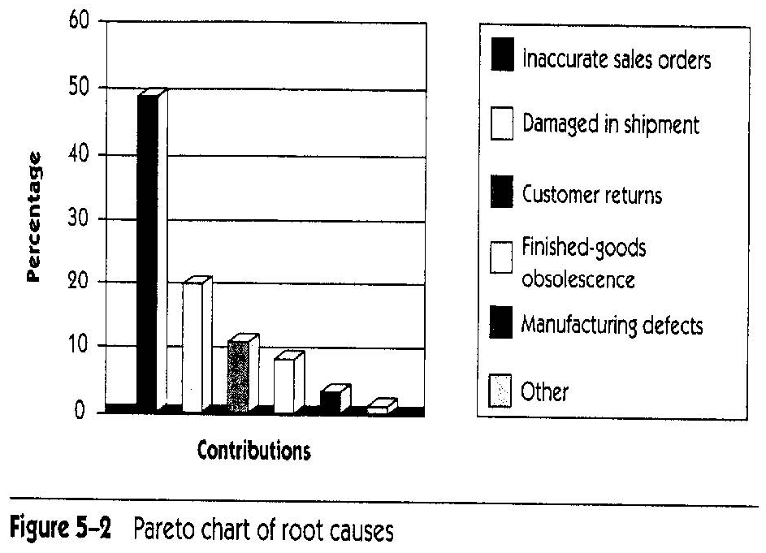
Problem Analysis – Understand Root Causes (3)
Address Root Causes
  Root causes do not all have same impact
  Some may not be worth fixing, at least not now
Estimate relative impact of root causes (e.g., with the help of a Pareto (bar) chart)
Create problem
statement for root
cause problem
identified as worth
solving (and with
computer solution)
Source: Leffingwell & Widrig

Slide 13
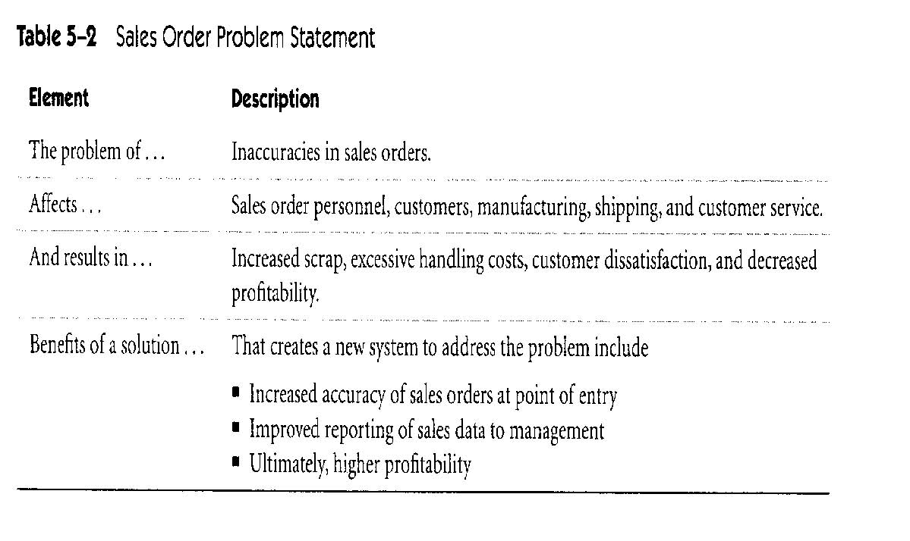
Problem Statement
Source: Leffingwell & Widrig

Slide 14
Problem Analysis – Stakeholder Profiles (1)
Stakeholder Profiles
Stakeholders are individuals, groups, organizations who are actively involved in the project, are affected by its outcome or are able to influence its outcome
Profile should include:
  Major value or benefit that stakeholder will receive from product (e.g., improved productivity, reduced rework, cost saving, ability to perform new tasks...)
  Likely attitude toward the product
  Major features and characteristics of interest
  Any known constraints that must be accommodated

Slide 15
Problem Analysis – Stakeholder Profiles (2)
How to identify Stakeholders?
Elicitation would ask questions such as
  Who uses the system?
  Who is the customer?
  Who is affected by outputs?
  Who evaluates/approves system?
  Other external/internal users?
  Who maintains the system?
  Anyone who cares? (e.g., legal/regulatory, etc.)

Slide 16
Problem Analysis – Product Vision and Project Scope
Product Vision: describes what the product is about and what it could eventually become
  Aligns all stakeholders in a common direction
Project Scope: identifies what portion of the ultimate long-term product vision the current project will address
  Draws boundary between what is in and what is out
Product Vision
Project Scope
for release 1.0
Project Scope
for release 1.1
…..
Project Scope
for release n

Slide 17
Vision Statement (1)
Vision Statement template (according to Moore)
  For [target customer]
  Who [statement of the need or opportunity]
  The [product name]
  Is [a product category]
  That [key benefit, compelling reason to buy or use]
  Unlike [primary competitive alternative, current system, or current business process],
  Our product [statement of primary differentiation and advantages of new product]

Slide 18
Vision Statement (2)
Example
For scientists who need to request containers of chemicals, the Chemical Tracking System is an information system that will provide a single point of access to the chemical stockroom and vendors. The system will store the location of every chemical container within the company, the quantity of material remaining in it and the complete history of each container's location and usage. This system will save the company 25% on chemical costs in the first year of use by allowing the company to fully exploit chemicals that are already available within the company, dispose of fewer partially used or expired containers and use a single standard chemical purchasing process. Unlike the current manual ordering processes, our product will generate all reports required to comply with government regulations that require the reporting of chemical usage, storage, and disposal.

Slide 19
Problem Analysis – Definition of Scope (1)
Definition of solution system boundaries
Requirements baseline is defined according to the release scope
New requirements during development are evaluated according to the scope
  New in­scope requirements can be incorporated if they are of
  high priority relative to the other requirements in the baseline
    Usually implies deferring or canceling other requirements or negotiating a new schedule
  Out­of­scope requirements should be deferred to a following release

Slide 20
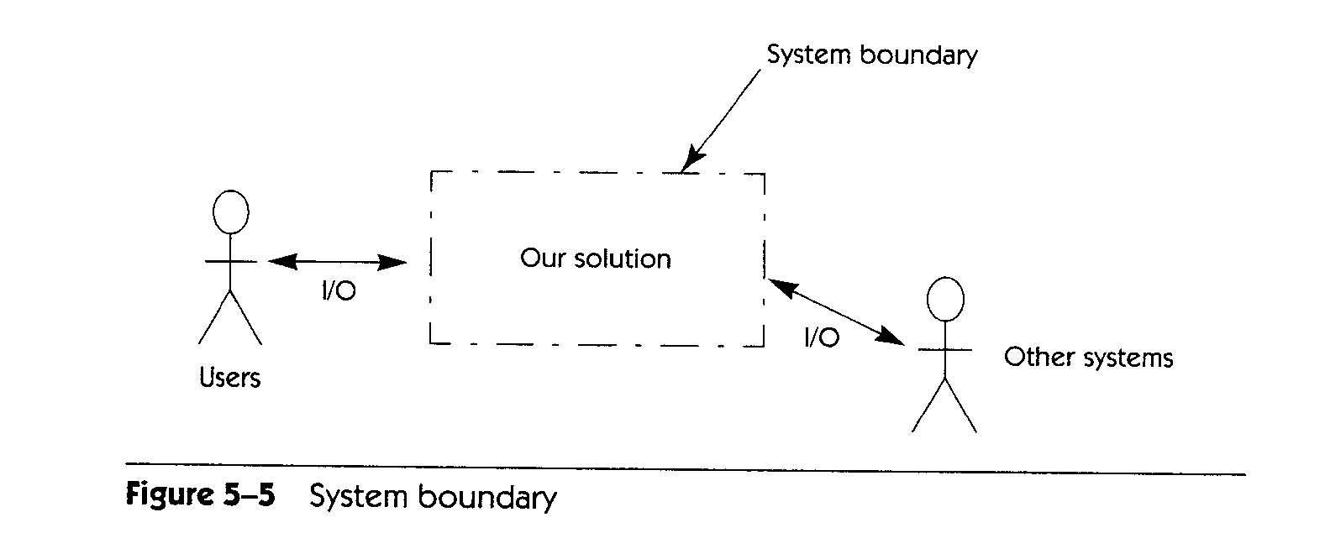
Problem Analysis – Definition of Scope (2)
Context Diagram
Top­level view of a system that shows the system’s boundaries and scope
  Identifies terminators outside the system
  Data, control, and material flow between terminators and the system
Source: Leffingwell & Widrig

Slide 21
Problem Analysis – Identify Constraints
Restrictions on the solution space
Put limitations on the ability to deliver a solution as envisioned
Usually non-functional requirements that impose major restrictions on the system
Sources of constraints include:
  Economics (e.g., costs, licensing issues)
  Politics (e.g., internal or external, interdepartmental issues)
  Technology (e.g., choice of technology/platform)
  Systems (e.g., existing system, compatibility issues)
  Environment (e.g., legal/environmental/security/standards)
  Schedule and resources (e.g., fixed schedule, team)

Slide 22
Vision and Scope Document (1)
Contents:
Business requirements
Vision of the solution
  Vision statement
  Major features (numbered list of major features or user capabilities unique to the new product)
  Assumptions (made while developing vision and scope)
  Major dependencies to external factors outside of the project’s control (e.g., pending industry standards, government regulations, other projects, third party suppliers, development partners)
Scope and limitation (for initial and subsequent releases)
Business context

Slide 23
Vision and Scope Document (2)
Contents – Scope and limitations:
Concept and range of proposed solution
  What the system is
Limitations
  Capabilities that the product won't include (what the system is not)
  Record rejected requirements with the reason for rejecting them
Scope of initial release
  Major features planned for initial release
  Acceptable quality characteristics of initial release
Scope of subsequent releases

Slide 24
Vision and Scope Document (3)
Contents – Business context:
Project Priorities
  Stakeholders must agree on the project priorities
  Help effective decision making
Operating Environment
  Environment in which system will be used (e.g., distributed environment)
  Vital availability, reliability, performance and integrity requirements linked to operating environment

Slide 25
Requirements Elicitation

Slide 26
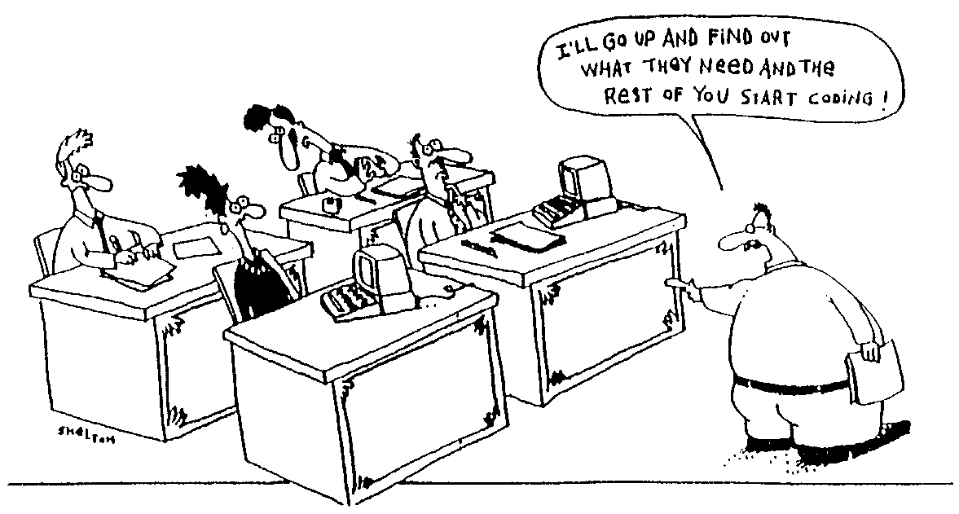

Slide 27
Goals, Risks, and Challenges

Slide 28
What is Requirements Elicitation?
Requirements elicitation is “the process of discovering the requirements for a system by communicating with customers, system users and others who have a stake in the system development”¹
More than a simple request or collection; should evoke and provoke!
Elicitation means “to bring out, to evoke, to call forth”
Human activity involving interaction between a diverse array of human beings
[1] Ian Sommerville and Pete Sawyer

Slide 29
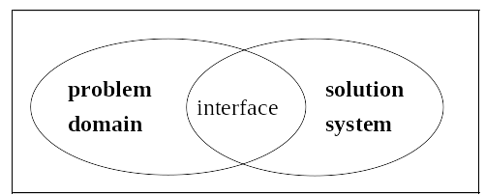
Elicitation Goals
Determine sources of information & appropriate techniques
Get information on domain, problem, constraints
  → requirements → system development
Determine the scope and feasibility early
Produce a first document
  Mainly user requirements and elicitation notes
  Potentially incomplete, disorganized, inconsistent
  But we must start somewhere!
Specification
  description of Solution System needed to
  satisfy Problem Domain
Hardware
Software
Domain
properties
Requirements

Slide 30
Consider the Following Conversation
Gerhard, a senior manager at Contoso Pharmaceuticals, was meeting with Cynthia the new manager of Contoso's information systems (IS) development group.
“We need to build a chemical-tracking information system for Contoso. The system should let us keep track of all the chemical containers we already have in the stockroom and in individual laboratories. That way, maybe the chemists can get what they need for someone down the hall instead of buying a new container from a vendor. This should save us a lot of money. Also, the Health and Safety Department needs to generate some reports on chemical usage for the government. Can your group build this system in time for the first compliance audit five months from now?”
Are the above requirements? Are they enough the build the system?

Slide 31
Elicitation Risks and Challenges (1)
You need to extract information from the brain of your customer without damaging the customer, much less his brain!
  Good technology and good tools can help, but
  cannot substitute for adequate social interaction!
Problems of scope
  System boundaries inadequately defined or defined too soon
  Unnecessary technical details
Problems of understanding
  Stakeholder not sure of what is needed
  Stakeholder has trouble communicating needs
  Stakeholder does not understand capabilities and limitation of computing environment

Slide 32
Elicitation Risks and Challenges (2)
Problems of understanding (cont’d)
  Stakeholder does not have full understanding of domain
  Stakeholders state conflicting requirements
Problems of volatility
  Stakeholders will not commit to a set of written requirements

Slide 33
Elicitation Risks and Challenges (3)
Other typical issues
  Experts seldom available
  Finding an adequate level of precision/detail
  Common vocabulary often missing
Requirements do not fall from the sky!
  Sometimes hidden
  Sometimes too obvious, implicit, ordinary…
  Assume == “ass” of “u” and “me”
Participants often lack motivation and resist to change
We need much effort and discussion to come up with a common agreement andunderstanding!

Slide 34
“Ignorance is a bliss”¹
According to Dan Berry, ignorance of a domain is a good thing!
Ignorance (not stupidity !) allows one to expose hypotheses and some implicit facts
Berry even suggests that one day, requirements engineers may advertise their domains of ignorance (rather than their domains of expertise) to find a job!
[1] The Matrix, 1999

Slide 35
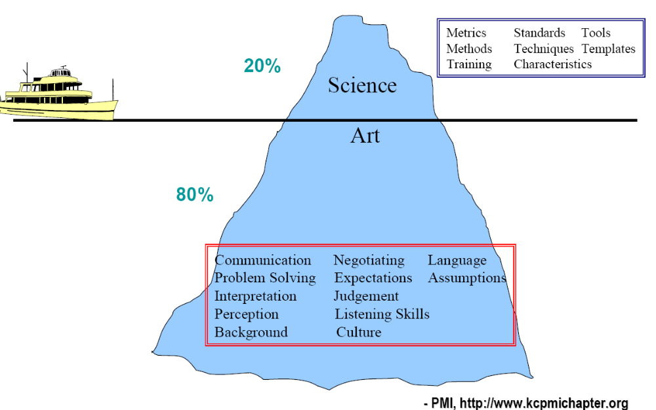
RE: More an Art than Science

Slide 36
Sources of Requirements

Slide 37
Sources of Requirements
Various stakeholders
  Clients, customers, users (past and future), buyers, managers, domain experts, developers, marketing and QA people, lawyers, people involved in related systems, anyone who can bring added value!
Pre-existing systems
  Not necessarily software systems
Pre-existing documentation
Competing systems
Documentation about interfacing systems
Standards, policies, collective agreements, legislation
…

Slide 38
Stakeholder – Customer/Client
Person who pays for the software development
Ultimately, has the final word on what will be the product
For an internal product, the client is probably a product manager
For the consumer market, the customer may be the marketing department

Slide 39
Stakeholder – Buyer
Person who pays for the software once it is developed
Possibly a user or a business owner buying a product for his employees
What features is he willing to pay for?
  Which are trivial or excessive?
Must participate actively in the project (or have a representative)

Slide 40
Stakeholder – User
... of the current system or future systems
Experts of the current system: indicate which functions to maintain or improve
Experts of competitors’ products: suggestions on designing a superior product
May have special needs or requirements
  Usability, training, online help ...
Do not neglect interest groups
  Expert users, or with disabilities or handicaps
Select users with care
  Different seniority
  Must speak with authority and be responsible and motivated

Slide 41
Stakeholder – Domain Expert
Expert who knows the work involved
Familiar with the problem that the software must solve. For example:
  Financial expert for finance management software
  Aeronautical engineers for air navigation systems
  Meteorologist for weather forecasting system, etc…
Also knows the environment in which the product will be used

Slide 42
Stakeholder – Software Engineer
Expert who knows the technology and process
Determines if the project is technically and economically feasible
Specifically estimates the cost and time of product development
Educates the buyer/client on the latest and innovative hardware or software, and recommends new features that will benefit from these technologies

Slide 43
Stakeholder – Other
Inspector
  An expert in governmental rules and safety relevant to the project
  Examples: safety inspectors, auditors, technical inspectors, government inspectors
Market research specialist
  Can play the role of the customer if the software is developed for the general public
  Expert who has studied the market to determine trends and needs of potential customers

Slide 44
Stakeholder – Other
Lawyer
  Familiar with laws and legal aspects
  Standards relevant to the project
Expert of systems that interact with the system to be built
  Knows the interfaces of the interacting systems
  May be interested in product features (if the product can help the interacting system to perform its tasks)
Others that bring added value
  People who will use your product as a basic building block

Slide 45
On Stakeholders Availability…
Stakeholders are generally busy!
  Have priorities other than you
  Are rarely entirely disconnected from their daily routine and tasks
  See their participation in the elicitation process as a supplementary task
Hence, you must have the support and commitment of managers (especially theirs!)
You must also avoid being perceived as a threat:
  Loss of jobs caused by the improved system
  Loss of autonomy, powers, or privileges
  To the recognition and visibility of their work

Slide 46
Requirements Elicitation Tasks

Slide 47
Tasks Performed as Part of Elicitation (1)
Planning for the elicitation
  Why? Who? When? How? Risks?
During the elicitation
  Examine the viability of the project (is it worth it?)
  Understand the problem from the perspective of each stakeholder
  Extract the essence of stakeholders’ requirements
  Invent better ways to do the work of the user
Following the elicitation
  Analyse results to understand obtained information
  Negotiate a coherent set of requirements acceptable by all stakeholders and establish priorities
  Record results in the requirements specification

Slide 48
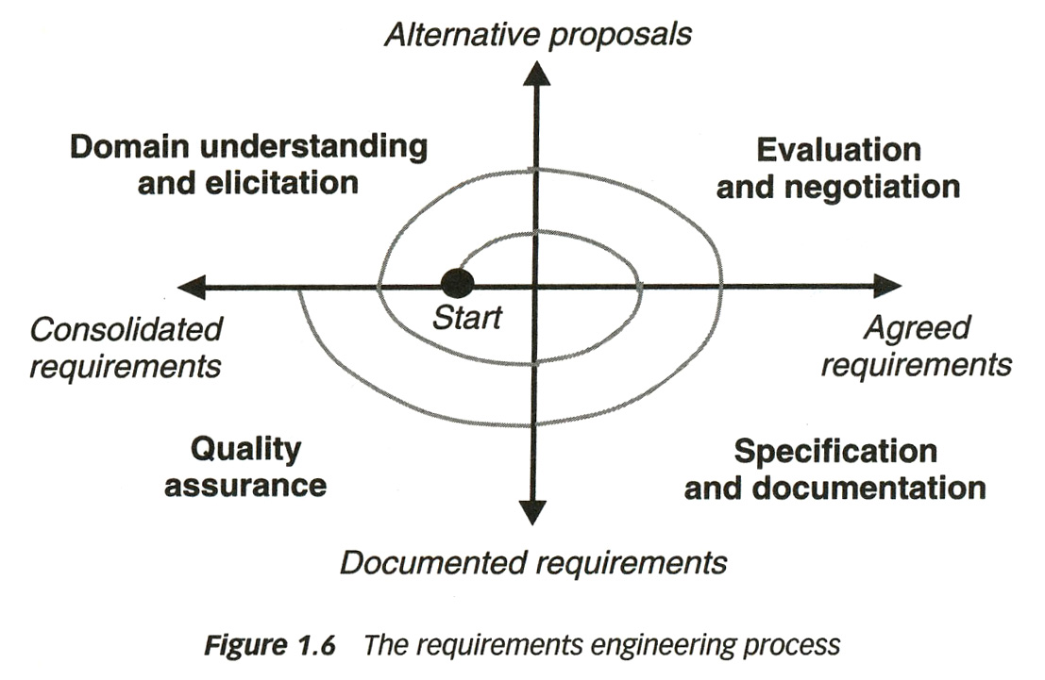
Tasks Performed as Part of Elicitation (2)
Repeat as needed
Elicitation is incremental
  Driven by information obtained
  You always do a bit of elicitation – analysis – specification – verification at the same time

Slide 49
Planning for Elicitation
Elicitation Plan should include:
Objectives
Strategies and processes
Products of elicitation efforts
Schedule and resource estimates
Risks

Slide 50
Elicitation Plan – Objectives / Strategies & Processes
Objectives: Why this elicitation?
  Validate market data
  Explore usage scenarios
  Develop a set of requirements, etc..
Set elicitation strategies and processes
  Approaches used
  Often a combination of approaches depending on the types and number of stakeholders
  Examples: Surveys (questionnaires)‏, workshops, interviews…

Slide 51
Elicitation Plan – Products
Usually set of rough requirements
  Written, audio, video notes
  Documentation
Deliverables depend on objective and technique, e.g.
  Notes
  Goals
  List of use cases, scenarios
  A set of high-level requirements
  Detailed Software Requirements Specification (SRS)
  Analysis of survey results
  Performance attribute specification
  ...
Generally: un-organized, redundant, incomplete

Slide 52
Elicitation Plan – Estimates
Identify development and customer participants in various elicitation activities
Estimate of effort for elicitation
Scheduling of resources

Slide 53
Elicitation Plan – Risks
Factors that could impede completion of elicitation activities
  e.g., hostile stakeholders
Severity of each risk
Likelihood of occurrence for each risk
Mitigation strategy for each risk

Slide 54
Examine Project Viability
Does-it make good business sense ?
  It's very difficult to cancel a project once started
Based on:
  Product's purpose
  Business advantage
  Costs vs. benefits
  Feasibility
  Scope
  Required resources
  Requirements constraints
  Risks

Slide 55
Project Viability – Purpose & Business Advantage
Purpose
  What is the product? What does the product do?
  Highest-level customer requirement
  Business need
  All other requirements must contribute in some way to the purpose
Business advantage
  Why build the product?
  The purpose of the product should be not only to solve the problem, but also to provide a business advantage
  How will the product help the work?
  A problem can be expressed as a difficulty that customers or users are facing or as an opportunity to produce some benefit, e.g., increased productivity or sales
  Solving the problem leads to software development (or purchase)

Slide 56
Project Viability – Cost vs. Benefits
Cost vs. benefits
How much will the product help our work?
How much will it cost to develop and operate the product?
Are the expected benefits greater than the anticipated costs?
  Demonstrate! If not, stop the project!

Slide 57
Project Viability – Feasibility
Feasibility
One reason for describing measurable requirements as soon as possible is to answer questions about feasibility
Technical feasibility
  Does the organization have the skills needed to build and operate the product?
  If not, stop the project
Economic feasibility
  Does the organization have the resources (time, money, staff) to construct the product?
  If not, stop the project

Slide 58
Project Viability – Scope (1)
Scope: product's purpose and the system's boundaries
  How much of the work will be done by the system-to-be-developed?
  How much of the work will be done by interacting systems?
Information needed for cost and time estimates
Define more precisely the problem to solve
  List all the things the system should have to do
  Exclude as much as possible to reduce the complexity of the problem
  Establish broader goals if the problem is too simple
  Example: an automated system for university registration
Initial list of wide problems
Reduced scope
For other systems
Course Browser
Room Allocation
Course Browser
Room Allocation
Registration
Registration
Exam Schedule
Exam Schedule
Payment
Payment
Later stage

Slide 59
Project Viability – Scope (2)
The product vision for the kind of product it should be - may affect multiple projects
  Point of view of customer, business
  Evolves relatively slowly
The scope for a single project, defining and communicating clear limits on what to implement
  Important for the Project Manager
  More dynamic vision
  Can be found in a requirements document
The requirements provide an understanding of what is needed to meet business objectives
  Many changes!

Slide 60
Project Viability – Required Resources
Required resources
  What are the required resources, i.e., money, time, and personnel?
  How do they compare with available money, time, and personnel?
If the latter are smaller than the former, we should not even start the project

Slide 61
Project Viability – Constraints
Requirements Constraints: Are there constraints that will restrict the system's requirements or how these requirements are elicited?
  Solution constraints:
    Mandated designs
    Mandated interacting systems
    Mandated COTS (commercial off-the-shelf) components
  Time constraints
  Budget constraints
Warning! Fight to not impose constraints on the process, platform, or language unnecessarily or prematurely!

Slide 62
Project Viability – Risks
Project Risks
Are there any high-probability or high-impact risks that would make the project infeasible?
For example:
  Lack of clear purpose
  Fragile agreement or disagreement on goals / requirements
  Unmeasureable requirements,
  Unstable requirements (rapidly or constantly changing)
  …

Slide 63
Understand Problem
Understand problem from each stakeholder's point of view (only the last few skills do not require social interaction!)
  Observe current system
  Interviews
  Apprenticeship
  Brainstorming
  Facilitation
  Make people open up to you
  Manage expectations
  Review documentation
  Questionnaires
  Identification of context
  Detection of ambiguities and noise

Slide 64
Extract Essence
Extract essence of stakeholders' requirements
Interpret stakeholders' descriptions of requirements
Possibly build models (may be part of your documentation!)
Gaps in the model behavior may indicate unknown or ambiguous situations
  Models help focus our efforts
  Should be resolved by asking the stakeholders (especially users)

Slide 65
Invent Better Ways
Invent better ways to do the user's work
Ask why documented requirements so far are desired
The client/user’s view can be limited by past experiences...
Consider whether the system should give the user more control over its transactions
Brainstorm to invent requirements the stakeholders have not yet thought of

Slide 66
Purpose of Vision and Scope Document
The Vision and Scope Document is an intermediate document during the elicitation process.
The idea is to do just enough investigation to form a justifiable and rational opinion of overall feasibility and the potential of the new system, and decide whether it is worth investing in further development¹
[1] C. Larman

Slide 67
Elicitation Problems

Slide 68
Elicitation Problems
According to Dean Leffingwell and Don Widrig:
The “Yes, But” syndrome stems from human nature and the users inability to experience the software as they might a physical device
“Undiscovered Ruins”: the more you find, the more you realize still remains
The “User and Developer” syndrome reflects the profound differences between the two, making communication difficult
“The sins of your predecessors” syndrome where marketing (user) and developers do not trust each other based on previous interactions, so marketing wants everything and developers commit to nothing

Slide 69
Elicitation Problems – “Yes, But”
When first time users see the system, the first reaction is either, “wow this is so cool” or “Yes, but, hmmmmm, now that I see it, what about this…? Wouldn’t it be nice…?”
Users’ reaction is simply human nature
Need to employ techniques that get the “yes, buts” out early
Anticipate that there will be “yes, buts” and add time and resources to plan for feedback
Tends to be user interface centric, tends to be the touch points of the system for the users

Slide 70
Elicitation Problems – “Undiscovered Ruins”
Teams struggle with determining when they are done with requirements elicitation
  Are we done when all the requirements are elicited or have we found at least enough?
  Like asking an archaeologist “how many undiscovered ruins are there?”
First scope the requirements elicitation effort by defining the problem or problems that are to be solved with the system
Employ techniques that help find some of those ruins and have the stakeholders buy-into the requirements

Slide 71
Elicitation Problems – “User and Developer”
Characteristic
Users do not know what they want, or they know what they want but cannot articulate it
Users think they know what they want until developers give them what they said they wanted
Analysts think they understand user problems better than users do
Everybody believes everybody else is politically motivated
Response
Recognize and appreciate the user as domain experts; try different techniques
Provide alternative elicitation techniques earlier; storyboard, role playing, prototypes…
Put the analyst in the users place; try role playing for an hour or a day
Yes, its part of human nature, so lets get on with the program

Slide 72
Elicitation Problems – “Living with the Sins…”
Like it or not, your users (marketing) and developers remember what happened in the past
  Quality programs that promised things would be different
  The last project where requirements were vague and/or were delivered short of expectations
  The team “unilaterally” cut important features out of the last release
Need to build trust, slowly
Do not over-commit to features, schedule, or budget
Build success by delivering highest priority features early in the process
Notes:
Dilbert – “Work is very rewarding”

Slide 73
Elicitation Problems – Other Factors (1)
Social and organizational factors
"No system is an island unto itself"
  All software systems exist and are used within a particular context (technical AND social)
  Social and organizational factors often dominate the system requirements
  Determining what these are can be difficult and time-consuming
    Developers are (usually) outsiders
    People don't always tell the truth
    Awareness of one's own "culture" can be hard

Slide 74
Elicitation Problems – Other Factors (2)
These factors tend to cut across all aspects of the system:
e.g., a system that allows senior managers to access information directly without going through middle managers
  Interface must be simple enough for senior managers to be able to use
  Middle managers may feel threatened or encroached upon, be resistant to new system
  Lower-level users may concentrate on activities that impress senior managers, which is not necessarily what they ought to be doing
  Users may not like "random spot checks"; may devise ways of hiding what they're doing

