Slide 1
Goal Modeling
KAOS
Adapted from J, Mylopoulos, the Tacos Project (Paris), and “A KAOS Tutorial”

Slide 2
Goal-Directed Requirements
Acquisition (KAOS)
(Organizational) goals lead to requirements.
Goals justify and explain requirements which are not necessarily comprehensible by stakeholders.
Goals can be used to assign responsibilities to agents so that prescribed constraints can be met.
Goals provide basic information for detecting and resolving conflicts that arise from multiple viewpoints

Slide 3
The KAOS Modeling Philosophy
Modeling a social setting involves a variety of concepts, including Goals, Agents, Concerned Objects, Actions, Constraints and Responsibilities.
Goals lead to assignments of responsibilities and designs of actions and artifacts
Use a metamodel to support reuse of generic domain modeling patterns [Dardenne93]
For example, the library domain is an instance of the “resource allocation” meta-domain, which also covers car/room/dwelling rental and is similar to airline/hotel reservation, class registration etc.

Slide 4
The KAOS Acquisition Process
Identify Goals, and their Concerned Objects.
Identify potential Agents and their Capabilities.
Operationalize Goals into Constraints.
Refine Objects and Actions.
Derive strengthened Objects and Actions to Ensure
Constraints.
Identify alternative Responsibilities.
Assign Actions to responsible Agents.
All this could be just as useful to someone doing
organizational design, rather than software development!

Slide 5
Four KAOS models :
Goal model
Responsability model
Operation model
Object model

Slide 6
Goal model
Goals are desired system properties that have been expressed by some stakeholders.
Stakeholder (wikipedia): third party who temporarily holds money or property; more recent meaning (widely used in management): person or organization that has a legitimate interest in a project or entity; the new use of the term arose together with and due to the spread of corporate social responsibility ideas…
interviews of domain experts and current & future users
analysis of existing systems
reading of available technical documents

Slide 7
Goal model
Each goal is either a root or is justified by at least another goal that explain WHY it is needed.
Each goal except a leave is refined as a collection of subgoals describing HOW it can be reached.
Identifying goals proceeds from either top-down, bottom-up and non-directional approaches: from intermediate goals are identified higher-level (business or strategical) goals and lower-level (system requirements) ones.

Slide 8
Goal model
Clear distinction between two low-level types of goals:
Requirements, to be achieved by a software agent,
Expectations, to be achieved by an agent which is part of the system environment.
Conflicts (and more generally obstacles that prevent goals to be achieved) must be identified as soon as possible.

Slide 9
Goal model
Domain properties:
Properties relevant to the application domain, used in refinements to prove that a refinement is complete. Ex: in order to satisfy a service request, an infrastructure to perform the service must be available.
There are two types of domain properties :
- domain hypotheses: domain object properties expected to hold ; ex: the elevator system has at least one cage to carry passengers,
- domain invariants: properties known to hold in every state of some domain object, e.g. a physical law, regulation or a constraint enforced by some environmental agent ; eg : for light buttons, we could state that « the light is either on or off ».
Infrastructure available

Slide 10
Goal model
Requirements can be gathered by means of open interviews. A more efficient way is to conduct less open interviews be reusing requirements patterns.
One of the long-term benefits of investing in KAOS technology consists in progressively modelling generic patterns of requirements.
Completeness of the goal model is ensured be reviewing the different diagrams during validation sessions with stakeholders.

Slide 11
Responsibility model
Information system: software system to be and the part of the environment with which it interacts.
Agent: humain being or automated component that are responsible for achieving requirements and expectations.
  We may stop refining goals into subgoals when they are placed (as requirements) under the responsibility of a single agent.
Assignment is used to link expectations to related agents (several agents may be assigned to an expectation).

Slide 12
Goal & Responsibility model
Graphical Conventions
Goal
(blue)
(yellow)
goal refinement
Requirement
(blue)
goals conflict
Expectation
(yellow)
(red)
responsibility
Agent
(pink)
assignment
Domain property

Slide 13
Goal model
Completeness criterion 1: a goal model is said to be complete with respect to the refinement relationship ‘if and only if’ every leaf goal is either an expectation, a domain property or a requirement.
Completeness criterion 2: a goal model is complete with respect to the responsability relationship ‘if and only if’ every requirement is placed under the responsability of one and only one agent (either explicitly or implicitly).

Slide 14
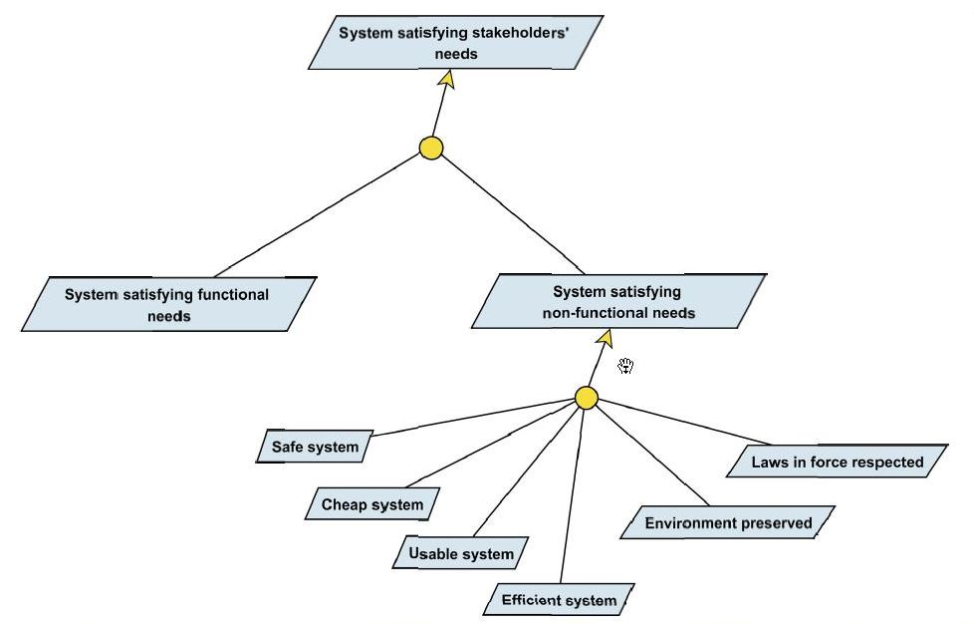
Beginning the Elevator case study…
Goal model
…with this generic goal pattern
(case driven decomposition)…

Slide 15
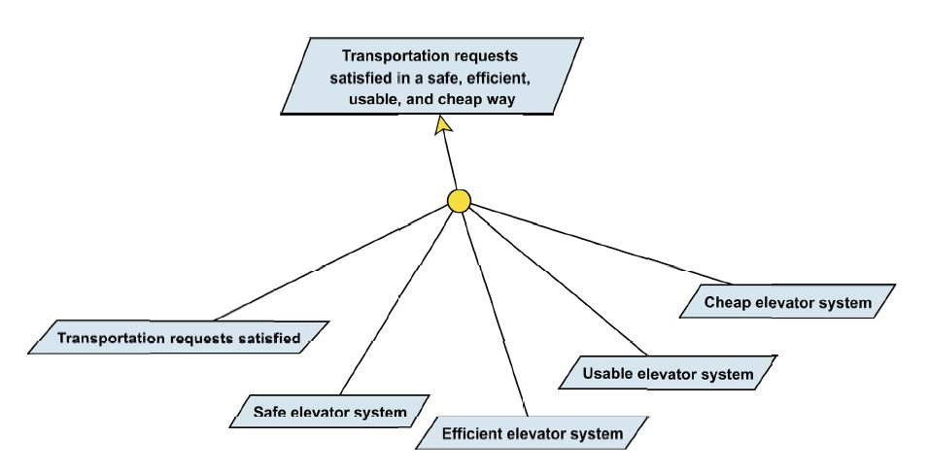
...applied to the elevator problem:
Goal model

Slide 16
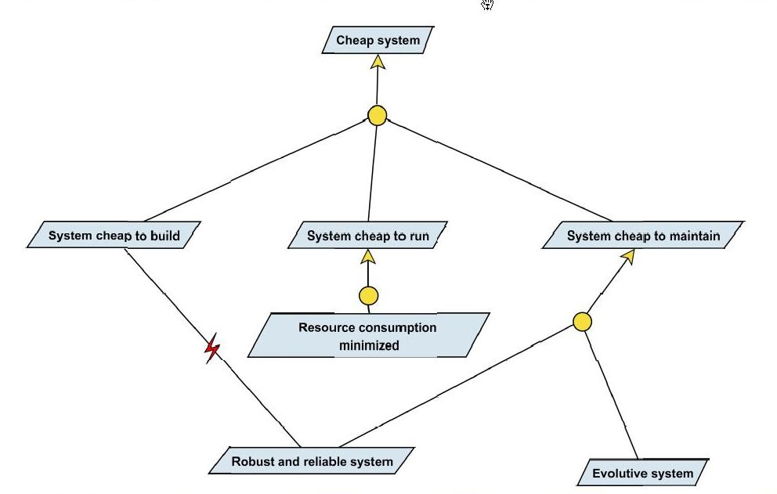
Another generic goal pattern
(milestone driven decomposition)
Goal model
Also appears in following schemes

Slide 17
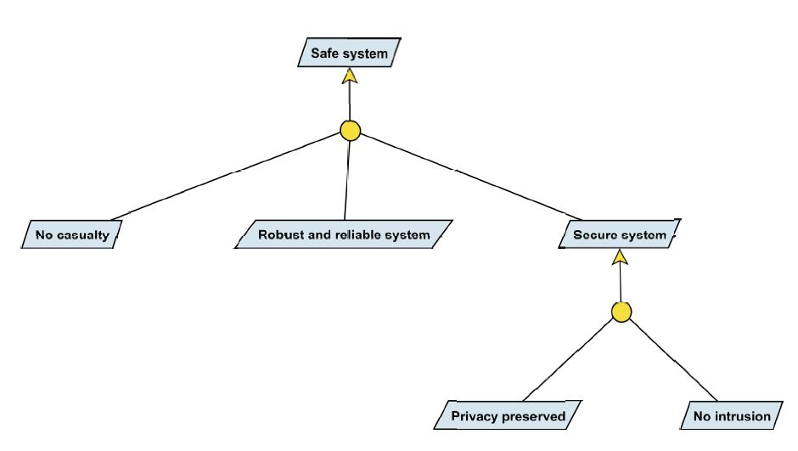
Generic goal « Safe system »
Goal model

Slide 18
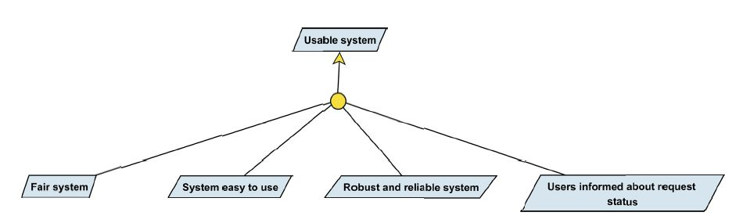
Generic goal « Usable system »
Goal model

Slide 19
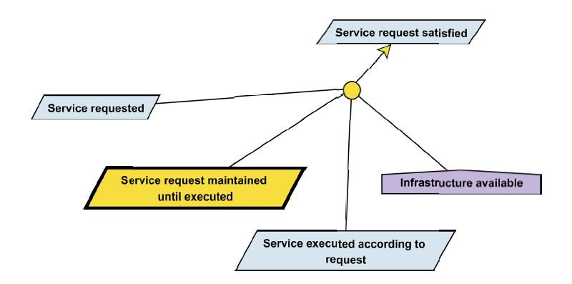
Goal model
Generic goal « Service request satisfied »…

Slide 20
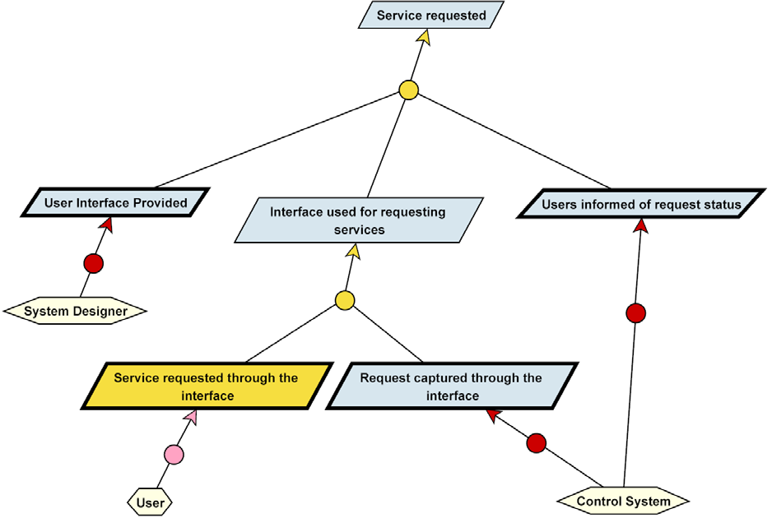
Generic pattern for the « Elevator called » goal
Goal model
(milestone driven decomposition)

Slide 21
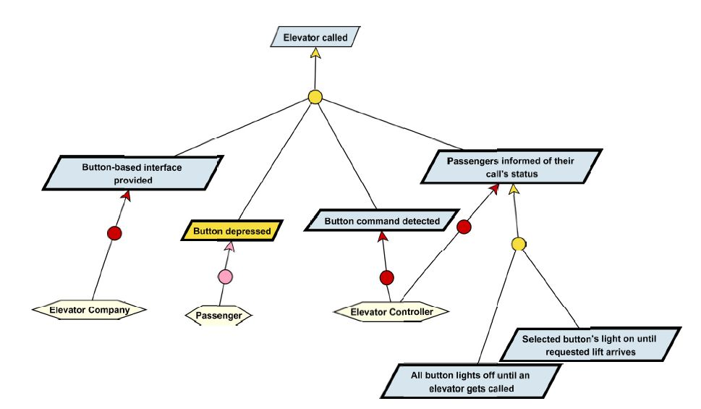
« Elevator called » goal
Goal model

Slide 22
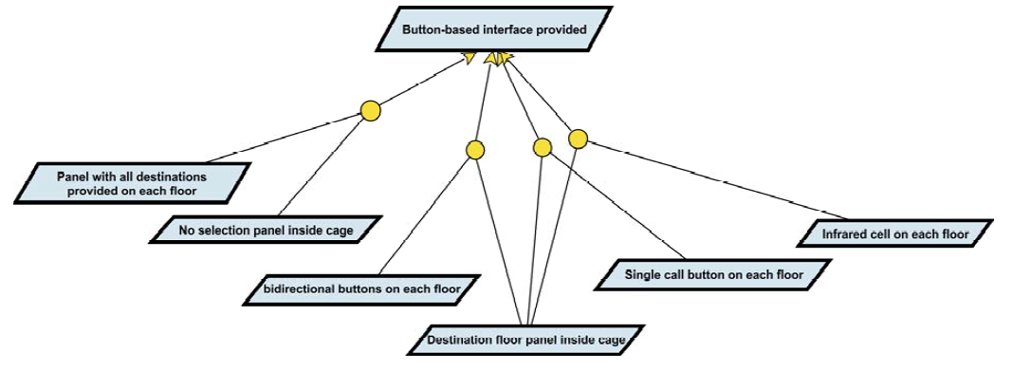
Goal model
How to deal with Alternatives:

Slide 23
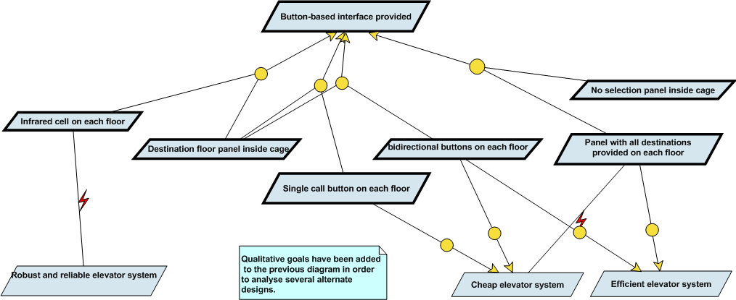
Goal model
Qualitative comparaison:
links to parent goals to which each requirement contributes
creating a conflit if it contributes negatively
The design having a bidirectional button panel on each floor seems to be the best compromise.

Slide 24
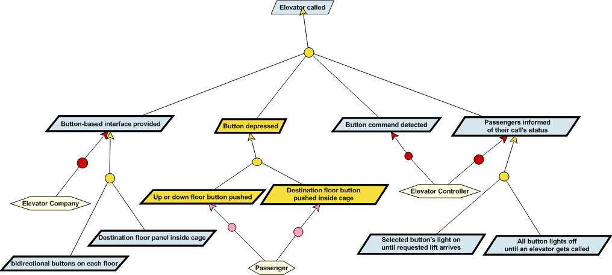
Goal model
Based on the bidirectional button panel design, we can now refine the goal « Button depressed »:

Slide 25
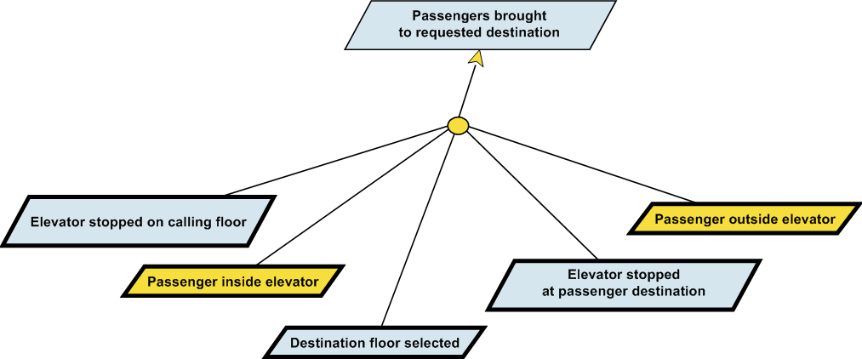
Goal model
Let’s now refine the goal « Passengers brought to requested destination », applying the milestone tactics:

Slide 26
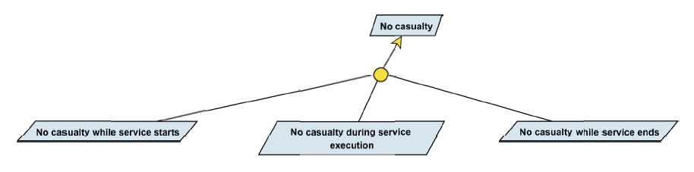
Goal model
To refine the goal « No casualty », we use a generic pattern that also use a milestone-driven refinement tactic:
Generic goal « No casualty »
The following figure shows how this pattern has been used, and how the « No intrusion » goal has been decomposed.

Slide 27
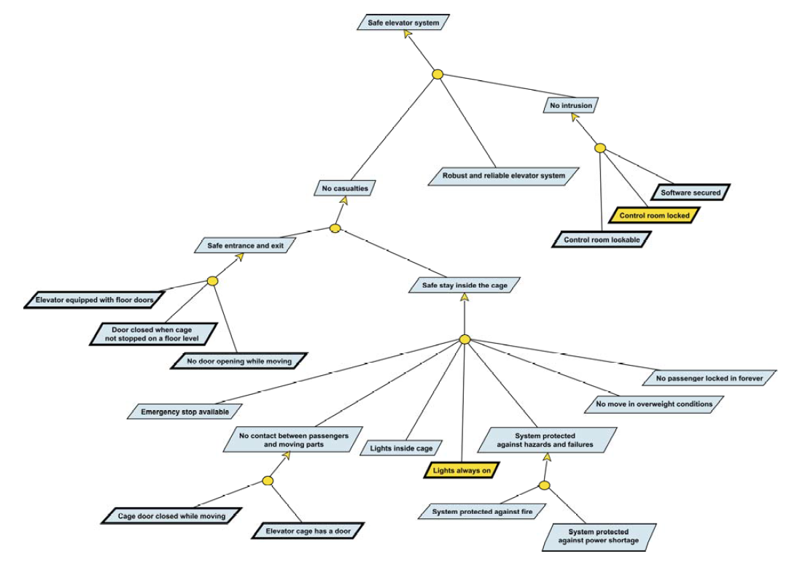
Leaf goals are refined later:
“Emergency stop available”.
“System protected against fire”.
“System protected against power failure”
“No move in overweight conditions”.

Slide 28
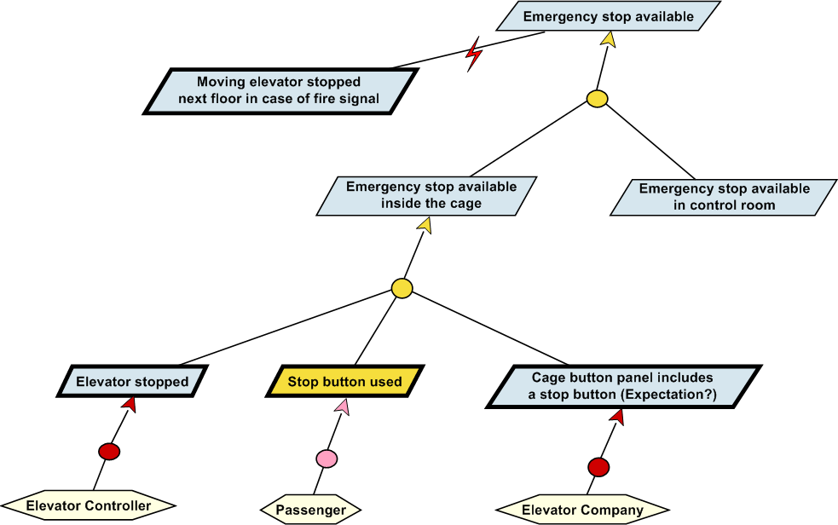
Goal model

Slide 29
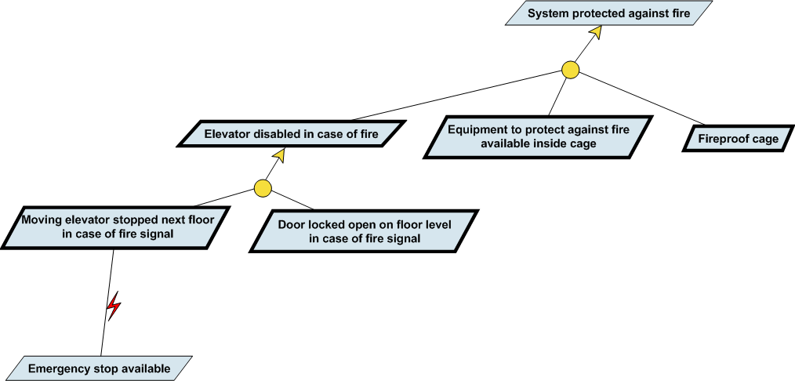
Goal model

Slide 30
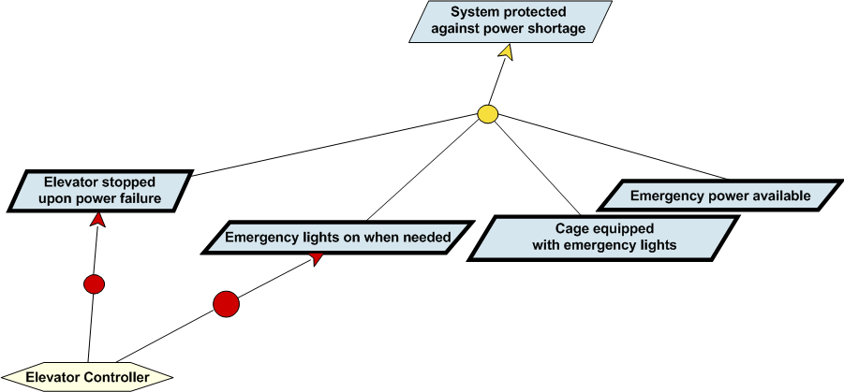
Goal model

Slide 31
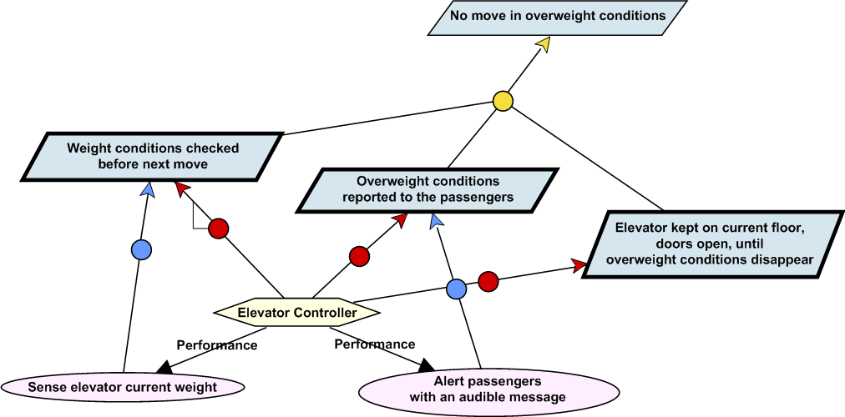
Goal model

Slide 32
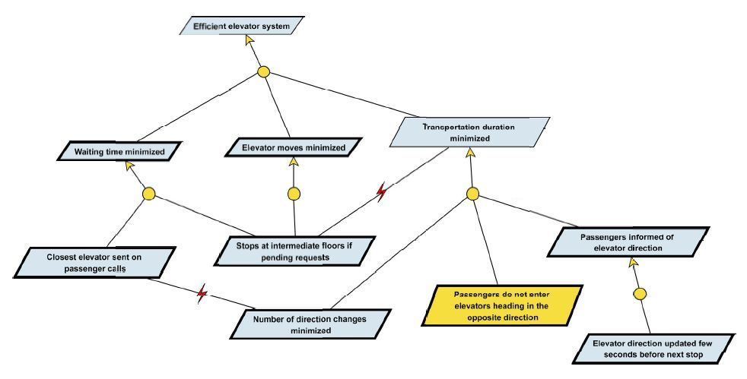
Goal model
First shot of what an efficient elevator system should be:

Slide 33
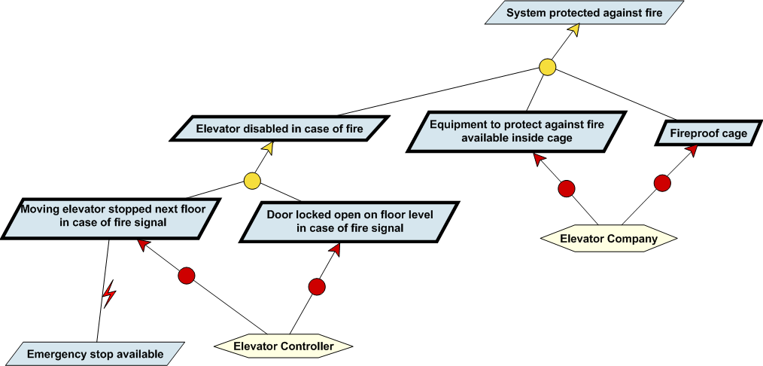
Responsibility model
« System protected against fire » with responsibilities:

Slide 34
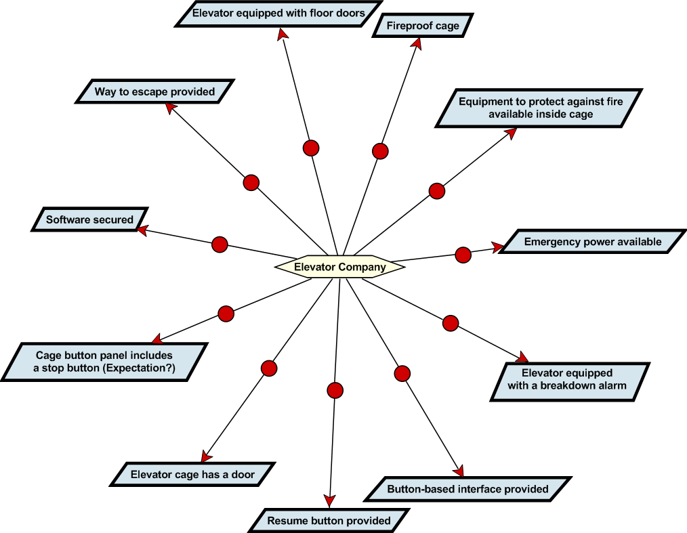
After all requirements are assigned to a responsible agent, a diagram is generated for each agent.

Slide 35
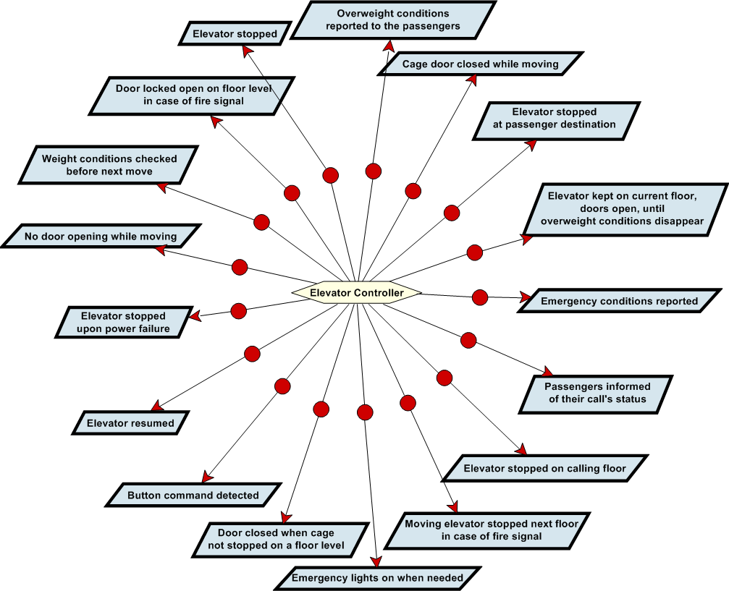

Slide 36
Object model
The Object model is used to define and document the concepts of the application domain that are relevant with respect to the known requirements and to provide static constraints on the operational system that will satisfy the requirements.
Part of the Object model are objects pertaining to the stakeholder’s domain and other objects for expressing requirements or constraints on the operational model.
There are three types of objects: entities, agents, relationships.

Slide 37
Object model
Entities: independant (needn’t refer to other objects) and passive (can’t perform operations) objects; may have attributes whose values define a set of states the entity can transition to
Agents: independant and active objects; they can perform operations that usually imply state transitions on entities (ex: elevator company, passenger, elevator controler)
Associations: dependant and passive objects that may have attributes (ex: "At" that links a cage and a floor)

Slide 38
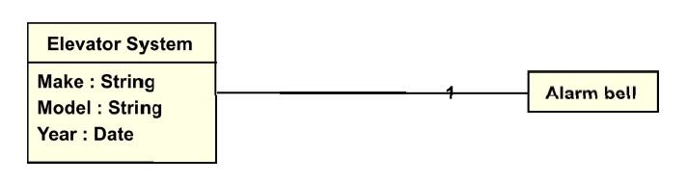
Object model
Ex: entity « Alarm bell » as a component of the « Elevator »:
Object identification is driven by the goal definition process. Most goals’s short and long definitions refer to domain objects being modelled and documented.
All modelled objects shall have their own entries in the glossary section of the requirements document. During review of the object model, stakeholders will formally agree on a common vocabulary.
Another way to identify new objects consists in looking at the requirements and discover the system components they are necessary for satisfying them.

Slide 39
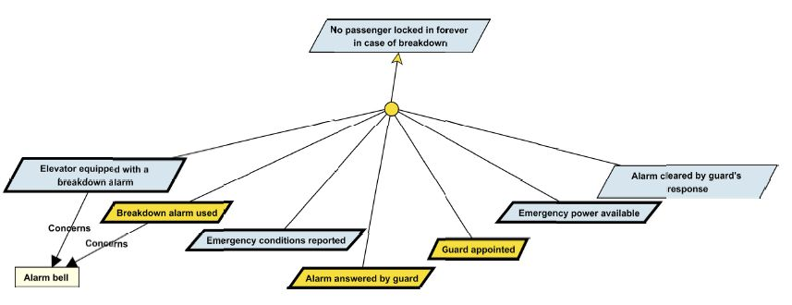
Object model
Objects may be represented in goal diagrams; the concerns relationship is used to link a requirement to the objects that are needed for it to be satisfied. Identifying those objects shall further restrict the space of solutions that can be proposed by the future system provider. Ex:

Slide 40
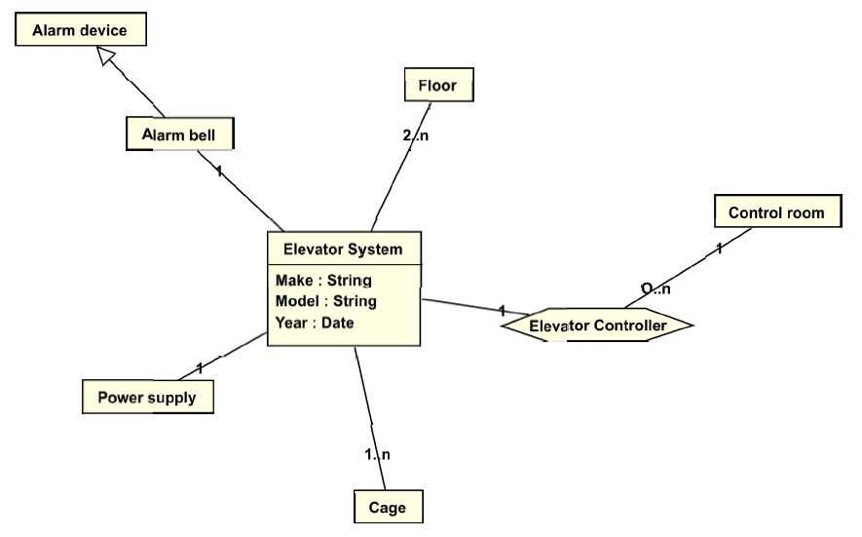
Object model
Object « Elevator system »:

Slide 41
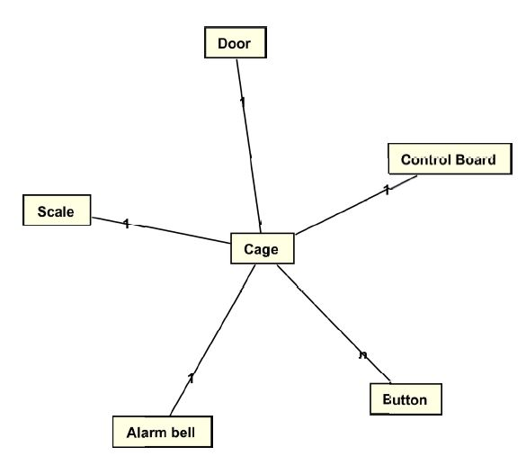
Object model
Object « Cage »:

Slide 42
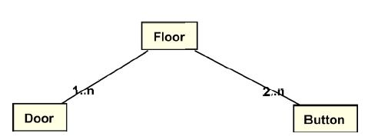
Object model
Object « Floor »:
The KAOS model is compliant with UML class diagrams in that KAOS entities correspond to UML classes; and KAOS associations correspond to UML binary association links or n-ary association classes. Inheritance is available to all types of objects (including associations).
Objects can be qualified with attributes.

Slide 43
Operation model
The Operation model describes all the behaviors that agents need to fulfill their requirements.
Behaviors are expressed in term of operations performed by agents.
Ex: press button, enter, exit (perform by passengers) ; open doors, close doors, move up, move down (perform by elevators).
Those operations work on objects: they can create objects, trigger object state transitions and activate other operations (by sending an event).
Operations are justified by the goal they operationalize: an operation without a goal means there’re missing goals, while a requirement without operations is just wishful thinking.

Slide 44
Operation model
Operations identification sources:
stakeholders, that typically describe processes rather than goals during interviews; the analyst then asks specific questions in order to identify the reasons behing the existing processes and hence unveil the goals that justify these processes;
existing requirements: operations explain how they have to be realized.

Slide 45
Operation model
Requirements can be operationalized by:
some object(s)
some agent behavior(s)
a combinaison of both
They are respectively requirements that describe static, dynamic, and both properties on the system:
the requirement « Elevator equiped with floor doors » will be operationalized by an object « Floor door »
requirements that describe dynamic system properties are operationalized by operations
the expectation « Stop button used » will be operationalized with an operation « Push button » and the « Button » entity

Slide 46
Operation model
In a process, operations are represented as ovals, concerned objects are connected to the operations by means of input and output links.
Events are represented as: . Events may be external or produced by operations (through an output link). They may start (cause) or stop operations.
An operation model (or process) typically composes operations performed by one or several agents to achieve a requirement.

Slide 47
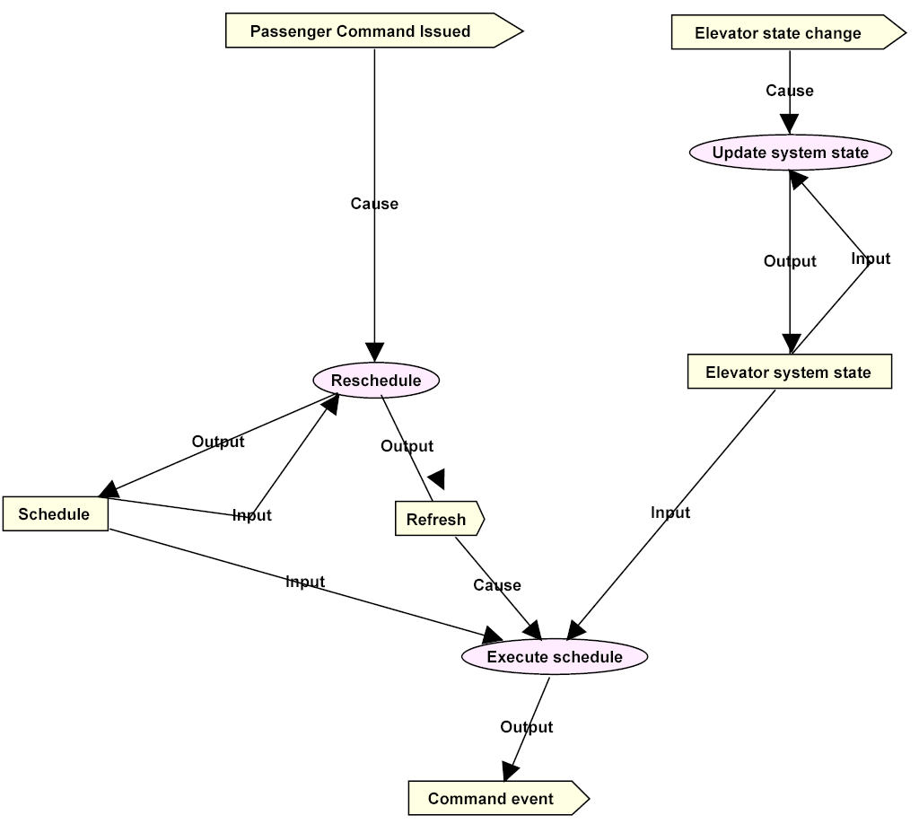
Operation model
Process
« Elevator control »

Slide 48
Operation model
Completeness criterion 3 : to be complete, a process diagram must specify
(i) the agents who perform the operations
(ii) the input and output data for each operation.
Completeness criterion 4 : to be complete, a process diagram must specify when operations are to be executed.
Completeness criterion 5 : all operations are to be justified by the existence of some requirements (through the use of operationalization links).

Slide 49
Operation model
Operations can be triggered explicitely by an event. If no event is specified, the operation will be triggered implicitly when all the data needed in input are available (data flow).
Requirements left unoperationalized are called « open requirements »; solution providers have the complete freedom to address the requirement as they want. The less open requirements are left in the model, the more precise the requirements document will be by eliminating possible implementations.

Slide 50
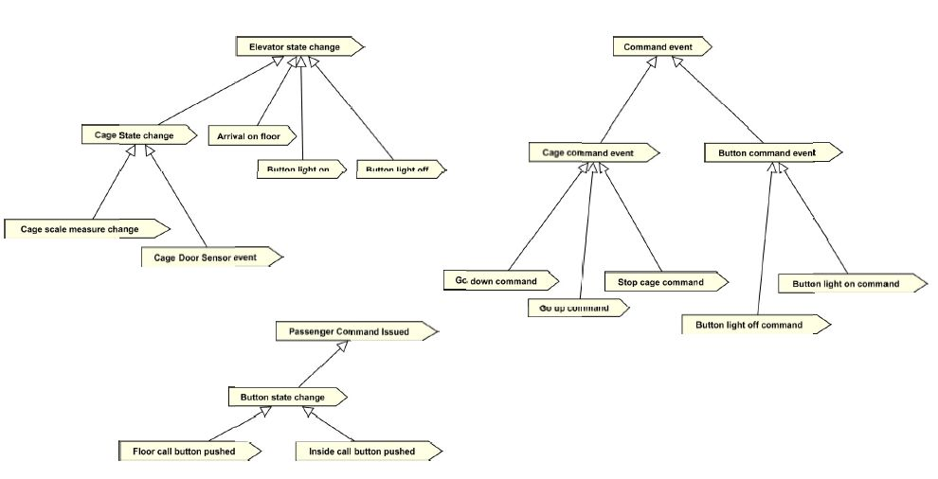
Operation model
Partial classification of the events of the process:

Slide 51
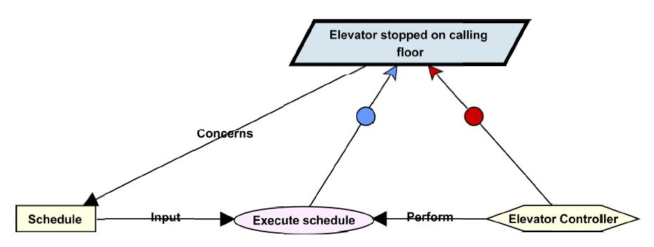
Operation model
Typical instance of a process pattern KAOS analysts have to reproduce in all projects:
(operationalizes)
(is responsible for)
A requirement is said to be "closed" when this trian-gular relationship Responsability-Operationalization- Performance has been established.

Slide 52
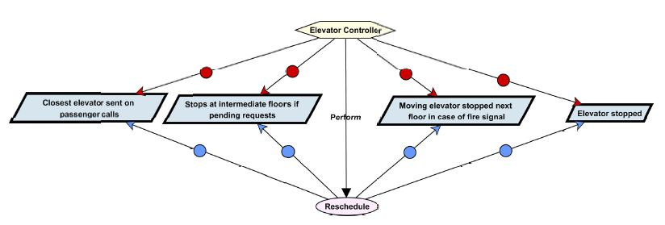
Operation model
Operationalization diagram for the Reschedule operation:

Slide 53
Obstacles
Dealing with obstacles.
Obstacles are situations in which a goal, a requirement or an expectation is violated. The obstacle is said to "obstruct" the goal, requirement or expectation.
Dealing with obstacles is very important for safety-critical systems: it allows analysts to identify and address circumstances at requirements engineering time (instead of at programming or running time) in order to produce for instance robust requirements or new requirements to avoid or reduce impacts of obstacles. The result will be a more reliable software.

Slide 54
Obstacles
Obstacle analysis with KAOS is a goal-oriented activity. It begins with exploring the goal model and with negating each goal in turn.
As a goal G is refined into goals G1, …, Gn if and only if G1, …, Gn all together imply G, we know that if goal G is violated, it is because at least one of its subgoals is violated.
Each leaf obstacle is then reviewed with domain experts to study whether it is worth considering it in the obstacle analysis. It allows the analyst to prune the obstacle space and to focus on the most relevant obstacles.

Slide 55
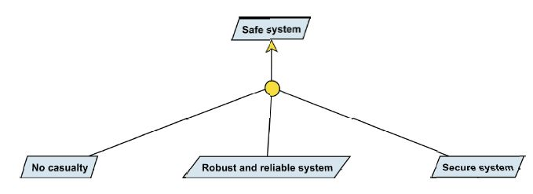
Obstacles
Application to:
casuality occurs during system use
some system component breaks down
somebody succeeds in hacking into the system.

Slide 56
Obstacles
Other application:
casuality occurs at service start
casuality occurs during service
casuality occurs at service end.

Slide 57
Obstacles
Next, conditions for the obstacle to be raised are looked for. Typical ways used to identify obstacles start by considering component failures or people behaving in an unexpected way, maliciously or because of some people’s capability limitation (disable people, children, …).
Ex: an obstacle to the goal "Elevator direction updated few seconds before next stop" occurs when blind people want to use the elevator system as they can’t read the indications.
Obstacles are linked to the goals they obstruct (obstruction link). Obstacles are refined the same way as goals, but while goals are generally ‘AND-refined’, obstacles are most often ‘OR-refined’.

Slide 58
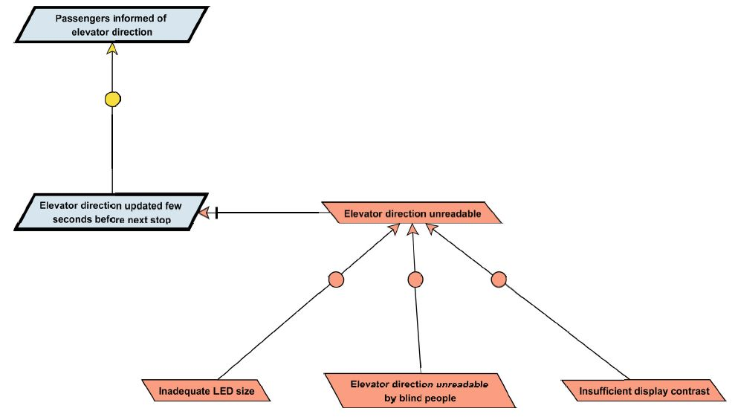
Obstacles
Obstacle to « Passengers informed of elevator direction »:
(Obstruct)
OR refinement

Slide 59
Obstacles
Having identified the conditions for it to occur, the analyst can fix the obstacle in several ways. A first way consists in defining new requirements that prevent the obstacle from occuring.
In the preceding example, one can add a new requirement: "Elevator direction announced by voice upon floor arrival".
New requirements are linked to the obstacle they resolve by a resolution link.
Other requirements for blind people could be "Floor level announced by voice upon floor arrival" and "Call buttons in Braille".

Slide 60
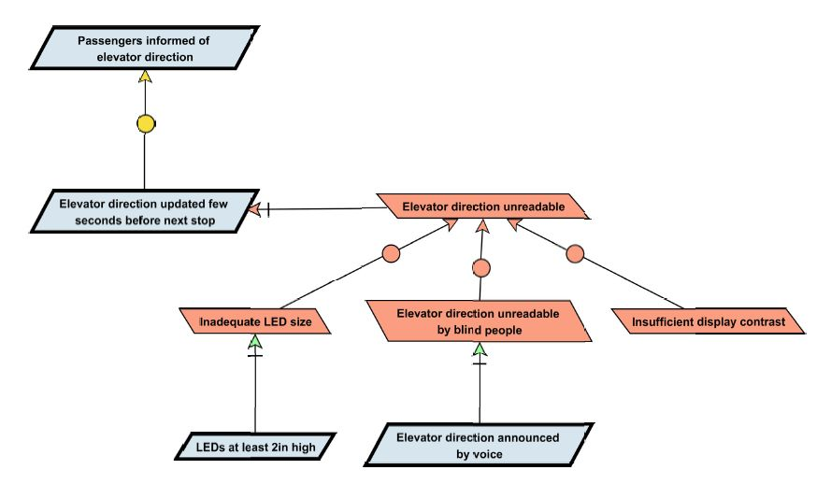
Obstacles
Obstacle resolution for « Passengers informed of elevator direction »:
(Resolve)

Slide 61
Obstacles
An important source of obstacles concerns system (and components) reliability and robustness. Reliability and robustness requirements aim at preventing failures to occur. One can for instance introduce requirements in terms of Mean Time Before Failure (MTBF), or in terms of a maintenance program to replace components systematically at the right time, and so on.
A second way to fix an obstacle is to restore the obstructed goal once the obstacle occurs. For instance, if an elevator failure puts the system out of order, a restoration requirement can prescribe the maximum delay within which the system must be repaired.

Slide 62
Obstacles
A third way to fix an obstacle consists in minimizing its effects.
  Suppose the building is equiped with two elevator cages, one serving floors 1 to 10, the other one floors 10 to 20. If one cage goes out of order, a requirement should prescribe that the system shall be self-reconfigured so that the other cage provides service to all floors (from 1 to 20).
It’s also possible to fix obstacles by modifying the KAOS model in different ways, for instance by substituting an agent with a more "capable" one, by weakening the obstructed goal so that the obstacle is no longer relevant or by substituting a goal to another one.

Slide 63
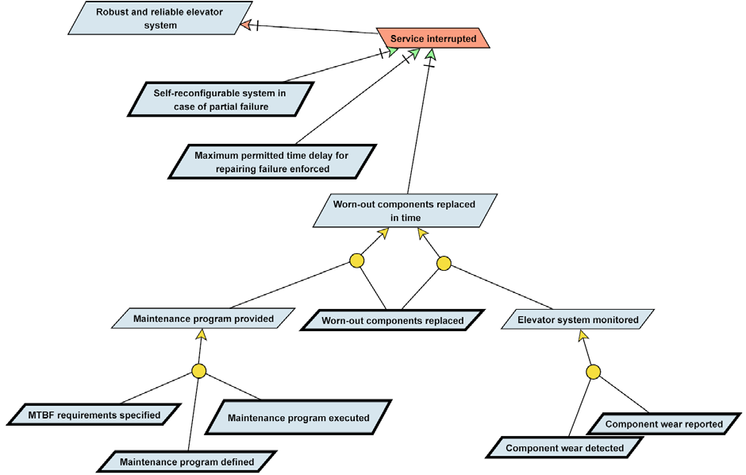
Obstacles
Possible refinement of the goal « Robust and reliable elevator system »:
Each branch can be opted for separately to satisfy the goal, but KAOS does not force exclusion

Slide 64
Conclusion
The structure of the requirements document generated from a KAOS model is borrowed from the IEEE 830-1998 standard for software requirements specification :
Table of contents
1. Introduction
1.1 Document purpose
1.2 System purpose
1.3 Definitions, acronyms, and abbreviations → glossary derived from
1.4 References the KAOS model
1.5 Overview
2. Overall description
2.1 System perspective
2.2 User requirements → a subsection for each goal diagram
2.3 User characteristics and a list of the requirements
2.4 Constraints
2.5 Assumptions and dependencies → assumptions & obstacles not
2.6 Apportioning of requirements dealed with

Slide 65
Conclusion
3. System requirements
3.1 System architecture → decomposition of the system by
KAOS agents (responsability model)
3.2 Object model → diagrams of the KAOS object model
3.3 Operation model → diagrams of the KAOS operation model
A major benefit of KAOS is that it provides a bidirectional traceability between the problem description and the expected solution description.
As systems require frequent changes, it is vital to keep the requirements document up to date with respect to the current state of development.
Requirements documents with KAOS tend to be more complete. Completness must be understood by looking at the five completness criteria: a complete KAOS model leaves no space for wishful thinking (a goal not refined), requirements with no responsible, unjustified operations, and operations for which we ignore who will execute what and when.

Slide 66
Conclusion
Completeness of the goal model also relies on 3 points :
the quality of the requirements definition phase (interviewing stakeholders, if operated properly, leads to a good goal covering rate)
the validation meetings during which stakeholders review consolidated goal diagrams (conflicts are addressed, forgotten goals have a new chance to come up)
refinement techniques that guarantee completness and consistency (generic refinement patterns that require formal notations for safety-critical applications).

