Slide 1
Non-Functional Requirements
Based pn slides from Tor Stålhane, Steve Easterbrook, Nan Niu, John Mylopoulos, Lawrence Chung, and Brian Nixon

Slide 2
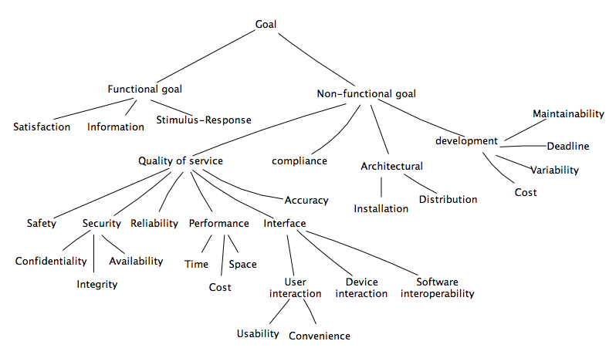
Concrete requirements from high level goals
Goal categorization:
Similar to requirements categorizations:

Slide 3
Non-functional requirements (NFR)
Non-functional requirements define the overall qualities or attributes of the resulting system
Non-functional requirements place restrictions on the product being developed, the development process, and specify external constraints that the product must meet.
Examples of NFR
  safety, security, usability, reliability and performance requirements.

Slide 4
Functional and Non-functional requirements
No clear distinction between functional and non-functional requirements.
Whether or not a requirement is expressed as a functional or a non-functional requirement may depend:
  on the level of detail to be included in the requirements document
  the degree of trust which exists between a system customer and a system developer.

Slide 5
Example
The system shall ensure that data is protected from unauthorised access.
  Conventionally, this would be considered as a non-functional requirement because it does not specify specific system functionality which must be provided. However, it could have been specified in slightly more detail as follows:
The system shall include a user authorisation procedure where users must identify themselves using a login name and password. Only users who are authorised in this way may access the system data.
  In this form, the requirement looks rather more like a functional requirement as it specifies a function (user login) which must be incorporated in the system.

Slide 6
Non-Functional Requirement - ISO 9126
ISO 9126 - non-functional requirements linked to “quality in use”.
Quality in use - users experience when using the system.
  Since the users’ experience is subjective, many of the quality factors will also be subjective.
Not an ideal situation, but a situation that we must live with.

Slide 7
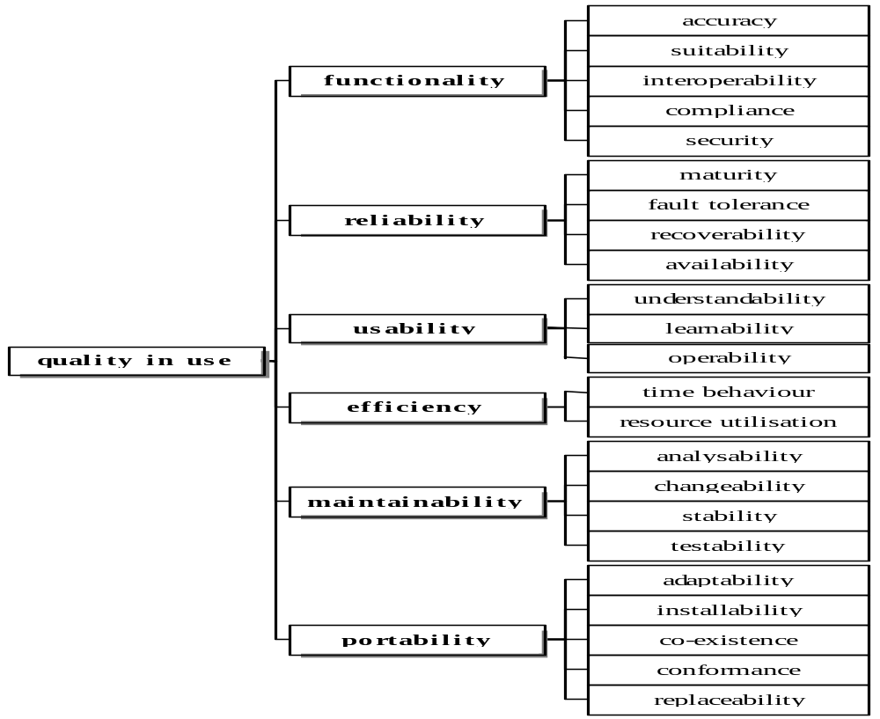
ISO 9126 Quality in use

Slide 8
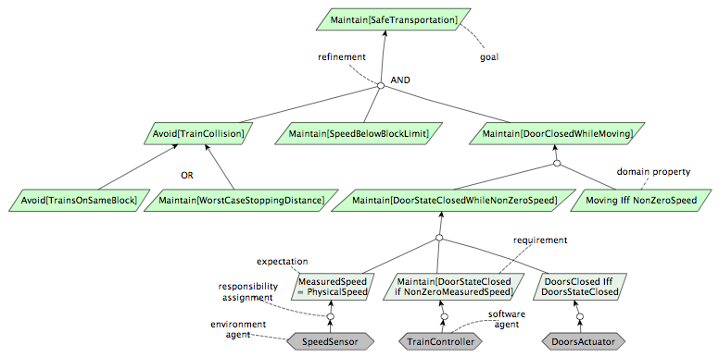
Concrete requirements from high level goals
Goal refinement tree:
Refinement links are two way links: One showing goal decomposition, other showing goal contribution

Slide 9
Software Qualities
➲ Think of an everyday object
 e.g. a chair
 How would you measure it’s “quality”?
➢ construction quality? (e.g. strength of the joints,…)
➢ aesthetic value? (e.g. elegance,…)
➢ fit for purpose? (e.g. comfortable,…)
➲ All quality measures are relative
 there is no absolute scale
 we can sometimes say A is better than B…
➢ … but it is usually hard to say how much better!
➲ For software:
 construction quality?
➢ software is not manufactured
 aesthetic value?
➢ but most of the software is invisible
➢ aesthetic value matters for the user interface, but is only a marginal concern
 fit for purpose?
➢ what’s the purpose? what’s fit?
10

Slide 10
Fitness
Source: Budgen, 1994, pp58-9
➲ Software quality is all about fitness to purpose
 does it do what is needed?
 does it do it in the way that its users need it to?
 does it do it reliably enough? fast enough? safely enough? securely enough?
 will it be affordable? will it be ready when its users need it?
 can it be changed as the needs change?
➲ Quality is not a measure of software in isolation
 it measures the relationship between software and its application domain
➢ cannot measure this until you place the software into its environment…
➢ …and the quality will be different in different environments!
 during design, we need to predict how well the software will fit its purpose
➢ we need good quality predictors (design analysis)
➢ Lulu’s work on Measuring Maintainability
 during requirements analysis, we need to understand how fitness-for-
purpose will be measured
➢ What is the intended purpose?
➢ What quality factors will matter to the stakeholders?
➢ How should those factors be operationalized?
11

Slide 11
Factors vs. Criteria
➲ Quality Factors
 These are customer-related concerns
➢ Examples: efficiency, integrity, reliability, correctness, survivability, usability,...
➲ Design Criteria
 These are technical (development-oriented) concerns such as anomaly
management, completeness, consistency, traceability, visibility,...
➲ Quality Factors and Design Criteria are related:
 Each factor depends on a number of associated criteria:
➢ E.g. correctness depends on completeness, consistency, traceability,...
➢ E.g. verifiability depends on modularity, self-descriptiveness and simplicity
 There are some standard mappings to help you…
➲ During Analysis:
 Identify the relative importance of each quality factor
➢ From the customer’s point of view!
 Identify the design criteria on which these factors depend
 Make the requirements measurable
12

Slide 12
Functionality – Factor
The capability of the software to provide functions which meet stated and implied needs when the software is used under specified conditions.

Slide 13
Functionality – Criteria
Suitability: Capability of the software to provide an appropriate set of functions for specified tasks and user objectives.
Accuracy: Capability of the software to provide the right or agreed.
Interoperability: Capability of the software to interact with one or more specified systems.
Compliance: Capability of the software to adhere to application related standards, conventions or regulations in laws and similar prescriptions.
Security: Capability of the software to prevent unintended access and resist deliberate attacks intended to gain unauthorised access to confidential information, or to make unauthorised modifications to information or to the program so as to provide the attacker with some advantage or so as to deny service to legitimate users.

Slide 14
Reliability – Factor
The capability of the software to maintain the level of performance of the system when used under specified conditions
Wear or aging does not occur in software.
Limitations in reliability are due to faults in requirements, design, and implementation.
Failures due to these faults depend on the way the software product is used and the program options selected rather than on elapsed time.

Slide 15
Reliability – Criteria
Maturity: Capability of the software to avoid failure as a result of faults in the software.
Fault tolerance: Capability of the software to maintain a specified level of performance in cases of software faults or of infringement of its specified interface.
Recoverability: Capability of the software to re-establish its level of performance and recover the data directly affected in the case of a failure.
Availability: Capability of the software to be in a state to perform a required function at a given point in time, under stated conditions of use.

Slide 16
Usability – Factor
Capability of the software to be understood, learned, used and liked by the user, when used under specified conditions.
Some aspects of functionality, reliability and efficiency will also affect usability, but for the purposes of this International Standard are not classified as usability.

Slide 17
Usability – Criteria
Understandability: Capability of the software product to enable the user to understand whether the software is suitable, and how it can be used for particular tasks and conditions of use.
Learnability: Capability of the software product to enable the user to learn its application
Operability: Capability of the software product to enable the user to operate and control it.
Likeability: Capability of the software product to be liked by the user.

Slide 18
Efficiency – Factor
The capability of the software to provide the required performance relative to the amount of resources used, under stated conditions
Resources may include other software products, hardware facilities, materials, (e.g. print paper, diskettes).

Slide 19
Efficiency – Criteria
Time behavior: Capability of the software to provide appropriate response and processing times and throughput rates when performing its function, under stated conditions.
Resource utilisation: Capability of the software to use appropriate resources in an appropriate time when the software performs its function under stated conditions.

Slide 20
Maintainability – Factor
The capability of the software to be modified.
Modifications may include corrections, improvements or adaptation of the software to changes in environment, and in requirements, and functional specifications.

Slide 21
Maintainability – Criteria
Changeability: Capability of the software product to enable a specified modification to be implemented.
Stability: Capability of the software to minimise unexpected effects from modifications of the software
Testability: Capability of the software product to enable modified software to be validated.

Slide 22
Portability – Factor
The capability of software to be transferred from one environment to another.
The environment may include organizational, hardware or software environment.

Slide 23
Portability – Criteria
Adaptability: Capability of the software to be modified for different specified environments without applying actions or means other than those provided for this purpose for the software considered.
Installability: Capability of the software to be installed in a specified environment.
Co-existence: Capability of the software to co-exist with other independent software in a common environment sharing common resources
Conformance: Capability of the software to adhere to standards or conventions relating to portability.
Replaceability: Capability of the software to be used in place of other specified software in the environment of that software.

Slide 24
Setting Requirements – 1
Can set non-functional requirements in at least three ways – to
The way the system behaves – user level
The way the product is developed – process level
The way the software is – product or metrics level

Slide 25
Setting Requirements – 2
If we will state requirements that are testable, we at least need to go to the criteria level.
In order to demonstrate how this can be done we will look at two important factors – maintainability and reliability.
What follows is only an example. There are several other ways to set reliability and maintainability requirements.

Slide 26
Setting Requirements – 3
The method used in the example is based on T. Gilb’s ideas of MbO – Management by Objectives.
We start with the requirement – e.g. the system shall be easy to maintain.
We then follow up with “what do you mean by…” until we reach something that is observable and thus testable.

Slide 27
Setting Requirements – 4
When we use MbO or other related techniques for setting requirements we will in most cases have a situation where:
The user will have to participate in the tests in one way or another.
There will be a strong link between requirement and test. In many cases the requirement will be the test.

Slide 28
The MbO – Customer View
Requirement: “The system shall be easy to maintain”
What do you mean by “easy to maintain”
No error identification and correction shall need more than two person-days.
Note – other changes are not mentioned.
For the customer, these requirements are OK.

Slide 29
The MbO – Developer View
Next step - ask the developers how they will achieve this requirement.
  For maintainability this can be requirements on
  Maximum class size
  Coupling and cohesion
  Self-documenting names for all entities
  Etc.

Slide 30
Maintainability Requirements - 1
Changeability:
No error shall need more than one person-days to identify and fix
Stability:
Not more than 10% of the corrections shall have side-effects
Testability:
The correction shall need no more than one person-day of testing. This includes all necessary regression testing

Slide 31
Reliability Requirements
Maturity:
MTTF = TTT / n. MTTF > 500 hrs.
Fault tolerance:
Under no circumstances shall the system crash.
Recoverability:
In case of an error, the time needed to get the system up and running again shall not exceed one hour (MTTR).
Availability:
MTTF /(MTTF + MTTR) > 0.998

Slide 32
Reliability Tests – 1
MTTF = TTT / n. MTTF > 500 hrs. Use 10 PCs. Test for two weeks => TTT = 800. Not more than one error.
Under no circumstances shall the system crash. Generate random input sets. No check for result is necessary – only crash / no crash,
In case of an error, the time needed to get the system up and running again shall not exceed one hour (MTTR).

Slide 33
Reliability Tests – 2
We need to consider three data:
The total testing time – TTT.
  For how long have we tested the system?
The usage frequency – UF.
  How often is the system used at the users’ site?
Number of users each time the system is used
We need to distinguish between test time – TTT – and usage time.

Slide 34
Reliability Tests – 3
Simple Example:
Have TTT = 400 hrs.
The system will be used one hour once a week
  e.g. for accounting purposes – at 10 sites.
We then have 10 hrs. of use per week.
  Under the assumption that all 10 sites use the system the way it is tested, our test is equivalent to 40 weeks of real use.

Slide 35
More Non-functional Requirements
Relatively simple to make requirement and tests for reliability, maintainability and other “objective” non-functional factors.
Subjective factors (e.g. usability) are more difficult.
  Will use usability as an example to show the couplings between

Slide 36
Usability requirements – 1
Understandability: The capability of the software product to enable the user to understand whether the software is suitable, and how it can be used for particular tasks and conditions of use.
Learnability: The capability of the software product to enable the user to learn its application
Operability: The capability of the software product to enable the user to operate and control it.
Likeability: The capability of the software product to be liked by the user.

Slide 37
Usability Requirements – 2
All the usability criteria are subjective.
As a result, tests will also have a strong component of subjectivism.
Understand
  Whether the software is suitable for a particular task
  How it can be used for particular tasks
  Under which conditions it can be used
Learn its application
Operate and control it (the software)
Is the software product liked by the user?

Slide 38
Requirements – First Step
First step - apply the MbO for each criteria.
Look at two of the requirements:
  Learn its application
  What does it mean to “learn application”
  Is the software product liked by the user
  What do you mean by “liked”?

Slide 39
Requirements – Second Step
Learn application:
  Can use the system after a one week course.
  Use the system for two weeks and then solve a set of standardized problems.
Like application:
  Score high on a likeability scale – e.g. 90 % score 7 or higher on a scale from 1 to 10 – after a one week course and two weeks of real use.

Slide 40
Requirements – to Remember
The test says much more about the requirement than the requirement itself does.
We need to
  Develop a course, a set of standardized problems and a likeability questionnaire.
  Include the customer’s participation in the test into the contract. Who will pay for this?

