Slide 1
How to Make a Domain Model
Tutorial

Slide 2
Basic Characteristics of Object Oriented Systems
Classes and Objects
Methods and Messages
Encapsulation and Information Hiding
Inheritance
Polymorphism and Dynamic Binding
Slide <number>

Slide 3
Classes and Objects
Class – Template to define specific instances or objects
Object – Instantiation of a class
Attributes – Describes the object
Behaviors – specify what object can do
Slide <number>

Slide 4
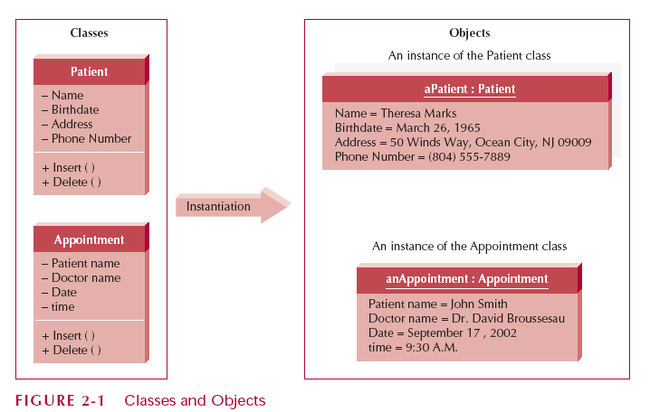
Classes and Objects
Slide <number>

Slide 5
Methods and Messages
Methods implement an object’s behavior
  Analogous to a function or procedure
Messages are sent to trigger methods
  Procedure call from one object to the next
Slide <number>

Slide 6
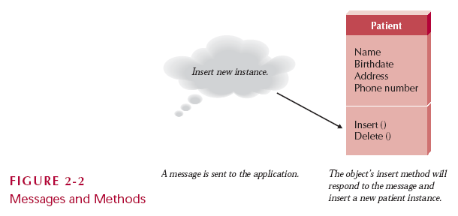
Messages and Methods
Slide <number>

Slide 7
Encapsulation and Information Hiding
Encapsulation
  combination of data and process into an entity
Information Hiding
  Only the information required to use a software module is published to the user
Reusability Key
  Use an object by calling methods
Slide <number>

Slide 8
Inheritance
Superclasses or general classes are at the top of a hierarchy of classes
Subclasses or specific classes are at the bottom
Subclasses inherit attributes and methods from classes higher in the hierarchy
Slide <number>

Slide 9
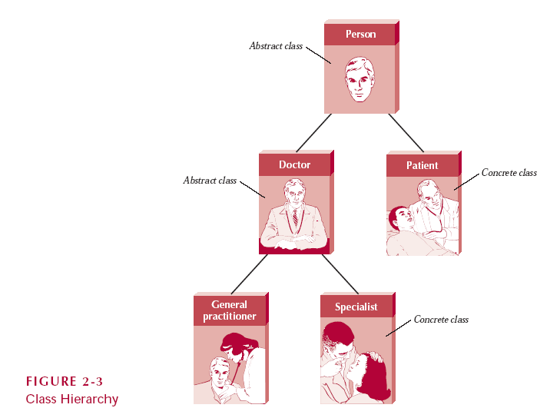
Class Hierarchy
Slide <number>

Slide 10
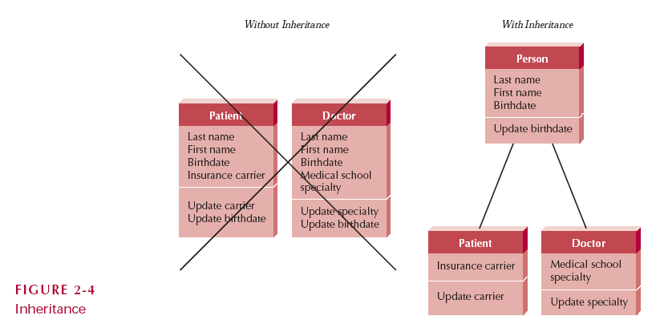
Inheritance
Slide <number>

Slide 11
Polymorphism and Dynamic Binding
Polymorphism
  A message can be interpreted differently by different classes of objects
Dynamic Binding
  Sometimes called late binding
  Delays typing or choosing a method for an object until run-time
Static Binding
  Type of object determined at compile time
Slide <number>

Slide 12
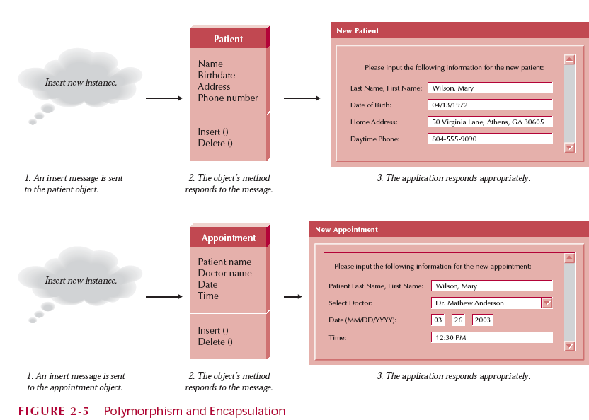
Polymorphish & Encapsulation
Slide <number>

Slide 13
What is a Domain Model?
Illustrates meaningful conceptual classes in problem domain
Represents real-world concepts, not software components
Software-oriented class diagrams will
be developed later, during design

Slide 14
A Domain Model is Conceptual, not a Software Artifact
Software Artifacts:
Conceptual Class:
SalesDatabase
Sale
amt item
vs.
Sale
Double amt; Item item;
void print()
What’s the
difference?

Slide 15
Domain Model Relationships
Conceptual Class Diagram
Domain Model
Classes, attributes, associations
Define terms
Use Case Model
Domain
objects
Glossary
Functional Requirements
Interaction Diagrams
Dynamic Behavior
What do you learn about when and how to create these models?

Slide 16
Why do a domain model?
Gives a conceptual framework of the things in the problem space
Helps you think – focus on semantics
Provides a glossary of terms – noun based
It is a static view - meaning it allows us convey time invariant business rules
Foundation for use case/workflow modelling
Based on the defined structure, we can describe the state of the problem domain at any time.

Slide 17
Features of a domain model
Domain classes – each domain class denotes a type of object.
Attributes – an attribute is the description of a named slot of a specified type in a domain class; each instance of the class separately holds a value.
Associations – an association is a relationship between two (or more) domain classes that describes links between their object instances. Associations can have roles, describing the multiplicity and participation of a class in the relationship.
Additional rules – complex rules that cannot be shown with symbolically can be shown with attached notes.

Slide 18
Domain classes?
Each domain class denotes a type of object. It is a descriptor for a set of things that share common features. Classes can be:-
Business objects - represent things that are manipulated in the business e.g. Order.
Real world objects – things that the business keeps track of e.g. Contact, Site.
Events that transpire - e.g. sale and payment.

Slide 19
How to Identify Domain Classes
Reuse an existing domain model
  There are many published, well-crafted domain models.
Use a conceptual class category list
  Make a list of all candidate conceptual classes
Identify noun phrases
  Identify nouns and phrases in textual descriptions of a domain ( use cases, or other documents)

Slide 20
Conceptual Class Category List
Physical or tangible objects
  Register, Airplane
Specifications, or descriptions of things
  ProductSpecification, FlightDescription
Places
  Store, Airport
Transactions
  Sale, Payment, Reservation
Transaction items
  SalesLineItem
Roles of people
  Cashier, Pilot
Containers of other things
  Store, Hangar, Airplane
Things in a container
  Item, Passenger
Computer or electro mechanical systems
  CreditPaymentAuthorizationSystem, AirTrafficControl
Catalogs
  ProductCatalog, PartsCatalog
Organizations
  SalesDepartment, Airline

Slide 21
Where identify conceptual classes from noun phrases (NP)
Vision and Scope, Glossary and Use Cases are good for this type of linguistic analysis
However:
Words may be ambiguous or synonymous
Noun phrases may also be attributes or parameters rather than classes:
  If it stores state information or it has multiple behaviors, then it’s a class
  If it’s just a number or a string, then it’s probably an attribute

Slide 22
e.g. From NPs to classes or attributes
Consider the following problem description, analyzed for Subjects, Verbs, Objects:
The ATM verifies whether the customer's card number and PIN are correct.
S V O O O
If it is, then the customer can check the account balance, deposit cash, and withdraw cash.
S V O V O V O
Checking the balance simply displays the account balance.
S O V O
Depositing asks the customer to enter the amount, then updates the account balance.
S V O V O V O
Withdraw cash asks the customer for the amount to withdraw; if the account has enough cash,
S O V O O V S V O
the account balance is updated. The ATM prints the customer’s account balance on a receipt.
O V S V O O
Analyze each subject and object as follows:
Does it represent a person performing an action? Then it’s an actor, ‘R’.
Is it also a verb (such as ‘deposit’)? Then it may be a method, ‘M’.
Is it a simple value, such as ‘color’ (string) or ‘money’ (number)? Then it is probably an attribute, ‘A’.
Which NPs are unmarked? Make it ‘C’ for class.
Verbs can also be classes, for example:
    Deposit is a class if it retains state information
C
R
A
A
R
A
A
A
M
A
A
M
R
A
A
M
A
R
A
C
A
A
C
A

Slide 23
Steps to create a Domain Model
Identify candidate conceptual classes
Draw them in a UML domain model
Add associations necessary to record
the relationships that must be retained
Add attributes necessary for information to be preserved
Use existing names for things,
the vocabulary of the domain

Slide 24
Monopoly Game domain model
(first identify concepts as classes)
Monopoly Game
Die
Board
Player
Piece
Square

Slide 25
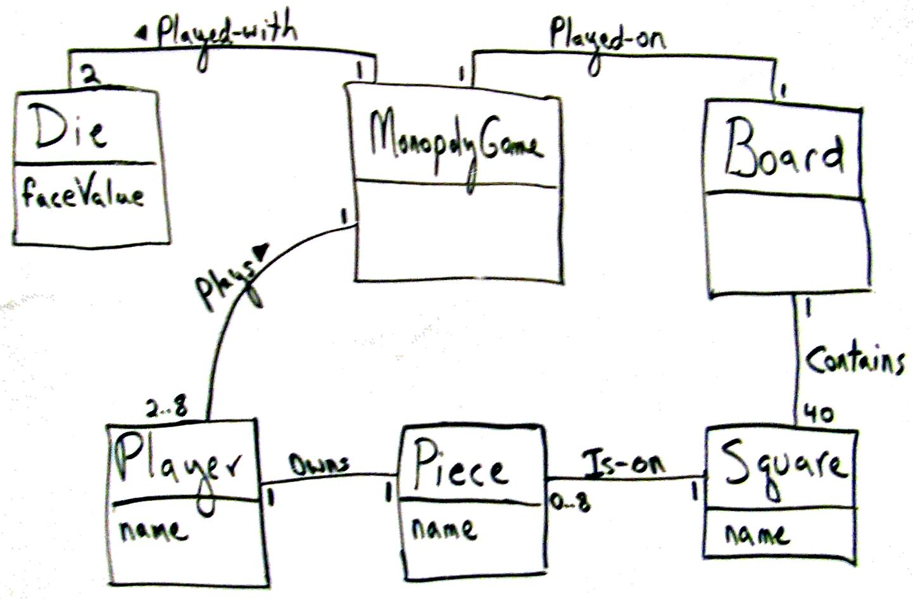

Monopoly Game domain model
Larman, Figure 9.28

Slide 26
Class names
Class Name creates the vocabulary of our analysis
  Use nouns as class names, think of them as simple agents
  Verbs can also be made into nouns, if they are maintain state
  E.g., “reads card” suggests CardReader, managing bank cards
Use pronounceable names:
  If you cannot read aloud, it is not a good name
Use capitalization to initialize Class names and demarcate multi-word names
  E.g., CardReader rather than CARDREADER or card_reader
  Why do most OO developers prefer this convention?
Avoid obscure, ambiguous abbreviations
  E.g., is TermProcess something that terminates
  or something that runs on a terminal?
Try not to use digits within a name, such as CardReader2
  Better for instances than classes of objects

Slide 27
Associations
A link between two classes (“has a”)
  Typically modeled as a member reference
  Notation from Extended Entity Relation (EER) models
A Person works for a Company
Role names and multiplicity at association ends
Direction arrow to aid reading of association name
Role
employee
employer
Person
Company
0..*
1
works for
Association Name

Slide 28
Adding Association
An association is a relationship between classes that indicates some meaningful and interesting connection.
In the UML, associations are defined as “the semantic relationship between two or more classifiers that involve connections among their instances.”

Slide 29
Structure (association) analysis
Lines connecting classes
In UML, simple line is an association
  Decorations for multiplicity, role names, constraints
Aggregations and composition:
  Arrow denotes navigability
  A black-filled diamond denotes a composition
    a part, unique to this whole
  A white-empty diamond denotes an aggregation
    a part, but not unique to this whole

Slide 30
Common Associations
A is subpart/member of B. (SaleLineItem-Sale)
A uses or manages B. (Cashier –Register, Pilot-airplane)
A communicates with B. (Student -Teacher)
A is transaction related to B. (Payment -Sale)
A is next to B. (SaleLineItem-SaleLineItem)
A is owned by B. (Plane-Airline)
A is an event related to B. (Sale-Store)

Slide 31
Roles and Multiplicity
Each end of an association is called a role.
Multiplicity defines how many instances of a class A can be associated with one instance of a class B.
e.g.: a single instance of a Store can be associated with “many”(zero or more) Item instances.

Slide 32
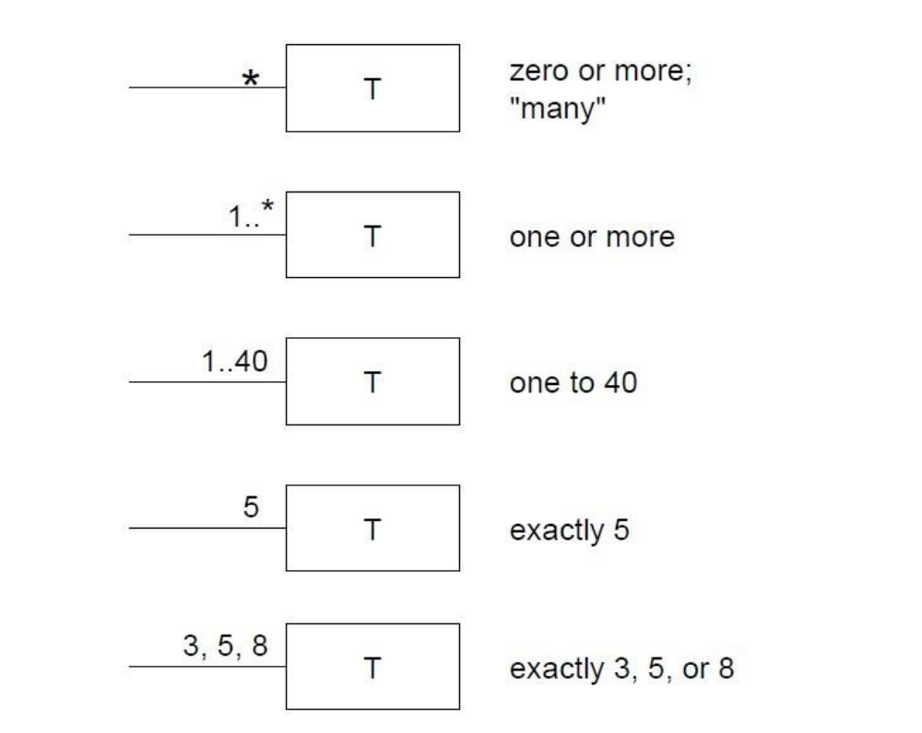
Some examples of Multiplicity

Slide 33
Adding Attributes
An attribute is a logical data value of an object.
Include the following attributes in a domain model: Those for which the requirements suggest a need to remember information.
An attribute can be a more complex type whose structure is unimportant to the problem, so we treat it like a simple type
UML Attributes Notation: Attributes are shown in the second compartment of the class box

Slide 34
Point of Sale System (POS) [1]
Basic Flow:
Customer arrives at a POS checkout with goods and/or services to purchase.
Cashier starts a new sale.
Cashier enters item identifier.
System records sale line item and presents item description, price, and running total. Price calculated from a set of price rules.
Cashier repeats steps 2-3 until indicates done.

Slide 35
Point of Sale System (POS) [2]
System presents total with taxes calculated.
Cashier tells Customer the total, and asks for payment.
Customer pays and System handles payment.
System logs the completed sale and sends sale and payment information to the external accounting (for accounting and commissions) and Inventory systems (to update inventory).
System presents receipt.
Customer leaves with receipt and goods (if any).

Slide 36
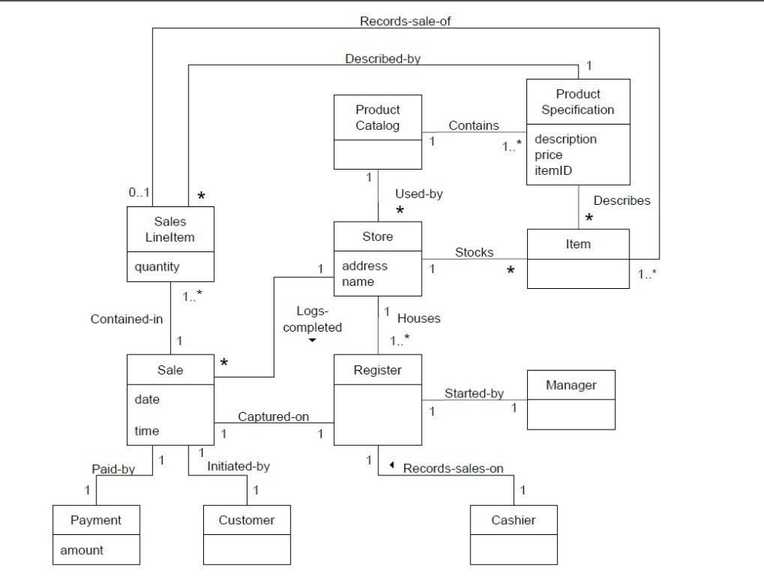
POS: Domain Model

