Slide 1
Requirements Analysis and Specification
Based on presentations by G. Mussbacher, G.V Bochmann, N. Niu, with material from: Wiegers: Software Requirements, Amyot 2008-2009, Somé 2008

Slide 2
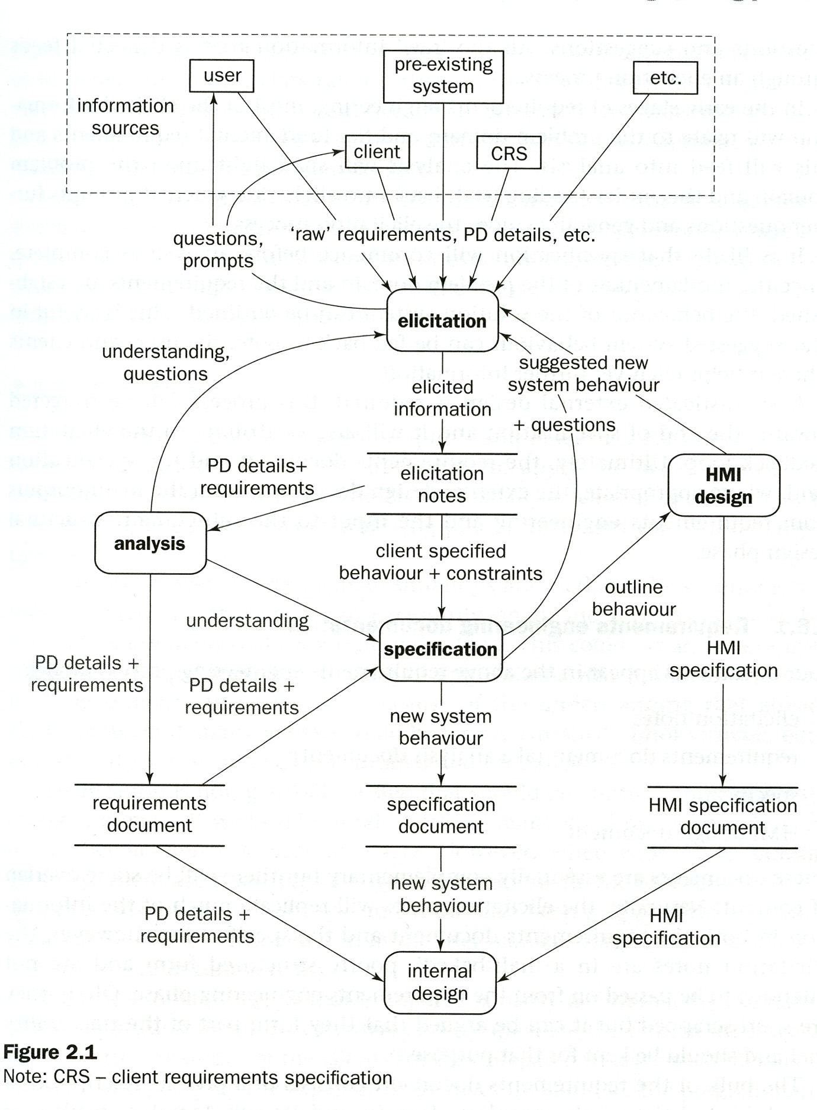
RE process model
(suggested by Bray)
Again, this diagram shows
RE activities (elicitation, analysis, specification, HMI design)
subsequent design activity (internal design)
RE documents (requirements, specification, HMI specification)
Important point:
Distinction between
Problem domain (described by requ. doc.)
System (to be built) (described by spec. doc.)
Note: one has to distinguish between current (problematic) version of the problem domain, and the projected future version which includes the system to be built.

Slide 3
What is Requirements Analysis
The process of studying and analyzing the customer and the user needs to arrive at a definition of the problem domain and system requirements
Objectives
  Discover the boundaries of the new system (or software) and how it must interact with its environment within the new problem domain
  Detect and resolve conflicts between (user) requirements
  Negotiate priorities of stakeholders
  Prioritize and triage requirements
  Elaborate system requirements, defined in the requirement specification document, such that managers can give realistic project estimates and developers can design, implement, and test
  Classify requirements information into various categories and allocate requirements to sub-systems
  Evaluate requirements for desirable qualities

Slide 4
Questions
We have seen how to specify requirements in terms of structure, standards, and writing rules, but:
  How to identify the real problems to solve in the elicitation results?
  How to detect conflicting aspects?
  How to negotiate to resolve conflicts?
  How to decide what is important and a priority?
  How to ensure that nothing is forgotten?
  How to validate that the findings of the analysis are good?
  How to use models in this context?

Slide 5
How to Find the Real Problems?
Ask: Why?
  Root cause analysis
  Determine (recursively) the factors that contribute to the problem(s) found by stakeholders
The causes do not all have the same impact nor the same weight
  Some may perhaps not deserve to be corrected, at least for the moment
Goal-oriented modeling can help understand these causes and their relationships
This analysis identifies problems that need to be solved

Slide 6
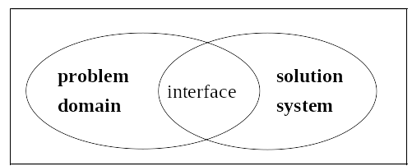
What is Requirements Specification?
The invention and definition of the behavior of a new system (solution domain) such that it will produce the required effects in the problem domain
Start from a knowledge of the problem domain and the required effects determined by elicitation and analysis
Generally involves modeling
Results in the specification document
  Precise expression of requirements, may include models
Specification
  description of Solution System needed to
  satisfy Problem Domain
Domain
properties
Requirements
Hardware
Software

Slide 7
Requirements Analysis
Problem analysis
  Development of product vision and project scope
Analysis and elicitation feed each other
Analysis goes hand-in-hand with modeling
Problem analysis
  Development of product vision and project scope
Analysis and elicitation feed each other
Analysis goes hand-in-hand with modeling
Problem analysis
  Development of product vision and project scope
Analysis and elicitation feed each other
Elicitation
Elicitation
Notes
Questions and points
to consider
Analysis
Requirements Specification

Slide 8
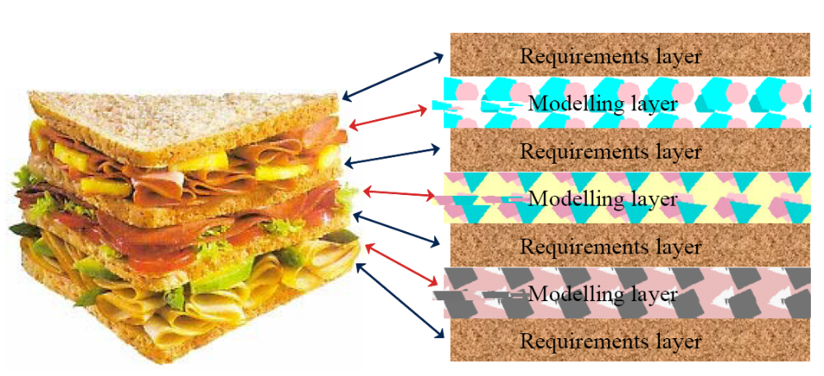
Requirements Modeling
Elicitation/analysis and modeling are intermixed
Source: http://www.telelogic.com/download/paper/SystemsEngineeringSandwich.pdf

Slide 9
Requirements Modeling
This is an essential task in specifying requirements
Map elements obtained by elicitation to a more precise form
Help better understand the problem
Help find what is missing or needs further discussion
Different modeling languages
  Informal:
  natural language
  Goal-oriented modeling (GRL)
  Functional modeling:
  UML (Unified Modeling Notation)
  SDL (Specification and Description Language)
  Logic, e.g. Z, VDM (Vienna Development Method)
  UCM (Use Case Maps)
  ...

Slide 10
Requirements Verification and Validation
Need to be performed at every stage during the (requirements) process
  Elicitation
    Checking back with the elicitation sources
    “So, are you saying that . . . . . ?”
  Analysis
    Checking that the domain description and requirements are correct
  Specification
    Checking that the defined system requirement will meet the user requirements under the assumptions of the domain/environment
    Checking conformity to well-formedness rules, standards…

Slide 11
Structuring requirements

Slide 12
Requirements Classification
In order to better understand and manage the large number of requirements, it is important to organize them in logical clusters
It is possible to classify the requirements by the following categories (or any other clustering that appears to be convenient)
  Features
  Use cases
  Mode of operation
  User class
  Responsible subsystem
This makes it easier to understand the intended capabilities of the product
And more effective to manage and prioritize large groups rather than single requirements

Slide 13
Requirements Classification – Features
A Feature is
  a set of logically related (functional) requirements that provides a capability to the user and enables the satisfaction of a business objective
The description of a feature should include¹
  Name of feature (e.g. Spell check)
  Description and Priority
  Stimulus/response sequences
  List of associated functional requirements
[1] Source: K.E. Wiegers

Slide 14
Requirements Classification – Feature Example (1)
3.1 Order Meals
  3.1.1 Description and Priority
    A cafeteria Patron whose identity has been verified may order meals either to be delivered to a specified company location or to be picked up in the cafeteria. A Patron may cancel or change a meal order if it has not yet been prepared.
    Priority = High.
  3.1.2 Stimulus/Response Sequences
    Stimulus: Patron requests to place an order for one or more meals.
    Response: System queries Patron for details of meal(s), payment, and delivery instructions.
    Stimulus: Patron requests to change a meal order.
    Response: If status is “Accepted,” system allows user to edit a previous meal order.
Source: K.E. Wiegers

Slide 15
Requirements Classification – Feature Example (2)
    Stimulus: Patron requests to cancel a meal order.
    Response: If status is “Accepted, ”system cancels a meal order.
  3.1.3 Functional Requirements
    3.1.3.1. The system shall let a Patron who is logged into the Cafeteria Ordering System place an order for one or more meals.
    3.1.3.2. The system shall confirm that the Patron is registered for payroll deduction to place an order.
    ......
Source: K.E. Wiegers

Slide 16
External design

Slide 17
Requirements Specification = External Design
Requirements Specification is «The invention and definition of the behavior of a new system (solution domain) such that it will produce the required effects in the problem domain »
During Requirements Analysis, one finds the existing properties of the problem domain, as well as the requirements that should be satisfied in the domain-to-be. We assume that the domain-to-be will include a new system-to-be-built and other aspects of the domain may also be changed.
The determination of this domain-to-be, including the system-to-be) is a typical design process. It is called external design because the system-to-be is considered during this process as a black-box and the external environment of it is designed (in a white-box manner) – the domain-to-be.

Slide 18
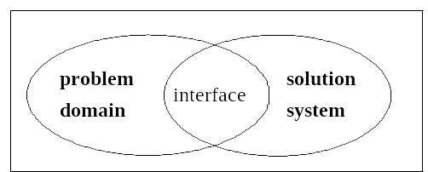
The World and the Machine¹
(or the problem domain and the system)
Specification (S)
Domain
properties (D)
these are assumptions about the environment of the system-to-be
Requirements (R)
Hardware (C)
Software (P)
Validation question (do we build the right system?) : if the domain-to-be (excluding the system-to-be) has the properties D, and the system-to-be has the properties S, then the requirements R will be satisfied.
D and S ⇒ R
Verification question (do we build the system right?) : if the hardware has the properties H, and the software has the properties P, then the system requirements S will be satisfied.
C and P ⇒ S
Conclusion:
D and C and P ⇒ R
[1] M. Jackson, 1995

Slide 19
Example
Requirement
  (R) Reverse thrust shall only be enabled
  when the aircraft is moving on runway.
Domain Properties
  (D1) Deploying reverse thrust in mid-flight
  has catastrophic effects.
  (D2) Wheel pulses are on if and only if wheels are turning.
  (D3) Wheels are turning if and only if the plane is moving on the runway.
System specification
  (S) The system shall allow reverse thrust to be enabled if and only if wheel pulses are on.
Does D1 and D2 and D3 and S ⇒ R?
  Are the domain assumptions (D) right? Are the requirement (R) or specification (S) what is really needed?
The assumption D3 is false
because the plane may
hydroplane on wet runway.
based on P. Heymans, 2005

Slide 20
Requirement specifications including assumptions
Often the requirements for a system-to-be include assumptions about the environment of the system.
The system specification S, then, has the form:
  S = A ⇒ G
  where A are the assumptions about the environment and G are the guarantees that the system will provide as long as A hold.
If these assumptions (A) are implied by the known properties of the domain (D), that is D ⇒ A, and we can check that the domain properties (D) and the system guarantees (G) imply the requirements (R), that is D and G ⇒ R, then the “validation condition” D and S ⇒ R is satisfied.

Slide 21
Specification with assumptions and guarantees (example)
Example: A power utility provides electricity to a client. The problem is that the monthly invoice is not related to the electricity consumption, because there is no information about this consumption.
Idea of a solution: introduce an electricity counter.
Specification of the electricity counter
  Inputs and outputs
    input power from utility (voltage, current) – voltage supplied by utility
    output power to client (voltage, current) – current used by client
    Reset button (input)
    consumption (output - watt-hours of electricity consumption)

Slide 22
Example (suite)
  Assumptions
    Input voltage < 500 Volts (determined by utility)
    Output current < 20 Amps (determined by client)
  Guarantees
    Output voltage = input voltage
    Input current = output current
    Consumption output shall indicate the consumption since the last reset operation, that is, the integral of (output voltage x output current) over the time period from the occurrence of the last reset operation to the current time instant.
Software example
Specification of a method providing the interface “List search(Criteria c. Assumption: c is a data structure satisfying the Criteria class properties. Guarantee: the returned result is a list satisfying the List class properties and includes all items from the database that satisfy c.

Slide 23
Formal Verification and Validation
Evaluating the satisfaction of “D and S ⇒ R” is difficult with natural language
  Descriptions are verbose, informal, ambiguous, incomplete...
  This represents a risk for the development and organization
Verification of this “validation question” is more effective with formal methods (see below)
  Based on mathematically formal syntax and semantics
  Proving can be tool-supported
We can also reduce this risk by using semi-formal modeling

Slide 24
The Use of Models

Slide 25
Models
According to B. Selic, a model is a reduced representation (simplified, abstract) of (one aspect of) a system used to:
  Help understand complex problems and / or solutions
  Communicate information about the problem / solution
  Direct implementation
Qualities of a good model
  Abstract
  Understandable
  Accurate
  Predictive
  Inexpensive

Slide 26
Modeling Notations
Natural language (English)
  No special training required
  Ambiguous, verbose, vague, obscure ...
  No automation
Ad hoc notation (bubbles and arrows)
  No special training required
  No syntax formally defined
  meaning not clear, ambiguous
  No automation
Semi-formal notation (URN, UML...)
  Syntax (graphics) well defined
  Partial common understanding, reasonably easy to learn
  Partial automation
  Meaning only defined informally
  Still a risk of ambiguities
Formal notation (Logic, SDL, Petri nets, FSM ...)
  Syntax & semantics defined
  Great automation (analysis and transformations)
  More difficult to learn & understand

Slide 27
Modeling notations (2)
Informal language is better
understood by all stakeholders
  Good for user requirements, contract
  But, language lacks precision
  Possibility for ambiguities
  Lack of tool support
Formal languages are more precise
  Fewer possibilities for ambiguities
  Offer tool support (e.g. automated verification and transformation)
  Intended for developers
Source (for decision table): Easterbrook and Callahan, 1997

Slide 28
Modeling Structure
Concepts of Entities and their Relationships. Use one of the following notations:
  ERD (Entity Relationship Diagram – the traditional version)
  UML class diagrams
  Relational tables
Can be used for the following
  Model of the problem domain (called “domain model”)
    The two versions: existing and to-be
  Model of input and output data structures of system-to-be
  Model of the stored data (database)
    not necessarily an image of the domain data
    Additional data is introduced (e.g. user preferences)
  Architectural design of the system-to-be

Slide 29
Modeling inputs and outputs
Nature of inputs and outputs:
  IO related to problem (problem data)
  Additional data related to solution (solution data)
    E.g., prompts, user options, error messages…
Collected in Data Dictionary using
  Plain text (natural language)
  EBNF
  Code-like notations
  Logic (e.g., VDM)
  Structure charts
  …
Graphical output (screens, forms)
  Iconic (representational) drawings, prototype screens or forms, printouts produced by operational prototype

Slide 30
Modeling Dynamic Behavior
Behavior modeling techniques
  Text (plain, function statements, use cases)
  Decision tables
  Activity Diagrams / Use Case Maps
  Finite state machines
    Simple state machines (FSM) : use state diagrams or transition table notation
    Extended state machines (e.g. UML State Machines – including SDL)
    Harel’s State Charts (concepts included in UML notation)
    Petri nets (allows for flexible concurrency, e.g. for data flow, similar to Activitity Diagrams)
  Logic (e.g. Z, VDM) for describing input-output assertions and possibly relationship to internal object state that is updated by operations)
It is important to chose what best suits the problem

Slide 31
Model Analysis
By construction
  We learn by questioning and describing the system
By inspection
  Execute/analyze the model in our minds
  Reliable?
By formal analysis
  Requires formal semantics (mathematical) and tools
  Reliable (in theory), but expensive (for certain modeling approaches)
By testing
  Execution, simulation, animation, test...
  Requires well-defined semantics and execution/simulation tools
  More reliable than inspection for certain aspects
  Possible to interact directly with the model (prototype)

Slide 32
Typical Modeling Approaches
Many approaches involve modeling to get a global picture of the requirements
  Structured Analysis (1970)
  Object-Oriented Analysis (1990)
  Problem Frames (1995)
  State Machine-Based Analysis
  Conflict Analysis
    E.g. with mis-use cases or with GRL/UCM models and strategies/scenarios
It is important to distinguish between
  Notation used for defining the model
  Process defining a sequence of activities leading to a desired model
Note: Analysis can be on individual requirements as well
  Remember tips and tricks on how to write better requirements

