Slide 1
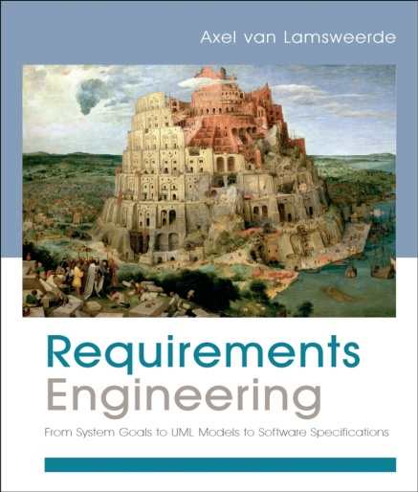
Fundamentals of RE
Chapter 7
Goal Orientation in RE

Slide 2
System objectives are pervasive in RE
As seen before ...
the WHY dimension of RE (Chap. 1)
understanding objectives in system-as-is, eliciting objectives of system-to-be (Chap. 2)
analyzing conflicting objectives, analyzing risks of not meeting critical objectives, evaluating options against objectives (Chap. 3)
specifying the rationale for specific requirements (Chap. 4)
checking that system objectives are satisfied by operational requirements (Chap. 5)
documenting satisfaction arguments & backward traceability to system objectives (Chap. 6)
⇒ Goals as key abstraction for driving the RE process

Slide 3
Goal orientation in RE: outline
What are goals?
The granularity of goals and their relationship to requirements and assumptions
Goal types and categories
Types of goals: behavioral goals vs. soft goals
Goal categories: functional goals vs. non-functional goals
The central role of goals in the RE process

Slide 4
What are goals?
Goal = prescriptive statement of intent the system should
satisfy through cooperation of its agents
"prescriptive statement": in optative mood
“shall”, “should”, “must”, ...
e.g. “Train doors shall be closed while the train is moving”
“Loan periods shall be limited to 2 weeks”
formulated in terms of problem world phenomena
"system": system-as-is, system-to-be
software + environment
"agent": active system component
responsible for goal satisfaction

Slide 5
Goal satisfaction requires agent cooperation
Maintain [SafeTransportation] ↔
on-board train controller + tracking system + station computer + passenger + train driver + ...
Achieve [BookCopyReturnedToShelves] ↔
patron + staff + library software
Agent = role, rather than individual
must restrict its behavior to meet its assigned goals
must be able to monitor/control phenomena involved in assigned goals
Agent types
software (software-to-be, legacy software, foreign software)
device (sensor, actuator, ...)
human

Slide 6
Goals vs. domain properties
Domain property = descriptive statement
about environment
indicative mood: “is", “are", etc --not prescriptive
e.g. “If train doors are open, they are not closed”
“A borrowed book is not available for other patrons”
The distinction between goals & domain properties is essential for RE ...
goals can be negotiated, weakened, prioritized
domain properties cannot
both required in requirements documentation

Slide 7
The granularity of goals
Goals can be stated at different levels of abstraction
Higher-level goals: strategic, coarse-grained
"50% increase of transportation capacity"
”Effective access to state of the art"
Lower-level goals: technical, fine-grained
”Acceleration command sent every 3 secs"
”Reminder issued by end of loan period if no return"
The finer-grained a goal,
the fewer agents required for its satisfaction

Slide 8
Goals, requirements & expectations
Requirement = goal assigned to single agent in software-to-be
"doorState = ‘closed’ while measuredSpeed≠ 0" ↔ TrainController
”Acceleration command sent every 3 secs” ↔ StationComputer
Expectation = goal assigned to single agent in environment
prescriptive assumption on environment
cannot be enforced by software-to-be (unlike requirements)
”Train left when doors open at destination” ↔ Passenger

Slide 9
Statement typology revisited in the presence of goals
Cf. general terminology introduced in Chap. 1 ...
software requirement ↔ requirement
system requirement ↔ goal involving multiple agents
incl. software-to-be
(prescriptive) assumption ↔ expectation
(descriptive) assumption ↔ hypothesis

Slide 10
Goal types
Behavioral goals: prescribe behaviors
vs.
Soft goals: state preferences among alternative behaviors

Slide 11
Goal types: behavioral goals
Prescribe intended system behaviors declaratively
implicitly define maximal sets of admissible agent behaviors
Can be satisfied in a clear-cut sense: YES or NO
goal satisfaction, formal analysis
Used for building operation models to meet them
”Worst-case stopping distance maintained”
“Reminder sent if book not returned on time”

Slide 12
Behavior goals prescribe sets of desired behaviors
DoorsClosed
WhileMoving
moving
closed
stopped
closed
stopped
open
stopped
closed
moving
closed

Slide 13
Behavioral goals: subtypes and specification patterns
Achieve [TargetCondition]:
[if CurrentCondition then] sooner-or-later TargetCondition
Achieve [BookRequestSatisfied]:
if a book is requested then sooner-or-later
a copy of the book is borrowed by the requesting patron
Achieve [FastJourney]:
if train is at some platform then within 5 minutes it is at next platform

Slide 14
Behavioral goals: subtypes and specification patterns (2)
Maintain [GoodCondition]:
[if CurrentCondition then] always GoodCondition
always (if CurrentCondition then GoodCondition)
Maintain [DoorsClosedWhileMoving]:
always (if a train is moving then its doors are closed)
Maintain [WorstCaseStoppingDistance]:
always (if a train follows another then
its distance is sufficient to allow the other to stop suddenly)

Slide 15
Behavioral goals: subtypes and specification patterns (3)
Accuracy goals are usually of type Maintain
Maintain [AccurateBookClassification]:
if a book is registered in the library directory then
always its keyword-based classification reflects its covered topics
Avoid [BadCondition]: dual of Maintain ...
[if CurrentCondition then] never BadCondition
Avoid [BorrowerLoansDisclosed]:
never patron loans disclosed to other patrons
Many security goals are Avoid goals

Slide 16
Goal types: soft goals
Capture preferences among alternative behaviors
Cannot be satisfied in clear-cut sense:
more satisfied in one option, less satisfied in another
goal satisficing, qualitative analysis
Used for comparing options to select preferred
Often take the form
Maximize / Minimize, Incresase / Reduce, Improve, ...
“Stress conditions of air traffic controllers shall be reduced”
“The workload of library staff shall be reduced”
“The bibliographical search engine shall be usable by non-CS students”

Slide 17
Goal categories
Classification into functional, quality, development goals
Categories may overlap; boundary not always clear
unlike goal types
Functional goals
prescribe intended services to be provided by the system
used for building operational models of such services
use cases, state machines (see later)
e.g. “Passengers transported to their destination”
“Train acceleration computed”
”Book request satisfied"

Slide 18
Goal categories: non-functional goals
Quality goals (not to be confused with soft goals, cf. book p. 271)
about quality of service ...
security "info about other patrons kept confidential"
safety "worst-case stopping distance maintained"
accuracy ”measured speed = physical speed”
”book displayed as available iff there is a copy in shelves"
performance ”acceleration command sent every 3 seconds”
usability
interoperability, ...
Development goals
about quality of development ...
cost, deadline, variability, maintainability, reusability, etc.

Slide 19
Goal categories (2)
goal
development
functional
quality
...
usability
satisfaction
information
...
safety
security
accuracy
performance
...
...
confidentiality
availability
integrity
time
space
...
...
See book, Fig. 7.5 p. 269
Helpful for eliciting overlooked application-specific instances
through taxonomy browsing

Slide 21
Using goal types & categories
Lightweight specification patterns
Heuristic rules for elicitation, validation, reuse, conflict management, ...
"Is there any conflict between Information goals and
Confidentiality goals?"
"Confidentiality goals are Avoid goals on sensitive info"
"Safety goals have highest priority in conflict resolution"
More specific types & categories
⇒ more specific heuristics

Slide 22
The central role of goals in the RE process
Goal refinement/abstraction as structuring mechanism
shows contribution links among goals
drives elaboration of reqs (subgoals)
provides rationale for reqs (parent goals)
rich traceability: strategic objectives → technical requirements
can be used to structure reqs document (cf. chap. 16)

Slide 23
The central role of goals in the RE process (2)
Goals support chains of satisfaction arguments (cf. Chap. 1)
Req, Exp, Dom |= G , SubG, Exp, Dom |= G
“in view of domain properties in Dom,
the reqs/subgoals in Req/SubG ensure that goal G is satisfied
under expectations in Exp”
R: doorsState = ‘closed’ if measuredSpeed ≠ 0
E: Doors are closed iff doorsState = ‘closed’ (↔ door actuators)
measuredSpeed = physicalSpeed (↔ speedometer)
D: Train is moving iff physicalSpeed ≠ 0
G: Doors are closed if train is moving

Slide 24
The central role of goals in the RE process (3)
Goals provide a criterion for reqs completeness
set REQ of requirements is complete if for all goals G :
{REQ, Exp, Dom} |= G
Goals provide a criterion for reqs relevance
r in REQ is pertinent if for some G :
r is used in argument {REQ, Exp, Dom} |= G

Slide 25
The central role of goals in the RE process (4)
Goal OR-refinement → capture of alternative options

Slide 26
The central role of goals in the RE process (5)
Support for evolution management
higher-level goals → more stable concerns
⇒ multiple system versions within single model ...
common parent goals
different OR-branches
Roots for conflict detection & resolution (cf. Chap. 16)
Anchors for risk management (cf. Chap. 9)

Slide 27
Avoid frequent misconceptions
Goal-oriented ≠ top-down
bottom-up elaboration as well (goal abstraction)
Goal-oriented ⇒ agent-oriented,
scenario-oriented
the magic RE triangle:
goals
coverage
responsibility
scenarios
agents
interaction

Slide 28
Scenarios as concrete vehicles for goal elicitation/validation
easy to get from or validate with stakeholders
DoorsClosed
WhileMoving
:Controller
:Train
:Passenger
arrival
doors
opening
entrance
doors
closing
G covers Sc:
Sc is subhistory in set of
behaviors prescribed by G
move
arrival
doors
opening

Slide 29
Part 2: Building System Models for RE
Introduction

Slide 30
RE activities require focus and structure
A recurrent problem ...
focusing, structuring elicitation sessions & artefacts (Chap.2)
identifying items at common level of granularity for comparison, evaluation (Chap.3)
structuring large, complex specifications (Chap.4)
focusing inspection, validation, verification on structured specs (Chap.5)
identifying change units, granularities of traceable items, derivation links for reqs evolution (Chap.6)
⇒ Model-driven approach to RE

Slide 31
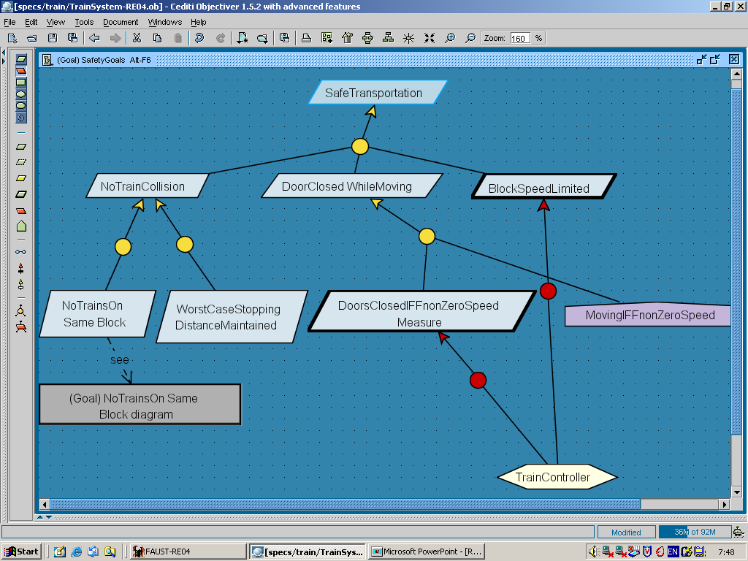
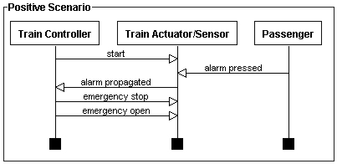
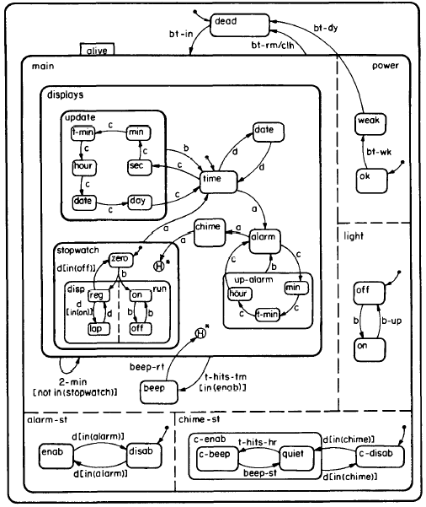
Model-Driven RE
Model:
abstract representation of system (as-is or to-be)
highlights, specifies, inter-relates key system features
Multi-view model:
different system facets for requirements completeness

Slide 32
Why models for RE ?
Focus on key aspects (abstraction from multiple details)
Provides structure for RE activities
target for what must be elicited, evaluated, specified, consolidated, modified
interface among RE activities: produce/consume model items
Facilitates analysis
support for early detection and fix of errors
Support for understanding, explanation to stakeholders
Basis for making decisions
multiple options made explicit
Basis for generating the requirements document (with tool)

Slide 33
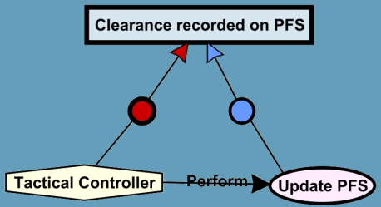
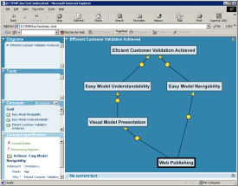
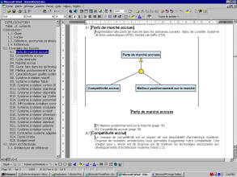

A goal-oriented approach to model-driven RE
interviews
existing systems
documents
modeling
analysis
generation of RE deliverables
.rtf
.pdf
.mif
.html

Slide 34

The lectures will summarize book chapters, see details there !
Concentrates on solid, replicable RE techniques
Emphasizes model construction, beyond mere use of diagrammatic notations
heuristic rules, tactics, modeling patterns, bad smells
UML compliance wherever possible
Unified Modeling Language, de facto standards
Specific diagrams when not supported by UML (e.g. goals)
Based on case studies in a variety of domains

Slide 35

What models for RE ?
Goals (Chap. 7, 8)
why ?

Slide 36
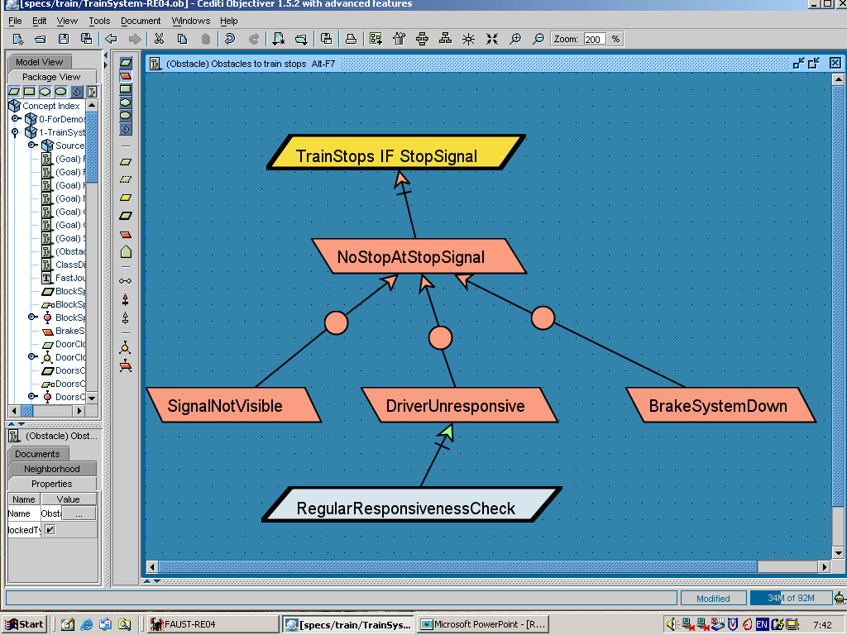
What models for RE ?
Goals (Chap. 7, 8)
Risks (Chap.9)
why ?

Slide 37
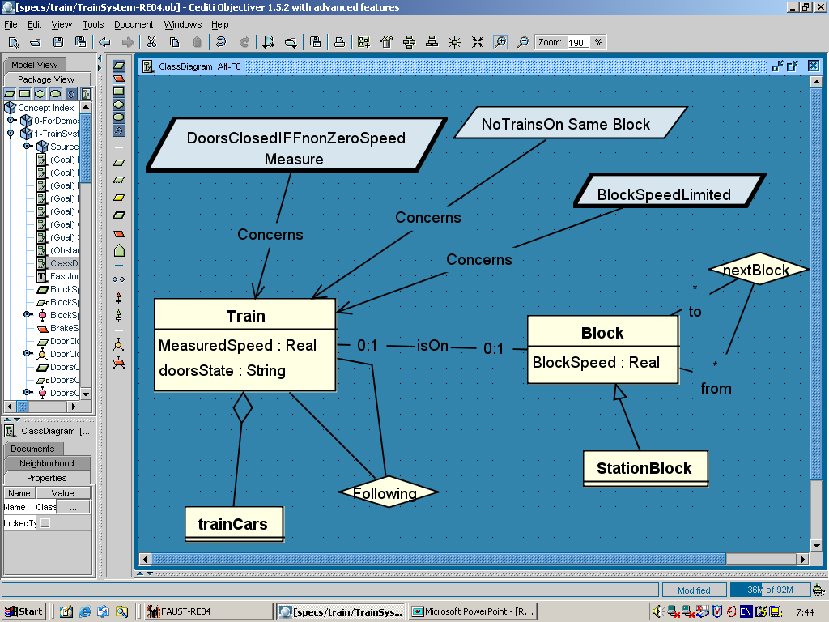
What models for RE ?
Goals (Chap. 7, 8)
Risks (Chap.9)
why ?
Conceptual objects (Chap.10)
on what?

Slide 38
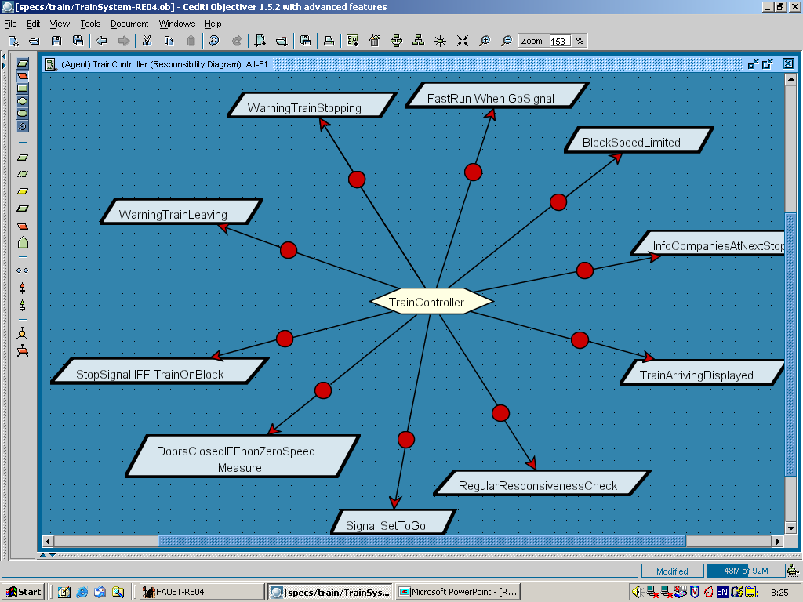
What models for RE ?
Goals (Chap. 7, 8)
Risks (Chap.9)
why ?
Conceptual objects (Chap.10)
Agents (Chap.11)
on what?
who ?

Slide 39
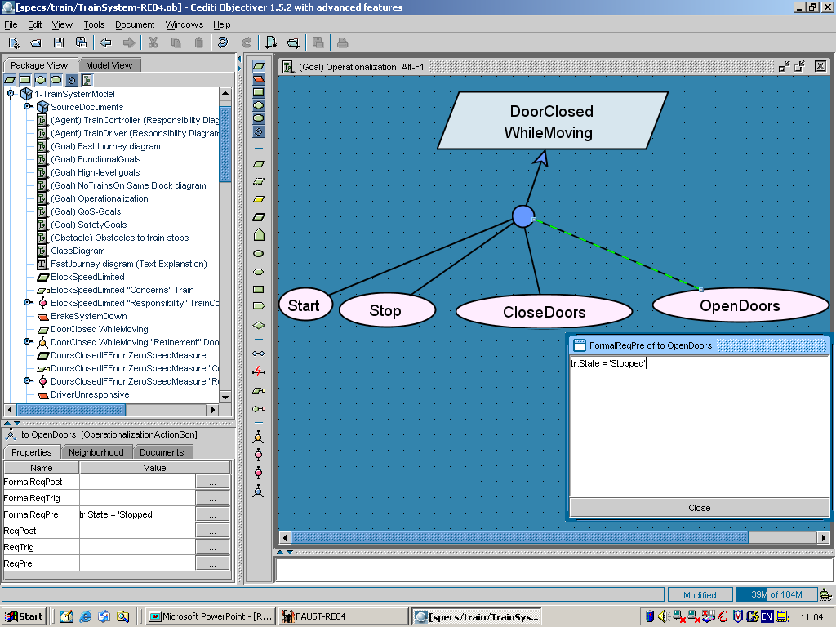
What models for RE ?
Operations (Chap.12)
what ?

Slide 40
What models for RE ?
Operations (Chap.12)
what ?
Behaviors -
Scenarios (Chap.13)
Behaviors -
State machines (Chap.13)

Slide 41
What models for RE ?
Operations (Chap.12)
Threats (Chap. 16)
I
what ?
Behaviors -
Scenarios (Chap.13)
Behaviors -
State machines (Chap.13)

Slide 42

Building system models for RE: more detailed outline
Chap.8: Modeling system objectives with goal diagrams
Chap.9: Risk analysis on goal models
Chap.10: Modeling conceptual objects with class diagrams
Chap.11: Modeling system agents and responsibilities
Chap.12: Modeling system operations
Chap.13: Modeling system behaviors: scenarios and state machines
Chap.14: Integrating multiple system views
Chap.15: A Goal-oriented model building method in action

