Slide 1
Modeling Issues
Modeling Enterprises
Based on slides from S. Easterbrook, N. Niu, E.S.K. Yu

Slide 2
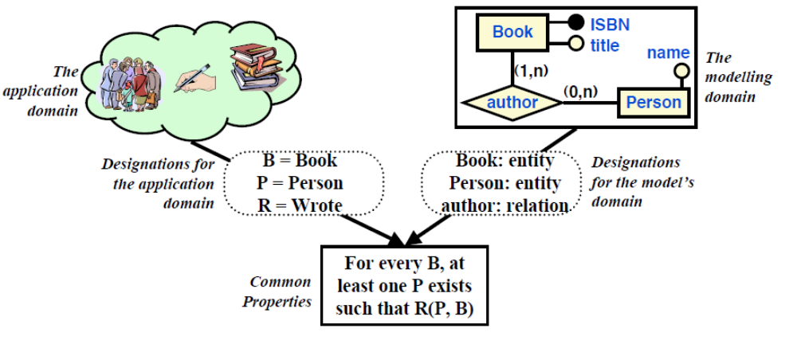
RE involves modeling
A model is more than just a description
 It has its own phenomena, and its own relationships among those phenomena.
➢ The model is only useful if the model’s phenomena correspond in a systematic way
to the phenomena of the domain being modeled.
 Example:
2
Source: Adapted from Jackson, 1995, p120-122

Slide 3
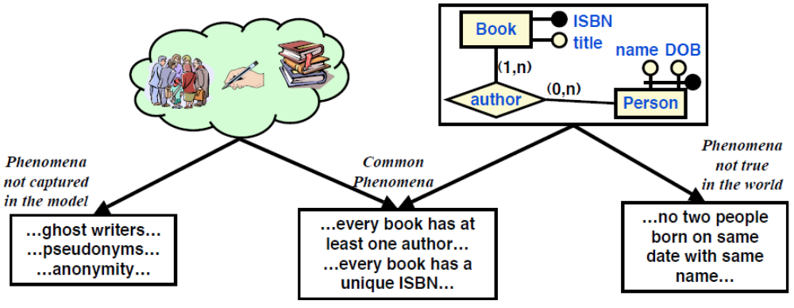
“It’s only a model”
➲ There will always be:
 phenomena in the model that are not present in the application domain
 phenomena in the application domain that are not in the model
➲ A model is never perfect
 “If the map and the terrain disagree, believe the terrain”
 Perfecting the model is not always a good use of your time...
3
Source: Adapted from Jackson, 1995, p124-5

Slide 4
Modeling…
➲ Modeling can guide elicitation:
 It can help you figure out what questions to ask
 It can help to surface hidden requirements
➢ i.e. does it help you ask the right questions?
➲ Modeling can provide a measure of progress:
 Completeness of the models -> completeness of the elicitation (?)
➢ i.e. if we’ve filled in all the pieces of the models, are we done?
➲ Modeling can help to uncover problems
 Inconsistency in the models can reveal interesting things…
➢ e.g. conflicting or infeasible requirements
➢ e.g. confusion over terminology, scope, etc
➢ e.g. disagreements between stakeholders
➲ Modeling can help us check our understanding
 Reason over the model to understand its consequences
➢ Does it have the properties we expect?
 Animate the model to help us visualize/validate the requirements
➲ Hickey and Davis paper, 4 roles modeling plays?
4

Slide 5
Choice of Modeling Notation
➲ natural language
 extremely expressive and flexible
➢ useful for elicitation, and to annotate models for readability
 poor at capturing key relationships
➲ semi-formal notation
 captures structure and some semantics
UML fits in here
 can perform (some) reasoning, consistency checking, animation, etc.
➢ E.g. diagrams, tables, structured English, etc.
 mostly visual - for rapid communication with a variety of
stakeholders
➲ formal notation
 precise semantics, extensive reasoning possible
➢ Underlying mathematical model (e.g. set theory, FSMs, etc)
 very detailed models (may be more detailed than we need)
➢ RE formalisms are for conceptual modeling, hence differ from most
computer science formalisms
Source: Adapted from Loucopoulos & Karakostas, 1995, p72-73
5

Slide 6
Desiderata for Modeling Notations
➲ Implementation
Independence
➲ Ease of analysis
 ability to analyze for ambiguity,
incompleteness, inconsistency
 does not model data
representation, internal
organization, etc.
➲ Traceability
➲ Abstraction
 ability to cross-reference
elements
 extracts essential aspects
 ability to link to design,
implementation, etc.
➢e.g. things not subject to
frequent change
➲ Formality
➲ Executability
 unambiguous syntax
 rich semantic theory
 can animate the model, to
compare it to reality
➲ Constructability
➲ Minimality
 can construct pieces of the
model to handle complexity and
 No redundancy of concepts in
the modeling scheme
size
➢i.e. no extraneous choices of how
to represent something
 construction should facilitate
communication
Source: Adapted from Loucopoulos & Karakostas, 1995, p77
6

Slide 7
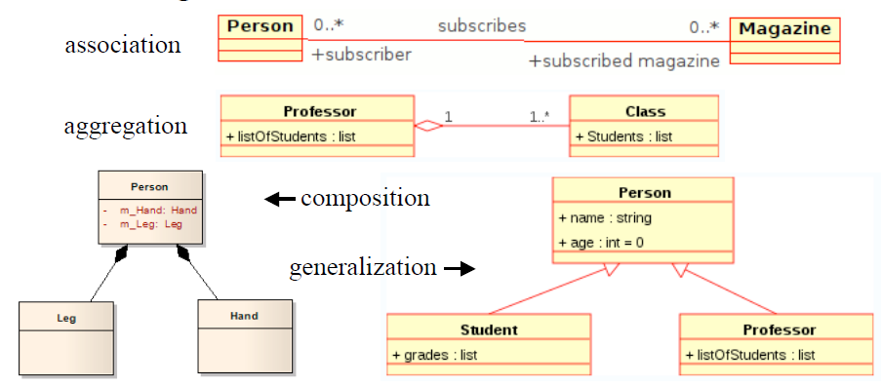
Meta-Modeling
➲ Can compare modeling schema using meta-models:
 What phenomena does each scheme capture?
 What guidance is there for how to elaborate the models?
 What analysis can be performed on the models?
➲ Class diagrams:
7

Slide 8
Modeling Principles
➲ Facilitate Modification and Reuse
 Experienced analysts reuse their past experience
➢ they reuse components (of the models they have built in the past)
➢ they reuse structure (of the models they have built in the past)
 Smart analysts plan for the future
➢ they create components in their models that might be reusable
➢ they structure their models to make them easy to modify
➲ Helpful ideas:
 Abstraction
➢ strip away detail to concentrate on the important things
 Decomposition (Partitioning)
➢ Partition a problem into independent pieces, to study separately
 Viewpoints (Projection)
➢ Separate different concerns (views) and describe them separately
 Modularization
➢ Choose structures that are stable over time, to localize change
 Patterns
➢ Structure of a model that is known to occur in many different
applications
8

Slide 9
Modeling Principle 1: Partitioning
➲ Partitioning
 captures aggregation/part-of relationship
➲ Example:
 goal is to develop a spacecraft
 partition the problem into parts:
➢ guidance and navigation;
➢ data handling;
➢ command and control;
➢ environmental control;
➢ instrumentation;
➢ etc
 Note: this is not a design, it is a problem decomposition
➢ actual design might have any number of components, with no relation to
these sub-problems
 However, the choice of problem decomposition will probably be
reflected in the design
9

Slide 10

Modeling Principle 2: Abstraction
➲ Abstraction
 A way of finding similarities between concepts by ignoring some details
 Focuses on the general/specific relationship between phenomena
➢ Classification groups entities with a similar role as members of a single class
➢ Generalization expresses similarities between different classes in an ‘is_a’
association
➲ Example:
 requirement is to handle faults on the spacecraft
 might group different faults into fault classes
based on location:
based on symptoms:
 instrumentation fault,
 no response from device;
 communication fault,
 incorrect response;
 processor fault,
 self-test failure;
 etc
 etc...
10
Source: Adapted from Davis, 1990, p48 and Loucopoulos & Karakostas, 1995, p78

Slide 11
Modeling Principle 3: Projection
➲ Projection:
 separates aspects of the model into multiple viewpoints
➢ similar to projections used by architects for buildings
➲ Example:
 Need to model the requirements for a spacecraft
 Model separately:
➢ safety
➢ commandability
➢ fault tolerance
➢ timing and sequencing
➢ Etc…
➲ Note:
 Projection and Partitioning are similar:
➢ Partitioning defines a ‘part of’ relationship
➢ Projection defines a ‘view of’ relationship
 Partitioning assumes a the parts are relatively independent
Source: Adapted from Davis, 1990, p48-51
11

Slide 12
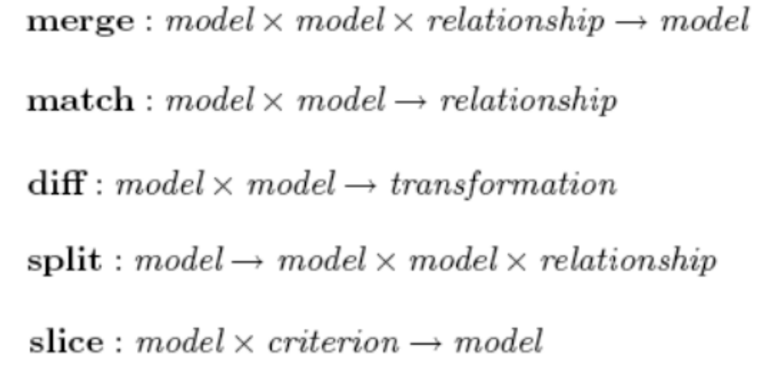

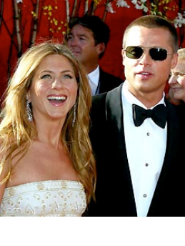
Model Management
➲ On model merging:
 Sometimes you don’t know whether models are inconsistent until you put
them together:
Source: Adapted from G. Brunet et al, A Manifesto for Model Merging, GaMMa’06.
12

Slide 13
Survey of Modeling Techniques
➲ Modeling Enterprises
Organization Modeling:
 Goals & objectives
 Organizational structure
 Tasks & dependencies
 Agents, roles, intentionality
i*, SSM, ISAC
Goal Modeling:
KAOS, CREWS
Information Modeling:
➲ Modeling Information & Behaviour
E-R, Class Diagrams
Structured Analysis:
 Information Structure
 Behavioral views
SADT, SSADM, JSD
Object Oriented Analysis:
➢ Scenarios and Use Cases
➢ State machine models
OOA, OOSE, OMT, UML
➢ Information flow
Formal Methods:
 Timing/Sequencing requirements
SCR, RSML, Z, Larch, VDM
➲ Modeling System Qualities (NFRs)
Quality Tradeoffs:
 All the ‘ilities’:
QFD, win-win, AHP,
➢ Usability, reliability, evolvability, safety,
security, performance, interoperability,…
Specific NFRs:
Timed Petri nets (performance)
Task models (usability)
Probabilistic MTTF (reliability)
1

Slide 14
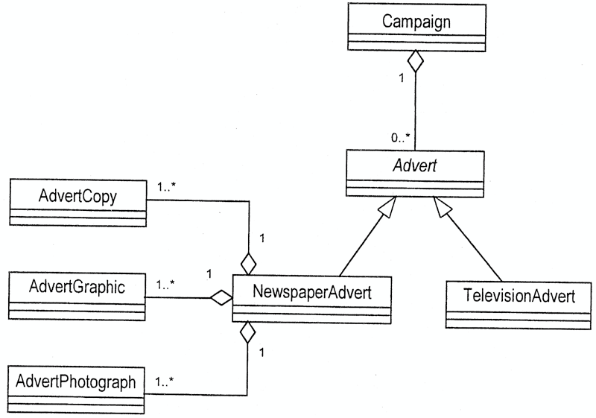
What is this a model of?
14

Slide 15
Summary
➲ Modeling plays a central role in RE
 Allows us to study a problem systematically
 Allows us to test our understanding
➲ Many choices for modeling notation
 Desiderata
 Principles
➲ All models are inaccurate (to some extent)
 Use successive approximation
…but know when to stop perfecting the model
 Every model is created for a purpose
 The purpose is not usually expressed in the model
…So every model needs an explanation
15

Slide 16
GOAL ORIENTATED MODELING

Slide 17
Motivation
Facilitate common understanding of the system
Support requirements elicitation with goals
Identify and evaluate alternative realisations
Detect irrelevant requirements
Justification of requriements with rationales
Proof of completeness for requirements specifications
Goals have greater stability than requirements

Slide 18
The Term ”Goal”
An intention with regard to the objectives, properties or use of the system

Slide 19
AND/OR Goal Decomposition
AND-decomposition of a goal:
  decomposition of a goal G into a set of sub-goals G1, …, Gn
  n>1
  Goal G is satisfied if and only if all sub-goals are satisfied
OR-decomposition of a goal:
  decomposition of a goal into a set of sub-goals G1, …, Gn
  n >1
  Goal G is satisfied if one of sub-goals is satisfied

Slide 20
Goal Dependencies
”Requires”-dependency
  G1 requires G2 if the satisfaction of G2 is a prerequisite for satisfying G1
”Support”-dependency
  G1 supports G2 if the satisfaction of G1 contributes positively to satisfying G2
”Obstruction” dependency
  G1 obstructs G2 if satisfying of G1 hinders the satisfaction of G2
”Conflict” dependency
  A conflict between G1 and G2 exists if satisfying G1 excludes satisfying G2 and vice-versa
Goal equivalence
  Satisfying G1 leads to the satisfaction of the G2 and vice-versa

Slide 21
Identifying Goal Dependencies
Context changes affect goal dependencies
Example: change of a data protection law in a country may prohibit the electronic localisation of a car
Stakeholders must be aware of such changes and constantly analyse their influences!

Slide 22
DOCUMENTING GOALS
A Template for Documenting Goals
Possible: goal documentation using unstructured natural language
Better: using templates with attributes
  Unique identifiers for goals
  Management attributes
  References to the context
  Specific goal attributes
  Possibility to include additional information

Slide 23
Seven Rules for Documenting Goals
Document goals concisely (but not to briefly)
Use the active voice
Document stakeholder's intention precisely
Decompose high-level goals
Clearly define the value of the goal
Document rationales for a goal
Avoid unnecessary restrictions; try to weaken existing restrictions
Apply these rules already during requirements elicitation to avoid the elicitation of inappropriate requirements!

Slide 24
Goal Modeling Languages and Methods
Model-based goal documentation
  helps understanding and communicating goals
  complements template-based documentation (each technique provides a different level of abstraction)
Common goal modeling languages include Goal-oriented Requirements Language (GRL), i* and KAOS
Goal modeling method consists of language, rules, guidelines and management practices
  Common goal modelling methods include Goal-Based Requirements Analysis Method (GBRAM), Goal-Driven Change method (GDC), the i* framework, the KAOS framework, the Non-Functional Rquirements (NFR) framework

Slide 25
Documenting Goals Using AND/OR Trees and AND/OR Graphs
•AND/OR trees
  Consist of nodes representing goal decompositions
  Hierarchical, each node has exactly one super-goal
  Graphical notation indicates type of decomposition (AND/OR)
  Feature models provide a similar approach
AND/OR graphs
  Some sub-goals contribute to the satisfaction of more than one super goal
  AND/OR graphs are acyclic

Slide 26
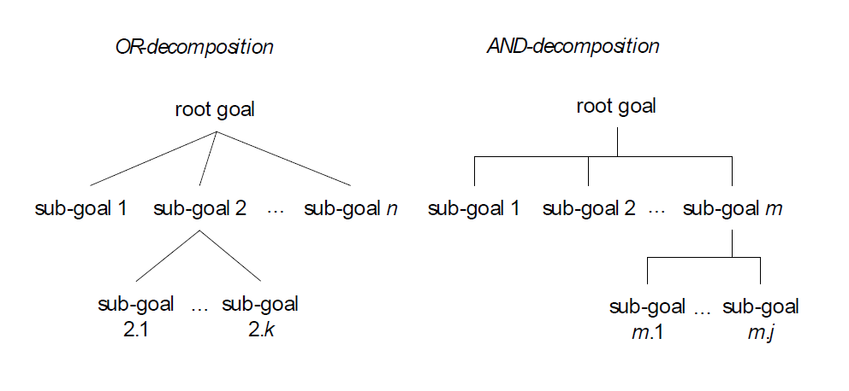
Notation of AND/OR goal trees

Slide 27
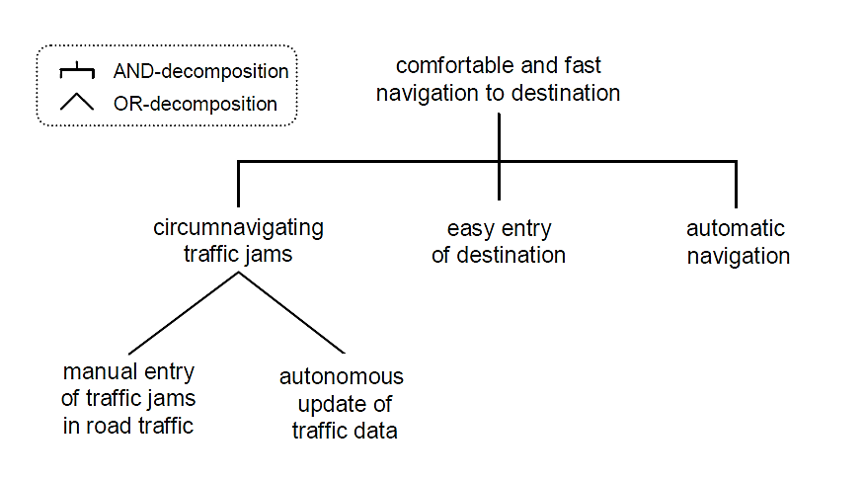
Example of goal modeling using AND/OR trees

Slide 28
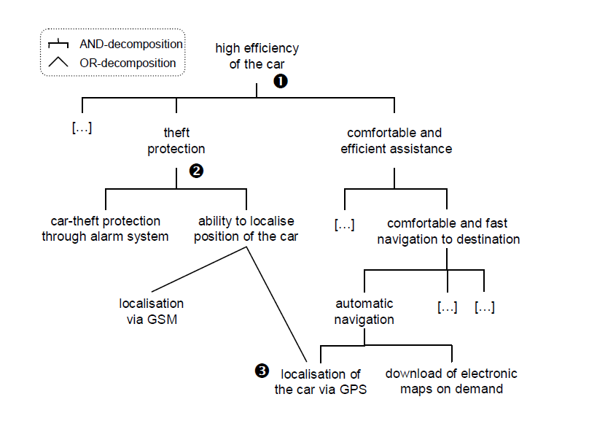
Example of a goal model documented using an AND/OR graph

Slide 29
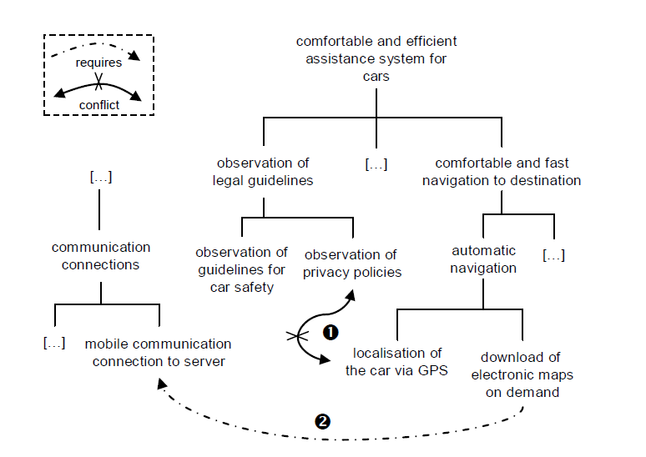
Example of goal modeling with extended AND/OR graphs

Slide 30
i* (i-Star)
Based on the modeling language GRL
AND/OR trees for documenting goal decompositions
Modeling constructs for quality aspects
Basic concepts
  Objects
  Dependencies
  Relationships

Slide 31
i* (i-Star) (cont‘d)
Objects
Actor: person or system having a relationship to the system to be developed
Goal: describes state in the world the actor would like to achieve
Task: particular way of doing something, typically consists of a number of steps (or sub-tasks)
Resource: physical or informational entity tha ctor needs to achieve a goal or perform a task
Softgoal: condition in the world the actor would like to achieved that is not sharply defined, typically a quality attribute of another element

Slide 32
i* (i-Star) (cont‘d)
Dependencies between actors in i*
Goal dependency: actor depends on another actor to achieve a goal
Task dependency: actor depends on another actor to perform a task
Resource dependency: actor depends on availability of a resource provided by another actor
Softgoal dependency: actor depends on another actor to perform a task that leads to the achievement of a softgoal

Slide 33
i* (i-Star) (cont‘d)
Relationships between Objects in i*
Means-end link: documents which elements (softgoals, tasks and/or resources) contribute to achieving a goal
Contribution link: documents positive or negative influence on softgoals by tasks or other softgoals
Task decomposition link: documents the essential elements (sub-tasks) of a task

Slide 34
i* (i-Star) (cont‘d)
Two kinds of goal models
Strategic Dependency Model (SDM)
  Documents dependencies between actors
  Documents on which tasks, goals, softgoals and resources they depend
Strategic Rationale Model (SRM)
  Details each actor by defining the actor‘s internal structure
  Provides rationales for the external dependencies

Slide 35
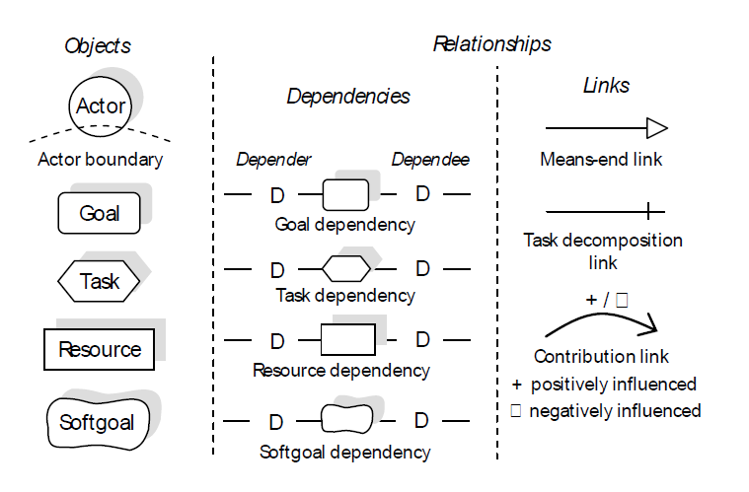
Notation of the modeling constructs in the i* framework

Slide 36
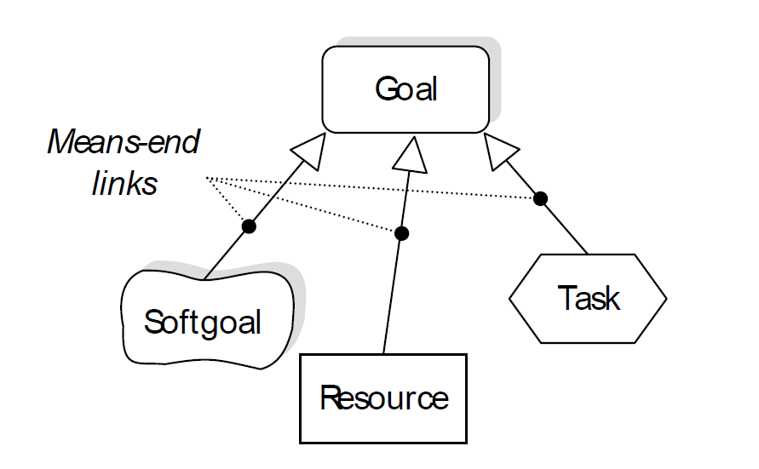
Means-end links in the i* framework

Slide 37
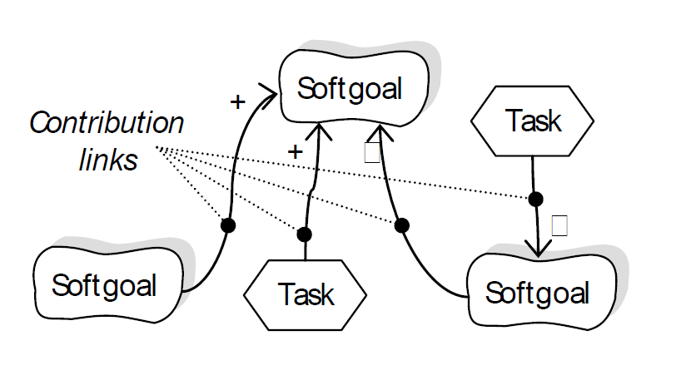
Contribution links in the i* framework

Slide 38
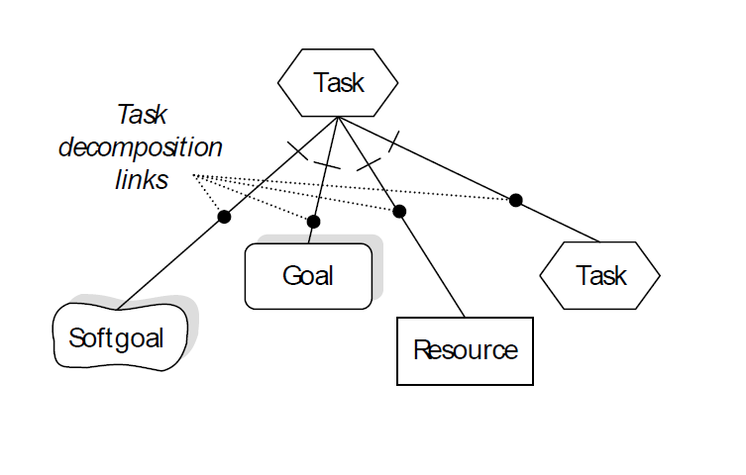
Task decomposition links in the i* framework

Slide 39
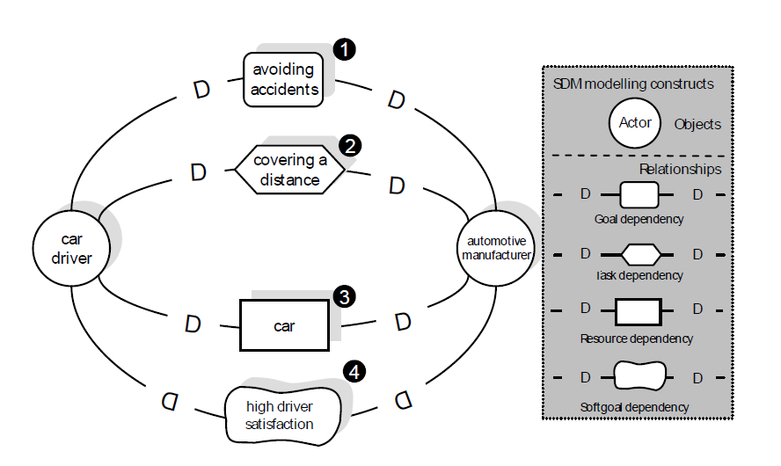
Example of a strategic dependency model in i*

Slide 40
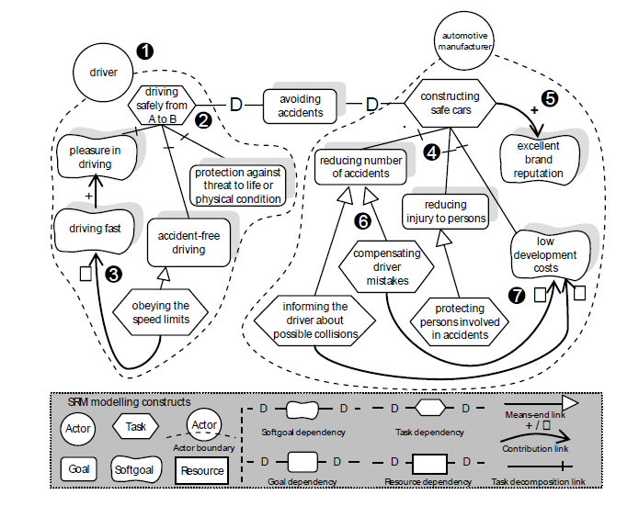
Example of a strategic rationale model in i*

Slide 41
Agent Orientation and
Information Systems
Eric Yu
University of Toronto
Presentation at Tsinghua University, Beijing, China
July 8, 1999

Slide 42
From GORE (Goal- Oriented Requirements Engineering)
to AORE (Agent-Oriented Requirements Engineering)

Slide 43
Benefits of GORE van Lamsweerde (ICSE 2000)
Systematic derivation of requirements from goals
Goals provide rationales for requirements
Goal refinement structure provides a comprehensible structure for the requirements document
Alternative goal refinements and agent assignments allow alternative system proposals to be explored
Goal formalization allows refinements to be proved correct and complete.

Slide 44
The Changing Needs of Requirements Modeling
Technology as enabler
  Goals are discovered; may be bottom-up
Networked systems and organizations
  Composite systems, but dispersed, fluid, contingent, ephemeral
  Same for responsibilities, accountability, authority, ownership,…
Increased inter-dependency and vulnerability
  Dependencies among stakeholders (inc. system elements)
  Impact of changes
Limited knowledge and control
  No single designer with full knowledge and control
Openness and uncertainties
  Can’t anticipate all eventualities / prescribe responses in advance
Cooperation
  Beyond vocabulary of “interaction” (behavioural)
  Reason about benefits of cooperation – goals, beliefs, conflicts

Slide 45
The Changing Needs of Requirements Modeling (cont’d)
7. Boundaries, Locality, and Identity
  Can transcend physical boundaries
  Want “logical” criteria for locality, identity – e.g., authority, autonomy, reach of control, knowledge
  Negotiated boundaries
  Reasoning about boundary re-alignment and implications

Slide 46
Development-World model refers to and reasons about…
Alt-2
Alt-1
To-be
As-is
Operational-World models

Slide 47
GORE & AORE research challenges
(framework components)
Ontology
Formalization
Analysis and reasoning
Methodologies
Knowledge Based Support
  Generic knowledge, e.g., common NFR goals, refinements, solution techniques (e.g., for security, safety,…)
  Larger patterns
Tools
Evaluation, Validation, Empirical studies
Heterogeneous modelling frameworks

Slide 48
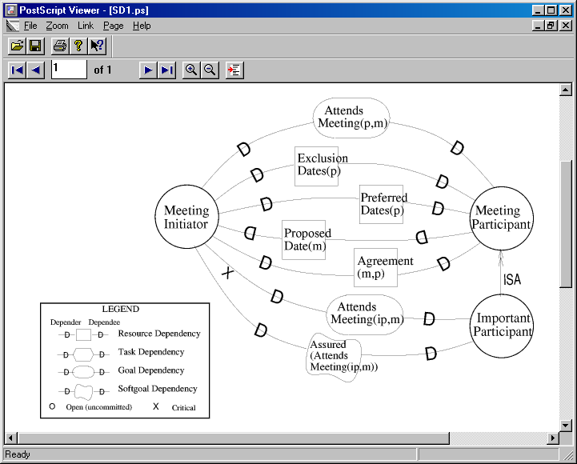
i* - agent-oriented modelling
Actors are semi-autonomous, partially knowable
Strategic actors, intentional dependencies
“Strategic Dependency” Model
Meeting Scheduling Example

Slide 49
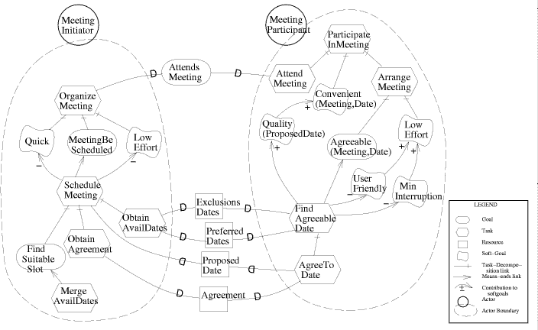
Revealing goals, finding alternatives
Asking “Why”, “How”, “How else”

Slide 50
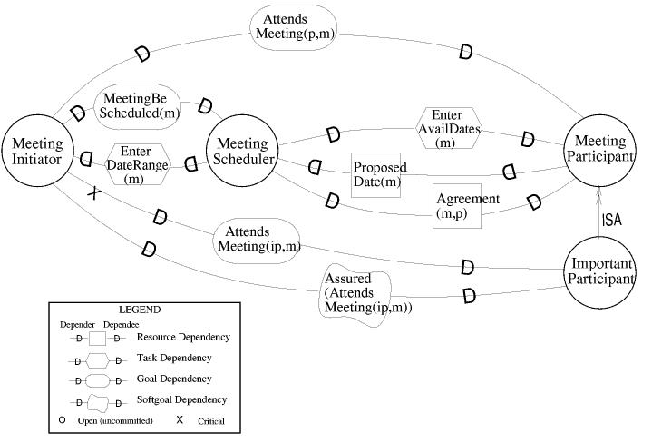
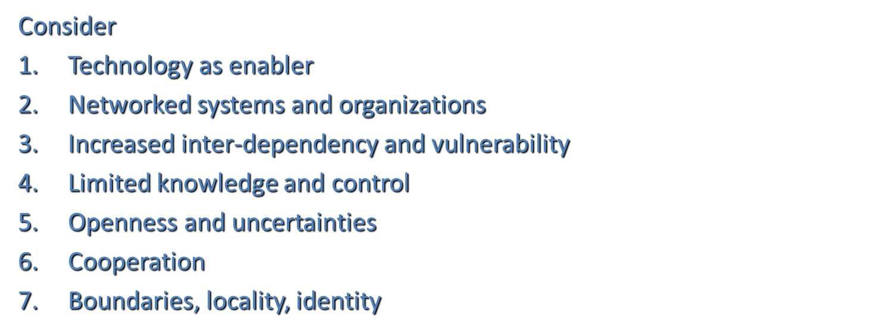
Scheduling meeting
…with meeting scheduler

Slide 51
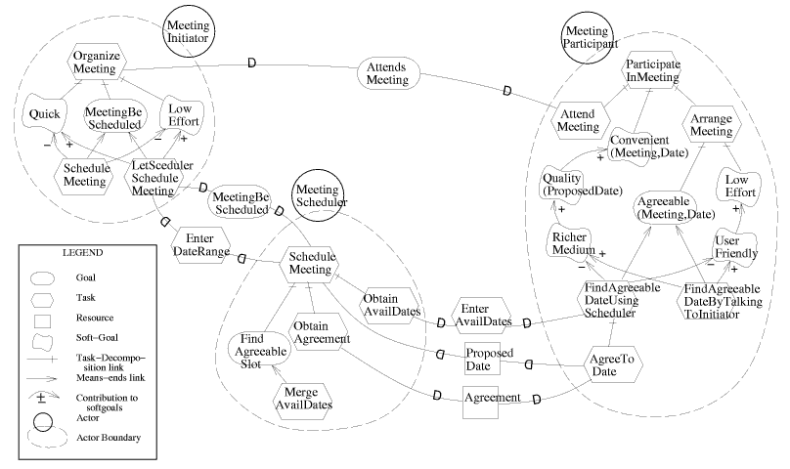
“Strategic Rationale” Model with Meeting Scheduler

Slide 52
Agent Orientation as a Software Paradigm
Situated
  sense the environment and perform actions that change the environment
Autonomous
  have control over their own actions and internal states
  can act without direct intervention from humans
Flexible
  responsive to changes in environment, goal-oriented, opportunistic, take initiatives
Social
  interact with other artificial agents and humans to complete their tasks and help others
Jennings, Sycara, Wooldridge (1998)

Slide 53
Analysis and Design of
Agent-Oriented Systems e.g., Wooldridge Jennings Kinny (JAAMAS 2000) “GAIA”
Analysis level
  Roles and Interactions
    Permissions
    Responsibilities
      liveness properties
      safety properties
    Activities
    Protocols
Design level
  Agent types
  Services
  Acquaintances
Modeling concepts being driven from programming again?!!
Structured Analysis from Structured Programming
OOA from OOD, OOP
AOA from AOP ??

Slide 54
What are the important concepts for
Agent Orientation as a Modeling Paradigm ?
Intentionality
Autonomy
Sociality
Identity & Boundaries
Strategic Reflectivity
Rational Self-Interest

Slide 55
Agent Orientation as a Modeling Paradigm
Intentionality
  Agents are intentional.
  Agent intentionality is externally attributed by the modeller.
  Agency provides localization of intentionality.
  Agents can relate to each other at an intentional level.
Autonomy
Sociality
Identity & Boundaries
Strategic Reflectivity
Rational Self-Interest

Slide 56
Agent Orientation as a Modeling Paradigm
Intentionality
Autonomy
  An agent has its own initiative, and can act independently. Consequently, for a modeler and from the viewpoint of other agents:
    its behavior is not fully predictable.
    It is not fully knowable,
    nor fully controllable.
  The behavior of an agent can be partially characterized, despite autonomy, using intentional concepts.
Sociality
Identity & Boundaries
Strategic Reflectivity
Rational Self-Interest

Slide 57
Agent Orientation as a Modeling Paradigm
Intentionality
Autonomy
Sociality
  An agent is characterized by its relationships with other agents, and not by its intrinsic properties alone.
  Relationships among agents are complex and generally not reducible.
  Conflicts among many of the relationships that an agent participates in are not easily resolvable.
  Agents tend to have multi-lateral relationships, rather than one-way relationships.
  Agent relationships form an unbounded network
  Cooperation among agents cannot be taken for granted.
  Autonomy is tempered by sociality.
Identity & Boundaries
Strategic Reflectivity
Rational Self-Interest

Slide 58
Agent Orientation as a Modeling Paradigm
Intentionality
Autonomy
Sociality
Identity & Boundaries
  Agents can be abstract, or physical.
  The boundaries, and thus the identity, of an agent are contingent and changeable.
  Agent, both physical and abstract, may be created and terminated.
  Agent behavior may be classified, and generalized.
Strategic Reflectivity
Rational Self-Interest

Slide 59
Agent Orientation as a Modeling Paradigm
Intentionality
Autonomy
Sociality
Identity & Boundaries
Strategic Reflectivity
  Agents can reflect upon their own operations.
  Development world deliberations and decisions are usually strategic with respect to the operational world.
  The scope of reflectivity is contingent.
Rational Self-Interest

Slide 60
Agent Orientation as a Modeling Paradigm
Intentionality
Autonomy
Sociality
Identity & Boundaries
Strategic Reflectivity
Rational Self-Interest
  An agent strives to meet its goals.
  Self-interest is in a context of social relations.
  Rationality is bounded and partial.

Slide 61
Beyond RE
Agent-Oriented Software Development
  Tropos – a full-fledge development framework driven by AORE concepts
Agent-Oriented Software Engineering
  Goal and agent modelling support for SE activities
  e.g., traceability for maintenance, AO as scoping, limiting propagation of change, assigning responsibilities in software eng. organizations, software processes, …
Business Goals/Arch. <-> System Goals/Arch.
  Business strategy modelling & analysis
    Intellectual Property management
  Security and Trust

Slide 62
Agent Abstractions
Agent abstractions are mentalistic
    beliefs: agent’s representation of the world
    knowledge: (usually) true beliefs
    desires: preferred states of the world
    goals: consistent desires
    intentions: goals adopted for action
Multi-agent abstractions involve interactions
    social: about collections of agents
    organizational: about teams and groups
    ethical: about right and wrong actions
    legal: about contracts and compliance
[Huhns AOIS’99]

Slide 63
Why Do These Abstractions Matter?
Because modern applications go beyond traditional metaphors and models in terms of their dynamism, openness, and trustworthiness
  virtual enterprises: manufacturing supply chains, autonomous logistics
  electronic commerce: utility management
  communityware: social user interfaces
  problem-solving by teams
[Huhns AOIS’99]

Slide 64
Agent architectures
Deliberative
Agents
Reactive
Agents
Hybrid
Agents
Agent
Architectures
Interacting
Agents
Other
Approaches
[Kirn AOIS’99]

Slide 65
Reactive Agents
Controller
World
Stimuli
Plans
Pattern 1
Plan 1
E
f
f
e
c
t
o
r
S
e
n
s
o
r
Pattern 2
Plan 2
.
.
.
.
.
.
Pattern n
Plan n
Agent
[Kirn AOIS’99]

Slide 66
Deliberative Agents
Cognition
World
Inference
Strategies
Memory
E
f
f
e
c
t
o
r
S
e
n
s
o
r
Goals
Environment
Model
Utility
Function
Inter-
pretation
Domain
Knowledge
Planner
Agent
[Kirn AOIS’99]

Slide 67
Types of Information Agents
User Interface
Agent
Application
Program
“Standard” information agents and architectures are becoming available
Reg/Unreg
(KQML)
Reply
Reply
Query or
Update
In SQL
Broker
Agent
Ontology Agent
Reg/Unreg
(KQML)
Mediator
Agent
Ontology
(CLIPS)
Reg/Unreg
(KQML)
Reg/Unreg
(KQML)
Mediated
Query (SQL)
Schemas
(CLIPS)
Mediated
Query (SQL)
Reply
Reply
Database Resource Agent
Database Resource Agent
[Huhns AOIS’99]

Slide 68
Agent-Orientation for Enterprise Information Systems
The Changing Nature of Enterprise
The Challenge for Enterprise Systems
Why Agent-Orientation for Enterprise Systems

Slide 69
The Changing Nature of Enterprise
distributed and networked
  people, organization, and work practices, not just the technology!
diversity, local autonomy, open-endedness
  much uncertainty, incomplete knowledge & control
  need flexibility
change and evolution
  constantly and rapid

Slide 70
The Challenge for Enterprise Systems
need to deal with conflicting needs and demands from many players / stakeholders
From Integration to Cooperation
Autonomous
Islands
Cooperation
“working together”
Full
Integration

Slide 71
Why Agent-Orientation for Enterprise Information Systems
Agent orientation addresses the demands and challenges of new enterprise environments and systems
What would it mean?
We should develop Agent-Oriented...
  requirements engineering techniques, models
  design and architectural approaches
  implementation methods and technologies
  run-time and evolution support

Slide 72
Modeling for Enterprise Systems
It is well-recognized that many types of modeling are required to deal with the various aspects of enterprise, e.g.,
activity modeling
function modeling
resource modeling
information modeling
organization modeling

Slide 73


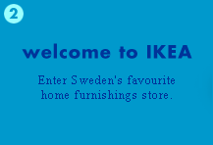



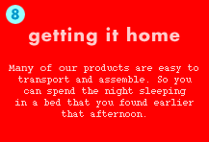
Consider one successful enterprise...
important organizational and social
aspects are missing in conventional models

Slide 74
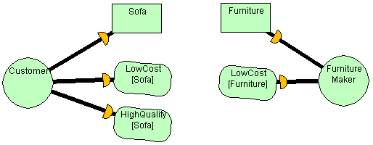
Wants and Abilities
I want
...
I can
provide
...

Slide 75
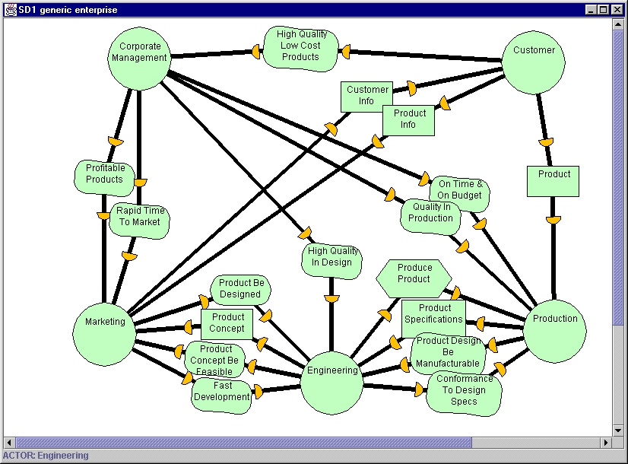
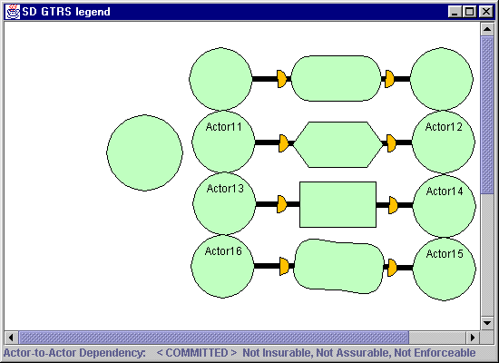
A Strategic Dependency Model
LEGEND
goal dependency
task dependency
resource dependency
softgoal dependency
actor

Slide 76
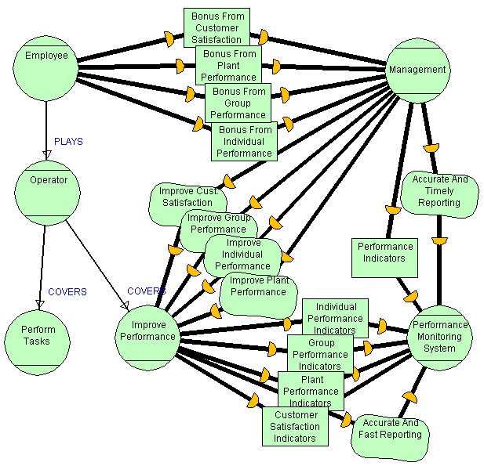
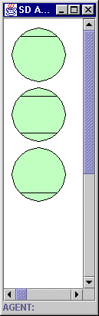
Roles, Positions, Agents
LEGEND
agent
position
role
A Strategic Dependency model showing reward structure for improving performance, based on an example in [Majchrzak96]

Slide 77
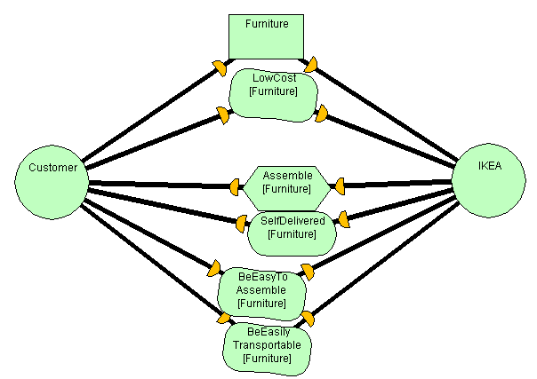
Some strategic dependencies between IKEA and its customers

Slide 78
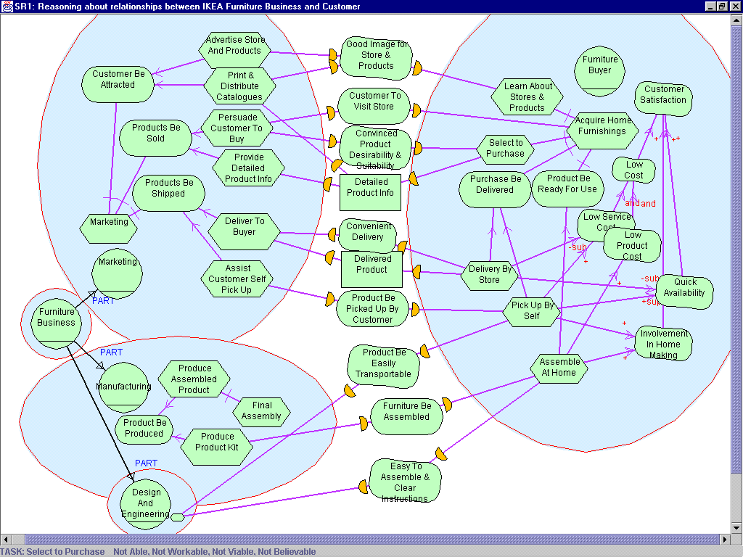
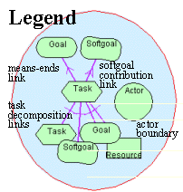
A Strategic Rationale Model

Slide 79
Analysis and Design Support
opportunities and vulnerabilities
  ability, workability, viability, believability
  insurance, assurance, enforceability
  node and loop analysis [Yu ICEIMT’97]
design issues
  raising, evaluating, justifying, settling
  based on qualitative reasoning

