Slide 1
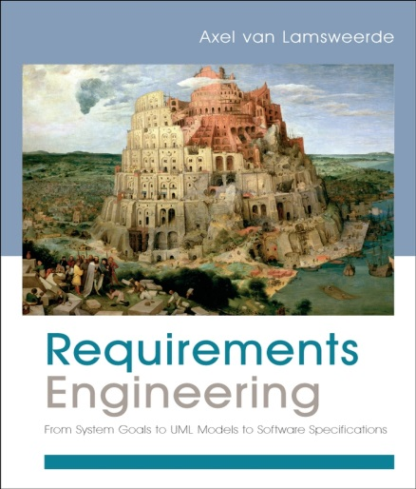
Building System Models for RE
Chapter 12
Modeling System Operations

Slide 2
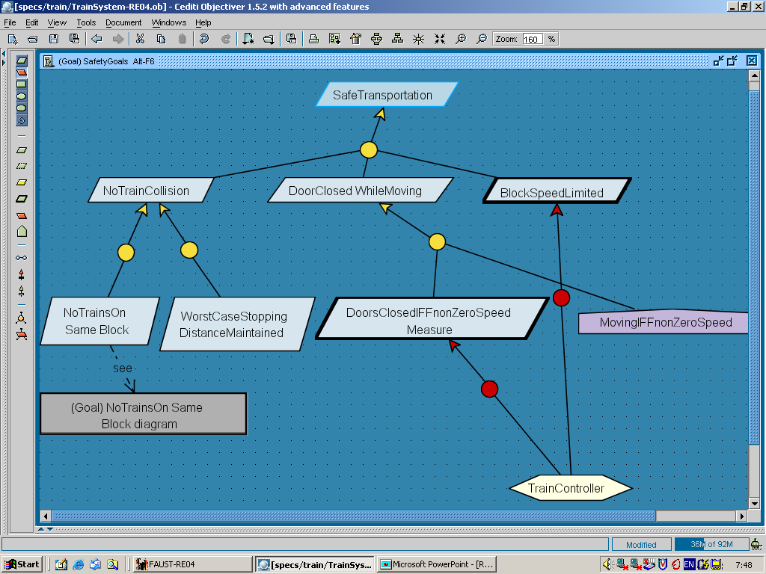
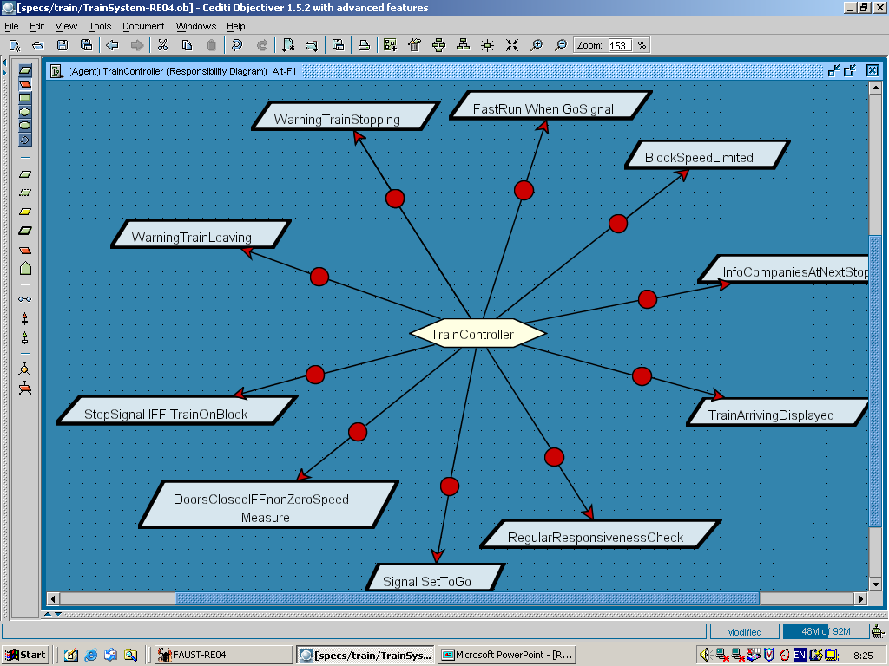
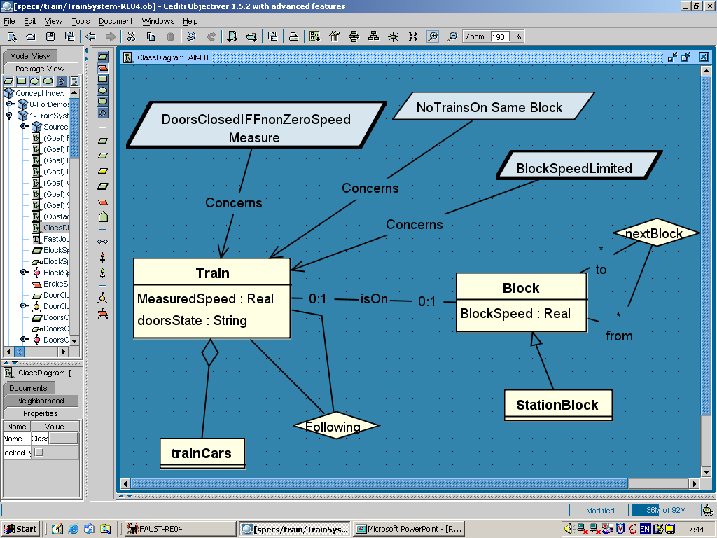
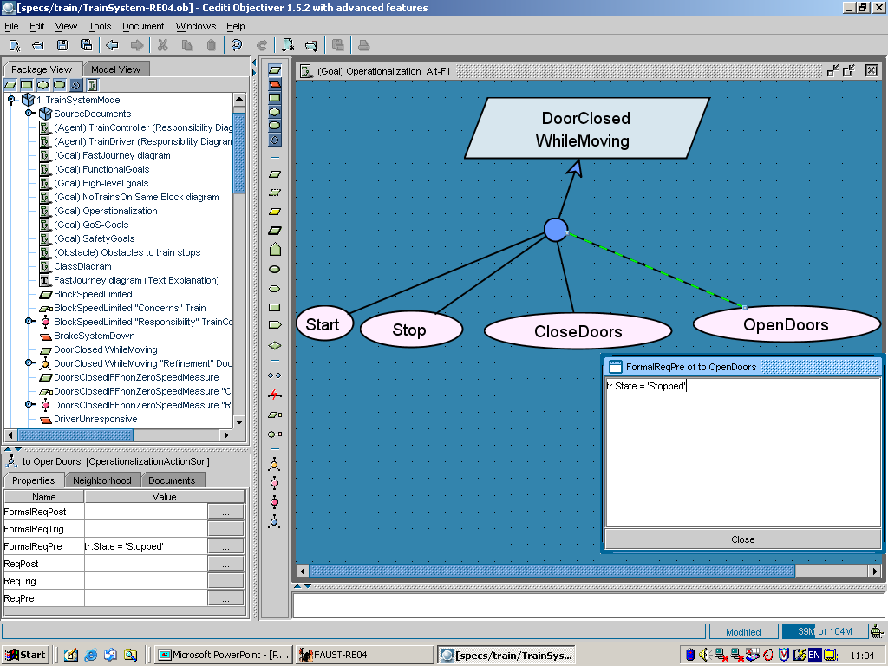
Building models for RE
Goals
Agents & responsibilities
Objects
Operations
what ?

Slide 3
The operation model
Functional view of the system being modeled
what services are to be provided ? (statics)
under what conditions for goal satisfaction ?
Represented by operationalization diagram, UML use cases
Multiple uses ...
software specifications --input for development team
description of environment tasks & procedures
basis for deriving ...
black-box test data
executable specs for animation, prototyping
definition of function points (for size estimation), work units, user manual sections
satisfaction arguments, traceability management

Slide 4
Modeling system operations: outline
What are operations?
Characterizing system operations
Operation signature
Domain pre- and postconditions
Operation performer
Goal operationalization
Required pre-, post-, trigger conditions for goal satisfaction
Agent commitments
Goal operationalization and satisfaction arguments
Goals, agents, objects & operations: the semantic picture
Representing operation models
Operationalization diagrams
UML use case diagrams
Building operation models: heuristics & derivation rules

Slide 5
What are operations?
Operation Op = set of input-output state pairs (binary relation)
Op ⊆ InputState × OutputState
state = tuple of functional pairs x_{i} |→ v_{i} (cf. Chap.10)
x_{i} : variable, v_{i} : corresponding value
input variables: object instances to which Op applies
output variables: object instances upon which Op acts
attributes of i/o variables instantiated as state variables
Operation applications yield state transitions (events)
operation
instance i/o variable
state variable

Slide 6
What are operations? (2)
Op must operationalize underlying goals from goal model
to make these satisfied => application under restricted conditions
Generally deterministic: relation over states is a function
no multiple alternative outputs from same input
Atomic: map input state to state at next smallest time unit
not decomposable into finer-grained operations
F decompose underlying goals, not operations ! (semantically simpler)
for operations lasting some duration: use startOp/endOp events
May be applied concurrently with others
intra-agent concurrency (beside inter-agent concurrency)
e.g. OpenDoors || DisplayWhichPlatform
Software operations, environment operations (tasks)
e.g. PlanMeeting , SendConstraints

Slide 7
Characterizing system operations
Basic features: Name, Def, Category
Signature
declares the input-output relation over states
input/output variables & their type (object from object model)
scope may be restricted to specific attributes (nothing else changes)
used in pre-, postconditions
graphical or textual annotation

Slide 8
Characterizing system operations: domain pre- and postconditions
Conditions capturing the class of state transitions that intrinsically defines the operation
DomPre: condition characterizing class of input states in domain
descriptive, not prescriptive for some goal
DomPost: condition characterizing class of output states in domain
descriptive, not prescriptive for some goal

Slide 9
Characterizing system operations: operation performer
An agent performs an operation if the applications of this operation are activated by instances of this agent (cf. Chap.11)
Consistency rules between operation model & agent model:
every input/output state variable in signature of operation performed by an agent must be monitored/controlled by it in the agent model
every operation is performed by exactly one agent
cf. Unique Controller constraint in agent model

Slide 10
Modeling system operations: outline
What are operations?
Characterizing system operations
Operation signature
Domain pre- and postconditions
Operation performer
Goal operationalization
Required pre-, post-, trigger conditions for goal satisfaction
Agent commitments
Goal operationalization and satisfaction arguments
Goals, agents, objects & operations: the semantic picture
Representing operation models
Operationalization diagrams
UML use case diagrams
Building operation models: heuristics & derivation rules

Slide 11
Goal operationalization
A set of operations operationalizes a leaf goal if their spec ensures that the goal is satisfied
These specs are prescriptive conditions on the operations ...
ReqPre: necessary condition on Op's input states to ensure G:
when DomPre true, Op may be applied only if ReqPre true
(permission)
ReqTrig: sufficient condition on Op's input states to ensure G:
when DomPre true, Op must be applied as soon as ReqTrig true
(obligation)
ReqPost: condition on Op's output states to ensure G

Slide 12
Specifying operations textually: example
Operation OpenDoors
Def Operation controlling the opening of all train doors
Input tr: Train / {Speed, Position}, Output tr: Train / DoorsState
DomPre The doors of train tr are closed
DomPost The doors of train tr are open
ReqPre For DoorsClosedWhileNonzeroSpeed
The speed of train tr is 0
ReqPre For SafeEntry&Exit
Train tr is at a platform
ReqTrig For FastEntry&Exit
Train tr has just stopped at a platform

Slide 13
Specifying operations textually: another example
Operation SendAccelerationCommand
Def Operation of sending an acceleration command to a train
Input tr: Train, cm: CommandMsg;
Output sm: Sent % association instance %
DomPre not Sent (cm, tr)
DomPost Sent (cm, tr)
ReqPost For SafeAccelerationCommand
The commanded acceleration sent to tr is within safe range
with respect to the preceding train’s position and speed
ReqTrig For CommandMsgSentInTime
No acceleration command has been sent to tr since 3 seconds

Slide 14
Goal operationalization (2)
A leaf goal is generally operationalized by multiple operations
An operation generally operationalizes multiple goals
all ReqPre/ReqPost are implicitly conjoined with DomPre/DomPost
if DomPre true, must be applied as soon as one ReqTrig true
(not applied if one or more ReqTrig true with DomPre false)
if DomPre true, may be applied provided all ReqPre true
(not applicable if all ReqPre true with DomPre false)
Consistency constraint on obligations & permissions:
if DomPre and (ReqTrig₁ or … or ReqTrig_{M})
then (ReqPre₁ and … and ReqPre_{N})

Slide 15
Agent commitments
For every goal G under responsibility of agent ag,
for every operation Op operationalizing G,
ag must guarantee that Op is applied ...
when Op’s DomPre holds,
as soon as one of Op’s ReqTrig holds
only if all Op’s ReqPre hold,
so as to establish Op’s DomPost together with all Op’s ReqPost
Extra consistency rules between operation and agent models:
ag responsible for G must perform all operations operationalizing G
if these operations operationalize other goals, ag must be responsible for these goals too

Slide 16
Agent commitments (2)
Agent non-determinism: eager vs. lazy behavior on ReqPre’s
eager: agent instance applies operation as soon as all ReqPre true (maximal progress)
lazy: agent instance applies operation only when obliged
(due to one ReqTrig true)
Agent concurrency:
ReqTrig’s on multiple operations true in same state
true parallelism, intra-agent or inter-agent

Slide 17
Goal operationalization and satisfaction arguments
The goal and operation models may be used to argue that operational requirements ensure higher-level objectives
bottom-up chaining of operationalization & refinement links
{Spec(Op₁), …, Spec(Op_{M})} |= OperationalizedGoal
{Subgoal₁ …, Subgoal_{N} , DOM} |= ParentGoal (cf. Chap.8)
Yield derivational traceability links for free
backwards: why this operational spec, for what goals?
forwards: how is this goal ensured?

Slide 18
Satisfaction arguments & derivational traceability: example

Slide 19
Modeling system operations: outline
What are operations?
Characterizing system operations
Operation signature
Domain pre- and postconditions
Operation performer
Goal operationalization
Required pre-, post-, trigger conditions for goal satisfaction
Agent commitments
Goal operationalization and satisfaction arguments
Goals, agents, objects & operations: the semantic picture
Representing operation models
Operationalization diagrams
UML use case diagrams
Building operation models: heuristics & derivation rules

Slide 20
Goals, objects, agents, operations: the semantic picture
operations
object states
behavioral
goals
agents
smallest
time unit
time

Slide 21
Representing operation models: operationalization diagrams

Slide 22
Representing operation models: UML use case diagrams
A use case outlines the operations an agent has to perform
+: interactions with ...
the agents controlling operation inputs
the agents monitoring operation outputs
+: optional (ill-defined) links ...
to exception operations with preconditions ("extend")
to sub-operations ("include")
A use case should operationalize the leaf goals underlying the operations in it
Decompose goals, NOT operations !! (=> precise semantics)
Generation of use cases from the operation & agent models is straightforward (see hereafter)

Slide 23
UML use case diagrams: example
operation
interaction
OpenDoors
...
...
agent
doorsActuator
CloseDoors
SendAccelerationCommand
boundary
Speed&Accel
Controller
OnBoardController
performing agent

Slide 24
UML use case diagrams: another example
ReserveBookCopy
precondition
<<extend>>
NotAvailable
<<extend>>
TooManyCopies
BorrowBookCopy
RefuseLoan
<<include>>
ExtendLoan
CheckForReservation
<<include>>
Patron
ReturnBookCopy
AddBookCopy
RemoveBookCopy
Staff
UpdateCatalog
Browser
WhichBooksOnTopic?
WhoBorrowedWhat?
LibrarySoftware

Slide 25
Modeling system operations: outline
What are operations?
Characterizing system operations
Operation signature
Domain pre- and postconditions
Operation performer
Goal operationalization
Required pre-, post-, trigger conditions for goal satisfaction
Agent commitments
Goal operationalization and satisfaction arguments
Goals, agents, objects & operations: the semantic picture
Representing operation models
Operationalization diagrams
UML use case diagrams
Building operation models: heuristics & derivation rules

Slide 26
Derive operations from goal fluents
For each behavioral goal: list atomic conditions F in its spec
For each F, look for ...
initiating operation: makes F true when F was false
=> DomPre = not F, DomPost = F
terminating operation: makes F false when F was true
=> DomPre = F, DomPost = not F

Slide 27
Identify operations from interaction scenarios
For each interaction event in a scenario ...
? is this an operation application by the source agent with output monitored by the target agent ?
? what is the atomic condition characterizing the interaction on the source agent timeline...
right before interaction => DomPre
right after interaction => DomPost

Slide 28
Strengthen DomPre, DomPost with conditions required by goals
Identify required permissions: if an operation's DomPost effect can violate a goal G under condition C ...
=> ReqPre for G: not C
e.g. OpenDoors: ReqPre for "Moving → Closed": not Moving
Identify required obligations: if an operation's DomPost effect is prescribed by a goal G to hold whenever condition C gets true ...
=> ReqTrig for G: C
e.g. OpenDoors: ReqTrig for "StoppedAtPlatform → Open": StoppedAtPlatform
Identify required additional effects: if an operation's DomPost is not sufficient to ensure the target condition T of goal G ...
=> ReqPost for G: missing subcondition from T
e.g. PlanMeeting: ReqPost for ConvenientMeeting: date not in excluded dates

Slide 29
Generating use case diagrams from operationalization diagrams
For each agent ag in agent diagram:
enclose all operations performed by ag in a rectangle labelled ag ;
for each such operation op in corresponding operationalization diagram:
for each other agent ag-env in the agent diagram:
if ag-env controls one of op’s input object attribute/association
or monitors one of op’s output object attribute/association
then include ag-env around ag’s rectangle
and draw an interaction link between op and ag-env
transfer op's DomPre, DomPost, ReqPres, ReqTrigs, ReqPosts

