Slide 1
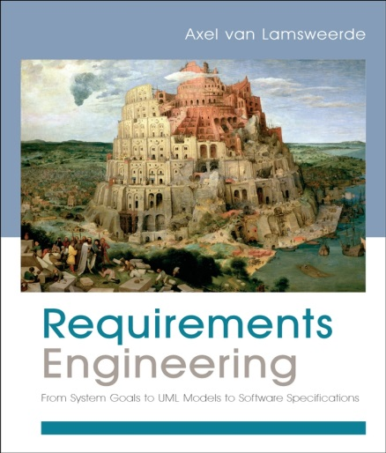
Building System Models for RE
Chapter 13
Modeling System Behaviours

Slide 2
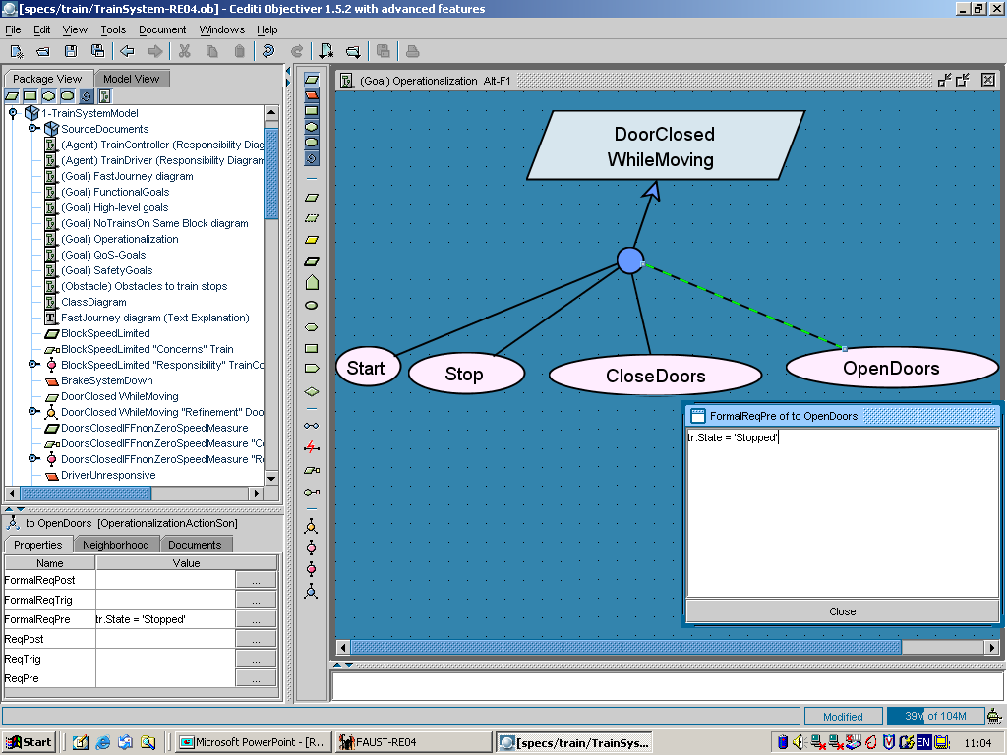
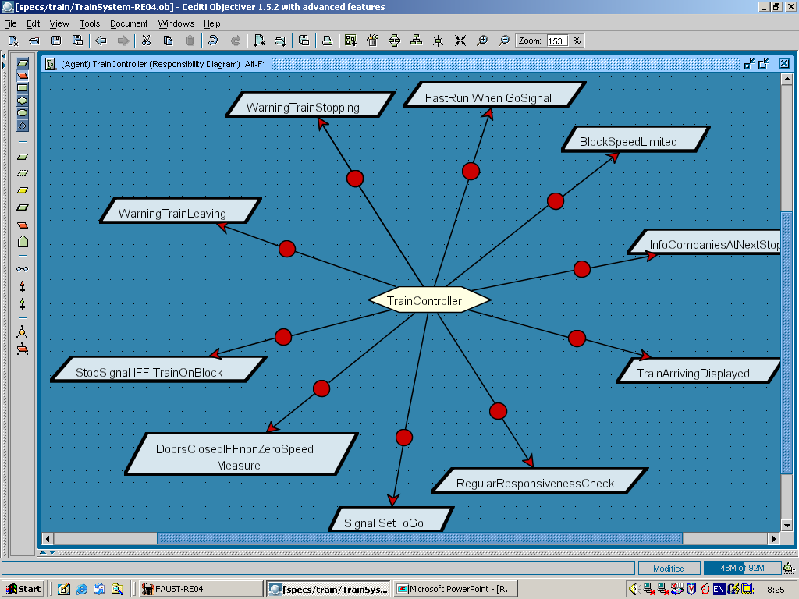
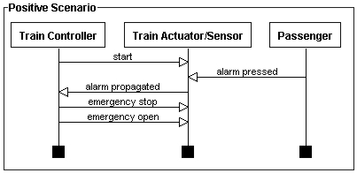
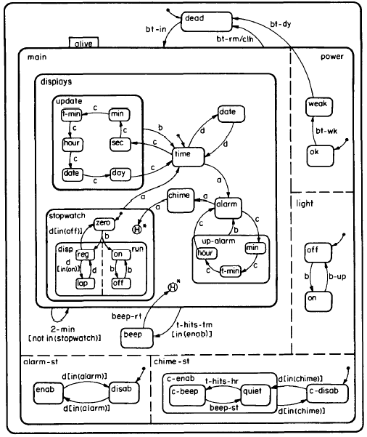
Building models for RE
Chap.11: Agents &
responsibilities
Chap.12: Operations
what ?
Chap.13: Behaviors -
Scenarios
Chap.13: Behaviors -
State machines

Slide 3
The behavior model
System dynamics: behavior of agents in terms of temporal sequences of state transitions for variables they control
instance behaviors: specific behaviors of specific agent instances -> scenarios: implicit states, explicit events
class behaviors: all possible behaviors of any agent instance
-> state machines: explicit states, explicit causing events
Actual behaviors (syst-as-is) or required behaviors (syst-to-be)
Represented by UML sequence diagrams, UML state diagrams
Multiple uses ...
instance level: scenarios for understanding, elicitation, validation, explanation, acceptance test data
class level: state machines for animation, model checking, code generation

Slide 4
Modeling system behaviors: outline
Modeling instance behaviors
Scenarios as UML sequence diagrams
Scenario refinement: episodes and agent decomposition
Modeling class behaviors
State machines as UML state diagrams
State machine refinement: sequential & concurrent substates
Building behavior models
Elaborating relevant scenarios for good coverage
Decorating scenarios with explicit state conditions
From scenarios to state machines
From scenarios to goals
From operationalized goals to state machines

Slide 5
Modeling instance behaviors through scenarios
Scenario = temporal sequence of interaction events among agent instances (cf. Chap.2, Chap.4)
instances of different agents or of same agent
interactions are directed ...
from source agent instance, controlling the event,
to target agent instance, monitoring the event
interactions are synchronous among event controller/monitor
Positive scenario: illustrates some way of achieving implicit goal(s)
normal scenario: in normal cases
abnormal scenario: in exception cases (don’t forget these!)
Negative scenario: illustrates some inadmissible behavior (obstacle)

Slide 6
Scenarios as UML sequence diagrams
environment agent instance
: OnBoardTrain
Controller
: TrainSensor/Actuator
p1: Passenger
software agent instance
Arrival
DoorsOpening
Entrance
interaction
event
DoorsClosing
time
Start
lifeline
Arrival
See book,
Sect. 13.1
DoorsOpening
Exit

Slide 7
Scenarios as UML sequence diagrams (2)
Event = instantaneous conceptual object
instances exist in single system states only
can be structured in the object model (cf. Chap. 10)
attributes, structural associations
F used for information transmission along interaction
event specialization/generalization with inheritance
Interaction events correspond to applications of operations
by source agent, notified to target agent (cf. operation model)
A sequence diagram defines ...
a total order on events along an agent’s lifeline (precedence)
a partial order on all scenario events
independent events on different lifelines are not comparable under precedence
A scenario may be composed of episodes (sub-scenarios)

Slide 8
Scenarios as UML sequence diagrams (3)
: LoanManager
: CopyManager
: Staff
BookRequest
(PatrId, BookId)
instance appears
LoanQtyOK ?
(PatrId)
event attributes
CpyAvailable ?
(BookId)
self-interaction
Reserved ?
(BookId)
OK-Available
(CopyId)
OK-Book
(PatrId, CopyId)
checkOut
(PatrId, CopyId)
instance disappears
simultaneity

Slide 9
UML sequence diagrams: negative scenarios, optional interactions
prohibited interaction
optional interaction

Slide 10
Scenario refinement: episodes
Episode = subsequence of interactions for specific subgoal
Appears as coarse-grained interaction
To be detailed in another diagram with specific interactions
Helpful for incremental elaboration of complex scenarios
reference to another diagram

Slide 11
Scenario refinement: agent decomposition
Coarse-grained agent instances may subsequently be decomposed into finer-grained ones
With finer-grained interactions

Slide 12
Scenarios are concrete vehicles for goal elicitation
: LoanManager
: CopyManager
: Staff
BookRequest
(PatrId, BookId)
WHY?
=>
Maintain
[LimitedLoanQty]
LoanQtyOK ?
(PatrId)
CpyAvailable ?
(BookId)
Reserved ?
(BookId)
OK-Available
(CopyId)
OK-Book
(PatrId, CopyId)
checkOut
(PatrId, CopyId)

Slide 13
Scenarios are concrete vehicles for goal elicitation (2)
easy to get from or validate with stakeholders
DoorsClosed
WhileMoving
:Controller
:Train
:Passenger
arrival
doors
opening
WHY ?
entrance
doors
closing
G covers Sc:
Sc is subhistory in set of
behaviors prescribed by G
move
arrival
doors
opening

Slide 14
Modeling system behaviors: outline
Modeling instance behaviors
Scenarios as UML sequence diagrams
Scenario refinement: episodes and agent decomposition
Modeling class behaviors
State machines as UML state diagrams
State machine refinement: sequential & concurrent substates
Building behavior models
Elaborating relevant scenarios for good coverage
Decorating scenarios with state conditions
From scenarios to state machines
From scenarios to goals
From operationalized goals to state machines

Slide 15

State machines
A state machine (SM) is specified by a transition relation
tr: S × E → S
S: set of explicit states (usually finite), for any class instance
E: finite set of events causing state transitions
Preferably, tr is a function: deterministic SM
Graphically, tr (S₁, e) = S₂ is represented by ...
S₁
e
S₂
Semantics: the transition to S₂ gets fired iff ...
we are in state S₁ and event e occurs
DoorsOpening
doorsClosed
doorsOpen
DoorsClosing

Slide 16
SM states vs. snapshot states
Snapshot state of an object instance (cf. Chap. 10):
tuple of functional pairs x_{i} |→ v_{i}
x_{i} : state variable (object attribute, association)
v_{i} : corresponding value
e.g. (tr.Speed |→ 0, tr.Location |→ 9.25, tr.DoorsState |→ Open,
On |→ (tr, block13), At |→ (tr, platform1))
SM state of object instance: class of snapshot states sharing same value for some behavioral state variable (equivalence class)
e.g.
SM state doorsClosed of Train instance tr includes snapshot states
{ tr.Speed |→ 0, tr.Loc |→ 3, tr.DoorsState |→ 'closed', At |→ (tr, pl1) } ,
{ tr.Speed |→ 5, tr.Loc |→ 9, tr.DoorsState |→ 'closed', At |→ (tr, nil) }

Slide 17
SM states
To model agent behaviors: one state machine per state variable controlled by an arbitrary agent instance
captures admissible sequences of transitions among SM states of corresponding object instance --for this variable
A SM state has some duration
corresponding object instance remains some time in it
Initial state = state when object instance appears in system
InstanceOf (o, Ob) gets true
initial state
DoorsOpening
doorsClosed
doorsOpen
DoorsClosing
SM state
SM for state variable tr.doorsState of TrainInfo object
controlled by TrainController

Slide 18
SM states (2)
Final state = state when object instance disappears from system
InstanceOf (o, Ob) gets false
checkOut
final state
Available
onLoan
Loss
Return
SM for state variable bc.Status of BookCopyInfo object
controlled by LibraryManager

Slide 19
SM events
Event instances are instantaneous phenomena ...
As seen before ...
event = object whose instances exist in single states
InstanceOf (ev, E) denoted by Occurs (E)
Can be structured ...
attributes, associations, specializations, to be declared in object model
corresponding attribute values can be attached to events in SM
No duration, unlike SM states
BookCopyInfo
Status
Available
checkOut (PatrID)
onLoan
Loss
Return (PatrID)
attribute value

Slide 20
Typology of SM events
External event: not controlled by agent associated with SM
temporal event
elapsed time period e.g. after (3secs), after (Timeout)
clock state change e.g. when (12:00pm)
external stimulus: event occurring in SM controlled by another
agent
state change, condition becoming true
to be notified from that other SM (see below)
e.g. TrainStart, PassengerAlarm
Internal event: controlled by agent associated with this SM
application of operation performed by the agent
e.g. DoorsClosing is an application of operation CloseDoors
Tip: use suggestive verb for operation,
corresponding noun for operation application

Slide 21
Events & state transitions
State transition = state change caused by event occurrence
S₁
e
S₂
S’₁
e’
the associated object instance gets to target state S₂ iff...
it is in source state S₁ and instance of event e occurs
or it is in source state S’₁ and instance of event e’ occurs
Automatic transition = no event label
fires without waiting for event occurrence

Slide 22
Guarded transitions
Transitions may also have a guard label
guard = Boolean expression on state variables
e [ guard ]
S₁
S₂
Necessary condition for transition firing:
the associated object instance gets into state S₂ ...
if it is in state S₁ and instance of event e occurs
and only if the guard is true
BookInfo
Status
copyReturn
guard
copyBorrowing
[ LastCopy ]
Borrowable
UnBorrowable
copyReturn
copyBorrowing [ not LastCopy ]

Slide 23
Guarded transitions (2)
Do not confuse ...
necessary condition for transition firing: guard true
sufficient condition for transition firing: event occurrence
Trigger condition: guard on transition with no event label
automatic transition with guard => necessary/sufficient cond
Idle
CoinsInsertion
MoneyCollected
Cancellation
Selection (Item)
[ Change < 0 ]
ChangeChecked
as soon as
guard
gets true
SM for
state variable
controlled by
VendingMachine
after (3 secs)
[ Change = 0 ]
[ Change > 0 ]
ItemGiven
ChangeGiven

Slide 24
Auxiliary actions in a state diagram
Action = operation associated with a transition
to be applied when transition fires
atomic
no meaningful effect on dynamics captured by SM states:
state resulting from operation application would clutter diagram
typically, info display/acquisition to/from agent’s environment
doorState
DoorsOpening
[AtPlatform and Speed = 0]
/ Display terminalInfo
doorsClosed
doorsOpen
DoorsClosing
/ Activate warningRinging
action

Slide 25
Avoiding irelevant states through actions: example
Idle
CardInsertion
CardInserted
not a
meaningful state
CardRead
CardValidated
alternative:
...
Idle
CardInsertion
CardInserted
/ readCard
CardValidated
...

Slide 26
Event notification
Important subclass of actions ...
event is notified from producing diagram to consuming diagram
causes transitions in consuming diagram
=> diagram synchronization
BookCopyInfo
Status
checkOut (PatrID)
/ send BookInfo.copyBorrowing
Available
onLoan
Loss
Return (PatrID)
/ send BookInfo.copyReturn
synchronization
event notification
from producer
to consumer
BookInfo
Status
copyReturn
copyBorrowing
[ LastCopy ]
Borrowable
UnBorrowable
copyReturn
copyBorrowing [ not LastCopy ]

Slide 27
Entry/exit actions
Entry action
within state, prefixed by “entry”
amounts to all incoming transitions labelled with this action
Exit action
within state, prefixed by “exit”
amounts to all outgoing transitions labelled with this action
=> avoids action duplication in diagrams

Slide 28
Entry/exit actions: example
(
entry action
Call
(TelNum, self)
Idle
Ringing
HangUp
(self)
TakeOff
(self)
TakeOff (self)
/ show TelNum
TakeOff
Tone
Connected
entry / show TelNum
ConnectionLost
(self, TelNum)
HangUp
(self)
Call
(self, TelNum)
Connection (self, TelNum)
/ show TelNum
Waiting
Calling
Tone
GetFree
(TelNum)
GetBusy
(TelNum)
Busy
Tone

Slide 29
Nested states for SM structuring
SM states can be decomposed into sub-states ...
convenient for incremental elaboration of complex SM
F coarse-grained states refined into finer-grained states
Sequential decomposition:
coarse-grained state becomes SM on sequential sub-states: visited sequentially
Parallel decomposition:
coarse-grained state becomes SM on concurrent sub-states: visited concurrently
Structuring mechanisms in UML borrowed from Statecharts [Harel, 1987]

Slide 30
SM refinement: sequential decomposition
Super-state is a diagram composed of sequential sub-states connected by new transitions
contains the nested sub-states (graphical nesting)
or contains “include” reference to other diagram
AccelerComnd
[ Acceler > 0]
TrainSpeedState
Moving
AccelerComnd
[ Acceler > 0]
Stopped
Accelerating
[ Speed = 0]
AccelerComnd
[ Acceler £ 0]
AccelerComnd
[ Acceler > 0]
initial sub-state
Decelerating
sequential sub-state
AccelerComnd
[ Acceler £ 0]

Slide 31
Sequential decomposition: same example with include reference
TrainSpeedState
AccelerComnd
[ Acceler > 0]
Stopped
Moving
include / movingSubStates
[ Speed = 0]
movingSubStates
AccelerComnd
[ Acceler £ 0]
Accelerating
Decelerating
AccelerComnd
[ Acceler > 0]
AccelerComnd
[ Acceler > 0]
AccelerComnd
[ Acceler £ 0]

Slide 32
Sequential decomposition: semantic rules
The object instance is in super-state iff it is in one (and only one) of the nested sub-states
Every incoming or outgoing transition of super-state is by default inherited by each sub-state
substates may have their own incoming/outgoing transitions
within super-state or to external states
To inhibit transition inheritance by each substate ...
for incoming transition to super-state: insert initial sub-state as predecessor of sub-state where to start
forces to start from there, not from anywhere
for outgoing transition from super-state: insert final sub-state as successor of sub-state where to leave
forces to leave from there, not from anywhere

Slide 33
Sequential decomposition: vending machine example
Idle
CoinsInsertion
MoneyCollected
Cancellation
Selection (Item)
[ Change < 0 ]
ChangeChecked
after (3 secs)
[ Change = 0 ]
[ Change > 0 ]
ItemGiven
ChangeGiven
GripToRow
RowOk
GripToItem
ItemOk
ItemPushed

Slide 34
Sequential decomposition: cash machine example
Active
KO-card
Validating
CardInsertion
Idle
OK-card
Cancellation
Selecting
Selection
inheritance
[Continue]
Maintenance
Request
Processing
End
[not Continue]
Maintenance
Printing
entry / readCard
exit / ejectCard
Exercise: capture paths in this SM as sequence diagrams (scenarios)

Slide 35
Sequential decomposition: thermostat controller
shutDown
Idle
[ Temp > Desired ]
[ Temp < Desired ]
[ Temp
= Desired ]
[ Temp
= Desired ]
Cooling
Heating
CoolActivating
HeatActivating
coolReady
/ CoolTurnOn
heatReady
/ HeatTurnOn
CoolActive
HeatActive

Slide 36
Parallel decomposition: concurrent behaviors
Agents often control multiple items in parallel
Problems with flat SM diagram ...
N item variables each with M values => M^{N} states !
same SM state mixing up different variables
Statechart = parallel composition of SM diagrams
one per variable evolving in parallel
statechart state = aggregation of concurrent substates
each may be recursively decomposed sequentially (or in parallel)
from M^{N} explicit SM states to M × N statechart states !
Statechart trace = sequence of successive aggregated SM states up to some point
Interleaving semantics: for 2 transitions firing in same state, one is taken after the other (non-deterministic choice)

Slide 37
Concurrent sub-states: example
parallel
composition
variable
doorsState
variable
trainSpeed
Trace example:
< (doorsClosed, trainStopped); (doorsClosed, trainMoving);
(doorsClosed, trainStopped); (doorsOpen, trainStopped) >
Model-checking tools can generate counterexample traces leading to violation of desired property (cf. Chap. 5)

Slide 38
Parallel decomposition: semantic rules
The object instance is in super-state iff it is in each of the nested concurrent sub-states
Every incoming or outgoing transition of super-state is propagated to each concurrent sub-state ...
for incoming transition: when it fires, an implicit transition to each concurrent substate is simultaneously fired (FORK mechanism)
for outgoing transition:
if no label: fires when implicit transitions from all concurrent substates were fired (in whatever order, JOIN mechanism)
if label: fires when event in label occurs with guard being true (forcing exit from all concurrent sub-states)

Slide 39
Fork / Join mechanisms: example
Processing
Transaction
Welcome
...
ClosingSession
Ok
GivingMoney
money
Taken
Money
Given
EjectingCard
card
Taken
Card
Ejected

Slide 40
Initial and final substates in concurrent diagrams

Slide 41
Combining parallel & sequential decomposition: guidelines for manageable diagrams
Introduce sequential sub-states for ...
refining complex, coarse-grained states
Introduce concurrent states for ...
state variables controlled by different agents
different state variables controlled by same agent
common events triggering multiple independent transitions
Insert ...
initial sub-state in each concurrent diagram, with outgoing transition to desired state
final sub-state in each concurrent diagram, with incoming transition from desired state
Avoid “spaghetti” diagrams where ...
transitions connecting sequential sub-states of a concurrent state to sequential sub-states of other concurrent states (or to outer super-states)

Slide 42
Parallel & sequential decomposition: example
Active
KO-card
Validating
Idle
CardInsertion
OK-card
Cancellation
Selecting
Selection
[Continue]
Processing
Maintenance
Request
End
[not Continue]
entry / readCard
exit / ejectCard
Printing
Maintenance
Checking
Testing
Devices
Self
Diagnosis
Fixing
[ not
More]
[More]
Waiting
Comnd
Executing
Command
key
Press

Slide 43
Combining parallel & sequential decomposition: guidelines for manageable diagrams (2)
When concurrent states are decomposed in sequential sub-states, check if any synchronization is required ...
same event requiring transitions in multiple sub-diagrams
event causing transition in consumer diagram to be notified in producer diagram (send action)
synchronizing guards on same state variable in different sub-diagrams
guard in sub-diagram refering to state variable modified by transition in other sub-diagram
Check lexical consistency of event names in order to avoid ...
undesired firing by different events with same name
non-firing due to same event having different names

Slide 44
TrainState
SpeedState
Moving
AccelerComnd
[ Acceler > 0 and
doorsState = ‘closed ’]
AccelerComnd
[ Acceler > 0]
Stopped
Accelerating
[ Speed = 0]
AccelerComnd
[ Acceler £ 0]
AccelerComnd
[ Acceler > 0]
synchronization:
train must be in
Stopped state for
getting into
doorsOpen state
Decelerating
AccelerComnd
[ Acceler £ 0]
DoorsState
DoorsOpening
[ AtStation
and Speed = 0 ]
doorsClosed
doorsOpen
DoorsClosing

Slide 45
Modeling system behaviors: outline
Modeling instance behaviors
Scenarios as UML sequence diagrams
Scenario refinement: episodes and agent decomposition
Modeling class behaviors
State machines as UML state diagrams
State machine refinement: sequential & concurrent substates
Building behavior models
Elaborating relevant scenarios for good coverage
Decorating scenarios with state conditions
From scenarios to state machines
From scenarios to goals
From operationalized goals to state machines

Slide 46
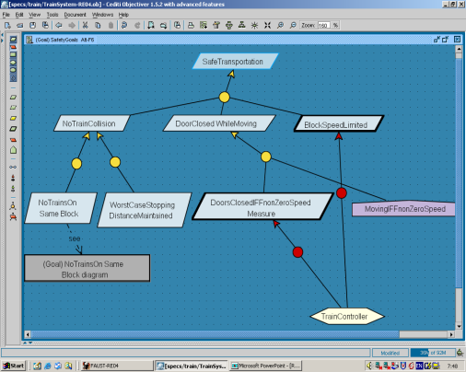
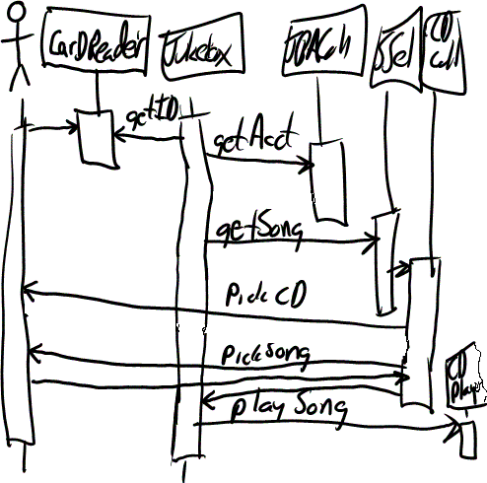

Goals, scenarios, state machines are complementary
J declarative, satisfaction arguments
J functional & non-functional, options
J many behaviors L but implicit
J early analyses
L too abstract? hard to elicit?
J concrete examples, narrative
J easier to elicit, validate
J explicit behaviors
J acceptance test data
L partial, few behaviors: coverage?
L implicit reqs, premature choices?
J visual abstraction
J explicit behaviors (entire classes)
J verifiable, executable
J code generation
L implicit reqs ... too operational?
L hard to build & understand

Slide 47
Elaborating relevant scenarios for good coverage
Work pairwise: one agent pair after the other
Ensure goal coverage by positive scenarios
Ensure obstacle coverage by negative scenarios
Identify auxiliary episodes
required for next interaction
info acquisition, agent authentication, help request, ...
Explore stimulus - response chains
if interaction = stimulus sent... what response is required?
Check scenarios for clean-up ...
split scenarios with unrelated concerns
remove irrelevant events
refine unmonitorable or uncontrollable interaction events
for related episodes: ensure common granularity

Slide 48
Elaborating relevant scenarios for good coverage (2)
Look for abnormal scenarios associated with normal ones...
"associated" = sharing common prefix episode,
then differing by possible exception case
look at these systematically ...
take all prefix episodes of normal scenario by increasing size
for each prefix: possible exceptions at the end ?
F possible use of exception patterns:
invalid data, unsatisfiable request,
no response, too late response, inadequate response,
cancel events, ...
for each exception: what suitable course of action?

Slide 49
Looking for associated abnormal scenarios: example
normal scenario

Slide 50
Looking for associated abnormal scenarios: example
smallest prefix of normal scenario
exception:
UnRegistered

Slide 51
Looking for associated abnormal scenarios: example
next prefix of normal scenario
exception:
UnRegistered
exception:
LoanQty-KO

Slide 52
Looking for associated abnormal scenarios: example
next prefix of normal scenario
exception:
UnRegistered
exception:
LoanQty-KO
exception:
notAvailable

Slide 53
Looking for associated abnormal scenarios: example
common prefix episode
differing postfix from
exception point

Slide 54
Modeling system behaviors: outline
Modeling instance behaviors
Scenarios as UML sequence diagrams
Scenario refinement: episodes and agent decomposition
Modeling class behaviors
State machines as UML state diagrams
State machine refinement: sequential & concurrent substates
Building behavior models
Elaborating relevant scenarios for good coverage
Decorating scenarios with state conditions
From scenarios to state machines
From scenarios to goals
From operationalized goals to state machines

Slide 55
Decorating scenarios with state conditions
Helpful for state-based reasoning from scenarios
State condition at timepoint on agent lifeline:
captures snapshot state of dynamic variables at this point
Structured as condition list: implicitly conjoined ...
monitored conditions: state of variables monitored by the agent
controlled conditions: state of variables controlled by the agent

Slide 56
Decorating scenarios with state conditions (2)
Condition lists are computed by down propagation along lifeline
From DomPre, DomPost of operations corresponding to interaction events (available from operation model)
For outgoing event:
add its DomPre to list of controlled conditions before it
add its DomPost to list of controlled conditions after it
remove any invalidated condition
For incoming event:
add its DomPost to list of monitored conditions after it
remove any invalidated condition

Slide 57
Propagating condition lists: example

Slide 58
From scenarios to state machines
State machines can be built incrementally from scenarios ...
so as to cover all behaviors captured by positive scenarios
while excluding all behaviors captured by negative scenarios
For building state diagrams from sequence diagrams,
3 steps:
Decorate scenarios with state conditions (as just seen)
Generalize scenarios into state machines
Check, extend & restucture resulting SMs

Slide 59
Generalize scenarios into state machines
One concurrent SM per variable controlled by the agent, whose paths cover all corresponding scenario lifelines
Lifeline selection: all lifelines refering to this controlled variable
SM path derivation:
sequence of states = sequence of lifeline state conditions on this controlled variable
transitions labelled with corresponding interaction event
add initial state, conditions on monitored variables as guards
remove transitions with no state change for this controlled variable
merge multiple occurrences of same state by folding => cycles
SM path merge:
take a path with initial state as first path
merge new path from its start: for each next state ...
- if already there: add incoming transition
- if not already there: add it + incoming transition

Slide 60
SM path derivation

Slide 61
SM path merge

Slide 62
Check resulting concurrent SM
Within concurrent state, for one controlled variable ...
Unreachable states ? (from initial state)
Missing states ? (incl. final state)
Missing or inadequate transitions ? (events, guards)
Missing actions ?
Between concurrent states, for different controlled variables
Synchronization needed? (as seen before)
Shared events? Synchronizing guards? Event notification ?
Lexical consistency of event names? (as seen before)

Slide 63
Modeling system behaviors: outline
Modeling instance behaviors
Scenarios as UML sequence diagrams
Scenario refinement: episodes and agent decomposition
Modeling class behaviors
State machines as UML state diagrams
State machine refinement: sequential & concurrent substates
Building behavior models
Elaborating relevant scenarios for good coverage
Decorating scenarios with state conditions
From scenarios to state machines
From scenarios to goals
From operationalized goals to state machines

Slide 64
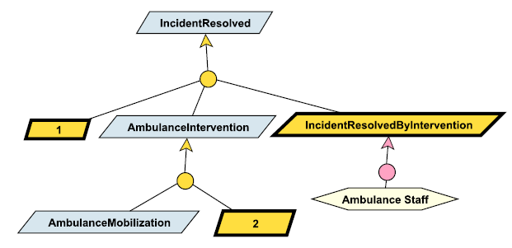
From scenarios to goals
Goals can be identified & specified from scenarios ...
generalize positive scenarios by covering more behaviors
while excluding all behaviors captured by negative scenarios
By asking WHY? questions about positive scenarios,
WHY NOT? questions about negative scenarios
cf. Sect. 8.8.2
Scenario decomposed in episodes
=> milestone refinement of scenario goal into episode subgoals
(cf. Section 8.8.5)
By mining behavioral goals from decorated scenarios

Slide 65
Identifying goals from scenario episodes: WHY questions and milestones
Milestone subgoals of
Achieve [MaximumAttendance]

Slide 66
Identifying goals from scenario episodes: WHY NOT questions
WHY NOT?
ß
Maintain [DoorsClosedWhileMoving]

Slide 67
Mining behavioral goals from decorated scenarios
Based on state conditions along timelines of decorated scenario (cf. Sect. 13.3.2)
For Achieve goals:
consider stimulus-response interaction patterns
if ConditionBeforeInteraction then sooner-or-later ConditionAfter
For Maintain goals:
consider invariance patterns from state transitions ST
if ST then always InvariantCondition unless NewCondition
These are leaf goals under responsibility of the agent associated with the timeline

Slide 68
Mining Achieve goals from stimulus-response interactions
Achieve [SignalSetToGo If NoTrainOnBlock]

Slide 69
Mining Maintain goals from invariant conditions along interactions
If Speed > 0 and doorsState = closed then
always doorsState = closed unless measuredSpeed = 0

Slide 70
Modeling system behaviors: outline
Modeling instance behaviors
Scenarios as UML sequence diagrams
Scenario refinement: episodes and agent decomposition
Modeling class behaviors
State machines as UML state diagrams
State machine refinement: sequential & concurrent substates
Building behavior models
Elaborating relevant scenarios for good coverage
Decorating scenarios with state conditions
From scenarios to state machines
From scenarios to goals
From operationalized goals to state machines

Slide 71
Deriving state diagrams from operationalized goals
One concurrent SM per agent; one concurrent sub-SM per variable controlled by the agent
For each dynamically relevant state variable ...
Operationalization selection: take all leaf goals constraining it + associated operations including it in their Ouput list
SM derivation: for each selected operation Op, derive a transition
(DomPre, DomPost) ⇒ (sourceState, TargetState)
with transition label Op
Conjunction of all ReqPre ⇒ transition guard
Disjunction of all ReqTrig ⇒ guard on event-free transition
Add label-free transition from initial state (based on variable's Init)
Check, extend, restructure this SM as needed
Can be used the other way round to find missing ReqPre, ReqTrig, Op

Slide 72
Deriving state diagrams from operationalized goals: example

