Slide 1
Distributed and Cloud Computing
K. Hwang, G. Fox and J. Dongarra
Chapter 2: Computer Clusters for
Scalable parallel Computing
Adapted from Kai Hwang
University of Southern California
March 30, 2012

Slide 2
What is a computing cluster?
A computing cluster consists of a collection of interconnected stand-alone/complete computers, which can cooperatively working together as a single, integrated computing resource. Cluster explores parallelism at job level and distributed computing with higher availability.
A typical cluster:
  Merging multiple system images to a SSI
  (single-system image) at certain functional levels.
  Low latency communication protocols applied
  Loosely coupled than an SMP with a SSI

Slide 3
Multicomputer Clusters:
Cluster: A network of computers supported by middleware and interacting by message passing
PC Cluster (Most Linux clusters)
Workstation Cluster
  COW – Cluster of Workstations
  NOW – Network of Workstations
Server cluster or Server Farm
Cluster of SMPs or ccNUMA (cache coherent Non-Uniform Memory Architecture) systems
Cluster-structured massively parallel processors
  (MPP) – about 85% of the top-500 systems

Slide 4
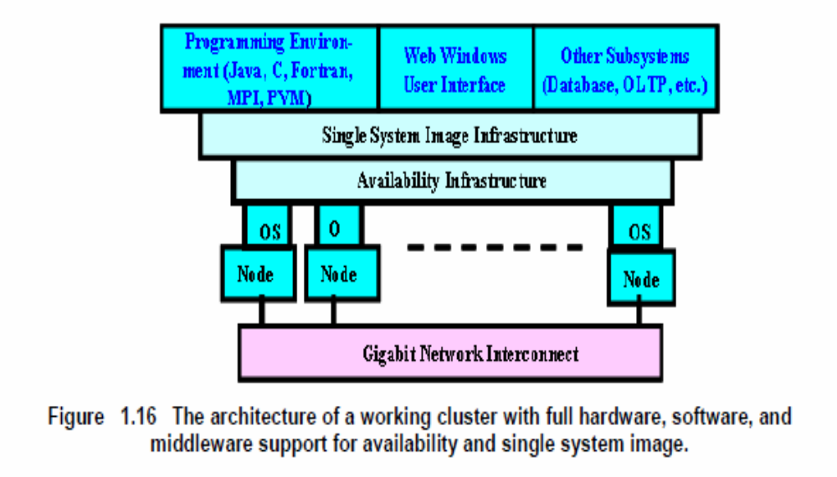
Multi-Computer Cluster Components

Slide 5
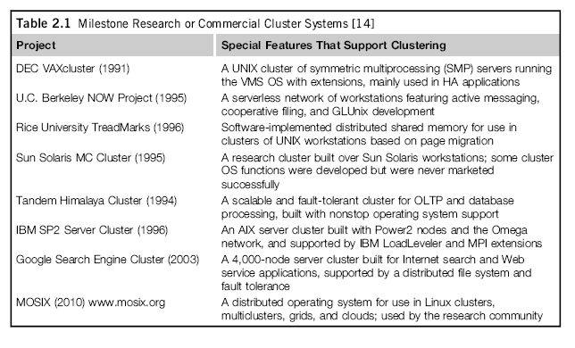

Slide 6
Attributes Used in Cluster Classification
Attributes | Attribute Value
Packaging | Compact | Slack
Control | Centralized | Decentralized
Homogeneity | Homogeneous | Heterogeneous
Security | Enclosed | Exposed
Example | Dedicated cluster | Enterprise cluster

Slide 7
Cluster Classification
Scalability : Adding servers to a cluster or adding more clusters to a network as the application need arises.
Packaging : Compact / Slack
  Compact – packaged in racks in machine room
  Slack – PC, workstations geographically distributed
Control : Centralized / De-centralized.
Homogenaity: Same vs. different platforms (e.g. CPUs, OSs)
Programmability : Ability to run a variety of applications.
Security : Exposure of intra-cluster communication.

Slide 8
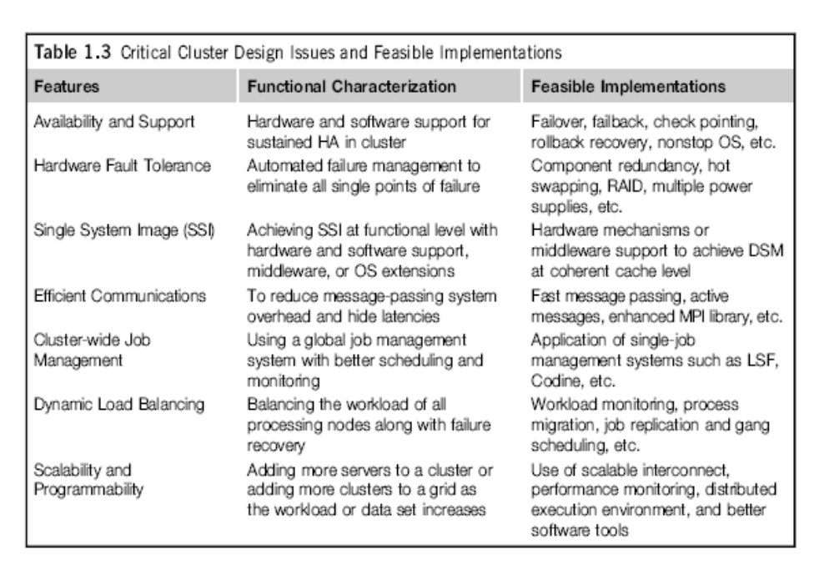

Slide 9
Operational Benefits of Clustering
High availability (HA) : Cluster offers inherent high system availability due to the redundancy of hardware, operating systems, and applications.
Hardware Fault Tolerance: Cluster has some degree of redundancy in most system components including both hardware and software modules.
OS and application reliability : Run multiple copies of the OS and applications, and through this redundancy
Scalability : Adding servers to a cluster or adding more clusters to a network as the application need arises.
High Performance : Running cluster enabled programs to yield higher throughput.

Slide 10
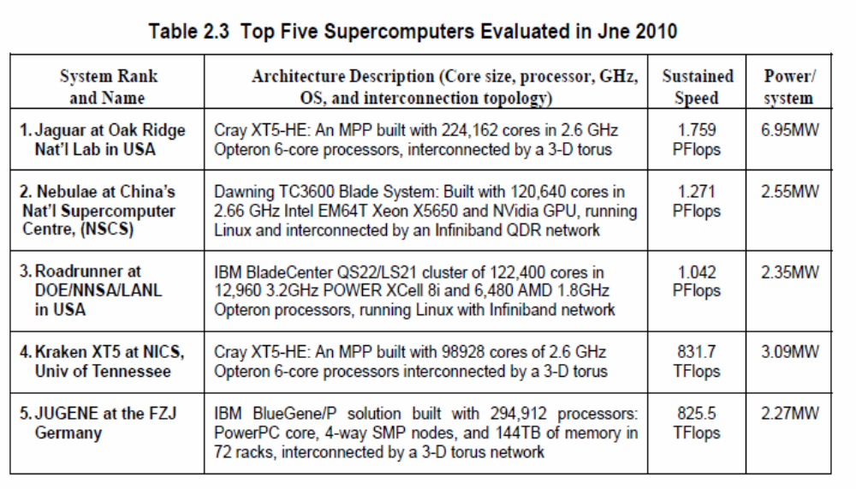
Top- 500 Release in June 2010

Slide 11
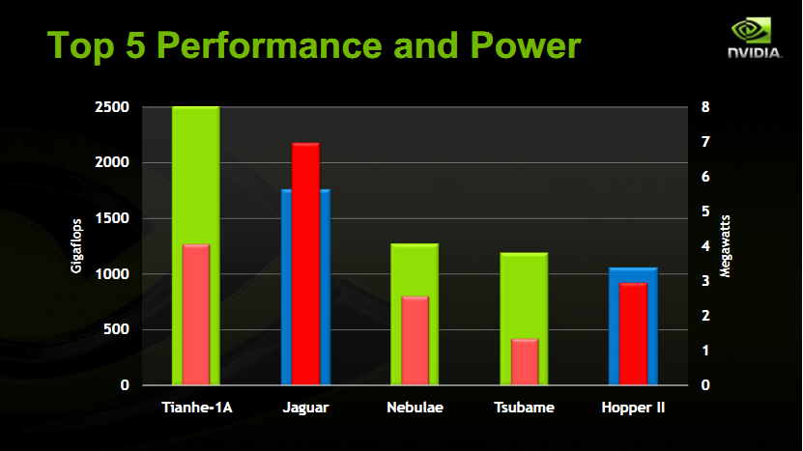
(Courtesy of Bill Dally, 2011)

Slide 12
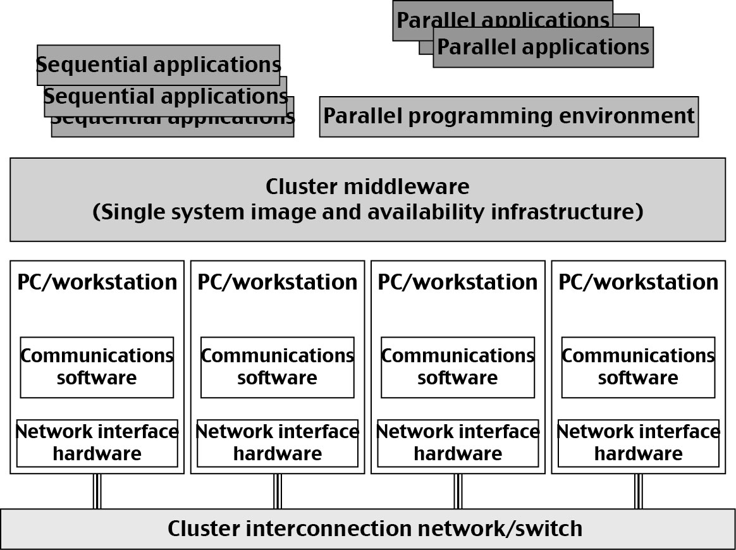
Basic Cluster Architecture
Computer Cluster built from commodity hardware, software, middleware, and network supporting HA and SSI

Slide 13
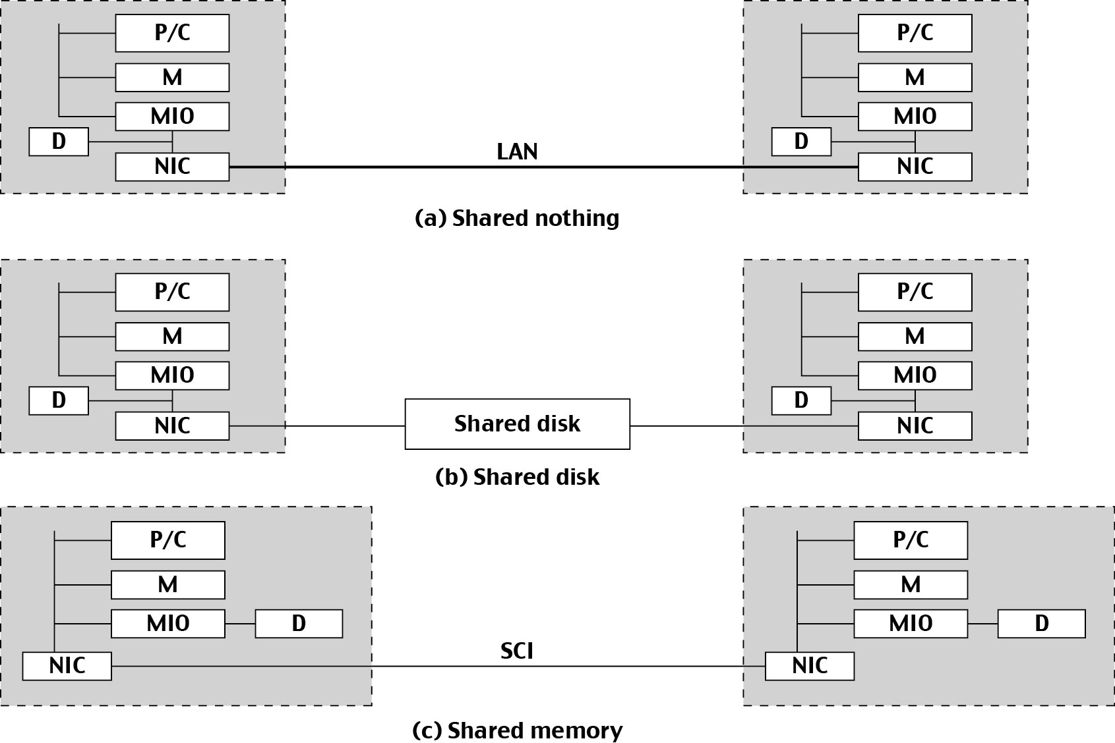
Resource Sharing in Cluster of Computers
Three ways to connect cluster nodes.

Slide 14
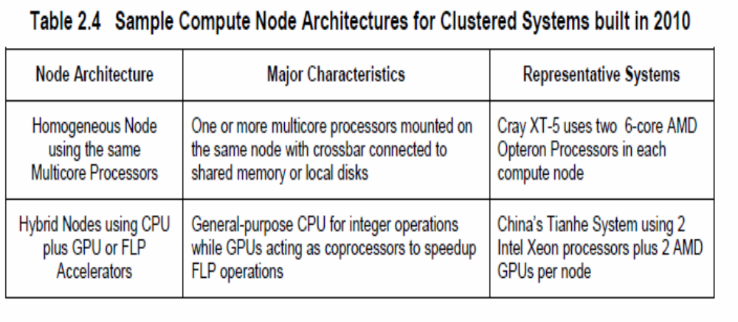
Compute Node Architectures :

Slide 15
Overview of Blue Gene L
Blue Gene L is a supercomputer jointly developed by IBM and Lawrence Livermore National Laboratory
It occupies 17 of the top 100 slots in the rankings at top500.org, including 5 of the top 10
  360 TeraFLOPS theoretical peak speed
Largest configuration:
  At Lawrence Livermore Nat’l Lab.
  Runs simulations on US nuclear weapon stockpile
  64 physical racks
  65,536 compute nodes
  Torus interconnection network of 64 x 32 x 32

Slide 16
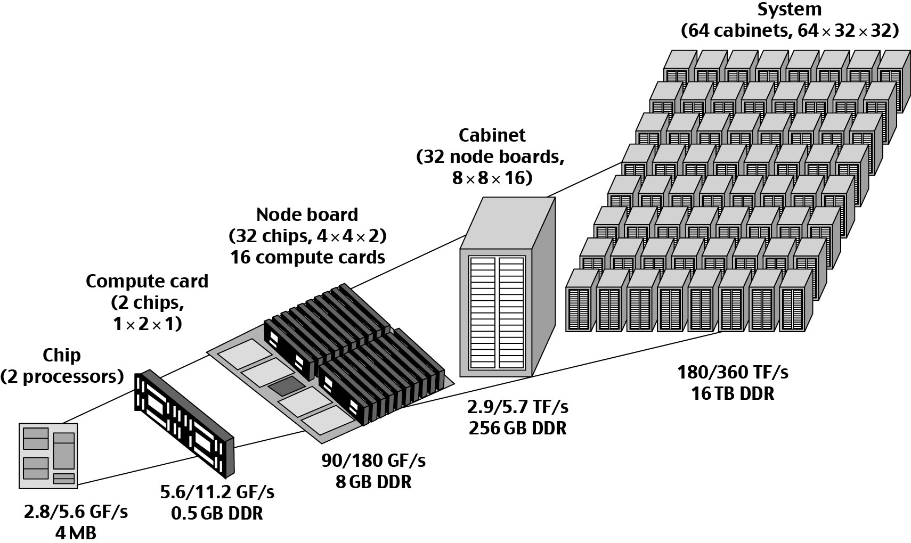
IBM BlueGene/L Supercomputer: The World Fastest Message-Passing MPP built in 2005
Built jointly by IBM and LLNL teams and funded by US DoE ASCI Research Program

Slide 17
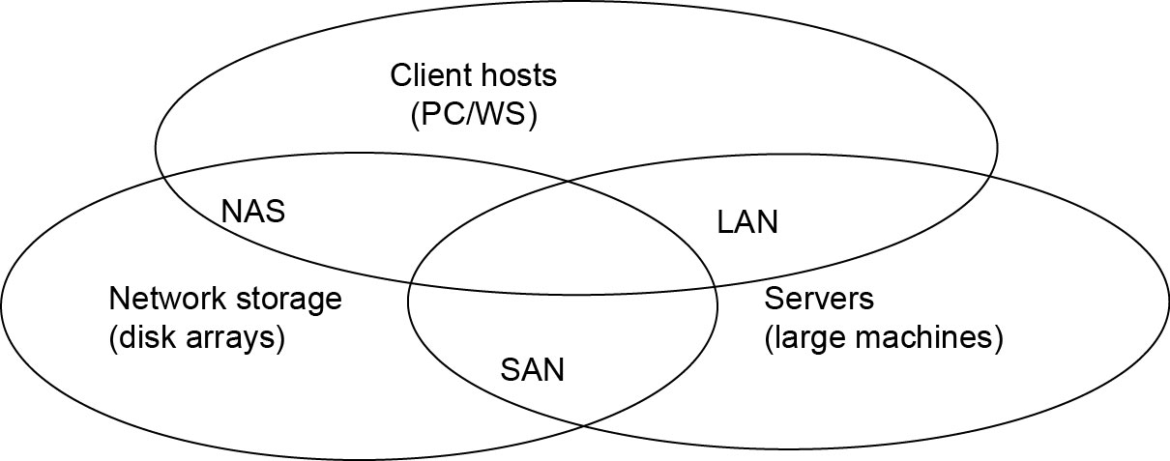
Standard Cluster Interconnects
SAN (storage area network) - connects servers with disk arrays
LAN (local area network) – connects clients, hosts, and servers
NAS (network attached storage) – connects clients with large storage systems

Slide 18
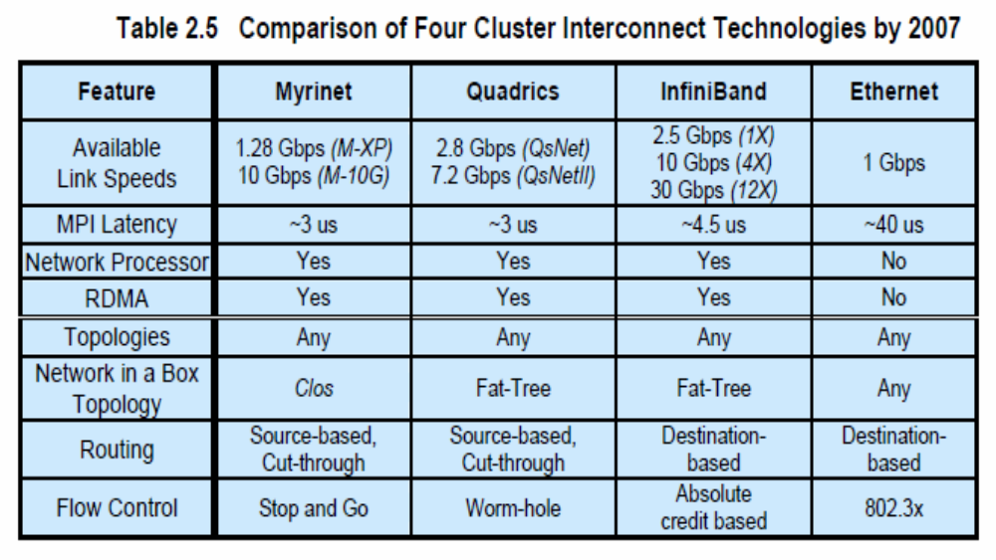
High Bandwidth Interconnects

Slide 19
Example : InfiniBand (1)
Provides applications with an easy-to-use messaging service.
Gives every application direct access to the messaging service without need not rely on the operating system to transfer messages.
Provides a messaging service by creating a channel connecting an application to any other application or service with which the application needs to communicate.
Create these channels between virtual address spaces.

Slide 20
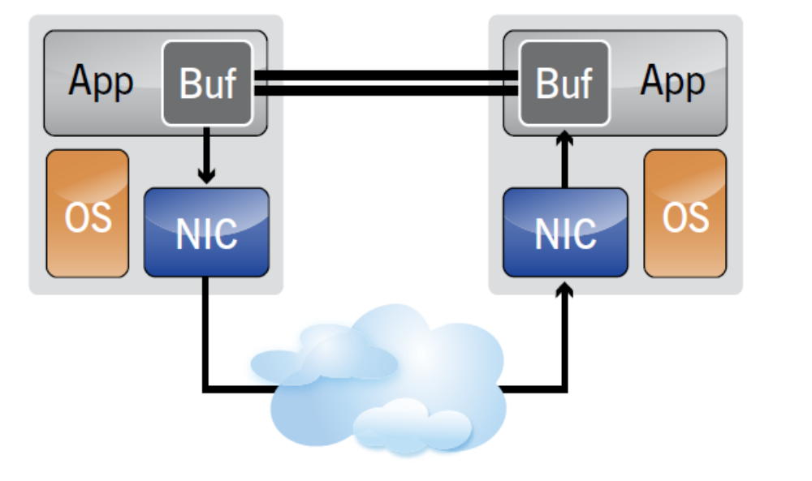
Example : InfiniBand (2)
InfiniBand creates a channel directly connecting an application in its virtual address space to an application in another virtual address space.
The two applications can be in disjoint physical address spaces – hosted by different servers.

Slide 21
InfiniBand Architecture
HCA – Host Channel Adapter. An HCA is the point at which an InfiniBand end node, such as a server or storage device, connects to the InfiniBand network.
TCA – Target Channel Adapter. This is a specialized version of a channel adapter intended for use in an embedded environment such as a storage appliance.
Switches – An InfiniBand Architecture switch is conceptually similar to any other standard networking switch, but molded to meet InfiniBand’s performance and cost targets.
Routers – Although not currently in wide deployment, an InfiniBand router is intended to be used to segment a very large network into smaller subnets connected together by an InfiniBand router.

Slide 22
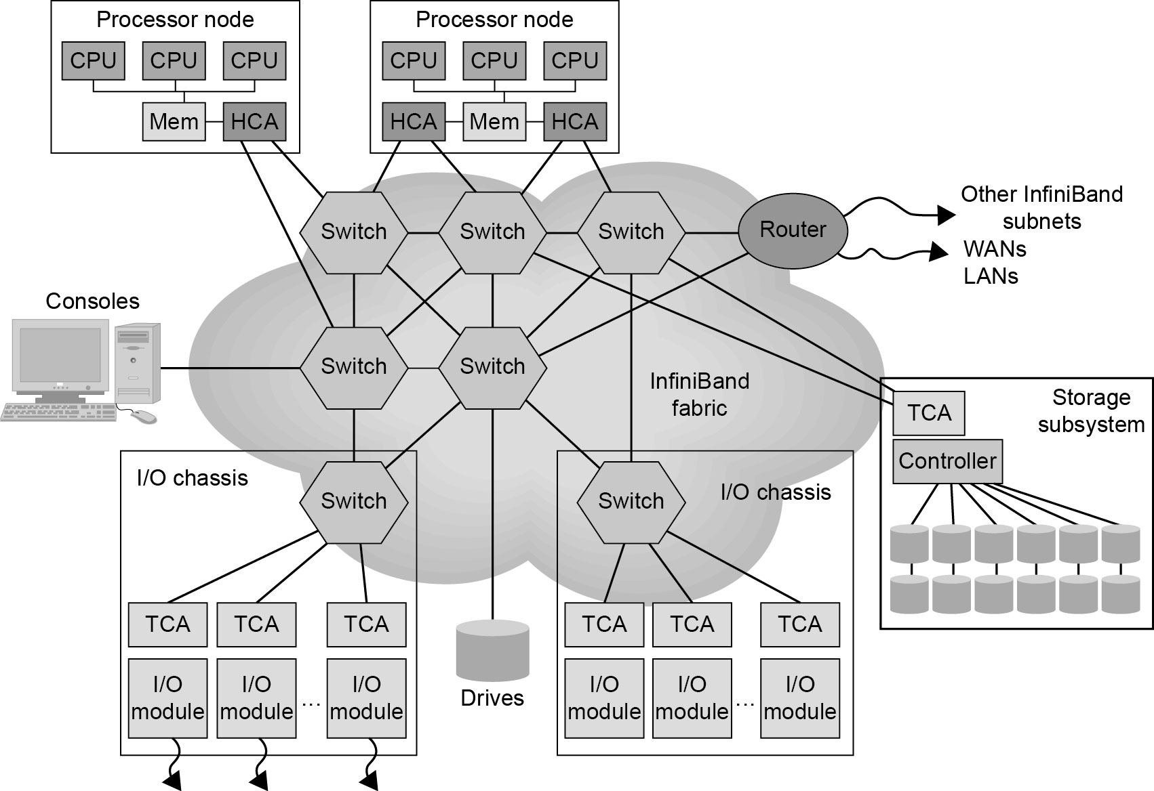
Example: InfiniBand System Fabric

Slide 23
Example: The Big Google Search Engine
A Supercluster built over high-speed PCs and Gigabit LANs for global web page searching applications provided by Google.
Physically, the cluster is housed in 40 PC/switch racks with 80 PCs per rack and 3200 PCs in total
Two racks to house two 128 x 128 Gigabit Ethernet switches, the front hosts, and UPSs, etc.
All commercially available hardware parts with Google designed software systems for supporting parallel search, URL linking, page ranking, file and database management, etc.

Slide 24
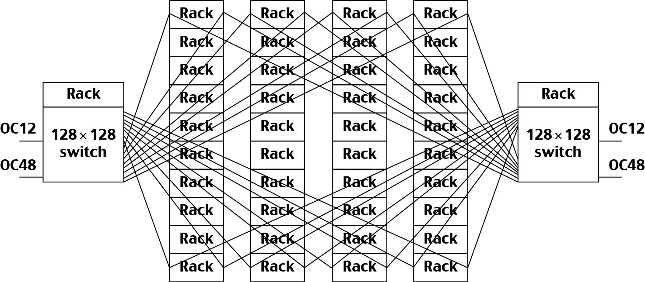
Google Search Engine Cluster

Slide 25
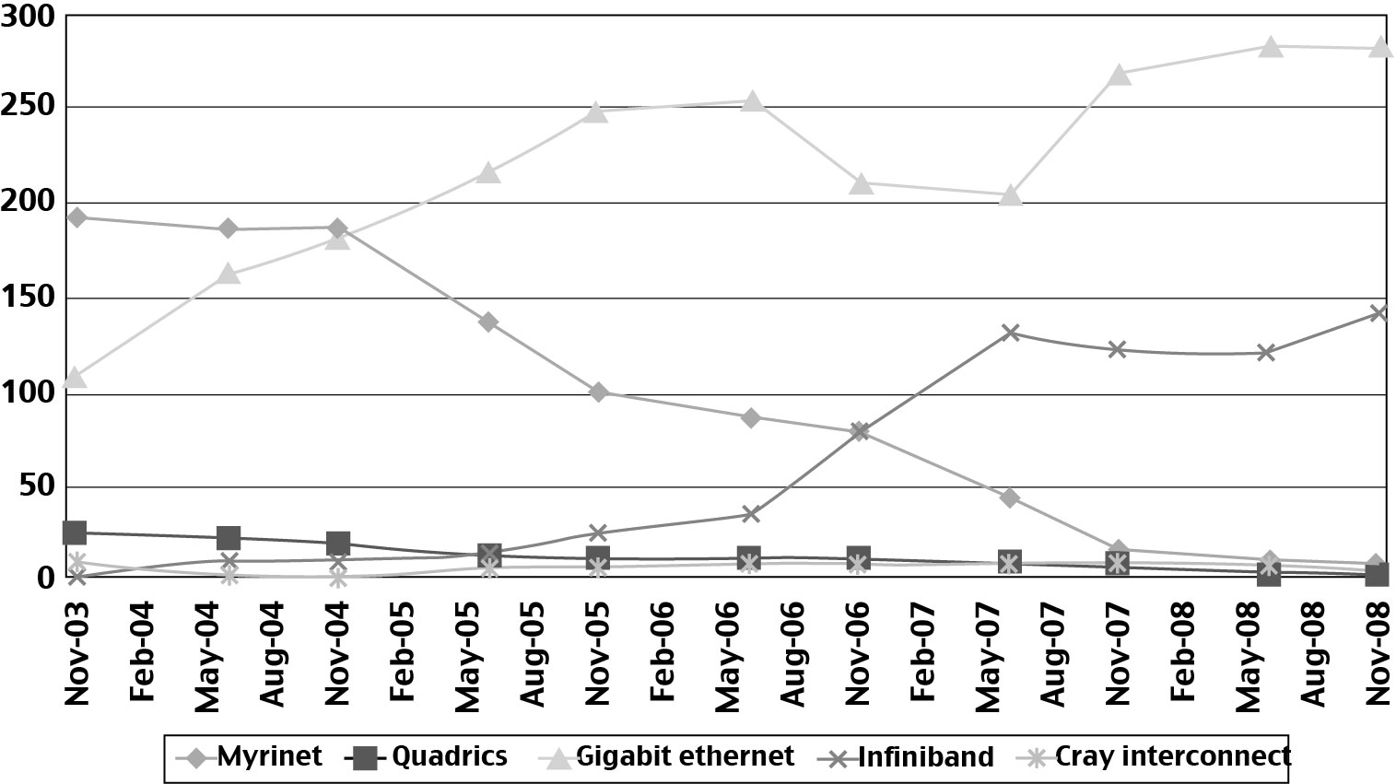
Distribution of high-bandwidth interconnects in Top-500 systems from 2003 to 2008

Slide 26
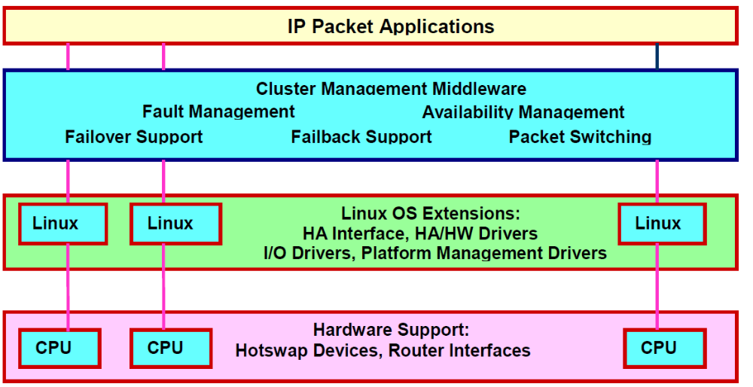
Hardware, Software, and Middleware Support
Middleware, Linux extensions, and hardware support for achieving high-availability in a cluster system

Slide 27
Design Principles of Clusters
Single-system image (SSI)
High availability (HA)
Fault tolerance
Rollback recovery

Slide 28
Single System Image (SSI)
A single system image is the illusion, created by software or hardware, that presents a collection of resources as an integrated powerful resource.
SSI makes the cluster appear like a single machine to the user, applications, and network.
A cluster with multiple system images is nothing but a collection of independent computers (Distributed systems in general)

Slide 29
Single-System-Image Features
Single System: The entire cluster is viewed by the users as one system, which has multiple processors.
Single Control: Logically, an end user or system user utilizes services from one place with a single interface.
Symmetry: A user can use a cluster service from any node. All cluster services and functionalities are symmetric to all nodes and all users, except those protected by access rights.
Location Transparent: The user is not aware of the whereabouts of the physical device that eventually provides a service.

Slide 30
Basic SSI Services
Single Entry Point
  telnet cluster.usc.edu
  telnet node1.cluster.usc.edu
Single File Hierarchy: xFS, AFS, Solaris MC Proxy
Single I/O, Networking, and Memory Space
Other
Single Job Management: GlUnix, Codine, LSF, etc.
Single User Interface: Like CDE in Solaris/NT
Single process space

Slide 31
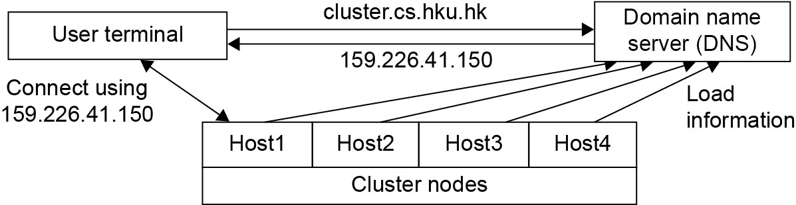
Example: Realizing a single entry point in a cluster of computers
Four nodes of a cluster are used as host nodes to receive users’ login requests.
To log into the cluster a standard Unix command such as “telnet cluster.cs.hku.hk”, using the symbolic name of the cluster system is issued.
The symbolic name is translated by the DNS, which returns with the IP address 159.226.41.150 of the least-loaded node, which happens to be node Host1.
The user then logs in using this IP address.
The DNS periodically receives load information from the host nodes to make load-balancing translation decisions.

Slide 32
B. Single File Hierarchy
Single file hierarchy - the illusion of a single, huge file system image that transparently integrates local and global disks and other file devices (e.g., tapes).
Files can reside on 3 types of locations in a cluster:
Local storage - disk on the local node.
Remote storage - disks on remote nodes.
Stable storage -
  Persistent - data, once written to the stable storage, will stay there at least for a period of time (e.g., a week), even after the cluster shuts down.
  Fault tolerant - to some degree, by using redundancy and periodical backup to tapes.

Slide 33
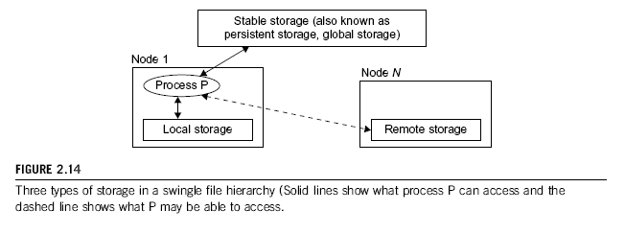
Example: Stable Storage
Could be implemented as one centralized, large RAID disk or distributed using local disks of cluster nodes.
  First approach uses a large disk, which is a single point of failure and a potential performance bottleneck.
  Second approach is more difficult to implement, but potentially more economical, more efficient, and more available.

Slide 34
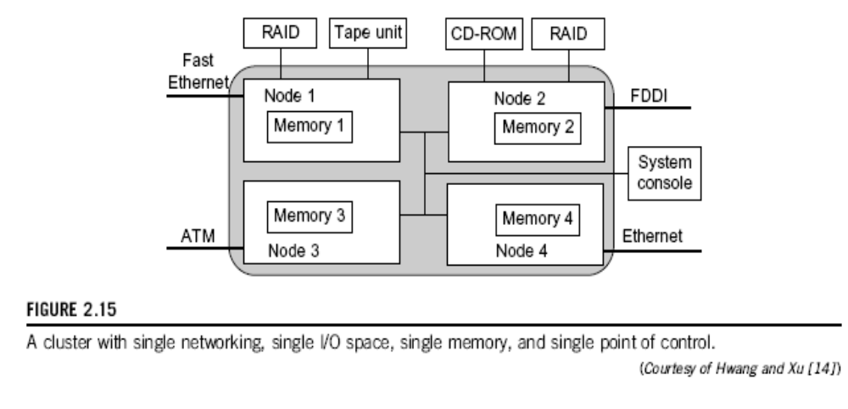
C. Single I/O, Networking, and Memory Space
To achieve SSI, we need a:
single control point
single address space
single job management system
single user interface
single process control

Slide 35
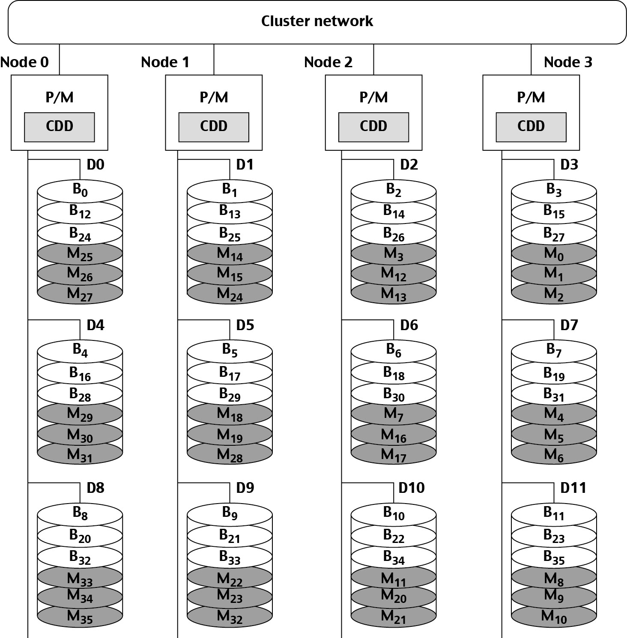
Example: Distributed RAID - The RAID-x Architecture
Distributed RAID architecture with a single I/O space over 12 distributed disks attached to 4 host machines (nodes) in a Linux cluster.
Di stands for disk I
Bj for disk block j
Bj’ an image (shaded plates) of block Bj.
P/M refers to processor /memory node
CDD is a cooperative disk driver.

Slide 36
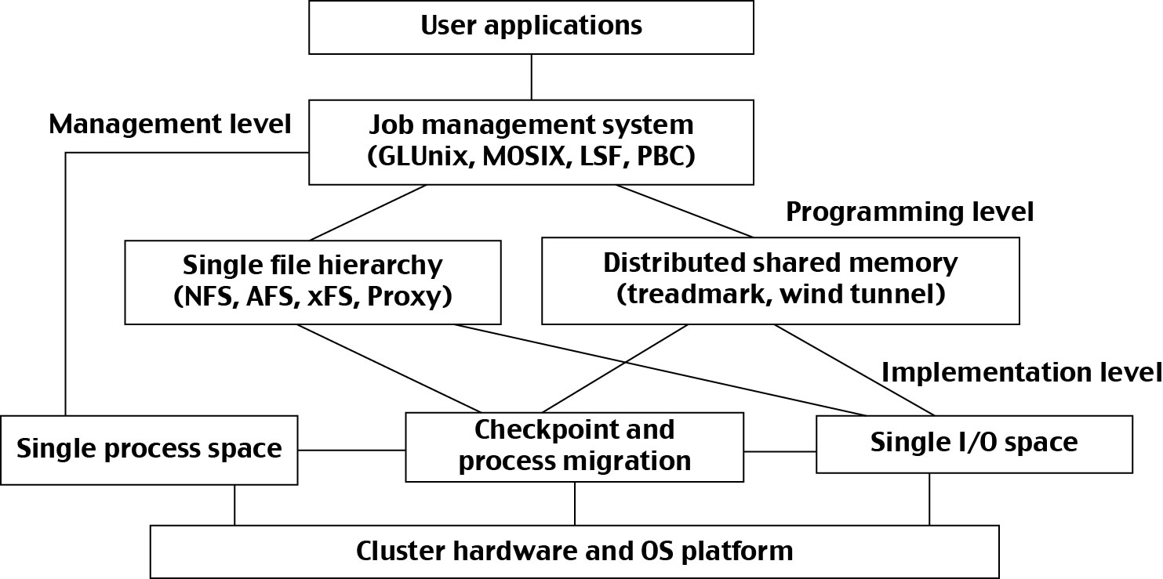
Three levels of middleware: job management, programming and implementation
Middleware Support for SSI Clustering:

Slide 37
High Availability Through Redundancy
Three terms often go together: reliability, availability, and serviceability (RAS).
Availability combines the concepts of reliability and serviceability as defined below:
  Reliability measures how long a system can operate without a breakdown.
  Availability indicates the percentage of time that a system is available to the user, that is, the percentage of system uptime.
  Serviceability refers to how easy it is to service the system, including hardware and software maintenance, repair, upgrade, etc.

Slide 38

Availability and Failure Rate
Recent Find/SVP Survey of Fortune 1000 companies:
An average computer is down 9 times a year with an average downtime of 4 hours.
The average loss of revenue per hour downtime is $82,500.
The operate-repair cycle of a computer system.
Availability = MTTF / (MTTF + MTTR)

Slide 39
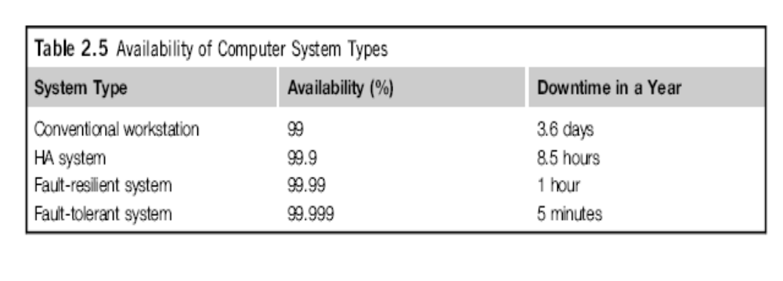

Slide 40
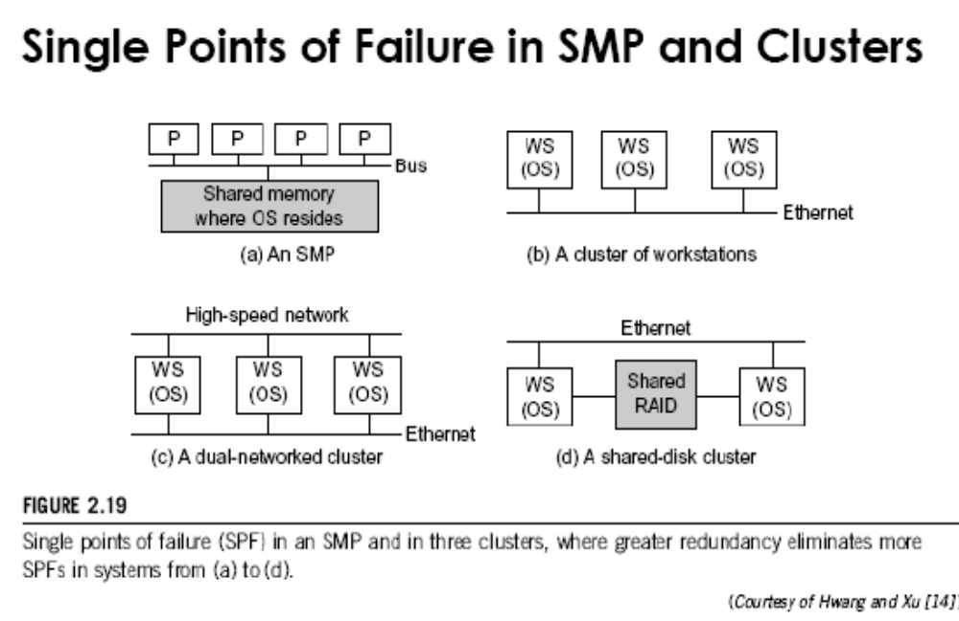
Single Points of Failure in SMP and Clusters

Slide 41
Fault Tolerant Cluster Configurations
Redundant components configured based on different cost, availability, and performance requirements.
The following three configurations are frequently used:
Hot Standby: A primary component provides service, while a redundant backup component stands by without doing any work, but is ready (hot) to take over as soon as the primary fails.
Mutual Takeover: All components are primary in that they all actively perform useful workload. When one fails, its workload is redistributed to other components. (More Economical)
Fault-Tolerance: Most expensive configuration, as N components deliver performance of only one component, at more than N times the cost. The failure of N–1 components is masked (not visible to the user).

Slide 42
Failover
Probably the most important feature demanded in current clusters for commercial applications.
When a component fails, this technique allows the remaining system to take over the services originally provided by the failed component.
A failover mechanism must provide several functions: failure diagnosis, failure notification, and failure recovery.
Failure diagnosis - detection of a failure and the location of the failed component that causes the failure.
  Commonly used technique - heartbeat, where the cluster nodes send out a stream of heartbeat messages to one another.
  If the system does not receive the stream of heartbeat messages from a node, it can conclude that either the node or the network connection has failed.

Slide 43
Recovery Schemes
Failure recovery refers to the actions needed to take over the workload of a failed component.
Two types of recovery techniques:
Backward recovery - the processes running on a cluster periodically save a consistent state (called a checkpoint) to a stable storage.
  After a failure, the system is reconfigured to isolate the failed component, restores the previous checkpoint, and resumes normal operation. This is called rollback.
  Backward recovery is easy to implement and is widely used.
  Rollback implies wasted execution. If execution time is crucial, a forward recovery scheme should be used.
Forward recovery - The system uses the failure diagnosis information to reconstruct a valid system state and continues execution.
  Forward recovery is application-dependent and may need extra hardware.

Slide 44
Checkpointing and Recovery Techniques
Kernel, Library, and Application Levels : Checkpointing at the operating system kernel level, where the OS transparently checkpoints and restarts processes.
Checkpoint Overheads: The time consumed and storage required for checkpointing.
Choosing an Optimal Checkpoint Interval: The time period between two checkpoints is called the checkpoint interval.
Incremental Checkpoint: Instead of saving the full state at each checkpoint, an incremental checkpoint scheme saves only the portion of the state that is changed from the previous checkpoint.
User-Directed Checkpointing: User inserts code (e.g., library or system calls) to tell the system when to save, what to save, and what not to save.

Slide 45
Cluster Job Scheduling and Management
A Job Management System (JMS) should have three parts:
A user server lets the user submit jobs to one or more queues, specify resource requirements for each job, delete a job from a queue, inquire about the status of a job or a queue.
A job scheduler that performs job scheduling and queuing according to job types, resource requirements, resource availability, and scheduling policies.
A resource manager that allocates and monitors resources, enforces scheduling policies, and collects accounting information.

Slide 46
JMS Administration
JMS should be able to dynamically reconfigure the cluster with minimal impact on the running jobs.
The administrator’s prologue and epilogue scripts should be able to run before and after each job for security checking, accounting, and cleanup.
Users should be able to cleanly kill their own jobs.
The administrator or the JMS should be able to cleanly suspend or kill any job.
  Clean means that when a job is suspended or killed, all its processes must be included.
  Otherwise some “orphan” processes are left in the system, wasting cluster resources and may eventually render the system unusable.

Slide 47
Cluster Job Types
Several types of jobs execute on a cluster.
Serial jobs run on a single node.
Parallel jobs use multiple nodes.
Interactive jobs are those that require fast turnaround time, and their input/output is directed to a terminal.
  These jobs do not need large resources, and the users expect them to execute immediately, not made to wait in a queue.
Batch jobs normally need more resources, such as large memory space and long CPU time.
  But they do not need immediate response.
  They are submitted to a job queue to be scheduled to run when the resource becomes available (e.g., during off hours).

Slide 48
Characteristics of Cluster Workload
Roughly half of parallel jobs are submitted during regular working hours.
Almost 80% of parallel jobs run for 3 minutes or less.
Parallel jobs running over 90 minutes account for 50% of the total time.
The sequential workload shows that 60% to 70% of workstations are available to execute parallel jobs at any time, even during peak daytime hours.
On a workstation, 53% of all idle periods are 3 minutes or less, but 95% of idle time is spent in periods of time that are 10 minutes or longer.
A 2:1 rule applies, which states that a network of 64 workstations, with a proper JMS software, can sustain a 32-node parallel workload in addition to the original sequential workload.
  In other words, clustering gives a supercomputer half of the cluster size for free!

Slide 49
Multi-Job Scheduling Schemes
Cluster jobs may be scheduled to run at a specific time (calendar scheduling) or when a particular event happens (event scheduling).
Jobs are scheduled according to priorities based on submission time, resource nodes, execution time, memory, disk, job type, and user identity.
With static priority, jobs are assigned priorities according to a predetermined, fixed scheme.
  A simple scheme is to schedule jobs in a first-come, first-serve fashion.
  Another scheme is to assign different priorities to users.
With dynamic priority, the priority of a job may change over time.

Slide 50
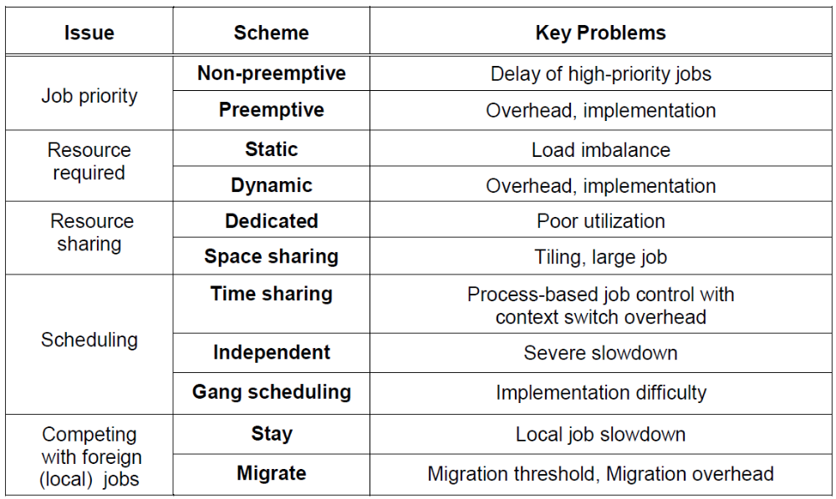
Job Scheduling Issues and Schemes for Cluster Nodes

Slide 51
Scheduling Modes (1)
Dedicated Mode :
Only one job runs in the cluster at a time, and at most one process of the job is assigned to a node at a time.
The single job runs until completion before it releases the cluster to run other jobs.
Space Sharing :
Multiple jobs can run on disjoint partitions (groups) of nodes simultaneously.
At most one process is assigned to a node at a time.
Although a partition of nodes is dedicated to a job, the interconnect and the I/O subsystem may be shared by all jobs.

Slide 52
Scheduling Modes (2)
Time sharing :
Multiple user processes are assigned to the same node.
Time-sharing introduces the following parallel scheduling policies:
  Independent Scheduling (Independent): Uses the operating system of each cluster node to schedule different processes as in a traditional workstation.
  Gang Scheduling: Schedules all processes of a parallel job together. When one process is active, all processes are active.
  Competition with Foreign (Local) Jobs: Scheduling becomes more complicated when both cluster jobs and local jobs are running. The local jobs should have priority over cluster jobs.
    Dealing with Situation: Stay or Migrate job

Slide 53
Migration Scheme Issues
Node Availability: Can the job find another available node to migrate to?
  Berkeley study : Even during peak hours, 60% of workstations in a cluster are available.
Migration Overhead: What is the effect of the migration overhead? The migration time can significantly slow down a parallel job.
  Berkeley study : a slowdown as great as 2.4 times.
  Slowdown is less if a parallel job is run on a cluster of twice the size.
  e.g. a 32-node job on a 60-node cluster – migration slowdown no more than 20%, even when migration time of 3 minutes.
Recruitment Threshold: the amount of time a workstation stays unused before the cluster considers it an idle node. What should be the recruitment threshold?

Slide 54
Job Management Systems Features
Most support heterogeneous Linux clusters.
  All support parallel and batch jobs.
If enterprise cluster jobs are managed by a JMS, they will impact the owner of a workstation in running the local jobs.
All packages offer some kind of load-balancing mechanism to efficiently utilize cluster resources. Some packages support checkpointing.
Most packages cannot support dynamic process migration.
  They support static migration: a process can be dispatched to execute on a remote node when the process is first created.
  However, once it starts execution, it stays in that node.
All packages allow dynamic suspension and resumption of a user job by the user or by the administrator.
  All packages allow resources (e.g., nodes) to be dynamically added to or deleted.
Most packages provide both a command-line interface and a graphic user interface.

Slide 55
END

