Slide 1
CSE 4308/5360 Artificial Intelligence I
Introduction

Slide 2
What is AI
What is Artificial Intelligence?

Slide 3
What is AI
What is Artificial Intelligence?
Systems that think like humans | Systems that think rationally
Systems that act like humans | Systems that act rationally

Slide 4
What is AI
Acting like Humans
Turing Test (Imitation Game) – Alan Turing (1950)
Suggested major components of AI: knowledge, reasoning, language understanding, learning
Still relevant today but not really useful

Slide 5
What is AI
Thinking like Humans
To build such a system we need to know how the brain works
What level of abstraction?
How to validate the system
Predicting and testing human behavior (Cognitive Science)
Identify from neurological data (Cognitive Neuroscience)
These are approaches now considered distinct from AI

Slide 6
What is AI
Thinking rationally
What is rational?
Is all human thought rational?
Rational thought has been studied since time of Aristotle
“Socrates is a man; all men are mortal; Therefore, Socrates is mortal”.
We can build systems that can, in principle, solve problems given in such a logical notation
Not exactly easy to represent all problems in this way
This may be computationally intractable

Slide 7
What is AI
Acting Rationally
Rational Behavior: Doing the ‘right’ thing
How to define right?
Whichever maximizes Goal Payoff
Doesn’t necessarily involve thinking (reflex).
Any thinking should be in service of rational action
Aristotle (Nichomachean Ethics):
Every art and every inquiry, and similarly every action and pursuit, is thought to aim at some good
This is the approach the textbook (and therefore the course) will be studying.

Slide 8
Rational Agent
An agent is an entity that perceives and acts
This course is about designing rational agents
Abstractly, an agent is a function from percept histories to actions:
f : P∗ → A
For any given class of environments and tasks, we seek the
agent (or class of agents) with the best performance
Caveat: computational limitations make perfect rationality unachievable so design best program for given machine resources

Slide 9
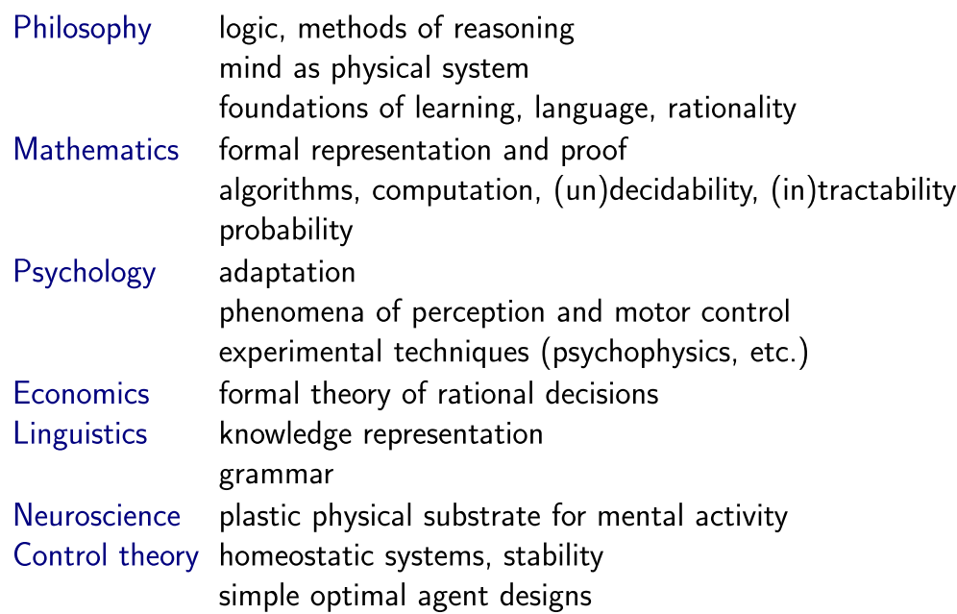
Foundations of AI

Slide 10
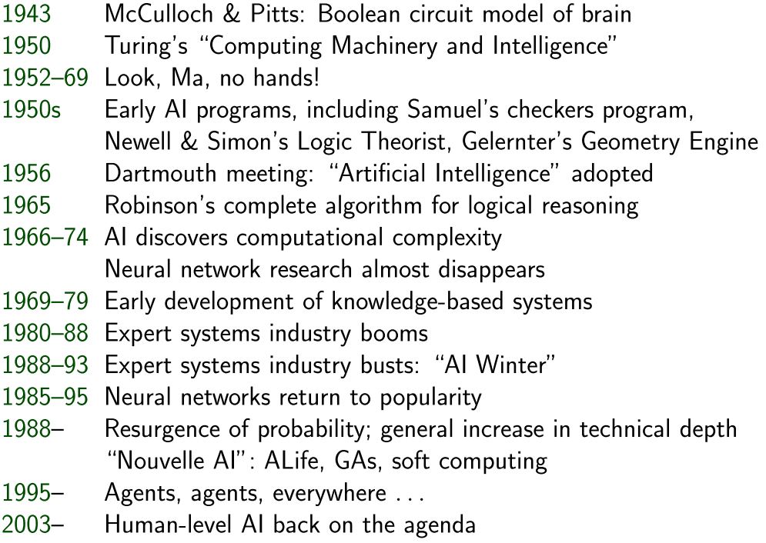
History of AI

Slide 11
State of AI
Pattern Recognition/Data Mining
Speech Recognition
Spam Control
Autonomous planning and scheduling
Automated Logistics
Navigation
Robotic Vehicles
Game Playing
Robotics
Machine Translation

