Slide 1
Time
——Analysis of Linux System Calls
Jiang Shibiao

Slide 2
Five system calls about time
time
stime
gettimeofday
settimeofday
*adjtimex
According to Linux 2.4

Slide 3
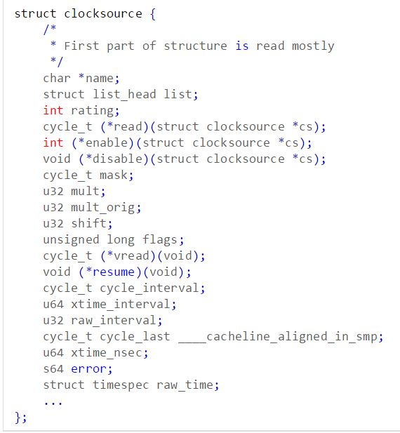
clocksource
Define the “clock device”
timing
count
Interrupt
Better clocksource has bigger rating

Slide 4
Time-related hardware
RTC: Real Time Clock
PIT: Programmable Interval Timer
TSC: Time Stamp Counter

Slide 5
Tick
Clock Tick
As soon as PIT is decreased to 0, it will cause a timer interruption, which is also called a tick.
HZ
the frequency of ticks in one second
usually =100 in x86
tick size: 1s / HZ (10ms in x86)
LATCH
the number of clock cycles during two ticks
the initial value of PIT

Slide 6
Interruption
Very important
Process
Maintain the system time
Count the usage of CPU
Handle system calls about time from user
Handle with timer
timer_interrupt(): update jiffies → as soon as possible
Bottom half stage: handle with timer and xtime

Slide 7
jiffies
unsigned long volatile __jiffy_data jiffies;
Store the number of ticks occurred since system start-up.
Volatile: no cache
Jiffies is updated in time, but xtime is not.
unsigned long wall_jiffies
Store the value of jiffies when xtime is updated.

Slide 8
Wall Time
struct timespec xtime __attribute__ ((aligned (16)));
struct timespec {
__kernel_time_t tv_sec; /* seconds */
long tv_nsec; /* nanoseconds */
};
Global clock
Records the time interval from 1970－01－01 00：00：00
Usually called by user, Not urge to update

Slide 9
Update Wall Time
static void update_wall_time(unsigned long ticks) {
do {
ticks--;
update_wall_time_one_tick();
} while (ticks);
if (xtime.tv_usec >= 1000000) {
xtime.tv_usec -= 1000000;
xtime.tv_sec++;
second_overflow();
}
}
Ticks = jiffies – wall_jiffies
Leap second

Slide 10
Time zone
struct timezone {
int tz_minuteswest; /* minutes west of Greenwich */
int tz_dsttime; /* type of dst correction */
};
struct timezone sys_tz;
Time zone for current system

Slide 11
time()
asmlinkage long sys_time(int * tloc) {
int i = CURRENT_TIME;
if (tloc) {
if (put_user(i,tloc))
i = -EFAULT;
}
return i;
}
#define CURRENT_TIME (xtime.tv_sec)

Slide 12
stime()
asmlinkage long sys_stime(int * tptr)
{
int value;
if (!capable(CAP_SYS_TIME))
return -EPERM;
if (get_user(value, tptr))
return -EFAULT;
write_lock_irq(&xtime_lock);
xtime.tv_sec = value;
xtime.tv_usec = 0;
time_adjust = 0;
time_status |= STA_UNSYNC;
time_maxerror = NTP_PHASE_LIMIT;
time_esterror = NTP_PHASE_LIMIT;
write_unlock_irq(&xtime_lock);
return 0;
}

Slide 13
stime()
xtime_lock: Spinlock
simply wait in a loop ("spin") while repeatedly checking if the lock is available until acquire it
Busier CPU usage than mutex lock
capable(CAP_SYS_TIME)): whether has authority to modify (only root)
Reset other value

Slide 14
gettimeofday()
asmlinkage long sys_gettimeofday(struct timeval *tv, struct timezone *tz) {
if (tv) {
struct timeval ktv;
do_gettimeofday(&ktv);
if (copy_to_user(tv, &ktv, sizeof(ktv)))
return -EFAULT;
}
if (tz) {
if (copy_to_user(tz, &sys_tz, sizeof(sys_tz)))
return -EFAULT;
}
return 0;
}

Slide 15
gettimeofday()
void do_gettimeofday(struct timeval *tv)
{
unsigned long flags;
unsigned long usec, sec;
read_lock_irqsave(&xtime_lock, flags);
usec = do_gettimeoffset();
{
unsigned long lost = jiffies - wall_jiffies;
if (lost)
usec += lost * (1000000 / HZ);
}
sec = xtime.tv_sec;
usec += xtime.tv_usec;
read_unlock_irqrestore(&xtime_lock, flags);
while (usec >= 1000000) {
usec -= 1000000;
sec++;
}
tv->tv_sec = sec;
tv->tv_usec = usec;
}

Slide 16
gettimeofday()
The accuracy of gettimeofday() reaches μs level.
usec = xtime.tv_usec + lost_usec + offset_usec
xtime.tv_usec: the last value of xtime
lost_usec＝(jiffies - wall_jiffies) * (1000000 / HZ)
offset_usec: the time interval after jiffies is updated (use TSC to get this number)
carry

Slide 17
settimeofday()
asmlinkage long sys_settimeofday(struct timeval *tv, struct timezone *tz)
{
struct timeval new_tv;
struct timezone new_tz;
if (tv) {
if (copy_from_user(&new_tv, tv, sizeof(*tv)))
return -EFAULT;
}
if (tz) {
if (copy_from_user(&new_tz, tz, sizeof(*tz)))
return -EFAULT;
}
return do_sys_settimeofday(tv ? &new_tv : NULL, tz ? &new_tz : NULL);
}

Slide 18
settimeofday()
int do_sys_settimeofday(struct timeval *tv, struct timezone *tz)
{
static int firsttime = 1;
if (!capable(CAP_SYS_TIME))
return -EPERM;
if (tz) {
sys_tz = *tz;
if (firsttime) {
firsttime = 0;
if (!tv) warp_clock();
}
}
if (tv) do_settimeofday(tv);
return 0;
}

Slide 19
settimeofday()
inline static void warp_clock(void)
{
write_lock_irq(&xtime_lock);
xtime.tv_sec += sys_tz.tz_minuteswest * 60;
write_unlock_irq(&xtime_lock);
}
void do_settimeofday(struct timeval *tv)
{
write_lock_irq(&xtime_lock);
tv->tv_usec -= do_gettimeoffset();
tv->tv_usec -= (jiffies - wall_jiffies) * (1000000 / HZ);
while (tv->tv_usec < 0) {
tv->tv_usec += 1000000;
tv->tv_sec--;
}
xtime = *tv;
time_adjust = 0;
time_status |= STA_UNSYNC;
time_maxerror = NTP_PHASE_LIMIT;
time_esterror = NTP_PHASE_LIMIT;
write_unlock_irq(&xtime_lock);
}

Slide 20
settimeofday()
warp_clock()
check whether it is the first time to set
adjust xtime according to time zone
tv->tv_usec－＝（lost_usec＋offset_usec)
Similar to gettimeofday()
Reset other time parameters

