Slide 1
Visual Question Answering
小组成员：章启航、胡晨旭、李广林、蒋仕彪、王宇晗

Slide 2
CONTENTS
01
02
03
Part One
Part Two
Part Three
VQA Background
Related Techniques
VQA Prospect

Slide 3

PART ONE
Background to VQA

Slide 4
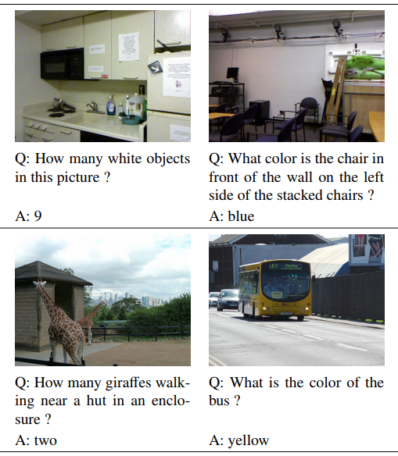
What is VQA?
Visual Question Answering (VQA) is a challenging task that has received increasing attention from both the computer vision and the natural language processing communities.
Given an image and a question in natural language, it requires reasoning over visual elements of the image and general knowledge to infer the correct answer.

Slide 5
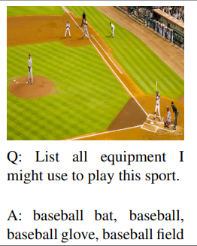
Value
VQA constitutes a truly AI-complete task, as it requires multimodal knowledge beyond a single subdomain.
It provides a proxy to evaluate our progress towards
AI systems capable of advanced reasoning combined
with deep language and image understanding.

Slide 6
PART TWO
Related Techniques

Slide 7
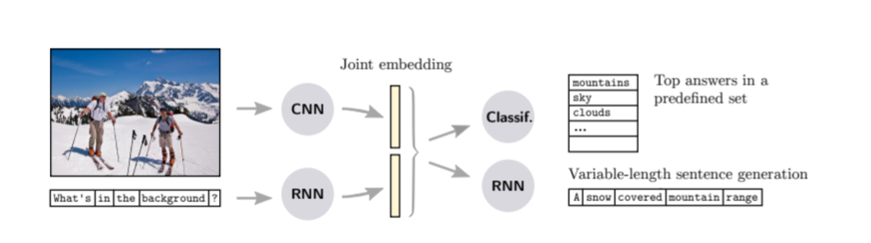
2.1 Joint embedding approaches
Motivation: Let the model to learn representations in a common feature space. A representation in a common space allows learning interactions and performing inference over the question and the image contents
Figure 1: features produced by CNN and RNN
Typical works:
“Neural-Image-QA” : RNN + LSTMs, encode feature text and queries together, produce answer word one by one.
CNN+DPPNet: Dynamically determine parameter for each query.
MCB: Randomly projecting the image and text features to a higher-dimensional space and convolve the vectors to Fourier space for efficiency

Slide 8
2.1 Joint embedding approaches
Performance and limitations: The joint embedding approaches are straightforward in their principle and constitute the base of most current approaches to VQA. The latest improvements still showed potential room for improvement on both the extraction of features and their projection to the embedding space.

Slide 9
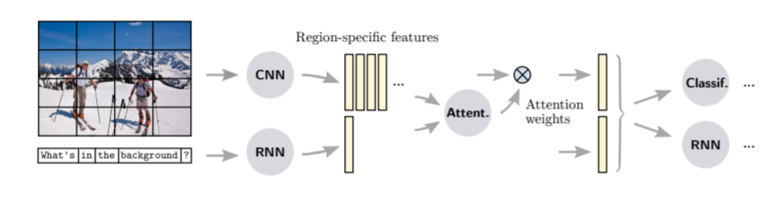
2.2 Attention mechanisms
Motivation: A limitation of most models presented above is to use global features to represent the visual input. This may feed irrelevant or noisy information to the prediction stage. The aim of attention mechanisms is to address this issue by using local image features, and allowing the model to assign different importance to features from different regions.
Figure 2: features produced by CNN and RNN with attention

Slide 10
2.2 Attention mechanisms
Performance and limitations: Attention mechanisms always improve over models that use global image features, multiple attention layers bring further improvements over only one layer of attention. Interestingly, attention mechanisms improve the overall accuracy on all VQA datasets, but show little or no benefit on Yes/No questions, so it needs other methods to improve performace on Yes/No questions.

Slide 11
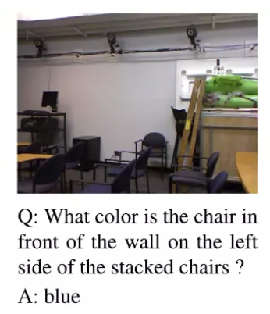
2.3 Compositional Models
Motivation: Embedding-based strategies present limitations related to the monolithic nature of the CNNs and RNNs used to extract representations of images and sentences. Is this a truck? only requires retrieving one piece of information from the image, whereas How many objects are to the left of the toaster? requires multiple processing steps, such as recognition and counting.
Goal: Compositional Models are designed to use modular architectures to exploit the compositional linguistic structure of the questions.

Slide 12
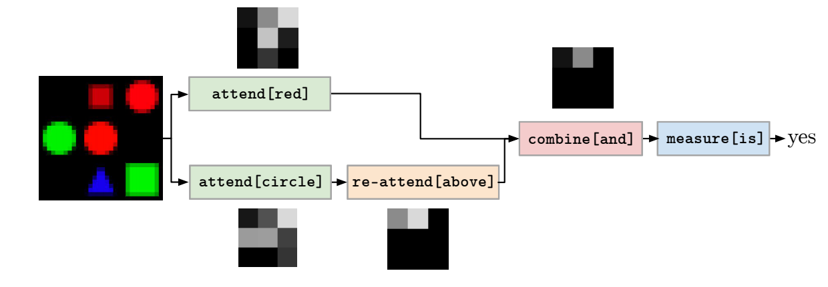
2.3 Compositional Models
Neural Module Networks is a representative approach of compositional models introduced by Andreas. NMNs reflect the complexity of a question in a network that is assembled on-the-fly for each instance of the problem.
Is there a red shape above a circle?

Slide 13
2.3 Compositional Models
Method: A set of possible modules is predefined, which take image features and attentions as input, and output the prediction. Their exact behavior will be acquired through end-to-end training on specific problem.
In question parsing process, NMN make use of semantic parsers to identify grammatical relations between parts of the sentence, and then transform parse trees into structured queries, in the form of compositions of modules.
Remark: NMN shows different strengths and weaknesses than competing approaches. e.g. It generally outperforms competitors on questions with a compositional structure because of its logical reasoning ability.
Unfortunately, the potential of the NMNs is dimmed in practice by the lack of truly complex questions in the VQA benchmark.

Slide 14
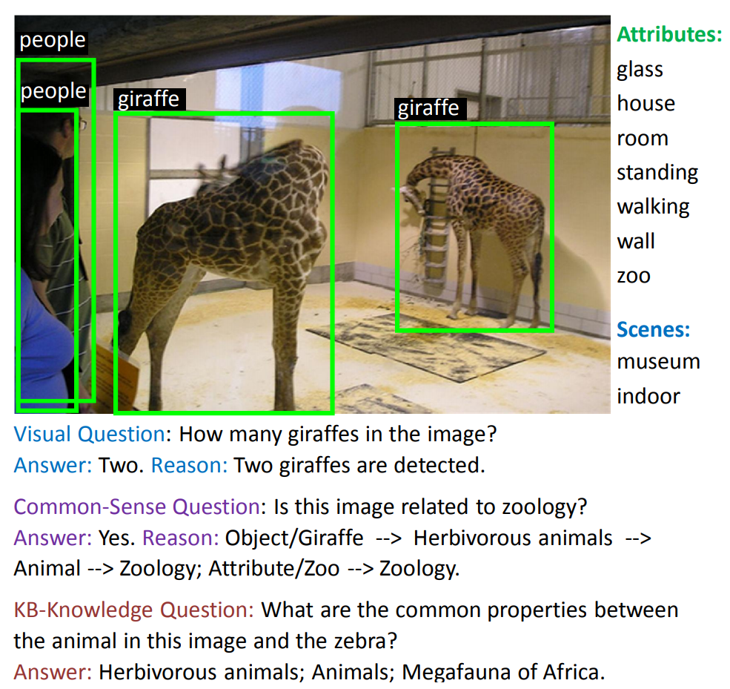
2.4 Models using external knowledge bases
Motivation: The task of VQA involves understanding the contents of images, but often requires prior nonvisual, information, which can range from “common sense” to topic-specific. Linking knowledge bases to VQA methods allows separating the reasoning from the representation of prior knowledge in a practical and scalable manner.
Goal: 1) decouple the reasoning from the actual storage of data or knowledge
2) more external structured representations of knowledge
3) interpretability

Slide 15
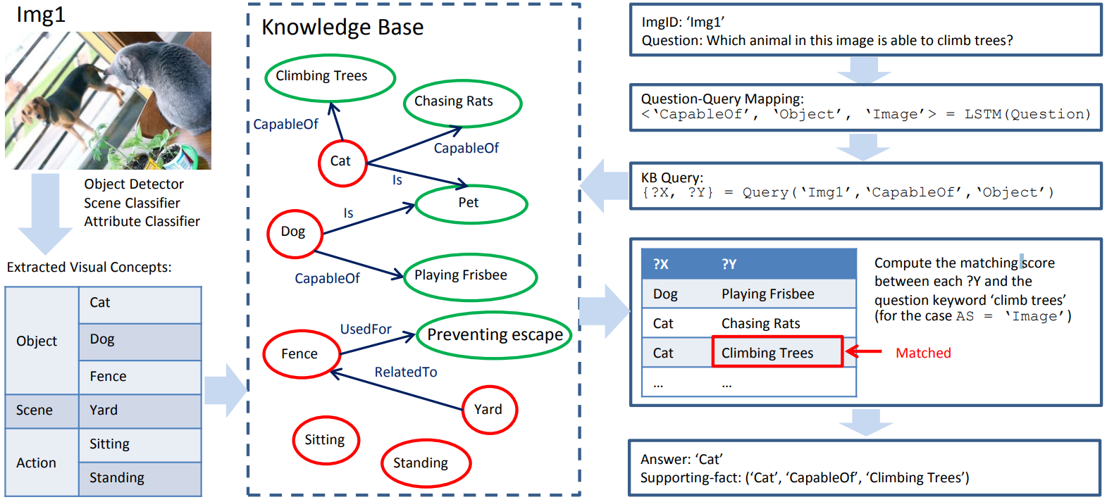
2.4 Models using external knowledge bases
Visual concepts are first extracted from the given image with CNNs, and they are then associated with nodes from KB that represent similar concepts.
Uses an LSTM and a data-driven approach to learn a mapping images/questions to queries over the constructed knowledge graph.
The final answer is obtained by summarizing the results of this query.

Slide 16
2.4 Models using external knowledge bases
Performance: Focus specifically on visual questions requiring external knowledges. This kind of methods significantly outperform joint embedding approaches on KB-VQA dataset in terms of overall accuracy.
Limitations: Most existing VQA datasets include a majority of questions that require little amount of prior knowledge, and performance on these datasets thus poorly reflect the particular capabilities of these methods.

Slide 17

PART THREE
VQA Prospect

Slide 18
How to learn common & good feature ?
Pretraining methods using large amount of data
Design proper self-supervised manner
Design mechanism to combine uncleaned visual and linguistic material
2. Associate learning for several different tasks
Design a scheme that can solve several tasks together, e.g. VQA, VCR (Visual Common Sense Reasoning), Caption
Feature learnt from diverse tasks is promising to be more general

Slide 19

THANKS

